Slide 1


Holistic Cancer Care Reviews – an introduction Module 2

Slide 2
Introduction
Training content for managing cancer as a long term condition
Purpose
The content within these slides can be used and adapted for local use in Protected Learning Time and other training sessions on cancer as a long term condition.
This module is one of five – it can be used in isolation or as part of a wider training package. The modules are:
Personalised cancer care interventions
Holistic cancer care reviews
Consequences of treatment
Psychological support and rehabilitation
Social needs of people affected by cancer
Intended audience
CCG clinical leads
Macmillan GPs
Primary Care Nursing Forum leads
Training Hubs
Social prescribing teams
Acknowledgements
The content contained within this module was co-developed with London clinicians from Transforming Cancer Services Team (part of Healthy London Partnership), Macmillan Cancer Support, Trusts and Primary Care.
When using these slides locally, please ensure branding includes Health Education England, Macmillan and Healthy London Partnership. Thank you

Slide 3
Aims and Objectives
Aims
Help improve understanding of the long term management of people affected by cancer
Objectives
Provide guidance on delivering holistic cancer care reviews in practice
Highlight transitions of cancer care and what could go wrong
Further information
Highlight online educational tools and resources that can enhance patient care

Slide 4
Background

Slide 5
Transitions of care - what can go wrong?
Lack of clear communication between primary and secondary care:
GP / practice not informed that patient is at end of treatment
No clear details re treatments and possible consequences – early and late
Delays in information transfer – patient arriving to GP before information received
Lack of confidence and knowledge in cancer:
GPs and practice nurses may lack knowledge of treatment received and potential effects/ increased risk of recurrence
Lack of knowledge and confidence in identifying and managing consequences of cancer and its treatment
Late onset effects not linked back to previous cancer and managed appropriately
Patients unaware of risk of consequences
Lack of clarity in role:
Holistic needs not addressed – district nursing/community care co-ordination, social needs, carer needs
Prescribing confusions – responsibilities etc
Patients not feeling their GP/Practice Nurse can manage their cancer needs
Lack of awareness of local services – specialist and generalists and rapid access routes

Slide 6


Top ten concerns experienced by patients living with and beyond cancer
What do you think they are?
The top ten needs below come from HNA data collected in hospital- useful to consider in terms of CCR content as they cross physical, emotional, practical and social domains
Worry fear and anxiety
Tired Exhausted or fatigued
Pain or discomfort
Money or finance
Eating appetite or taste
Moving around
Uncertainty
Sleep problems
Sadness or depression
Thinking about the future
Source EHNA data for London 2018 collated by RM Partners Informatics team.

Slide 7
Understanding the Cancer Quality Outcome Framework (QoF)

Slide 8
QOF CCR Requirements
Changes made to QOF specification 2019/20
Encourages a more robust review – more explicit re content
Encourages use of a template
Encourages face to face reviews
‘This review represents an opportunity to address patients’ needs for individual assessment, care planning and on-going support and information requirements’
‘the patient’s individual health and support needs, which will vary with, for example, the diagnosis, staging, age and pre-morbid health of the patient and their social support networks. In collaboration with the National Cancer Survivorship Initiative (NCSI), Macmillan primary care community has produced a template which recommends that this could cover a discussion of the diagnosis and recording of cancer therapy, an offer of relevant information, medication review, benefits counselling and recording of a carer’s details’
‘It is preferable that a review should be face-to-face in most’ cases’
Notes:
Highlight that CCR integral to Personalised Care for PLWC in the community so encouraging and educatiing re good quality CCRs should be a part of All cancer Mac GP work
Main reason is to highlight that the changes to QOF for this year have made things more explicit including what should be discussed and that a template should be used as per recent communications
Mac GPs should be encouraging use of Macmillan templates aligned in all IT systems other than microtest currently.
Some concern re recent survey results that Mac GPs not encouraging use of Mac template or perhaps not even using themselves

Slide 9
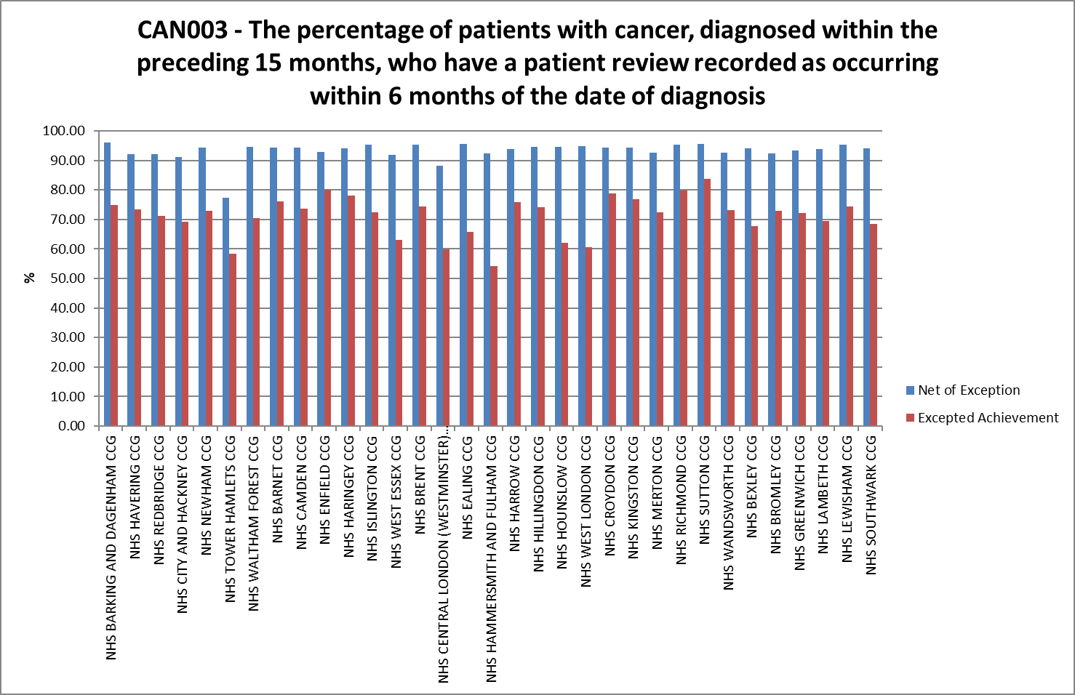
QOF CAN003: Patient Review within 6 months of diagnosis
2018/19 - The percentage of patients with cancer, diagnosed within the preceding 15 months, who have a patient review recorded as occurring within 6 months of the date of diagnosis (with exclusions).

Slide 10
Cancer Care Reviews (CCRs)

Slide 11
CCRs in practice – what do we know?
Through a range of focus groups and interviews with primary care clinicians in London – they have been asked about how they conduct CCRs, their understanding, its purpose and how CCRs can be improved.
Feedback outlined:
Majority are conducted with a GP, face to face or via the telephone.
Sometimes practice nurses conduct CCRs, but only with a supportive GP Partner encouraging them to do so.
Some “CCRs” don’t involve patients at all, and are considered a tick box exercise eg recording of clinical appointment letters.
Length of appointment times vary, from a five minute telephone call to twenty minute face to face in the surgery.
Majority understand that the reviews are to highlight the needs of patients diagnosed with cancer
A small proportion feel that their consultations are holistic, this leaves an assumption that the “needs” of the patients are more medical in nature.
* https://www.myhealth.london.nhs.uk/system/files/Cancer%20Care%20Review.pdf
55

Slide 12
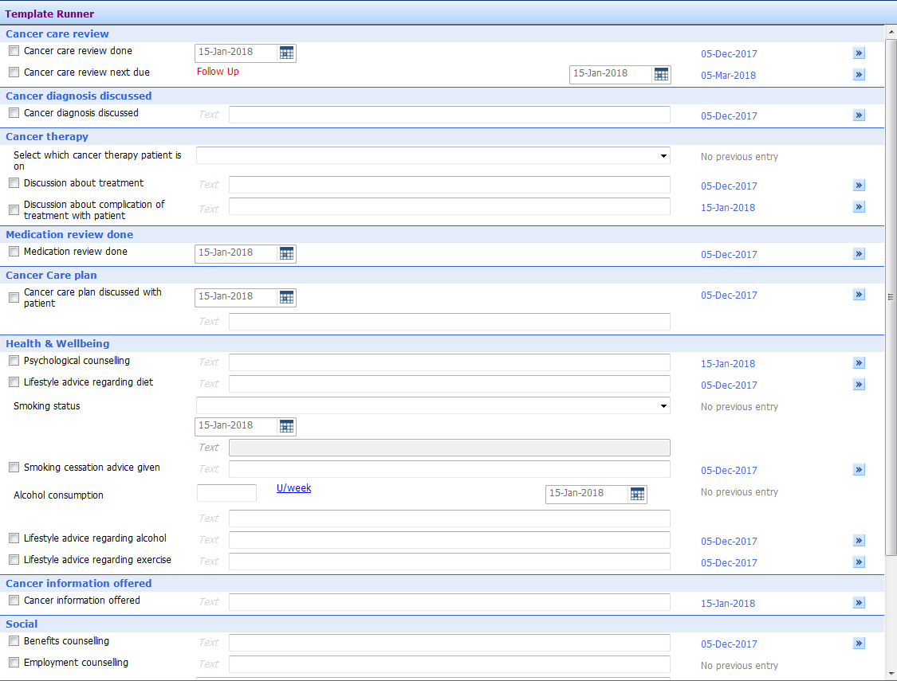
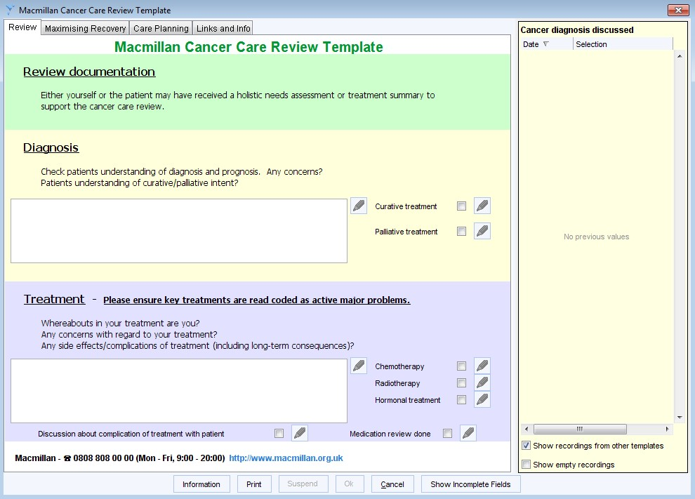
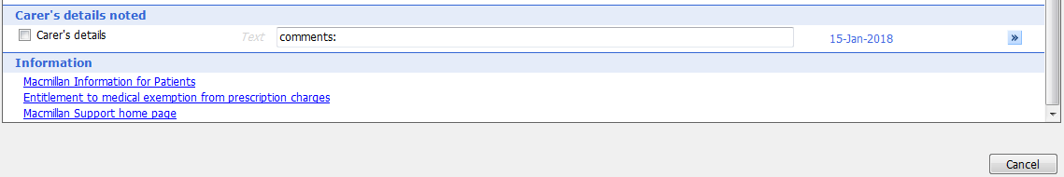
Cancer Care Review IT templates
TPP SystmOne
EMIS Web

Slide 13

Cancer care reviews: recommended content (1)
Opportunity to discuss the diagnosis
What does the patient understand, are there any unanswered questions?
Discussions regarding treatment
Has treatment started, being received or completed?
Explore physical, psychological ,emotional and social consequences- of the cancer and its treatment . These can be short and long term .
Review of physical symptoms- for example lymphoedema, fatigue, incontinence, pain, breathlessness etc
Psychological – consider depression and anxiety screening
Social/financial- work, loss of income, practical help needed, any care needs?
Medication review
current , new, any contraindications.

Slide 14

Cancer Care Reviews- Recommended content (2)
Lifestyle advice
Consider advice on smoking, diet, alcohol, physical activity​ (some treatments can increase cardiovascular risk)
​Social support
Financial advice / DS1500 & other benefits / prescription entitlements / social care needs?​
Carers
Are they themselves a carer ? How is their carer/loved ones coping?​ Do they need support?
​Unscheduled care planning
what to do in an emergency, check contact numbers/plans
Follow up & monitoring plans
e.g. type and frequency of follow up, input from other teams (AHPs, district nurses etc.), screening appointments (e.g. future DEXA scans if on certain treatments, frequency of blood test follow up e.g. PSA)​. Use of diary dates. Coding essential.

Slide 15
Having Heard about Cancer Care Reviews
Your next patient with cancer: What might you now do differently?
Your practice/area : What improvements could be made relating to CCRs?
The next few slide outline a London based proposal for a model to support patients diagnosed with cancer within primary care ( more information is available in the resource section.)

Slide 16
Understanding the 4 point model

Slide 17
4 –Point model : a London based proposal
In 2015, London’s regional cancer board endorsed the 4 Point model for supporting people with cancer. The aim of the 4 point model is to support people with a diagnosis of cancer to self-manage whilst they have cancer and in the longer term. For some people, they may live with terminal cancer (or they may be in remission) for many years or decades.
Trigger points for the London holistic CCR model are:
Point 1: Add patient to cancer register at notification from hospital confirming a new diagnosis (via 2ww, routine outpatient, screening, A&E, other primary care routes, previous diagnosis/recurrence).
Point 2: CCR with newly registered patients with cancer diagnosis in last 3- 6 months
Point 3: On receipt of Treatment Summary and /or transfer of care / discharge to community or primary care teams to offer an appointment 6-12 months after treatment ends.
Point 4: Annual review as part of long term management
Point 1: QOF CAN001
TCST’s 4 Point CCR Model
Point 4: NG56
Point 2: QOF CAN003
Point 1: QOF CAN001
56

Slide 18
Point 1
Point 1: Patient added to cancer register (QOF CAN001)
The purpose of a register in QOF is to define a cohort of patients with a particular condition or risk factor, and thereby supporting ongoing management and support.
A comparison of London prevalence data with London QOF register numbers shows that there were 18,000 patients not listed in London’s practice cancer registers.
58

Slide 19
Point 2
Point 2: 1st intervention: First contact after diagnosis (QOF CAN003)
Telephone call and/or letter to patient regarding recent diagnosis with invitation for the patient to attend the practice for a chat regarding their diagnosis. This could be completed by GP or practice nurse within six months of diagnosis (i.e. QOF CCR).
Letter is sent to patients who have just received a cancer diagnosis (templates are available from the TCST).
The letter is to be tailored with the GP or GPN name, oncologist name, name of the key worker (if known), treating hospital; the type of cancer diagnosis and includes an outline of the personalised care interventions that they should be receiving along with the Macmillan Top Ten Tips*.
Signposting to local support groups and other resources including Cancer Care Map
* http://www.macmillan.org.uk/_images/what-to-do-after-treatment-guide_tcm9-300403.pdf

Slide 20
Point 3
Point 3: 2nd intervention: Holistic cancer care review at the end of primary treatment as standard (eg local incentive scheme, sample available from TCST)
Appointment triggered by a date entered into the Cancer Register and/or receipt of Treatment Summary / transfer to primary care.
Extended consultation conducted by GP or primary care nurse depending on complexity of
patients’ needs (e.g. double or triple appointments may be required).
Use of a clinical template for holistic CCR that captures whether the patient had an HNA in secondary care and their information needs (template available from the TCST). Using Treatment Summaries or discharge letters, discuss consequence of treatment (including late effects) and further advice on physical activity, healthy lifestyles, signs and symptoms to be aware of regarding recurrence carer’s needs.
Professionals to undertake appropriate training modules in living with and beyond cancer. A bespoke prospectus of training modules are available from the TCST.
Primary care MDT meeting to discuss patients on register outlining care planning actions and review any Significant Event Audits (SEAs) related to recurrence or subsequent primary cancer diagnosed via emergency routes.
* https://www.healthylondon.org/sites/default/files/Primary%20Care%20Cancer%20Checklist%20-
%20ED%20%26%20LWBC_final_0.pdf

Slide 21
Point 4
Point 4: 3rd intervention: Cancer incorporated and reviewed at an annual LTC Review (QOF generic, long term conditions local incentive scheme, NICE Guidance for Multimorbidity (NG56))
Annual review may be for a period of time, for example up to five years, or it may be indefinite. It may also only apply to groups patients who have specific needs e.g. multi-morbidities, social risk factors, part of a local integrated care framework.
The LTC review should include a conversation regarding the person’s psycho-social and physical needs re cancer (e.g. preventing recurrence and detecting and/or managing any consequences of treatment), healthy lifestyle advice, as well as any other long term conditions and/or social risk factors that the person may have. Needs of carers should also be taken into account.
61

Slide 22
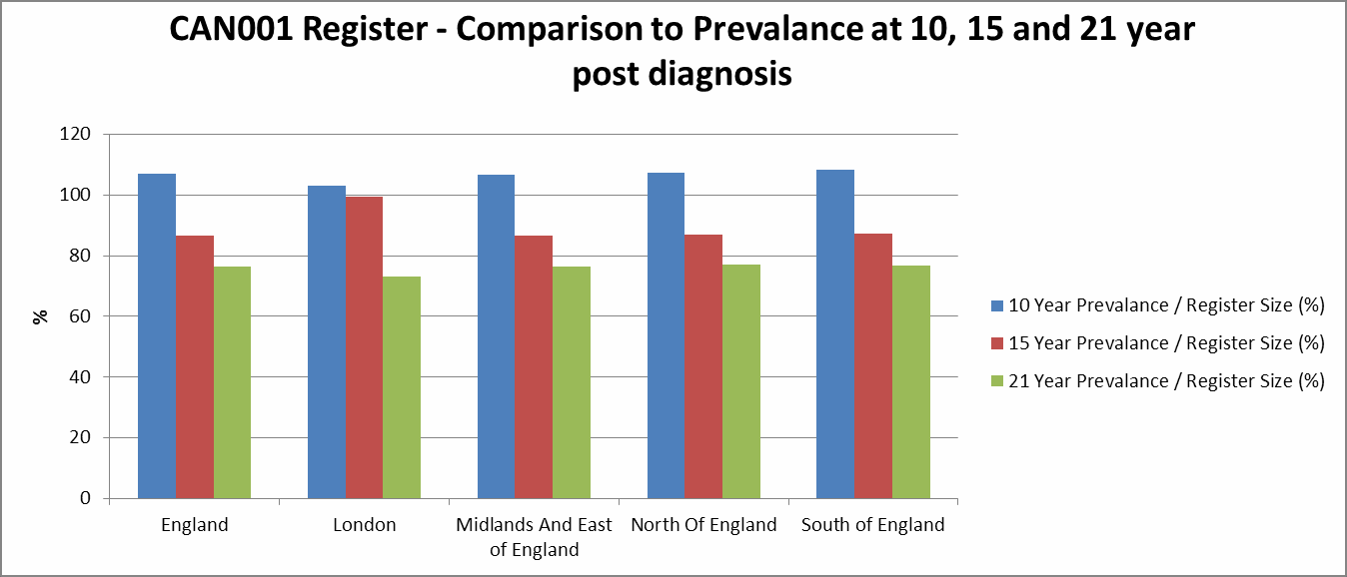
Long term survival and safety netting
It’s important that cancer survivors are safety netted properly, particularly regarding the risk of subsequent cancers and early detection of consequences of treatment.
TCST Guidance will encompass safety netting in primary care for: 4 Point Model, stratified follow up pathways, consequences of treatment and subsequent cancers.

Slide 23
Resource

Slide 24





Online resources: managing patients with cancer
RCGP CoT toolkit
eLearning for Health– open to all professionals, free, with certificate.
Macmillan Learn Zone
Healthtalk online
BMJ Learning
TCST

Slide 25

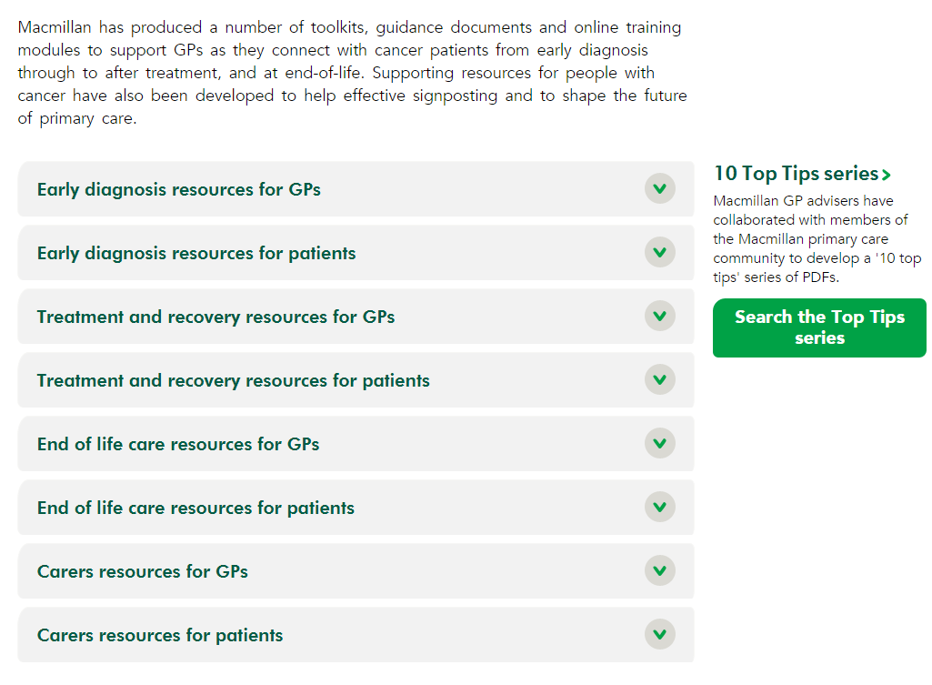
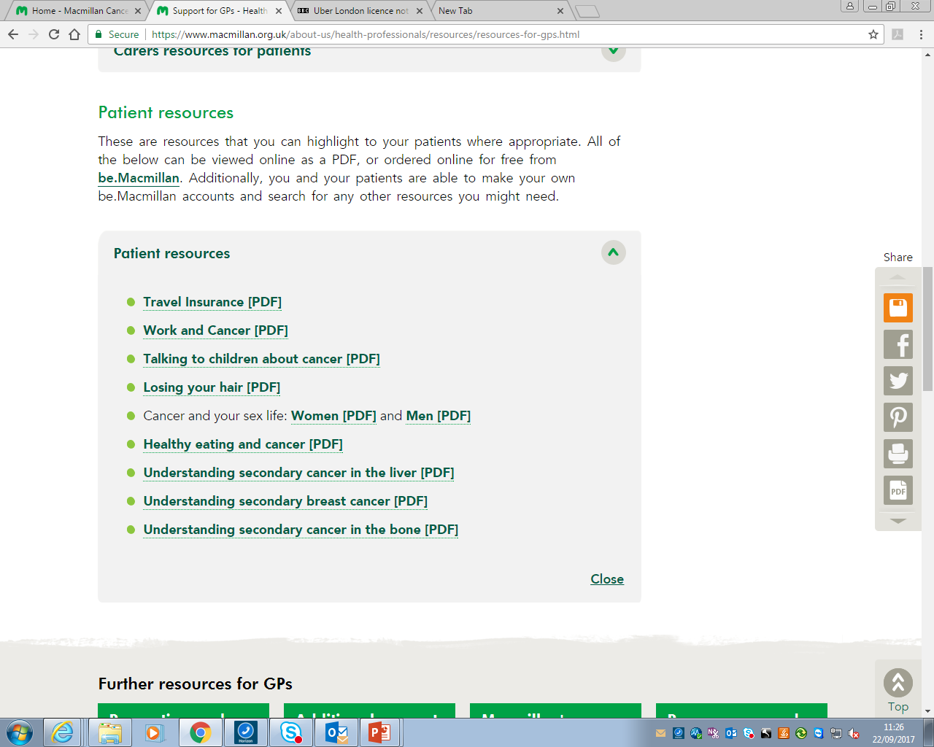
Resources for primary care teams
www.macmillan.org.uk/gp
Notes:
New Primary Care Resources Webpage. It’s great. Covers resources, toolkits and information relevant for a primary care professionals spanning the entire cancer pathway. Its live now. You should all have received a business card with this address on, we would encourage you to take a look and share this webpage with colleagues. It is relevant for GPs across the UK and details any nation specific resources are indicated. It also includes resources that may be useful for you to signpost patients to such as travel insurance guides.

Slide 26
Further resources
NICE Guidance 56 https://www.nice.org.uk/guidance/ng56
RCGP Consequences of Treatment Toolkit http://www.rcgp.org.uk/clinical-and-research/toolkits/consequences-of-cancer-toolkit.aspx
Macmillan resources for primary care https://www.macmillan.org.uk/about-us/health-professionals/resources/resources-for-gps.html
TCST’s resources on cancer https://www.healthylondon.org/our-work/cancer/
TCST’s analysis on cancer (tableau presentations) https://public.tableau.com/profile/transforming.cancer.services.for.london#!/
Rubin et al, ‘The expanding role of primary care in cancer control’, Lancet Oncology (2015) 16: 1231–72
Jefford et al, ‘Implementing improved post-treatment care for cancer survivors in England, with reflections from Australia, Canada and the USA’, British Journal of Cancer (2013) 108, 14–20 | doi: 10.1038/bjc.2012.554
Khan et al, ‘A qualitative study of unmet needs and interactions with primary care among cancer survivors’, British Journal of Cancer (2011) 105, S46 – S51

