Slide 1
Empowered Leadership Training
A four-day line management course to empower line managers with the knowledge, skills and confidence to cultivate a supportive, inclusive and high-performing work environment.
v1.1

Slide 2

Creating inclusive and effective workplaces
According to CMI research, 82% of managers in their role have not received any formal management training, making them "accidental managers." Poor line management contributes to high turnover rates, low staff morale, and poor performance.
Our new line management course stems from key recommendations in the NHS HR and OD report (November 2021), which outlined the vision for developing the people profession over the next decade. This led to the "Expectations of Line Managers in Relation to People Management" framework launched in November 2023, aligning with Leadership Way, NHS People Promise, and the NHS Long Term Workforce Plan.
Effective line management is crucial for improving staff retention, performance, and job satisfaction.
1 in 3 people have left a role due to poor relationships with their line manager.
CMI Report

Slide 3
A course to embed effective line management
This training is for:
Existing line managers, irrelevant of number of years experience and of level of seniority
By taking part in this course people will be able to:
Further develop effective leadership and management practices
Create inclusive and supportive work environments
Build strong relationships with direct reports and teams
Improve communication and collaboration skills
Foster a culture of high performance and accountability
Prioritise staff wellbeing and development Align work with their organisation’s strategic objectives.
New line managers, within their first six months
People who are about to move into their first management roles

Slide 4
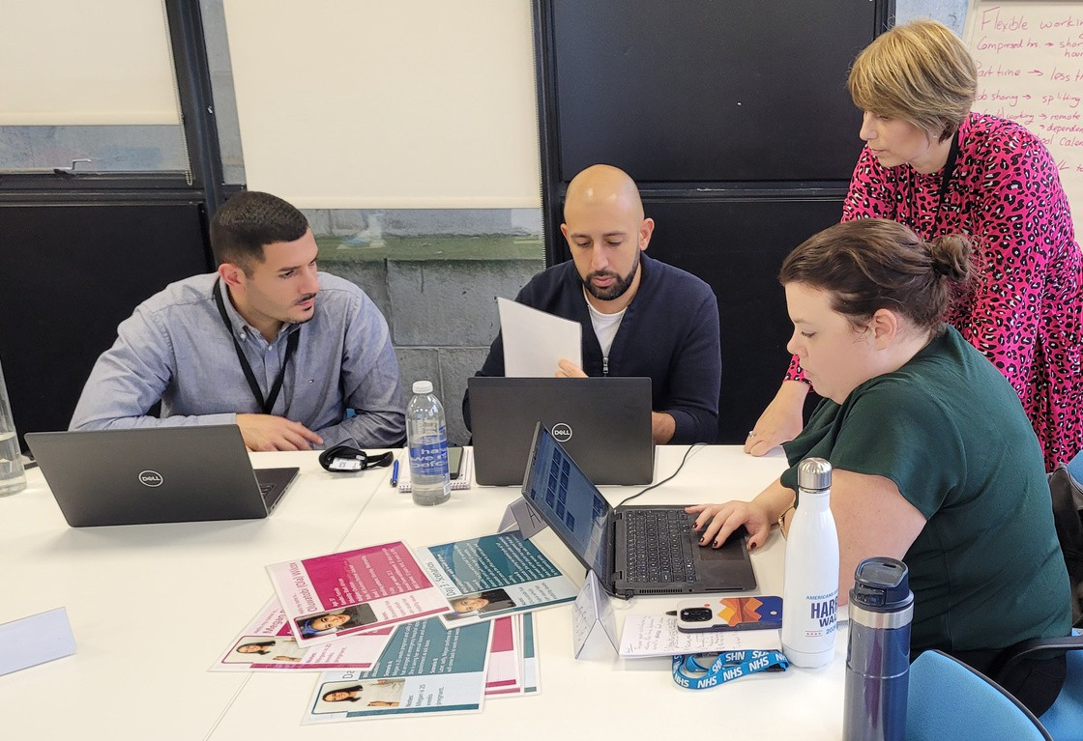
The training will include:
“Can’t fault the course at all.
Challenging, engaging, thought provoking and relevant to our role as leaders. Fantastically presented by the team, well done. 10/10!”
“I really enjoyed the training, it felt transformational. Extremely useful and meaningful content. I now feel more confident to do my job as a line manager.”
4x face-to-face small group sessions
Bite-sized learning videos focusing on key policies
A dedicated online platform with key information
A digital badge that can be used online on completion and CPD accreditation
Course content
Day 1: Managing people, inclusion, neurodiversity.
Day 2: Leadership awareness and emotional intelligence, coaching skills, effective feedback, better conversations.
Day 3: Leading for success, appraisals and objective setting.
Day 4: Managing performance, managing concerns and conflict.

Slide 5

Contact us for more information
Email
rf-tr.tphclearninganddevelopment@nhs.net
Social Media
www.linkedin.com/company/tp-hc
Website
www.transformationpartners.nhs.uk
People buy into the leader before they buy into the vision.
John C. Maxwell

