Slide 1

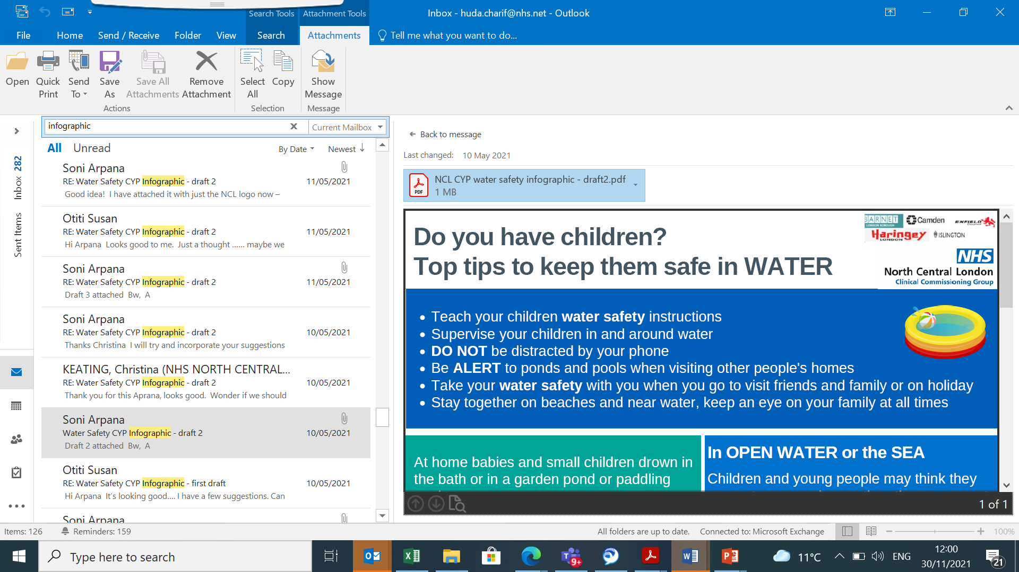
CDOP Asthma and air pollution
Kirstie Kinross and Christina Keating
01/12/2021 CDOP Meeting

Slide 2

Asthma deaths and air pollution
Ella Adoo-Kissi-Debrah, Died in 2013.
Age 9 years old
Southwark Coroner's Court concluded :
Medical cause of death:
1a) Acute Respiratory failure
1b) Severe Asthma
1c) Air pollution
Narrative conclusion:
Died of asthma contributed to by exposure to excessive air pollution
Notes:
who lived near the South Circular Road in Lewisham, south-east London,
On the

Slide 3
Air pollution
Air pollution refers to substances in the air that harm human health, welfare, plant or animal life.
Most pollution in London is caused by road transport and domestic and commercial heating systems.

Slide 4
UK Air Quality Standards Regulations 2010
sulphur dioxide (SO2)
nitrogen dioxide (NO2)
nitrogen oxides (NOx)
particulate matter (PM10 and PM2.5)
lead
benzene
carbon monoxide (CO)
benzo(a)pyrene
ozone (O3)

Slide 5
Air pollution London
Particulate matter (PM)
Particulate pollution can harm our heart and lungs - it is linked to asthma and death.
Nitrogen dioxide (NO2)
At high concentrations, NO2 can inflame the airways and long-term exposure can affect lung function and breathing - it can also worsen asthma.
Notes:
The two pollutants of most concern in London are:
Research shows that particles with a diameter of ten microns and smaller (PM10) can be inhaled deep into the lungs as smaller particles can penetrate deeper. PM2.5 can have a particularly bad impact on health.

Slide 6
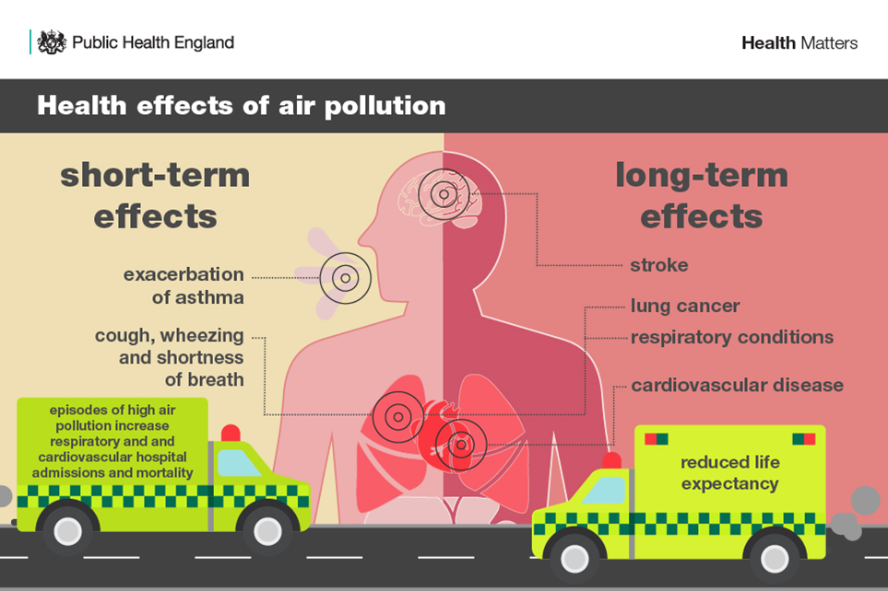
Health Impacts of air pollution
Notes:
Air pollution can cause short term symptoms and long term effects.

Slide 7
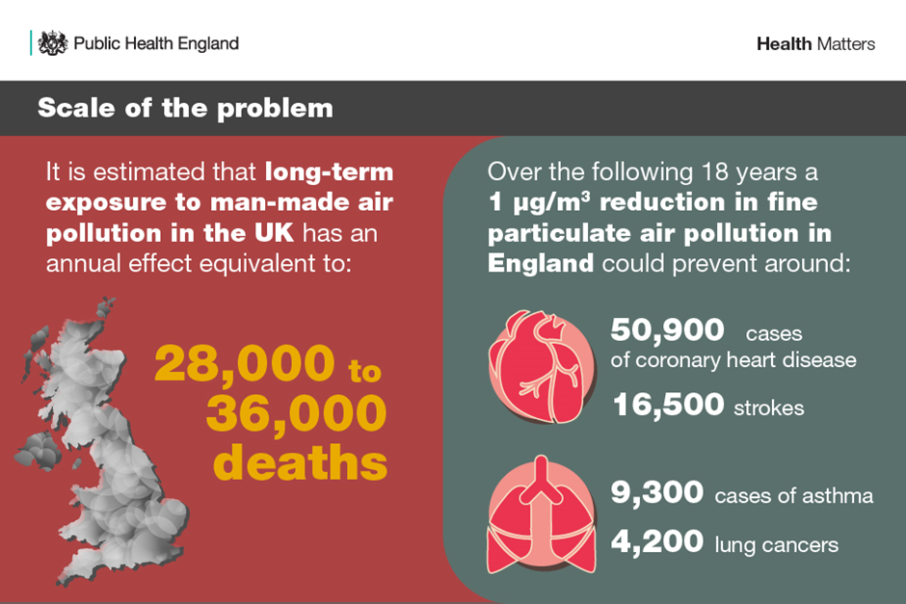
Scale of the problem

Slide 8
Coroners Matters of concern
National limits of particulate matter are set far higher than the WHO guidelines.
Low public awareness of the sources of information about national and local pollution levels.
Adverse effects of air pollution on health are not being sufficiently communicated to patients and their carers by medical and nursing professionals.

Slide 9
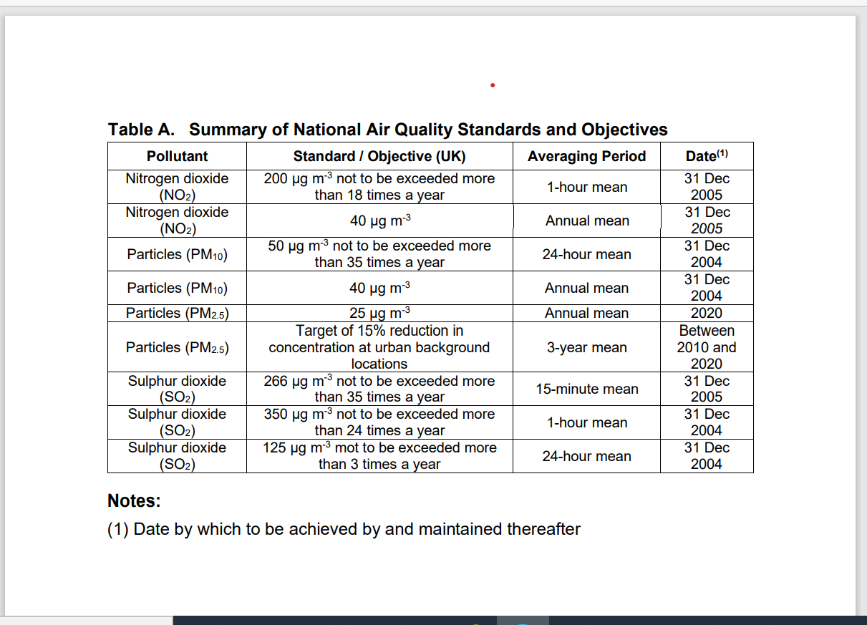
National standards

Slide 10
Summary of World Health Organisation Guideline for Air quality Standards
2021
Pollutant | WHO standard | Averaging Period
Particles (PM 10) | 15 | Annual Mean
Particles (PM2.5) | 5 | Annual Mean
Nitrogen Dioxide | 10 | Annual Mean

Slide 11
Borough Performance

Slide 12
Air quality Action Plans
Statutory requirement
All 5 boroughs have an UpToDate plan published online
Common themes but varying detail and targets
One borough have adopted and documented WHO recommendations (Camden)
Some collaboration in grant funded projects but limited
Not all boroughs measure the same number of sites, equipment and values.

Slide 13
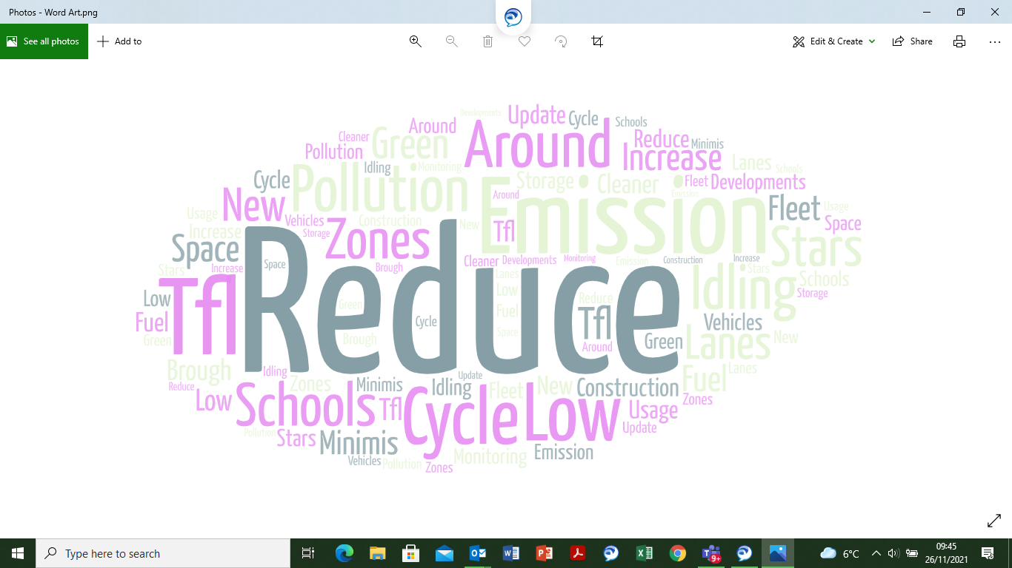
Air Quality action plans – common themes

Slide 14
Recommendations
Support campaigns to lobby for changes in legislation to review national standards and lower emissions.
- Suggest all boroughs consider aiming to reduce air quality limits to WHO national standards.
Increase public awareness
- Collaboration with health, local authority and other stakeholders
- NCL Paediatric asthma network already plan to identify and develop resources
Communicate adverse effects of poor air quality to patients.
-Patient advice leaflet
-Educate frontline practitioners - teaching sessions, Infographic
- Include in the asthma friendly schools initiative
Notes:
Air pollution is one of the greatest environmental risk to health. By reducing air pollution levels, countries can reduce the burden of disease from stroke, heart disease, lung cancer, and both chronic and acute respiratory diseases, including asthma.
The lower the levels of air pollution, the better the cardiovascular and respiratory health of the population will be, both long- and short-term.

Slide 15
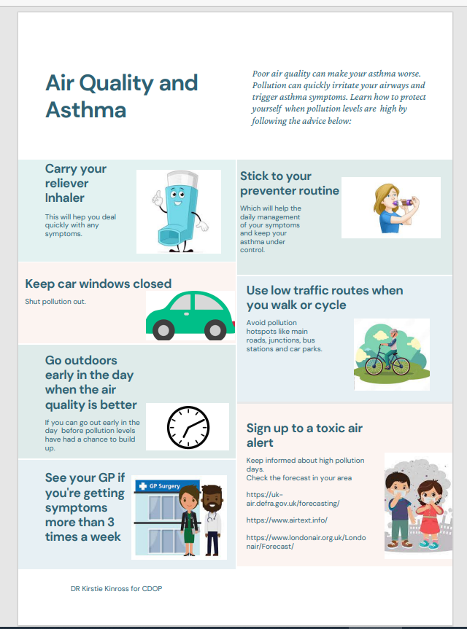
Patient advice leaflet

Slide 16
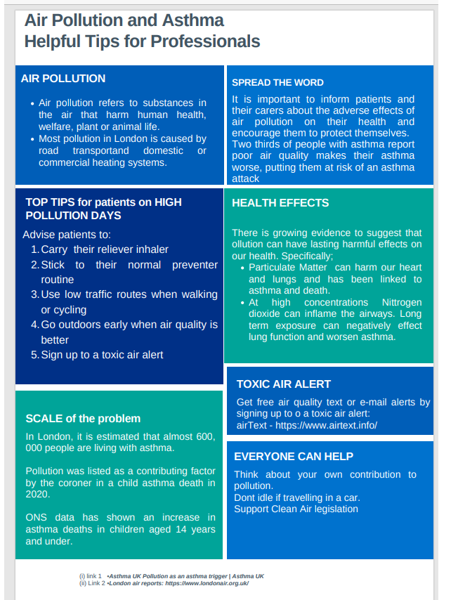
Frontline practitioners Infographic

Slide 17
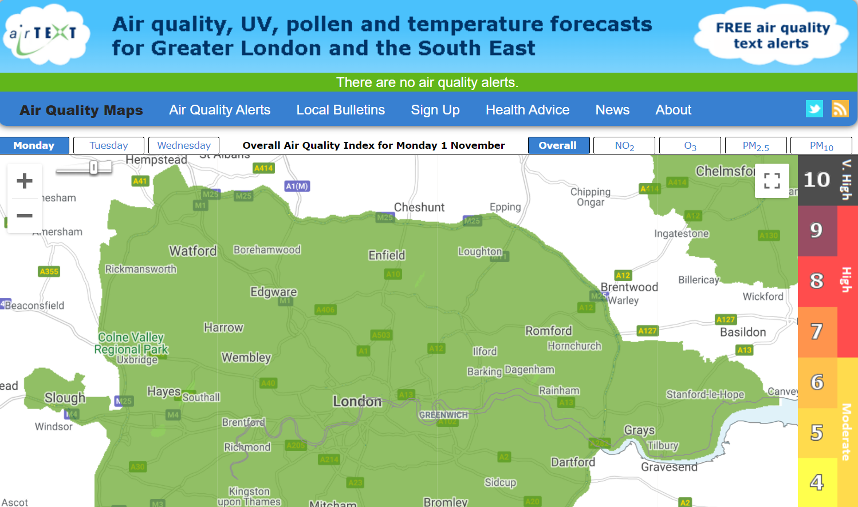
Air text

Slide 18
References
Environmental Protection UK: Local Air Quality Management (helpful summary of the Local Air Quality Management (LAQM) framework, including duties for local authorities)
Defra UK AIR: UK and EU Air Quality Limits (the legal limits for air pollution in the UK and the deadlines for when these were supposed to have been achieved)
Defra: LAQM Support Website (Further information about the LAQM framework and local authority-focused guidance and recommendations about the measures which should be included in Action Plans etc.)
London air reports: https://www.londonair.org.uk/
WHO Air Quality Guidelines 2021 What are the WHO Air quality guidelines?
Air pollution forecast and alerts airText - Air pollution forecasts for Greater London, Chelmsford and Colchester
Asthma UK Pollution as an asthma trigger | Asthma UK

Slide 19
With thanks to:
Baljinder Heer-Matiana, Assistant Director of Public Health – Children, Young People and Maternity, Camden and Islington Public Health.
Jo Hetherington , Pollution Officer Islington
Tom Parkes, Senior Air Quality Officer, Camden Council
Ned Johnson, Principal Officer Pollution Enfield council
Kenny Abere, Lead Officer - Pollution • Planning, Building Stands & Sustainability Haringey Council

