Slide 1
The New
London Social Prescribing Map
Showcase
Social Prescribing & Community Led Prevention,​
Transformation Partners in Health and Care ​
These are historic slides for reference. The London Social Prescribing Map is no longer active.
​

Slide 2
Aims and Agenda
These are historic slides for reference. The London Social Prescribing Map is no longer active.
In this session, you will:
Gain an understanding of what's new to the London Social Prescribing map and the benefits
Be able to use the new platform and features
Have a clearer picture of social prescribing provision, innovative work and proactive social prescribing interventions across London
Gain an understanding of how the map can support your work e.g. through building local & regional connections, tracking progress and meeting system priorities
Time | What
11:00-11:05 | Welcome and introductions
11:05-11:15 | The London Social Prescribing Map: what it is, who it’s for and the benefits
11:15-11:30 | Step by step walking through the platform and how to use it
11:30-11:45 | Questions and slido how can the map be improved or made more useful? what other categories would be useful to add to the map?
11:45 | Close and thank you

Slide 3
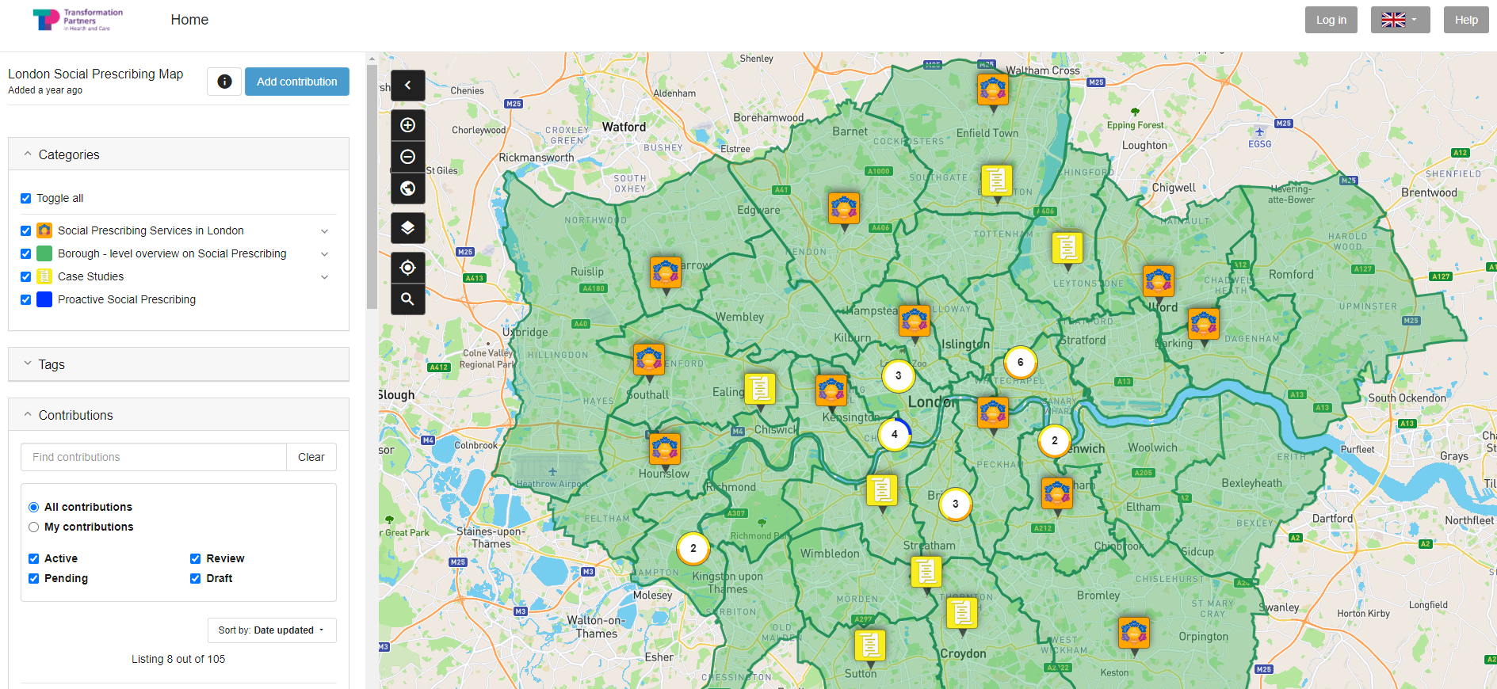

What is the London Social Prescribing Map?
What is it?
A visual tool – a map of London – find it here!
An overview of how social prescribing is being approached in each of the boroughs
Information about services, including key contacts, visibility of service models, case management and monitoring tools, case studies and annual reports etc. in one place
TPHC mapping service provision in collaboration with SP Managers and SPLW Team Leads to input information
5 ICS areas
32 boroughs
Currently showcasing 18 social prescribing service providers including individual surgeries, PCNs, GP Federations, local authority, housing associations and VCSE orgs – aim to have all London-based services
Case studies and proactive SP interventions

Slide 4
The New London Social Prescribing Map
What's new to the map?
Opportunity to include case studies of exciting and innovative projects or social prescribing initiatives
Opportunity to include examples of proactive social prescribing outreaching to local communities to improve access
Simpler step by step for adding to the map
Ability to edit/customise information more easily
Context and drivers
Supporting ICS priorities, 2023/24 network contract DES requirements e.g. proactive social prescribing offer
Connecting people working in social prescribing services, VCFSE and primary care across London when capacity is strained
Opportunity to connect with social prescribing services quickly & easily, to improve awareness of services and access
Increase visibility and recognition of exciting and impactful work happening across social prescribing in London to address social determinants of health, reduce health inequalities and enable more integrated care
Need for an open-source tool collating information on social prescribing landscape across London in one place to provide easier access to useful resources, service information and contacts
Desire for greater collaboration and good practice sharing regionally and nationally

Slide 5
The New London Social Prescribing Map
Who can use it?
Social prescribing services in and out of London to connect, collaborate and share learnings
VCFSE organisations to build partnership with social prescribing and healthcare services, strengthening routes of referral or exploring ways of working together
Primary Care Networks, Local Authority, as well as Universities, Colleges, Housing Associations, Police, Fire and Rescue to create stronger anchor networks at place
People and communities to find local social prescribing services and improve access
ICS, system, regional and national partner organisations involved in social prescribing including GLA, OHID, NHSE, ADPH etc.
How we plan to engage stakeholders
Sharing guidance & offering support in adding contributions
Spotlighting a case study/proactive SP example each month and sharing in our newsletters!
Sharing the map via social media, in bulletins and via networks
Sharing and promoting TPHC case studies on the map
A webinar to showcase the map and illustrate how to use it – develop and share a short video recording as guidance

Slide 6
Why and how to get involved?
What are the benefits?
Space to share and promote service models with a wide range of stakeholders involved or interested in SP, raising profile
Opportunity to connect & promote SP services in a local area, improving access for people in the local community
Platform to showcase & easily share case studies demonstrating impact (proactive social prescribing or innovative projects)
Unique opportunity to support expansion of SP into new settings, such as secondary care, through providing open access to information about service models and pathways
What you can submit:
We want all SP services across London to contribute information about their service provision – it is a quick & user-friendly process which should take max half an hour!
You can also promote your case studies or proactive social prescribing interventions on the map
Who? | Benefits
Services | Increased visibility of own service provision as well as access to similar services and information Enables greater partnership working across primary & secondary care, VCSE and community services in a local area
SPLWs | Opportunity to connect with other link workers, VCFSE & 3rd sector organisations
ICS and System Partners | Documents how services and localities are meeting DES spec requirements – opportunity to tailor support to meet priorities

Slide 7
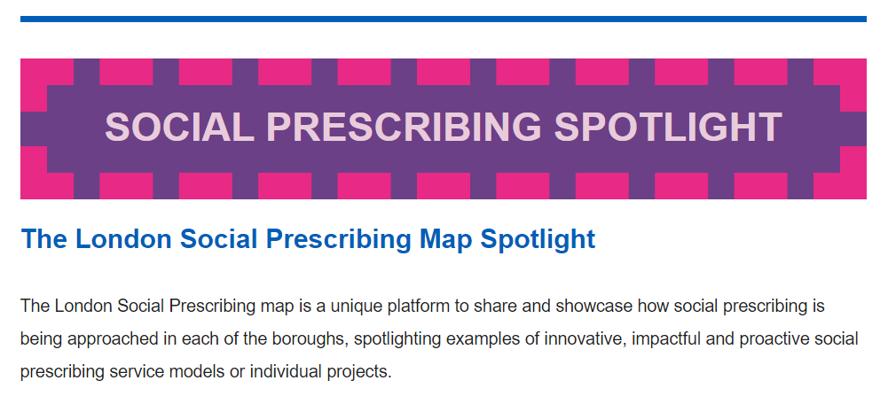
Opportunities!
Submissions that:
highlight an innovative or new model of social prescribing
evidence impact of proactive outreach
demonstrate effective cross-sector partnership and collaboration
or illustrates where social prescribing has influenced commissioning or wider health inequalities strategy
Could be spotlighted in our monthly newsletters!
Opportunities to be involved:
Add your service contribution and any case studies to the map
Use the map as a platform to quickly & easily share & promote your service
Share the link to the map with SPLWs, HWBCs, CCs, PCN staff and VCSE partners in your local area
Work with us to develop your Proactive Social Prescribing intervention into a case study to be shared with the system!
We can work with SP managers, SP Leads or Link Workers to input your example and will support with sharing pan London, raising awareness of your service, the intervention & the impact on health inequalities

Slide 8
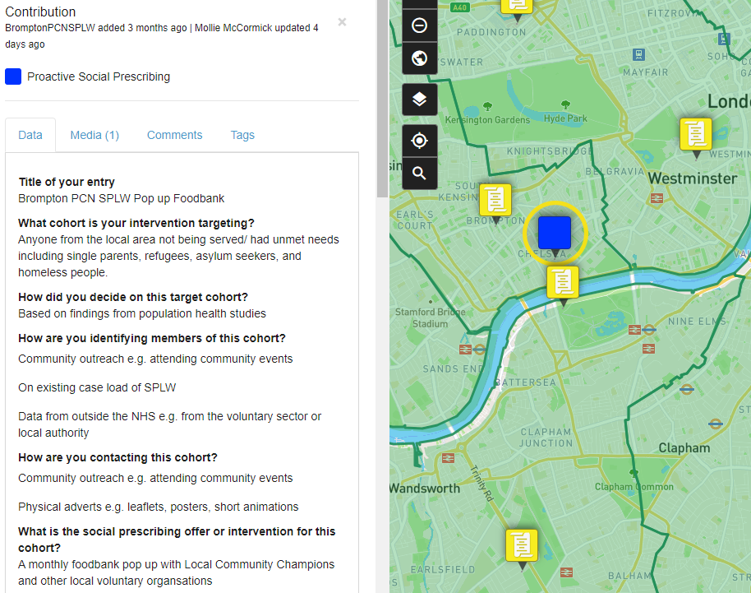
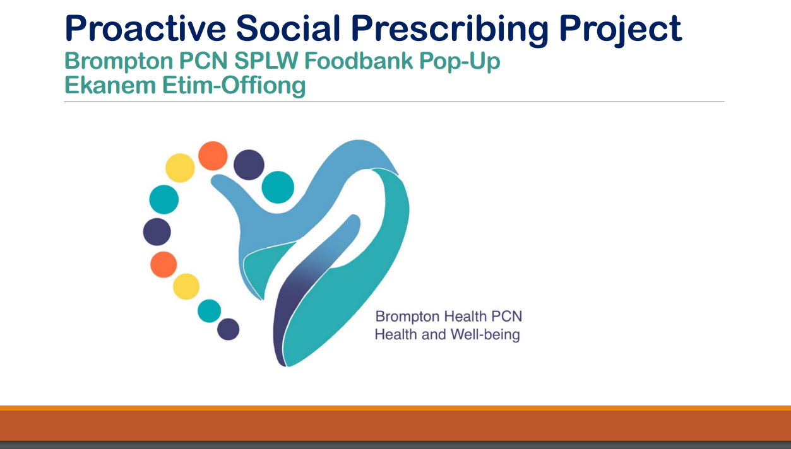
The New London Social Prescribing Map
Example Proactive Social Prescribing Intervention!
Share examples of proactive social prescribing interventions to illustrate how services are meeting the 2023/24 network contract DES requirements
You can link to online resources, information or upload media files to support your contribution
See the proactive SP project at Brompton PCN here

Slide 9

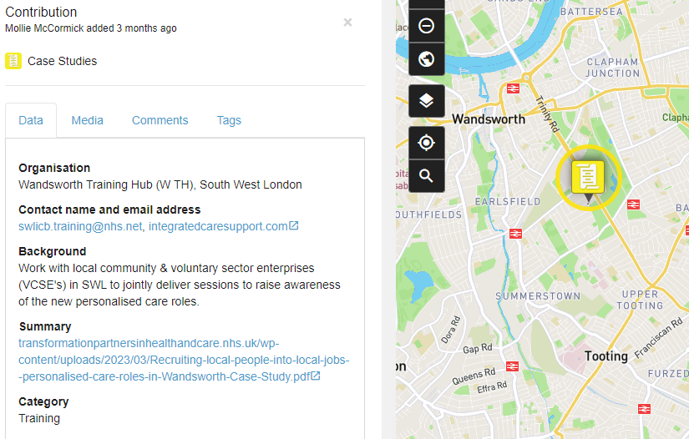
The New London Social Prescribing Map
Example case study!
You can link to online resources, information or upload media files to support your contribution!
See here for examples of case studies!

Slide 10
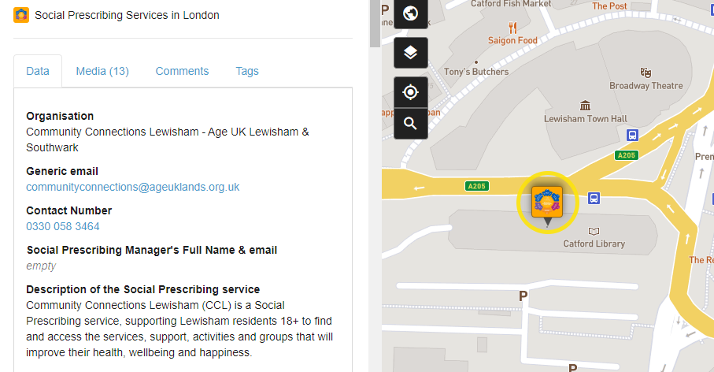
The New London Social Prescribing Map
Example Social Prescribing Service!
Service level contributions can include information about contact details, models & referral pathways, training & induction, outcome measures & evaluation, partnerships & networks, and more.
See here for examples of services!

Slide 11
The New London Social Prescribing Map
We'd like to hear from you!
How can the map be improved or made more useful?
What other categories might be useful to add to the map?
Reach out to mollie.mccormick@nhs.net to share your thoughts

Slide 12
The New London Social Prescribing Map
Following the webinar, we will..
Edit and share a shorter video walking through the platform and how to add a contribution
Develop and share an FAQ on our website
Explore ideas around how the map could be improved or expanded
Reach out to mollie.mccormick@nhs.net to share your thoughts

Slide 13
User Guide: Adding a contribution
Contributing to the London Social Prescribing Map is easy!
See further slides for a more detailed explanation of each step.
Sign up here using your email address, Twitter or Google account. Use a generic email address that key staff members of the service can all access
Click the Add Contribution button located at the top of the sidebar.
Use the magnifier icon to set the exact address location to set your pin on the map. Or click the Point icon to place the pin manually
Choose a category that best describes your entry and input the details of your social prescribing service, case study or proactive social prescribing example in the fields provided. You can also add media files such as documents (reports, pdf files, newsletters), pictures and videos. It is a great way to showcase your best practice and achievements.
Click on the Add Contribution button to complete the process. Your entry will be sent for approval and added to the Map.
You can always edit your profile information, login, password or contribution or delete your entry.
If you have any questions or you’d prefer to add your contribution with our support please email
rf-tr.socialprescribing@nhs.net or mollie.mccormick@nhs.net.

Slide 14
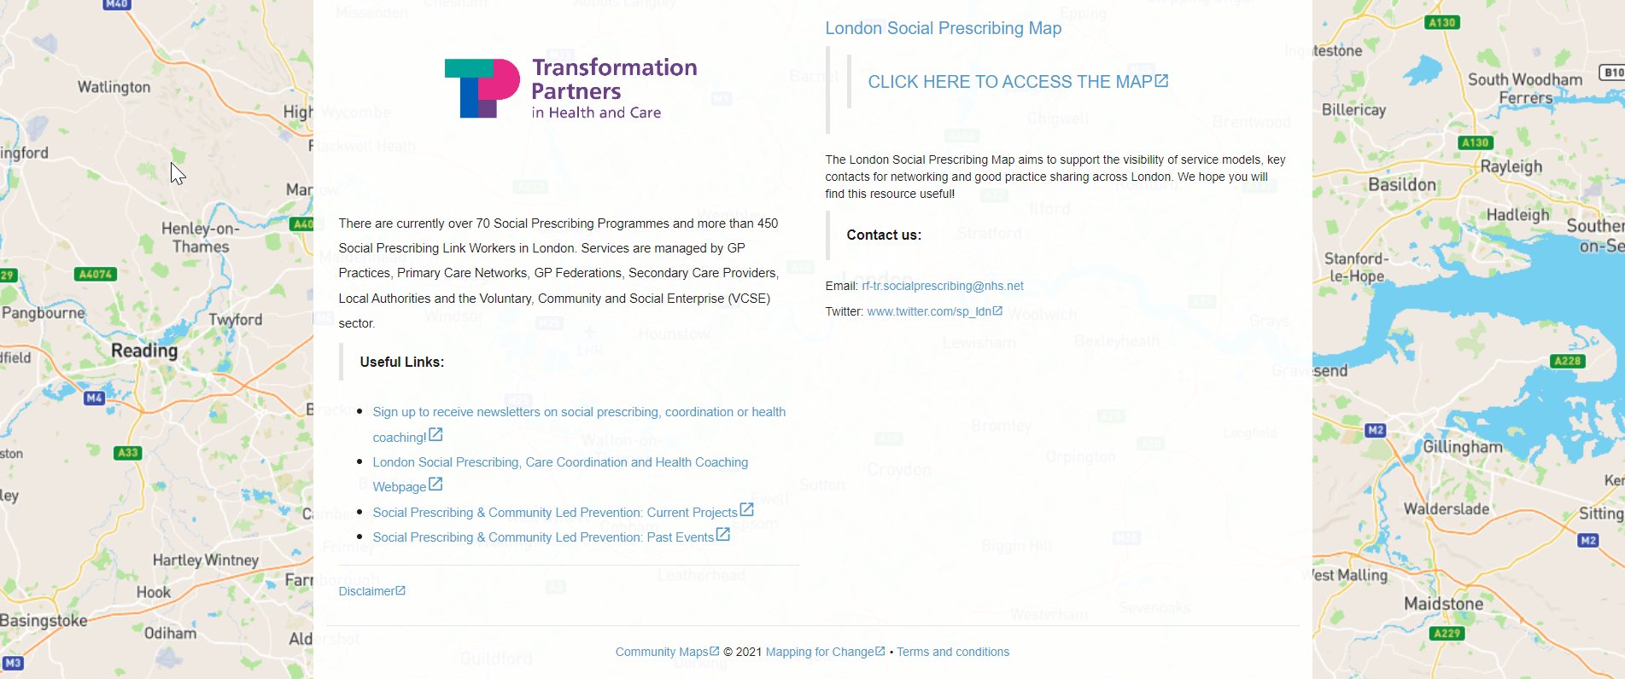
Step 1
Click on the text in the right column (circled) to access the map or access one of the Map shortcuts below.

Slide 15
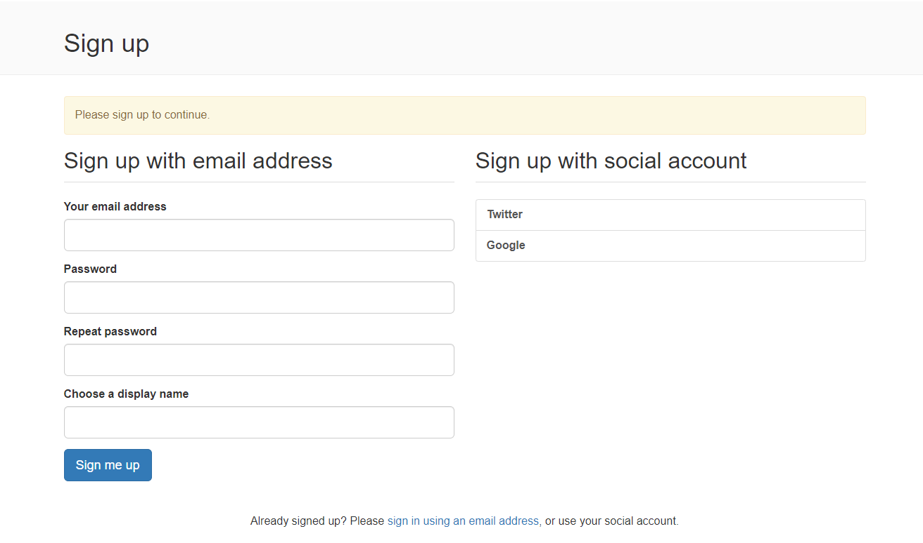
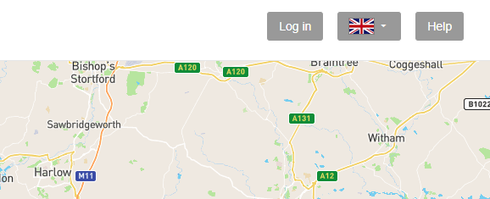
Step 2
Click sign up/log in in the top right-hand corner
Sign up using your email address, Twitter or Google account. You will be able to add your contribution after receiving a confirmation email. Use a generic email address that key staff members of the service can all access

Slide 16

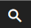
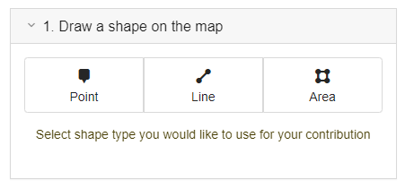
Step 3
Click the button located at the top of the sidebar.
You can use the magnifier icon ( ) to set the exact address location for your pin on the map
Or click the Point icon to place the pin manually.

Slide 17
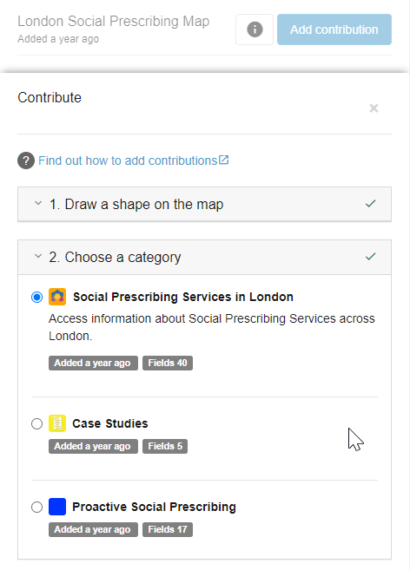
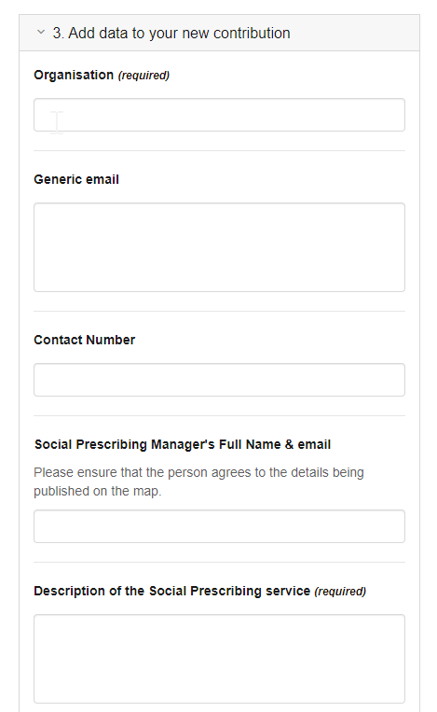
Step 4
Choose an appropriate category and complete all required fields
All Social Prescribing Services – to add your SP service
Case Studies – to quickly upload a SP case study
Proactive Social Prescribing – to add details about proactive social prescribing interventions
Compulsory fields are marked - the more you include the more comprehensive and interesting profile you create.
Remember that you can always edit it at a later stage.

Slide 18

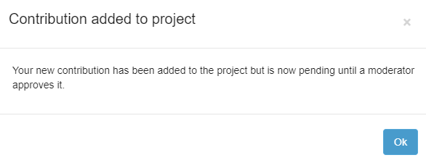
Step 5
Click on the Add Contribution button to complete the process.
Your entry will be sent for approval and added to the Map.
If you need more time to complete your entry, click on the Save draft button and finish your contribution later.

