Slide 1


Learning Disability Presentation
Healthy London Partnership
August 1st, 2022
Striving for excellence
www.enfield.gov.uk

Slide 2

Sarah Pope – Service Manager Community Nursing, Enfield Integrated Learning Disability Service
Chris O’Donnell – Person Centred Approaches and Engagement Lead Enfield Integrated Learning Disability Service

Slide 3
Some Definitions…
A learning disability is a significantly reduced ability to understand new or complex information, to learn new skills (significantly impaired intelligence)
A reduced ability to cope independently (impaired social/adaptive functioning)
AND the above started before adulthood (before 18) with a lasting effect on development. (DoH)
All 3 criteria are needed to meet the definition of learning disability What is NOT a learning disability (but may be a learning difficulty, which is more broadly defined in education legislation)
Dyslexia
Attention Deficit Hyperactivity Disorder (ADHD)
Specific difficulties with e.g. maths, reading
Loss of skills due to mental health problems, substance misuse, etc
Asperger Syndrome / Autism (although about 40% of Autistic people also have Learning Disabilities
An NHS Guide for General Practice
Notes:
Ref snomed codes – maybe talk to Mayo to see if there are any preferred codes?

Slide 4
Some Numbers…
It is estimated about 2% of the population will have a learning disability.
In Enfield this would be about 6,600 people
The Integrated Learning Disability Service have assessed approximately 1,450 people as having a learning disability
Of these approximately 950 are eligible for a funded care package
These are very typical figures as seen across the country
Notes:
Information and importance of reconciled registers

Slide 5
About Enfield Integrated Learning Disability Service
A joint funded services consisting of;
  Social Work – Promoting independence / Care Act duties
  Psychiatry – Including Medication Management (STOMP)
  Psychology – Therapeutic Input and PBS
  Physiotherapy
  Occupational Therapy (Functional)
  Employment Service
  Art Therapy
  Speech and Language Therapy – communication and dysphagia
For more information, and to request a referral, visit our website
Notes:
Mention Functional OT’s and Dysphagia team within SaLT.
Make clear we don’t have

Slide 6
About Enfield Integrated Learning Disability Service
Community Nursing – health promotion, transition to adulthood, complex epilepsy, admissions (and discharges), mental health, weight management, hypertension…
Also MDT’s for Dementia, Behaviour (PBS), End of Life Care Planning, (…and healthy living drop-ins) – vaccination hub
For more information, and to request a referral, visit our website
Notes:
Mention Functional OT’s and Dysphagia team within SaLT.
Make clear we don’t have

Slide 7
Learning from Lives and Deaths (LeDeR)
LeDeR was Established in 2017 by NHS England and NHS Improvement.
It is the first of its kind and was created to
Improve care,
Reduce health inequalities and
Prevent people with a learning disability dying sooner than the general population.
From late 2021 LeDeR will include improving services for autistic people too.
This is now part of the NHS long term plan
Notes:
Neither mandated nor funded. Very good compliance in NCL, but patchy across the country. Does add some uncertainty to data interpretation

Slide 8
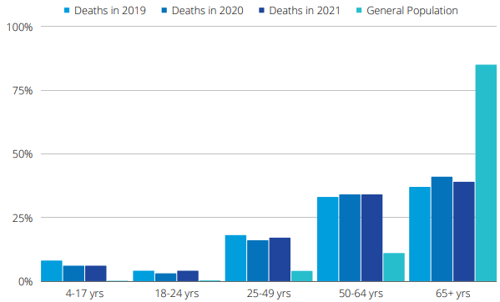
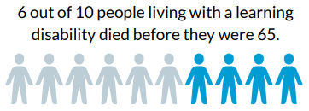
People with Learning Disabilities are far more likely to die younger than the population as a whole – Men by 22 years, women by 26 years.
This is only 15 out of 100 for the whole population

Slide 9
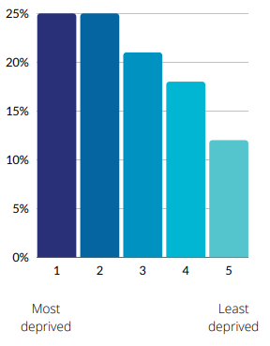
Over 50% of people with a learning disability died in areas rated as some of the most deprived in England.

Slide 10
People who died had an average of 2.45 long term health conditions.
Most prevalent health conditions were –
  Epilepsy
  Cardiovascular Conditions
  Mental health Conditions
  Sensory Impairments
  Dysphagia
Only 10% of those who died had no long term health conditions

Slide 11
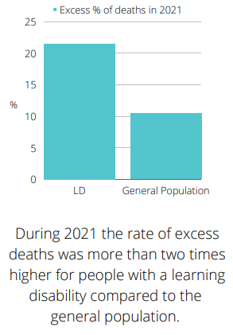
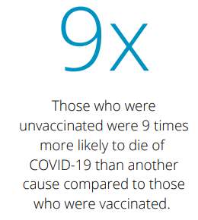

Slide 12
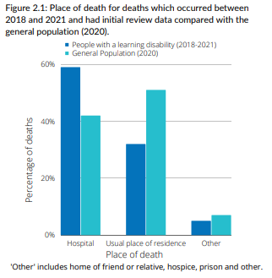
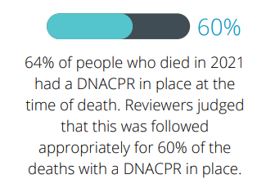

Slide 13
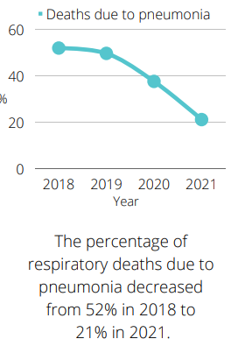
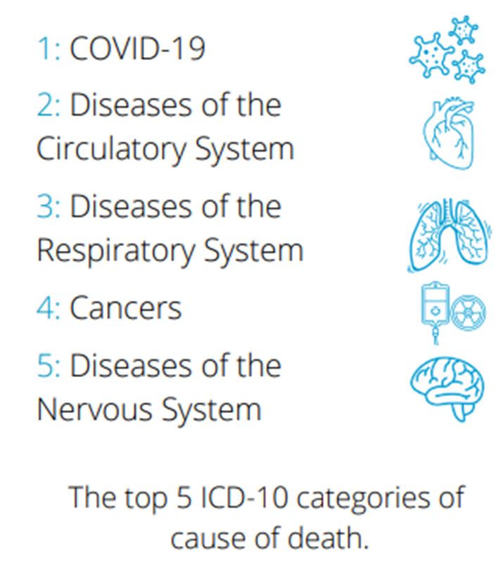

Slide 14
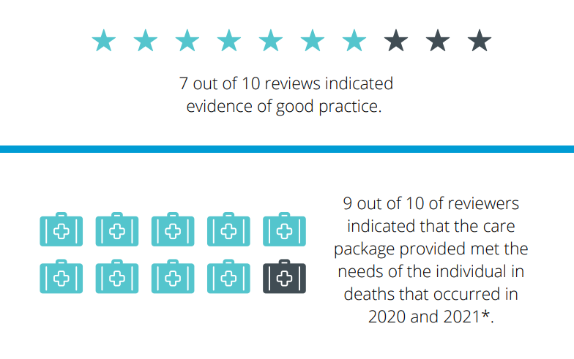

Slide 15
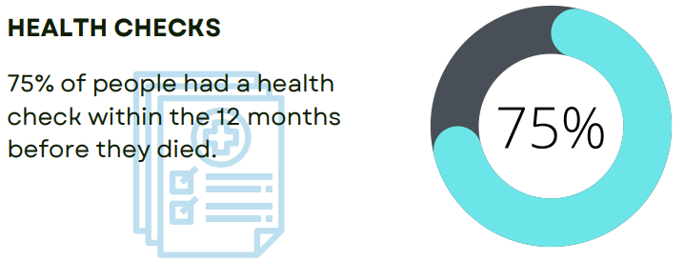

Slide 16
Other themes
Inconsistent application of mental capacity act
Inconsistencies in Structured Judgement Reviews (timely and level of details)
Late diagnosis of treatable conditions
Delays in receiving in patient treatment
Delays in escalation from social care services

Slide 17
Inconsistencies in Multi-Disciplinary approaches in the community
Poor discharge processes
Good practices in person centred end-of-life care planning
Diagnosis not shared across organisations limiting access to reasonable adjustments
Lack of awareness of Learning Disabilities Issues

Slide 18
Partnership Working
Currently developing close working relationships with
Community Service
Primary Care
Acute Trusts
Service User Groups
Carers
Voluntary and Community Sector

Slide 19
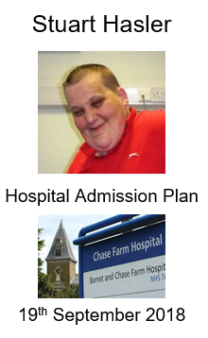

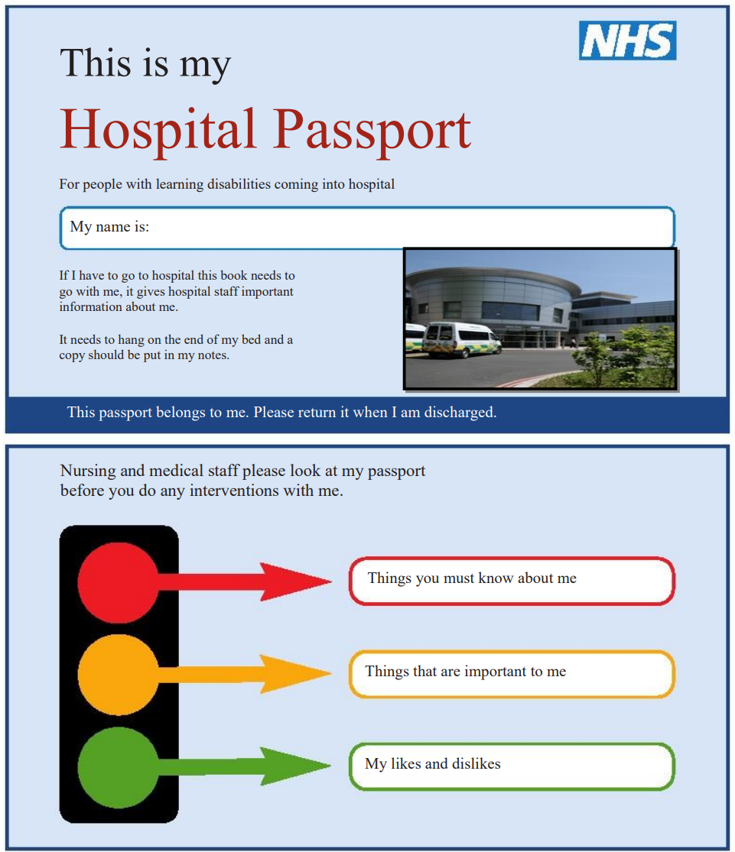

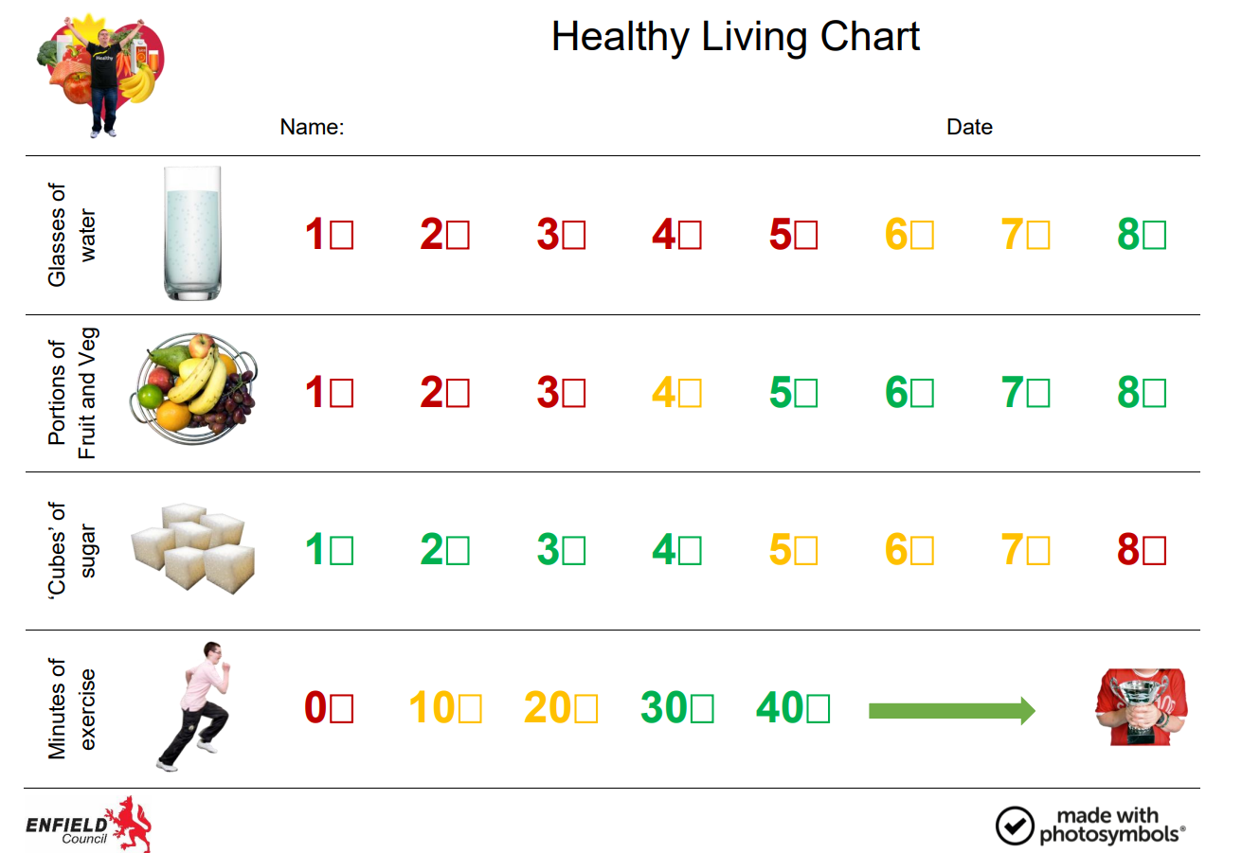

Slide 20
Further Reading
Whzan Blue Box escalation tool
Learning from Lives and Deaths Annual Reports
MENCAP
British Institute of Learning Disabilities
Easy Health
Health Passport App

Slide 21
Some Enfield Resources
We maintain an Easy Read web page with many health resources
Acute Liaison Nurses
Hospital Passports
GP Liaison Nurses
Accessible Information
Annual Health Checks
Reasonable Adjustments
Health Action Plans

