Slide 1


SMI: Severe Mental Illness
Care Coordinator Peer Support
November 2022

Slide 2
SMI…
People with psychological problems that are often so debilitating that their ability to engage in functional and occupational activities is severely impaired.

Slide 3
SMI conditions
Schizophrenia
Bipolar Affective Disorder
Major depressive disorder
OCD – Obsessive Compulsive Disorder
PTSD – Post Traumatic Stress Disorder
Personality Disorder

Slide 4
‘Psychosis’
This is acute stage that can present in all above conditions
Where patient finds it difficult to function normally due to severe symptoms of conditions including hallucinations, delusions, severe low mood
When patients have been well treated and there are no acute attacks for some time patient can be ‘in remission’

Slide 5
Management
Psychotherapy
Physical health checks
Anti- psychotic medication – e.g. Risperidone, Ariprazole, Quetiapine, Clozapine, Lithium, Olanzapine

Slide 6
Risk
Vulnerable patients
Self Neglect
Self harm /Suicide
Harm to others

Slide 7
SMI + physical health checks
People with SMI are at a greater risk of poor physical health and have a higher premature mortality than the general population [footnote 2]. People with SMI in England:
die on average 15 to 20 years earlier than the general population
have 3.7 times higher death rate for ages under 75 than the general population
experience a widening gap in death rates over time

Slide 8
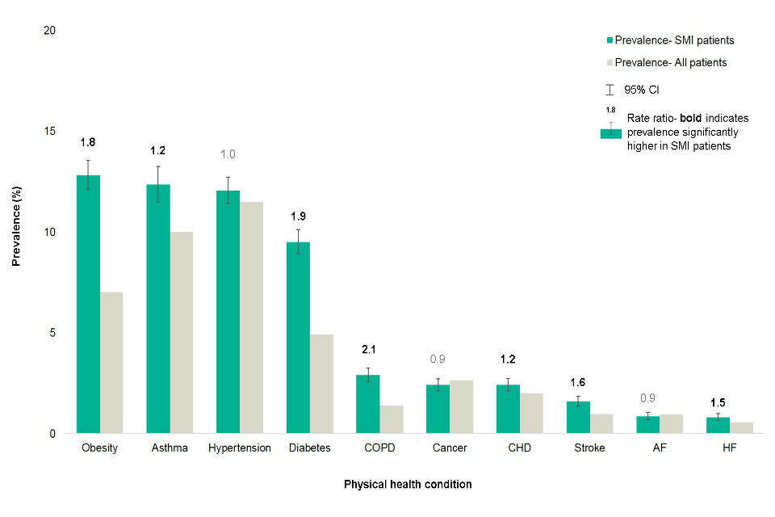
Prevalence (age and sex standardised) of physical health conditions for severe mental illness (SMI) and all patients aged 15 to 74

Slide 9
Communication
Empathy
Adaptations – written summary, collateral history, NOK/POA, sensory adaptation
Multiple consultations
Liaising with colleagues

Slide 10




Practicalities and boundaries
Telephone consults - Caller ID, Introductions, talking speed, volume.
F2F consults – positioning, body language, panic buttons, involving other team members
?video consults
Emotional boundaries and time management

Slide 11





How to support?
Explore what is already in place
Social Services
Voluntary and community services
Navigating systems
Empowering

