Slide 1
Embedding the personalised care roles
System support session
May 2023

Slide 2
Topic | Time | Who?
Intro to the session Support activity to date Who we are Purpose of the day | 5 min | Jenny Brooks
Who is in the room | 5 min | Jenny Brooks
Key guidance Workforce development frameworks by NHSE Toolkit for embedding the three personalised care roles and tackling inequalities ARRs and Funding post 2023/24 Q&A | 5 min 10 min 15 min | Jenny Brooks Jonathan Sampson (NHSE Primary care team)
Sharing and reflection - mentimeter What are your biggest challenges to recruiting, employing and embedding the roles? What support would be most helpful to solve some of these challenges? Reflections | 15 min | All
Summary and close | 5 min | Jenny
Notes:
Jenny to get all peer support recordings uploaded to closed youtube links
Get all slides uploaded to website
Any other links to key resources

Slide 3
Social Prescribing & Community Based Prevention - TPHC
(Formerly HLP) What support has there been to date?
A full list of resources, recordings and useful links is at the end of this pack
Led support for the three personalised care roles in primary care, and held NHSE Regional Learning Coordinator and facilitator roles for the past year including
Peer supports – Monthly for each of the roles to connect and problem solve with their peer group, including an SP managers group
Training and learning – Regular sessions for each role to learn about patient cohorts/particular skills, webinars and commissioned trainings
Leadership development – Ran the Social Prescribing Innovators Programme to support 12 pilots in improving local SP services in London, currently training people in action learning set facilitation, held other one off workshops
Communications – Monthly newsletters with latest guidance, news, resources, events, training and recordings
Led support for managers and those embedding the roles including ICS, THs, and PCNs and held NHSE PCN Advisor role for the past year including:
Workshops and learning – Sessions to share information, guidance and problem solve at a pan London level
1:1 support – Targeted support with specific issues or help setting up a service for social prescribing/care coordination/health coaching
Local support – Ad hoc work e.g. workshops at ICS level, mapping activity in specific ICSs or boroughs
Guidance and resources – Developed toolkit for embedding the roles, summaries of WDFs
Communications – Monthly newsletter with latest guidance, news, resources, events, training and recordings

Slide 4
Purpose of today
Learn about the latest key resources, guidance and top takeaways for supporting these roles (Workforce development frameworks, toolkit, PCN DES, ARRs funding and GP contracts)
Connect with others across London also managing/embedding the roles to share challenges and ideas
Help us understand what regional support is useful around managing/embedding the personalised care roles
Social Prescribing Link Workers
Workforce development framework summary for SPLW,
Full WDF
One-page explainer for SPLW
Care Coordinators
Workforce development framework summary for CC
Full WDF
One-page explainer for CC
Health and Wellbeing Coaches
Workforce development framework summary for HWBC
Full WDF
One-page explainer for HWBC

Slide 5
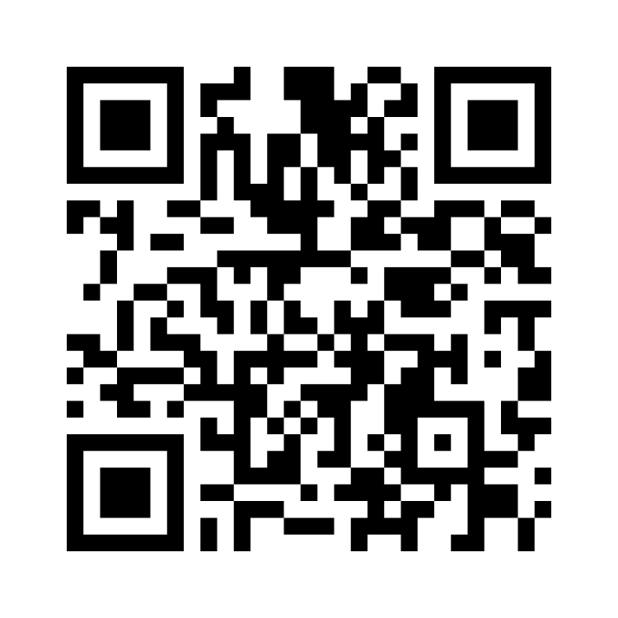
Who is in the room?
Use the Mentimeter!
https://www.menti.com/al2kzh3a5int
Or go to menti.com
And enter: 8641 9036
Use the Teams Q&A function for any questions throughout the event

Slide 6
Key Guidance
Workforce Development Frameworks (NHSE): A top line how-to for recruiting, employing, managing and embedding the roles
Includes:
What training and induction they need before referrals
Competency framework showing what skills they need
What supervision is, who can give them supervision
What caseloads are and the limits of this
How they can develop and progress into specialist roles
Tools to evidence their work
PCN Toolkit: Using Social Prescribing, Health Coaching and Care Co-ordination to tackle health inequalities: A practical guide to embedding the roles and ensuring their work tackles inequalities, with examples throughout.
Includes:
Context of personalised care – why the roles are being expanded, policy drivers
What is health inequalities, how the roles can support them, proactive social prescribing
Tips for embedding the roles, working as one team, measuring impact
Asset based working, place based partnerships, NHS and VSE partnerships
Social Prescribing Link Workers
Workforce development framework summary for SPLW,
Full WDF
Care Coordinators
Workforce development framework summary for CC
Full WDF
Health and Wellbeing Coaches
Workforce development framework summary for HWBC
Full WDF
PCN Toolkit
One-page explainer for CC
One-page explainer for HWBC
One-page explainer for SPLW

Slide 7
Personalised Care and the GP network contract
Jonathan Sampson, Senior Programme Manager
May 23

Slide 8

Direction of travel – Primary care
Stage
Access Recovery Plan
23/24 NHSE planning guidance has highlighted the importance of making it easier for people to access primary care services, particularly general practice.
Ensure people can more easily contact their GP practice (by phone, NHS App, NHS111 or online)*
Planning
Further development of and integration with the NHS App to help patients identify their needs, manage their health and get the right care in the right setting
Improve Access to General Practice
Ensure that everyone who needs an appointment with their GP practice gets one within two weeks and those who contact their practice urgently are assessed the same or next day according to clinical need
Empower patients to take control of their healthcare
Continue on the trajectory to deliver 50 million more appointments in general practice by the end of March 2024
Increase / Maintain workforce
Continue to recruit 26,000 Additional Roles Reimbursement Scheme (ARRS) roles by March ‘24
Improve retention and staff attendance through a systematic focus on all elements of the NHS People Promise
Increase General practice capacity
Expanding direct access and self-referrals to community services where GP intervention is not clinically necessary empowers patients to take control of their healthcare, streamlines access to services and reduces unnecessary burden on GP appointments.
Prevention and the effective management of long-term conditions are key to improving population health and curbing the ever increasing demand for healthcare services.
Transfer lower acuity care away from both general practice and NHS 111 by increasing pharmacy participation in the Community Pharmacist Consultation Service
| Page ‹#›

Slide 9
Personalised care and the PCN contract
Contract specification 2023/24 – PCN Requirements and Entitlements
A PCN must provide to the PCN’s patients access to a social prescribing service
  a. directly employ Social Prescribing Link Worker(s); or
  b. sub-contract provision of the service to another provider
PCNs must continue to work with commissioners to improve their social prescribing programme and their use of shared decision making and keep the effectiveness of those measures under review.
They should review and continue to offer a proactive social prescribing service, expanding the offer to a new cohort(s) based on population health management data and PCN capacity
Personalised care
| Page ‹#›

Slide 10
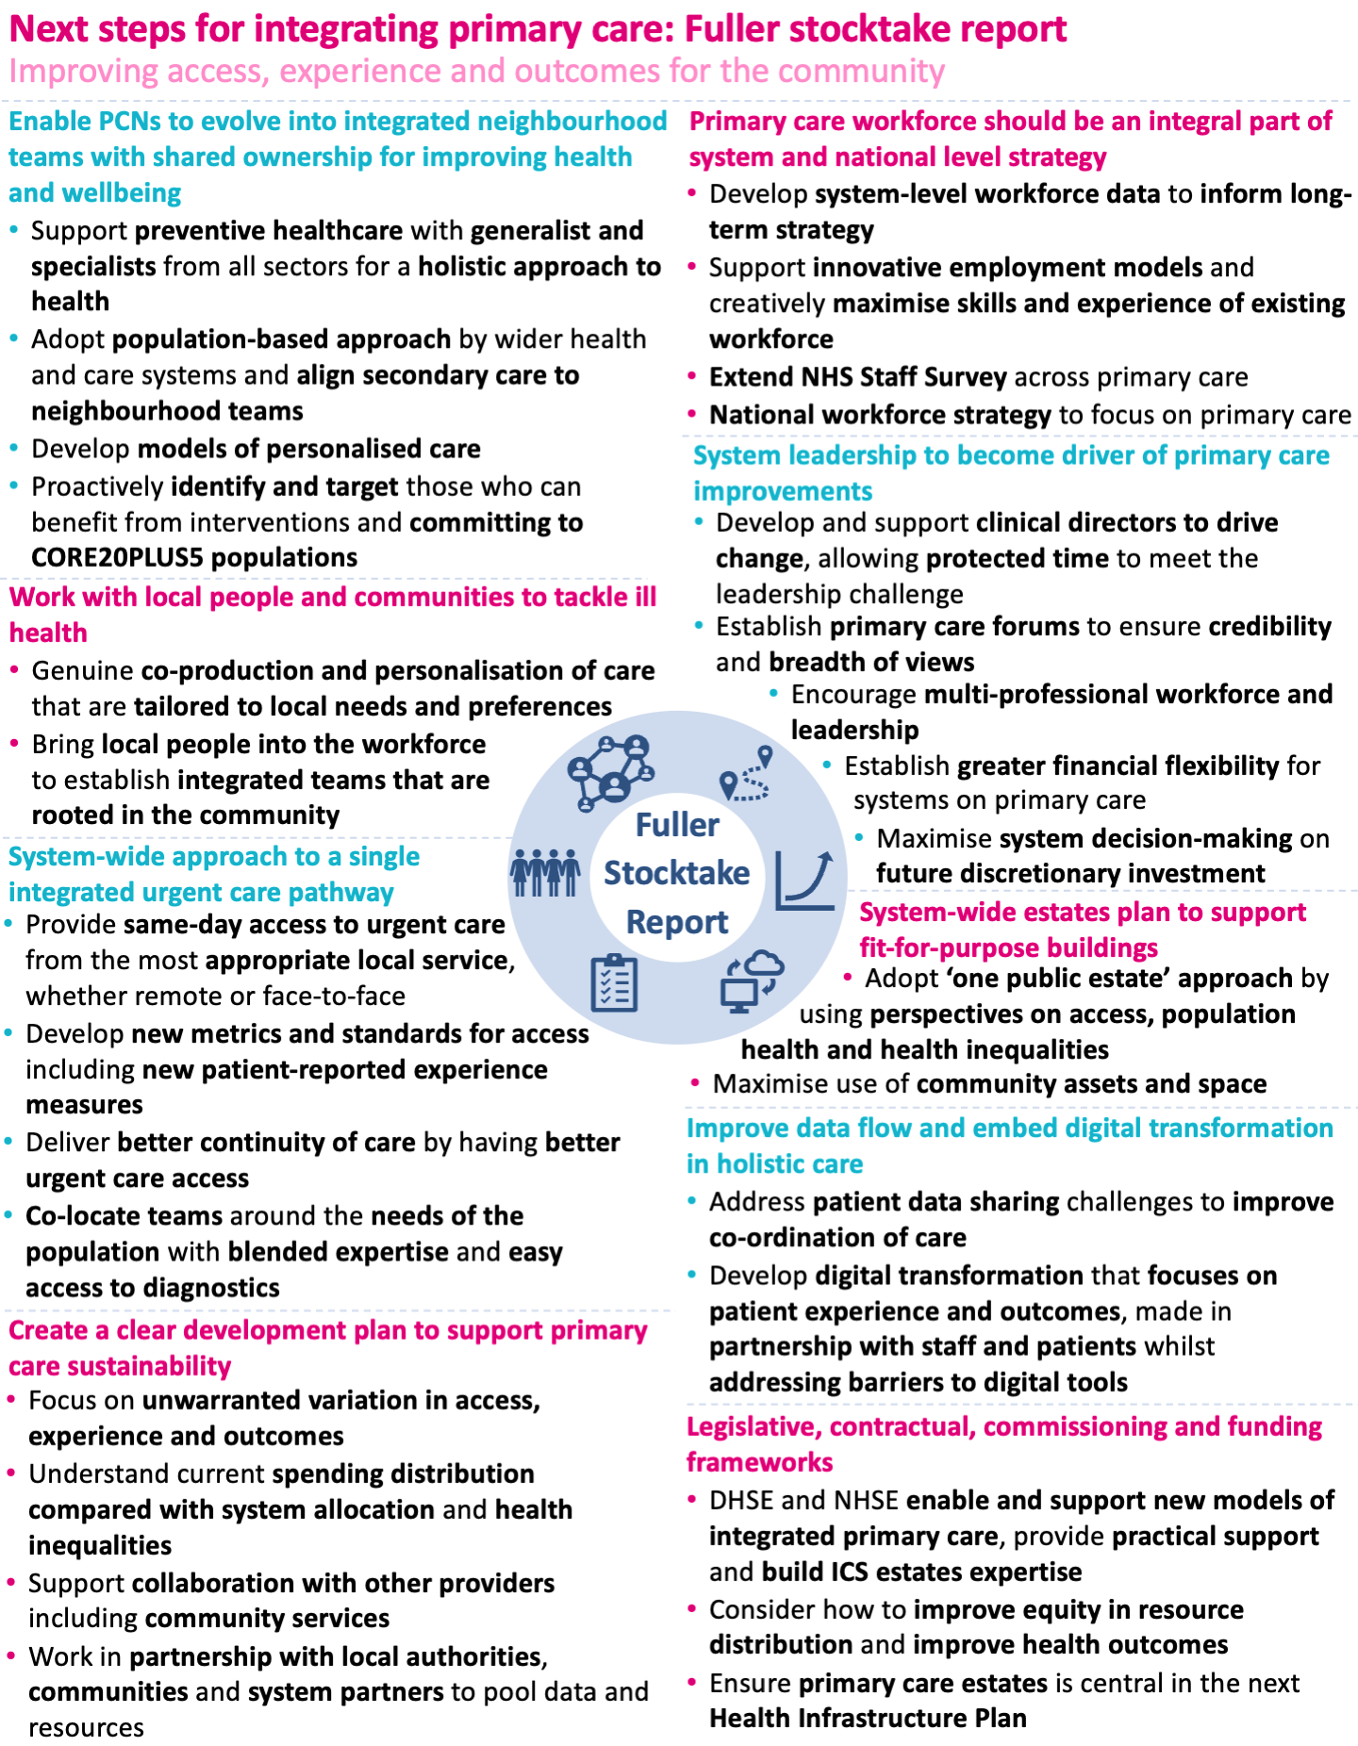
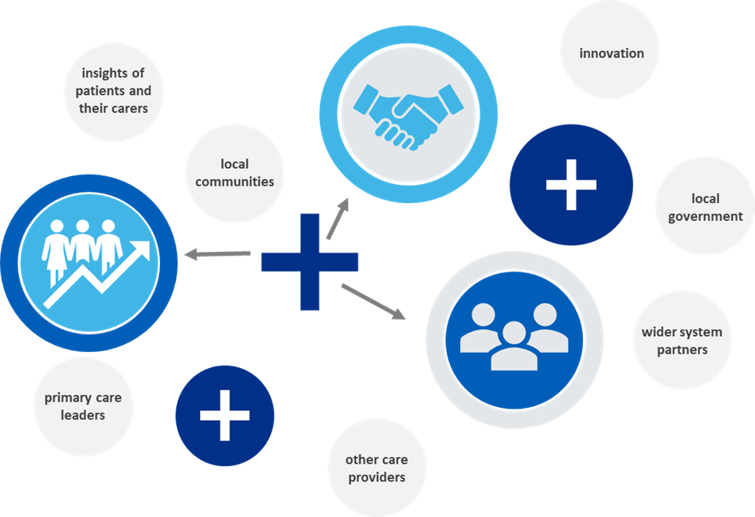
Fuller stocktake report
Partnership, collaboration and new ways of working is at the heart of making ICSs a success. By drawing on insights, resourcefulness and innovation of patients and their carers, local communities, local government, other care providers and wider system partners as well as primary care leaders, a thriving integrated primary care system can be developed.
Fuller
Snapshot summarising the Fuller Stocktake report – Carnall Farrar

Slide 11
Additional Roles Reimbursement Scheme
Stage
The ARRS scheme started in 2019/20 and PCNs were eligible to start claiming from July 2019
PCNs were able to claim funding for four reimbursable roles - clinical pharmacists, social prescribing link workers, physician associates and physiotherapists
The scheme was founded on the principle of funding for additionality; the baseline was taken for the reimbursable roles at 31 March 2019
A PCN with 50,000 population was entitled to a maximum of £74k for the 9 months from July 2019 to March 2020
ARRS Background
| Page ‹#›

Slide 12
Roles recruited
Employee Role | Apr-22 | May-22 | Jun-22 | Jul-22 | Aug-22 | Sep-22 | Oct-22 | Nov-22 | Dec-22
Allied Health Professionals | 538 | 533 | 553 | 569 | 579 | 599 | 614 | 634 | 563
Support roles | - | - | - | - | - | - | 31 | 50 | 58
Mental Health Practitioners | 71 | 80 | 86 | 75 | 79 | 75 | 74 | 74 | 77
Nursing associates | 61 | 62 | 60 | 59 | 64 | 76 | 77 | 77 | 73
Personalised care roles | 994 | 1,030 | 1,055 | 1,083 | 1,103 | 1,167 | 1,169 | 1,203 | 1,102
Pharmacy roles | 979 | 1,028 | 1,020 | 1,051 | 1,058 | 1,101 | 1,138 | 1,150 | 1,025
Total | 2,643 | 2,734 | 2,773 | 2,837 | 2,882 | 3,019 | 3,102 | 3,188 | 2,898
Summary
The data come from the ARRS claims portal and includes all approved and submitted for approval claims
December ‘22 data likely to lower because of time lag in processing claims
| Page ‹#›

Slide 13
Changes to ARRS in 2023/24
The maximum reimbursable amount for a PCN rises by 38% to £22.96 per patient (weighted list size)
A PCN of 50,000 would be eligible to claim up to £1.15m in 23/24
Total maximum funding available to London PCNs is in the region of £225m
increasing the cap on Advanced Practitioners from two to three per PCN
reimbursing PCNs for the time that First Contact Practitioners spend training to become Advanced Practitioners
Introducing Advanced Clinical Practitioner Nurses and apprentice Physician Associates (PAs) as reimbursable roles
removing recruitment caps on Mental Health Practitioners
2023-2024
| Page ‹#›

Slide 14
Changes to ARRS beyond March 2024
In 2020, NHS England advised that ARRS-recruited staff will be treated as part of the core general practice cost base beyond 2023/24 and so permanent contracts where appropriate should be offered by PCN employers
The national team encouraged PCNs to continue to recruit, making full use of their ARRS entitlement to improve access to care and support for patients, with the knowledge that support for these staff will continue
During 2023/24 the ARRS will be reviewed to ensure that it remains fit for purpose and aligned to future ambitions for general practice
The future of the ARRS scheme beyond March 2024 will be the subject of negotiations between DHSC and the GPC
2024 and beyond
| Page ‹#›

Slide 15
Q&A
Funding available other than for salaries of these ARRS roles. EG how do we cover back office/supervision costs? Also, the openness and opportunity available for voluntary/charity organisations to provide some of these roles? What support is available for these?
Interprofessional interactions, Integration with Mental Health Practitioners and other ARRS’ roles.
Is there funding to support training of managers to better support these roles they are now managing as they are ever increasing, changing roles
Training and Supervision support for Social Prescribers
What support models are working best for these roles?
Q&A

Slide 16
Breakout rooms
8 minutes on each – https://www.menti.com/al2kzh3a5int
10 min to feedback
Thinking around challenges and what support would be most useful

Slide 17
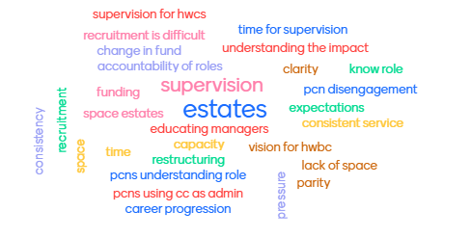
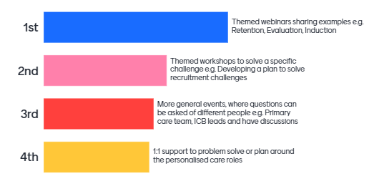
Challenges
Top support wanted

Slide 18
Resources and useful links
Social Prescribing Link Workers
Workforce development framework summary for SPLW,
Full WDF
Care Coordinators
Workforce development framework summary for CC
Full WDF
Health and Wellbeing Coaches
Workforce development framework summary for HWBC
Full WDF
PCN Toolkit
One-page explainer for CC
One-page explainer for HWBC
One-page explainer for SPLW
PCN DES Contract
NHSE GP Contract Hub
A letter has been sent to GP practices and PCNs on the 6th March to outline the key changes to the GP contract in 2023/24.
PCN DES Contract
Personalised Care DES
Health Inequalities DES
Fuller Stock Take Report of Primary Care
PCN planning template – to support development of plans for enhanced access service within the Network Contract DES.
ARRs
Integrating the additional roles into PCNs – King’s fund
ARRS claims portal guidance webinar
Guidance for accessing allocated ARRS funding
Personalised Care DES
PCN support session: Co-producing a Proactive Social Prescribing Service
  Recording
  Slides
What is proactive SP - a 3 minute video by NALW

Slide 19
Opportunities and how to stay up to date!
Does your borough have peer support for SPLWs, CCs or HWBCs?
Peer support is an invaluable tool to support and connect the frontline. We can help in setting them up – find out more here.
Sign up to receive our newsletters here!
System support newsletter for people managing and embedding the roles
Workforce newsletter for those working in a personalised care role
We add all our previously shared resources, recordings and guidance to our website and resource database here.
Do you want support to develop a case study from your service?
NHSE are looking for people to develop case studies with around wider roles, including non-clinical and ARRs roles to improve patient and public awareness of these within the MDT. Some examples include:
    Good example of MDT working, or a specific role benefiting patients
    Some data/stats such as:
          Improvements in patient satisfaction levels/survey responses etc
          Freeing up capacity in other areas so more patients are being seen/getting the care they need
          Quicker access to healthcare professionals
          Any anecdotal feedback from patients
    If you are interested in developing a case study showcasing the work of your MDT, then please contact Janet Somers at janet.somers@nhs.net.

Slide 20
Opportunities for your personalised care workforce
Would a personalised care role in your team benefit from advanced training?
This advanced skills module is targeted at the ARRS personalised care roles, and helps them to explore how they can undertake group assessments and follow ups using a group care model e.g.
Complete group holistic needs assessments and co-create personalised plans in line with 5 steps to well-being in a group setting
Run group coaching and group personalised care and support planning
Offer group follow up and “check in” sessions for clients
Get more from personalised care pathways by combining group care with one to one sessions
This offer is limited to our May and June dates. The link to book is: https://www.elcworks.co.uk/advanced-personalised-care-practitioner-training/
This promotional code will provide you with access free of charge: PERSONALISEDCARE2023
The available dates are:
WED 17 MAY 09.00 – 11.00; THURS 08 JUNE 10.00 – 12.00
Please ask your colleagues to sign up to receive our newsletters here!
System support newsletter for people managing and embedding the roles
Workforce newsletter for those working in a personalised care role
We add all our previously shared resources, recordings and guidance to our website and resource database here.

Slide 21
Next steps and close
Recording, slides and themes from breakouts will be shared
The Appendices have national updates on DES/ARRs for personalised care
We’ll be summarising what we heard today and suggesting some ways to support
Thank you for your participation!

Slide 22
Appendices

Slide 23
NHSE National Updates on Contracts
PCN DES contract specification and personalised care guidance for 2023/24
Contract specification 2023/24 – PCN Requirements and Entitlements
A PCN must provide to the PCN’s patients access to a social prescribing service
directly employ Social Prescribing Link Worker(s); or
sub-contract provision of the service to another provider
Additional Personalised Care Guidance: Proactive social prescribing and shared decision making requirements
Guidance: PCNs must continue to work with commissioners to improve their social prescribing programme and their use of shared decision making and keep the effectiveness of those measures under review.
They should review and continue to offer a proactive social prescribing service, expanding the offer to a new cohort(s) based on population health management data and PCN capacity

Slide 24
NHSE National Updates on Contracts
Coding Activity and Outcomes
Coding activity and outcomes relating to social prescribing is an essential component of Primary Care Network (PCN) and Social Prescribing Link Worker (SPLW) activity. Coding activity and outcomes are essential so that we can better understand variation across regions and the impact and benefits of social prescribing.
Contractually: A PCN must ensure referrals to the Social Prescribing Link Worker(s) are recorded within GP clinical systems using the new national SNOMED codes (see section 7.4.1 and 5.4.7).
For social prescribing, these codes are:
871731000000106 – Referral to social prescribing service (procedure)
To be used when an individual accepts a referral to the SPLW– for first interaction in an episode of care only, not to be used to code ongoing activity
871711000000103 – Social prescribing declined (situation)
To be used when an individual declines a referral to the SPLW

Slide 25
NHSE National Updates on Contracts
Changes to Impact and Investment Fund
The number of indicators in the IIF will be reduced from 36 to five, including the removal of the social prescribing indicator. The five remaining indicators will focus on a small number of key national priorities: two indicators related to flu vaccinations, learning disability health checks, early cancer diagnosis and 2-week access indicator. The remainder of the IIF will now be worth £246 million and will be entirely focused on improving patient experience of contacting their practice and receiving a response with an assessment and/or be seen within the appropriate period (for example same day or within 2 weeks where appropriate, depending on urgency).

Slide 26
NHSE National Updates on Contracts
Increased flexibility of Additional Roles Reimbursement scheme (ARRS)
Recruitment through the Additional Roles Reimbursement scheme (ARRS) has been strong, and as of 31 December 2022 stands at 25,262 additional FTE. PCNs are on track to meet the 26k target for March 2024 over a year early. Staff are providing significant numbers of additional appointments, improving patient access to general practice, and providing personalised, proactive, care for the populations that they serve. During 2023/24 NHS England will review the ARRS to ensure that it is tailored to deliver future ambitions for general practice. Staff employed through the scheme will be considered part of the core general practice cost base beyond 2023/24 as previously confirmed, and PCNs can offer permanent contracts where appropriate. We encourage PCNs to continue to recruit, making full use of their ARRS entitlement.

Slide 27
NHSE National Updates on Contracts
Additional Personalised Care Guidance: Proactive social prescribing and shared decision making requirements
As part of the Enhanced Health in Care Homes service, care home residents should be offered and be part of a personalised care and support planning conversation within 7 days of admission to the care home, or readmission following a hospital episode. This should be enabled by MDT arrangements.
As part of the Tackling Neighbourhood Inequalities service, PCNs must review their identification of a population experiencing inequality in health provision and/or outcomes, and ensure there is a plan to tackle the unmet needs of that population.
As part of the Medication Review and Medicines Optimisation service, clinicians should conduct structured medication reviews in line with the principles of shared decision making.
They should continue to implement any improvements to SDM conversations based on their audit of patients experience of shared decision making which was carried out in 2022/23. Improvement actions might include participating in SDM training via the Personalised Care Institute. We would also encourage PCNs to consider repeating the audit to help assess the impact of any changes they have made.

