Slide 1
TOP TIPS ON EMIS POPULATION SEARCHES
Dr Nadine Singh

Slide 2
AIMS
How do you Do EMIS searches?
Examples of Useful Searches
Arden’s Templates

Slide 3
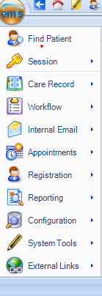
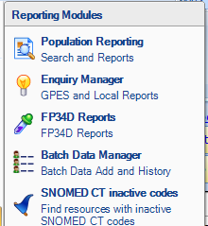
EMIS searches
Click on EMIS button
Click on Reporting
Then Click on Population Reporting

Slide 4
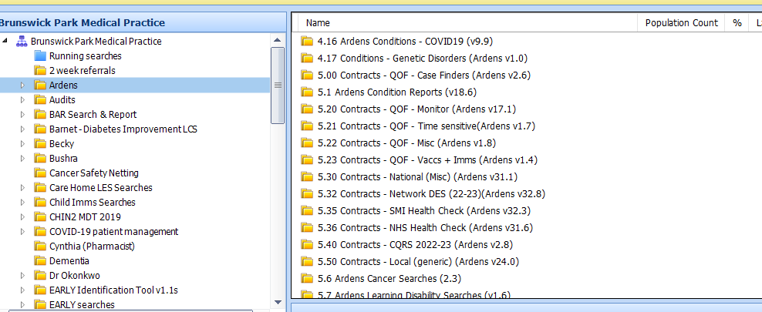
TOPIC ONE
Most of the searches you will need should be in the Ardens Folder within your Practice Folder
Subtitle

Slide 5
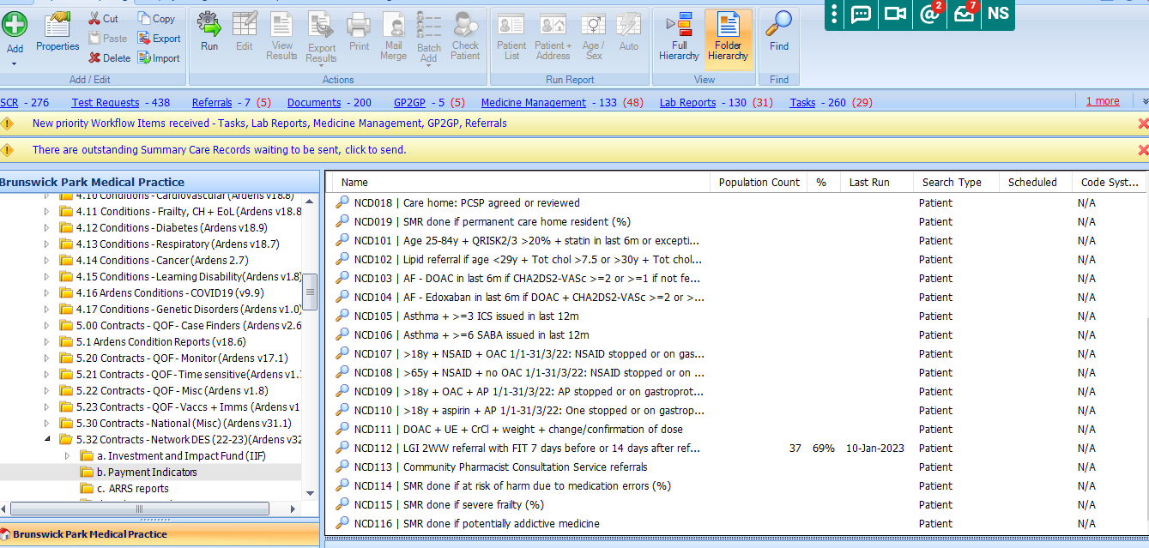
Examples of Searches : FIT test for Lower GI 2WW Referrals

Slide 6
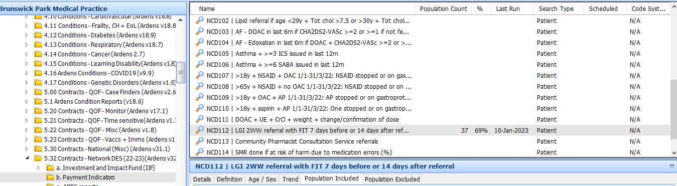
FIT Test for Lower GI 2WW
Click on Run to see the report
Then click on Patient Included (see arrow)
Below this will appear the relevant patients included in the report

Slide 7
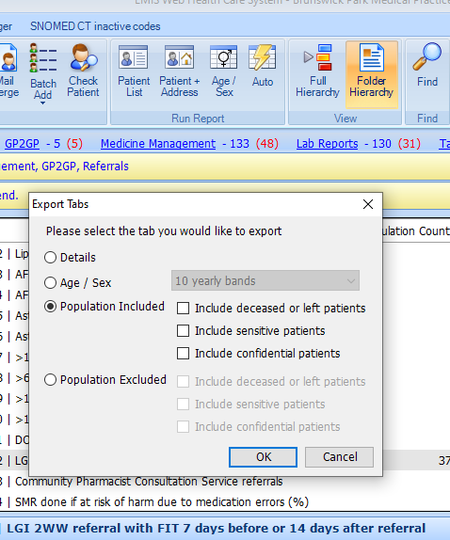
Exporting Results to EMIS
Click CSV
Click Population Included

Slide 8
OTHER SEARCHES
Learning Disability – Patients who are due their outstanding Checks
Ethnicity Data
Flu
QOF

Slide 9
Resources
Ardens Support – Via Facebook/Email Updates
https://support-ew.ardens.org.uk/support/solutions/articles/31000158342-ardens-search-folders-overview#:~:text=Frailty%2C%20CH%20%2B%20EoL-,The%20Ardens%20condition%20searches%20have%20been%20designed%20to%20support%20GP,Care%20Home%20and%20EOL%20patients.

Slide 10
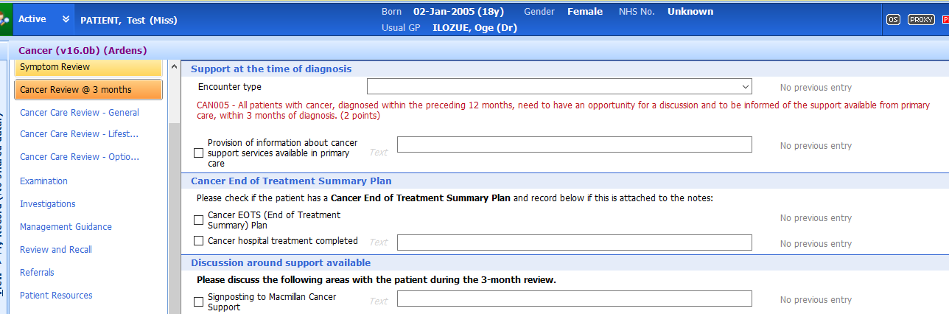
Ardens Templates
Cancer Care review within 3 months : Provision of Information
Add text, images, art, and videos.
Add transitions, animations, and motion.
Save to OneDrive, to get to your presentations from your computer, tablet, or phone.
Open the Design Ideas pane for instant slide makeovers.
When we have design ideas, we’ll show them to you right there.

Slide 11




THANK YOU

