Slide 1
Social Prescribing Managers Network for London
Jun 2023 – V2

Slide 2
What is a London network for Social Prescribing Managers?
Purpose of Network:
To connect those working hard to build an effective social prescribing service together across London
A safe space to discuss opportunities and challenges to delivering effective social prescribing for those that need it the most
Planned activity:
Regular online meet ups
Occasional, in person learning and social sessions (1-2 per year)
WhatsApp group so people can connect outside of the hosted sessions
Proposed membership:
Core Group: People that are managing a number of SPLWs, based out of a VCSE org, GP federation, local authority and so on, PCNs (may be unusually large or forward thinking) that have 4 or more SPLWs
To be discussed: PCNs that have large teams, lead SPLWs, ICS or training hub leads very involved in this work
Organised and co-ordinated by:
The regional ‘Community Based Prevention and Social Prescribing’ team at TPHC, taking a steer from members of the group

Slide 3
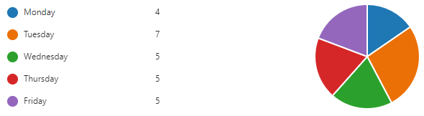
Plan for regular network meet ups
Frequency & logistics:
Every 6 weeks for 90 mins
Mostly online with some in person sessions planned
Same day and time each time: Tue, 9am (avoiding lunch time)
All meetings for the year in the diary, but agenda / theme for discussion circulated the week prior
Organised and co-chaired by Dan Hopewell (Bromley By Bow Health) & Jenny Brooks (TPHC)
Proposed format (up for discussion):
15 mins – Intros (boroughs introducing themselves as part of a check in activity)
45 mins – Themed discussion
  10 mins exploring challenges and opportunities
  20 mins of sharing existing work around chosen theme
  20 mins discussion about new ways of working / idea generation & next steps
25 mins – updates from TPHC & burning questions you have for each other (e.g. what are others doing around proactive SP? How do others manage their team? Etc.)
5 mins – Poll for what to discuss in next session

Slide 4
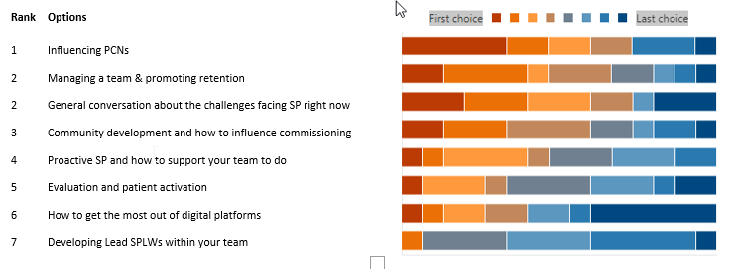
Preference for themes to discuss
We asked: Which of the following themes would be most keen to discuss with your peers?
The list below is in order, starting with the most popular theme (Apr 23)

Slide 5

The WhatsApp group and how it works
Organised and coordinated by the London regional team at TPHC
How people use the group:
To ask each other questions
Find other managers and innovators with overlapping work
To share experiences, learning, useful resources or events
How can people join the group:
Join the whatsapp group via a link here
This link can be forwarded onto others
Who is the group for:
This is open to those managing a number of SPLWs, based out of a VCSE org, GP federation, local authority and so on, PCNs (may be unusually large or forward thinking) that have 4 or more SPLWs
Members can complete a bio slide to share a bit of information about themselves with other members
  LINK TO THE BIO SLIDES
These slides are designed to keep track of who is in the group and allow you to contact each other, as well as email documents etc.

Slide 6
Other things cited as options for future discussion
  Career development for SPs
  Connecting with your local boroughs
  Service co-design or co-production with patients
  How others are supported as managers, type of support and framework used to guide them
  How to use the ARRS underspend for learning & development for our Social Prescribers
  Differing Styles of delivery and managing expectations about the service.
  Specialist SPLW
  Frameworks and structured ways of working
  Funding the prescription
  How others are managing more referrals than capacity (increasing waiting times)
  SP outcome measurement and data capture

