Slide 1
Children and young people mental health wait times: insights, learning and best practice
6th November 2024 – 15:00 - 16:30

Slide 2
Agenda – Children and young people mental health wait times: insights, learning and best practice
Time | Content | Lead
15.00 | Welcome, housekeeping and introduction | Dr Cathy Lavelle
15.10 | NHSE update | Grace Harding
15.20 | London Region update | Beth McGeever
15.30 | TPHC presentation | Jenny Taylor
15.40 | Q&A with delegates | Cathy Lavelle and all
15.50 | Introduction to case studies | Jenny Taylor
15.55 | Northumberland case study | Michelle Bouhleli and Katy Paul
16.05 | East London case Study | Dr Sophia Ulhaq and Kamel Cheradi
16.15 | Q&A with delegates | Cathy Lavelle and all
16.25 | Wrap up and close | Cathy Lavelle and Jenny Taylor

Slide 3



Welcome and Housekeeping
Please note that we have turned the mute function on and also cameras off function for all delegates in this webinar.
We want to encourage you all to please use the CHAT function to ask questions and provide comments
This event will be recorded. We will be sharing the recording on our website and with the delegates of this event.

Slide 4
NHS England update
Grace Harding, Programme Manager – Children and Young People’s Mental Health

Slide 5
Helpful terms and definitions
Term | Definition
Full CMH metric | The metrics first published in September 2024 which use referral-spells to measure the wait from referral to receiving help.
Single referral | Measuring waiting times using only one referral
Referral spell | Measuring waiting times using in-scope referrals within a single provider, where they overlap or where the time lapse in between is no more than 5 days
Contact-based | Time to first contact (CYP), time to second contact (Adults)
Referral to help/Full clock stop | Defines our full metric waiting times. Time to stopping the clock e.g. for an adult to have a meaningful assessment, a baseline outcome measure recorded and start a clinical/social intervention OR co-produced care plan
90th percentile wait | The longest 10% of waiters have waited this amount of time or longer
Median | 50% of people are waiting this length of time or longer; 50% of people are waiting this length of time or less.

Slide 6
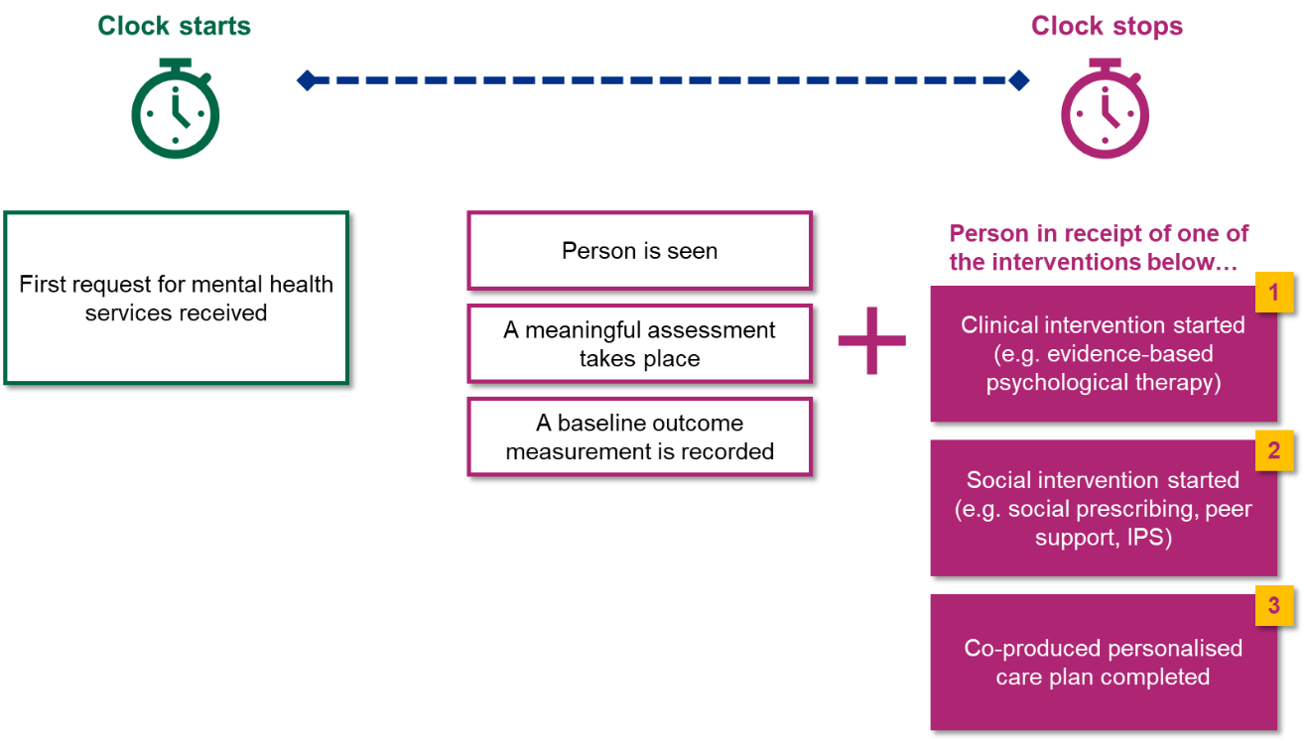
NHS England published data on CMH waiting times in September 2024, which looks at the time taken to receive meaningful help
A list of SNOMED codes accepted for clock stops can be found in the SNOMED reference set.
The date that the request was received should be used, not the date that the referral was processed
The outcome measure recorded can be any PROM or CROM.
It is recommended that ReQol-10, GBO and DIALOG are used across the patient journey.

Slide 7


CYP CMH
Any baseline outcome measure including PROMS, CROM and PREMs will count towards the clock stop.
Clock starts
Help starts
(Clock stops)
Referral received
Understand need and goals
An intervention code detailing the nature of the contact is flowed to the Mental Health Services Data Set (MHSDS) via SNOMED codes
Advice
OR
An outcome and/or experience measure is flowed to the MHSDS
Shared decision making
Signposting
The metric covers all services and pathways within the CYP CMH pathway, including Mental Health Support Teams (MHSTs)
OR
Communicate in an accessible manner
Formulation/
Care Plan
OR
Consultation
A list of SNOMED codes accepted for clock stops can be found in the SNOMED reference set.
OR
Evidence based intervention
OR
Autism/ ADHD assessment

Slide 8
The available metrics*
Metric (all metrics reporting separately for CYP and Adult CMH) | Clock stop/contact based | Single referral/referral spell
Number and proportion of referral-spells receiving full clock stop within 4 week | Full clock-stop | Referral spell
Number and proportion of referral-spells waiting more than 104 weeks for a full clock stop | Full clock-stop | Referral spell
Number and proportion of referral-spells waiting more than 104 weeks for a first/second contact | Contact-based | Referral spell
Number and proportion of referral-spells waiting more than 78 weeks for a full clock stop | Full clock-stop | Referral spell
Number and proportion of referral-spells waiting more than 78 weeks for a first/second contact | Contact-based | Referral spell
Number and proportion of referral-spells waiting more than 52 weeks for a full clock stop | Full clock-stop | Referral spell
Number and proportion of referral-spells waiting more than 52 weeks for a first/second contact | Contact-based | Referral spell
Number of referral-spells waiting for a full clock stop at end of reporting period | Full clock-stop | Referral spell
Number of referral-spells waiting for a first/second contact at end of reporting period | Contact-based | Referral spell
90th percentile time waiting for a first/second contact | Contact-based | Single referral AND referral spell
Median time waiting for a first/second contact | Contact-based | Single referral AND referral spell
*Full list of metrics available here

Slide 9
Key points to note
The ‘meaningful help’ full clock stop metrics require systems to be recording and flowing data to the MHSDS, including SNOMED assessment and intervention codes.
Due to historically poor data quality, we expect that the metrics will not currently be reflective of actual performance of teams
No performance management targets or standards will be set for the meaningful help metrics in 2024/25. Systems should focus on improving data quality and completeness.
  This includes closing historical open waits by the end of this financial year
  To support this process, we have removed the requirement for an assessment code for referral spells which were open and had at least one contact prior to April 2024.

Slide 10
NHS Operational Planning Guidance 24/25 asked systems to focus on long waits in CYP and Adult UEC and CMH services
NHS England has circulated a collection tool for ICBs and provider to complete with trajectories to reduce 104 week waits. The collection tool includes backing data at an ICB and provider level for 104, 78 and 52 week waits.
104
Where an ICB or provider has 2% or fewer waits beyond 104 weeks, ICBs should work to eliminate 104 week waits by the end of 2024/25.
78
Where an ICB or provider indicates elimination of 104 week waits in 2024/25, they should provide improvement trajectories for 78 week waits.
52
Where an ICB or provider indicates elimination of 78 week waits in 2024/25, they should provide improvement trajectories for 52 week waits
The 104 week wait collection tool only looks at contact-based metrics.
ICBs should return the completed collection tool to england.mhinfrastructure@nhs.net by COP Friday 8th November.

Slide 11
Adult CMH - Proportion of people waiting over 104, 78 or 52 weeks for full clock stop or 2nd contact
July 2024 – 39%
July 2024 – 28%
July 2024 – 21%
July 2024 – 23%
July 2024 – 15%
July 2024 – 10%
Full Clock Stop, 2 contacts
Key points to note:
The 104ww collection tool looks at only contact-based metrics. The graphs above include full clock-stop for comparison.
The metrics use referral-spell methodology which stitches together referrals which occur within 5 days of each other at a provider level

Slide 12
CYP CMH - Proportion of people waiting over 104, 78 or 52 weeks for full clock stop or 1st contact
July 2024 – 47%
July 2024 – 33%
July 2024 – 24%
July 2024 – 35%
July 2024 – 19%
July 2024 – 12%
Full Clock Stop, 1 contact
Key points to note:
The 104ww collection tool looks at only contact-based metrics. The graphs above include full clock-stop for comparison.
The metrics use referral-spell methodology which stitches together referrals which occur within 5 days of each other at a provider level

Slide 13
Community Mental Health Waiting Times 2024/25
Q1 – Launching the new waiting time metrics
Q2 – publishing the new metrics
Q3 – addressing 104 week waits and DQ improvement for full metric
Q3 onwards - Ongoing development of updates to metrics including for MHSDS V7
Guidance published including metric methodology
FAQs released
Adult and CYP dashboards continuing to support DQ improvement
First data published in September with full time-series from April 2024
Ongoing webinars, SQL code, updates to FAQs
104 week wait collection tool to be returned by 8th November
Data quality improvement, including closing historical open waits
Ongoing updates to FAQs
Engagement to test multiple provider pathway approach (MHSDS v7)
Work to understand in-treatment waits
Continued engagement on proposed adjustments to methodologies
Notes:
Sam

Slide 14
NHSE London region updates
Beth McGeever, Senior Programme Manager

Slide 15
NHS England Children and Young People’s Community Mental Health Waiting times updates: London
Beth McGeever, Senior Programme Manager, MH programme NHSE London region
6th November 2024
If you have any questions about the data or information contained in this pack please contact england.londonmentalhealth@nhs.net

Slide 16
Measuring waiting times is critical to help us understand how long people wait to access meaningful help
Service users and carers report that it is important to them, specifically through the Clinically Led review of standards for MH
The length of time people wait can impact experience and outcomes
Data can be used to support systems to address health inequalities
Waiting times help us to understand changes in demand across systems and identify support and resources
Data enables us to demonstrate the impact of investment in mental health and secure future funding
Measuring waiting times can help us to support systems to deliver timely and appropriate care
Measurement helps us understand local and regional variation, and areas of best practice

Slide 17
Focussing on waiting times is a key priority for the region and we are providing ongoing support to systems
NHS England has:
Published data on the full waiting times metric for community mental health services (full clock stop) as set out in the clinically led review of standards, with a view to demonstrating where people are receiving meaningful help from services.
Published data on contact-based clock stops (referral-spell) and, as set out in the planning guidance, is asking systems to review long waits (104 weeks) with a view to eliminating.
Systems are asked to:
Review the full clock stop data for adults and children and young people’s community mental health, to identify areas where the full clock stop is not being met, focussing on ensuring that people are receiving meaningful help from services and focussing on improving data completeness and improving data quality.
Review the contact-based data for adult and children and young people’s community mental health services.
Submit trajectories for eliminating 104, 78 and 52 week waits in adults and children and young people’s MH CMH services to england.londonmentalhealth@nhs.net by close of play 6th November (see annexe one for supporting resources).
Regional timeline:
September 2024
October
November
November- onwards
Phase
Ad-hoc support from the regional MH team is available to ICBs and providers as required to support implementation
NHS England publishes full clock stop data for adults and CYP community mental health and contact-based clock stop data.
National SQL script published and socialised.
National waiting times webinar.
London specific waiting times community of practice
15th October: regional Directors of Performance Network (WT focus)
w/c 14th October: regional SQL script for referral-spell contact based waiting times to be made available.
Trajectories for eliminating 104,78 and 52 week waiting to be submitted cop 6/11/2024.
w/c 14th November: regional SQL script for full clock stop based waiting times to be made available.
Regional review of trajectories and play back to LMHB (December)
Report in shadow form to LMHDG and LMHB full clock stop data for adults and CYP.
Future support sessions on the elements of the full clock stop to be scheduled, e.g. SNOMED, care plans, and outcomes.
Objectives
This additional regional resource will further support ICBs and providers with the development of trajectories due 6th Nov.
We will be doing a demo of this tool today.

Slide 18
Children and Young People’s Mental Health – Waiting Times
Presented by Jenny Taylor

Slide 19
Introduction
Transformation Partners in Health and Care (TPHC) are committed to supporting children, young people (CYP) and families to be able to access mental health support when they need it.
Over the course of the pandemic, we saw a rise in referral numbers and acuity. The ongoing cost of living crisis has continued to put pressure on communities and services. The latest prevalence data for England has shown that one in five children and young people aged eight to 25 had a probable mental disorder in 2023. All of this has led to an increased level of need for CYP mental health services.
Whilst we have come a long way in increasing access to community mental health services, we know that many children and young people are still having to wait too long. Young Minds' End the Wait Campaign captured feedback from young people on their mental health including the impact of long waits. Over 40% reported waiting over a month for mental health support after seeking it and almost 1 in 10 were turned away when they tried to get support.
Waits can occur both at the beginning of a treatment pathway, between referral to services and a first contact, but crucially we know there are also ‘hidden waits’ experienced by CYP waiting between a first and second or subsequent contacts with a service.
In addition, we know that many young people and families face inequalities in access, experience and outcomes.
The NHS England National Mental Health team have also recently shared draft guidance on measuring waiting times for CYP mental health, and all areas will now need to work on implementing this.
To address these issues the London Mental Health Board agreed Children and Young People’s (CYP) mental health waiting times as a pan-London priority area. This presentations reviews the learning from the work we did which aimed to:
understand the current waiting times in London and the factors driving long waits
explore inequalities in access for those on waiting lists
hear from young people about their experiences and work with them on solutions
capture and share examples of best practice
develop an online resource hub to showcase webinars, case studies, data reports and our insights and evidence review.

Slide 20
Approach
In order to meet the programme aims outlined, we took the following approach:
Desk-based research
Stakeholder engagement
Data diagnostic
Report and recommendations
Explored published evidence on the impact of long waits for CYP waiting for mental health services
Captured examples of where services have cleared waiting lists or back logs
Captured examples of good practice or programmes aiming to reduce waiting times, including 4 Week Wait Pilots
Explored models and evidence around support for young people while they wait for mental health services
Reviewed evidence and insights from young people on waiting times for CYP mental health services
Set up a London Youth Board of 20 young people aged 16-25 to provide insights, experience and input into development of the programme
Engaged with leads from the 4 Week Wait Pilot areas in London and across England to learn from their experiences of delivery
Engaged with stakeholders to review learning around clearing back logs and from those implementing support for CYP on waiting lists
Undertook waiting times data analysis per ICB to understand driving factors and target areas for improvement and transformation
Examined length of waiting times, both for initial waits and hidden waits, across London ICBs and providers
Undertook equalities analysis by reviewing waiting times by demographic groups including ethnicity and gender
Gathered qqualitative and quantitative intelligence through stakeholder engagement
Used learning from desk-based research, stakeholder engagement and data analysis to develop understanding and insights around wating times across London
Explored the identified inequalities highlighted from data diagnostic, evidence review and Youth Board
Developed recommendations for advancing the understanding of CYPMH waiting times and targeting improvement
Captured and share best practice examples

Slide 21

Summary of key findings
In London, CYP are waiting extended periods of time for services, there are significant health inequalities impacting waiting times, and extended waiting times have an impact on outcomes. Across the evidence review, data diagnostic, review of 4WW pilots and engagement with young people, we have gathered insights into a number of contributory factors to extended waiting times and also how waiting times can be improved. A number of common themes emerged from our work which are summarised below.
Pathways
Inequalities
Key finding: where waiting times have been successfully improved, sites have considered whole pathway approaches and key models/approaches.
This includes considering the ‘front door’ to services; improving throughput and flow; reviewing operational processes; and supporting safe and effective discharge
Sites where waiting times have been improved have employed key models/approaches for providing services
Key finding: a number of inequalities exist for waiting times, including links to access, experience and outcomes
Data diagnostic has found inequalities in waiting times for CYP who are Black or Mixed ethnicity, male, or waiting for neurodevelopmental services
Long waits have a negative impact on outcomes
Those who are waiting for services aged 16-18 may face additional inequalities in relation to transition to adult services
Demand and capacity
Workforce
Key finding: structured approaches to planning for demand and capacity have a beneficial impact on waiting times
This includes demand and capacity modelling; job planning and skill mix assessment; streamlining processes and procedures; and approaches to clear existing backlogs.
Key finding: it is important to consider culture and buy-in to transformation plans in relation to waiting times, and to support staff through changes
Providing staff teams with supervision and training also plays a role in keeping staff engaged and supported

Slide 22
Pathways - overview
Where waiting times have been successfully improved, sites have considered whole pathway approaches and key models/approaches.
Learning from both the review of evidence and the 4 Week Wait Pilot sites has indicated that consideration of the whole pathway for CYP mental health services, from access to flow through services to discharge, has helped lead to reduced waiting times. This includes a consideration of the ‘front door’ to services, ensuring there are as few barriers as possible to access. It also includes consideration of patient flow, including by intervention rather than service to enable understanding of where the longest waits are. Key models have been employed by sites to provide services including iTHRIVE and CAPA. Lastly work to deliver effective and safe discharge has helped to improve waiting times.
Access to services
Consider:
Front Door
Single Point of Access
Enhanced triage
Assessment teams
Flow through services
Consider:
Patient flow
Case management
Discharge
Consider:
Length of support
Discharge procedures
Support to improve end of treatment
Waiting well
Consider implementing approaches to support those on waiting lists

Slide 23
Inequalities - overview
A number of inequalities exist for waiting times, including links to access, experience and outcomes
Learning from the review of evidence, data diagnostic and from young people has shown that CYP face a broad spectrum of inequalities in relation to waiting times, and in the interlinked domains of access, experience and outcomes.
Through our evidence review, we know that long waits can negatively impact outcomes and CYP’s chance of seeking help and engaging with services. In addition, a survey undertaken as part of Young Minds’ ‘End the Wait’ campaign heard from over 13 000 young people providing feedback on the impact of long waits for mental health services.
Work to examine mental health services data has unearthed a number of key inequalities in relation to waits experienced by CYP for first and second contact with services. Some groups of young people are facing longer waits than others, including males, those from Black, mixed heritage and Asian communities as well as young people waiting for neurodiversity services. We also know that there are differences in waiting times across different ICB areas and providers meaning CYP may wait longer based on where they live.
Given that we know some young people face longer waits than others, and that waiting longer can have a negative impact on outcomes, it follows that the inequalities experienced by young people waiting for services may have a negative impact on their eventual outcome and chance of improved mental health.
Through working directly with young people as part of our Youth Advisory board, we have also heard that young people are concerned about age related inequalities potentially experienced by those aged 16-18 who transition to adult services before they are seen by CAMHS, or before they have completed their treatment in CAMHS.

Slide 24
Demand and capacity - overview
Structured approaches to planning for demand and capacity have a beneficial impact on waiting times
Learning from the 4 Week Wait Pilots and from the evidence review indicates that where approaches to consider demand and capacity have been employed, this has had a beneficial impact on waiting times. This can include demand and capacity modelling approaches where tools are utilised to help services understand any gaps between the current service capacity and the demand that they are seeing in their service.
Alongside examining demand and capacity within services is undertaking job planning and skill mix assessment for staff teams.
A number of 4 Week Wait pilot areas looked at job planning as part of their approaches, particularly to ascertain how much clinical time was available each week and to use this to help plan. However although common in certain health professions, there are also difficulties with how job planning can be perceived by staff and it is crucial to ensure clear rationale is given for job planning approaches, demonstrating the intended benefits for staff.
Looking at the mix of skills within staff teams to support demand and capacity planning was also found to be beneficial, however a key challenge for many pilot areas was maintaining the correct skills mix in their teams alongside staff turnover.
The increase in referrals and acuity seen throughout the pandemic has meant that many CYP mental health teams are now managing a waiting list and need to explore approaches to clear existing backlogs. There are a number of good practice examples and pilots emerging across England aiming to reduce waiting times through clearing backlogs for mental health services.

Slide 25

Workforce - overview
It is important to consider culture and buy-in to transformation plans in relation to waiting times, and to support staff through changes
A key finding from our stakeholder interviews with 4 Week Wait pilot areas, through our evidence review and when talking to teams about reducing backlogs was that staff teams are central to success. Given the pressures that services have been under over the last few years it is important to address the workforce challenges that CYP mental health services face. A recent King’s Fund report has shown that while the NHS workforce has continued to grow, demand has continued to grow faster. Addressing workforce challenges involves a strategic approach taking many factors into consideration.
Recruitment and retention – alongside increases in referral numbers and acuity many pilot areas reported that workforce capacity is an ongoing issue that they face. Recruiting and retaining staff with the right skills mix has always and continues to be difficult for many areas.
Culture – learning from 4 Week Wait pilots showed that it is important to get staff buy-in around any transformation plans. When staff feel supported and fully able to understand proposed changes, this has led to the greatest chance successful implementation and of sustaining change.
Staff Training – many pilot areas have prioritised staff training. This included training to address any skills or expertise gaps, providing support to take on any changes they were making to the pathway or models that they were bringing in.
Staff Supervision – providing supervision for staff teams is an important part in supporting staff teams and many pilot areas ensured that they were providing support and supervision for their teams.
Acuity and Referrals – all of the stakeholders that we spoke to in developing this evidence review mentioned the increases in referrals and acuity that services has seen throughout and following on from the Covid-19 pandemic. This has had an ongoing impact on the work they were undertaking around reducing waiting times and meeting the needs of young people in their communities.
Optimisation - it is important for areas to consider how they are capturing and reporting clinical time. This will help them to fully understand the capacity that their teams have to complete clinical contacts, clinical administration as well as wider multi-disciplinary team support. Teams should consider whether they are accurately capturing this time and whether their data and patience record systems, admin processes support this.

Slide 26
Insights from Young People
Inequalities
Support for CYP and families when waiting
  The Youth Board discussed inequalities quite broadly including thinking about intersectionality. However they also raised some key questions and concerns about age and racialised communities.
  Age – Risk is that YP will turn 18 before wait time ends. At 18 they could be sent directly to adult services and then have to wait again. YP also discussed how ageism could be linked to the postcode lottery of what support is available locally.
  Racialised communities – The group discussed concerns around adultification of black children, stigma, YP more likely to be dealt with by police, issues around accessing support for different groups and whether staff were representative of communities.
  The young people were very interested in opportunities to provide support for young people who are on waiting lists. Young people identified the following ideas for what support could be providing for those who are waiting:
  Groups - offering group support which could be digital, in person, condition based or age based
  Digital – apps or forums for YP to share and support each other, could have different spaces e.g., self help
  Learning - learning about the different types of therapy available
  Participation - offer other activities for young people to be involved in to provide a greater sense of purpose
How to know about services and how to contact them
  A key theme raised by the Youth Board was around communications and how to improve them. Young people commented on:
  Many young people, parents and carers are not aware of what support is available for them locally. How can the NHS improve this.
  How can services offer better two way communication with CYP/families. For example if a young person needs to change an appointment or if they no longer need one..
Journey through pathway and having to repeat stories
  The youth board fed back concerns about whether services have developed joint up working or mechanisms to avoid young people having to retell (often triggering or upsetting) experiences so many times whilst seeking and receiving support for their mental health.

Slide 27
Recommendations and next steps

Slide 28
Recommendations
This work presents a number of considerations for providers and systems on how to tackle the issues related to long waiting times for CYP. We suggest the following recommendations for ICBs and providers to advance this agenda:
Consider whole pathway approaches and transformation activities at each stage of the treatment pathway, including access, flow and discharge.
Consider implementing waiting well approaches to sit alongside treatment pathways to provide additional support to CYP who are waiting.
Consider inequalities approach and interrogate local data/insights to understand which services have the longest waits, which CYP are waiting the longest and if any specific groups of young people are disproportionately negatively impacted by long waits.
Consider implementing evidence based models for delivering CYP mental health care to support improvement with waiting times e.g. iTHRIVE.
Consider local workforce challenges, approaches to address these and support to teams to engage with these activities.
Engage with young people and parents/carers to gain insights and understanding into what is important to them when tackling waits.
Ensure any work to address waiting times is aligns with and works towards meeting NHSE’s draft ‘Guidance for Measuring Waiting Times for Children and Young People's Mental Health Services’

Slide 29
Next Steps
Resource hub - We have developed a resource hub on our website which allows us to share information, learning and best practice. The resource hub features our evidence and insights review, our data diagnostic reports, case studies including two which are featured in todays webinar and recordings of previous webinars.
Measuring Waiting Times Metric - We are working closely with NHSE and NHS London to align wider work aiming to tackle longest waits, improve data quality and implementing the measuring waiting times guidance.
Waiting Times Proposal – We have also reached out to ICB leads for feedback on a proposal to identify and explore areas where we might provide support to common challenges and addressing once for London. Currently reviewing the proposal and timelines with ICB leads to identify next steps.
IThrive:
Continuing work to support delivery of a workshop for each London ICB to translate assessment tools into a locally owned transformation plan.
Procuring one ‘Leading System-Wide Transformation’ training module to 30 people from each of the 5 London ICBs
iThrive team and the CYP Programme will continue to jointly host Community of Practice events.

Slide 30
For more information please contact:
Jenny Taylor, Project Manager – jennifer.taylor85@nhs.net
TPHC CYP Mental Health Transformation Team –
rf-tr.cyp-programme@nhs.net

Slide 31
Q & A

Slide 32
Introduction: Case studies
Jenny Taylor

Slide 33
Case studies: reducing waiting times for children and young people’s mental health services
Northumberland Children and Young People’s Service

Slide 34


CYP Mental Health Waiting times Webinar.
Northumberland CYPS
Lessons learnt from being a
4 week wait trailblazer site.
Katie Paul and Michelle Bouhleli
6th November 2024

Slide 35
Where it started
The 2018 Government Response to the Consultation on Transforming Children and Young People’s Mental Health Provision: a Green Paper and Next Steps and the NHS LTP committed us to
“testing approaches that could feasibly deliver four week waiting times for access to NHS support, ahead of introducing new national waiting time standards for all children and young people who need specialist mental health services”,
At the same time the wider roll out of Mental Health Support Teams (MHSTs) in education settings.

Slide 36


We became 1 of 14 pilot sites
Greater Manchester
Northumberland
Doncaster and Rotherham
Stoke-on-Trent and North Staffordshire
South Warwickshire
Gloucestershire
Buckinghamshire
Oxfordshire
Camden
Tower Hamlets
Haringey Bromley
Liverpool and Sefton
Nottingham and Nottinghamshire

Slide 37
Our focus
Access
Wait times
Flow / throughput – staff support
Multi agency working
We were the only service that incorporated our Neurodevelopmental pathway

Slide 38
How it worked
Regular face to face meeting with NHS England to learn and support the other 13 sites.
Support other NHS trusts – helping sharing our practice
Dorset CAMHS
Norfolk and Suffolk NHS Foundation Trust
NHS England Review and engagement with staff team with recommendations.

Slide 39








Review of services

Slide 40
Access / Referral Team / Assessment
Referrals
Telephone Consultation / paper / Early help hub / CYPS interface
Accept assessment with Clinician or senior member of staff
Discuss at emotional mental health interface weekly
Signpost
Welcome event for ND assessment pathway (advice and support)
When a child is accepted they leave there appointment with their next appointment

Slide 41
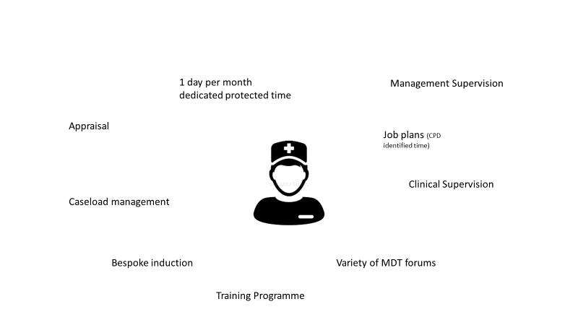
Supporting Staff

Slide 42
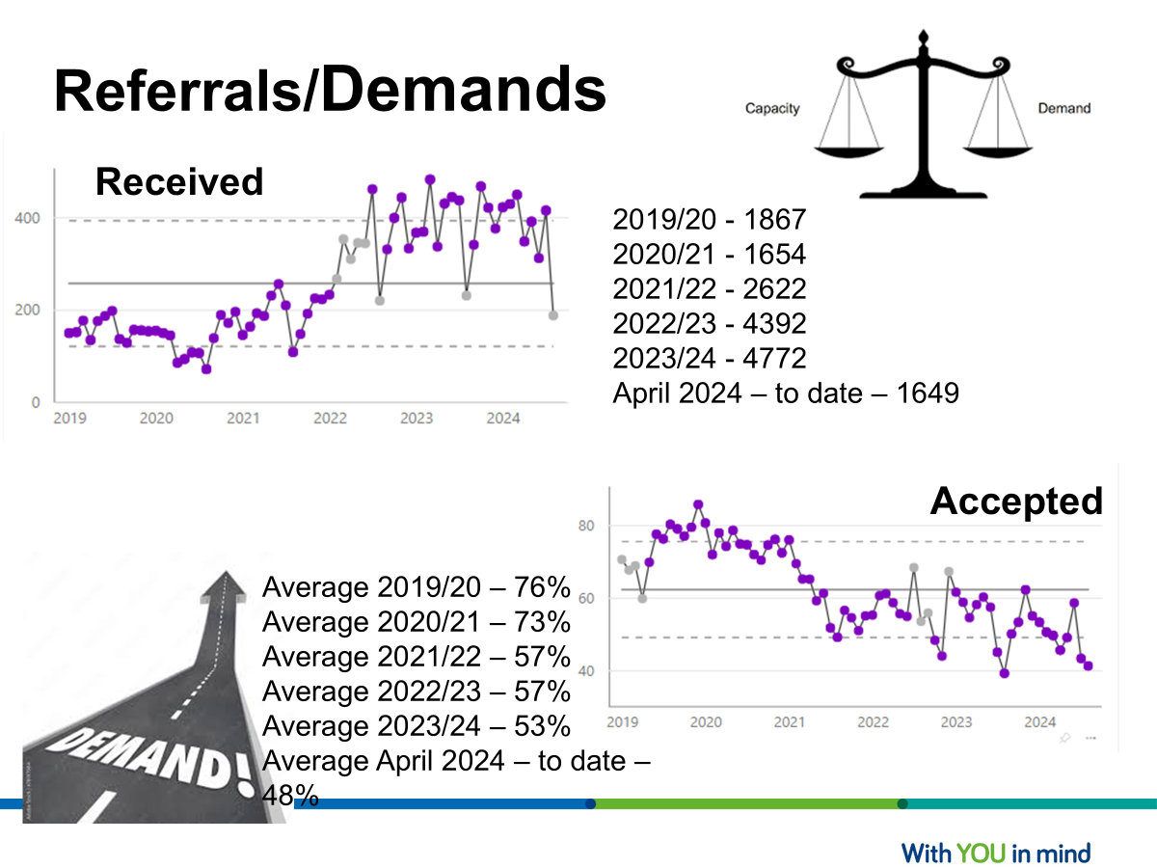

Slide 43

Good practice and Feedback from
NHS England
There are genuine short waits to access CYPMH services. This was confirmed by the CYP and families the MH SIT spoke to during the review. We believe the key factors that have supported the delivery of this are:
Leadership across agencies demonstrates a collaborative approach to developing a model that is understood by all partners; with a shared language; needs-led approach to delivery; utilising the Thrive framework.
The referral triage and consultation model delivers rapid access to a skilled assessment of the needs of the CYP at the initial point of contact between professionals and the CYPMH pathway, and between the CYP and families and the CYPMH pathway.

Slide 44

Good practice and Feedback from NHS England cont………
Within CNTW there has been a process of ongoing, senior level oversight of the delivery of innovative service developments related to:
Setting out the strategic vision and operational direction
Delivering PTLs/oversight over waits
Designing and implementing clinical pathways
Job planning, capacity mapping
Managerial oversight over activity vs. plan

Slide 45
Recommendations
Waits/visibility of waits across pathways – Patient tracking
System working
Deliver further integration between services through:
Mapping points of access, pathways and transitions between pathways at a system level, and identify and remove any unnecessary
steps, barriers or duplications, to provide parity of access for all CYP.
Developing clinical governance arrangements for co working patients who are accessing treatment in multiple pathways
simultaneously.
Developing a system wide involvement and participation strategy

Slide 46

Current Picture Today
Mental Health and Learning disability Pathway are meeting our 4 week wait
“2 face to face appointments within 4 weeks”
ND 1st appointment with 2-3 weeks
Revisiting referral criteria
Resetting the service

Slide 47
Current picture today cont…..
We have developed an inhouse Referral team to incorporate Referrals / Duty and initial assessment carried out by senior clinicians Band 7+
Review service specification due to demands / external exportation
Continue with Multi agency work to ensure CYP’s need are met review of graduated response.
Constant work force planning to ensure appropriate trained work force to meeting the ever changing needs of CYP

Slide 48
Please contact
Michelle Bouhleli – michelle.Bouhleli@cntw.nhs.uk
Katie Paul – katy.paul@cntw.nhs.uk

Slide 49
Case studies: reducing waiting times for children and young people’s mental health services
Improving Capacity & Flow in a Community Eating Disorder Service – East London

Slide 50
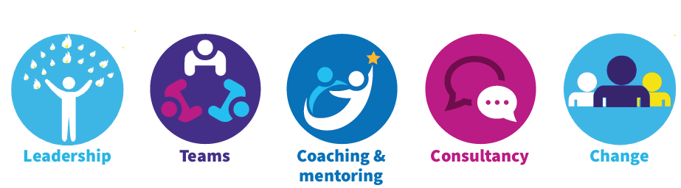
Improving Capacity & Flow in the
Community Eating Disorder Service:
How QI & Leadership led to a reduction in wait time
Kamel Cheradi
General Manager
Dr Sophia Ulhaq
Associate Clinical Director
6th November 2024

Slide 51
Background & Aims
The Community Eating Disorder Service (CEDS) is a busy, dynamic service supporting diverse range of young people and families across 3 East London Boroughs
We have a hospital at home pathway that offer intensive treatment in the community to those who are very unwell, to encourage treatment in the community and prevent unnecessary admission to psychiatric inpatient hospital
During the Covid-19 pandemic eating disorder services across London and England reported large increases in referral numbers and acuity/complexity
Notes:
Choose spot for longest team member in the room so they can all look around
Are there more new starters/or older starters? Who started around the pandemic/lockdown (March 2020)?
What is this telling us?
what might be difficult/easy based on these dynamics?

Slide 52
Background & Aims
CEDS saw the average time from referral to routine assessment increase to 17 weeks, which is significantly longer than the 4-week National target and 2-week local target
Wait times to access treatment increase namely access to Psychiatry & Therapy with some families waiting 6- 12 months
Impact of delayed treatment on Eating Disorder prognosis- further entrench symptoms and impact long term functioning
Low staff morale, high staff turnover, use of locums, vacant posts
Notes:
Choose spot for longest team member in the room so they can all look around
Are there more new starters/or older starters? Who started around the pandemic/lockdown (March 2020)?
What is this telling us?
what might be difficult/easy based on these dynamics?

Slide 53
Approach
We were newly appointed leads- fresh set of eyes, and had energy and permission from Directors to improve the service
Deming’s Lens of Profound knowledge- to spend the time to understand and appreciate the system
  Focus groups with staff to listen to their perspective and experiences
  Using service user feedback, complaints and compliments to center the young people and families
  Curious & strengths based approach
  Recruitment campaign to support stabilising the team staffing structure
Using Quality Improvement (QI) framework and set up a project to address the issues around capacity and flow through the service, with a focus on reducing wait times for young people and families
Notes:
Choose spot for longest team member in the room so they can all look around
Are there more new starters/or older starters? Who started around the pandemic/lockdown (March 2020)?
What is this telling us?
what might be difficult/easy based on these dynamics?

Slide 54
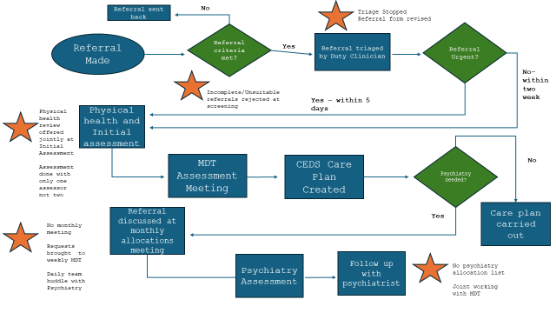
Approach- Process mapping
The team used process mapping to understand and highlight areas of bottlenecks, delays, duplication and inefficiencies in the referral process
Notes:
Choose spot for longest team member in the room so they can all look around
Are there more new starters/or older starters? Who started around the pandemic/lockdown (March 2020)?
What is this telling us?
what might be difficult/easy based on these dynamics?

Slide 55
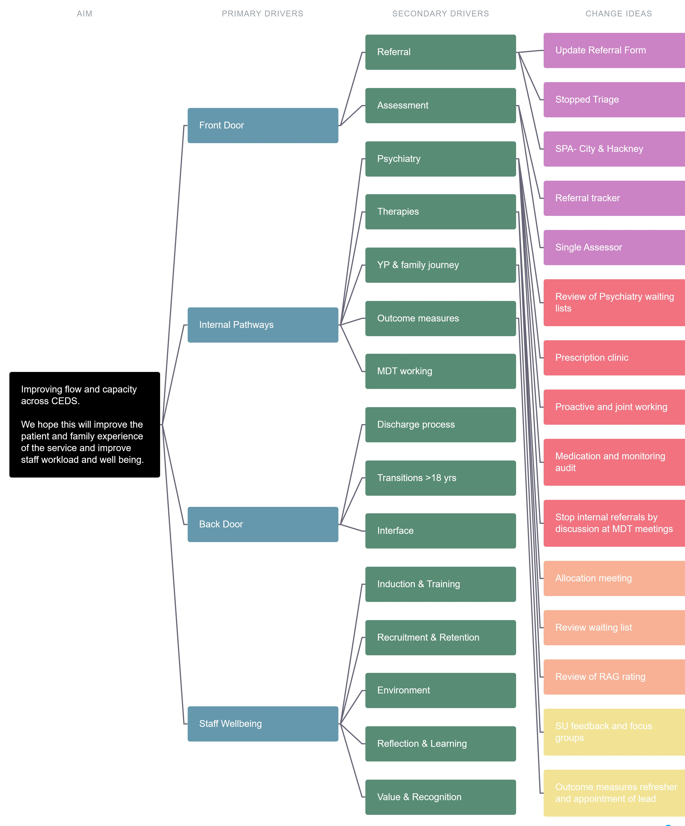
Approach- produce Driver Diagram
Notes:
Choose spot for longest team member in the room so they can all look around
Are there more new starters/or older starters? Who started around the pandemic/lockdown (March 2020)?
What is this telling us?
what might be difficult/easy based on these dynamics?

Slide 56
Approach- Change Ideas
Reviewing the referral form
Stopping extra steps in the referral process e.g. triage
Set up weekly referrals meeting and use of an action tracker
Moving from two assessors to one to offer a timelier assessment appointment.
A proactive recruitment campaign
Notes:
Choose spot for longest team member in the room so they can all look around
Are there more new starters/or older starters? Who started around the pandemic/lockdown (March 2020)?
What is this telling us?
what might be difficult/easy based on these dynamics?

Slide 57
Approach- Change Ideas
Regular psychiatry clinics were set up to clear the backlog of those waiting.
Culture shift from working in silos and operating separate lists to more collaborative and dynamic joint working between disciplines
Therapy job plans reviewed, and capacity was discerned for each therapist to support timely allocation
Regular review of progress in therapy with focus on outcomes and ensuring appropriate through-put
Notes:
Choose spot for longest team member in the room so they can all look around
Are there more new starters/or older starters? Who started around the pandemic/lockdown (March 2020)?
What is this telling us?
what might be difficult/easy based on these dynamics?

Slide 58
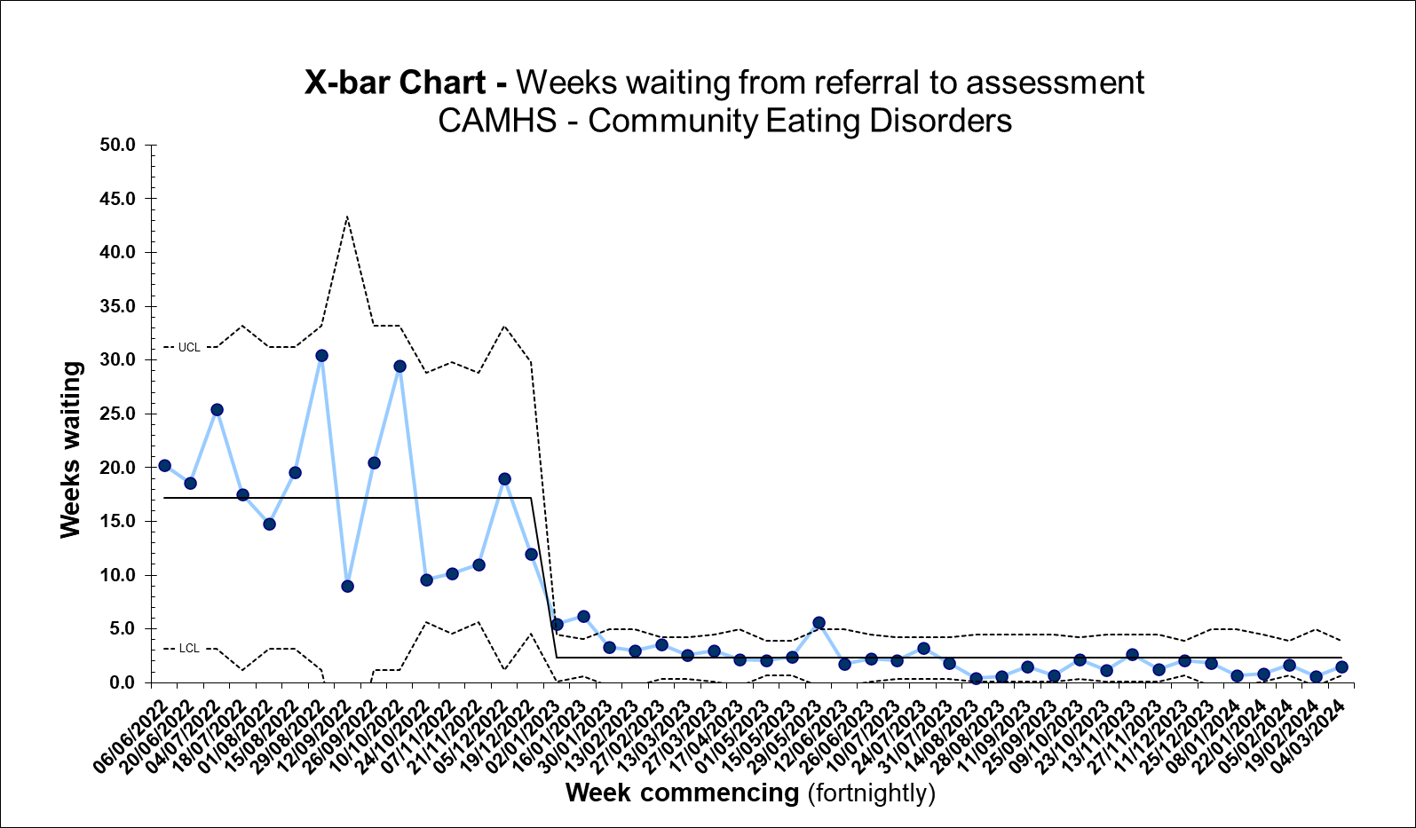
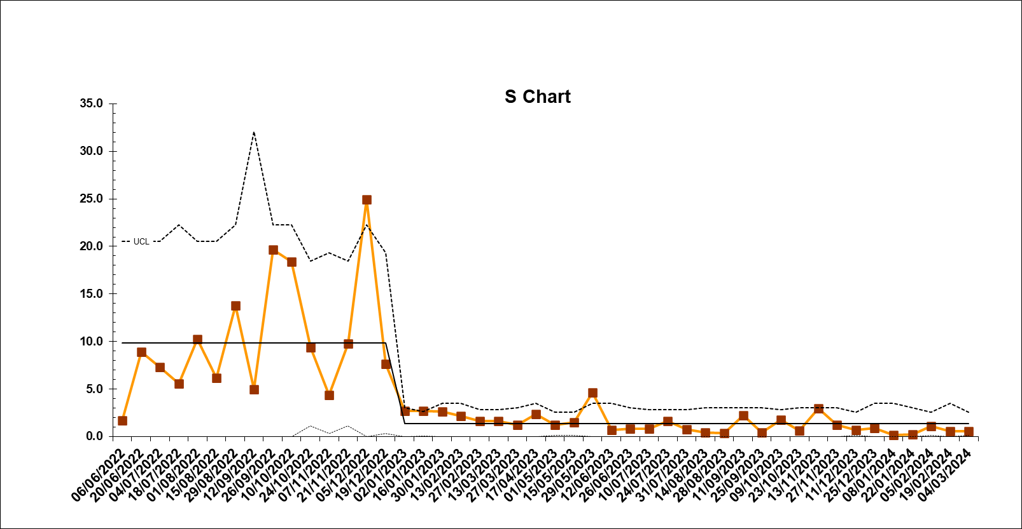
Results & Impact
X Bar and S Charts demonstrating average wait time from routine referral to assessment from 17 weeks to 2 weeks (June 2022 to June 2023)
Notes:
Choose spot for longest team member in the room so they can all look around
Are there more new starters/or older starters? Who started around the pandemic/lockdown (March 2020)?
What is this telling us?
what might be difficult/easy based on these dynamics?

Slide 59
Results & Impact
The psychiatry wait list reduced from 75 to 0 between September to December 2022.
The family therapy wait list reduced from 50 to 0 between September 2022 to April 2023.
The service now has shifted in its culture, towards more proactive, young person and family centred approach and has developed a collaborative and dynamic way of working, with no internal waiting lists.
Time from referral to routine assessment is stabilised at the local target of 2 weeks, and families access treatment pathways in a timely fashion, usually within 2 weeks.
Notes:
Choose spot for longest team member in the room so they can all look around
Are there more new starters/or older starters? Who started around the pandemic/lockdown (March 2020)?
What is this telling us?
what might be difficult/easy based on these dynamics?

Slide 60
Challenges & Key Learnings
Change Management during a time of poor staff morale and high demands on service:
Using Appreciative Enquiry
Strengths based and curious approach to understanding the landscape
Spent time with staff to get their perspective and understand the whole problem
Helps to build trust, support staff buy in and started the thinking in the team around bottlenecks and change ideas.
Using service user feedback to motivate staff to help effect change
Centralising young people and families’ voices & experience
Sharing feedback from complaints, compliments and other forms of informal feedback to the team
Giving permission to think outside the box for the best interest of service users
Notes:
Choose spot for longest team member in the room so they can all look around
Are there more new starters/or older starters? Who started around the pandemic/lockdown (March 2020)?
What is this telling us?
what might be difficult/easy based on these dynamics?

Slide 61
Challenges & Key Learnings
High Impact Leadership highlights core behaviours to improve care, improve the health of populations and improve cost:
Person-centredness
Front line engagement
Relentless focus
Transparency
Boundarilessness
How we did this:
Persistent leadership presence and visibility
Clarity over clinical model
Centering young people and families
Thinking outside the box
Sustainability and staff wellbeing in mind
Reference: Swensen S, Pugh M, McMullan C, Kabcenell A. High-Impact Leadership: Improve Care, Improve the Health of Populations, and Reduce Costs. IHI White Paper. Cambridge, Massachusetts: Institute for Healthcare Improvement; 2013. (Available at ihi.org)
Notes:
Choose spot for longest team member in the room so they can all look around
Are there more new starters/or older starters? Who started around the pandemic/lockdown (March 2020)?
What is this telling us?
what might be difficult/easy based on these dynamics?

Slide 62
Summary
The QI framework was used hand in hand with High Impact Leadership:
within a context of setting a clear vision for the service
investing in opportunities to build the will for change
create the capacity to undertake improvement work
This yielded positive results that we have used to shape the culture of the service and to continue to have quality, innovation and systems thinking as key function of the team
Notes:
Choose spot for longest team member in the room so they can all look around
Are there more new starters/or older starters? Who started around the pandemic/lockdown (March 2020)?
What is this telling us?
what might be difficult/easy based on these dynamics?

Slide 63
Q & A

Slide 64
Next steps and close

