Slide 1
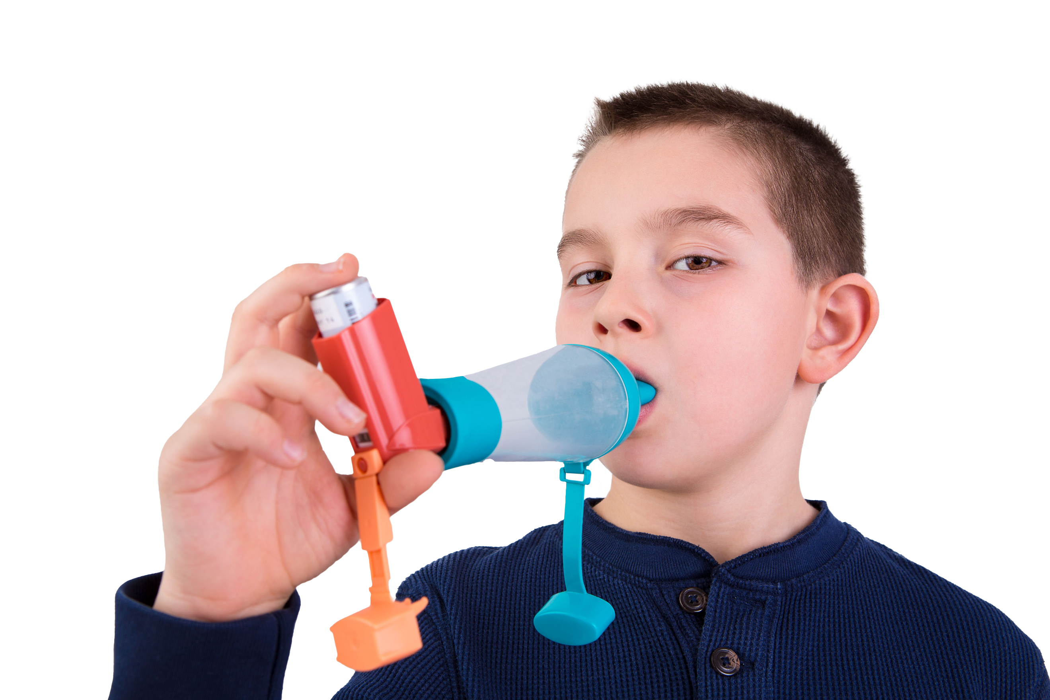
#AskAboutAsthma 2024: fact sheet for youth organisations
Asthma is the most common long-term medical condition affecting children and young people.
1 in 11 are affected by the condition, which is around 3 in every London classroom.
Many have badly managed asthma, with over 20,000 admitted to hospital every year in England. Over 4% of these have such a severe episode that they are admitted to intensive care.
Children die in London every year because of asthma. 90% of asthma deaths are preventable: these children should have gone on to lead full and productive lives.
London’s annual #AskAboutAsthma campaign raises awareness of 4 simple asks that can make a big difference to how children and young people experience their asthma – having an asthma plan, attending a regular asthma review, using inhalers properly and knowing how air pollution affects them.
This campaign has been running for 8 years, led by NHS England – London’s babies, children and young people’s transformation team. This year’s campaign takes place from 9-15 September 2024.
This year’s theme is Helping children and young people with asthma to live their best lives. See the campaign webpage to find out more.
How youth organisations can support the #AskAboutAsthma campaign:
Use the 2024 campaign toolkit to raise awareness that asthma can be managed with the 4 asks with your group members and their parents/carers
Print and display the #AskAboutAsthma campaign poster on your notice boards to encourage children, young people and their parents/carers to speak to their GP, nurse or pharmacist if they need help managing their asthma.
Enhance your own knowledge and understanding of children and young people’s asthma by reading our blogs, listening to our podcasts and sharing what you learn on social media. During the campaign week, new content will be released daily, so check out the 2024 campaign webpage for more details and join in.
Promote an inclusive environment in all of your groups and clubs by sharing information about asthma more generally so your kids understand what it is and how it might impact people who have the condition. See our spotting signs/symptoms of asthma poster to help you share information about asthma and common triggers.
Encourage young people and their families to think about the impact of indoor and outdoor air pollution at home and on the way to/from school and afterschool clubs – air pollution, smoking and vaping can trigger asthma so it’s important to minimise exposure where practical and possible. Support and more information is available on smoking cessation from Stop Smoking London.
While vaping can help smokers quit, it is not harmless and is not for young people under 18. It is especially important to protect young lungs and brains. Youth groups can help by talking to young people about vaping.
Did you know…?
Asthma is the most common chronic medical reason for students missing school. Absenteeism due to illness represents a
barrier to
achievement and standards.
Key messages
Asthma should not limit children and young people’s lives in any way.
Good asthma control means having NO symptoms.
Following the 4 asks means children and young people can live their best lives.
Find out if your group members with asthma have the 4 asks in place and encourage their parents/carers to speak to their child’s GP, asthma nurse or pharmacist if they need support.
Contact us
For more information contact the #AskAboutAsthma team on: england.cyptransformationldn@nhs.net
Follow us on social media to stay up to date on the campaign:
X: bcyp_nhsldn
Instagram: bcyp_nhsldn

