Slide 1
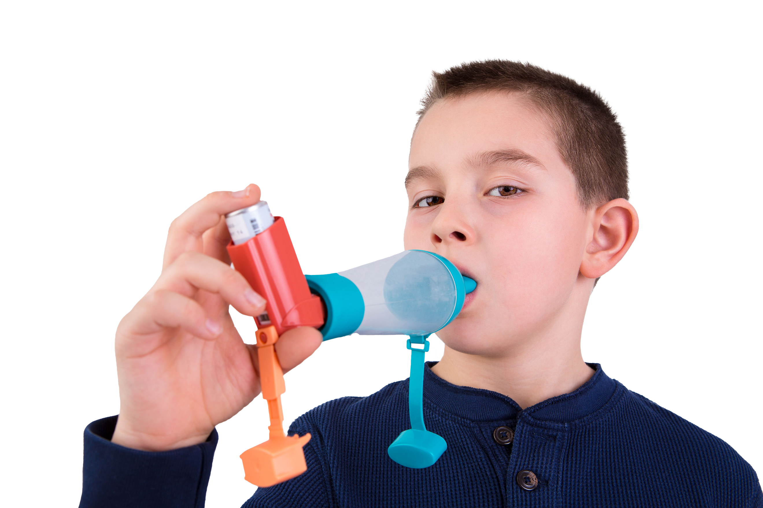
#AskAboutAsthma 2024: fact sheet for hospitals
Asthma is the most common long-term medical condition affecting children and young people
1 in 11 are affected by the condition, which is around 3 in every London classroom
Many have badly managed asthma, with over 20,000 admitted to hospital every year in England. Over 4% of these have such a severe episode that they are admitted to intensive care
Children die in London every year because of asthma. 90% of asthma deaths are preventable: these children should have gone on to lead full and productive lives.
London’s annual #AskAboutAsthma campaign raises awareness of 4 simple asks that can make a big difference to how children and young people experience their asthma – having an asthma plan, attending a regular asthma review, using inhalers properly and knowing how air pollution affects them
This campaign has been running for 8 years, led by NHS England – London’s babies, children and young people’s transformation team. This year’s campaign takes place from 9-15 September 2024.
This year’s theme is Helping children and young people with asthma to live their best lives. See the campaign webpage to find out more.
How hospitals can support the #AskAboutAsthma campaign:
Use the 2024 campaign toolkit to raise awareness that asthma can be managed with the 4 asks with your patients and parents/carers
Paediatric departments can display this #AskAboutAsthma campaign poster in reception areas to encourage parents to speak to their child’s clinician for help managing their asthma, or hold a stall in the hospital with placebo inhalers to demonstrate how to use them.
Everyone in your paediatric teams can develop their understanding of children and young people’s asthma by attending the #AskAboutAsthma conference and daily webinars, reading our blogs, watching our videos and listening to our podcasts.
Consider how you are supporting patients and their families for whom English is their second language and extra support may be needed. Translated resources are available.
Share messaging with your asthma patients and their parents/carers around asthma triggers and why it’s important to minimise exposure where practical and possible:
Smoking: support and more information is available on smoking cessation from Stop Smoking London.
Vaping: parents/carers of children with asthma can be reminded vaping is not recommended for young people under 18. It is also best not to vape around babies and children. Parents/carers of older children and teenagers can visit the Better Health website for support about talking to young people about vaping.
Damp and mould: babies, small children, older people, people with asthma, and people with allergies are more likely to be affected by damp and mould. Parents/carers of children with asthma can visit the Asthma + Lung UK website for information if they are concerned about mould or damp in their homes. Hospital teams can also refer to the London Damp and Mould Checklist.
Did you know…?
Asthma is one of the top three causes of emergency admission to hospital (4,000 in London each year).
Key messages
Asthma should not limit children and young people’s lives in any way.
Good asthma control means having NO symptoms.
Following the 4 asks means children and young people can live their best lives.
Ensure your patients with asthma have the 4 asks in place and encourage their parents/carers to speak to you if they need support.
Contact us
For more information contact the #AskAboutAsthma team on: england.cyptransformationldn@nhs.net
Follow us on social media to stay up to date on the campaign:
X: bcyp_nhsldn
Instagram: bcyp_nhsldn

