Slide 1
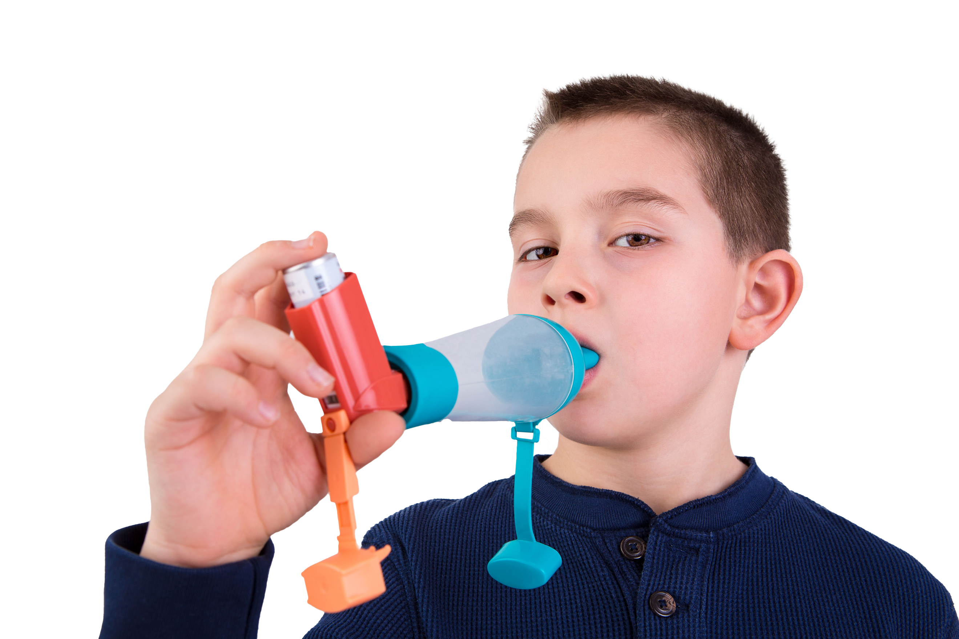
Asthma is the most common long-term medical condition affecting children and young people
1 in 11 are affected by the condition, which is around 3 in every London classroom
Many have badly managed asthma, with over 20,000 admitted to hospital every year in England. Over 4% of these have such a severe episode that they are admitted to intensive care
Children die in London every year because of asthma. 90% of asthma deaths are preventable: these children should have gone on to lead full and productive lives.
#AskAboutAsthma 2024: fact sheet for schools and governors
London’s annual #AskAboutAsthma campaign raises awareness of 4 simple asks that can make a big difference to how children and young people experience their asthma – having an asthma plan, attending a regular asthma review, using inhalers properly and knowing how air pollution affects them
This campaign has been running for 8 years, led by NHS England – London’s babies, children and young people’s transformation team. This year’s campaign takes place from 9-15 September 2024.
This year’s theme is Helping children and young people with asthma to live their best lives. See the campaign webpage to find out more.
How schools and governors can support the #AskAboutAsthma campaign:
Use the 2024 campaign toolkit to raise awareness that asthma can be managed with the 4 asks with pupils in your school and their parents/carers and include information in newsletters, bulletins and at school assemblies.
Print and display the #AskAboutAsthma campaign poster on your notice boards to encourage children, young people and their parents/carers to speak to their GP, nurse or pharmacist if they need help managing their asthma.
Enhance your own knowledge and understanding of children and young people’s asthma by reading our blogs, listening to our podcasts and sharing what you learn with your networks and on social media. Attend our LearnLive broadcast for schools on Friday 13 September at 10am. During the campaign week, new content will be released daily, so check out the 2024 campaign webpage for more details and join in as much as you can.
Asthma can be seen as a stigma by some children, meaning they don’t want to use their inhalers. Teachers and other staff can promote an inclusive classroom environment by teaching about asthma and common triggers more generally. Find some lesson plans here and see our spotting signs of asthma poster to help you get started.
Could your school become an Asthma Friendly School?
  The benefits include all staff being trained in managing asthma, including asthma attacks, and giving confidence to children and young people with asthma and their parents that they will be safe at school
  Find out more here: Asthma Friendly Schools
Did you know…?
Asthma is the most common chronic medical reason for students missing school. Absenteeism due to illness represents a
barrier to
achievement and standards.
Key messages
Asthma should not limit children and young people’s lives in any way.
Good asthma control means having NO symptoms.
Following the 4 asks means children and young people can live their best lives.
Find out if your pupils with asthma have the 4 asks in place and encourage their parents/carers to speak to their child’s GP, asthma nurse or pharmacist if they need support.
Contact us
For more information contact the #AskAboutAsthma team on: england.cyptransformationldn@nhs.net
Follow us on social media to stay up to date on the campaign:
X: bcyp_nhsldn
Instagram: bcyp_nhsldn

