Slide 1
ASTHMA
Notes:
Introduction to Students –
We are going to think about asthma today.
I/we will tell you some facts about asthma, and show you a couple of video clips.
I/we will explain how to take asthma medication or how to help your friend if they have asthma. (Posters will be up in the school)
I/We will tell you about how your school cares for students with asthma. ( Care Plan and easy access to inhalers and spacers)

Slide 2
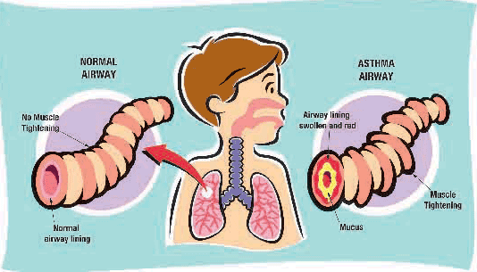

What is Asthma
Notes:
Ask for a show of hands if you know someone with asthma or if you have asthma…
Tell them how many children in the UK have asthma and how many in their school.
Explain asthma is a very common condition that effects a lot of people young and old, you cannot ‘catch’ asthma but you can help your friends if they have asthma.

Slide 3
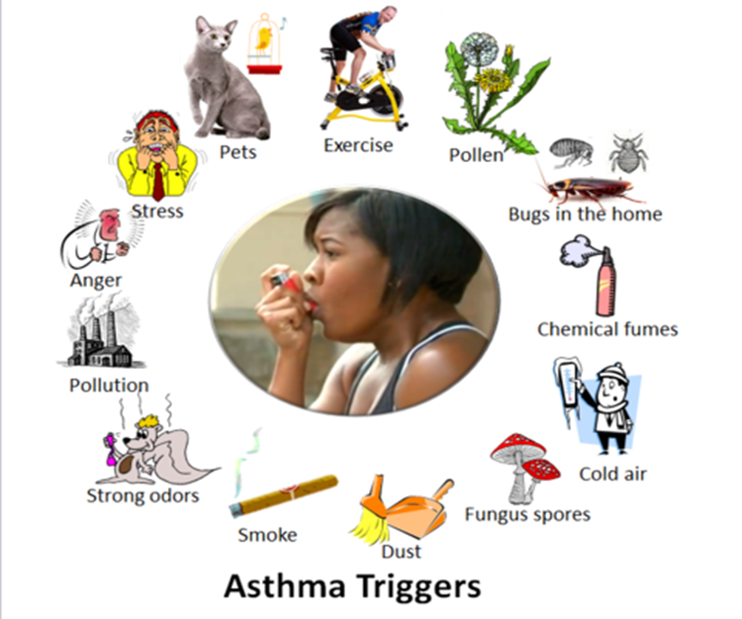
ASTHMA TRIGGERS

Slide 4




WHO HAS ASTHMA ?
CAN ANYBODY GET ASTHMA ?

Slide 5
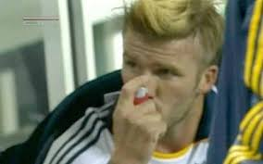


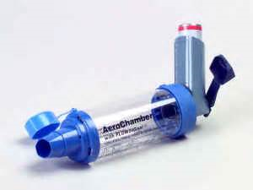
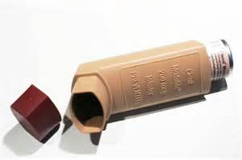
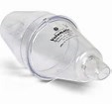
WHATS WRONG HERE ?
Notes:
You cannot catch asthma –
If your parents have asthma you are more likely to have it
Niall Horan (one direction) – incorrectly using his inhaler without a spacer!
David Beckham
Rebecca Adlington (Olympic gold medalist (swimmer)

Slide 6
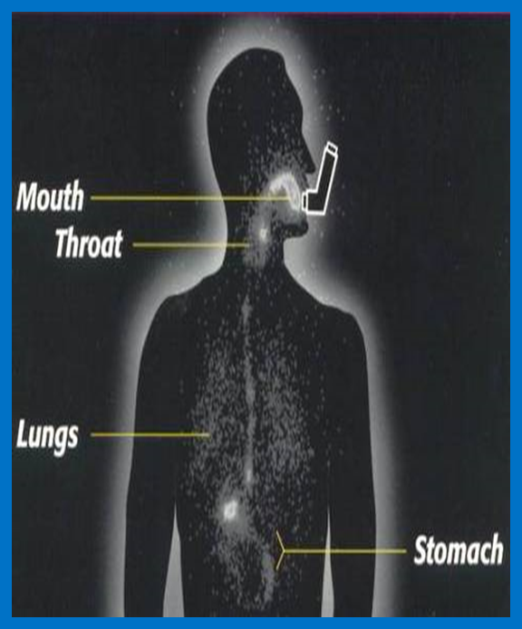

Slide 7

Asthma Medicines
Most children with asthma will have a blue inhaler
Lots of children with asthma will also have a brown inhaler
You must use a spacer device
Preventer
Reliever
Notes:
How do you know if you or your friends asthma is getting worse? Coughing /wheezing/Difficulty in breathing
You are having an asthma attack if your asthma symptoms are getting worse and they do not go away when you use your blue reliever or they return within minutes to hours after using it.
The brown inhaler is a PREVENTER!. This is used every day
help prevent future asthma attacks.
The brown inhalers should NOT be used in asthma attacks!

Slide 8
In an Emergency…
Call for adult help
Try not to panic – be reassuring
Help your friend to use their inhaler (one spray and 5 breaths)

Slide 9
In School
DO know where your Inhaler and Spacer are kept.
You will have a school asthma plan which you should sign
Talk to an adult if you are feeling unwell or if you can see your friend is unwell.

Slide 10
Your School wants to help you!
An asthma register (list of children with asthma)
School asthma plans (for children with asthma)
Emergency Kit (You must not touch these)
Training/Information for everyone!

Slide 11

ANY QUESTIONS ?

Slide 12


GOODBYE
THANK YOU FOR LISTENING

Slide 13
Whittington Health
Magdala Avenue
London
N19 5NF
7272
Tel: 020 3070
Fax: 020 7288 5550
Website: www.whittington.nhs.uk

