Slide 1
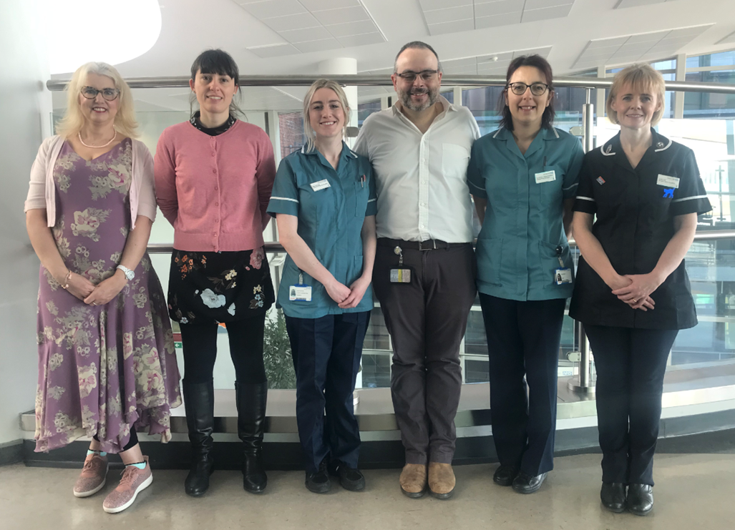
A Lesson in School safety:
The Asthma Friendly Schools Project
Ms Monique Rodesano
Islington Long Term Condition Nurse
monique.rodesano@nhs.net

Slide 2
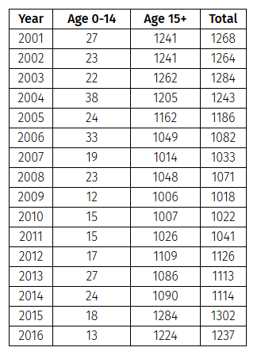
1 in 10 children in the UK have asthma
1/3 of children have a wheezy episode
A child is admitted to hospital with asthma every 17 minutes
3 in 4 admissions are potentially preventable in primary care
NHS spends £1 billion on asthma & asthma treatments –
1% of NHS budget on just one disease
Asthma Deaths in England since 2001.
Asthma: the scale of the problem

Slide 3
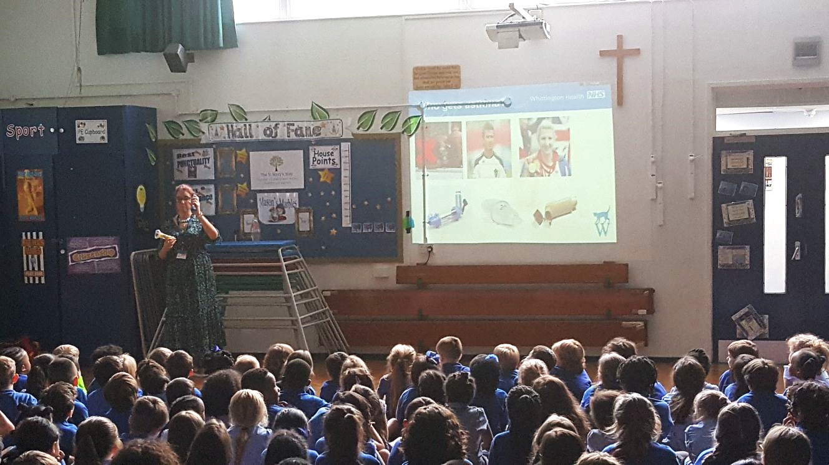
Islington Schools
25,890 (25,053) CYP attend school in Islington
61 mainstream
6 special schools
Approx.2800 have asthma
11% of CYP

Slide 4
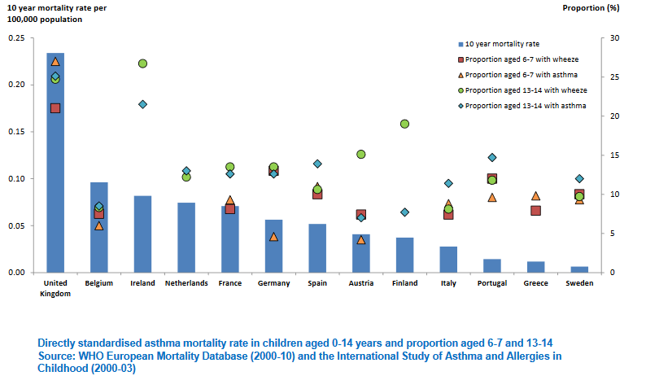
Mortality Rates

Slide 5
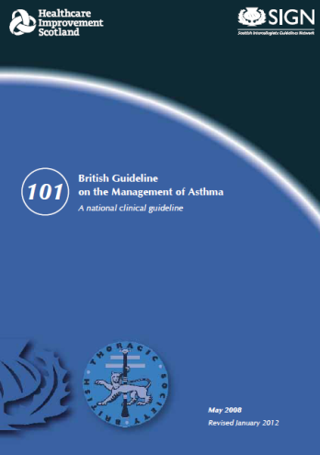
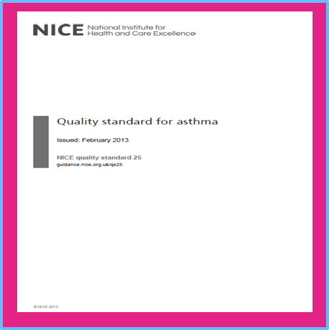
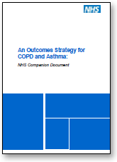
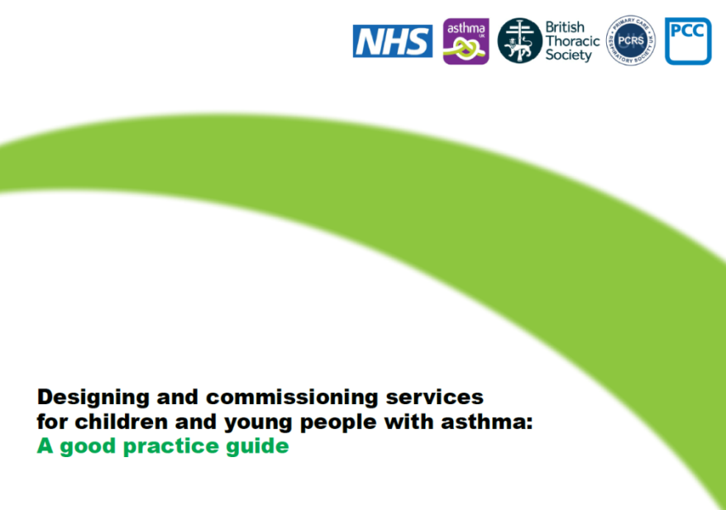
Despite >14 documents in the last 5 years , still high mortality,
Emergency admissions and variations : we don’t need more

Slide 6
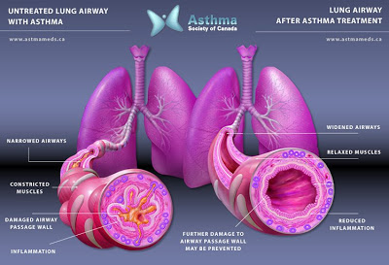
What is asthma ?

Slide 7
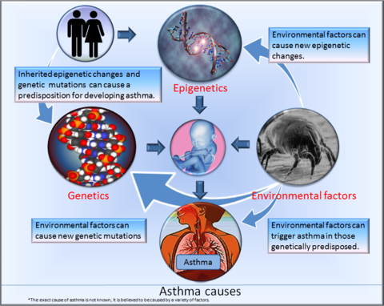
What causes asthma ?

Slide 8
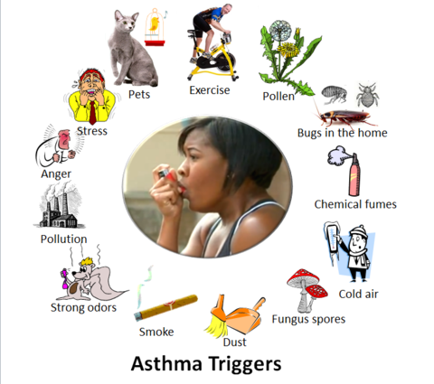
Asthma triggers

Slide 9
Inhalers and Spacers

Slide 10
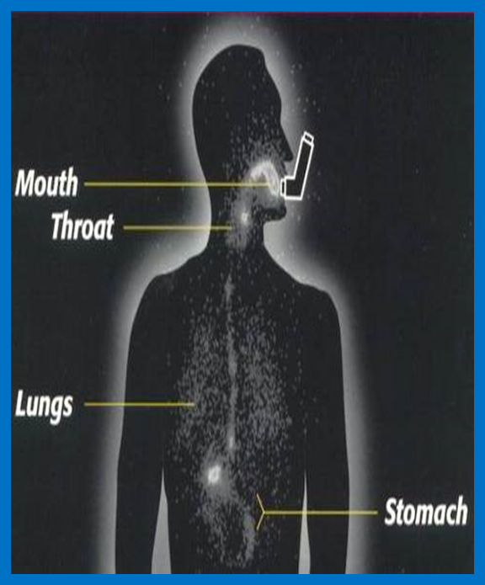
The importance of correct technique

Slide 11
5 Asthma friendly school gold standards

Slide 12
School Asthma Care Plan

Slide 13
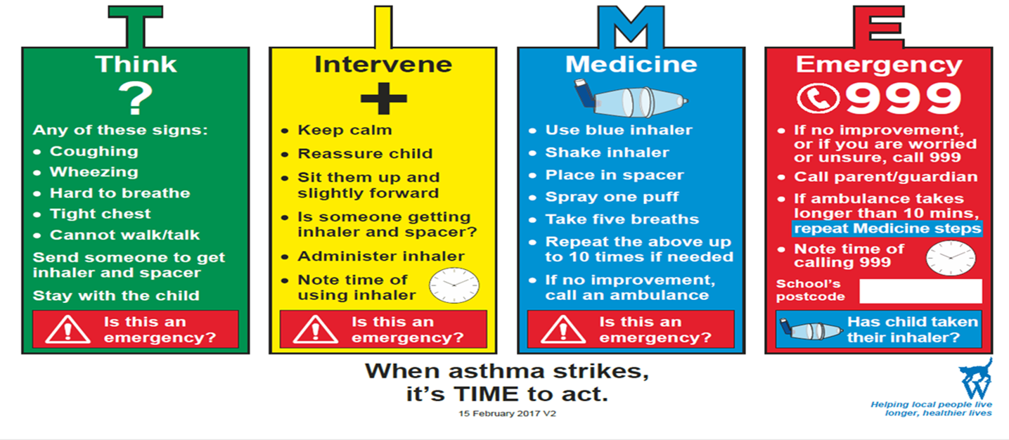

Slide 14
Any Questions

Slide 15
Karen.rodesano@nhs.net

