Slide 1
Helping young Londoners to access mental health support when you need it
Updated January 2023
Notes:
This is a short assembly aimed at young people in key stage 3-5. The assembly will explore the following themes:
Why looking after your mental health matters and 5 Ways to Wellbeing
What to do if you need urgent mental health support
How to contact an NHS helpline or access other support in London
Animation on the NHS helplines

Slide 2
Slides:
Why looking after your mental health matters
Introducing ‘5 Ways to Wellbeing’
Reaching out if you’re worried or feeling down
Digital mental health tools
What to do if you need urgent mental health support
Animation on how NHS helplines work
More information

Slide 3
Why looking after your mental health matters
Young people have a lot to deal with day to day.
There are many pressures like exams, worries about friends or loved ones, keeping up with social media – all of which can impact your mental health.
We all have mental health just like we all have physical health.

Slide 4
5 Ways to Wellbeing
A great way to look after your mental health is to use the 5 Ways to Wellbeing.
Connect – staying in touch with others helps you to share experiences and support each other e.g., hang out with friends
Move – being active is important for both your mental and physical health e.g., try a local park run or go for a walk
Learn – having new experiences can be a fun way to boost your confidence e.g., try something new like exploring a new genre of music
Give – helping others can give you a sense of purpose and achievement e.g., volunteer in your community or in your school
Focus – being present and taking time for self-care is important e.g., try yoga or meditation
Notes:
Introduce the 5 ways to wellbeing outlined in this slide. You can then ask students to talk in small groups or to the person next to them to come up with their own ideas for how they would look after their mental health using the 5 ways to wellbeing. More information on the 5 ways to wellbeing can be found on the Good Thinking website via this link: https://goodthinking-strapi.s3.eu-west-2.amazonaws.com/JC_0423_CYP_5_Ways_Poster_v3b_c9c05c4725.pdf

Slide 5
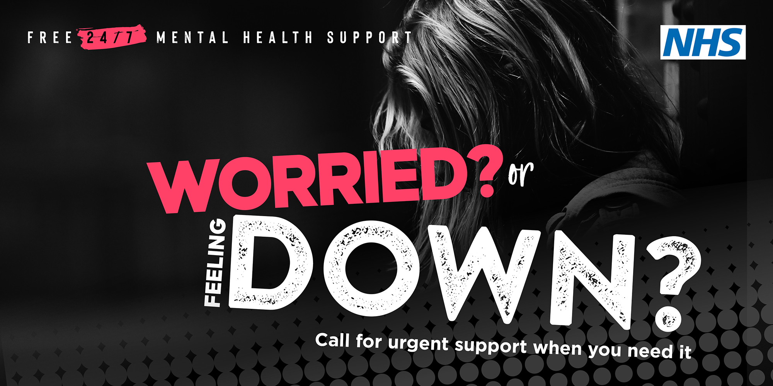
Get support if you are worried or feeing down
Reach out to a parent, carer, friend, teacher or someone else you trust and let them know how you’re feeling so they can help support you.
It’s important that you don’t struggle alone.
If you’re already receiving support from mental health professionals, you should have your own Safety Plan or a Care Plan.
When you’re struggling, try to follow this plan one step at a time until you are safe and let your mental health professional know what’s going on.
If you or someone else is in immediate danger or it’s a medical emergency, call 999 straight away or go to A&E.
Notes:
This slide explains why it’s important to reach out to someone you trust if you are struggling.
If a young person is already receiving help from a mental health service, they should have their own Safety Plan or a Care Plan which they should try to follow, one step at a time, until they are safe. It’s important that they also let their mental health professional know what’s going on as soon as they can.
More information can also be found on the NHS England website: https://www.nhs.uk/nhs-services/mental-health-services/

Slide 6
Digital support to help look after your mental health
There are many ways to help you understand more about how you're feeling, and how to feel better
You can access various free digital tools, including apps and virtual support to help you cope with life experiences:
Good Thinking: London's free digital wellbeing service. Feeling anxious? Stressed out? Not sleeping properly? Good Thinking is here to help boost your mental wellbeing
Kooth is available for all young people in London and provides an online mental wellbeing community which provides free, safe and anonymous support
Shout Text Service – Shout is the UK’s first and only free, confidential, 24/7 text messaging support service

Slide 7
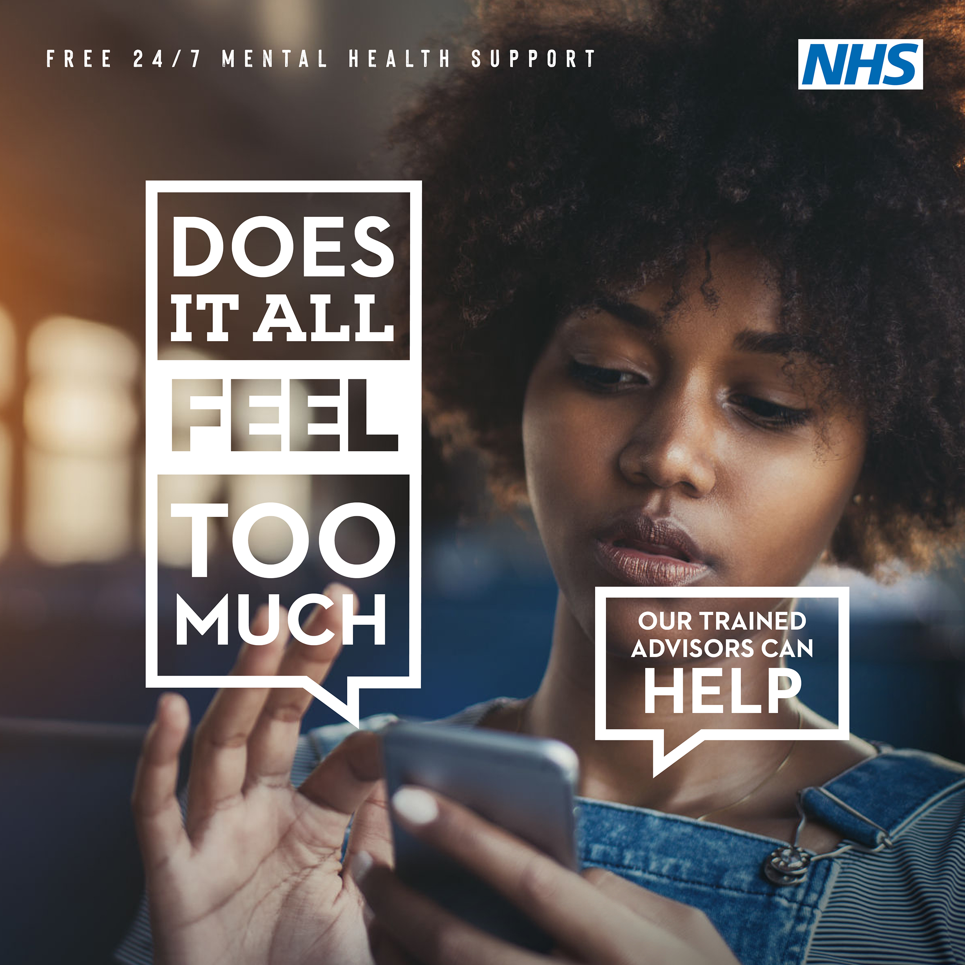
Living in London can be stressful, support is always available
Life can be really difficult and young people might sometimes feel completely overwhelmed. This can be triggered by many things that may require an immediate response.
That’s why every London borough (and other places around England) has developed a mental health helpline which is run by NHS-trained mental health advisors and clinicians.
You can call the urgent helplines for free support and advice. Help is available 24 hours a day, 7 days a week.
Telephone numbers for each London borough can be found at:
www.healthylondon.org/urgentsupportlines
Notes:
This slide introduces the urgent mental health support telephone helplines which are available in every London borough, set up by the NHS.
Young people, or their parents/carers can call 24/7, for free support or advice. They can discuss their current mental health needs and advisors provide access to further support if needed.

Slide 8
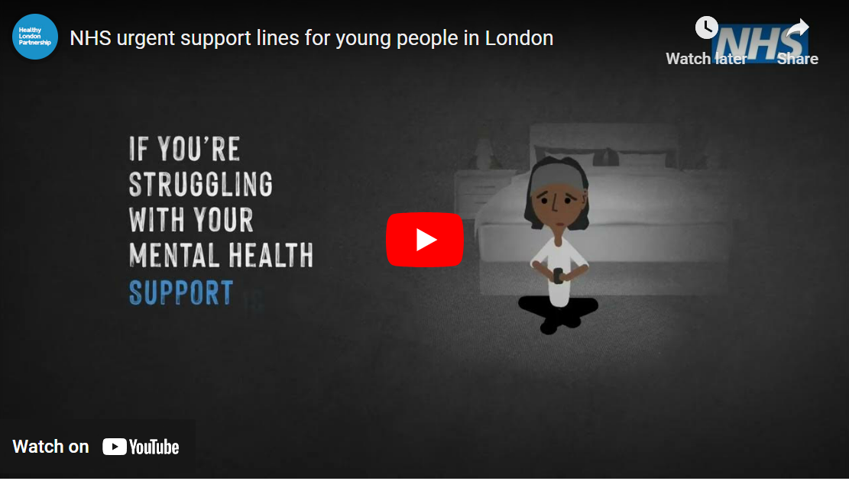
Watch this short video explaining how the helplines work
Notes:
The animation video is available on YouTube at the following link: https://www.youtube.com/watch?v=CF40VZEB_MY

Slide 9
More information
Find more information about NHS urgent mental health support and telephone numbers for all London boroughs at:
www.healthylondon.org/urgentsupportlines
You can also find mental health support with specific advice for young people from:
Good Thinking
Shout Text Service
Young Minds
Kooth
The Mix

