Slide 1
.
Population Health Improvement Project Evaluation

Slide 2
Testing the Value of Prevention
What we did…
Identify: People with or diabetes or with a high and growing BMI with potential low level mental health needs
Intervene: Proactive, holistic, personalised care offered by the social prescribing team
Impact: Aim to improve activation and health while reducing GP demand

Slide 3
Impact of Social Prescribing on the Health of Diabetics
 | Patients | BMI | BMI Trend | HbA1c
Diabetics who had no social prescribing support | 3486 | 31 | Stable | 54
Diabetics who had social prescribing support | 86 | 30 | 1 point drop | 51
Diabetics supported by social prescribers in the last 12 months have a lower HbA1c, lower BMI and their BMI is falling over time
Looking at all 453 patients who were supported by social prescribers, against a backdrop of rising GP demand, these patients saw their demand fall by 2 appointments compared to the previous year
Notes:
The 86 patients include those in the pilot

Slide 4
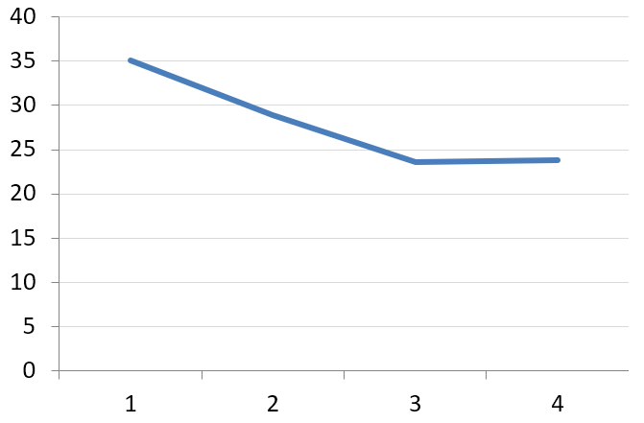
Impact on Patient Activation and System Demand
Patients started with an average activation level of 2.5 and this rose to 3.3
As activation rises, it’s only a matter of time before physical health improves and contacts fall
A 0.8 point rise in activation is linked to a reduction of 4 GP appointments per patient per year
A 0.8 point rise in activation is linked to primary and secondary care demand savings of £445 per patient per year
GP Contacts
Before
After
1
not able
2
a little able
3
quite able
4
very able
Patient Activation Level:
A person’s knowledge, skills and confidence in managing their own health and wellbeing

Slide 5
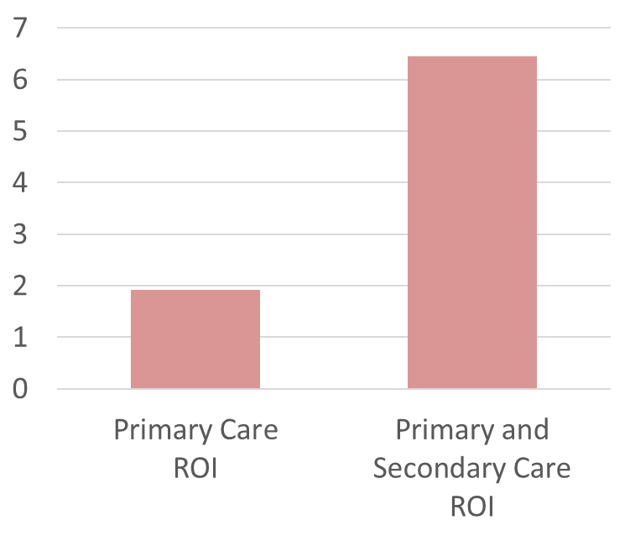
The Return on Investment of the Intervention
Patients received, on average, 180 minutes of support from a Social Prescriber
This support may pay for itself nearly 2 times over in reductions in primary care demand and 6 times over in reductions in primary care and secondary care demand
This does not count the cost of any onward referrals but it also doesn’t count benefit in year 2, benefit to other providers or the benefit of better health to patients
Return on Investment (ROI):
Do the benefits of an intervention exceed the input costs?

Slide 6
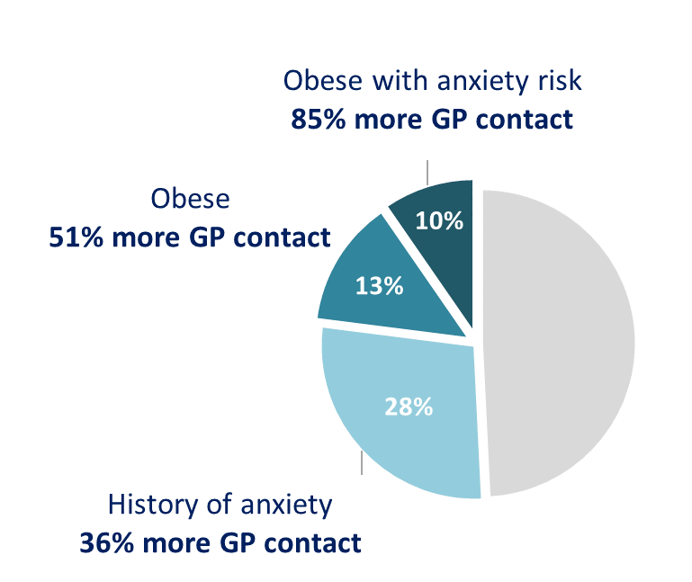
Why This Matters to Our PCN?
A large number of people in our PCN may benefit from proactive prevention and these numbers are growing each year
These people are more likely to live in deprived areas, suffer health inequalities and have social needs
Supporting the 10% of people who are obese with anxiety risk could help them improve their wellbeing and manage their health while ‘saving’ up to 18,000 GP appointments a year
The Needs of Our PCN’s Population

