Slide 1
.
Population Health Improvement Project Evaluation

Slide 2
Testing the Value of Prevention
What we did…
Identify: People with mild or moderate frailty, anxiety, living alone or with one other person with high and growing BMI and GP demand
Intervene: Proactive, holistic, personalised care offered by the Social Prescribing and Care Coordination team
Impact: Aim to improve activation, wellbeing and health while reducing GP demand
30 patients who took up support have been evaluated

Slide 3
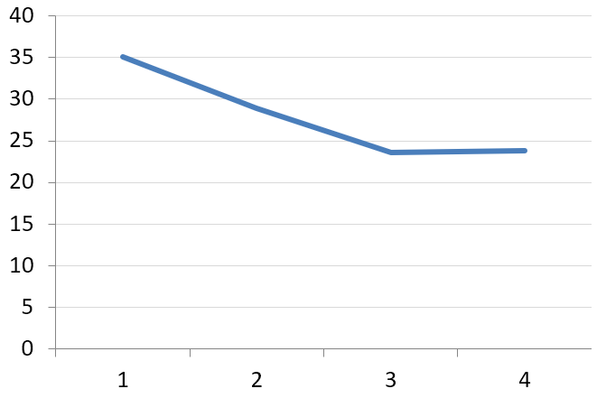
Impact on Patient Activation and System Demand
Patients started with an average activation level of 2.1 and this rose to 3
As ability rises, it’s only a matter of time before physical health improves and contacts fall
A 0.9 point rise in activation is linked to a reduction of 5 GP appointments per patient per year
A 0.9 point rise in activation is linked to primary and secondary care demand savings of £524 per patient per year
GP Contacts
Before
After
1
not able
2
a little able
3
quite able
4
very able
Patient Activation Level:
A person’s knowledge, skills and confidence in managing their own health and wellbeing

Slide 4
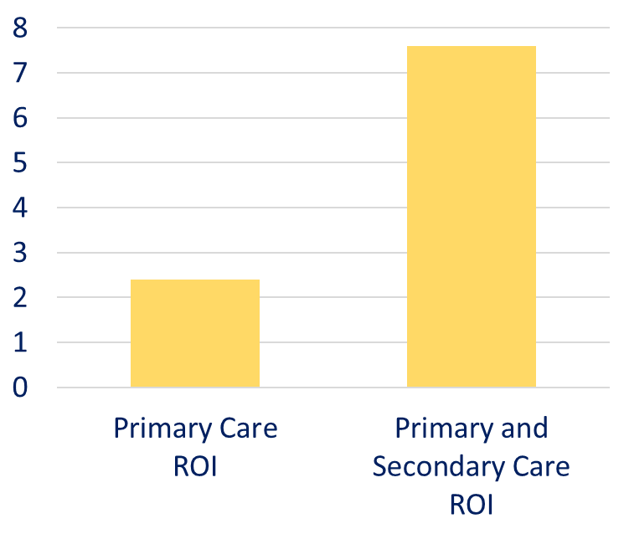
The Return on Investment of the Intervention
Patients received, on average, 180 minutes of support from a Social Prescriber or Care Coordinator
This support may pay for itself 2 times over in reductions in primary care demand and 7 times over in reductions in primary care and secondary care demand
This does not count the cost of any onward referrals but it also doesn’t count benefit in year 2, benefit to other providers or the benefit of better health to patients
Return on Investment (ROI):
Do the benefits of an intervention exceed the input costs?

Slide 5
How Did Patients Feel?
You offered me help when I was at my worst and I'll never forget that. The service was caring and understanding - tell your boss it’s a 10/10 from me. Thank you for getting me to a better place.
You have been very approachable and treated me with a lot of kindness and understanding, thank you following up everything for me. You've been a superstar, it's been a real joy.
It was very reassuring to know I had someone there
Very impressed as you never let me go
You brought out a little bit of the old spark in me
I have had the chance to talk about my problems and been linked to services which have been a great help as I would not have through about asking these services for support.
It's amazing how you looked at everything, I can't thank you enough, you dug me out of a hole - everything is great about the service.

Slide 6
Impact of Social Prescribing on Older People
 | Patients | GP Contacts | GP Demand Trend | Hospital Admissions | Falls | Repeat Meds
Patients over 65 who have just started receiving social prescribing support | 67 | 24 | Rising | 1 for every 6 patients | 1 for every 4 patients | 8
Patients over 65 who had social prescribing support 1+ year ago | 36 | 17 | Stable | No admissions | 1 for every 7 patients | 7
Older people who were supported by social prescribers have fewer admissions, fewer falls and fewer repeat medications. They also had fewer contacts with specialist nurses and had 7 fewer GP contacts last year.
Notes:
The 36 patients include some of those in the pilot

Slide 7
Testing the Value of Prevention
What we did…
Identify: People with moderate frailty, with 3 or more conditions (falls risk, falls, UTIs, constipation, memory, delirium, dementia, confusion and incontinence) with high and growing GP demand who have not seen a community nurse
Intervene: Proactive primary care frailty nursing support, including home visits
Impact: Aim to improve activation and stabilise health while reducing GP demand
23 patients who took up support have been evaluated

Slide 8
Impact on Patient Activation and System Demand
Patients started with an average activation level of 2.3 and this rose to 3.4
As ability rises, it’s only a matter of time before physical health improves and contacts fall
A 1.1 point rise in activation is linked to a reduction of 5 GP appointments per patient per year
A 1.1 point rise in activation is linked to primary and secondary care demand savings of £612 per patient per year
GP Contacts
Before
After
1
not able
2
a little able
3
quite able
4
very able
Patient Activation Level:
A person’s knowledge, skills and confidence in managing their own health and wellbeing

Slide 9
How Did Patients Feel?
I know if I needed advise you would be the first port of call. It's very good to know there's help if I need it.
Feel the service is useful, you took his memory seriously and got him tests and diagnosis. We know we can ring you if we need you.
I think it’s brilliant and Faye has been very supportive and helpful. 100%
I always have someone to turn to
I don't feel on my own
At first I thought why do I need this. Good to know there is someone you can contact especially when there are a lot of barriers to accessing GPs.
I’m extremely likely to recommend this service. It is good to be able to talk to someone regarding personal problems.

Slide 10
Impact of Early Intervention on Frail Patients
 | Patients | GP Contacts | GP Demand Trend | Hospital Admissions | Falls | Community Nurse Contacts
Patients who have just started receiving support from a frailty nurse | 80 | 25 | Rising | 1 for every 5 patients | 1 for every 3 patients | Over 4
Patients who have received support from a frailty nurse for 1 year or more | 85 | 15 | Stable | 1 for every 43 patients | 1 for every 6 patients | Less than 2
Mild and moderately frail people were supported by a general practice frailty nurse, each receiving an average of
4 nurse contacts.
These patients had fewer admissions, fewer falls and fewer UTIs. They also had fewer contacts with community nurses and had
10 fewer GP contacts.
Notes:
The 85 patients include those in the pilot

Slide 11
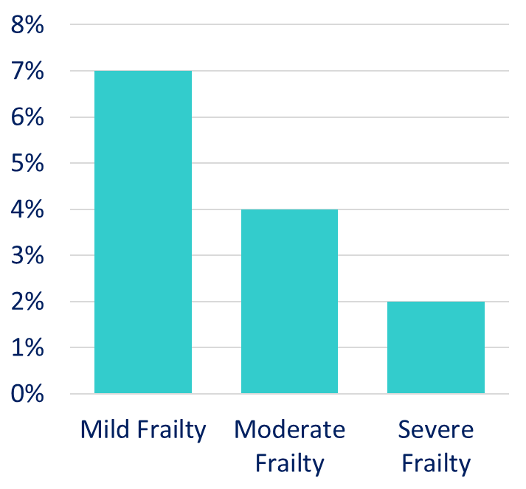
Why This Matters to Our PCN?
Levels of frailty are rising rapidly
Within the next 20 years the number of people over 65 is likely to increase by 40% and the number of people over 80 will increase by 69%
Quality of life improvements have mitigated the impact of an aging population on frailty services but improvements have stalled due to lifestyle factors like smoking and obesity
Patients with severe frailty have 5 times more GP contact
3
% of Population
4
5
Frailty in Our PCN
Figures in the bars show how much more GP contact these patients have
Notes:
https://ageing-better.org.uk/sites/default/files/2019-03/The-state-of-ageing.pdf

