Slide 1
Resource pack
New Care Coordinators in London
March 2022

Slide 2
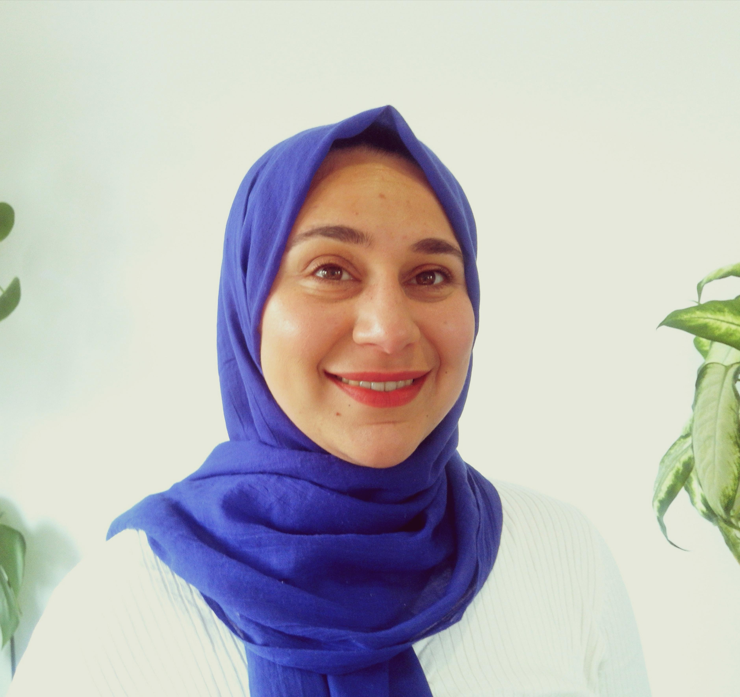
London Care Coordinator Network Manager
I am the London Care Coordinator Network Manager. My role is primarily to help develop Care Coordinators across London, build peer support and networking opportunities for them locally and help PCNs understand and embed the role effectively.
We now have a group of Local CC Champions for each of the five ICS areas in London who are also helping to connect local CCs and share local knowledge and resources.
Together with the other London Personalised Care Team leads I support supervisors or employers on how the role can be better supported, developed and integrated, providing clarity on where they sit within the wider personalised care and health inequalities agenda.
I regularly share the feedback and challenges of London CCs to the national NHSE team and have been involved with the work on the new CC roadmap outlining the national expectation in terms of training, role, supervision and support
I work alongside Jenny Brooks, project officer at Healthy London Partnership to support you. Please contact us if you have any queries (see contacts page)
Rafif Mansour, Salaried GP in Barnet, SPIN fellow working in collaboration with Barnet training hub to support Care Coordinators
New Care COORDINATORS in London

Slide 3
Have a read
NHS England has a range of materials to help you in your job. A section has been added to the FutureNHS Collaboration Platform* for new CCs which provides all the guidance, training, templates and info you need to carry out your role, including:
Welcome pack for new Care Coordinators
National Care Coordinator Future NHS area: National resources located here
London Care Coordinator Future NHS area: here you can ask peers questions and access resources
Care Coordinator roadmap (TBC March) – outlining development, training and the value of Care Coordinators
Network Contract Directed Enhanced Service – page 89 details the contract guidelines around Care Coordinators and reimbursement of their pay through ARRS
* If you are not registered with the FutureNHS Collaboration Platform you can join here.
New Care COORDINATORS in London

Slide 4
Top tips for new Care Coordinators
Sign up to receive the fortnightly London Care Coordinator emails and hear about events, access peer support and general updates relating to Care Coordination.
Attend the national Care Coordinator share and learn sessions. Sign up here.
Watch and share this three-minute video on Care Coordinators in primary care with colleagues.
Undertake e-learning related to personalized care, care coordination or clinical conditions you may work with.
Email the Care Coordinator champions in your ICS, to connect to CCs in your patch.
Read Information for New Care Coordinators
Watch the webinar on the value of Care Coordinators in tackling health inequalities and showcase of examples across London.
Look through NHSE’s Care Coordinator case studies here.
Make sure you are looking after yourself, you can book a free coaching session for primary care staff.
New Care COORDINATORS in London

Slide 5
What support you can expect
Monthly Peer Support Sessions – These happen on Mondays usually at the end of the month, if you sign up to the mailing list, you will receive the calendar invites.
The plan for these sessions is below. Please find the recordings and resources from the sessions here.
May:
Day in the life of a Care Coordinator (2 care coordinators presenting for ~10 minutes about their work, what it looks like day-to-day, split of activities, groups they are a part of)
June- Sept:
Spotlight on different work areas/cohorts
Including background to clinical area/service, presenting of case studies, tools/tips to work with this patient group, external speaker, working through a patient case example
Example areas: Diabetes, SMI, Care homes, Carers, Frail, Health inclusion groups, excluded groups/lack of access
1:1 Support Sessions
These sessions are designed to offer additional support to work through challenges or help you develop your role further. They run every other Monday. You can sign up as an individual or small group.
Please sign up for a 30 minute slot here.
New Care COORDINATORS in London

Slide 6
Connect to peers
Please contact the care coordinator champions in your ICS to be included in ICS level peer support groups, conversations and meetings.
If you do not know what ICS or PCN you work in, you can enter your practice name here to find out.
Care Coordinator Champion Contacts
Name | Email | ICS | Borough
Ellie Hatch-Mccarthy | ellie.hatch-mccarthy@nhs.net | NCL | Barnet
Rupert York | rupert.york1@nhs.net | NCL | Camden
Nasima Begum | nasima.begum12@nhs.net | NEL | Hackney
Navjot Rai | navjot.rai@nhs.net | NEL | Redbridge
Francesca Caruana | francesca.caruana1@nhs.net | NEL | Tower Hamlets
Lucy Walsh | lucy.walsh9@nhs.net | NEL | Barking and Dagenham
Janine Woolf | janine.woolf@nhs.net | NWL | Harrow
Anita Thakkar | anita.thakkar@nhs.net | NWL | Brent
Berlinda Asman | berlinda.asman@nhs.net | SEL | Bexley
Aiden Wickham | aidan.wickham1@nhs.net | SEL | Lambeth
Felipe | f.oliveiracardoso@nhs.net | SEL | Lambeth
Hamdi Ibrahim | hamdi.ibrahim@nhs.net | SWL | Croydon
Abdihakim Mohamed | Abdihakim.mohamed1@nhs.net | SWL | Croydon
Natasha Gill | natasha.gill4@nhs.net | SWL | Richmond
Kunal Trivedi | kunal.trivedi@nhs.net | SWL | Croydon
New Care COORDINATORS in London

Slide 7
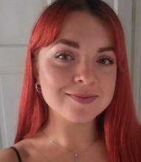
Contacts
Please feel free to contact our team if you have any questions related to Care Coordination in London:
Rafif Mansour
Care Coordinator Network Manager
Email: r.mansour@nhs.net
Jenny Brooks
Regional Learning Coordinator Support
PCN development Project Officer
Healthy London Partnership
Email: jennifer.brooks14@nhs.net
New Care COORDINATORS in London

Slide 8
Resources
HLP Care Coordination Website
London Mailing List and peer support sign up form
Information for New Care Coordinators (National level)
Welcome and induction pack for new Care Coordinators
PCI Care Coordinator role description, access PCI accredited training here
E-learning for healthcare platform
Care Coordinator roadmap (including competency framework)
Supported self management shared resources
FutureNHS Collaboration Platform (National workspace including Webinars)
FutureNHS Collaboration Platform (London Region page)
Care Coordinator case studies
Guidance on MDTs and working in MDTs
MDT case studies
Sign up to the personalised care bulletin
Sign up for the integrated care bulletin
New Care COORDINATORS in London

