Slide 1
What is QI?
​“A relentless focus on the needs of patients, families and carers; proper and sophisticated use of data for learning and improvement; systems thinking; a commitment to engage with the workforce; widespread use of rapid test​s of change (PDSA cycles) for continual learning; the removal of waste from processes, products and services; and the pursuit of joy at work."
Kings Fund - Improving Quality in the English NHS 2016

Slide 2
The Quality Improvement Journey
Identifying the quality issue
Understand the problem
Developing a strategy and change ideas
Testing
Implement & sustaining the gains
Deciding what to improve
When to use QI
Pareto
Flow Chart
Fishbone
3-part data review
Divergent/ convergent thinking
Driver diagram
Engaging the team
Creativity methods
Policy, training, manuals, resource
Quality control,
Audit and assurance processes
Benchmarking
PDSA
Time series analysis (run charts, control charts)

Slide 3
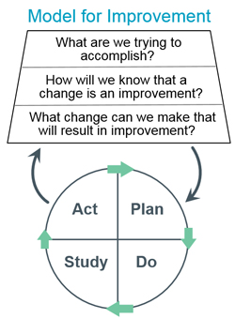
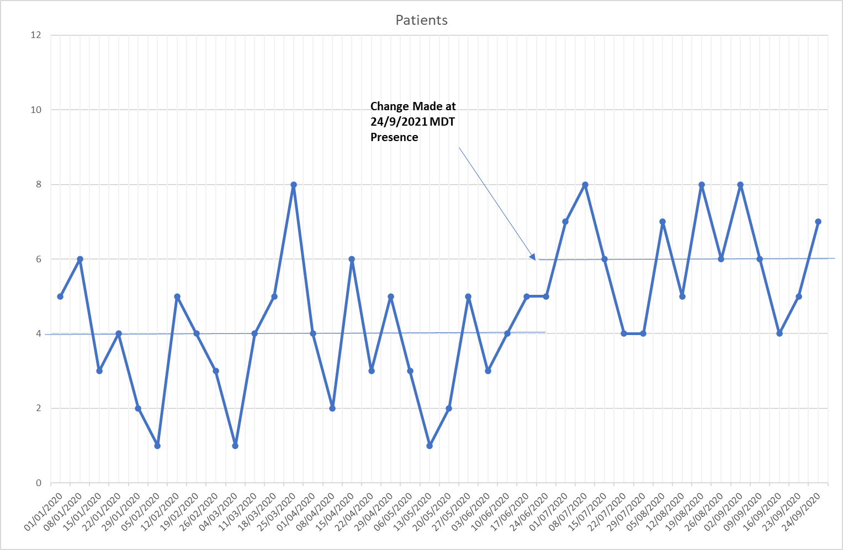
Systematic Approach to addressing complex issues
What does success look like? What are we trying to achieve? By how much? By when?
What if we try this? What happens? Is it better? Is it worse? Permission to fail …… as well as succeed

