Slide 1
PERSONALISED CARE FOR LONDON
Social Prescribing Innovators Programme
Investing in London's problem solvers.
Application workshop
@SP_LDN
hlp.socialprescribing@nhs.net

Slide 2
Agenda
Time | Agenda – Thursday 7th July 2022 | Speakers
09:00 (10 mins) | 01 Welcome, purpose of session, housekeeping and brief introductions | Mollie McCormick Project Officer, Personalised Care Team
09:10 (15 mins) | 02 Social Prescribing Innovators Programme: - What it is & context - The goals & desired impact - Programme support offer and timeline - Opportunity for questions (5 mins) | Mollie McCormick Project Officer, Personalised Care Team
09:25 (20 mins) | 03 Challenges - What is Quality Improvement? - Brainstorming session: group collaborative suggestions for common challenges - Tool: Jamboard | Charles Kennedy-Scott Joint Project Lead - Digital Accelerator Change Team, North East London
09:45 (30 mins) | 04 Solutions: (5 mins) - Explain activity (15 mins) - Pick a common challenge from previous exercise - Fishbone diagram – collaborative brainstorming of all the possible causes of the common challenge (10 mins) - Brainstorm ideas for possible solutions - Tool: Jamboard | Charles Kennedy-Scott Joint Project Lead - Digital Accelerator Change Team, North East London
10:15 (15 mins) | 05 Application support: - What to start thinking about / what we'll ask in application - Success factors and criteria - What we will and won’t fund - How to cost up your idea | Mollie McCormick Project Officer, Personalised Care Team
10:30 (15 mins) | 06 Q&A session - Opportunity to ask questions - FAQ document to be developed after the session | All
10:45 | 07 Finish

Slide 3
Purpose of the session
Get a taster of the programme structure and offer of support
Learn more about the programme, the goals and target impact
Receive support with writing a successful application and information on application processes
Build connections and network with others working within Social Prescribing
Crowdsource shared challenges in delivering an impactful service
Ask any questions about the programme
We asked, you answered: What is the main thing you would like to get out of this session?
Application criteria - what makes a good applicant and who can apply
Application questions and information required
Application process and tips for strong applications
Support with breaking down funding that you'll need
Better understanding and discussion around the suggested/common challenges
Opportunity to discuss potential areas of innovation and share best practice
Programme logistics & timetable - how it will fit into your work
Support and coaching offer available

Slide 4
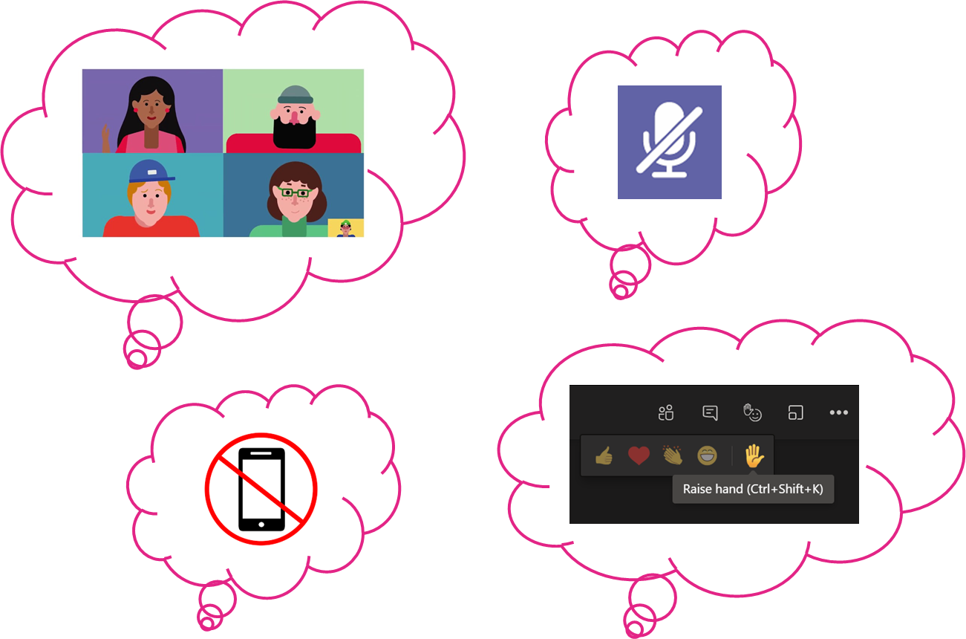
Housekeeping
Please be mindful of general virtual housekeeping rules

Slide 5
What is it?
Social Prescribing Innovators Programme
The Programme aims to support Social Prescribing services and individual Social Prescribing Link Workers across London to mitigate challenges they face in delivering social prescribing in primary care by testing and sharing innovative ways of working.
This is a pilot fund with an award of up to £10k granted to individuals or groups from Social Prescribing services.
Successful applicants will benefit from a 6-month programme of support between Sept 22- Feb 23 to help deliver projects against their specified ‘challenge’.
Funding will be used to support an individual or small team to innovate a solution to their chosen challenge(s), this could involve:
Implementing a Social Prescribing service design change
Carrying out a local pilot to test solutions to systemic challenges in embedding social prescribing successfully into the health service
Develop solutions to specific priorities within the NHS, following the COVID pandemic, including tackling inequalities
Projects for this fund will begin in September 2022.
Key resources:
Online application form
Information for Applicants
FAQ document in development: to be released Monday 11th July

Slide 6
Social Prescribing Innovators Programme
Inputs
Activities
Outputs
Outcomes
Impact
£10k grants​ to be awarded to local Social Prescribing services with chosen challenge
Programme of support (including 1:1 coaching, project and developmental support) to take a continuous improvement approach to achieve meaningful change
Local Social Prescribing services to test new approaches to old/systemic challenges
Community of practice for change makers participating
Ad-hoc support and connection building where most needed for each project to support success
10/12 projects tackling challenges to effective Social Prescribing
Case studies of the approach tested ​
Development of resources that will be useful across the system
A toolkit to share with ICSs to run similar programmes focused on improvement
Better insights into challenges embedding Social Prescribing in PCNs
Examples of innovative work to share with other Social Prescribing services
System empowered to innovate and develop meaningful solutions
A process to enable meaningful bottom-up change on the frontline
Social Prescribing better embedded and more sustainable
Social Prescribing services able to provide an impactful service to London's most disadvantaged communities, reducing health inequalities
Collective of leaders improving Social Prescribing who can demonstrate its impact
Notes:
Add detailed inputs and outputs – what is the programme, eg. 1:1 coaching sessions

Slide 7
Programme Offer and Support
Successful applicants will benefit from a 6-month programme of support to help deliver projects against their specified ‘challenge’.
This will include:
4x monthly Quality Improvement training sessions – project lead and deputy only (half day)
3x Bi-monthly skills share to support you as a changemaker for all project participants (1.5 hours)
3x Bi-monthly Peer Consulting Group with your programme peers – project leads only (2 hours)
3x Bi-monthly 1:1 coaching sessions to develop your leadership in improvement – project leads only (45 min)
3x Bi-monthly Board check-in, support and feedback to present on your project and receive support (2 hours)
Monthly drop-in support sessions – optional ad-hoc support all project participants (1.5 hours)
Additional support provided:
Cohort Whatsapp group
Networking opportunities with cohort as well as wider partners
Access to ad hoc support through partners (decision making board) for specialised topics e.g. digital
Potential to access further Quality Improvement training or more specialised skills training
Opportunity to innovate and explore new ways of working

Slide 8
Programme timetable
Standard training (mandatory)​ | Peer support ​ | Project support ​ | Development support ​ | Month​
​ | Pre-programme support meet (2hr)​ Preparing for your project​ |  |  | Aug​
QI Session 1: Scoping and planning TBC (half day)​ | Monthly HLP led peer support drop ins ​ |  | Peer consulting group – 2 hour​ 2. 1:1 45 min coaching session​ | Sep​
QI Session 2: Implementing change TBC (half day)​ | Monthly HLP led peer support drop ins (same day as skills share)​ | Board check-in and support and feedback​ | Skills share ( 1.5 hour)​ | Oct​
QI Session 3: Tracking progress and refining TBC (half day)​ | Monthly HLP led peer support drop ins ​ |  | Peer consulting group – 2 hour​ 2. 1:1 45 min coaching session​ ​ | Nov​
QI session 4: Measuring success and evaluation TBC (half day)​ | Monthly HLP led peer support drop ins (same day as skills share)​ | Board check-in and support and feedback​ | Skills share ( 1.5 hour)​ ​ | Dec​
​ | Monthly HLP led peer support drop ins ​ |  | Peer consulting group – 2 hour​ 2. 1:1 45 min coaching session​ ​ | Jan​
​ | Monthly HLP led peer support drop ins (same day as skills share)​ | Board check-in and support and feedback​ | Skills share ( 1.5 hour)​ ​ | Feb​
Programme graduation: Sharing success celebration – present results and forward plan w/c 27 March 22​ |  |  |  | Mar​
All peer, project and development support sessions will be recorded for those unable to attend. Underlined sessions are mandatory to attend

Slide 9
The decision making board
A collective of leaders who can support us throughout the project lifecycle to:
Help us decide who to award funds to
Share feedback on the programme and processes of the Innovation Fund, to inform the Pilot, as well as the refined 23/24 fund
Champion your areas of expertise by supporting successful applicants, connecting them with people in your network that might be able to support
Help us promote the programme to those in their network
Name | Role | Organisation | Specialty areas
Zlatina Nikolova | SPLW, SP Advocate | Age UK Islington | Social prescribing, VCSE
Kateryn Florez | SPLW | OneWestminster | Social prescribing, VCSE, Psychology
Nirja Joshi | GP, Fellow, SWL Long Covid Education Champion | Wandsworth Training Hub | Social prescribing improvement, Long COVID, Clinical, Primary Care
Liz Ayres | Lead Transformation Programme Manager (Kingston and Richmond) | SWL CCG | Transformation, Commissioning, Health Inequalities, ARRS
Suzi Griffiths | Project manager | Healthy London Partnership | CYP, Social Prescribing, Local Authority
Devika Vadher | Senior Manager - Personalised care London | NHSEI London Region | Personalised Care, NHS, Digital Social Prescribing, Public health, Primary care, Dental
Stephanie McKinley | London Social Prescribing Network Manager | LondonPlus | VCSE, Green SP, Thriving Communities, Partnerships, Physical activity SP, Cost of Living crisis
Anthony Atherton | Peer Leader | NHSEI | Coproduction
Dan Hopewell | Director of Innovation | Bromley By Bow Centre | Innovation, Data and evaluation, Social Prescribing, Service design, Research, Population Health, Health Creation and communities
Jagan John | GP (Aurora Medcare) GPWSI in Cardiology ( BDCHS) Personalised Care Clinical Lead Clinical Chair Barking &Dagenham Chair NEL CCG | NEL ICS | ICS, Clinical, Social Prescribing, Leadership, Primary Care, Cardiology
Thomas Kador | Lecturer in Creative Health, researcher, lead for Creative Health MASc | University College London | Academic, research, ARRS, Social Prescribing, Evaluation, Creative health, Health inequalities, mental health, wellbeing

Slide 10
Timeline
Dates for your diary
Activity | Timeframe (date and time where applicable)
Social Prescribing Innovators Programme launch – publish guidance and application form | Wednesday 22nd June 2022 – 12 noon
Application workshop and Q&A | Thursday 7th July 2022 – 9-11am
Release of application workshop recording | Monday 11th July 2022
Deadline for applications | Wednesday 20th July 2022 – 12 midnight
Clarification period | Monday 25th – Friday 29th July 2022
Outcome of applications communicated | Week commencing 8th August 2022
Deadline to accept offer of programme place and confirm programme team names | Monday 15th August 2022 – 12 midnight
Programme launch | Monday 5th September 2022
Programme wrap-up | Tuesday 28th February 2023
Showcase projects | March 2023

Slide 11
PERSONALISED CARE FOR LONDON
03 Challenges
Link to Jamboard
@SP_LDN
hlp.socialprescribing@nhs.net

Slide 12
PERSONALISED CARE FOR LONDON
04 Solutions
Link to Jamboard
@SP_LDN
hlp.socialprescribing@nhs.net

Slide 13
PERSONALISED CARE FOR LONDON
05 Break
@SP_LDN
hlp.socialprescribing@nhs.net

Slide 14
PERSONALISED CARE FOR LONDON
05 Application
@SP_LDN
hlp.socialprescribing@nhs.net

Slide 15
Application Guidance
What to expect
Section A: About you
Full name, organisation name, organisation type
Job title or role and the job titles/roles of all those in group (if applicable)
Contact details
Section B: About your proposal
The challenge and why it's a problem
Why existing solutions are insufficient
Other possible solutions to overcome the challenge
People, resources or partners needed to make this a success
How to engage local communities and partners to coproduce
Impact of solving this problem and how it will be measured
How project learnings will benefit other services
How approach will support current priorities in the NHS
How approach will tackle health inequalities
How it could be scaled to other areas
Section C: Funding and budget
Amount applying for
Breakdown of what funding will be used for
Any additional funding or added value
Section D: QI Team Assessment – scale of 1-5
I or the project team have worked on improvement projects before.
I or project team are proactive and willing to try new techniques.
I or the project team have diverse professional backgrounds and experiences.
I or project team have a good understanding of coproduction and use this approach in our work.
I or the project team have the authority to make all decisions required as part of this project, or have buy-in from someone who can.
I or project team have the time to dedicate to the 6-month support programme and towards developing an improvement project.
Section D: QI Team Assessment – qualitative questions
What does Quality Improvement mean to you?
What are the relevant skills and experience you (and your project team) can bring to working on an improvement project?
Please provide a list of the specific people who are aware of and will support your involvement in this programme. Please provide all names and job titles.
What is your plan for engaging and securing buy-in from key stakeholders in your improvement project?
If you need further support or have any accessibility requirements, please get in touch: hlp.socialprescribing@nhs.net

Slide 16
Application Guidance
What would an ideal application look like for the Innovation Programme?
Applicants should choose a challenge that impacts their social prescribing service being able to:
Have a sustainable workforce
Run effectively and efficiently
Tackle health inequalities
Reduce pressure on other NHS services
In the application you will be asked for some suggested solutions to your chosen challenge.
There is ringfenced funding specifically for projects related to recruitment and retention.
With this in mind, we will prioritise applications looking at challenges to this as well as those in two other priority areas: Access and Impact.
Challenge theme | Example challenges
Recruitment and retention | Lack of progression in the SP service leading to well embedded SPLWs moving onto other roles
Access – social prescribing reaching the right people | Lack of access and uptake of social prescribing among specific cohorts of people e.g. refugee populations
Impact – demonstrating the benefit of social prescribing | Lack of consistent collection of data to inform around who is likely to benefit most from SP

Slide 17
Application Guidance
Successful applicants will need to demonstrate the following in their application:
A clear understanding of the challenge(s) to social prescribing:
How it creates a barrier for social prescribing to thrive
How the challenge(s) may be widespread
A broad understanding of the existing solutions:
How they are insufficient
Creative and strategic thinking in suggested alternative solutions
Goals/outcomes of suggested solutions that are appropriate, feasible and achievable
Project planning, deliverables and risks
A good idea of the people, partners and resources required to enable this work and why
How you plan to engage them
A strong understanding of coproduction and how to apply it
How overcoming the challenge(s) will have a positive impact, in particular on:
Tackling health inequalities
PCN work
A clear understanding of and ability to carry out evaluation, specifically in terms of:
How to measure impact
Data collection and analysis
That you have considered how the learnings from this programme could be shared and a willingness to scale solutions
An understanding of the current priorities within the NHS and how the solution can support

Slide 18
Application Guidance
Key criteria
There is an online application process, launching 22nd June. The application form can be found here. If you have any accessibility requirements, we are keen to support, please get in touch: hlp.socialprescribing@nhs.net​
The deadline for submitting is 12 midnight on Wednesday 20th July 2022​
Expectations
Part of an organisation that is based in London - please note, we will be looking for a geographical spread of projects across London.
Projects should focus on solutions to support Social Prescribing service design - not funding voluntary/community sector activities which individuals are referred to.
The Innovators programme is an opportunity to lead a 6-month pilot project between September 2022 and February 2023 and participants will be expected to share outcomes and learnings publicly. Participants must be willing to publicly share outcomes and learnings at the end of their project - even if key deliverables are not achieved.
The application deadline is midnight on the 20th July 2022. Projects and programme support will commence in September 2022 and will run until February 2023. Participants need to be able to commence projects and programme support at the beginning of September 2022 and have capacity to commit to the 6 month programme.
Must have a direct link to Social Prescribing.
Attend all mandatory sessions.

Slide 19
Application Guidance
What can you spend the money on?
Funding can go towards | Funding can't go towards
Staff salaries | Voluntary/community sector activities alone
Equipment | Activities that replace government funding
Organisational development and training | Political activities
Small-scale refurbishment | Retrospective costs
Any running costs | Loan repayments
Project activities | Any activities that generate profits for private gain

Slide 20
Application Guidance
How to cost up your idea?
Coming to the programme with a challenge rather than a fully agreed solution makes it more difficult to cost up the project. The steps below will help you consider how much you could need.
Brainstorm some of the possible solutions to your challenge
Do any of these solutions require buying something? E.g. an information system, space
Do any of these solutions involve bringing in a specific role? E.g. a community development worker for 3 months
What capacity of the team members is required to develop the solutions? Could you cost this?
Do you need extra project management support? Could you cost this?
Is there any additional expertise you might need for the process or solution? E.g. costs for a data analyst or graphic designer
Example costs:
Staff costs: e.g. A SPLW for 3 months = 7.5k
Evaluation support: e.g. Data analysis and evaluation support = 2k
Comms output: e.g. Video production cost = £500 - 1.5k

Slide 21
PERSONALISED CARE FOR LONDON
06 Any Questions?
@SP_LDN
hlp.socialprescribing@nhs.net

