Slide 1
An informal guide to building a PHM Community of Practice
This document contains a range of resources to be used as a toolkit to support individuals design, establish and grow a Community of Practice or CoP. It is not a statement of policy.
June 2021

Slide 2

What is a Community of Practice, and why create one?
Communities of Practice (CoPs) are groups of people who share a concern or a passion for something they do and learn how to do it better as they interact regularly (see here). They may be called other things – a learning network, an improvement community or a thematic group, and can differ in scale and sophistication, but the key principle of shared learning among members remains.
Communities of Practice are often formed to:
Solve a problem “how do we reduce our hospital’s COPD re-admissions”
Find or share information “what is the latest international best practice in diabetes care”
Re-use assets “can I use the partnership agreement you wrote last year”
Co-ordinate activity “can we align our recruitment to aid local development”
Build an argument “which areas have effective digital CKD pathways, why is this”
Build confidence “before I submit the proposal to the board I’ll test it with peers”
Build evidence “our new obesity strategy evaluation may be useful for others”
Organise visits “can we visit your new neuro-diverse care pathway”

Slide 3
PHM Communities of Practice Overview
The National PHM Community of Practice launched in 2019 and has continued to host quarterly events face to face (in central London) and virtual post Covid via Webex and MS Teams (preferred). The face to face CoP’s were attended by over 130 delegates, the virtual sessions have hosted over 1000 delegates. The PHM CoP;
Provides an opportunity for systems to;
  Share peer learning across systems nationally and a chance to hear from international speakers on their experience of delivering PHM
  Attend breakout discussions and workshops on relevant PHM topics
  Network between systems
Include key note presentations showcasing national and international best practice for PHM, break out sessions for systems to discuss and work through opportunities for PHM and panel discussions. The CoP is based around the three I’s for building capability around population health management (see next slide)
Are attended by a varied audience consisting of stakeholders from a range of professions working with PHM at various levels of the system
All CoP presentations can be found on The PHM Academy.

Slide 4
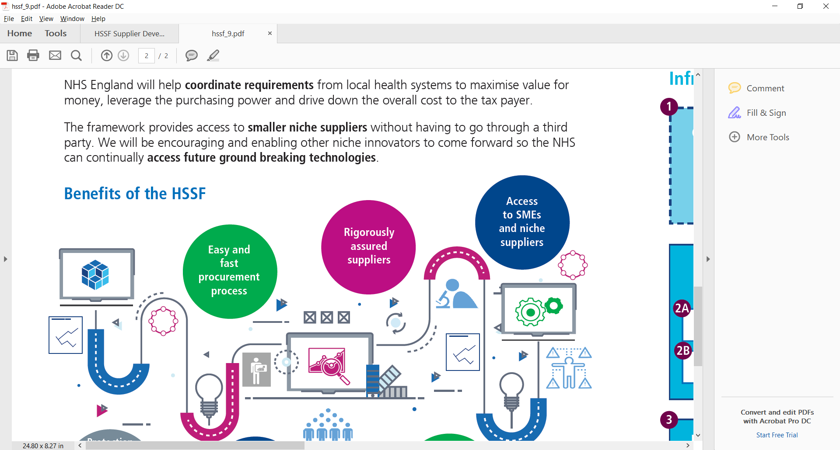
3 I’s – building capability for population health management
      Infrastructure
      Intelligence
      Interventions
What are the basic building blocks that must be in place?
Organisational Factors such as dedicated system leadership and decision making on PHM
Digitised health & care providers and common health and care record
Integrated data architecture and a single version of the truth
Information Governance that ensures data is shared safely, securely and legally
Opportunities to improve care quality, efficiency and equity
Supporting capabilities such as advanced analytical tools and software and system wide multi-disciplinary analytical teams, supplemented by specialist skills
Analyses - to understand health and wellbeing needs of the population, opportunities to improve care, and manage risk
Interpretation of the data and analyses, to work with and advise providers and clinical teams
Care models focusing on proactive interventions to prevent illness, reduce the risk of hospitalisation and address inequalities
Care model design and delivery through` integrated personalised interventions tailored to population needs
Community well-being - asset based approach, social prescribing and social value projects
Workforce development - upskilling teams, realigning and creating new roles
Incentives alignment – value and outcome based contracting

Slide 5
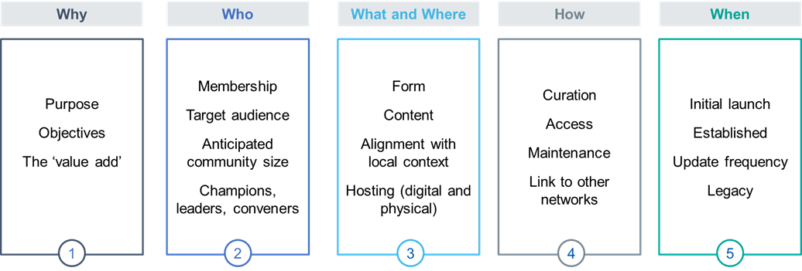
What do I need to consider when establishing a Community of Practice?
It is important to review if any other forums exist that serve a similar purpose to avoid duplication
Focus on what would be of most benefit for those who will be part of it - involve these people directly in the design and build momentum for it to be locally led as well if possible. A user led and locally maintained Community of Practice (CoP) is likely to be more effective than a centrally provided and maintained offer which may not be the right fit for those involved. The following design questions may be useful to consider when establishing a CoP with local leads.
The design questions set out below may be useful to work through when working to establish a community of practice. It is important to remember whilst the design process can be facilitated, it should be user led to ensure the community of practice can meet the needs of its members.

Slide 6
Considerations
Plan
Create
Curate
Review and evaluate
Consider and confirm the need, test with others
Set out the initial aim (the why) and likely participants (the who) and consider frequency
Identify related groups and check they
don’t already meet your need. Think from an member perspective will an additional forum be good use of their time
Identify which platform you will use to deliver the CoP
Build a core team to help with delivery, consider carefully the roles of
  Co-ordinator / convener / senior advocate
  Information and knowledge management lead
  Admin support
Develop a draft charter for the group, see template here, and also in the Gardner’s Guide to CoPs – this covers the why, who, what and how of your CoP.
Use Q’s CoP Top Trumps and the pre-launch checklist in the Gardner’s Guide to identify gaps in your charter
Consider what digital tools will support the CoP - use HEE’s Online Platforms for CoPs
Find and welcome members, leverage related groups
Start sharing resources that support the aim and focus topic of the CoP, for example
  host an expert development session
  hold a workshop on a specific challenge and share outputs
  share best practice materials you already have access to
  Set out a member list and areas of expertise.
See Q’s live streaming webinar tools guide if you host these online
Encourage member engagement/discussion on these, perhaps use external stimulus
Review and update the charter and roles
Ensure members, particularly new ones, are confident to participate and are doing so
Keep information sharing sections updated, removing or relocating materials if needed
Share success and progress, if the CoP is online, consider holding a physical meeting
Make sub-groups if your knowledgebase or community is becoming unwieldy
Conduct a health check (see the Gardner’s Guide) and refresh the charter if needed
Periodically review the CoP’s value. Does it need refreshing or bringing to a close?
Measure against the charter, use Google Analytics or ask members
If refreshing the CoP, consider re-scoping purpose, or joining with other groups
If closing, consider how to capture and share learnings effectively

Slide 7
Why might CoPs succeed, why might they fail?
SUCCESS
Identified strategic objectives
FAILURE FACTORS
Lack of focus/value for members
Strong leadership and a sponsor that champions PHM
Access to SME
No hierarchy pressures
Feedback and progress shared
Lack of a core, engaged group
Low level of 1-1 interactions
Agenda and discussion are not meaningful to members work
Intangible practice
Lack of strong enthusiastic leadership
A number of similar forums that have the same aims and objectives
*Drawn from experience of national CoP’s

Slide 8
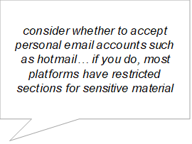
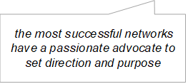
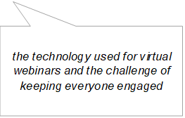
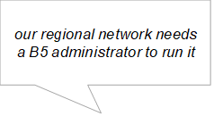
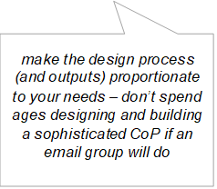
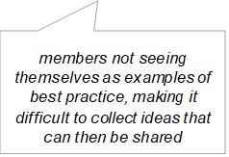
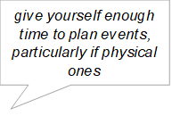
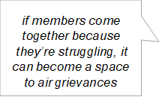
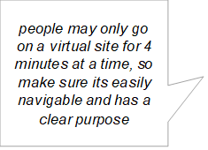
Reflections from those that have established communities of practice
On setting up a community of practice
On managing and maintaining a community of practice
On the challenges

Slide 9
CoP resourcing considerations
Recommended internal resourcing based on previous CoP’s
Role | Recommended WTE (approx) | Key Responsibilities to include
SRO | .05wte ( ½ day needed the week of COP to attend and brief) | To act a s a key internal stakeholder and consult with wider team members (Inc. senior leadership) to inform/influence; Agenda Themes Intended outcomes Identifying key note speakers Final agenda sign off Final costing sign off Attending COP events if required Signing off content development (blogs, vlogs etc) on Regional Academy site
Lead Facilitator | .1wte ( 1 /2 hours per week, 1 day will be needed the week of the event to brief and facilitator at the COP) | Liaising with SRO in regards to agenda Briefing of key note speakers and SRO prior to events Identifying and liaising with key note speakers to invite to speak Lead facilitator of the COP Identifying opportunities of comms development for the Regional Academy site
COP Programme manager | .2wte (1 day per week) | Project management of COP Joint working with Lead facilitator and SRO Liaising with any key note speakers to arrange attendance Project management of the regional PHM Academy site
BSO | .2wte around (1 day per week, could be two days the week of the COP) | Sending out communications regarding COP Updating invite lists (checking with SRO that the right stakeholders are engaged) Sending on communications post COP Administration of the PHM Academy site
Breakout Facilitators | .1wte Main requirements are on the day of the COP | Facilitating breakout rooms on the day of COP Providing write ups of the break out discussion Write up any break out notes facilitating the COP and just before the COP to agree breakout duties with the lead facilitator
Comms Lead | .2wte | Link between COP team and any regional comms to ensure meetings to ensure meeting don’t clash

Slide 10
Where can I get ideas from? Examples of existing CoPs
 | CoP | Purpose (why) | Membership and scale (who) | Form, content and delivery (what, where and how)
National (NHS) | Population Health Management (PHM) Academy and CoP sessions | To spread and share learning on PHM | 3000 members on PHM academy 100-200 joining ‘CoP’ sessions Originally was only by invitation, now open to all | National PHM Academy hosted on NHS Futures, with blogs, national guidance and e-learning links. The team also delivered ‘CoP’ sessions (now online following COVID) that shared PHM best practice and are saved on the site. The site also hosts local PHM academies – e.g. Midlands.
 | Elective Care Transformation Programme’s Community of Practice | To share knowledge and materials, and collaborate more effectively | 2,500 members Largely open access | Hosted on NHS Futures. Holds case studies, toolkits, pathway examples. Monthly newsletter and forum – shares national webinars. Full time admin handles queries, site admin and content curation.
 | Mental Health System Improvement Network | To support learning about emerging and future demand and capacity implications for mental health | 400 members | Online, hosted on NHS Futures. Contains webinars, system maturity tools and modelling/optimisation tools.
Regional (NHS) | Sustainable Development Unit’s Regional Networks | To embed sustainability locally | Size varies by network NHS, PHE or LA staff in region | Supported by the SDU: Northern Region - google group and emails for members to get answers to questions, network ran by Public Health Registrars, yearly central event. Midlands Region – independent website with case studies, local network links etc. Involves face to face and virtual meetings. Southern Region – KnowledgeHub
 | Respiratory Community of Practice for the East | Connecting people, enabling the sharing of activity, learning and approaches to service improvement. | 100 members East region | Provides a space for questions and resource sharing. Managed on NHS Networks
 | Four focussed CoPs within South East London Cancer Alliance | Varies by CoP, for patient involvement - to develop a vision for patient involvement, initiate projects and identify gaps. | 15 to 30 members All working in cancer pathway | Series of CoPs started through and supported by the Health Innovation Network (e.g. who also initiated the London Diabetes in Pregnancy CoP accessed here) The cancer CoPs each have their own convener and specific aims. See here for details.
Non-NHS examples | Q communities – Measurement for Improvement | To bring together guidance, analytical templates and academic publications in one place to support sharing knowledge and experience between members. | 300 members Email-to-access | Hosted by the Health Foundation as part of their Q community (which hosts many networks and CoPs). Provides a forum for questions, sharing news on events and links to a Kahootz site for uploading materials.
 | Inclusive and sustainable economies group | To support place-based action on inclusive and sustainable economies | 250 members Open to NHS, PHE and LA staff | Hosted on KnowledgeHub, facilitated by the National Health Inequalities team at PHE. Regular updates, shared resources and group polls – including monthly webinars.
 | Healthy Aging Challenge CoP | A learning community for members to collaborate, problem-solve and share their expertise, learnings and insights. | Unknown size Open to all, including research partners | Run by the Centre for Ageing Better. Core members funded Healthy Aging Challenge Dedicated website including a resource library, events and newsletters

Slide 11
PHM Academy and Regional Academies
PHM Academy
A shared workspace for colleagues across the country to learn more about PHM, to share experiences and lessons learnt the PHM Academy can support systems to;
Learn about PHM and why its important for systems
Find key documents and resources about PHM development
Chat with colleagues across the country in the PHM discussion forum
Use how to guides on core PHM capabilities
Keep up to date with the latest news
Regional Academies
A shared workspace developed and managed by regions to support regional colleagues to learn more about PHM, share experiences and lessons learnt. Regional Academies can be used by regions to;
Share upcoming regional events
Link to useful regional websites
Host useful documentation to be shared across the region
Hold webinar recordings to be accessed and shared
The Midlands, Lancashire and South Cumbria and East of England have set up Regional Academies and are developing as they move forward with PHM

Slide 12
Useful resources
Regional COP support meetings (Monthly starting on the 25th February 2021)
NHSE/I Relationship Managers can support with providing SMEs to give an overview of PHM for the ‘launch’ of regional CoP’s’
NHSE/I PHM Academy
PHM Academy- CoP Resources for systems
NHS Scotland Building a CoP
NHSE&I Cooking up a CoP
Q’s CoP Support Toolkit
HEE Effective Networks
National Voices Enabling Change through CoPs
PHM Academy- CoP Resources for systems
National CoP Resources for internal use
National Voices Enabling Change through Communities of Practice
HEE Effective networks and Online Platforms for Communities of Practice
Scottish NHS Knowledge Network Communities of practice and how to build them
NHS Leadership Academy Communities of Practice for System

Slide 13
Useful logistics resources
Multiverse guidance
Mentimeter guidance – PHM Team preference over Slido for interactive audience participation and evaluation and can be shared afterwards
Slide deck templates (annex)
System Transformation Events, Products & Tools page on SharePoint

Slide 14
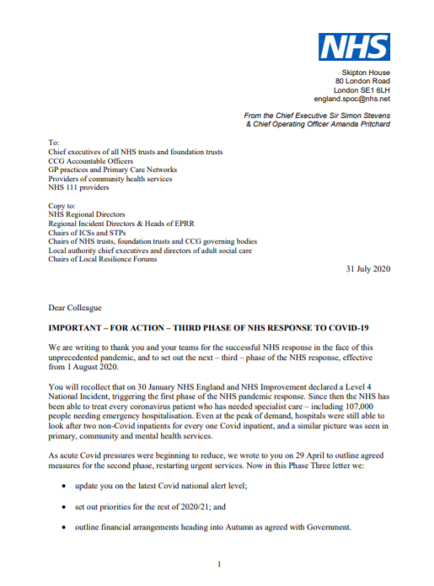
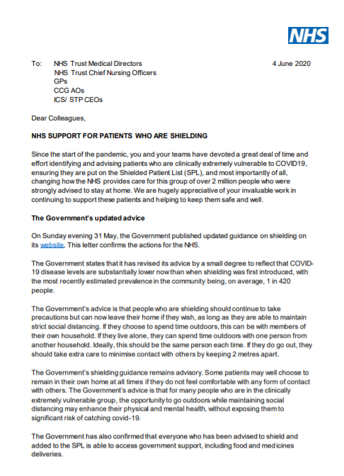
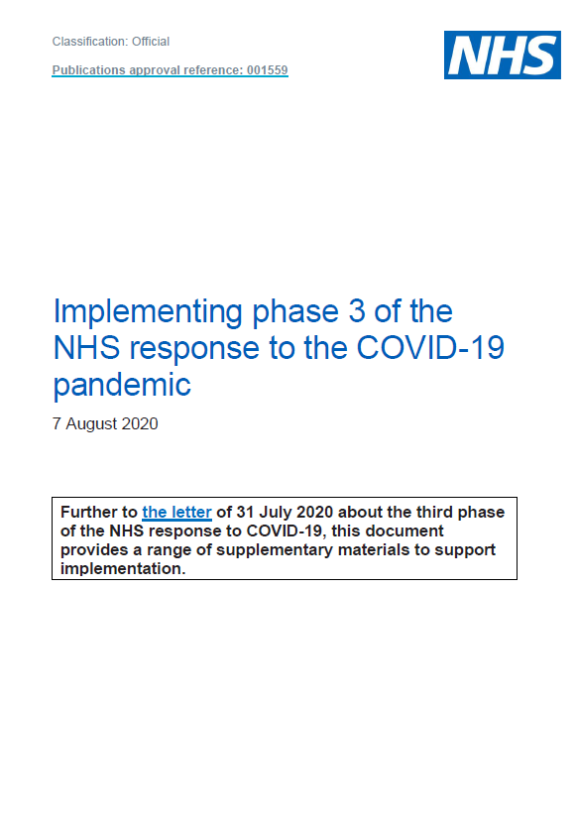
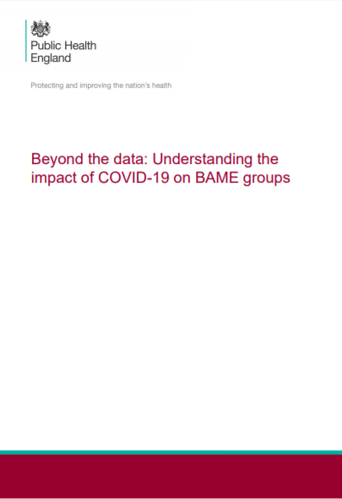
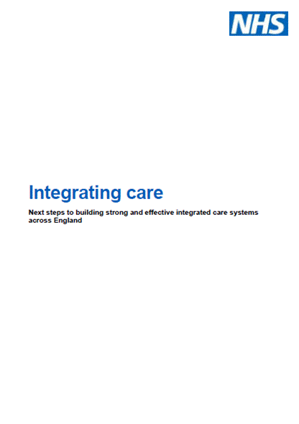
Effective population health management is a common theme across current system priorities
Current system priorities – vaccination programme, ongoing management of COVID-19 (including managing those at highest risk), Phase 3 recovery, and PHE’s recommended actions for addressing health inequalities all emphasise the need for for good data, effective risk stratification and service prioritisation, collaboration across Local Authorities and Voluntary Sector, interventions tailored to population needs, a focus on place, prevention, addressing wider determinants and more effective disease management.

Slide 15
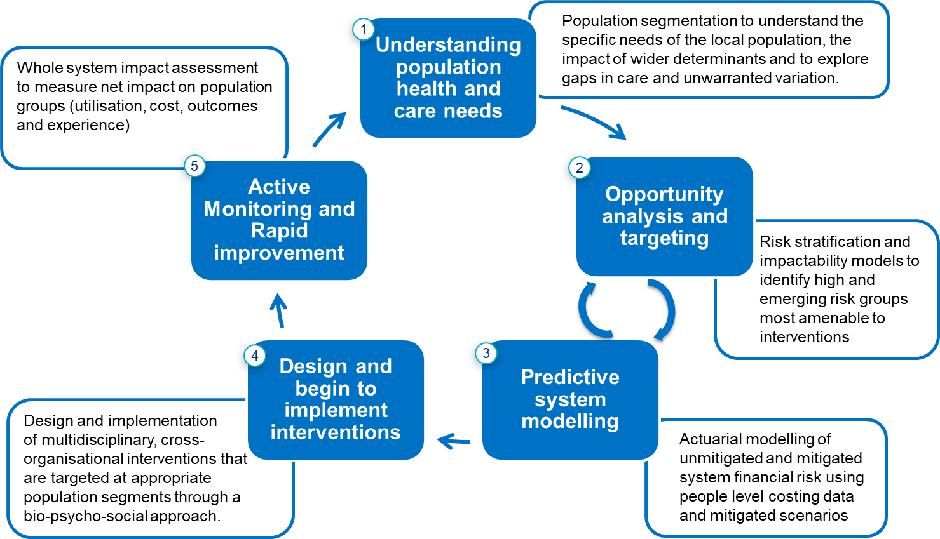
What is Population Health Management?
Population Health…
… is an approach aimed at improving the health of an entire population.
It is about improving the physical and mental health outcomes and wellbeing of people, whilst reducing health inequalities within and across a defined population. It includes action to reduce the occurrence of ill-health, including addressing wider determinants of health, and requires working with communities and partner agencies.
Population Health Management is about:
Using data-driven insights and evidence of best practice to inform targeted interventions to improve the health & wellbeing of specific populations & cohorts
The wider determinants of health, not just health & care
Making informed judgements, not just relying on the analytics
Prioritising the use of collective resources to have the best impact
Acting together – the NHS, local authorities, public services, the VCS, communities, activists & local people. Creating partnerships of equals
Achieving practical tangible improvements for people & communities
Population Health Management…
…improves population health by data driven planning and delivery of proactive care to achieve maximum impact.
It includes segmentation, stratification and impactability modelling to identify local ‘at risk’ cohorts - and, in turn, designing and targeting interventions to prevent ill-health and to improve care and support for people with ongoing health conditions and reducing unwarranted variations in outcomes.

Slide 16
Ground Rules
Delegate attendees will be auto muted on entry
Only facilitators/ speakers will be able to unmute themselves in the main room
Facilitators/ speakers please make sure to mute after your presentation
Please only turn on your camera if you are presenting as this will save bandwidth
Please use chat function for questions and tech support
We will be writing up a Q&A doc that will answer all Qs that come through on the chat so if not answered during session please do not worry this will be circulated after the CoP
Get ready to use www.menti.com for engagement and feedback

Slide 17
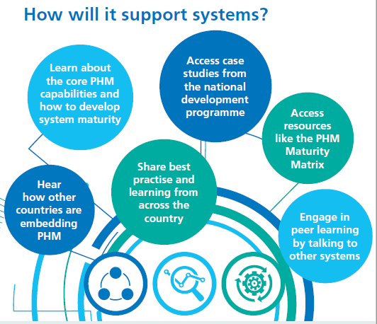
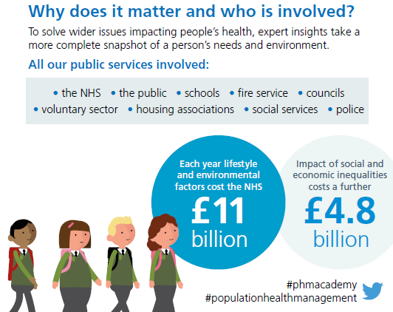
What is the Population Health Management (PHM) Academy?
The Population Health Management (PHM) Academy is the most up-to-date and inspirational hub of information around PHM approaches and on-going work for the NHS and its partners.

