Slide 1
PERSONALISED CARE FOR LONDON
Putting the Personalised Care DES spec in action:
Co-producing a Proactive Social Prescribing Service
@SP_LDN
hlp.socialprescribing@nhs.net

Slide 2
PCN Support
Purpose of the team:
Supporting PCNS to successfully embed the three, personalised care roles (Social Prescribing Link Workers, Health & Wellbeing Coaches and Care Coordinators) to effectively tackle health inequalities and support primary care
Build a network of those that employ or are working to embed the three personalised care roles in their work, facilitating a community of practice across London
Dr Hina Shahid
Hina is a Portfolio GP in North West London and has a background in Public Health. She has worked in the VCSE sector for 15 years in community engagement, outreach and health inclusion, and health systems strengthening in the UK and internationally and working as an associate with the HLP Health Inequalities team
Lianna Martin
With over 20 years experience in the VCSE and social enterprise sector developing projects and partnership, Lianna has spent at the Bromley by Bow Centre and spent a couple of years supporting the network of SPLWs across London and is a Programme Manager at HLP in the Health Inequalities, Personalised Care team supporting the NHS to address social determinants of health.
Jenny Brooks
Jenny is a health inequalities project manager in the social Prescribing team at Healthy London Partnership. As well as PCN support, she managers the Social Prescribing Innovators Programme. Her background is in data analytics and service improvement in the NHS, with particular interest in population health management and partnership working.
@SP_LDN
hlp.socialprescribing@nhs.net

Slide 3
The PCN advisor offer
A monthly, pan London ‘Connect and Share’ session for those that employ and/or are looking to embed the three personalised care roles in their PCN: themed and open sessions with presentations of good practice case studies across London plus time for Q&A and discussion.
Thu 18th November 12.30pm: Embedding the three personalised care roles. RECORDING HERE
Thu 13th Jan 2022, 12.30pm: Open session (workshop) exploring different ways personalised care roles can support primary care and communities at this time: Slides here.
Feb 2022: Spotlight on Care Coordinators and how best to use them (Wed 16th Feb 3pm) Recording and slides here.
Mar 2022: Spotlight on Health and Wellbeing Coaches and how best to use them Recording and slides here.
Apr 2022: Population health and the PC ARRS roles: Recording and slides here
June 2022: Coproducing a proactive social prescribing service. Recording and slides here.
1-1 support – every Wednesday there will be 30 minute slots available to….
Ask questions, explore challenges, think through strategies to use the personalised care roles, get advice on resources or peers to connect with.
Book in via the following link: https://calendly.com/pcn-advisors-london/30min.
Available to present at meetings: The PCN advisors can come and speak at PCN or CCG meetings with CDs, PCN or ARRS managers on topics such as embedding the personalised care roles, social prescribing, how the roles can tackle health inequalities. Email us: hlp.socialprescribing@nhs.net
WhatsApp group for those that employ and/or are looking to embed the three personalised care roles in their work to connect with each other informally. We have set this up and trial and see if it is useful. We’re open to suggestions on alternatives but for now you can join the group. Use this THIS LINK to add your details and access the group.
We also hope to :
Send a monthly email with updates, resources, answers to common questions being asked, useful events and so on
Communicate challenges up to NHSE and the wider system, developing ideas for projects that might usefully mitigate some of these challenges
Co-produced PCN toolkit & FAQ Guide including useful case studies

Slide 4
Plan for today...
TIME | ITEM
3.00 | Intro to the session, initial reflections
3.10 | Context of the DES spec Other important specs – HI, PCN HI leads, CORE20PLUS5 – Michelle Pilling Place based working, ICS formation
3.30 | PCN case study/example – engaging with the communities/stakeholders
3.50 | Action planning break out groups
4.10 | Sharing back with the group and summary
4.20 | Summary and close
It is an informal session – talk to each other & share resources in the chat
The presentations will be recorded & circulated with slides
@SP_LDN
hlp.socialprescribing@nhs.net

Slide 5
Where are we currently?
In the room….
Mix of PCN managers and leads, Social Prescribers, Primary care and personalised care delivery leads
Top 5 areas of support wanted
Information/models
Case studies, good practice and ways of working
Understanding the process/ practical framework
Clear expectations/requirements of the DES
Co-design/stakeholder/engagement/partnership support

Slide 6
What are the key actions from the spec?
Personalised care DES
2.1 Proactive Social Prescribing & community development
30 Sept – bring together VCSE, LA, community to co design targeted programme to increase access for a specific cohort with unmet need using:
Lived experience
Population health and inequality data
Social prescribing data
Set evaluation framework e.g. outcome measure and referral target (use SNOMED codes)
Recruit more or specialise link workers as needed
1 Oct – Deliver targeted intervention
22/23 – implement minimum dataset once launches
March 23 – extend to more groups based on population health approach and PCN capacity

Slide 7
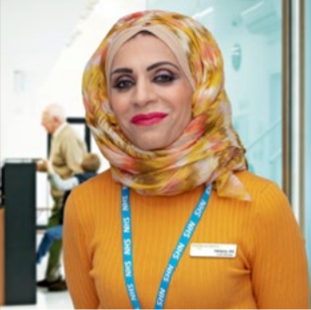
Implementing the Proactive Social Prescribing Service Specification
Michelle Pilling
Senior Lead, Social Prescribing
NHS England/Improvement
NHS England and Improvement Personalised Care Group
@Pers_Care
@PillingMichelle
Michlle.pilling@nhs.net

Slide 8
Social Prescribing - The NHS Long Term Plan
We will roll out the NHS Personalised Care model across the country, reaching 2.5 million people by 2023/24 and then aiming to double that again within a decade.
As part of this work, through social prescribing the range of support available to people will widen, diversify and become accessible across the country.
Link workers within primary care networks will work with people to develop tailored plans and connect them to local groups and support services. Over 1,000 trained social prescribing link workers will be in place by the end of 2020/21 rising further to 4,500 by 2023/24, with the aim that over 900,000 people are able to be referred to social prescribing schemes by then.

Slide 9
Number of SPLWs
Approx. 33% of those recruited under ARRS, are in a personalised care role. PCNs intend to increase this in Q4.
Social Prescribing Link Workers
2021/22 Number of Roles (FTE 2021) | Number of Roles (FTE) to end of 2021/22 (hiring ambitions)
2,527 | 2,554
Health & Welbeing Coaches
2020/21 Number of Roles (FTE 2021) | Number of Roles (FTE) to end of 2021/22 (hiring ambitions)
699 | 925
Care Coordinators
2020/21 Number of Roles (FTE 2021) | Number of Roles (FTE) to end of 2021/22 (hiring ambitions)
2,775 | 2,889
* PCNs recruitment intentions report for 2021/22 - Personalised Care Roles [28/09/2021]

Slide 10
Referrals – National Overview December 2021
Qtr 4 993,231 (GPES - cumulative number of individuals who have been referred to a social prescribing service since April 2019).

Slide 11
Social Prescribing DES
Network Contract DES B3.10.
A PCN must work in partnership with commissioners, social prescribing schemes, Local Authorities and voluntary sector leaders to create a shared plan for social prescribing which must include how the organisations will build on existing schemes and work collaboratively to recruit additional social prescribing link workers to embed one in every PCN and direct referrals to the voluntary sector.

Slide 12
Personalised Care Service Spec. 22/23
NEW for 22/23 – Personalised care service specification – proactive social prescribing element.
Aligns to the Tackling neighbourhood inequalities service specification.
Requirements for PCNs:
By 30 September 2022, as part of a broader social prescribing service, a PCN and commissioner must jointly work with stakeholders including local authority commissioners, VCSE partners and local clinical leaders, to design, agree and put in place a targeted programme to proactively offer and improve access to social prescribing to an identified cohort with unmet needs. This plan must take into account views of people with lived experience.
From 1 October 2022, commence delivery of the proactive social prescribing service for the identified cohort.
By 31 March 2023, review cohort definition and extend the offer of proactive social prescribing based on an assessment of the population health needs and PCN capacity.

Slide 13
Proactive Social Prescribing – community development Service Specification
To deliver the Proactive Social Prescribing aspects of the requirements, PCNs may wish to:
• Use Population Health Management (PHM) data and intelligence from Social Prescribing
services and the Health Inequalities Improvement Dashboard in conjunction with lived
experience to identify the patient cohort(s)
• Work collaboratively with local partners to inform service design for accessible and sustainable
provision for the patient cohort(s)
• Set targets for improved access and monitor performance against these; for example,
reviewing referral targets and outcome measures
• Utilise funding from the Additional Roles Reimbursement Scheme (ARRS) to increase service
capacity where available; including, if possible, recruiting specialist Social Prescribing Link
Workers with specific skills or knowledge for the patient cohort(s) identified
• Implement the national social prescribing minimum dataset, including demographic data
collection, when introduced in 22/23.

Slide 14
Anticipatory Care
Anticipatory care helps people to live well and independently for longer through proactive care for those at high risk of unwarranted health outcomes. Typically, this involves structured proactive care and support from a multidisciplinary team (MDT). It focuses on groups of patients with similar characteristics (for example people living with multimorbidity and/or frailty) identified using validated tools (such as the electronic frailty index) supplemented by professional judgement, refined on the basis of their needs and risks (such as falls or social isolation) to create a dynamic list of patients who will be offered proactive care interventions to improve or sustain their health.
Anticipatory care is intrinsically linked to population health management models developing and already in place in systems across the country. The service focuses on the “rising risk population”, comprising those with multiple long-term conditions and/or frailty, who may have underlying risk factors like unhealthy lifestyles, behavioural risks, social isolation or poor housing. Addressing many of these risk factors will require non-clinical interventions and strong working relationships with local voluntary, community and civic groups, as well as system public health teams.
By 30 September 2022, a PCN must agree a plan with their ICS and local partners (including acute, community and care providers), with whom the Anticipatory Care service will be delivered jointly.
By 1 October 2022, a PCN must have, in partnership with relevant local providers, commenced the operation of the service in line with the agreed plan.

Slide 15
Tackling Neighbourhood Health Inequalities (TNHI) Service Specification – overview
TNHI was designed to help meet the NHS commitment to address health inequalities. It is part of the 5-year package of interventions, set out in 5-year GP contract framework Investment and Evolution (July 2019) which set out new services that PCNs are expected to deliver, using additional workforce and funding afforded under the Network Contract. Since then, the NHS health inequalities agenda has further expanded in the shape of CORE20+5.
The requirements were phased in from 1 October 2021 – 1 March 2022 and are set out in the Network Contract Directed Enhanced Service (DES) (2022/23) and described in the supplementary guidance, and included:
From 1 October 2021
Learning Disabilities (LD) register health checks
Serious Mental Illness (SMI) physical check
Ethnicity recording
Health Inequalities (HI) lead
By 28 February 2022
Identification a population experiencing inequalities in health provision / outcomes, develop a plan to tackle its unmet needs
From 1 March 2022 service delivery commenced
Notes:
Notes on nominated payee:
Unlike the requirements over who can hold the Network Contract DES, the nominated payee does not have to hold a registered list and be delivering an essential primary medical services contract. The nominated payee must, however, hold a primary medical services contract (GMS, PMS or APMS) and be party to the Network Agreement.
An APMS provider (including a provider who holds a hybrid NHS Standard Contract that is delivering primary care services under a Schedule 2L arrangement) can therefore be a nominated payee, even if they do not hold the Network Contract DES. As such, it is possible that a GP Federation holding an APMS contract for extended access or improved access (or another reason), could be nominated as the payee if all the core PCN GP practices agree. It also means that the same GP Federation could be nominated to be the payee for more than one PCN.

Slide 16
TNHI – Health Inequalities lead
PCNs leads for tackling health inequalities within the PCN should now be in place and will provide a named, visible point of contact for health inequalities issues in the PCN.
Components of the role include:
developing and sharing knowledge and understanding of the local health inequalities;
championing progress on nationally defined priority targets;
advocating for resources to be targeted at those populations with the most pressing needs;
supporting the development of strategies within the PCN and the wider health system to recruit to Additional Role Reimbursement Scheme (ARRS) roles which support work to address health inequalities; share learning within and between PCNs
Promoting awareness of the CORE20+5 agenda
The HI lead will act as a focal point and champion for this work
Resources include
Health Inequalities eLearning modules via the RCGP Health Inequalities Learning Hub.
Health Anchors Learning Network
Targeted support from NHS England’s Health Inequalities Improvement team
Notes:
Notes on nominated payee:
Unlike the requirements over who can hold the Network Contract DES, the nominated payee does not have to hold a registered list and be delivering an essential primary medical services contract. The nominated payee must, however, hold a primary medical services contract (GMS, PMS or APMS) and be party to the Network Agreement.
An APMS provider (including a provider who holds a hybrid NHS Standard Contract that is delivering primary care services under a Schedule 2L arrangement) can therefore be a nominated payee, even if they do not hold the Network Contract DES. As such, it is possible that a GP Federation holding an APMS contract for extended access or improved access (or another reason), could be nominated as the payee if all the core PCN GP practices agree. It also means that the same GP Federation could be nominated to be the payee for more than one PCN.

Slide 17
TNHI – meeting unmet needs of a population – identify a population
A PCN must identify a population within the PCN experiencing inequality in health provision and/or outcomes and develop a plan to tackle their needs.
PCNs must work collaboratively across their locality and system to identify the population to be supported by the service engaging by commissioners and local/regional data teams to use data and intelligence systematically to identify this population.
Public Health teams in local authorities, and analytical teams in CCGs, can supply further intelligence to inform the selection of the population – especially via the fingertips tools.
The Health Inequalities Improvement Dashboard (HIID) brings together a range of indicators to help users, from national to local level, understand where health inequalities exist in their area; what is driving these inequalities; and what local insights and actions they can take to drive improvement.
Priority Wards (contained within EHI RightCare Packs) will be added to the dashboard which will include quarterly data identifying Priority Wards together with the top 10 conditions for each ward and place.
The 'Core20' and 'PLUS' target population components of the Core20PLUS5 approach should guide PCNs in population identification.
Notes:
Notes on nominated payee:
Unlike the requirements over who can hold the Network Contract DES, the nominated payee does not have to hold a registered list and be delivering an essential primary medical services contract. The nominated payee must, however, hold a primary medical services contract (GMS, PMS or APMS) and be party to the Network Agreement.
An APMS provider (including a provider who holds a hybrid NHS Standard Contract that is delivering primary care services under a Schedule 2L arrangement) can therefore be a nominated payee, even if they do not hold the Network Contract DES. As such, it is possible that a GP Federation holding an APMS contract for extended access or improved access (or another reason), could be nominated as the payee if all the core PCN GP practices agree. It also means that the same GP Federation could be nominated to be the payee for more than one PCN.

Slide 18
TNHI - Population Health Management approach
Population Health Management (PHM) uses joined up information from across health and care partners to understand which factors are driving health inequalities and poor outcomes to support redesign of care for at risk groups.
The PHM Academy on FutureNHS helps systems get started with PHM and learn about the core capabilities using e-learning materials, case studies and more:
https://future.nhs.uk/populationhealth
Notes:
Notes on nominated payee:
Unlike the requirements over who can hold the Network Contract DES, the nominated payee does not have to hold a registered list and be delivering an essential primary medical services contract. The nominated payee must, however, hold a primary medical services contract (GMS, PMS or APMS) and be party to the Network Agreement.
An APMS provider (including a provider who holds a hybrid NHS Standard Contract that is delivering primary care services under a Schedule 2L arrangement) can therefore be a nominated payee, even if they do not hold the Network Contract DES. As such, it is possible that a GP Federation holding an APMS contract for extended access or improved access (or another reason), could be nominated as the payee if all the core PCN GP practices agree. It also means that the same GP Federation could be nominated to be the payee for more than one PCN.

Slide 19
Context
The 2019 NHS Long Term Plan (LTP) set out key commitments to accelerate action to prevent ill health and tackle health inequalities.
2.26. To support local planning and ensure national programmes are focused on health inequality reduction, the NHS will set out specific, measurable goals for narrowing inequalities, including those relating to poverty, through the service improvements set out in this Long Term Plan.
NHS England, working with PHE and our partners in the voluntary and community sector and local government, will develop and publish a ‘menu’ of evidence-based interventions.
2. The NHS 2021/22 Operational Planning Guidance asked systems and providers to focus on five priority areas for tackling health inequalities, which have set the system-wide context for Core20PLUS5. This focus on health inequalities was re-emphasised in the 2022/23 Operational Planning Guidance
3. COVID-19: The disproportionate impact of the pandemic people from the most deprived areas, ethnic minority communities, and other vulnerable groups, has highlighted now more than ever the urgent need to tackle health inequalities.

Slide 20
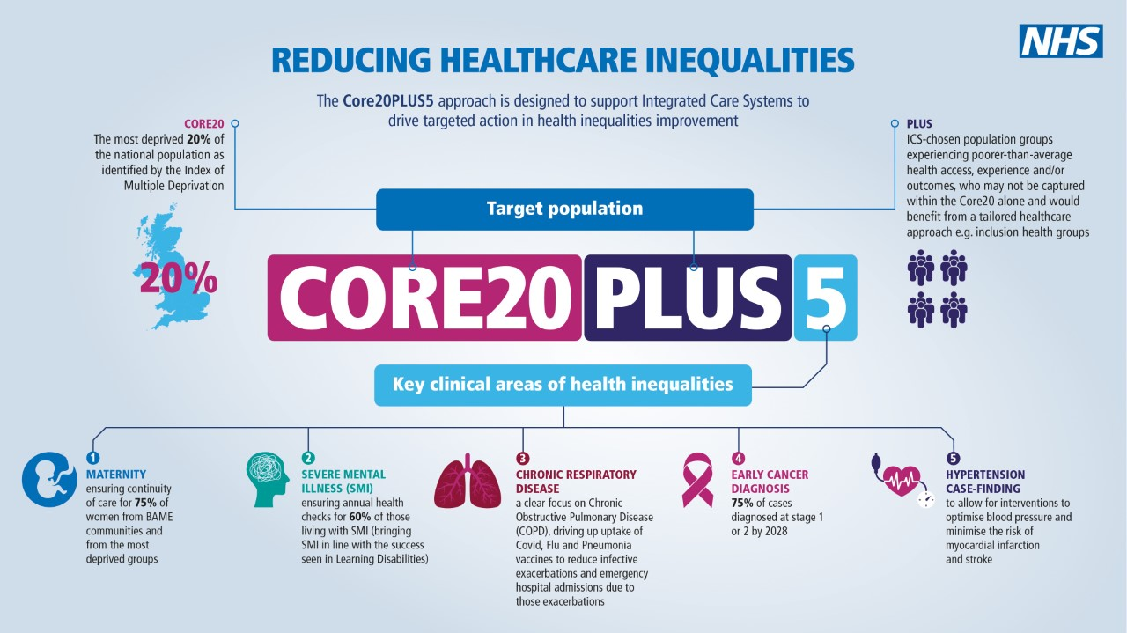

Slide 21
Core20PLUS5: A Focused Approach
Core20PLUS5 offers ICSs a multi-year and focused delivery approach to enable prioritisation of energies and resources in the delivery of NHS LTP commitments to tackling health inequalities within the existing funding envelope.
Role of Social Prescribing is paramount to people & communities
FOCUS
The Health Inequalities agenda is broad: we recognise we can’t ‘do it all’ immediately
In identifying the NHS contribution to the wider system effort to tackle health inequalities, we recognised the need for a focused approach for tackling health inequalities
This focused approach enables us to gain traction thus demonstrating impact in reducing health inequalities
TRACTION
IMPACT

Slide 22
Quality Improvement Methods
Core20PLUS5 will be driven by QI methodology, including:
Strengths-based approach:​
Identify Exemplars​
Build from strength​
Co-Production:​
Engaging Communities in design, implementation & evaluation.​
Genuinely listen with curiosity
Data-driven Improvement – Creating virtuous circles of data generating actionable insight which then drive interventions to bring about improvement thus generating intelligence about what works

Slide 23
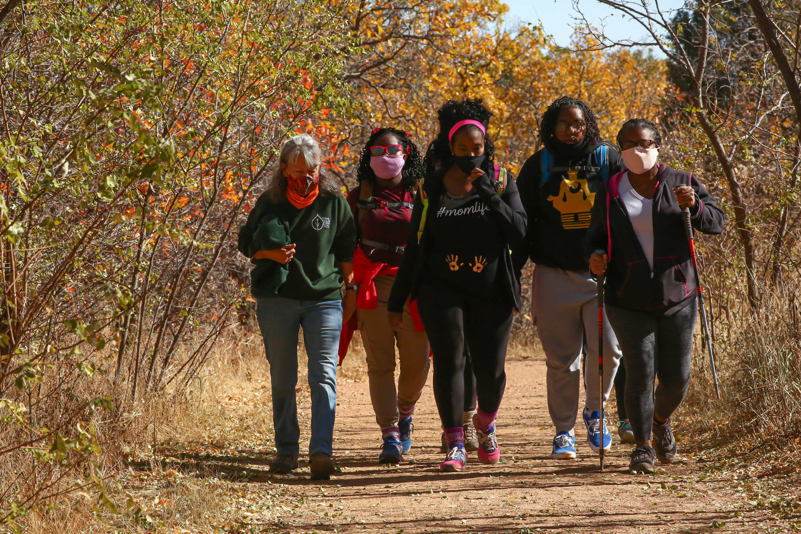
Proactive Approaches to Social Prescribing
SPLWs support PHM approaches through proactive case finding of people and cohorts experiencing inequality in access to and outcomes from services, including inclusion health groups and high intensity users
Also support with proactive outreach – identification and support of people who don’t usually attend primary care, reaching out to prevent ill-health and target undiscovered health needs.
Proactive targeting within the community to identify people and cohorts experiencing inequity of quality, access and outcomes from services, such as inclusion health groups
Work proactively with communities to discover hidden needs, engage with communities to identify solutions, and support the community to deliver sustainable and accessible support offers, reducing demand on GP services
Collect data on social and environmental factors affecting people’s health, enhancing GP population knowledge

Slide 24
Growing the Workforce Specialist Roles
Children and young people’s social prescribing service: Stort Valley and Villages PCN
Reducing the number of young people referred to secondary mental health care through social prescribing within primary care.
In 2019, practices within Stort Valley and Villages Primary Care Network (PCN) sought a new way to provide mental health support to children and young people at a time when CAMHS and other tier 2 services were overwhelmed. They developed a children and young people’s social prescribing service (CYPSPS) to tackle the wider determinants of health and reduce the number of young people being referred to secondary care by supporting them within primary care

Slide 25
In Practice – Health Inequalities
In Bristol, the local social prescribing scheme employs a link worker specifically to engage with South Asian communities in an ethnically diverse inner-city area.
This approach has helped to engage with the elderly population in this group, who have not historically accessed welfare and advisory services, or wider community assets, which has compounded social isolation and the impacts of health inequalities experienced by this group.
Through this approach, people have been supported to engage with statutory services to maximise the support they can receive (i.e. housing benefit and universal credit) and access services and groups through informal translation services provided by the link worker.
The link worker has also worked with local VCSEs to identify gaps in provision and support delivery; for example, women’s peer support groups for mental health.

Slide 26
PHM and Proactive Social Prescribing
Stakeholder engagement
Targeted programme
Proactive Social Prescribing
Review
Creating opportunities for patients to receive the best possible support locally, to identify gaps in local provision, working with existing or new community groups to create services that bridge the gap. Community based support include services located in the voluntary, community and social enterprise (VCSE) sector, such as allotment groups, walking groups, choirs and activities that promote mental and physical wellbeing.
Started by linked primary and secondary care data. From 32,000 PCN population, identified 116 patients living with heart failure with high deprivation index scores, and after assessing their care records found 37 people who could benefit from being reviewed by either a social prescriber, a care co-ordinator, a GP, pharmacist or heart failure nurse
Jane had heart failure, diabetes, schizophrenia, learning difficulties and a thyroid problem. She frequently called GP out of hours or 999 whenever she needed health advice. She was overweight, and got breathless after walking a very short distance. Any exertion made her dizzy, so she was falling over quite regularly but she didn’t want any walking aids. She had generally poor eyesight – related to her diabetes – but hadn’t had a recent eye test.
She has not called 999 or the GP out of hours since the team made contact. Her self-assessed outcome scores have improved and she says she feels fantastic now her home has been redecorated, she’s eating better, able to get out more and feeling less isolated. Thanks to the PHM project, they were able to get a clearer picture of Jane’s situation and make sure she got the extra support she needed.
Titan PCN Bedfordshire, Luton and Milton Keynes ICS social prescribing case study

Slide 27
In Practice – Jane’s Story (PHM)

Slide 28
Context of the spec
PCN Health Inequalities Supplement
PCN responsibilities. The PCN health Inequalities lead is responsible for coordinating this.
Identify populations experiencing HI
Engage these communities
Develop a plan by 28 Feb – what intervention is to be delivered and how the outcome will be measured (must add value on top of other DES specifications)
Proposed activities – these are only suggestions
Develop knowledge, data intelligence e.g. dashboards and PHM tools
Progress national targets related to HI (e.g. ethnicity recording)
Advocate for targeting of resources at PCN and system level for specific groups
Recruitment of ARRS to tackle HI
Partner anchor systems to enhance the soc determinants of health
Champion equitable recruitment and staff practices
Share learning across PCNs to deliver HI objectives
Training
The end of the document outlines training and support for PCN HI leads

Slide 29
Context of the spec (2)
ICS formation and integration
Enhanced health in care homes
Waiting well
VCSE, anchor organisations
Importance of place based working to tackle major priorities
Population health
Tailoring to local needs
Reducing health inequalities
Prevention and the social determinants of health
Non clinical and connector roles

Slide 30
Example: NWL – Brompton PCN
Set up
Accessed CCG support for setting up service
Build on good practice and existing relationships from COVID-19 with Local Authority Foodbanks (from regular multistakeholder engagement groups)
Health need identified by food bank – due to existing relationship
Brought together key stakeholders in a working group to plan
(SPLW, Lead SP GP, LA - food banks, OneYou service - outreach BP/healthy lifestyle service)
Targeting multiple aspects of health inequity – SPLW sitting in food banks
Improving access – registering unregistered population
Improving acceptability – Starting with offering a blood pressure check to get talking and see what other support may be needed
Social determinants – getting referrals to social prescribing from those impacted by cost of living crisis and may not present to GPs
Diagnosis of high blood pressure – Opportunistic BP checks with OneYou

Slide 31
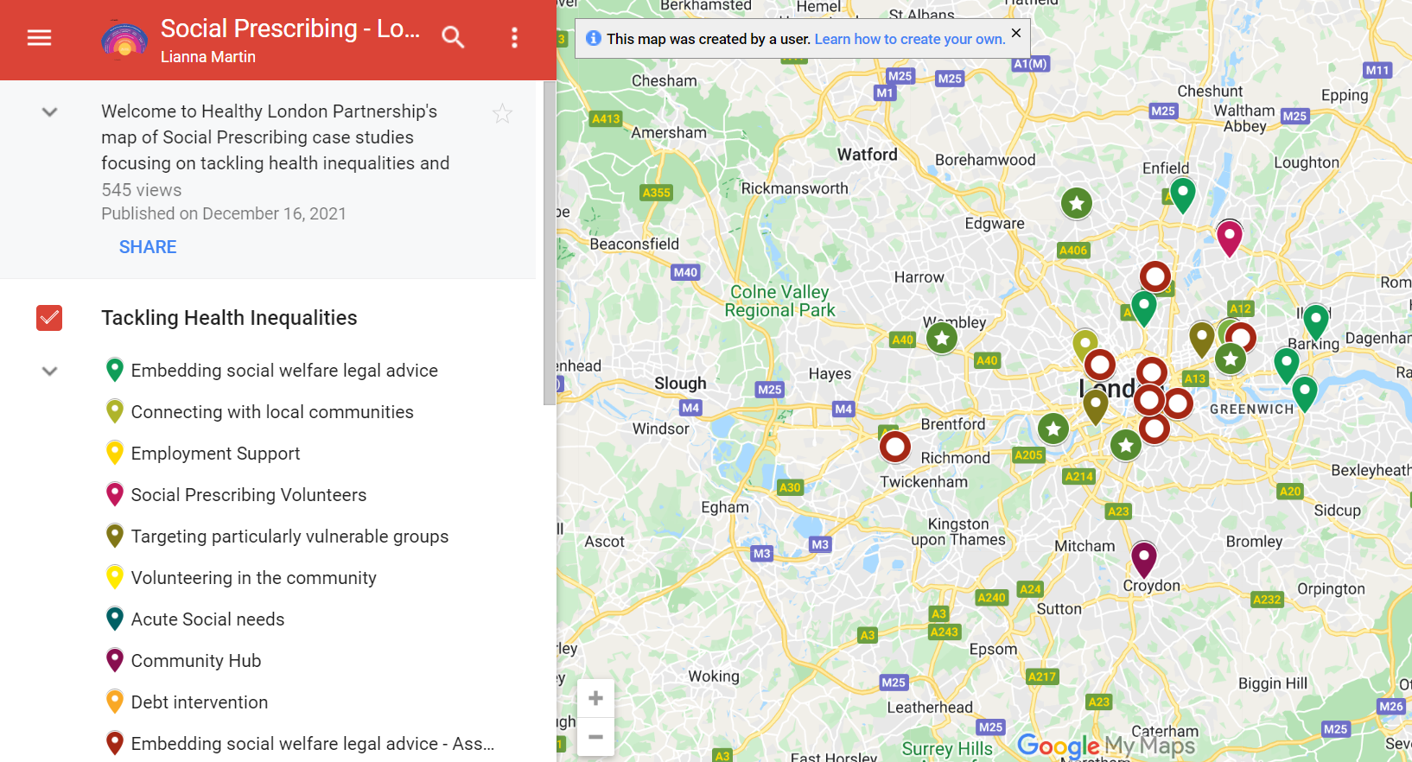
Examples of proactive SP in London
MAP HERE

Slide 32
What could the next steps look like?
Who has a stake in this work – Who you rally together for this work? – in your PCN, borough and wider, ARRS
Mapping assets as a group– what people, resources, meetings, data, networks, anchor VCSE can I engage with that are already present?
Who can do what? Can you set up a working group? Can you designate leads for these three areas:
Lived experience
Population health and inequality data
Social prescribing data
Brainstorm ways to access, analyse and draw insights from the three information sources, for example
An analysis of SP access: Who is currently accessing the SP service? Who is not? What health inclusion groups does the service see?
Local needs assessment: What are the local health issues? Is there a high burden of a particular condition? Or is there a particular impact of a specific social determinant? Is there evidence for increased GP or acute utilisation among specific groups?
Lived experience mapping: What does the community understand to be its key issues? How are these impacting health and social determinants? Where can SP help?

Slide 33
Action planning
What are your next steps? (20 mins)
You may want to think about:
- Who has a stake in shaping and delivering this piece of work that I might / should consult (individuals and orgs both inside and outside of the PCN)?
- What assets do we have access to that might help deliver this work (venues, existing meet ups, data, staff etc)?
- What are the practical next steps we can take?
- What support regionally would be useful?

Slide 34
Feedback from breakout rooms
Hounslow
Looking at patients with respiratory difficulties in Hounslow – working with this group called ‘Respiratory group’ so working with PCN to convince them to engage. Show them this is needed, PCN pilot now to generate referrals.
Support from region – document – requirements from DES spec in a structured way, to show clinical directors, to allow work to go ahead.
Workshop- thinktank group in Jul, council and mental health team – collaboration with them. How can we discuss this work with them, council is on board with collaborating.
Nottingham
Most deprived patients – get into work, signed off, into system, goes around in circles. Working with job centre, DWP, engaging other community groups e.g. faith groups, fayres, community group and GP fed – data aspect, police, council referring in, local VCSE
Capture data proactively by SPLWs, if a clinician indicates fit note, flag on system, SPLW calls them about housing issues.
Run local reports – 66k patients in patch, aiming to hit 97% of them – interaction with them, had some support needed
Engaging PPG group- feedback and support. 3 levels of data collection – CCG, SPLWs, patient groups
Quarterly review meetings. Can share SOP
Stratford
SPLW call patients with repeat fit notes – so could be a piece of work for us too
In Newham working across the borough and each PCN doing own project. Should we be extending the HI project cross-borough? Or pick a new cohort.
Bromley by bow
We’re more focused on PCN level projects that cross borough
More specialist orgs work usually at borough
Example: Postcode breakfast – E1,E3,E2 – quarterly or more frequently – SPLW convene the breakfast – collab with VCSE, local authority. Then borough level work can go to all of these, understand what might be wanted across all PCNs in the boroughs. Also allows all the organisations t connect better with each other.

Slide 35
Feedback from breakout rooms (2)
Assets available:
Who:
Charities
Other SPLWs
Other ARRs e.g. lead pharmacist
CD/Clinical leadership
Fellows
EMIS/Data search people e.g. clinical coding, GP fed, receptionist
Homeless teams/local authority
Council
Mental health services
What:
Directory of services (DOS)
Network of VCSE orgs
Social determinants data
Training on EMIS
Postcodes of rent arrears
Time
Specialist SPLWs
Checklists
Examples of other PCNS

Slide 36
Some other key enablers to think about
ARRS workforce – can you utilise the wider ARRS such as Care Coordinators and others in coordinating this work and engaging with patients?
Ringfencing time for community development for SPLW – do they have time to engage with communities, not just take referrals?
SPLW caseloads – do they have capacity for proactively identifying people to work with and fit these in? A caseload should be 200-250, as outlined in the IIF

Slide 37
The plan for PCN Support Sessions
In response to challenges we’ve heard from the bottom up, we are setting up a series to practically support you to tackle them.
The benefit of doing this at Pan-London level means best practice is shared, challenges worked through in partnership and a collective understanding is achieved.
The draft plan for the series – part best practice sharing, part workshop, these sessions could cover:
Personalised care DES spec – what else would be useful?
Challenges- recruitment and retention, funding, supervision
Evaluating impact
Future
Breaking down key parts of the workforce development frameworks
What would you like to see at the next session?

Slide 38
Where to access further support
Programmes to support you:
Complete Care Community – A programme by Arden&GEM to support PCNs in tackling health inequalities. SWL CCG is currently running a targeted SP programme for North Hampton PCN with this support. Contact: contact.ardengem@nhs.net to join the second phase later this year.
Time4Care:
NAPC: Offers bespoke PCN development support for social prescribing and wider. An example of support with community engagement is here. Email: napc@napc.co.uk; More information is available on our website: www.napc.co.uk
Networks to join:
Join the WhatsApp group
NHS Confed PCN manager network – aims to connect leaders in their role to improve the health of communities, help them utilise partnerships at neighbourhood, place and system and drive the direction of primary care
Health Inequalities Future NHS: news, opportunities, events, case studies to tackle inequality in communities
Population Health Management Future NHS: guidance, training, case studies on targeting specific populations

Slide 39
Resources and tools
How to link in better with the community
Guide on working with council to help build place-based action to reducing HI. This guide produced by the Local Government Association will provide inspiration to everyone seeking to build a more inclusive, healthy and prosperous economy in their local area.
How the NHS can work with communities and people: King’s fund guidance
Report by Prof Chris Ham on creating the conditions for success in systems leadership and partnership working
Identifying community assets: TLAP’s paper on the asset-based area makes the case for adopting an asset-based approach to care and support with practical examples of steps to shift in the direction of an building asset-based communities and support whole system change. https://www.thinklocalactpersonal.org.uk/Latest/Ten-Actions-for-an-Asset-based-Area/
Bromley by Bow centre resources (Guides to developing integrated health hubs; Engaging communities, co production; Case studies)
How to work better with VCSE sector
Bromley by Bow centre resources (Guides to developing integrated health hubs; Engaging communities, co production; Case studies)
Innovation Unit resources page (about partnerships, how to overcome challenges, tips for influencing for VCSE)
Institute for Voluntary Action Connecting Health Communities
The King's Fund Healthy Communities Together.
Carrying out co-production
The coalition for collaborative care and its partners have developed a model for co-production to set out how to bring about a culture of co-production and how to do it: https://coalitionforpersonalisedcare.org.uk/resources/a-co-production-model/
An informal guide to producing a community of practice
For engaging or recruit a PCN Health Inequalities lead
The Health Inequalities DES supplement outlines the role of PCNs in reducing health inequalities and the responsibility of a HI lead.
Resources on reducing health inequalities locally: https://www.england.nhs.uk/about/equality/equality-hub/resources/
Curriculum to support primary care teams to tackle health inequalities: https://www.fairhealth.org.uk/ ; Health Inequalities eLearning modules via the RCGP Health Inequalities Learning Hub
BMA clinician’s toolkit: https://www.bma.org.uk/what-we-do/population-health/addressing-social-determinants-that-influence-health/reducing-health-inequalities-in-your-local-area-a-toolkit-for-clinicians
Please see the sample job description for a PCN HI lead here
Examples of how population health data has been used to inform social prescribing
North Dorset: Using segmentation dashboard to identify who is at risk e.g. almost in shielding category + other factors. Then proactively calling them.
Lancashire and South Cumbria: Segmenting population and risk stratifying by activation levels to design service and support offered to this
Merton: Using EMIS codes and patient records to identify potential long COVID-19, then Care Coordinators texting patients to ask whether their symptoms have remained, offering those who have symptoms a group clinic.
Lewisham: Using EMIS codes to identify people at risk of health inequalities, more detail on these slides.

Slide 40
Supportive Self-Management: key resources
1. | Measurement and evaluation within supported self-management This guide describes the steps for planning hot to use measurement within supported self-management, based on evidence and good practice.
2. | Health & Wellbeing Coach Welcome pack - The welcome pack is designed for newly appointed health and wellbeing coaches in primary care networks.
3. | Care Coordinator workers Welcome pack - The welcome pack is designed for newly appointed care coordinators in primary care networks.
4. | Health Coaching guide and technical annex Designed to support the delivery of health coaching. This guide should be used when commission and when deciding what can or should be counted and reported as health coaching in a local area.
5. | Care Coordinator recruitment pack An optional resource to provide support to PCN’s in the recruitment or engagement of care coordinators. The resource includes: Sample job description Sample person specification Sample job advert Sample interview questions
6. | Health & Wellbeing Coach recruitment pack An optional resource to provide support to PCN’s in the recruitment or engagement of care coordinators. The resource includes: Sample job description Sample person specification Sample job advert Sample interview questions
7. | Care Co-ordination practice leaflet - Primary Care practice leaflet to explain the role of Care Coordinators to patients
8. | Health and Wellbeing FAQ’s
9. | Care Coordination- Primary Care leaflet - This document provides an in-depth summary of the roles and application of the Care Coordinator within primary care.
10. | Health & Wellbeing Coach Mentor: Caroline Haines, caroline.haines1@nhs.net
11. | Care Coordinator Mentor: Dr Ali Hassas, alihassas@nhs.net
12. | FutureNHS Collaboration Platform - Source of good practice guidance, webinars, updates and more. Something we should be encouraging link workers to join. To join please email: england.supportedselfmangement@nhs.net
@SP_LDN
hlp.socialprescribing@nhs.net

Slide 41
Social prescribing and personalised care: key resources
1. | Summary Guide, which gives a clear picture of what a good social prescribing scheme looks like for everyone - also includes a common outcomes framework to help measure the impact of social prescribing on people, the local system, and the voluntary and community sector.​
2. | Reference Guide for PCNs supports PCNs with information on setting up social prescribing services including support for recruitment, induction and supervision - also outlines quality assurance measures, and how info can be gathered to help develop a consistent evidence base for social prescribing. ​
3. | Welcome and induction pack for link workers in primary care networks (PCNs).​
4. | Handout for practice staff to give to people who are referred to a social prescribing link worker. ​
5. | Themed fortnightly webinars for link workers​
6. | Regional Learning coordinators (London = lianna.martin@nhs.net) provide learning and peer support for link workers (SPLWs) at both a regional and Primary Care Network (PCN) level
7. | Regional Facilitators support local system leaders to bring partners together to create and deliver place-based plans across the ICS/STP footprint which support the development of social prescribing and community-based approaches and to embed link workers in every Primary Care Network​.
8. | Regional PCN Advisors - support PCNs to embed the three personalised care roles within primary care: Social Prescribing Link Workers (SPLWs), Health and Wellbeing Coaches (HWbCs) and Care Coordinators (CCs) (London = lianna.mrtin@nhs.net + hina.shahid1@nhs.net)
9. | Accredited online training through Health Education England​
10. | Personalised Care Institute - Free courses available through the Personalised Care Institute. Core skills training shared decision making and personalised care and support planning training that is available free online from the PCI would be, on the whole, relevant and of benefit to the personalised care roles.
11. | Social Prescribing Slide deck Generic slide deck for social prescribing presentations
12. | Directed Enhanced Service sets out how commissioners must offer to primary medical services contractors the opportunity to participate in the Network Contract Directed Enhanced Service (DES). It outlines the eligibility requirements and process for primary medical services contractors to participate; and sets out the relevant rights and obligations for PCNs and commissioners.
13. | Network Contract DES – VAT Information This document is an information note from NHS England regarding the Network Contract DES and VAT
14. | IIF Implementation Guidance 2021-22 This document sets out guidance for primary care networks (PCNs) implementing the Investment and Impact Fund, as per the requirements set out in the 2021/22 Network Contract Directed Enhanced Service (DES) Specification.
15. | Key DES-IIF and operating changes 2021-22
16. | FutureNHS Collaboration Platform Source of good practice guidance, webinars, updates and more. Something we should be encouraging link workers to join. To join please email: england.socialprescribing@nhs.net
@SP_LDN
hlp.socialprescribing@nhs.net

