Slide 1



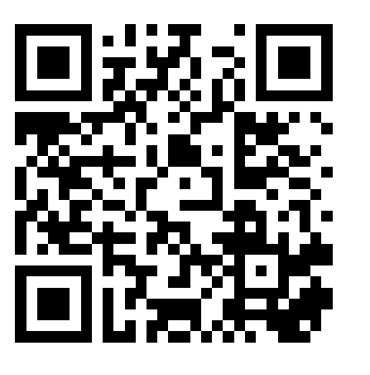

PERSONALISED CARE FOR LONDON
PCN advisor session: Population health and the PC ARRS roles
@SP_LDN
hlp.socialprescribing@nhs.net
Join at slido.com
#PHM

Slide 2
PCN Advisors
Purpose of the role:
  Supporting PCNS to successfully embed the three, personalised care roles (Social Prescribing Link Workers, Health & Wellbeing Coaches and Care Coordinators) to effectively tackle health inequalities and support primary care
  Build a network of those that employ or are working to embed the three personalised care roles in their work, facilitating a community of practice across London
Dr Hina Shahid
Hina is a Portfolio GP in North West London and has a background in Public Health. She has worked in the VCSE sector for 15 years in community engagement, outreach and health inclusion, and health systems strengthening in the UK and internationally. She is an undergraduate tutor, GP Appraiser and also works in social research and health policy and has supported SPLWs in thinking through culturally appropriate practice
Lianna Martin
With over 20 years experience in the VCSE and social enterprise sector, developing projects and partnership work, and previously at the Bromley by Bow Centre, Lianna is also a Regional Learning Coordinator for Social Prescribing and a Programme Manager at HLP in the Health Inequalities, Personalised Care team. Her time is dedicated to pan London initiatives supporting the development of social prescribing, enabling it to thrive
@SP_LDN
hlp.socialprescribing@nhs.net

Slide 3
The PCN advisor offer
A monthly, pan London ‘Connect and Share’ session for those that employ and/or are looking to embed the three personalised care roles in their PCN: themed and open sessions with presentations of good practice case studies across London plus time for Q&A and discussion.
  Thu 18th November 12.30pm: Embedding the three personalised care roles. RECORDING HERE
  Thu 13th Jan 2022, 12.30pm: Open session (workshop) exploring different ways personalised care roles can support primary care and communities at this time: Slides here.
  Feb 2022: Spotlight on Care Coordinators and how best to use them (Wed 16th Feb 3pm) Recording and slides here.
  Mar 2022: Spotlight on Health and Wellbeing Coaches and how best to use them Recording and slides here.
  Apr 2022: Population health and the PC ARRS roles: Today
1-1 support – every Wednesday there will be 30 minute slots available to….
  Ask questions, explore challenges, think through strategies to use the personalised care roles, get advice on resources or peers to connect with.
Book in via the following link: https://calendly.com/pcn-advisors-london/30min.
Available to present at meetings: The PCN advisors can come and speak at PCN or CCG meetings with CDs, PCN or ARRS managers on topics such as embedding the personalised care roles, social prescribing, how the roles can tackle health inequalities. Email us: hlp.socialprescribing@nhs.net
WhatsApp group for those that employ and/or are looking to embed the three personalised care roles in their work to connect with each other informally. We have set this up and trial and see if it is useful. We’re open to suggestions on alternatives but for now you can join the group. Use this THIS LINK to add your details and access the group.
We also hope to :
Send a monthly email with updates, resources, answers to common questions being asked, useful events and so on
Communicate challenges up to NHSE and the wider system, developing ideas for projects that might usefully mitigate some of these challenges
Co-produced PCN toolkit & FAQ Guide including useful case studies

Slide 4


Plan for today...
TIME | ITEM
3:00 | Introduction to the session – Hina Shahid, GP in NWL, PCN advisor
3:05 | The context of health inequalities, social determinants and personalised care – Dan Hopewell, Director of Innovation, Bromley by Bow Centre
3:15 | The national agenda on personalised care and population health - Nicola Gitsham, NHSEI
3:25 | Local system example: Lewisham Community engagement work, developing a HI pathway (CCs and homelessness), coding for HI – Aaminah Verity – PCN HI lead, SPIN fellow
3:45 | How to get started with PHM Resources, tools and networks – Jenny Brooks, HLP
3:55 | How to use population health to drive the personalised care roles and influence – Jag Mundra, National Association of Primary Care
4:15 | Open Q&A
4:30 | Close
It is an informal session – talk to each other & share resources in the chat
Join at slido.com​
#PHM
To ask the speakers questions
The presentations will be recorded & circulated with slides
@SP_LDN
hlp.socialprescribing@nhs.net

Slide 5
Who is in the room?
Mix of personalised care, population health focused and general practice roles
Mostly practice, PCN managers, programme/transformation managers and ARRS (personalised care and pharmacist/FCP)
Some GPs/partners/Clinical directors and ICS or borough leads
Notes:
Just over 100 signed up
About 50/50 london, outside of London

Slide 6


What does tackling health inequalities mean to you?
ⓘ Start presenting to display the poll results on this slide.

Slide 7
What do the roles do
Care Coordinators | Health & Wellbeing Coaches | Social Prescribing Link Workers
Work along side clinicians and the MDT, acting as a point of contact connecting patients, their clinicians and other teams involved in their care. Take time with patient, using personalised care support planning over sessions to identify patient needs and offer to coordinate various aspects of their care. Act as a bridge between primary care and the community. Manage their own caseload of patients offering: Continuity of care – a point of contact alongside busy clinicians with a chance for follow-ups Allyship & advocacy - conversations to support understanding health conditions and prepare for their appointments, ensuring needs are attended to Signposting to other personalised care or team members as required e.g. SPLW. Mostly support those with long term conditions, vulnerable patients or those with complex needs. Can work with clinicians in certain defined areas: e.g. learning disabilities, cancer care, nursing home residents, or they may have a mixed case load. | Work with patients to help them take proactive steps to improve the way they manage their physical and mental health conditions: Goal setting - Guide and support people with LTCs to set self-identified health and wellbeing goals Behaviour change - Use specialist coaching and behaviour change techniques, usually over a number of sessions Help patients to develop their knowledge, skills and confidence in managing their own health to improve their quality of life Tend to support with physical and mental health conditions, and with one or more LTCs such as type 2 diabetes, COPD, or those at risk of developing a LTC. | Address wider issues (social determinants of health) that impact people’s health & wellbeing. Take time with patient, using personalised care support planning, motivational interviewing & health coaching approaches, over several sessions to identify what matters to the person and connect them with: practical, social and emotional support within their community activities that promote wellbeing e.g. arts, sports, natural environment. Act as a bridge between primary care and the community - Identify and nurture community assets by working with partners such as VCSE, LA and NHS. Tend to support people experiencing loneliness, complex social needs, mental health needs or multiple LTCs.
@SP_LDN
hlp.socialprescribing@nhs.net

Slide 8
The context of health inequalities, social determinants and personalised care
Dan Hopewell
Director of Innovation – Bromley by Bow Centre

Slide 9
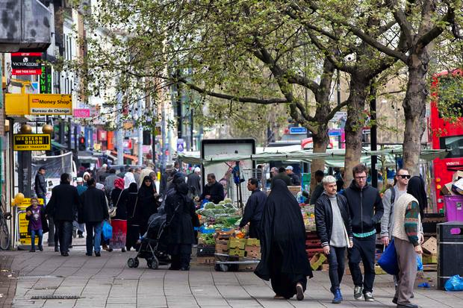
Health inequalities:
Inequalities of what and for whom

Slide 10
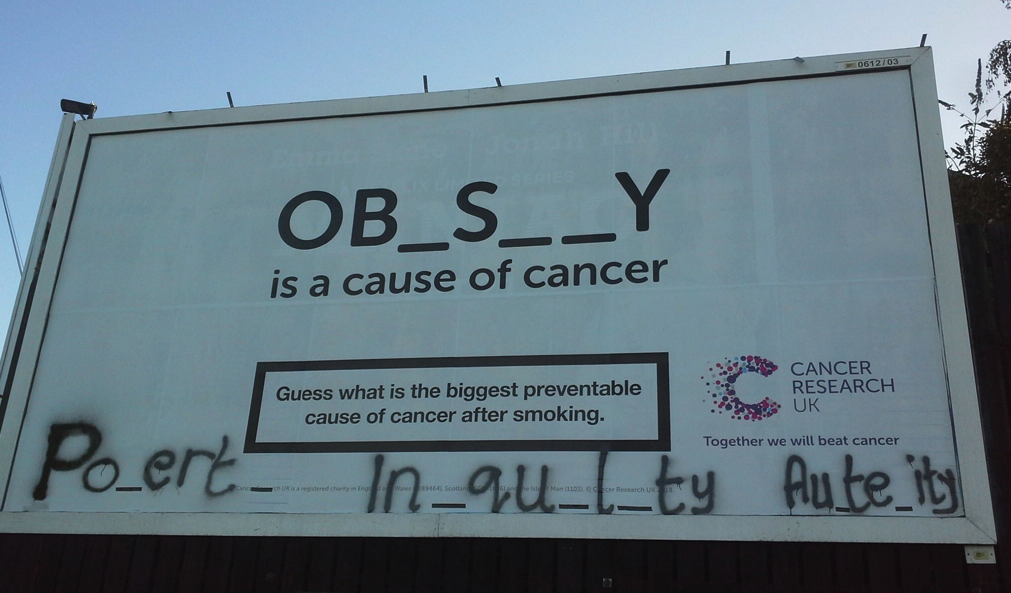
Are we really clear? Perhaps not quite, yet*
*Look more closely, what are the causes behind the causes?

Slide 11
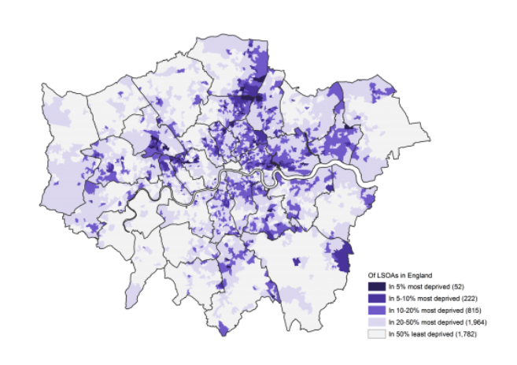
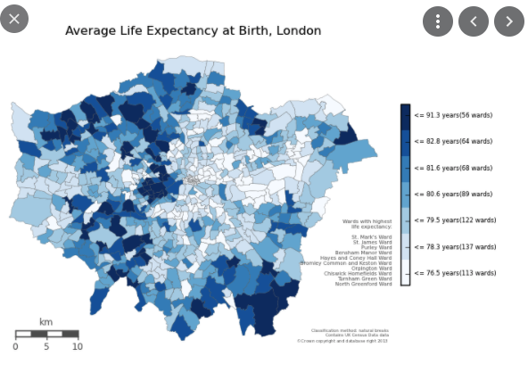
Deprivation levels
(IMD)
Deprivation is a major determinant of health
Bow
Life expectancy levels
Bethnal Green
Bromley by Bow
Whitechapel
Canary Wharf

Slide 12

Why is there a 20 year healthy life expectancy gap and a 10 year life expectancy gap between the people living on two streets, that are only 100 mts apart, when they both access the same GP practices and hospitals?
And what can we do about it?
Bow
Bethnal Green
Bromley by Bow
Whitechapel
Canary Wharf

Slide 13
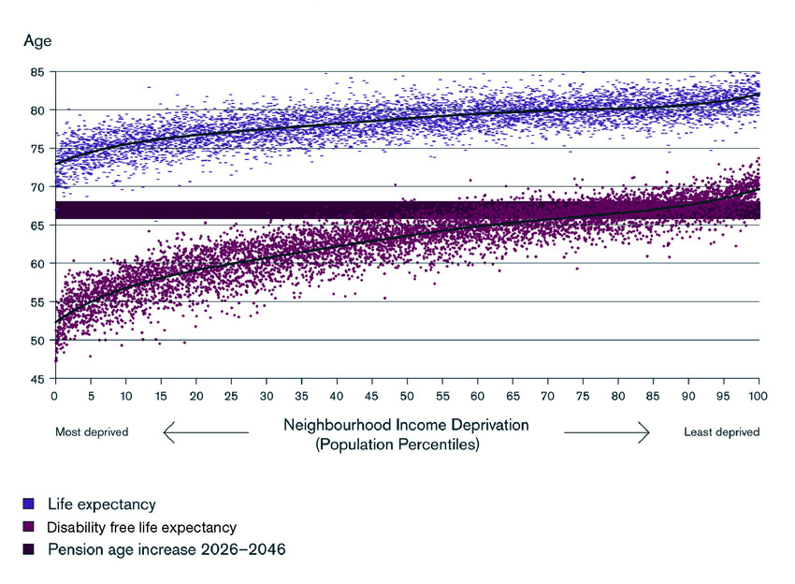
Socio-economic status is the major determinant of life expectancy and healthy life expectancy
70% of the Tower Hamlets population are located in the most deprived quintile of this diagram
Notes:
20% of households in Tower Hamlets living on less than £15,000, and 50% on less than £30,000, almost 50% of children in poverty, 70% of the borough’s residents located in the most disadvantaged quintile.
That gives one an idea of the health impact across the population of the social determinants of health in our community. That impact is demonstrated by an 10 year life expectancy difference and a 17 year disability-free life expectancy difference in Tower Hamlets between the most and least deprived men in our community.
Effectively 70% of Tower Hamlets residents are in the quintile that is at risk of developing Long Term Conditions from their 40s and 50s onwards, compared to those at the opposite end who develop them around 65 years old. That implies a huge reduction in quality of life, and a huge cost to the health service. More than half the inequality of life expectancy is due to the different rates of smoking between social economic groups.
The impact has huge implications, not least for our health services that are ever more stretched by the increasing level of demand. Whilst some of that increase in demand is the result of increases in longevity, much of it is the result of the effects social inequality and health inequalities, for example the growing levels of obesity and depression.
The effect of the accumulation of health issues in early adulthood is that BbBC GPs report they see people in their 40s who present health conditions one would expect to see in their 60s.

Slide 14
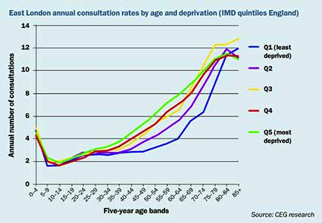
Socio-economic status is the major determinant of consultation rates.
It is estimated that at least 1 in 5 general practice consultations are directly or indirectly caused by social issues that are troubling the patient
Notes:
Note the effect of deprivation on consultation rates at General Practice
From 0 – 30 years consultation rates are broadly the same across the five socio-economic quintiles
From 30 onwards the diverge with those in the lowest socio-economic quintile attending general practice most frequently and those in the highest socio-economic quintile least frequently. The divergence is greatest between 50-70 where the rates of consultation are double between the lowest and the highest socio-economic quintiles. From 75 years onwards the rates begin to converge again with those in the second most deprived beginning to be the ones with the highest consultation rates.

Slide 15
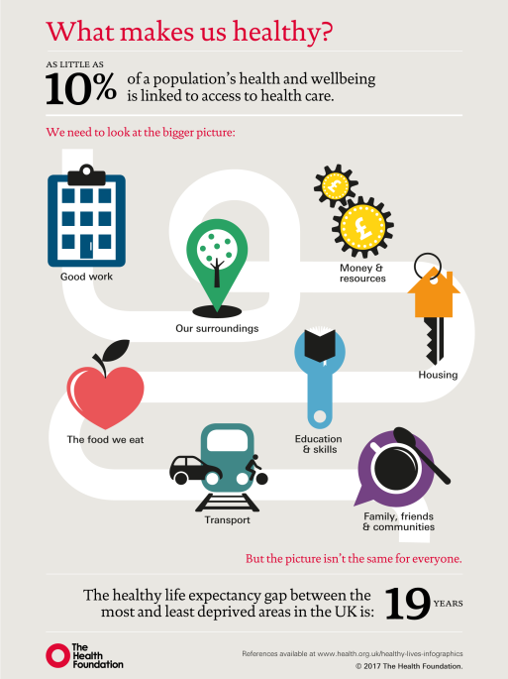

What really creates health and wellbeing in our communities?
And how might we respond to that understanding?
Notes:
How the Marmot review created an understanding of the importance of the Social Determinants of Health and in a sense theorised our model, which is, in many senses a response to that understanding, albeit instinctively created ten years earlier

Slide 16
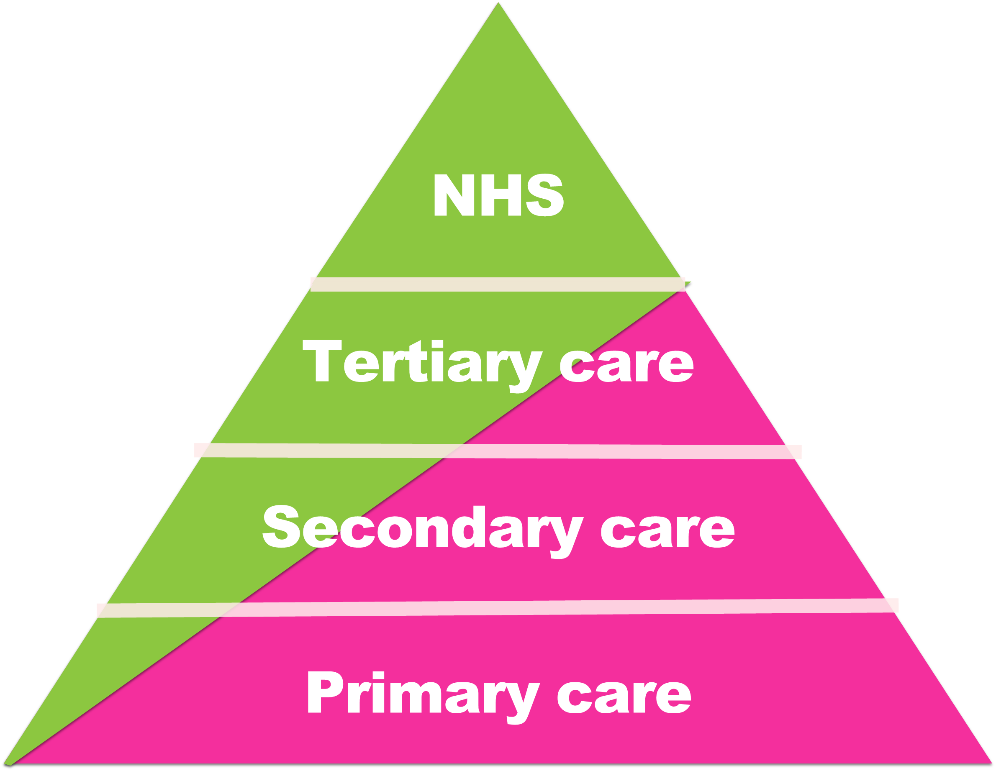
Rethinking care*
Care accessed through the NHS
Care accessed in communities
Care provided by family and friends
Self care, your choices
*does the advent of Integrated Care Systems and Primary Care Networks create an opportunity to rethink care?
1997

Slide 17


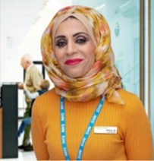

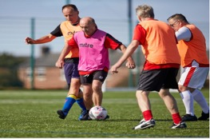

Personalised Care, Population Health Management and Health Inequalities
Nicola Gitsham
Head of Healthcare Inequalities and Personalised Care,
NHSE/I
@nicolagitsham
@Pers_Care
#SOCIALPRESCRIBING
#Link Workers
#personalisedcare

Slide 18
What is personalised care?
The NHS Long-Term Plan commits to making personalised care business as usual across the health and care system.
It means people have choice and control over the way their care is planned and delivered, based on ‘what matters’ to them and their individual strengths and needs.
This happens within a system that makes the most of the expertise, capacity and potential of people, families and their communities, taking a whole-system approach and integrating services around the person.
It is an all-age model, from maternity and childhood through to end of life, encompassing both mental and physical health support.
It provides a positive shift in power and decision-making that enables people to feel informed, have a voice, be heard and be connected to each other and their communities.

Slide 19
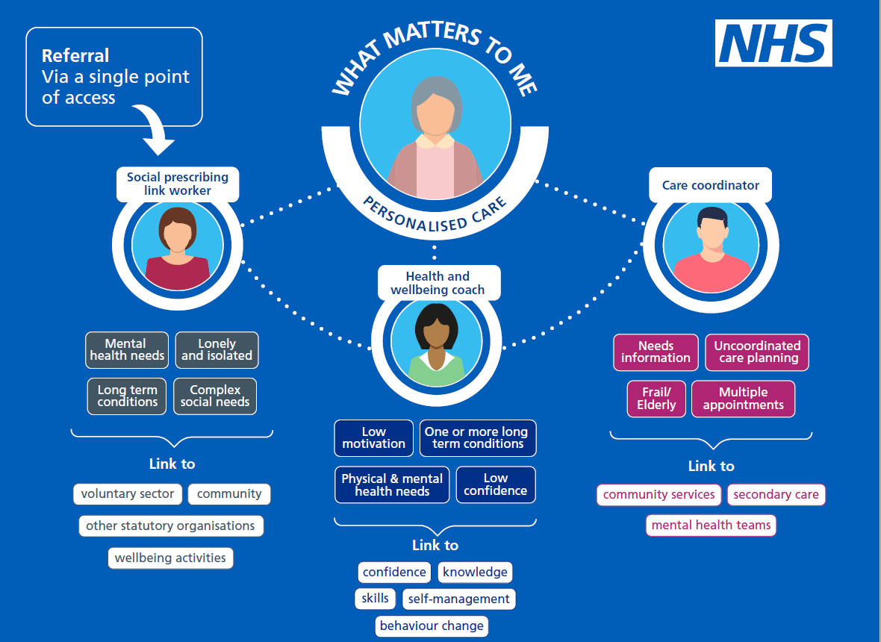
The three personalised care roles

Slide 20
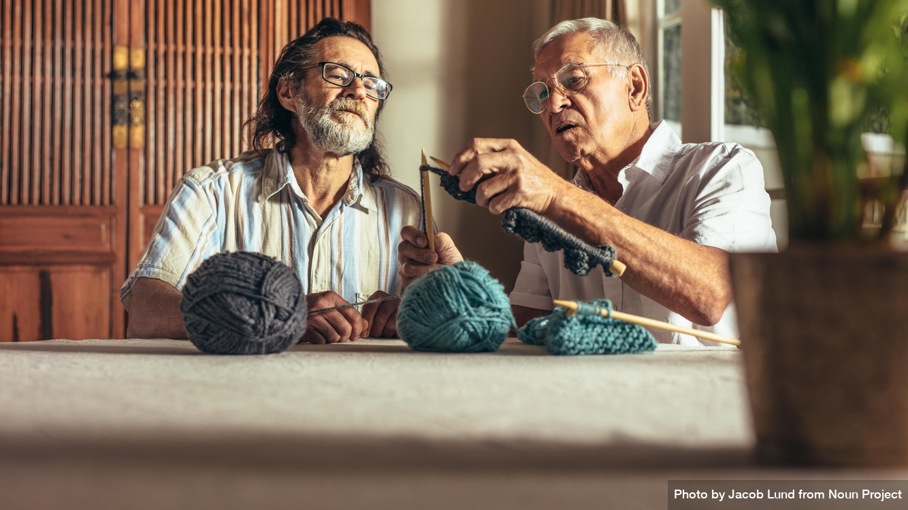
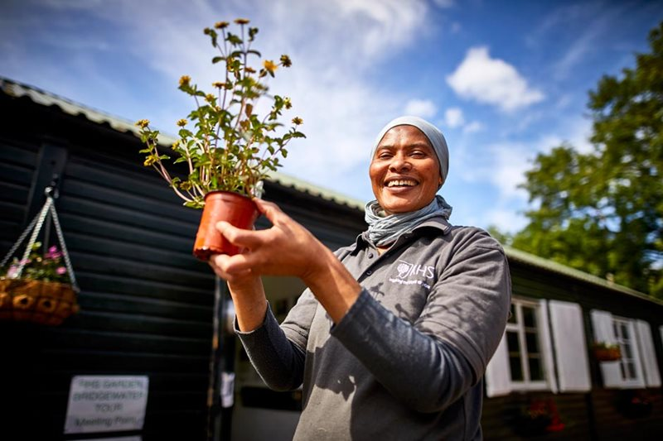

In practice
In Bristol, the local social prescribing scheme employs a link worker specifically to engage with South Asian communities in an ethnically diverse inner-city area.
This approach has helped to engage with the elderly population in this group, who have not historically accessed welfare and advisory services, or wider community assets, which has compounded social isolation and the impacts of health inequalities experienced by this group.
Through this approach, people have been supported to engage with statutory services to maximise the support they can receive (i.e. housing benefit and universal credit) and access services and groups through informal translation services provided by the link worker.
The link worker has also worked with local VCSEs to identify gaps in provision and support delivery; for example, women’s peer support groups for mental health.

Slide 21

Population Health and the NHS Long Term Plan
The Long Term Plan sets out new commitments for action to improve prevention.
New integrated care systems (ICSs) will help to deliver this as the NHS continues to move from reactive care towards a model embodying active Population Health Management:
Greater integration of services to support a more proactive approach to care delivery
Population health management using predictive prevention to better support people to stay healthy and avoid illness complications

Slide 22
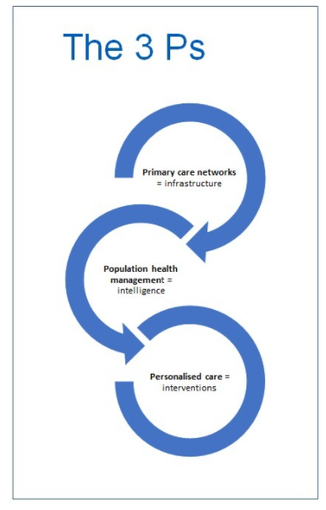
Population Health Management
Supports ICSs at all levels to understand the areas of greatest health need and match NHS services to meet them:
Through identification of those groups of people who are at risk of adverse health outcomes
To predict which individuals are most likely to benefit from different health and care interventions
Highlights health inequalities and inequalities in access
To understand and consider the best ways to meet the medical, social and wellbeing care needs of both individuals and communities within a defined population.
Identifies missed elements of pathways of care for individuals and ensure that those gaps are filled.

Slide 23
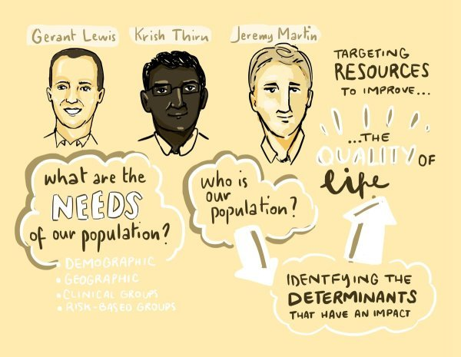
Population Health
Using the collective resources of the local system, NHS, local authorities, the voluntary sector and others to improve the health of local areas.
Capturing the circumstances of life to tackle the multidimensional causes of ill health – the cause of the causes’.
Working out who’s missing – capturing the people not seen in the data
Expanding the use of untapped data sources (proactive outreach) and new forms of data (e.g. citizen-generated data, geographic street level data) to provide a more accurate picture of who is excluded.

Slide 24
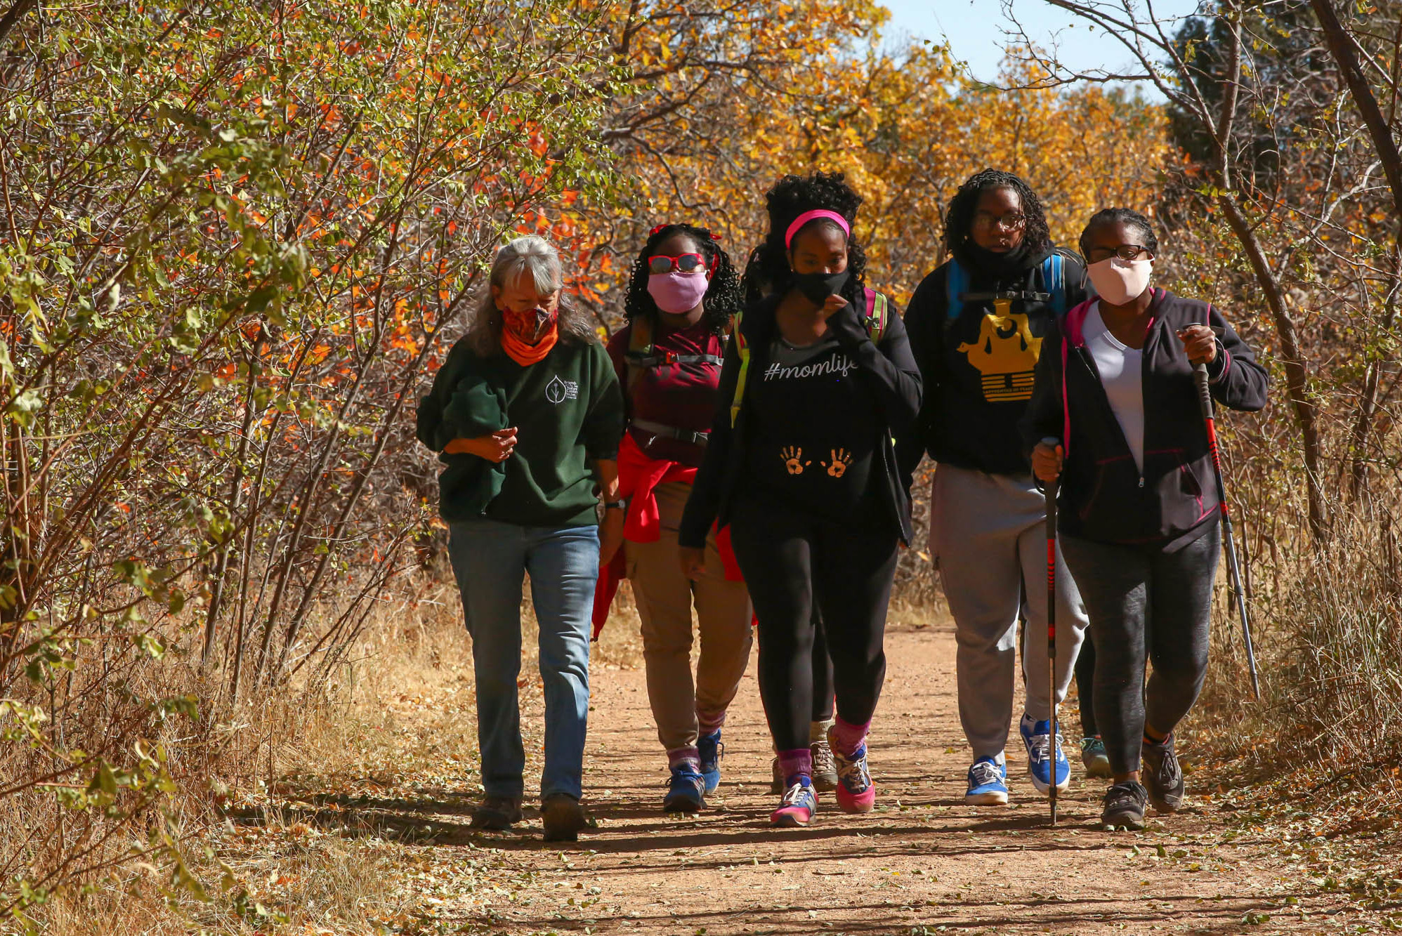
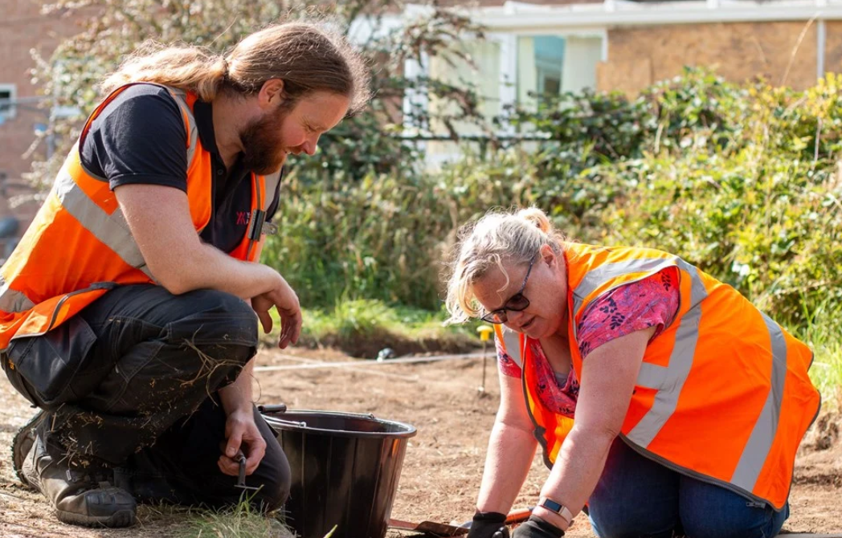
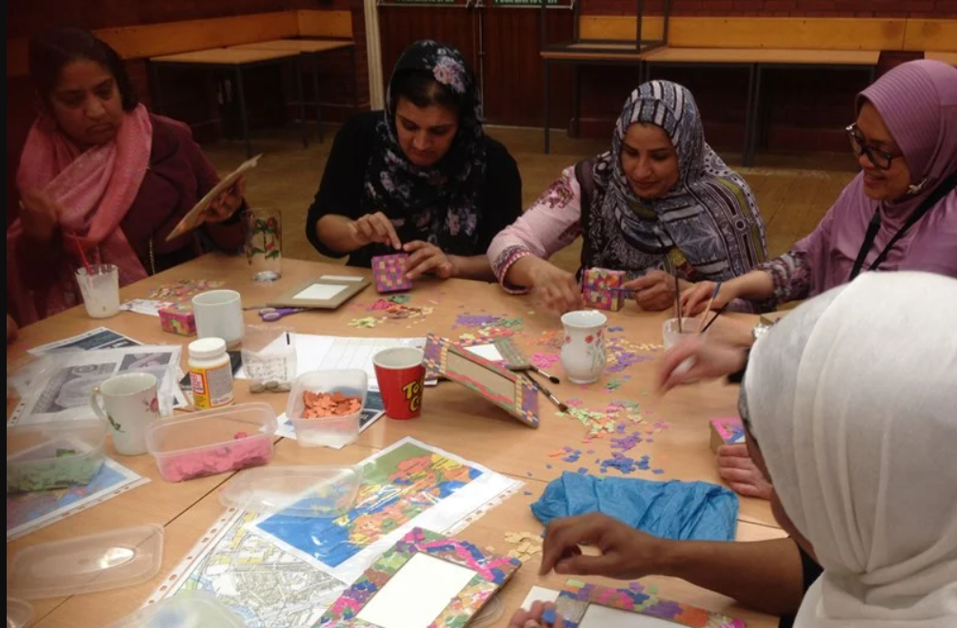
PHM and Personalised care
Roles support PCNs’ PHM approaches through proactive case finding of people and cohorts experiencing inequality in access to and outcomes from services, including inclusion health groups and high intensity users
Also support with proactive outreach – identification and support of people who don’t usually attend primary care, reaching out to prevent ill-health and target undiscovered health needs.
Proactive targeting within the community to identify people and cohorts experiencing inequity of quality, access and outcomes from services, such as inclusion health groups
Work proactively with communities to discover hidden needs, engage with communities to identify solutions, and support the community to deliver sustainable and accessible support offers, reducing demand on GP services
Collect data on social and environmental factors affecting people’s health, enhancing GP population knowledge

Slide 25
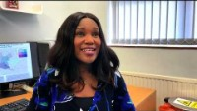
Jane’s story
Summary:
Personalised care means people have choice and control over their care
They can receive help and support with things that really matter to them, instead of relying on medical interventions that might not be the best option
Personalised care interventions and roles can be used as part of a PHM approach
https://www.youtube.com/watch?v=2y9m5fLIuR8

Slide 26
Personalised care 22/23
NEW for 22/23 – introduction of the personalised care service specification – proactive social prescribing https://www.england.nhs.uk/wp-content/uploads/2022/03/directed-enhanced-service-personalised-care-March-2022.pdf Supports the Tackling Neighbourhood Inequalities service specification) https://www.england.nhs.uk/wp-content/uploads/2022/02/B1366-tackling-neighbourhood-health-inequalities-supplementary-guidance-v1.1.pdf
By 30 September 2022, as part of a broader social prescribing service, a PCN and commissioner must jointly work with stakeholders including local authority commissioners, VCSE partners and local clinical leaders, to design, agree and put in place a targeted programme to proactively offer and improve access to social prescribing to an identified cohort with unmet needs. This plan must take into account views of people with lived experience.
From 1 October 2022, commence delivery of the proactive social prescribing service for the identified cohort.
By 31 March 2023 review cohort definition and extend the offer of proactive social prescribing based on an assessment of the population health needs and PCN capacity

Slide 27
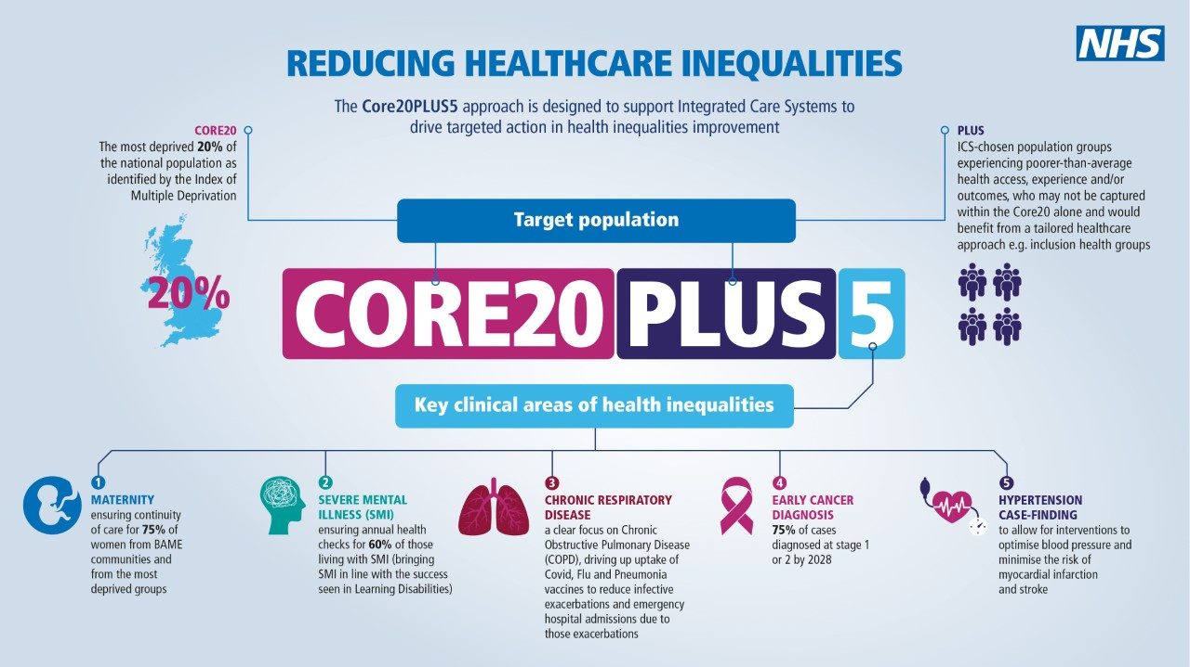

Slide 28
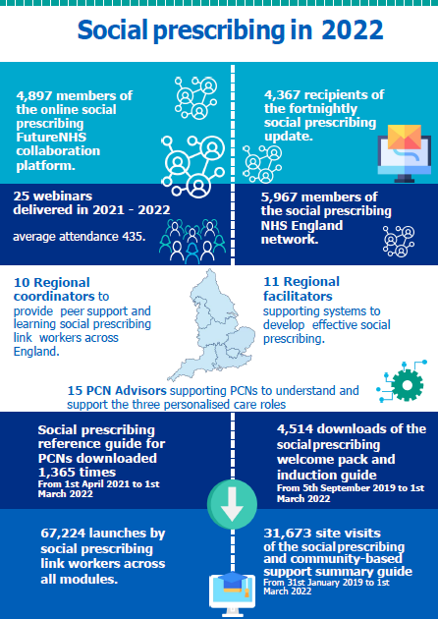
Support for introducing SPLWs
SP and community-based support summary guide
Reference guide & technical annexes for PCNs
Interactive Welcome & induction pack for SPLWs
Themed fortnightly webinars – over 6,500 attended live
12 Free HEE accredited online learning modules – 3 new
Online SP collaborative community on NHS Futures and Fortnightly SP Bulletin; Sign up via england.socialprescribing@nhs.net
Draft Competency Framework and Workforce roadmap
Notes:
Regional Facilitators – provide strategic support within the regions and support PCNs to embed SPLWs as part of the multi-disciplinary team
Case studies available on clinical supervision

Slide 29
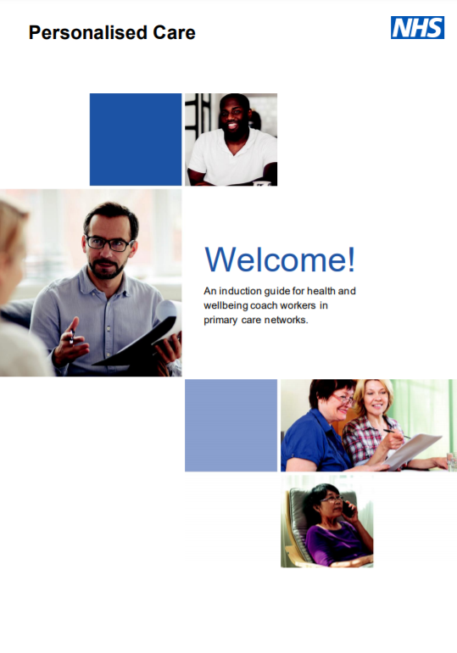
Support for Health Coaching and Care Co-ordination
A welcome pack for newly appointed health and wellbeing coaches in primary care networks.
Designed to support the delivery of health coaching, this guide and technical annexes should be used when commissioning and when deciding what can or should be counted and reported as health coaching in a local area.
A Care Coordinators’ welcome pack for newly appointed care coordinators in primary care networks.
A supported self-management summary guide.
Monthly share and learn webinars.
Future NHS online Health and Wellbeing Coach and Care Co-ordinator workspace.
Email england.supportedselfmanagement@nhs.net for more information.

Slide 30
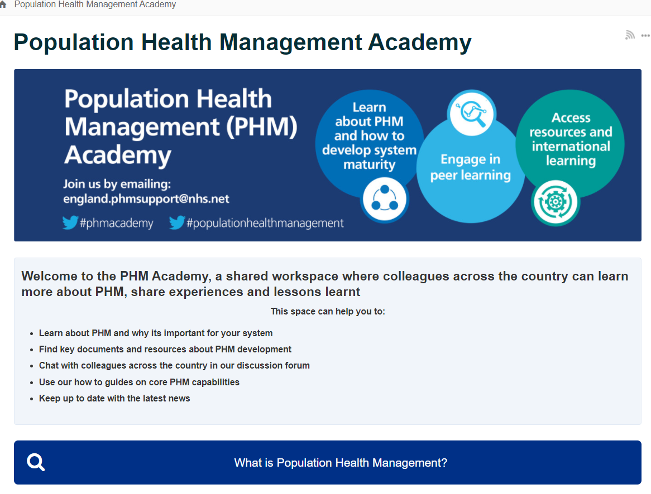
NHSE/I PHM Academy
Workspace on FutureNHS site
Aimed at systems and regional colleagues and contains documents, resources and information on utilising PHM
Also includes a number of practical case studies, webinar series and discussion forums
Email england.phmsupport@nhs.net to join

Slide 31
Health Inequalities
For more information on the Health Inequalities dashboard and Core20PLUS5, please contact the Health Inequalities Improvement team on:
​ Contact us on: england.healthinequalities@nhs.net

Slide 32

North Lewisham PCN Approach to Health Inequalities
Dr Aaminah Verity
North Lewisham PCN Lead for Health Inequalities
Aaminah.verity@nhs.net

Slide 33
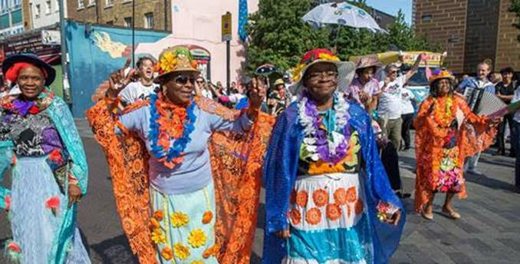
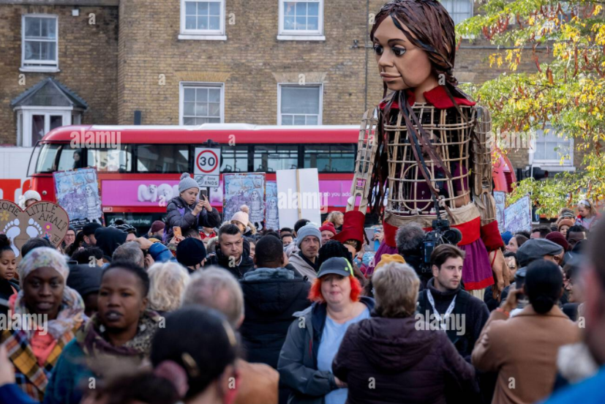
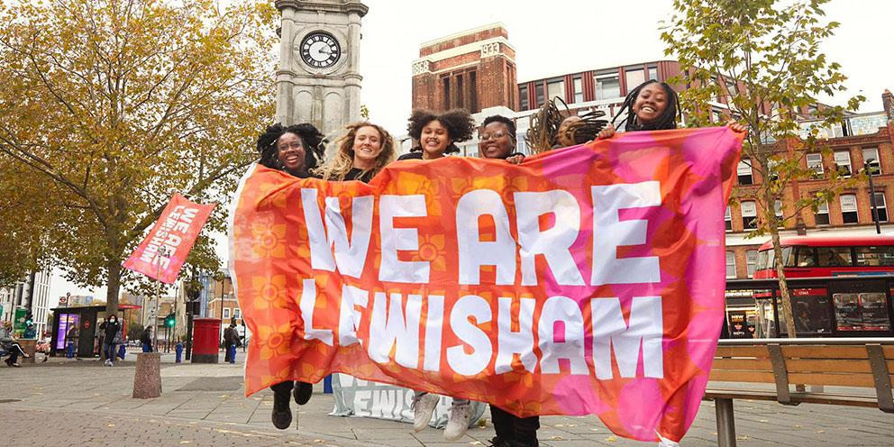
North Lewisham Community
Notes:
9 GP practices
80,000 population
Vibrant and exciting community
High proportion of non-white migrant residents
High socioeconomic deprivation
High proportion of inclusion health groups
Lowest male life expectancy 75 vs 81 2 miles away

Slide 34
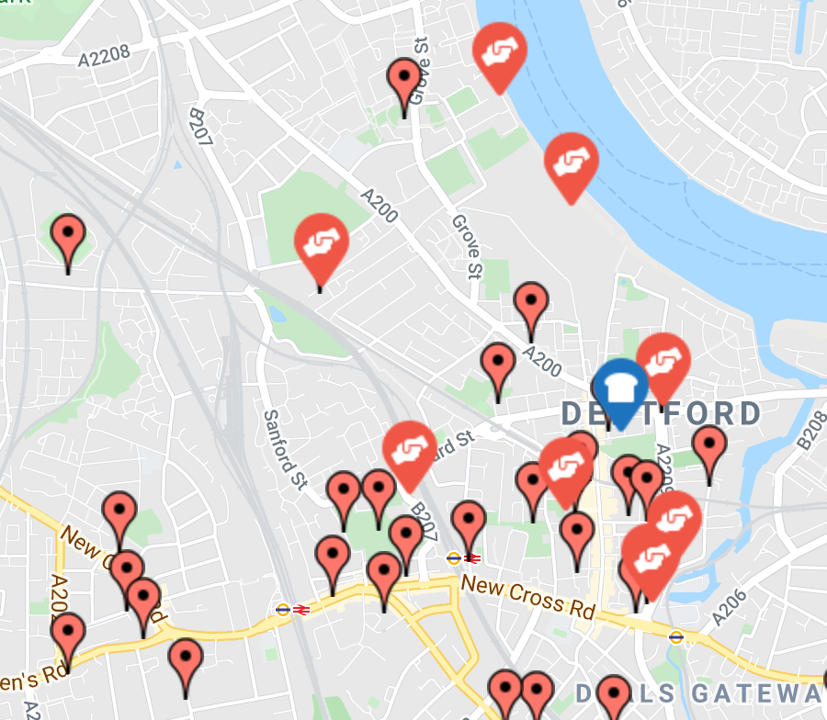
Community Engagement
115 organisations and individuals mapped
32 organisations fed into understanding local health inequalities
Lack of Trust
Barriers to care
Poverty
Notes:
In March 2021 NLPCN covid vaccine uptake was highlighted as a health inequality - ~40% of BAME eligible had a first dose compared to 86% of white residents
GP fellows, Retired GPs and support from local authority community development team
Lack of trust - Racism, Not linked to community, poor communication to community, previous bad experiences
Barriers – Language, digital exclusion, difficulties registering (homeless/migrant), rapid changes in services not communicated
Poverty – social determinants of health, poor quality housing, difficulty prioritising health - zero hours contracts

Slide 35
Ideas & Solutions from the Community
Hiring Community Link Worker
Improving access to GP care
Data Strategy
North Lewisham Health Inequalities Forum
Improving COVID-19 Vaccine Uptake
Notes:
In collaboration with the community organisations/individuals we were working with co-designed solutions

Slide 36
Improving COVID-19 Vaccination Uptake
Identify
Funding
Training
Community engagement
Pop up clinic
Notes:
Rapid engagement
Found digital exclusion/complex booking process: simplified booking process, walk in options, slip
Pop ups with not enough engagement were poorly attended or used as a way for those motivated for vaccine to attend
Identify
Data tool: Low uptake or disparity between ethnic minorities
Identify community organisation (VSCO)
Funding
£500 participatory funding
VSCO will recruit up to 10 volunteers
Volunteers offered £30 voucher for participation in a 2-hour training session
Training - (Week 1)
Upskill volunteers to feel confident to have conversations about the vaccine and answer questions
Community engagement – (Week 2/3)
VSCO organise community engagement strategy
Volunteers do engagement they have the offering of the pop up vaccine clinic to invite eligible residents
A focus on a conversation over data recording if door knocking
Pop up clinic (Week 4)
Run by VSCO
like a health fair, health promotion

Slide 37
Notes:
Here are 2 of the posters for the pop-up events
Health Activities
Health Checks
Mindfulness
Massage
Benefits checking
Diabetes risk assessments
Community gardening
2000 Community Action Centre
115 vaccines
6 Chinese undocumented migrants
Illiterate 65yo
50 Brazilian Portuguese speaking fast food drivers
New Cross Gate Trust
126 Vaccines
11 undocumented migrants
4 temporary residents- 2 over 70y
81yo unable to get 2nd dose
80+ year old Indian couple who were stuck in the UK due to the pandemic visiting their daughter had not managed to get vaccine despite temporary registration
9 Undocumented migrants most over 50yr, who heard through flyer in bus stop, one in the UK for more than 17 years without GP registration
Homeless man with anxiety who only came because it was in his area and he knew the community leader

Slide 38
Community Link Worker
Using ARRS Roles Creatively
(SP) Community Link Worker Joyce Jacca
Local recruitment
Bridge between GP practices and the community
Developing the Community Forum
Notes:
PCN anchor institute
Stakeholder list expanded by another 30 organisations/individuals
Critical role in building trust and relationships
Linking with VCSOs to build links and trust
Identifying outreach opportunities
Embedded in the community

Slide 39
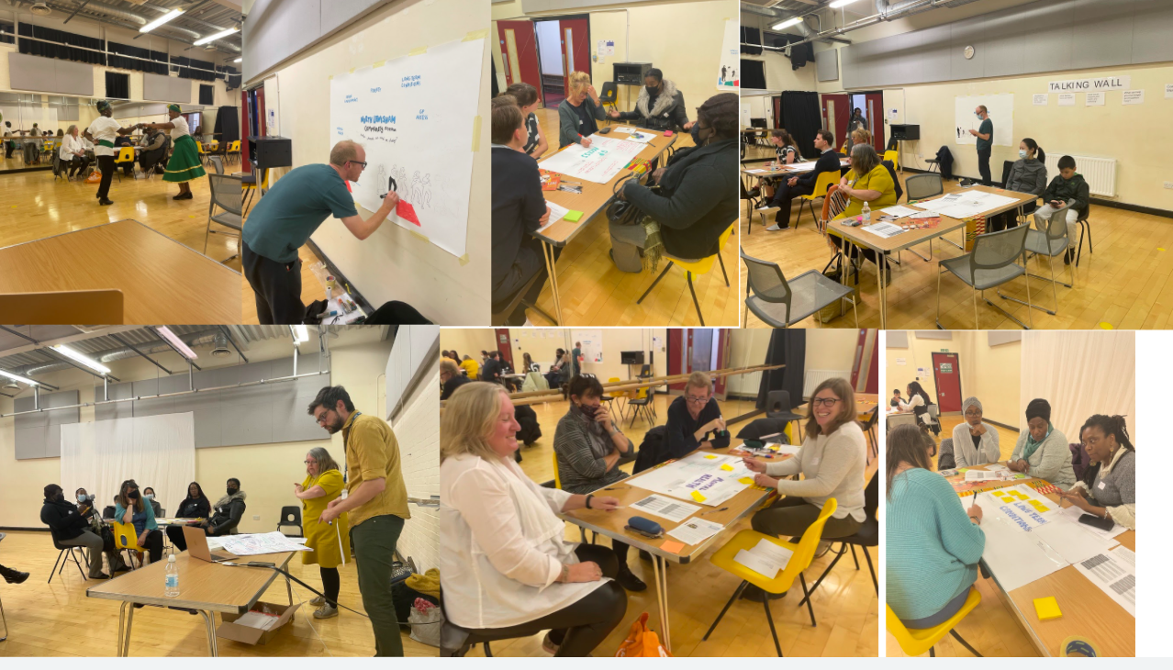
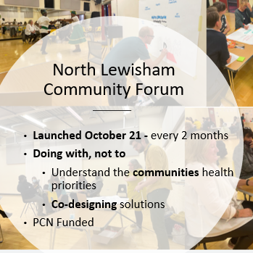
Notes:
Rotating Community venue
Building trust
Hybrid model – 30 - 50 attendees
Local dance and food
FEEDBACK

Slide 40
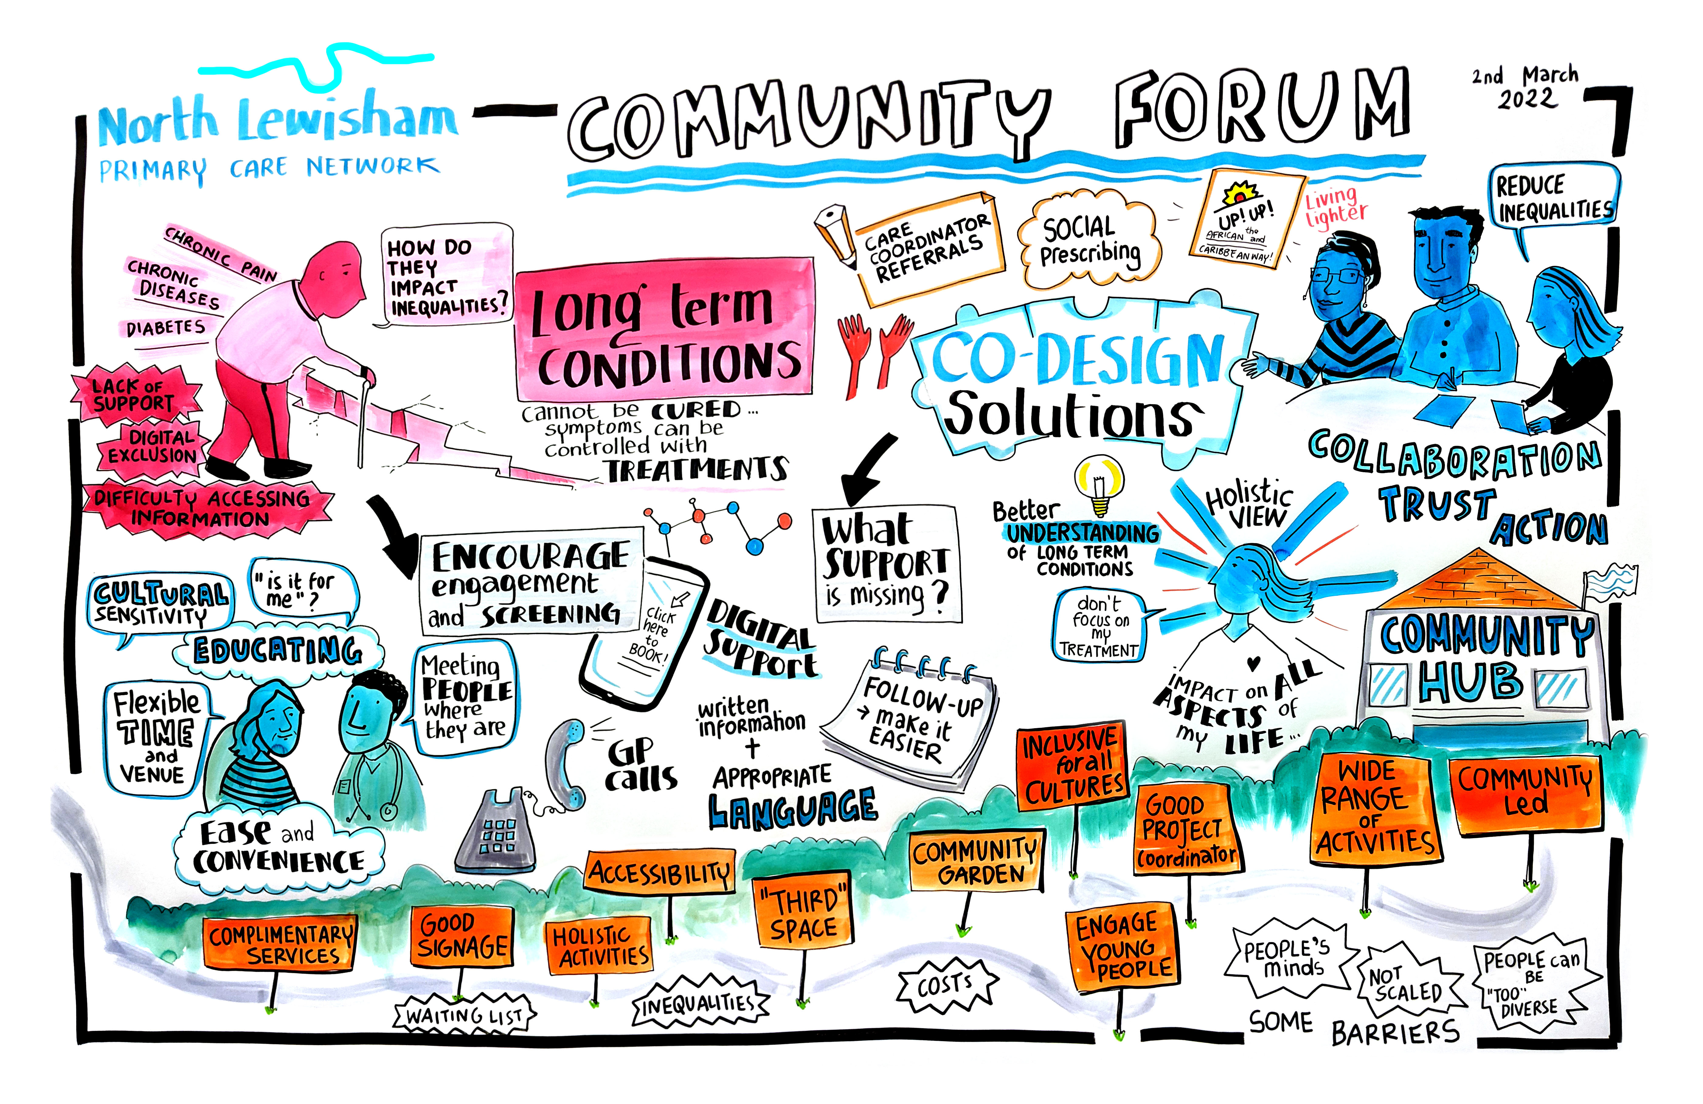
Notes:
example of the visual minutes we produce from each event to circulate with community rather than written notes

Slide 41

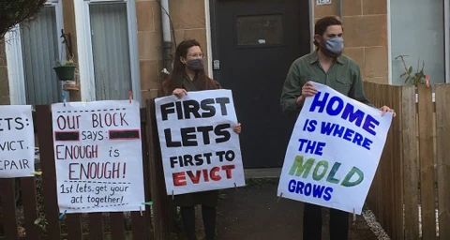
Outputs
Advocacy
  Poverty communities no. 1 priority
  GPs standing with community
  Strategic Vision for the PCN
  Housing working group
Improving Access to GP Care
Focus group with receptionists
CC referral pathway
Program of training for reception staff and clinicians (Safe Surgeries+)
Choose well and GP Access Messaging
CC led digital exclusion training
Notes:
Employ from within our community
Residents guide for how to manage housing system
Codesigned access guide
Collaborative digital exclusion training - bringing in community organisation providing digital inclusion but they joined a training sessions with our CCs on how to upskill people on using the digital suite of tools in the NHS

Slide 42
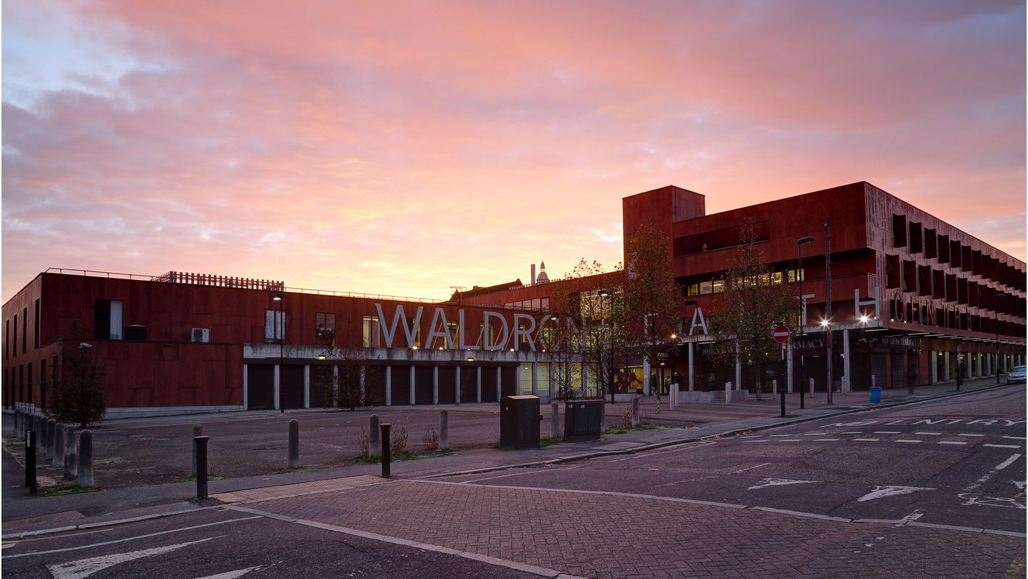
Care Coordinators For Health Inequalities
Homeless Services
Community Organisations
Social Prescribers
CC Team
Inclusion Health CC
Front of House CC
Lived Experience of Exclusion
Direct support to improve engagement
GP
Practices
Notes:
Inclusion health based on the groundswell HHPA program
Practical support in attending follow ups and hospital stays
Support to find out information
Support a client to address their health issue
Pay for travel including taxis if needed
Front of house
Face to face presence (started last week and facilitated 6 GP registrations already)
Multi-lingual
Local recruitment

Slide 43
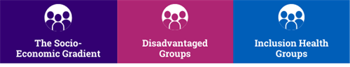
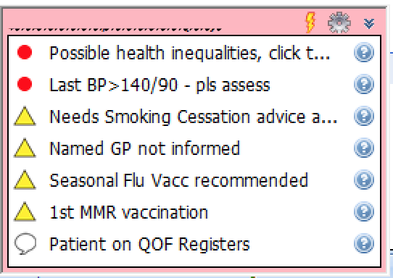
Data Strategy – Helping GPs Prioritise
How do we identify those at risk of health inequalities as clinicians?
300 Emis Codes = ?possible of health inequality
Outcomes:
  Coding Template
  Clinical and administrative guidance
  Every contact counts
  Proactive Screening/health promotion
Notes:
300 emis codes based on established vulnerabilities: inclusion health codes

Slide 44
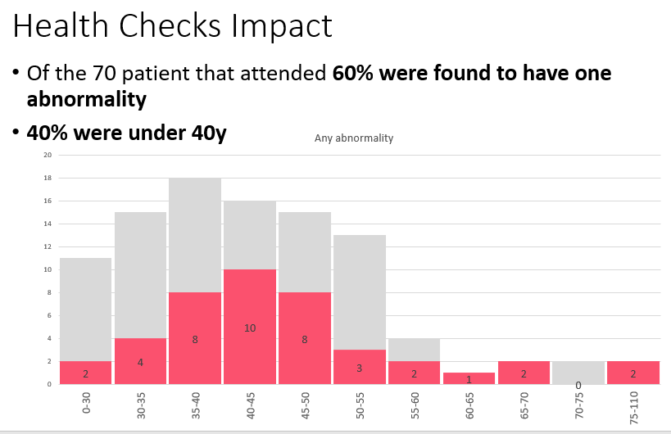
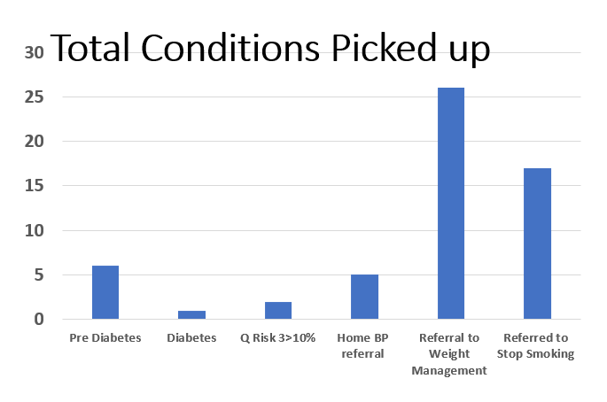
Targeted Health Checks
ARRS supported health checks
1 GP practice
  781 patients identified
  87 booked (70%)
  70 attended (80%)
Notes:
Pilot in 70 patients- Health Checks 60% had an abnormality including x 1 diabetic, x5 HTN, X4 prediabetic – all younger than 40
I’m aware there is a year long study in barking looking at lowering the age of health checks for BAME and deprived populations from 30-39
Those at risk of health inequalities are more likely to be at risk of CV disease younger
They are less likely to come forward for health screening opportunities
This is a driver of health inequalities early morbidity and mortality in our population
Learning
Younger, sicker patients
Proactive call and recall increases response rates
Rolling this out across the PCN in pilot with lhcp+PH adding in lowest imd and ethnic minority
We are in week 2 of the pilot and have around 80% attendance and immediate feedback with POCT
- Culturally appropriate weight loss clinic and looking at building lifestyle medicine clinic to support those identified at high risk

Slide 45

NLPCN Model for Health Inequalities
COMMUNITY LED ​
COLLABORATIVE ​
PRIORTISED ​
RESOURCED ​
REPLICABLE
Notes:
Community organisations at the centre to build back trust in mainstream services
Using Asset Based approach​
Working collaboratively with partners: CCG, Public health Lewisham Council. locally and combined efforts
PCN Clinical directors support this to be at the core of all PCN Activities ​
PCN as an anchor institute
GP lead + fellows who have time and resource to drive forward change
Long term funding participatory funding budget
Replicable: has been taken up by PH lewisham to replicate pcn Hi fellows in every PCN in Lewisham
Key learning
Listening
Provide space & time to build relationships and trust
ARRS - roles locally
Commit to funding long term
Connect & act as a catalyst
Shift power and where health happens
Share learning and data

Slide 46
Top Tips for PCN Health Inequality Focus
Name a lead & attract fellows
Work with your community FEEDBACK
Make it the core of your PCN targets
Understand your PCN's HI needs
Use the resource you have and advocate for more
Get support from other organisations
Notes:
Pathway https://www.pathway.org.uk,
Deep End https://www.gla.ac.uk/researchinstitutes/healthwellbeing/research/generalpractice/deepend/,
Fair Health https://www.fairhealth.org.uk/
Need to be resourced to think about what to do: think about the inclusion health groups that are represented and what your Core20PLUS5 looks like https://www.inclusion-health.org/pcn/ https://www.england.nhs.uk/about/equality/equality-hub/core20plus5/
Recurring meetings like the community forum are key to being able to show the community that we’re working together not for or to them
Gold thread to the PCNs work
Using ARRS funding, think about how to use IIF and PCN DES allocations. Find and demonstrate the need and then we can advocate for funding for this work

Slide 47

Acknowledgements
Pathway
Samantha Dorney-Smith
Dr Nigel Hewett
North Lewisham PCN
Dr Forgan & Dr Kalwij: Clinical Directors
Joyce Jacca: Community Link Worker
GP fellows:
  Dr John McGuinness
  Dr Lola Fakoya-Sales
  Dr Edward Morris
The care coordination team
The practices of NLPCN

Slide 48
Where to start? PHM & Personalised care
Jenny Brooks – Healthy London Partnership
Join the NHS future areas.
Understand what PHM is and how SP and personalised care interacts with it
Dig into case studies of what is already happening
Access resources to develop understanding of how you can tackle health inequalities and apply PHM
Develop practical skills through training and understand links to policy
Identify data sources and ways to build your PHM capabilities to apply your approach

Slide 49
1. Join the future NHS areas
Population Health Management Academy - Integrated Care (future.nhs.uk)
Access resources, training and tools to create a PHM strategy, build capability and more. (For everyone)
Population and Person Insight - FutureNHS Collaboration Platform
Access information about the PAPI dashboard, how it can be used, tools and training to carry out segmentation.
(For those who already understand PHM and want to dig into doing it)
Equality and Health Inequalities Network - FutureNHS Collaboration Platform
Understand the latest guidance on reducing health inequalities, how to include this in your approach, as well as access the Health inequalities dashboard for ICS level.
(For everyone, but especially ICS level colleagues and those helping implement a strategy to reduce HI)
Forum to discuss PHM and SP
General PHM forum
About regional PHM academies and how to build a PHM community of practice

Slide 50
2. Understand what PHM is and how SP and personalised care relates
Specific resources on PHM and personalised care
Many local PHM programmes utilise social prescribing or have personalised care aspect… but the link between the two is often not formalised.
PHM and Social prescribing lunch and learn – Future NHS log in required
  See the recording and slides. The session presents case studies, an update on the social prescribing minimum data set and more.
Tackling health inequalities toolkit – in development
Case studies – on next slide

Slide 51
3. Dig into case studies of what is already happening
Where? | Target group | What?
North Dorset | Rising risk COVID patients | Using segmentation dashboard to identify who is at risk e.g. almost in shielding category + other factors. Then proactively calling them.
Lancashire and South Cumbria | Different levels of activation | Segmenting population and risk stratifying by activation levels to design service and support offered to this
Lancashire and South Cumbria | Low activation patients before winter | COVID-19 winter response, targeting low activation 13 weeks before winter to develop personalised care plans, build trust and activation
Leeds | Frail and end of life | Proactive frailty model, first provide coordinated care then proactively identify those that are frail and then provide personalised care and SP
Bromley CCG | Multiple | Targeted cohorts for SP (combination of specific conditions, social determinants and hospital admissions
Southwark | Latin American community | Overcoming language barriers to getting vaccinated in Southwark by engaging with Latin American VCSE organisations.
Waltham Forest | Faith groups and various communities in WF | SPLWs working with community groups to dispel vaccine myths, developing a series of films to explain the vaccine from a scientific perspective
Black country and West birmingham | Vaccine hesitant; socially deprived | In depth phone calls to those who declined vaccine, partnered with BAME local organisation.
Rochdale | Ethnic minorities | Community champions programme to develop bespoke communications, and pop up vaccinations in culturally appropriate locations. E.g. specific guidance on vaccination during Ramadan

Slide 52
4. Access resources to develop understanding of how you can tackle health inequalities and apply PHM
Understanding health inequalities
What are health inequalities – by the Kings Fund
What drives health inequalities – about the social determinants of health
Understanding population health
Population health patient case study video
About PHM - getting started – population health academy workspace (general guidance and videos) – Future NHS log in required
PHM case studies– Future NHS log in required
Tackling health inequalities
BMA clinicians toolkit to tackling HI
Open access tool to access a personalised guide in targeting health inclusion groups
Applying PHM
PHM for PCNs – population health academy workspace (measure maturity, read case studies, learning guides) – Future NHS log in required
E-lfh population health toolkit – sign posts to free resources mapped to the 11 core population health curriculum areas
Guide to building a PHM community of practice - Future NHS log in required
Community development and engagement
Bromley by Bow centre resources (Guides to developing integrated health hubs; Engaging communities, co production; Case studies)
Guidance on working with people and communities – by the Kings Fund
Innovation unit resources on partnering with VCSE (about partnerships, how to overcome challenges, tips for influencing for VCSE)

Slide 53
5. Develop practical skills through training and understand links to policy
Training
Population health
Population health management e-learning by e-lfh (Introduction, assessing needs, segmentation, risk stratification and surveillance)
Health inequalities
E-learning courses for all general practice staff in tackling health inequalities
Health Inequalities eLearning modules via the RCGP Health Inequalities Learning Hub
Inclusion Health Education Mapping and Review: Full Report, learn what tools and education are free or low cost
Policy
Personalised care DES Spec: Proactive SP service set up for Oct delivery:
By 30th Sept –Bring together VCSE, LA, community to co design targeted programme to increase access for a specific cohort with unmet need using:
  Lived experience
  Population health and inequality data
  Social prescribing data
Health inequalities DES Spec: Assign a Health Inequalities lead:
By 28th Feb 23 – The lead should coordinate activities for a PCN to identify populations experiencing inequalities, engage these communities and develop an intervention plan for these cohorts to improve their outcomes. This must add value above other DES specifications.

Slide 54
6. Identify data sources and useful resources to help build your PHM capabilities and apply your approach
Understand what infrastructure is needed to bolster the approach
Overarching guidance on PHM technical capabilities (note: this resource is in depth and more focused at an ICS level, and not SP specific)
Name | Owner | Content | Coverage | Granularity | Link to overarching page | Overview | Guidance link | Gain access | Dashboard link
PAPI | Population and person insight team NHSE | Population split by demographics including various deprivation measures, condition, comorbidities, COVID-19 vulnerability, acute service use at one time point or over time (segment flow) at every level down to PCN level. | National | PCNs | Link | Link | Link | Self register on viewpoint: Link | Link
HIID | Equality and health inequalities network team NHSE | ICS level metrics to inform plans to tackle health inequalities: COVID vaccine uptake by ethnicity, age and deprivation, hospital activity of all types by ethnicity, digital exclusion stats, SMI health check and learning disability health check figures | National | ICS | Link | Link | Link | Get access to Foundry then specific dashboard: Link | Link
Fingertips (National general practice profiles) | PHE | Practice level population statistics e.g. deprivation scores, age, % with LTC, caring responsibility, unemployed | National | GP practice | Link | Link | Recording | Open access | Link
Fingertips (Wider determinants of health) | PHE | Borough level social determinants (natural and built environment, work, vulnerability, incoime, crime, education, marmot indicators, health outcomes, health assets). Compare between areas, look at relationships between risk factors and outcomes. | National | Borough | Link | Link | Link | Open access | Link
Shape Atlas | PHE | Practice and PCN level population statistics e.g. QOF population, compared to neighbouring areas | National | GP practice | Link | Link | Link | Self sign up | Link

Slide 55
.
Population Health Improvement Made Simple
Jag Mundra

Slide 56
What are the top 4 health improvement opportunities in my area?
Obesity 80% more GP contact | Anxiety 80% more GP contact
Frailty 120% more GP contact | Respiratory 60% more GP contact
30-45%
25-35%
10-20%
30-35%
Prevention is the best way to reduce growing GP demand
Notes:
Obesity = those with a BMI greater or equal to 30 (overweight = 54% of those with a BMI recorded)
Anxiety = those with 1 or more anxiety related code on their record (likely underreported as coding isn’t consistent)
Frailty = those with an eFi score greater than 0
Respiratory = those who smoke or have asthma or COPD

Slide 57
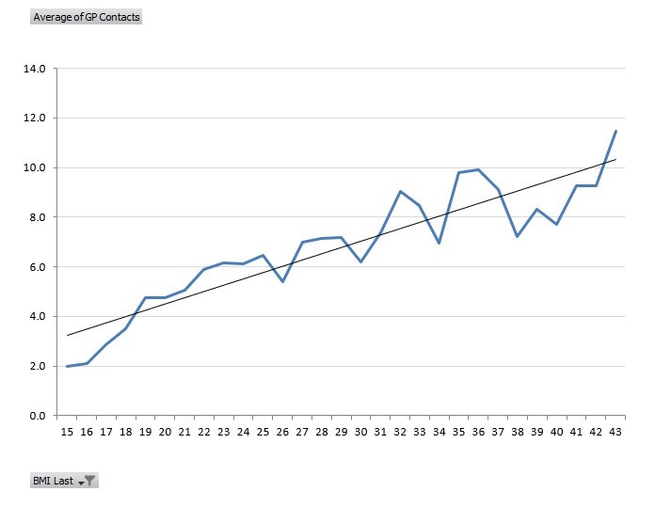
Great population health management = great demand management
Obese patients have nearly double the number of GP contacts
GP Appointments per year
Anxious patients have nearly double the number of GP contacts
BMI

Slide 58
What interventions have the biggest impact on health and demand?
Health Coaching | Social Prescribing
Practice Nursing | Lifestyle Nudging
Lower BMI &
GP Appts
Holistic care is key and every contact really does count

Slide 59
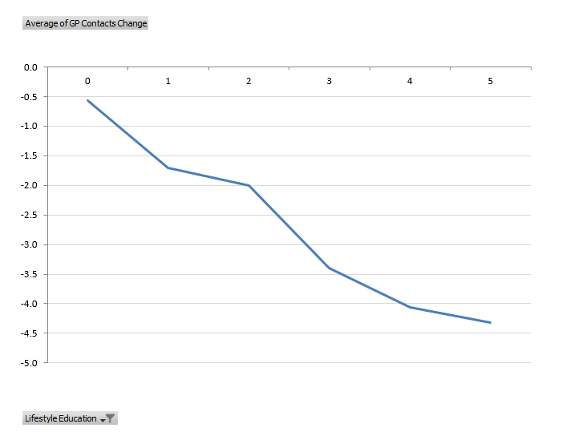
Lifestyle education is linked to falling BMI and falling appointment demand
The more lifestyle education a patient had, the bigger the fall in appointment demand and BMI
Change in GP contacts
Patients with no lifestyle education saw their BMI rise by 0.3 points
Patients who had lifestyle education saw their BMI drop by 0.5 points
Lifestyle Education

Slide 60
How do I get started with a project to address health inequalities?
Start (very) small | Focus on prevention
Involve others | One thing to measure
Even one patient is enough, provided you measure an outcome

Slide 61
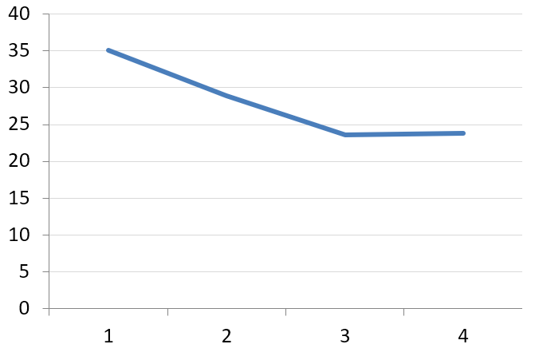
Improving health confidence is key to improving population health
Patients not able to manage their own health and wellbeing see their GP 10 more times a year – a 40% difference, but when confidence improves, then it’s only a matter of time before physical health improves and GP contacts fall
GP Contacts
1
not able
2
a little able
3
quite able
4
very able
Q1: How would you rate your ability managing your own health and wellbeing?
Q2:
What one thing do you need to help you improve your health and wellbeing?
You can capture this using the following Snomed code:
Patient Activation Measure Level 962851000000103

Slide 62
The interventions that have the biggest impact on our populations are ones that help us move, eat better, sleep and connect with ourselves and others
* and measure health confidence

Slide 63
Appendix

Slide 64
How to estimate the impact of your project on NHS demand
Example: Patients started with an average score of 2.1 and their score rose to 3.1
= (3.1-2.1) / 3 x £1670 = £557
This rise is correlated to primary and secondary care demand savings of £557 per patient per year. This includes a reduction of about 5 GP appointments (see chart)
GP Contacts
Before
After
1
not able
2
a little able
3
quite able
4
very able
Q1: How would you rate your ability managing your own health and wellbeing?
Notes:
If a patient’s activation rises from 1 to 4 it ‘saves’ the NHS about £1670 a year in reduced primary and secondary care demand
Note that this does not count the benefit to: -
Mental health services
Community services
Ambulatory service
Local Authority
Voluntary & charity sector
Private sector
Nor the value of better health to the patient
You can capture activation using the following Snomed code - Patient Activation Measure Level 962851000000103
This is in the Arden SPLW template
£1670 figure derived from – Barker I, Steventon A, Williamson R, et al. BMJ Qual Saf Epub ahead of print: [please include Day Month Year]. doi:10.1136/ bmjqs-2017-007635 and average unit costs for 20/21

Slide 65
Simple searches to identify the most ‘impactable’ patients
Medically complex? - Use repeat medications
Mental health need? - Use anxiety coding
Lifestyle need? - Use BMI
Social need? – Use GP appts and look who’s left
Look for change or the ‘vector’ to further refine
Combine these and play with the thresholds to get to the right number of patients
Use Townsend score to look for people in deprived areas (the higher the score the more deprived the area). This is stored in under the patient contact details when you’re building a search

Slide 66
Addressing Inequalities: Who might need support?
54% | female
53 | years old
3 | times more social need
49% | smokers
30 | BMI
44 | HbA1c
2 | times more anxiety
8 | repeat meds
18 | GP appts per year
10% | growth in GP appts
4 | times more hospital contacts
Identified a cohort of 124 patients meet living in the most deprived postcodes with high GP demand

Slide 67
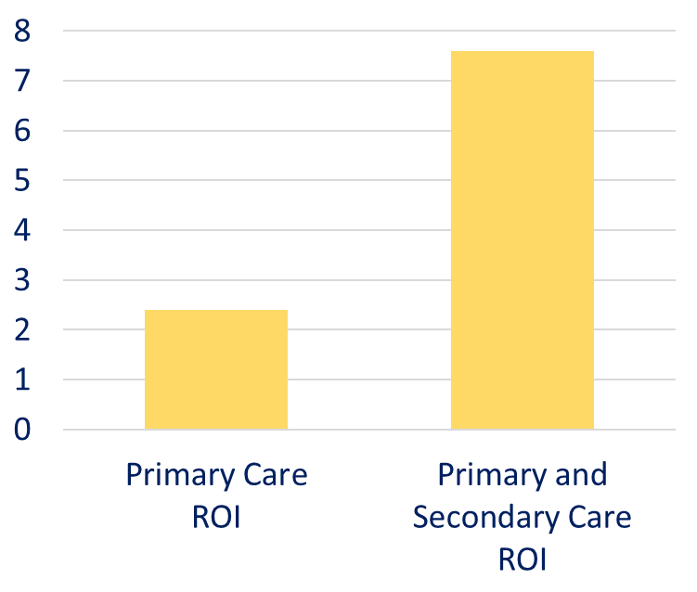
The Return on Investment of a Typical Intervention
Patients received, on average, 180 minutes of support from a Social Prescriber or Care Coordinator
This support may pay for itself 2 times over in reductions in primary care demand and 7 times over in reductions in primary care and secondary care demand
This does not count the cost of any onward referrals but it also doesn’t count benefit in year 2, benefit to other providers or the benefit of better health to patients
Return on Investment (ROI):
Do the benefits of an intervention exceed the input costs?

Slide 68
Impact of Social Prescribing on Older People
 | Patients | GP Contacts | GP Demand Trend | Hospital Admissions | Falls | Repeat Meds
Patients over 65 who have just started receiving social prescribing support | 67 | 24 | Rising | 1 for every 6 patients | 1 for every 4 patients | 8
Patients over 65 who had social prescribing support 1+ year ago | 36 | 17 | Stable | No admissions | 1 for every 7 patients | 7
Older people who were supported by social prescribers have fewer admissions, fewer falls and fewer repeat medications. They also had fewer contacts with specialist nurses and had 7 fewer GP contacts last year.
Notes:
The 36 patients include some of those in the pilot

Slide 69
Other things you could measure
Feelings change > Health improves > Demand reduces
Activation (previous slide)
Wellbeing (ONS4)
Anxiety (GAD2)
Depression (PHQ2)
LTC management (EQ5D)
BMI
HbA1c
ACT scores
Blood Pressure
Let us know what improvements you’ve made and we’ll help you work out a Return on Investment

Slide 70
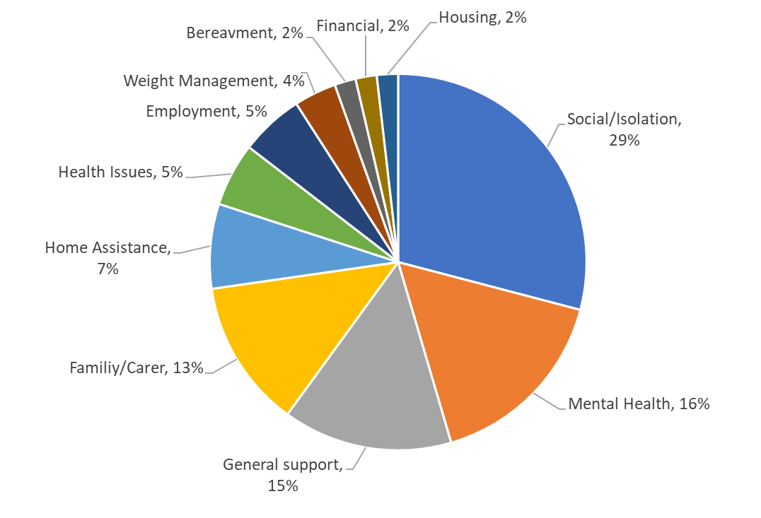
What help do people typically need?
Question:
What one thing do you need to help you improve your health and wellbeing?
Relationships are key

Slide 71
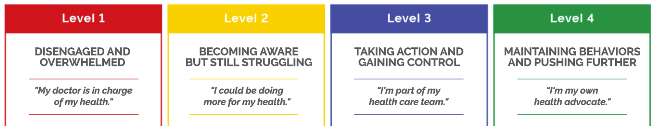
The Power of Patient Activation
The Patient Activation Measure (PAM) measures a person’s knowledge, skills and confidence in managing their own health and wellbeing
Increasing a patient’s activation leads to improved health and reduced health utilisation
GP appointments | 18% | â
Other PC appointments | 18% | â
A&E attendances | 32% | â
A&E admissions | 38% | â
Elective admissions | 20% | â
Outpatient appointments | 19% | â
Length of stay | 41% | â
GP appointment DNA | 23% | â
Outpatient DNA | 28% | â
Reduction if a patient’s activation rises from 1 to 4
Have not counted the benefit to…
Mental health services
Community services
Ambulatory service
Local Authority
Voluntary & charity sector
Private sector
Nor the value of better health to the patient
= £1670 per patient per year

Slide 72
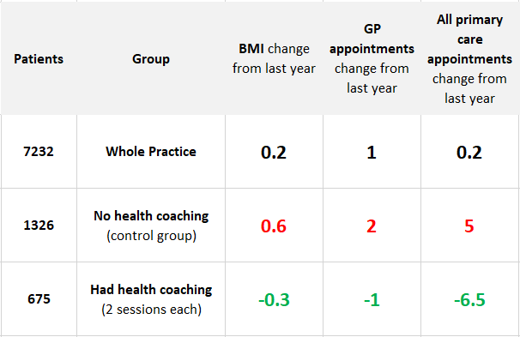
Proactive, holistic, preventative care is linked to lower BMI and GP appointments
2 health coaching sessions are correlated to a reduction of just under 12 appointments
Similar impact seen for health checks, lifestyle advice, self-care planning and social prescribing potentially offering a strong return on investment in terms of patient benefit and reduction in GP demand.
What other kinds of targeted ‘health nudges’ could help large at-risk populations?
Notes:
Context: Demand is rising, we’ve tried everything at the acute end, only thing we have left is stopping people from getting sick, PHM interventions really work and work quickly
Generally, the most impactive initiatives are the ones with FOUR features: -
They have the strongest working relationships with the widest group of health and non-health providers
They get the furthest upstream from acute/medicalised care into prevention, self-care, improving wellbeing and addressing the social determinants of health
They use their data to identify and proactively reach out to patients who will benefit from support the most (rather than use the initiative as a reactive ‘referral into’ service during a GP appointment)
They start small but quickly measure what works to help them fail quick and learn and build a case for change
Contrast a typical ‘good’ health ROI of 2 vs the ROI of Health Coaching (in Dorset) of nearly 13
If you can’t start a small nudge intervention with a small group of patients at least start collecting PAM

Slide 73
The PCN advisor offer (1)
Our offer of support:
Pan London, the PCN Advisors aim to:
    Develop a network of people across the capital to connect to build sustainable models of good practice - you are all the pioneers in this forward thinking and evolving field after all!
    Collate, make sense of and share case studies and resources useful to this work
    Complement local efforts to support the embedding of the three roles
This will be delivered through the following:
A monthly, pan London ‘Connect and Share’ session for those that employ and/or are looking to embed the three personalised care roles in their PCN: themed and open sessions with presentations of good practice case studies across London plus time for Q&A and discussion.
  Thu 18th November 12.30pm: Embedding the three personalised care roles. RECORDING HERE
  Thu 13th Jan 2022, 12.30pm: Open session (workshop) exploring different ways personalised care roles can support primary care and communities at this time: Slides here.
  Feb 2022: Spotlight on Care Coordinators and how best to use them (Wed 16th Feb 3pm) Recording and slides here.
  Mar 2022: Spotlight on Health and Wellbeing Coaches and how best to use them Recording and slides here.
  Apr 2022: Population health and the PC ARRS roles: Sign up here

Slide 74
The PCN advisor offer (2)
1-1 support – every Wednesday there will be 30 minute slots available to….
  Ask questions, explore challenges, think through strategies to use the personalised care roles, get advice on resources or peers to connect with.
Book in via the following link: https://calendly.com/pcn-advisors-london/30min.
Available to present at meetings: The PCN advisors can come and speak at PCN or CCG meetings with CDs, PCN or ARRS managers on topics such as embedding the personalised care roles, social prescribing, how the roles can tackle health inequalities. Email us: hlp.socialprescribing@nhs.net
WhatsApp group for those that employ and/or are looking to embed the three personalised care roles in their work to connect with each other informally. We have set this up and trial and see if it is useful. We’re open to suggestions on alternatives but for now you can join the group. Use this THIS LINK to add your details and access the group.
We also hope to :
Send a monthly email with updates, resources, answers to common questions being asked, useful events and so on
Communicate challenges up to NHSE and the wider system, developing ideas for projects that might usefully mitigate some of these challenges
Co-produced PCN toolkit & FAQ Guide including useful case studies

Slide 75
Supportive Self-Management: key resources
1. | Measurement and evaluation within supported self-management This guide describes the steps for planning hot to use measurement within supported self-management, based on evidence and good practice.
2. | Health & Wellbeing Coach Welcome pack - The welcome pack is designed for newly appointed health and wellbeing coaches in primary care networks.
3. | Care Coordinator workers Welcome pack - The welcome pack is designed for newly appointed care coordinators in primary care networks.
4. | Health Coaching guide and technical annex Designed to support the delivery of health coaching. This guide should be used when commission and when deciding what can or should be counted and reported as health coaching in a local area.
5. | Care Coordinator recruitment pack An optional resource to provide support to PCN’s in the recruitment or engagement of care coordinators. The resource includes: Sample job description Sample person specification Sample job advert Sample interview questions
6. | Health & Wellbeing Coach recruitment pack An optional resource to provide support to PCN’s in the recruitment or engagement of care coordinators. The resource includes: Sample job description Sample person specification Sample job advert Sample interview questions
7. | Care Co-ordination practice leaflet - Primary Care practice leaflet to explain the role of Care Coordinators to patients
8. | Health and Wellbeing FAQ’s
9. | Care Coordination- Primary Care leaflet - This document provides an in-depth summary of the roles and application of the Care Coordinator within primary care.
10. | Health & Wellbeing Coach Mentor: Caroline Haines, caroline.haines1@nhs.net
11. | Care Coordinator Mentor: Dr Ali Hassas, alihassas@nhs.net
12. | FutureNHS Collaboration Platform - Source of good practice guidance, webinars, updates and more. Something we should be encouraging link workers to join. To join please email: england.supportedselfmangement@nhs.net
@SP_LDN
hlp.socialprescribing@nhs.net

Slide 76
Social prescribing and personalised care: key resources
1. | Summary Guide, which gives a clear picture of what a good social prescribing scheme looks like for everyone - also includes a common outcomes framework to help measure the impact of social prescribing on people, the local system, and the voluntary and community sector.​
2. | Reference Guide for PCNs supports PCNs with information on setting up social prescribing services including support for recruitment, induction and supervision - also outlines quality assurance measures, and how info can be gathered to help develop a consistent evidence base for social prescribing. ​
3. | Welcome and induction pack for link workers in primary care networks (PCNs).​
4. | Handout for practice staff to give to people who are referred to a social prescribing link worker. ​
5. | Themed fortnightly webinars for link workers​
6. | Regional Learning coordinators (London = lianna.martin@nhs.net) provide learning and peer support for link workers (SPLWs) at both a regional and Primary Care Network (PCN) level
7. | Regional Facilitators support local system leaders to bring partners together to create and deliver place-based plans across the ICS/STP footprint which support the development of social prescribing and community-based approaches and to embed link workers in every Primary Care Network​.
8. | Regional PCN Advisors - support PCNs to embed the three personalised care roles within primary care: Social Prescribing Link Workers (SPLWs), Health and Wellbeing Coaches (HWbCs) and Care Coordinators (CCs) (London = lianna.mrtin@nhs.net + hina.shahid1@nhs.net)
9. | Accredited online training through Health Education England​
10. | Personalised Care Institute - Free courses available through the Personalised Care Institute. Core skills training shared decision making and personalised care and support planning training that is available free online from the PCI would be, on the whole, relevant and of benefit to the personalised care roles.
11. | Social Prescribing Slide deck Generic slide deck for social prescribing presentations
12. | Directed Enhanced Service sets out how commissioners must offer to primary medical services contractors the opportunity to participate in the Network Contract Directed Enhanced Service (DES). It outlines the eligibility requirements and process for primary medical services contractors to participate; and sets out the relevant rights and obligations for PCNs and commissioners.
13. | Network Contract DES – VAT Information This document is an information note from NHS England regarding the Network Contract DES and VAT
14. | IIF Implementation Guidance 2021-22 This document sets out guidance for primary care networks (PCNs) implementing the Investment and Impact Fund, as per the requirements set out in the 2021/22 Network Contract Directed Enhanced Service (DES) Specification.
15. | Key DES-IIF and operating changes 2021-22
16. | FutureNHS Collaboration Platform Source of good practice guidance, webinars, updates and more. Something we should be encouraging link workers to join. To join please email: england.socialprescribing@nhs.net
@SP_LDN
hlp.socialprescribing@nhs.net

