Slide 1
Senior Mental Health Lead role and Whole School/College Approach to Mental Health & Wellbeing
London Celebration Event
24th March 2022

Slide 2
My background
My role
London Regional Lead, Mental Health Delivery Division at Department for Education ​
Work in partnership with health colleagues to successfully establish MHSTs in schools/colleges to support the children and young people's mental health and wellbeing.
20 years teaching in an Islington primary school (10 years as Deputy Head, role included SMHL)
7 years as a governor in a Barnet primary school (overseeing safeguarding, curriculum & wellbeing)

Slide 3
Senior Mental Health Lead role and Whole School/College Approach to Mental Health & Wellbeing
Important role of education settings
Senior Mental Health Lead role
Whole School/College Approach (WSCA) - how it works best
Celebration – sharing positive feedback from London settings
Notes:
Kicking off the event, I shall try and set the scene for some of the extensive and brilliant work going on with schools and colleges across London to support the MHWB of CYP.
Don't plan on giving lots of detailed information, just some basics and focus on the celebratory aspect of today's event.

Slide 4
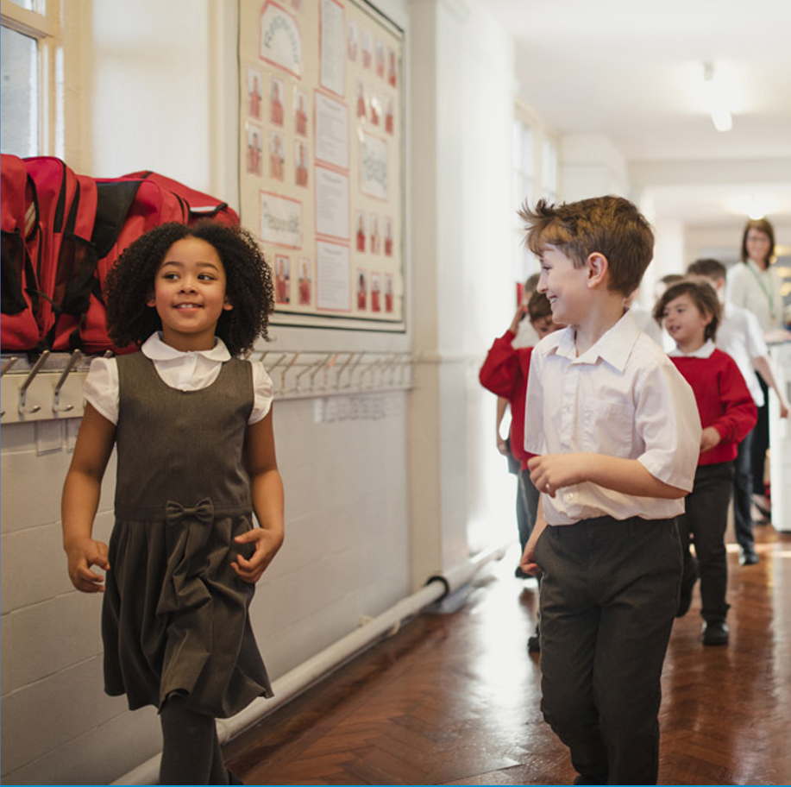
Schools and colleges have a critical role to play in promoting and supporting mental wellbeing
Prevention
Identification
Early Support
Referral
Notes:
The fact you are here at this event means that whatever your background and role, you have expertise or an interest in supporting MHWB.
A statistic you may already be familiar with, is that it is estimated that 75% of enduring mental health disorders have commenced by the age of 18, 50% at age 15. Get it right in childhood and reap the benefits in later years.
Crucial role schools play. Facilitating MHWB promotion and support through education settings is key. Schools/colleges work directly with CYP in the formative years of their lives. They know the CYP, know the community, know the current issues. Having the day to day contact with CYP/families allows for prevention and early identification to be far more effective, rather than services only being accessed when issues have become more critical and reached the referral stage (families often more likely to access wider services through a school too).
Education staff have developed incredible skills in pastoral care, but they are not trained clinicians. Instead they are professionals in pedagogy, T&L, behaviour, who are on the front line dealing with the effects of poor MHWB and they have limited capacity. Therefore, MH work in schools must be a reciprocal partnership between health and education where the two sectors value each other’s expertise.

Slide 5
Senior Mental Health Lead role
A senior mental health lead is a strategic leadership role in a school or college, responsible for overseeing the setting's whole school or college approach.
Over 100 DfE quality assured courses
Grants and support for state schools to access training meeting their needs
Knowledge and skills to implement a whole school or college approach to MH&WB
Further information:​
Senior mental health lead training - GOV.UK (www.gov.uk)
Notes:
There will be varying degrees of awareness amongst you about the role of a SMHL, so I'll just clarify in a nutshell what the role is and since this is a celebration event, I'll share some of the latest good news about the DfE's funded training for SMHLs.
The idea is that all education settings should have a designated member of staff who leads on the mental health and wellbeing provision. It is a strategic role, which needs to be championed by the senior leaders in order to bring about holistic change. Although it is not a mandatory role for schools, the need for one is becoming increasingly recognised. 84% of schools had a lead in 2021, up from under 50% in 2016.
There is DfE funded training for all settings to train a member of staff in this role. And training is underpinned by the WSCA to MHWB.
If you want to find out more about the accredited courses on offer and the grant application, then the .gov page has all the up to date information you need. But there really is a vast array of courses to choose from to meet the needs of the school/staff member (different time commitments, online or face-to-face, different price brackets and to accommodate different levels of prior expertise).

Slide 6
Senior Leads feedback
The training has been an invaluable way to draw together all my ideas and initiatives about having a whole school approach to Mental Health… The skills gained from the course will enable me to lead by example as a Senior Mental Health Lead and also put into place systems to support my staff and students whilst drawing on the practice of others. It has been excellent.
This has been a very interesting unit. It has made me reflect on where I am at the moment, and what I want to achieve going forward. The challenge to me is that we can't do it on our own as a school and I need to consider how we can engage other partners in our community. It is key from this unit that mental health is a collective responsibility and that we are a community within a community.
As at the 12th January 2022:
Over 8,000 eligible schools and colleges have applied for a senior mental health training grant since applications opened in October 2021.
Over 6,500 senior leads have booked onto a Department for Education quality-assured senior mental health lead training course.

Slide 7
Senior Mental Health Lead training news
On 8 February, we announced an additional £3 million to be provided to extend training to more schools and colleges given high demand, so that everyone eligible who wishes to access training before the end of May 2022 will be able to.
We continue to quality assure courses each month and will be asking for feedback on learners' experience starting in April.
The new course selection tool is now live on Carnegie’s website (Choosing a Senior Mental Health Lead training course | Carnegie Centre of Excellence for Mental Health in Schools | Leeds Beckett University )
First publication of the list of schools and colleges that have claimed a training grant will be aligned with a broader statistical release around mid-April. We will then refresh and publish this list on a regular basis to help partners to target support for uptake and embeddedness.
Notes:
More funding has been confirmed to extend access to the training.
More courses to choose from (over 100 to choose from now).
New selection tool to help choose a course that fits an individual's needs best.
Publishing list of schools/colleges that have claimed the grant to help give oversight of uptake in your area. Knowing which schools have and have not accessed the training helps people know where to focus particular support.

Slide 8
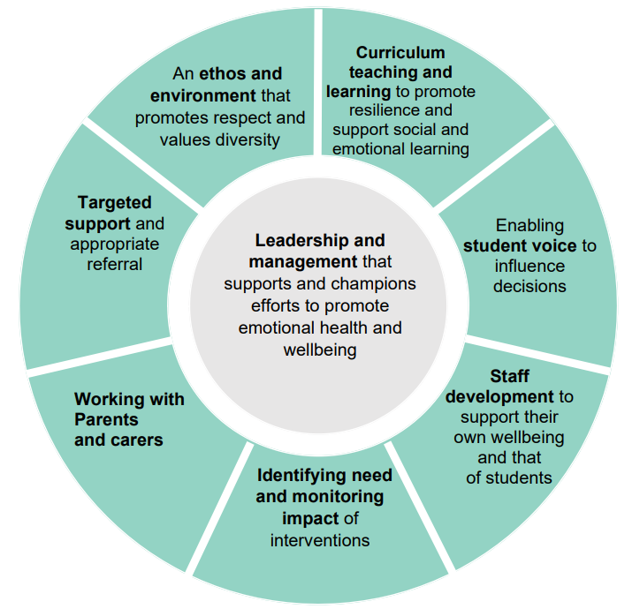
Effective Whole School/College Approach to Mental Health & Wellbeing
Notes:
I can't talk about SMHL without talking about WSCA because the role is underpinned by how WSCA is developed at a setting. WSCA is the key to sustained and wider impact for CYP.
I imagine that most of you at this event are very familiar with these 8 principles of WSCA so rather than talk through them one by one, I thought I would just share some examples where there is some really effective practice in WSCA to MHWB and how impactful it has been.
One example of a model I'll talk through is of a SMHL who developed a multi-disciplinary approach to MH at her school by setting up weekly pastoral team meetings. These were attended by the SENCO, DSL, school counsellor, CAMHS and EMHP every week, and often (and specifically invited where necessary), EP, Early Help Practitioner, Behaviour Outreach support worker and a host of other professionals. The SMHL chaired the meetings and talked through cases which had been brought to her through school, either new concerns, often minor, as well as on-going cases. This gave the opportunity for professional dialogue about the issues and possible support and actions. These might be anything from continued monitoring and supporting school staff with universal offers and advice, to ensuring the best referral pathways were chosen and everything in between. The school was benefiting from specialist expertise, services were able to share their offer and ensure cross-over was avoided or joined up work was implemented where needed. Some impactful work that came from this includes:
Whole class interventions on emotional regulation to target a cohort with common difficulties
Referrals to wider services being accepted (and where there might be wait times, plans could be put in place for the short term)
Parents accessing specialist local services (e.g. voluntary organisations for substance misuse or domestic abuse, parenting courses, or really practical things like housing support etc)
School staff having training in identifying MH needs and later trauma informed practice
Behaviour policy being adapted to be more trauma informed
Pupil voice being embedded into practice throughout the school year and influencing change
A shared language for emotional regulation being taught and used widely across the school
Daily check-ins becoming part of school routine so that all pupils feel seen and staff can follow up on issues
Assemblies and events were planned out in the school calendar and executed with support of professionals and high quality resources
The list goes on, but the point is that the was a holistic shift in the school's approach to MHWB, facilitated by the SMHL, and it was rolled out carefully over time in a joined-up way, accounting for all 8 principles of WSCA.

Slide 9
Parent and child feedback
“We still use the ideas of seeing the anxiety from another perspective, naming it, explaining it and then disputing it. Every morning we do a sort of breathing exercise which has hugely helped [our daughter] to be able to gradually soothe herself. Her sense of ownership, awareness and understanding is amazing in an 8 year old!
This support has helped us immeasurably.”
“Hi just want to say a massive thank you. I honestly feel like I've got my daughter back she's like a different person. She looked forward to speaking with you so much I'm over the moon how much this has helped. As I'm writing this she is singing and dancing with her headphones on this is something so small but makes me so happy to see her so happy. Thank you again for all your support and help.”
“The most helpful part of this was knowing that I wasn't going to be judged about what I said and that I wasn't going to be seen as 'doing it for attention’. Going through ways to cope/ deal with the depression or anxiety were also helpful as it has shown me which ones will and won't work”

Slide 10
Snapshot of feedback from London schools 2021
Notes:
DfE survey schools and colleges about their views on various aspects of the MHST service.
You'll see from these 2021 results (2022 surveys to be going out to settings very soon) that the service received incredibly positive responses nationally which is great and should be celebrated, but also note that London settings were particularly positive about their experience of the MHST service.

Slide 11
Quotes from London schools about the work of MHSTs
“This is an excellent programme that has contributed to the high quality of emotional and mental health support we are able to deliver to our school community.” SECONDARY SMHL
“It is seriously a fantastic programme and will make such a difference to early help and support at primary school giving families and children coping strategies for life. I cannot recommend it enough! Thank you” PRIMARY SMHL
“I honestly don't know where our mental health provision would be without our MHST and what I would do without them” PRIMARY SMHL
“We have been very pleased with the work undertaken as part of this program. It has made mental health services much more accessible for our families” PRIMARY SMHL
Notes:
Finish with some celebratory feedback from school staff.
And to add my own personal feedback- having moved from working on supporting MH in specific London schools (as a senior leader and as a governor), and now being part of the authorities that are pushing this work forward on a national level, I am so impressed by the passion and expertise of people working in the vast amount of teams across health, education, communities and so on who are working so hard to support the MHWB of our children and young people and I look forward to continuing to drive this important work forward.

Slide 12
Department for Education © Crown copyright 2022
Kirstie.Stroud@education.gov.uk

