Slide 1




Jayne Abbott
Children & Young People’s Mental Health Lead
Resilient Schools Programme Manager

Slide 2

The Department for Education (DfE) recognises that: “in order to help their pupils succeed; schools have a role to play in supporting them to be resilient and mentally healthy” There is good evidence to support this assertion and Ofsted has highlighted that children and young people themselves say that they want to learn more about how to keep themselves emotionally healthy. Moreover, schools have a duty to promote the wellbeing of students.

Slide 3
Resilient Schools 2017 - 2021

Slide 4
Uptake of Resilience Schools Programme
6 Special Schools (2 remaining)
15 Secondary Schools (17 remaining)
56 Primary Schools (38 remaining)

Slide 5
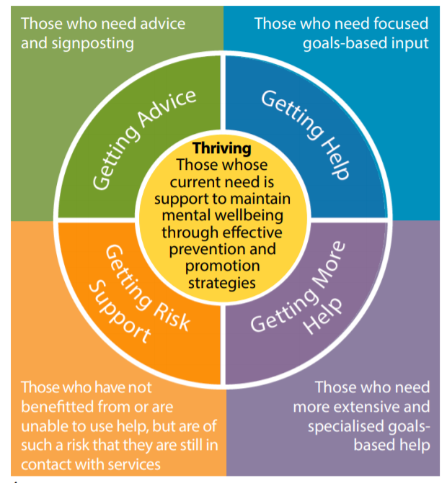
Resilience Schools & the Thrive Model
Resilient Schools
Qwell
Kooth
BICS
Clinical Intervention- CAMHS
. IAPT Therapy Services
. CAMHS

Slide 6

Barnet Integrated Clinical Service
Barnet Education Learning Support
CAMHS
Inclusion Advisory Teams
Voluntary Section
Family Services
Barnet Safeguarding Partnership
CYP Mental Health Board
Suicide Prevention Partnership
Schools
Health Schools London
Partnership Working

Slide 7
What is the Barnet Resilient Schools Programme?
The Programme Aims To:
Raise awareness and de stigmatise mental health
Help school communities (pupils, staff, parent and carers to recognise their own and others mental health needs and be confident to seek support for themselves and others.
Through awareness be able to intervene early to prevent the escalation of poor mental health
Notes:
My focus today will be on moving into our Universal offer open to any school in Barnet and how we distinguish between those that are making some use of the Resilients Schools Offer and those that are really embedding the whole school approach – and how are schools being recognised for this – Resilient Schools logo?

Slide 8

RESILIENT SCHOOLS UNIVERSAL OFFER
CORE COMPONENTS
SUPPORT
TRAINING
Mapping Tool
Mental Health First Aider
Suicide Prevention
Digital Resilience
Kooth and Qwell
Network Meetings
Peer to Peer Support
Support through Programme Manager and Health Improvement Officer
Resilient Schools website
Links to new evidence-based support and resources
Resilience in Schools Forum – Inclusion Advisory Team
Pastoral Forum – Barnet Integrated Clinical Services
Mindfulness
Department for Education Return to Wellbeing
Physiological First Aid
Emotion coaching
Unconscious Bias
Restorative Justice
Zones of Regulation
Evidence of being a Resilient School

Slide 9
Evidence that you are a Resilient School that raises awareness and de-stigmatises poor mental health?
Mapping Tool
Will demonstrate all that you are doing
Mental Health Awareness
Have at least 1 trained MHFA
Staff training
Promotion of Kooth and Qwell
Posters around the school
Staff know about Qwell
Will demonstrate challenges or things you might decide to work on
Deliver mental health awareness to pupils
Parent training
Staff knowledge of Kooth for signposting
Book a presentation
Self Harm and Suicide
Digital Resilience
Ensure this is in your safeguarding/wellbeing policy
Book on Papyrus Suicide Prevention training
Raise awareness of the impact on mental health through signposting to resources
Will play a part in informing future trainings/interventions

Slide 10
MAPPING TOOL
This can underpin, reinforce a Whole School approach – not replace it.
Looking at your key strengths
Looking at your challenges
Using as a reflective piece
Enables and formalises the sharing of good practice between schools
on, anger
An ethos and
environment that
Promotes respect
And values diversity
Curriculum,
teaching and
learning to promote
resilience and support
social and emotional
learning
Targeted
support and
Appropriate
referral
Enabling
student voice
to influence
decisions
Leadership and management
that supports and champions
efforts to promote emotional
health and wellbeing
Staff
development
to support their own
wellbeing and that
of students
Working with
parents/carers
Identify need and
monitoring impact of
interventions
(Source Public Health England and Children and Young Peoples Mental Health Coalition, 2015)

Slide 11
Identifying Need and Monitoring Impact
Key Question: How does the school or college assess the needs of students and the impact of interventions to improve wellbeing?
Links with the Ofsted Inspection Framework: When inspecting the quality of leadership in and management of the school Ofsted inspectors should consider the effectiveness of monitoring and evaluation and the extent to which it is shared with governors. They should also consider how well the school meets the needs of all vulnerable groups of pupils. Assessing and responding to the emotional health and wellbeing needs of children and learners, and taking steps to mitigate the impact this has on their capacity to learn could provide supportive evidence in relation to all key judgement areas: the achievement of pupils at the school, the quality of teaching in the school, the behaviour and safety of pupils at the school and the quality of leadership in and management of the school.

Slide 12
Working with Parents/Carers
Key Question: How does the school or college work in partnership with parents and carers to promote emotional health and wellbeing?
Links with the Ofsted Inspection Framework: . Links with the Ofsted inspection framework: The Ofsted inspection criteria expects schools to be engaging parents in supporting pupils’ achievement, behaviour and safety and their spiritual, moral, social and cultural development. Ofsted inspectors have a duty to have regard for the views of parents. Inspectors will also take account of the results of any surveys carried out or commissioned by the school

Slide 13

Youth Mental Health First Aid
To preserve life where a person may be a danger to themselves or others
To provide help to prevent the mental health problems developing into a more serious state
To promote the recovery of good mental health
To provide comfort to a person experiencing a mental health problem
Covering the Mental health problems of:
Depression ~ Anxiety ~ Eating Disorders ~ Psychosis ~ Self Harm and Suicide
Covering the Mental health Crisis Situations of:
Suicidal behaviour/thoughts
Panic attack/Acute stress reaction
Acute psychotic behaviour

Slide 14

Engagement-Mental Health First Aid
191 Trained Youth Mental Health First Aiders
213 Trained by end of Academic Year (2021/22)
89 schools have at least one Youth Mental Health First Aider
32 young people trained as peer champions

Slide 15

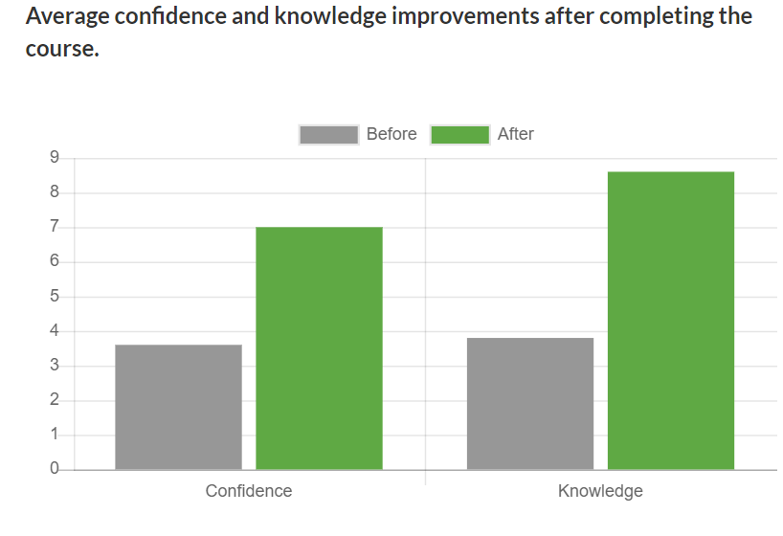
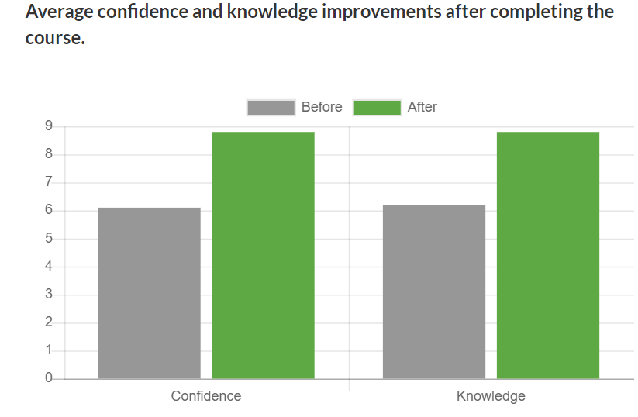
Thought-provoking. I genuinely feel that the course has changed my way of thinking. I realise that you don't know what is going on in people's lives. I shall always try to be kind and tolerant and remember if someone is behaving unusually, there is most likely to be a reason for it.
The course was delivered in a very personal yet professional manner. It was discussed in detail to support my understanding and develop my knowledge in this field. Completing this course has enabled me to have the confidence to share my experience and knowledge of this subject with my team and family who live alongside this. It has given me a broader scope in how to support a young person experiencing these issues in their life and to use the correct terminology to support them. It has been hugely beneficial and I am honoured to be part of this community and look forward to making a difference in society. Thank you

Slide 16
Lessons Learnt From Our Pilot Phase
That’s many schools address most of the Whole School Approach – they just need to demonstrate it and map out gaps.
That schools want to do everything but don’t have the capacity.
That schools need recognition for their achievements – RS logo.
That a programme works well when it continues to be co produced.
Resilience in Schools Forum – support with the key principles of whole school approach.
Youth Mental Health First Aid Training for ALL schools
Pastoral Forum – working in partnership with Barnet Integrated Clinical Team
Availability of Programme Manager and Health Improvement Officer when needed
Self Harm and Suicide Document
Development of RS website

Slide 17
Moving into the Universal Offer
Delivery of Mental Health Awareness throughout the school community – a commissioned service.
Recognition for Schools using the Resilient Schools Logo
Peer Champions - a commissioned programme for 16+
Training and support for our Youth Mental Health First Aiders
Continue to work closely with schools to inform future decision making.
Ensure RS continues to align with pathways for mental health in Barnet using the Thrive approach and continues to work in partnership with others.
Looking at evidence/outcomes – how do you evidenced that a preventative approach and building of resilience stopped escalation of poor mental health later on??? (quantitive not qualitive)

