Slide 1
Mental Health Support Teams
Workforce Update
North East and Yorkshire MHST Forum
10th March 2022

Slide 2

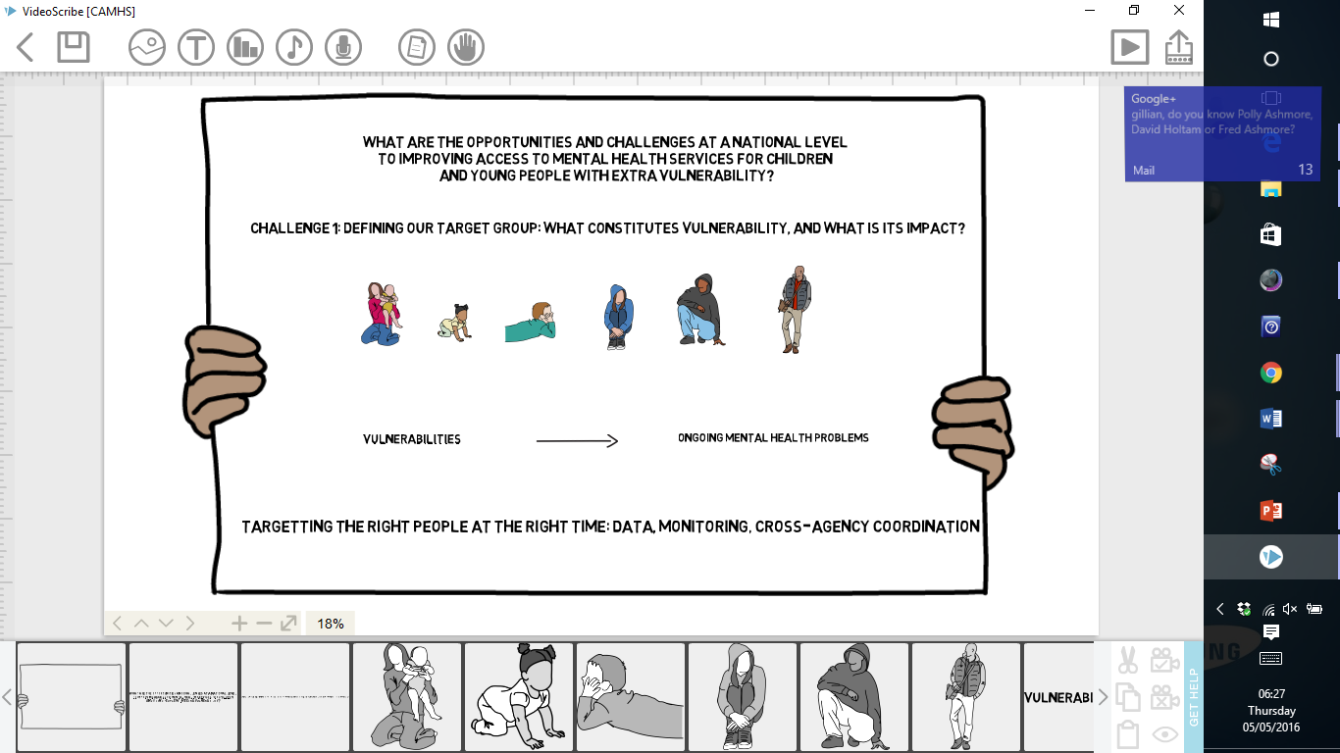
The NHS Long Term Plan
Four Week Waiting Times
Test approaches that could deliver 4ww times for access to NHS support, ahead of introducing new national waiting time standards for all children and young people who need specialist MH services
Eating Disorders
Boost investment in children and young people’s eating disorder services to continue seeing 95% of urgent cases within 1 week, and within 4 weeks for non-urgent cases.
Crisis Services
With a single point of access through NHS 111, all children and young people experiencing crisis will be able to access crisis care 24 hours a day, 7 days a week by 2023/24
Comprehensive offer for 0-25 year olds integrated across health, social care, education, and the voluntary sector to address health inequalities
Digital Therapies
Develop digitally enabled care pathways for children and young people in ways which increase inclusion
Whole pathways, including inpatient beds
Extension of New Models of Care/Provider Collaboratives continue to drive integrated pathways
Access
MHSTs form part of the commitment that by 2023/24, at least an additional 345,000 children and young people aged 0-25 will be able to access NHS-funded mental health services
Mental Health Support Teams (MHSTs)
MHSTs working in schools and colleges – early intervention and whole school approach across 20-25% of country by 2023
Wider Commitments
Additional investment in Youth Justice services
Reduced waiting times and increased support for children and young people with learning disabilities and/or autism
6,000 highly vulnerable children with complex trauma will receive consultation, advice, assessment, treatment and transition into integrated services

Slide 3
Significant new funds for CYPMH in NHS Long Term Plan
 |  | Baseline Year | Year 1 | Year 2 [FYFVMH Ends] | Year 3 | Year 4 | Year 5 [Settlement Ends]
 |  | 2018/19 | 2019/20 | 2020/21 | 2021/22 | 2022/23 | 2023/24
Children and Young People’s Community and Crisis | Central / Transformation | 65 | 68 | 49 | 113 | 150 | 218
 | CCG baselines | 170 | 195 | 231 | 261 | 319 | 383
 | Total | 235 | 263 | 280 | 375 | 469 | 601
Children and Young People’s Eating Disorders | Central / Transformation | 0 | 0 | 0 | 0 | 0 | 0
 | CCG baselines | 30 | 41 | 52 | 53 | 53 | 54
 | Total | 30 | 41 | 52 | 53 | 53 | 54
Mental Health Support Teams (MHSTs) and 4 week waiting time pilots | Central / Transformation | 24 | 76 | 115 | 136 | 185 | 249
 | CCG baselines | 0 | 0 | 0 | 0 | 0 | 0
 | Total | 24 | 76 | 115 | 136 | 185 | 249
Children and Young People’s (CYP) Mental Health Total | Central / Transformation | 89 | 144 | 164 | 249 | 335 | 467
 | CCG baselines | 200 | 236 | 283 | 314 | 372 | 437
 | Total | 289 | 380 | 447 | 563 | 707 | 904
Over £900m in additional funding has been made available during the Long Term Plan period
This is on top of existing mental health spend before 2018/19
Main funding streams are:
Growth in existing CYP Mental Health services (CAMHS) and CYP crisis
Continued expansion of CYPMH community eating disorder services to meet the access standard
Implementation of Mental Health Support Teams in schools and colleges
£79m additional funding was made available in 2021/22 in response to the COVID-19 pandemic.
This funding forms part of the £500 million for mental health announced at the 2021 to 2022 spending review. It is being used to:
accelerate MHST
Complete 4 week wait pilots
improve capacity for CYPMH community and crisis and eating disorder
Notes:
Funding is increasing dramatically – amounts up to 23/24 are confirmed.
Underline that funding for already established MHSTs will continue beyond 24/25 as funding will go into baseline. This funding will be used to maintain and develop the workforce.

Slide 4
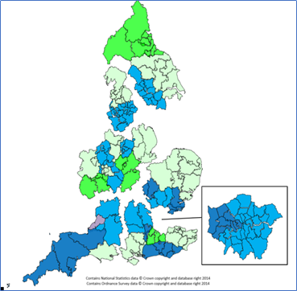
MHSTs: What has been achieved to date?
The Long-Term Plan Ambition: Mental Health Support Teams are being rolled-out to cover 20%-25% of the country by 2023
As a result of the Spending Review funding we have accelerated roll out of Mental Health Support Teams to around 399 teams, covering an estimated 3 million children and young people (35% of those in England) by 2023/24.
MHSTs are rolled out in two 'waves' per year (training waves commence in September and January)
2018/19: 58 ‘trailblazer’ MHSTs are now operational. Twelve of these sites are also piloting a four-week waiting time.
2019/20: 125 MHSTs are in their set-up phase and despite the pandemic should become fully operational during 2020/21
2020/21: further 104 MHSTs began recruitment and training in November 2020
2021/22: a further 112 teams have been commissioned
By mid April 2022
we expect to be able to confirm we have reached our LTP ambition of 20-25% coverage a year earlier than planned as wave 3&4 sites complete their training
update pupil coverage of 26%
confirm Wave 7 & 8 sites which will take us to 503 teams
ICS coverage information can be found on the NHS England page here

Slide 5
The Multi-Year Approach to MHST Site Selection
Having moved away from an annualised Expression of Interest Approach, regions have been supported to develop multi-year trajectories and plans for future MHST waves based on EMHP training places and funding in 2021/22 and beyond to achieve at least 20 - 25% coverage by 2023/24.
This new approach includes;
Providing a regional assessment of current MHST coverage, as part of a wider data pack, which will support local planning, reflect the needs of CYP and address gaps. Including a ‘minimum coverage’ benchmark at regional and STP/ICS level of 20%-25% by 2023/24 in the expectation that funding would be baselined at that point.
Refreshing existing guidance and site selection criteria.
Maintaining national oversight of the programme and that it is being delivered in-line with the operating principles and programme priorities.
Providing a national support offer throughout the site selection and mobilisation stages from NHSEI, DfE and HEE.
Regions can develop a locally determined approach that should be;
Multi-agency with clear collaboration between health and education and wider stakeholders
Informed by achieving more equitable MHST coverage across STPs/ICSs based upon a review of the Regional Data Pack and identification of ‘gaps’ in MHST coverage
Meet the needs of children and young people, based upon a review of inequalities, such as those highlighted in the Regional Data Pack and local intelligence
Developed through assessment of a site’s competency and state of readiness to establish an MHST
Advantages
Regions will be able to plan coverage as one process - will simplify planning
Increased confidence across NHSEI /HEE and training providers
Regions enabled to design and deliver MHST expansion tailored to local need, based on local expertise and knowledge of what works
Consideration of whole duration of the programme, rather than a year-by-year basis, will provide greater opportunity for equitable coverage aligned with CYP mental health needs and inequalities.
More time for local areas to plan and prepare, including engagement with key partners locally.
This multi-year planning process will incorporate site allocations for Waves 5 – 10:
*Subject to impact of COVID-19
Wave of Delivery | EMHP Training Cohorts Start Date
Wave 5 | September 2021*
Wave 6 | January 2022
Wave 7 | September 2022
Wave 8 | January 2023
Wave 9 | September 2023
Wave 10 | January 2024

Slide 6
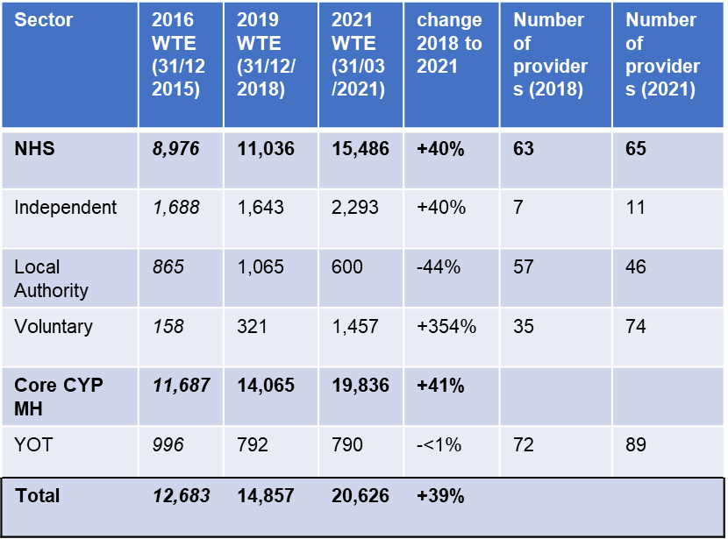
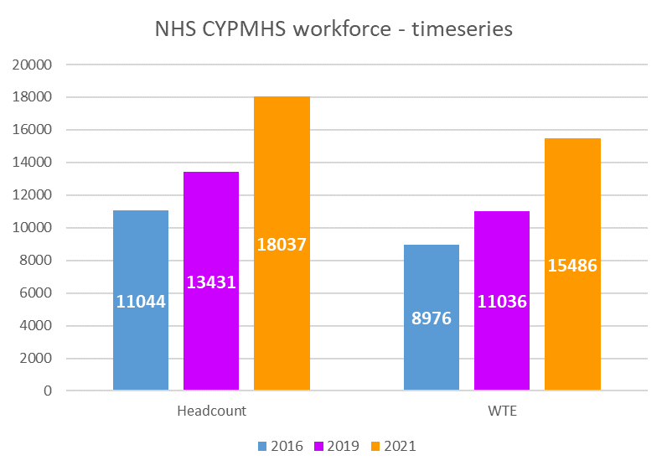
The CYPMH workforce is growing
According to latest NHS Benchmarking Report (October 2021)
the total workforce expanded by 39% since 2018
NHS, independent and voluntary sectors grew substantially, whilst the LA workforce shrank
CYPMH workforce sectoral composition:
78% are within the NHS
12% in the independent sector
7% in Voluntary Organisations
3% in Local Authorities
NHS vacancies:
have increased but remain at 9%.
The majority are in nursing.
NHS staff retention:
Has fallen marginally from 83% to 80%.
The full workforce audit report was published on 2nd November, and is on the HEE website
Notes:
Data from NHS Benchmarking shows that the CYPMH workforce, starting from a low base, has expanded consistently since 2012/13. Workforce expansion is just about keeping pace with increases in access, but vacancies increased by 2% in 20/21, and these dramatic increases must continue.
We can also see that the turnover of staff has increased marginally.

Slide 7
CYPMH Workforce Growth up to 21/22
Education Mental Health Practitioners (EMHPs) - over 1,600 trained or in-training since 2018-19
Children Wellbeing Practitioners (CWPs) – over 1,700 trained or in-training since 2016-17
Recruit to Train/CYP IAPT therapists – over 3,000 trained since 2011-12, and over 400 in 2021-22
Clinical Psychologists - 914​ training in 21-22, an increase of over 25% on the previous year
Child and Adolescent Psychotherapy – 76 training in 21-22, plus 25% on previous year
Family/Systemic Psychotherapy – part funding for 27 new starters on AFT accredited MSc qualifying courses​
Notes:
CWPs and EMHPs will be a substantial part of the increased workforce to enable increased early intervention and prevention in both community and educational settings, alongside core professions like clinical psychologists, child and adolescent psychotherapists, psychiatrists, etc.

Slide 8
Workforce developments in 22/23
Remotely delivered EMHP training will be piloted to increase access to existing and future training programmes.
Trainings for Senior Wellbeing Practitioners (EMHPs and CWPs)
Professional registration for EMHPs and CWPs
CYPMH Primary Care/Additional Roles Reimbursement Scheme (ARRS) offer
Annual NHS Benchmarking workforce audit
Initiatives for enhancing CYPMH nursing education and training.
Crisis team and 24/7 crisis line staff training
Online Trauma Informed Care training package
Initiatives for widening participation in the workforce
Youth Intensive Psychological Practitioners (YIPPs) will begin training

Slide 9
Children's Wellbeing Practitioner and Education Mental Health Practitioner Retention and Career Progression
Career progression pathways for CWPs and EMHPs through a Senior Wellbeing Practitioner role and training
Apprenticeship routes into trainings likely later
Training EMHPs and CWPs in supervision and extending clinical skill range so that trainee-supervisor skillsets are optimally-matched and pressure reduced on other senior clinical staff
2 years post qualification experience expected, but 1 year alongside existing qualifications/skills possible
Aim is to offer training places from January 2023
Several areas including Barnet, Cornwall, and Coventry already have CWPs and EMHPs in B6 supervisory/Senior roles

Slide 10


EMHP and CWP Registration
Registration with British Psychological Society (BPS) and British Association for Behavioural and Cognitive Psychotherapies (BABCP), identical processes.
EMHP and CWP courses will be accredited by BPS and will involve grandparenting for those who’ve already trained
Registers expected to be open by spring/summer 2022
Mandatory
Existing EMHPs and CWPs will have between 12-18 months to register
Expected to reassure:
    employers through accountability of clinical practice
    prospective trainees of validity of career path
Further details about maintaining registration will be shared by the professional bodies
Notes:
The BPS will accredit courses from January 2022, and accept HEE’s assurance of previously delivered courses so that already trained EMHPs and CWPs are able to register assuming they are working in accordance with the BPS and BABCP guidelines.
EMHPs and CWPs will need to be working in systems of care as defined by guidance issued by the professional bodies, which will include being supported properly.

Slide 11
Maintaining a full complement of EMHPs
Each MHST is funded to maintain four EMHPs
EMHPs drop out of training (attrition) as well as moving on after qualification (turnover)
A limited central fund for attrition is distributed by HEE, and new sites are given priority access
Where EMHP vacancies exist in sites after the set-up year, an underspend will have accumulated
MHSTs are encouraged to utilise underspend to directly commission EMHP trainings from HEIs, where training capacity is available
Remotely delivered training places may be accessible

Slide 12
Widening Participation in the workforce
Driven by the need for choice and compatibility in clinical care, and the advantages of workforce diversity
Ambition to empower local areas to recruit and appoint staff to reflect their local communities, and enable HEIs to utilise L6 (graduate) as well as L7 (post-graduate) training routes
Supported by:
    Widening Participation sub-group of EMHP Curriculum Development Group
    MHST Equalities and Diversities Group
Output so far include:
    Case study of representative recruitment in Calderdale
    Guidance on achieving workforce diversity in CWP Implementation Guide (forthcoming) and MHST Operating Manual V2 (forthcoming)
    Factoring into senior CWP/EMHP work – ambitions for apprenticeship routes, ensuring HEIs continue to offer L6/7 routes into CWP PGDip
    Analysis of HEE data on training cohort diversity
    Analysis by HEIs of training cohort diversity
Planned work includes:
    Survey of providers on representative recruitment and widening participation practices (April/spring 22)

