Slide 1
MHSTs in SW London: Moving to a more specialist focus with examples from a trauma informed team and a specialist FE College team
Dr Annika Clark
Consultant Clinical Psychologist

Slide 2
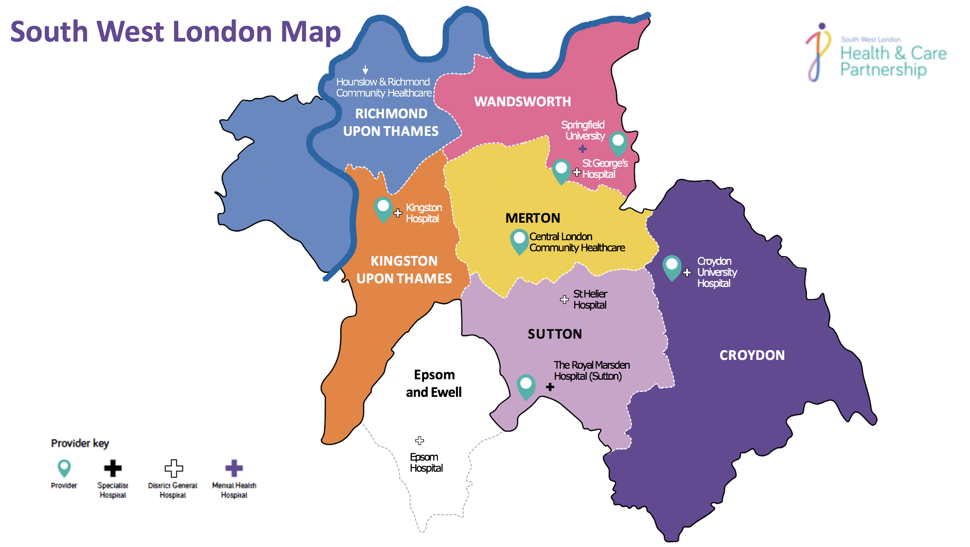
South West London footprint and context
Notes:
16 teams, 4 providers

Slide 3
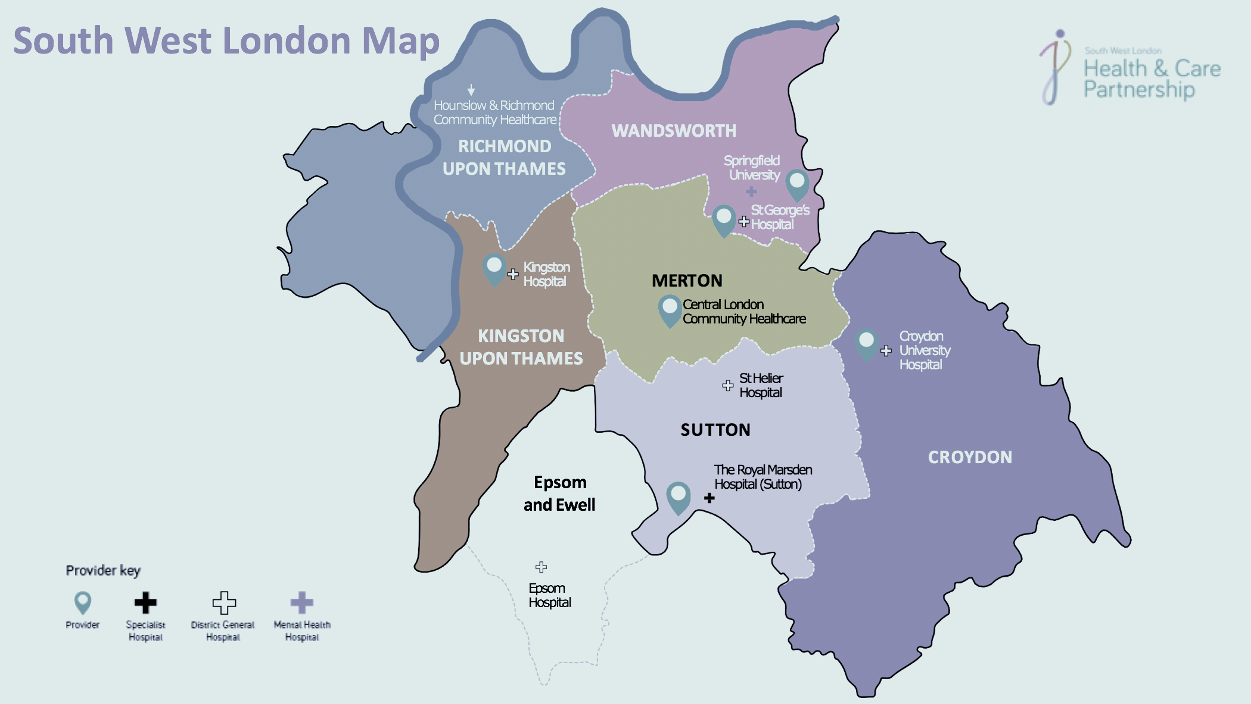
SWL model
Each MHST:
Works with a set group of schools, called a cluster
Each cluster has a Cluster Lead, a Headteacher, who leads and shapes the cluster
Cluster meetings are attended half termly, attended by a leadership or MH representative from each school; the MHST lead, borough commissioner and borough education inclusion lead. Other stakeholders join as appropriate.
Early intervention / prevention remit, with an additional specialist focus depending on local population need

Slide 4
The Battersea Trailblazer Mental Health Support Team
Multidisciplinary team: Psychotherapist, Clinical Psychologist, Occupational Therapist, Dramatherapist, EMHPs
Working across 15 Primary schools and 3 Secondary schools in Battersea
Team set-up in 2020
Trauma focus

Slide 5
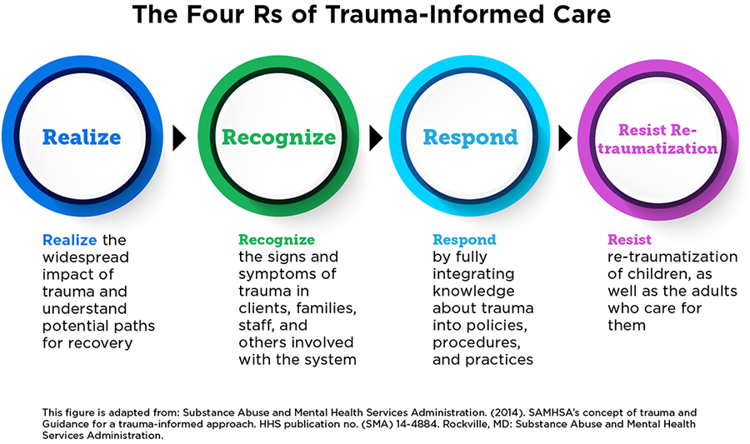
Realise
Recognise
Realise
Recognise
Notes:
So what does it actually look like?
In essence, a trauma‐informed approach is not a standalone intervention, technique or checklist that can be delivered in isolation, but rather a framework to guide systems. It requires constant awareness, sensitivity and possibly a cultural change at an organisational level
It is based on incorporating four key assumptions and six key principles, that are infused across all levels of an organisation rather than implementing a prescribed set of practices or interventions.
These are the four key assumptions that underlie a trauma informed approach and which highlight ways in which schools can begin to become trauma informed.
It may be that some of you have a good knowledge of this already or have a good understanding of the impact and signs and symptoms but are unsure how to respond or how best to support students. A whole school TIA ensures all members of staff feel confident in all of these areas. It is one that prioritises mental health and wellbeing of students and knows how to support
Realize – understanding the scope of the problem
Recognise – how trauma may present in different ways and how that may influence young people at school
Respond – this can happen in a variety of ways from responding to behaviour in the classroom to using strategies to support students who are overwhelmed and making onward appropriate referrals
Resist – be aware of how school and teachers can inadvertently retraumatse students if they have a lack of awareness

Slide 6
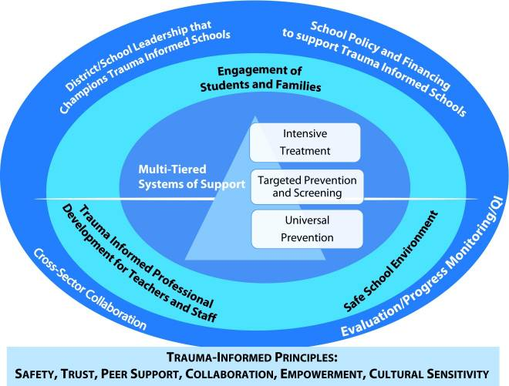

Slide 7
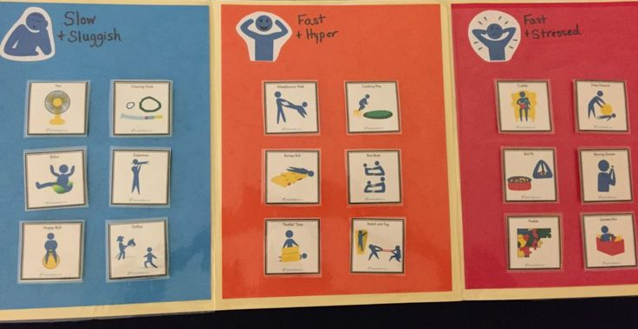
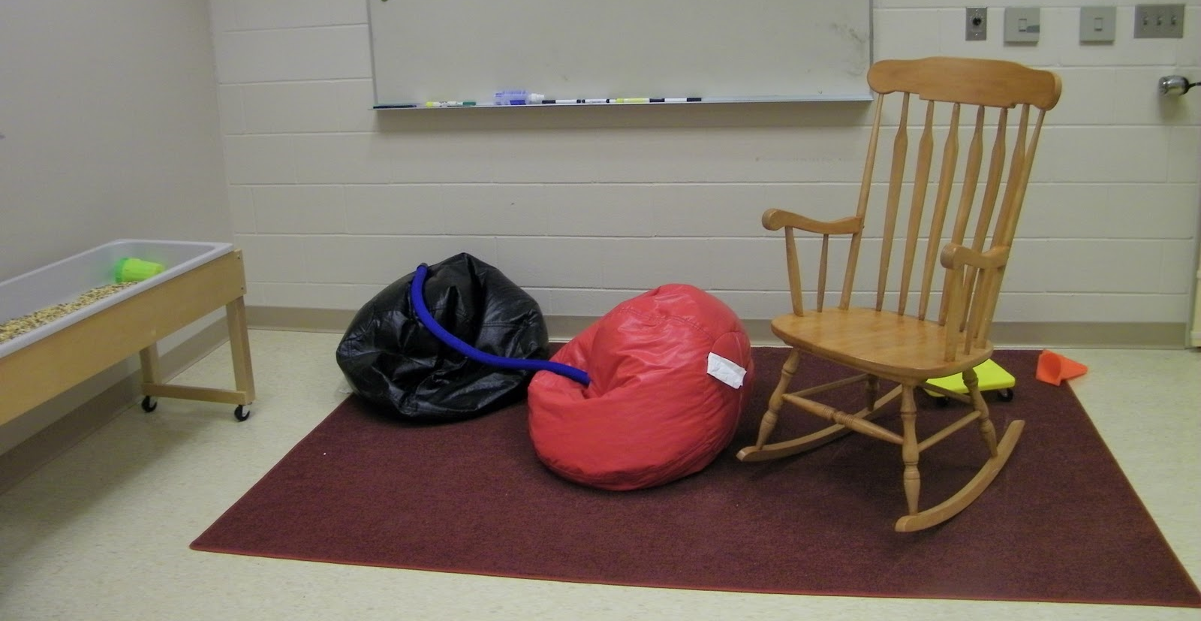
OT role in trauma informed schools
Role of an occupational therapist in a school is to support the occupation of the student. Focus on function and skills building
Trauma impacts a child’s occupational performance in the role of a student; including occupational performance areas of education, social participation and play (Whiting, 2018).
OT within the Battersea MHST:
Using a universal approach…
Analysing school tasks and environments to identify barriers to engagement in school life- sensory /attachment lens.
Sensorimotor arousal regulation- increasing understanding of how students and staff can regulate through their senses for a calmer, easier school day.
Assisting the implementation of predictable routines and activities, including movement breaks and opportunities for sensory regulation.
Work in collaboration with other members of Battersea MHST and school staff.
Decreasing barriers around education, social participation and play (focus on enjoyment and fun).
Working collaboratively with CYP and reducing social isolation & occupational injustices
Promoting healthy occupations and leisure for positive physical and mental wellbeing.
Notes:
We do all sorts and some may seem a bit strange on the surface..
The occupation of going to school, being a student- performance areas of academic work, play , social interaction
This may include:
Help school staff to understand sensory behaviours
To advise of sensory strategies and classroom adaptations for those struggling ith trauma or mental health concerns
To think about the social environment
Within the MH support team :

Slide 8
The FE College Mental Health Support Team
Multidisciplinary team: Educational Psychologist, Clinical Psychologist, Social Worker / CBT Therapist, Dramatherapist, EMHPs
Working across 6 large FE Colleges, one in each of the 6 SWL boroughs
Team set-up in 2020
Transition to adulthood focus

Slide 9
Issues specific to working in FE Colleges
Students are 16+, with a large adult student population
Enormous institutions with fixed timetables and little flexibility
Very different culture to schools: less nurturing, more adult focused
Only students with high MH needs or in crisis are known to Student Services
Self referral pathways are not well used

Slide 10
Notes:
b

Slide 11
Resources on our youtube channel
https://www.youtube.com/channel/UCrRKV84lb8Jr69Z7ZhjSjCg/videos
Or search for:
Children & Young People’s Wellbeing Service – SWLSTG NHS Trust

