Slide 1








London Domiciliary Care COVID-19 Vaccine information pack
Produced by
Healthy London Partnership
and NHS E/I in partnership with:
Publication date: 21/04/2022
Version 6
This London guide is designed to complement and not replace local guidance and professional judgement. It will be updated to align with other national and regional guidance once published.
To provide feedback on this pack please contact: london.hcic@nhs.net

Slide 2
Change log
Version 6 updates;
Updated slides:
Vaccine programme overview
Why are boosters important?
Truths about the vaccine
Booster vaccinations

Slide 3
How to use this pack
This resource pack has been developed to provide clear guidance for domiciliary care providers in London about the COVID-19 vaccine and bring useful resources and information together in one place to help them maximise vaccine take-up by staff.
Please note that information and process are continuing to develop, please continue to follow local process and guidance.
Topics covered in this resource pack:
Key messages
Vaccine programme overview
Why should people receive a vaccine?
What is the process of getting a vaccine?
Domiciliary Care managers – preparing for staff vaccines
What are vaccines?
How do the Moderna and Pfizer/BioNTech vaccines work?
How do the Oxford/AstraZeneca and Janssen vaccines work?
Why get vaccinated if I’ve already had COVID-19?
Why do I need a booster?
How have the vaccines been made quickly and safely?
Demonstrating vaccine status in the NHS App
Domiciliary care staff vaccinations: Top tips
Truths about the vaccine
Who is receiving the vaccine?
Booster vaccinations
Information on the Oxford/AstraZeneca vaccine
COVID-19 vaccine animations tackling misinformation
Other resources for addressing COVID-19 vaccine hesitancy and misinformation
Pregnancy and breastfeeding
Variants of concern
What are the possible side effects?
How were the vaccines approved?
What happens after the vaccination?
Vaccine information leaflets
Capacity Tracker
FAQs section
Resources

Slide 4

Key messages
This is why they have been prioritised to receive the vaccine, including the booster doses
Domiciliary Care staff are at increased personal risk of catching COVID-19, and passing it on to vulnerable people.
People who are supported by domiciliary care staff are often vulnerable if they catch COVID-19 and many have been very badly affected by it.
Vaccinated people are far less likely to get COVID-19 with symptoms. Vaccinated people are less likely to get serious COVID-19, to be admitted to hospital, or to die from it and vaccinated people are less likely to pass the virus to others.
Booster jabs are important for staff to maintain high levels of protection so will be available to all staff 3 months after the last dose was received.
In the UK, four vaccines have been authorised by the Joint Committee for Vaccination and Immunisation.
You get the currently available vaccines in two doses. The first dose of the vaccine offers good levels of protection, but to get maximum protection everyone must get a second dose and the booster.

Slide 5
Vaccine programme overview
Following extensive trials, there are four safe and effective vaccines for COVID-19 currently licenced by UK regulators, as per the Green Book, and three are in regular use. They are:
Pfizer BioNTech COVID-19 mRNA vaccine BNT162b2 (Comirnaty®)
AstraZeneca COVID-19 vaccine (Vaxzevria®)
Moderna COVID-19 vaccine (Spikevax®)
The single dose, Janssen COVID-19 vaccine (Janssen Ad26.COV2-S [recombinant]) has also been licenced in the UK, but the Moderna and Pfizer vaccines are being predominantly used.
Vaccines are now being delivered in hundreds of local vaccination services, pharmacies and pop-up venues. Find out your nearest vaccination site here.
As of April 4th 2022, the NHS has delivered over 16 million COVID-19 vaccines in London.

Slide 6

Why should people receive a vaccine?
Staff:
Domiciliary care staff are at increased personal risk of getting COVID-19 due to their work.
If Domiciliary care staff get COVID-19 they are at risk of passing it on to the people they support.
The more people that get vaccinated, the more we can protect the most vulnerable people including your own family.
People supported by domiciliary care staff are often vulnerable and they are more likely to:
Catch COVID-19 due to the nature of needing support with personal care and needing to attend health and other appointments.
Become seriously unwell and more likely to die from COVID-19 due to their age and underlying health conditions.
People with learning disabilities experience significant health inequalities, are at greater risk of premature deaths, and have been more severely affected by COVID than the rest of the population.

Slide 7
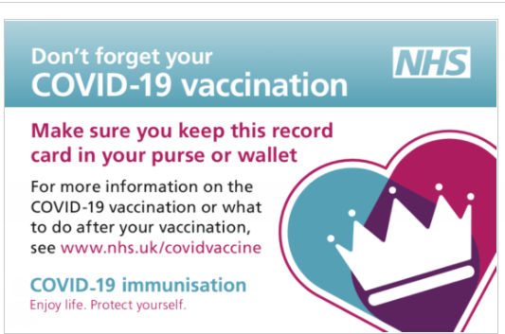
What is the process of getting a vaccine?
Staff can get their vaccine either by walking in to any Vaccination Centre or participating Community Pharmacy, showing their ID. Or they can book in via the National Booking Service across Vaccination Centres or participating Community Pharmacies:
Receive first vaccine
Given vaccine record card – take a photo in case you lose it
Given 2nd vaccine dose: around 8 weeks for people over the age of 18, or 12 weeks after first dose for younger people
Given booster 3 months after their second dose. Those who are immunosuppressed will be contacted separately to have a third and fourth full dose of the vaccine.
You can also download the NHS App, as you’ll be able to demonstrate your COVID-19 vaccination history using it

Slide 8
Domiciliary Care managers – preparing for staff vaccines
This includes agency staff
Keep staff records of vaccinations and report via the Capacity Tracker (as you do with flu vaccination) – see the Capacity Tracker slide
Consider the logistics of releasing staff to receive their vaccine, while maintaining staffing levels in the Domiciliary Care sector.
Support new staff to receive the vaccine. Understand that there may be a need for a few days off for staff after a vaccine dose.
If staff are struggling to access their vaccination proof, then advise them to call 119 who can go through any issues with them. 119 may need you to send over extra information to support your worker.
Do talk to staff about the vaccine
Do use the resources in this pack
You may find the Q&A video for social care staff useful
London ADASS video – Go Get the COVID-19 Vaccine
London ADASS video – Vaccinations save lives
You may find the London COVID vaccine FAQs useful (please see the end of this pack for the FAQs, or contact england.londonehchprogramme@nhs.net if you want to check for updated questions)

Slide 9
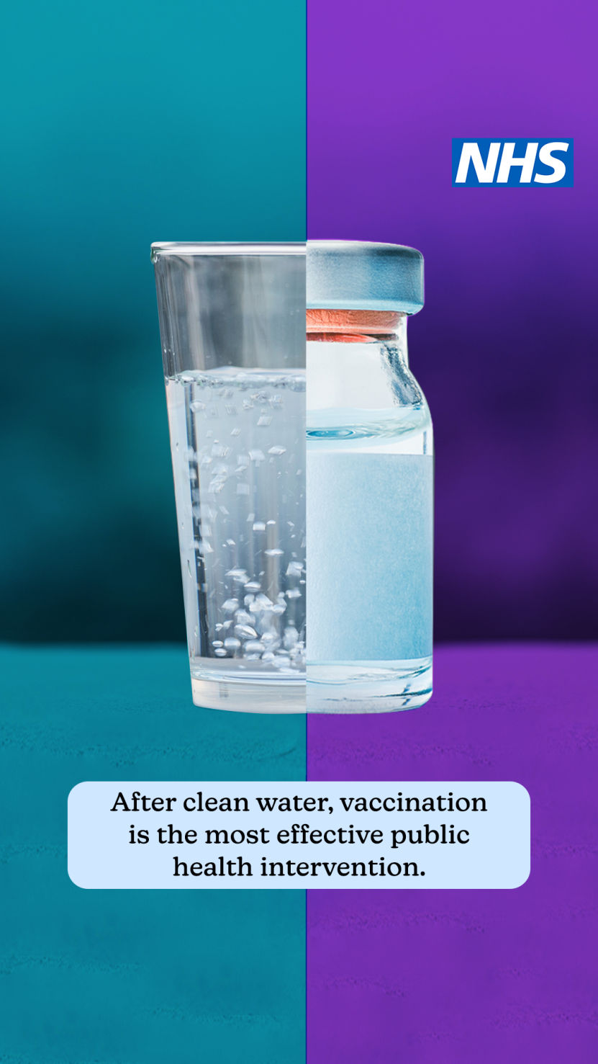
What are vaccines?
Vaccines are a medicine. Instead of treating patients with diseases, they:
Significantly reduce the chance that someone will catch a disease in the first place
Reduce the harm caused by the disease for people who do still catch it, so that they do not get seriously unwell from it
To keep high levels of protection it is important to have the full course of three vaccinations (doses 1, 2 and the booster)

Slide 10


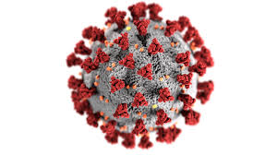

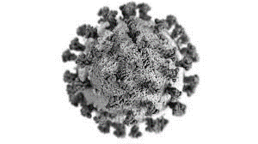

How do the Moderna and Pfizer/BioNTech* vaccine work?
The scientist takes part of the virus to make the vaccine. This part of the virus cannot give you COVID-19
Once injected the immune system produces virus fighters called anti-bodies and T-Cells
You have two injections a minimum of 8 weeks apart
If you come into contact with COVID-19 the virus fighters (anti-bodies and T-Cells) remember it and can fight it
*Pfizer BioNTech COVID-19 mRNA vaccine BNT162b2 (Comirnaty®) &
Moderna COVID-19 vaccine (Spikevax®)

Slide 11
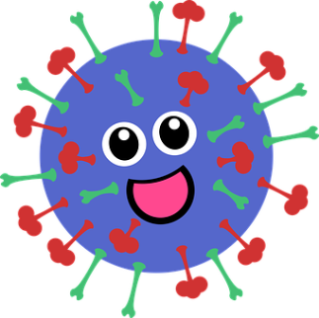

How do the Oxford/AstraZeneca and Janssen vaccines work
Instructions on how to make the protein are found on the surface of the COVID-19 virus
The instructions are added to a safe virus to make the vaccine
You have two injections a minimum of 8 weeks apart
Once injected the vaccine stimulates your immune system to produce virus fighters called anti-bodies and T-Cells
If you come into contact with COVID-19. The virus fighters (anti-bodies and T-Cells) can fight it
You can find a video about the Oxford vaccine here: https://www.youtube.com/watch?v=DUTRaOOblI8&feature=youtu.be&app=desktop
AstraZeneca COVID-19 vaccine (Vaxzevria®). Janssen COVID-19 vaccine (Ad26.COV2-S [recombinant])

Slide 12

Why get vaccinated if I’ve already had COVID-19?
1. Exposure to COVID-19 through infection results in antibodies. Receiving a COVID-19 vaccination, causes the body to create, T cells. Both are virus fighters.
2. Unfortunately, the protection against the virus that antibodies give us wears off over time, so the virus can overpower our immune system again.
3. The vaccines also cause our immune systems to create a vastly increased amount of a type of white blood cell called T Cells. White blood cells, such as T Cells, are another effective virus fighter.
4. What’s so good about T Cells?
T Cells are ‘memory cells’, and recognise more protein snippets from viruses, than antibodies. They remember how to fight the virus, and can act quickly, which makes them more resilient in the face of new variants.
T

Slide 13
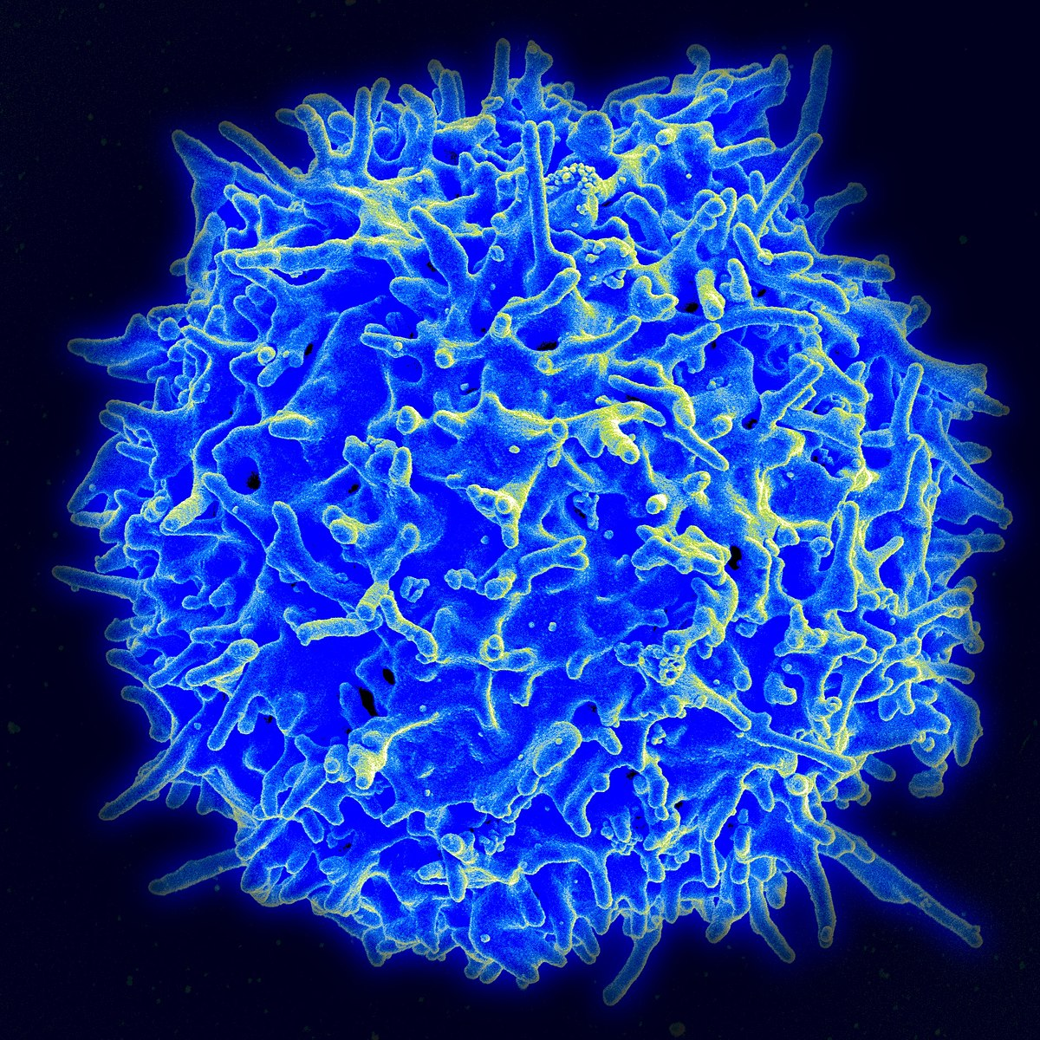
Why are boosters important?
Getting a booster vaccine not only tops up the antibodies in our body - it also ensures that older T cells are backed up by newer ones. This helps them retain their memory of how to fight the virus for longer. This ensures stronger, longer lasting protection against future infection than having had COVID-19 itself.
T cells help to prevent the virus from spreading to other cells and to clear an infection that has already started, which could spell the difference between mild and severe disease.
They also help to reduce transmission, by reducing the amount of virus that infected people carry in their bodies.
The findings show that around 6 months after a second dose of any of the COVID-19 vaccines, protection against death with Omicron was around 60% in those aged 50 and over. However, this increased to around 95% 2 weeks after receiving a booster vaccine dose.
The data continue to show high levels of protection against hospitalisation from the booster. After a Pfizer booster (after either primary vaccination course), vaccine effectiveness against hospitalisation started at around 90%, dropping to around 75% after 10 to 14 weeks.
After a Moderna booster (mRNA-1273) (after either primary vaccination course), vaccine effectiveness against hospitalisation was 90% to 95% up to 9 weeks after vaccination.
Notes:
Source: https://www.gavi.org/vaccineswork/t-cell-army-how-infection-busting-cells-previous-coronavirus-exposure-could-protect

Slide 14
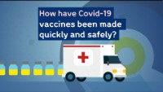
How have the vaccines been made quickly and safely?

Slide 15
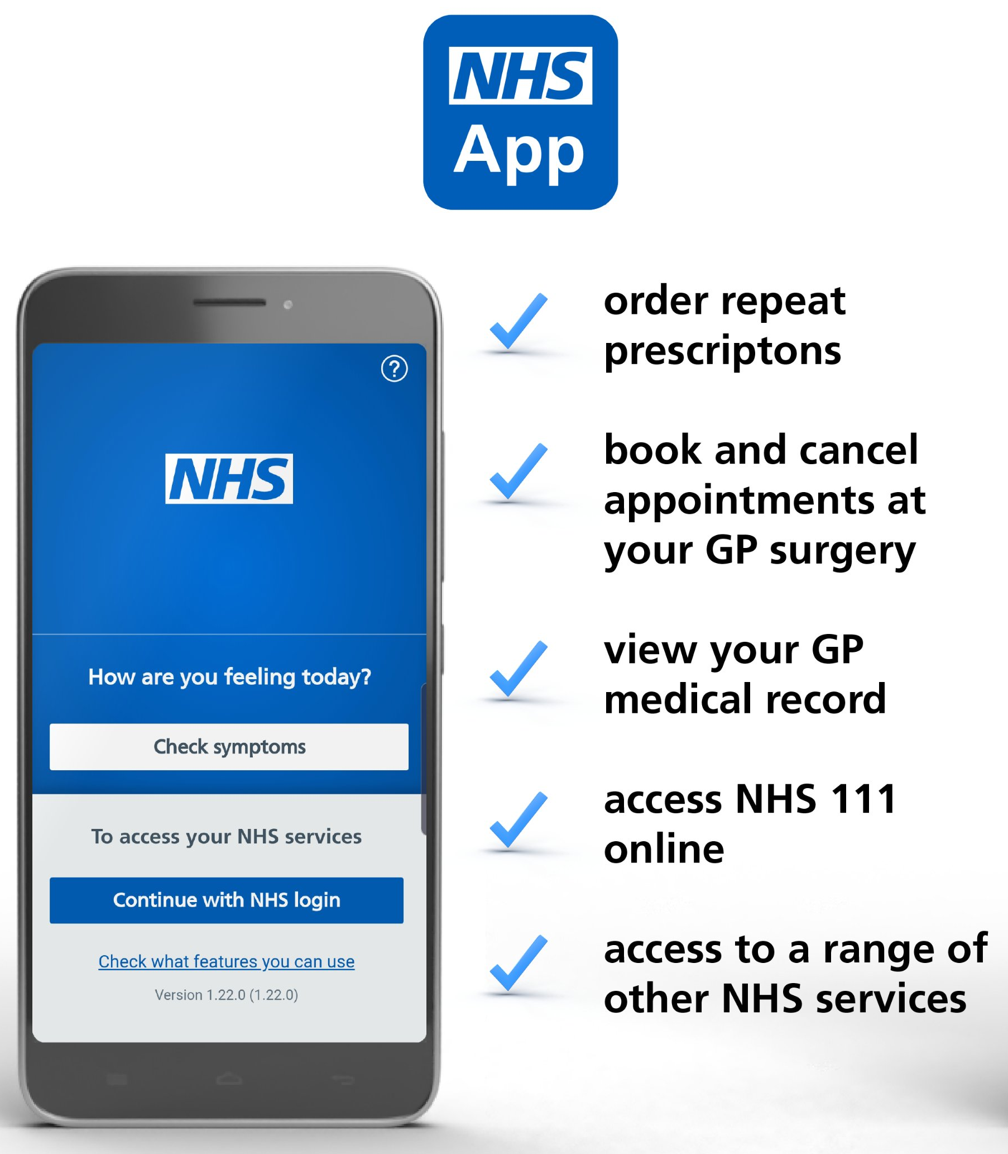
Demonstrating Vaccine Status in the NHS App
Vaccination status means proof of vaccination, or proof of exemption from getting a vaccine.
The NHS App is a simple and secure way to access a range of services on your smartphone or tablet. It is free from app stores. You need to be 16 or over to use the NHS COVID Pass service and registered with an NHS GP practice in England. The NHS App should not be confused with the NHS COVID-19 App which offers the fastest way to see if you’re at risk from coronavirus.
Find out more about the app and its benefits here.
View and share the COVID Pass on the app to demonstrate your vaccine status, for domestic use or travel abroad
Find out more here:
https://www.bt.com/content/dam/bt-sft/assets/documents/bt-skills-for-tomorrow-helping-others-nhs-app-guide-leaflet.pdf
https://www.bt.com/skillsfortomorrow/home-life/helping-others-nhs-app-guide
If you are unable to access your vaccination status, then you should call 119 who will run through any issues with you. You should also receive a letter letting you know of any issues and who to contact.

Slide 16
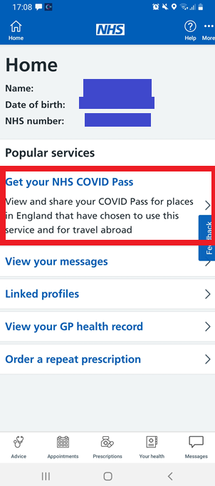
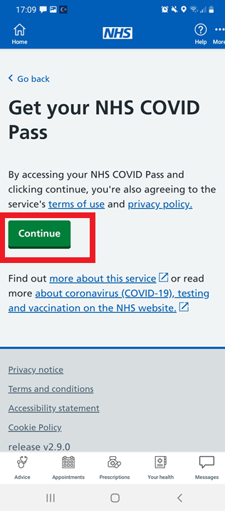
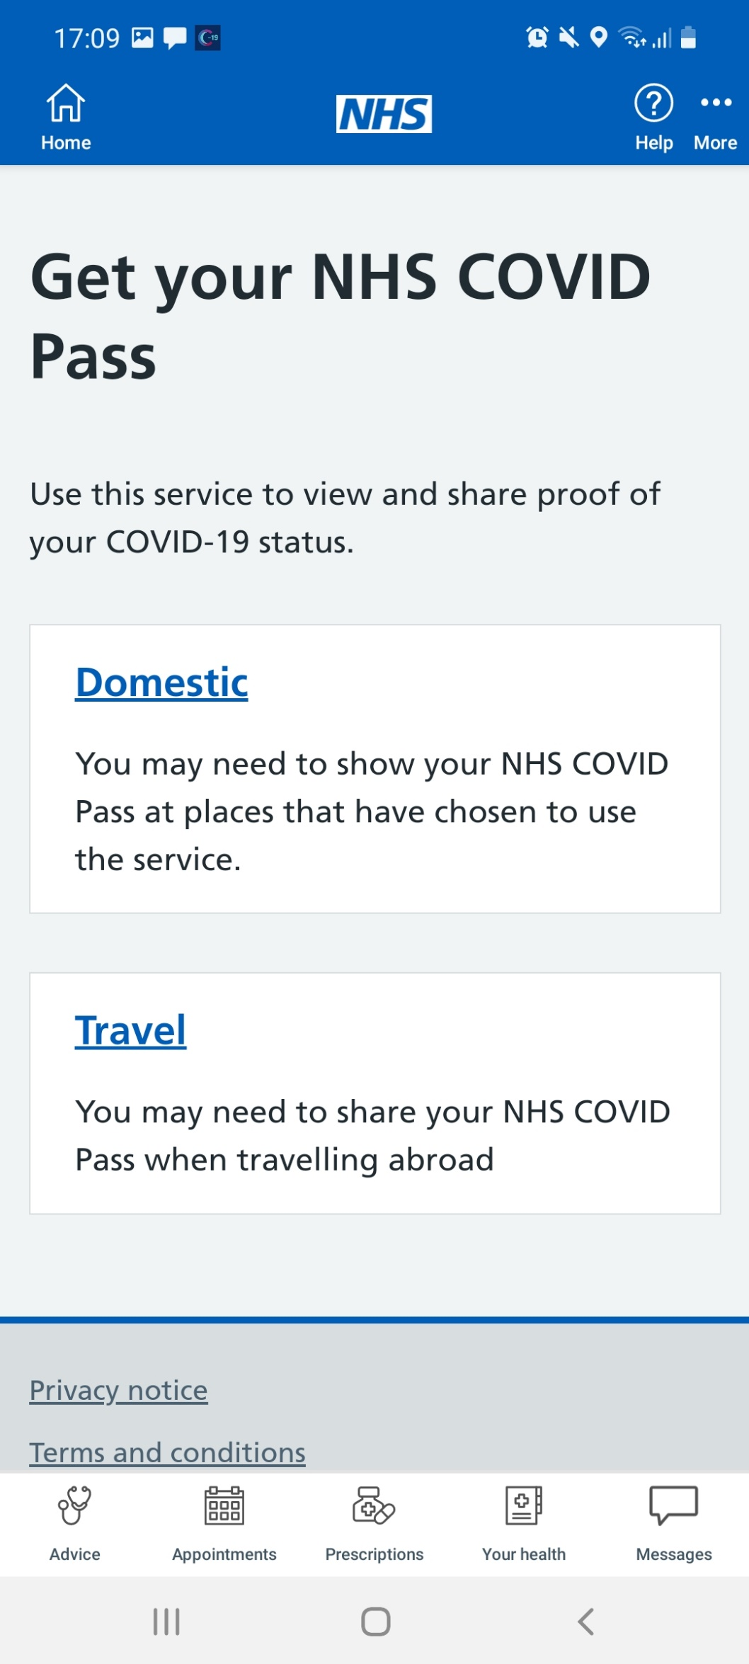
How to demonstrate your vaccination status in the NHS App
Once you have signed in to the NHS App, click ‘Get your NHS COVID Pass’
On the next screen, press ‘Continue’
Select ‘Travel’. This is because the travel pass offers more detail and better evidence of vaccination status

Slide 17
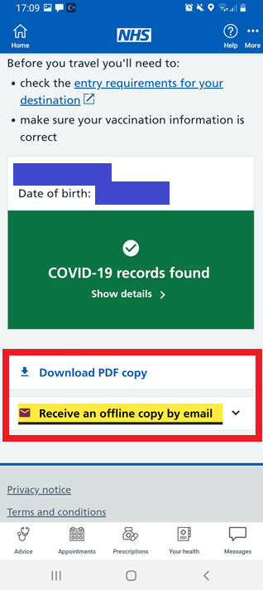
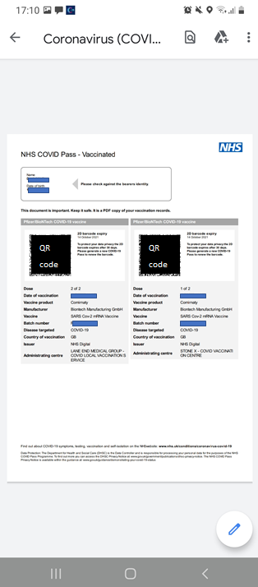
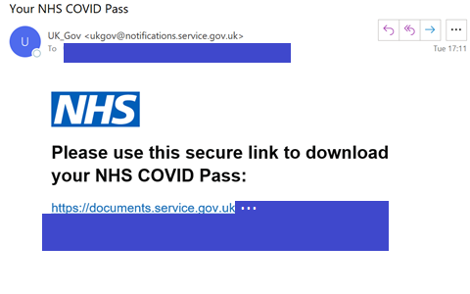
How to demonstrate your vaccination status in the NHS App
Select Download PDF copy or Receive an offline copy by email
You will be able to print the information that you receive (see right side of this slide), or email it to managers or colleagues to demonstrate vaccination status
People who have had a booster vaccine are also able to demonstrate this using the NHS App COVID Pass.

Slide 18
Domiciliary care staff vaccinations: Top tips
Engagement
Use a combination of different methods:
- Videos of personal stories to help allay fears
- 1:1 conversations with people from similar backgrounds that are relatable, as well as with health professionals for conversations about specific concerns
- Q&A sessions and webinars
Access
Connect with local community champions to widen voices staff have access to
Partner with NHS colleagues and community groups to share up to date information with staff
Staff have been paid for the time taken to get the vaccine in their own time to remove financial barriers associated with lost earnings both to get the vaccine and for sick pay if they experience side-effects
Arrange for buddy schemes for peers to get the vaccines together
Ensure methods of booking are accessible and in multiple formats (text, phone line, online)
Ensure staff aware that they can drop-in for vaccine without a pre-booked appointment

Slide 19

London ADASS Video – Go get the vaccine!
Link to video here

Slide 20
Truths about the vaccine
You may have seen some false information about the vaccine on the internet.
The statements that follow are truths about the vaccine:
The vaccine does not affect fertility. There is absolutely no evidence, and no theoretical reason, that any of the vaccines can affect the fertility of women or men. This video has more information on the safety of vaccines for pregnant women. And this video discusses the impact on new-borns, of mothers getting vaccinated in or before pregnancy.
Nothing goes into a vaccine unless it is absolutely necessary. The vaccine only contains what it needs in order to produce the virus fighting cells, be safe, be deliverable, and be stored. The vaccine does not contain any meat or blood products, does not contain a microchip, and is not magnetic.
The vaccine only gets you to produce an immune response (the “virus fighters”). The parts of the virus in the vaccine cannot reproduce in your body and cannot give you COVID-19.
Domiciliary Care staff are high priority to receive the vaccine due to the risk they have of catching COVID-19 (see the who receives the vaccine slide)
The vaccine went through all the normal stages of development and approval
By the beginning of March 2022, in London, almost 1.5 million vaccine doses had been delivered to Black Londoners of different backgrounds, with no different profile of side-effects to people from other ethnic groups. At the same time, over 3 million vaccine doses had been delivered to Asian or British Asian Londoners of different backgrounds, with no different profile of side-effects to people from other ethnic groups. See Weekly Data for more information.

Slide 21
Who is receiving the vaccine?
The Joint Committee on Vaccination (JCVI) and Immunisation advises UK health departments on immunisation
The JVCI advises that the first priorities of any COVID-19 vaccination programme should be the prevention of death from COVID-19 and the protection of social care and health care staff.
Care home staff and residents are in the highest priority groups specified by the JCVI, meaning that their access to vaccination is prioritised.
Everyone aged 12 and above is now eligible for two doses of the vaccine. For those aged 12-15 the second dose should be no sooner than 12 weeks after their first.
People who are immunosuppressed are being offered a third primary dose 8 weeks after their second dose. .
5 to 11 year olds who are either in a clinical risk group or are a household contact of someone of any age who is immunosuppressed should be offered a vaccine.
The JCVI has recommended a booster (fourth) jab, at least 3 months after their third primary dose, for those who are most vulnerable, for example those on chemotherapy or have issues with their immune system. Long term residents over the age of 65 and everyone over the age of 75 will also be eligible for the fourth jab.
Booster vaccine doses are available on the NHS, 3 months after the second dose, for all people aged 18 and over, people aged 16 and over with a health condition that puts them at high risk of getting seriously ill from COVID-19, people aged 16 and over who are a main carer for someone at high risk from COVID-19, and people aged 16 and over who live with someone who is more likely to get infections (such as someone who has HIV, has had a transplant or is having certain treatments for cancer, lupus or rheumatoid arthritis).
The full information is here: Priority groups for coronavirus COVID-19 vaccination

Slide 22
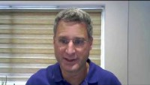
Boosters – keeping us all safe
UK study finds mRNA COVID-19 vaccines provide biggest booster impact (video from Reuters)

Slide 23
Booster vaccinations
First booster vaccine doses are available on the NHS, 3 months after the second dose, for all people aged 18 and over, people aged 16 and over with a health condition that puts them at high risk of getting seriously ill from COVID-19, people aged 16 and over who are a main carer for someone at high risk from COVID-19, and people aged 16 and over who live with someone who is more likely to get infections (such as someone who has HIV, has had a transplant or is having certain treatments for cancer, lupus or rheumatoid arthritis).
The JCVI has recommended a second (Spring) booster for all residents in an older adult care home and everyone in the general population over the age of 75, 3-6 months after their last dose. Full guidance can be found here. The Spring booster will also be available to people aged 12 years and over with a weakened immune system.
Most people will be offered a booster dose of the Pfizer/BioNTech vaccine or a half dose of the Moderna vaccine. This means your booster dose may be different from the vaccines you had for your first and second doses and is perfectly fine. Some people may be offered a booster dose of the Oxford/AstraZeneca vaccine if they cannot have the Pfizer/BioNTech or Moderna vaccine.

Slide 24
How to get a Booster Vaccine
It is easier now than ever for staff to access a vaccine.
If you had your second dose more than 3 months ago, you can get your vaccine in a local pharmacy, a vaccination centre, a walk-in centre, or a pop-up clinic.
The COVID-19 vaccination online booking service is available to use to book into a vaccine clinic online.
You can pre-book your COVID-19 booster dose online if it's been 2 months (61 days) since you had your 2nd dose. You'll be offered appointment dates from 3 months after the date of your 2nd dose.
It is helpful, but not essential, to know your NHS number when booking.
Staff can also attend a walk-in clinic from 3 months after their 2nd dose. You can find your nearest or most convenient walk-in vaccination site here.
Staff attending a walk-in site are encouraged to bring proof of employment such as staff ID, a letter or a payslip from their employer within the last 3 months.

Slide 25
Information on the Oxford/AstraZeneca vaccine
The benefits of the vaccine far outweigh the risks for the majority of adults. The Joint Committee on Vaccination (JCVI) has advised a preference for people under the age of 40 without underlying health conditions to receive an alternative to the Oxford/AstraZeneca vaccine – where available and only if this does not cause substantial delays in being vaccinated. See here for more information.
Up to 22 December 2021, there were <0.001% of extremely rare blood clots (Vaccine-induced Thrombotic Thrombocytopenia/ VITT) with low platelet counts in the UK in people who have received the Oxford/AstraZeneca vaccine. Most of these reports were reported after a first dose. These extremely rare blood clots can occur naturally in people that have not had the vaccine and in people with COVID-19.
People who have had their first dose of the AstraZeneca vaccine should still get their second dose (unless they had one of the rare blood clots).
Some people should not have the AstraZeneca vaccine – Check here to find out more in relation to the vaccine, or speak to a clinician to check if your condition will impact your option of getting the vaccine.
You can find more information here.

Slide 26
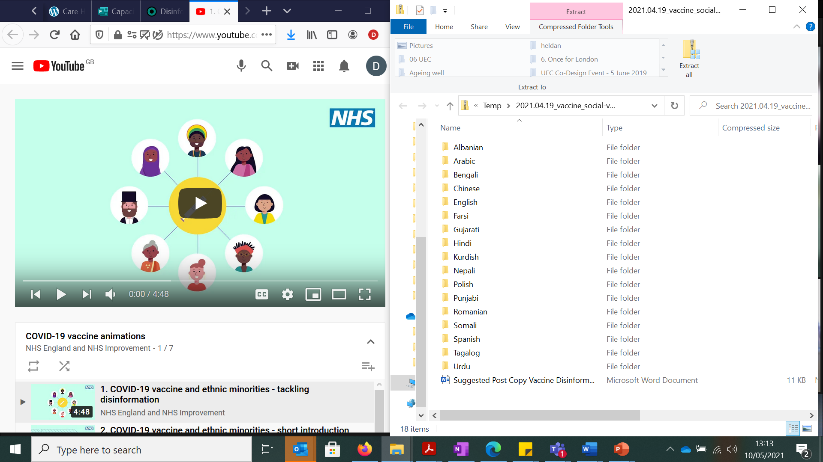
COVID-19 vaccine animations tackling disinformation
NHSE/I has launched a series of animations and suggested information aimed at tackling disinformation about the COVID-19 vaccine and encouraging uptake among ethnic minority groups. The animations are available in 17 different languages. Download them from the Campaign Resource Centre or watch on YouTube.

Slide 27
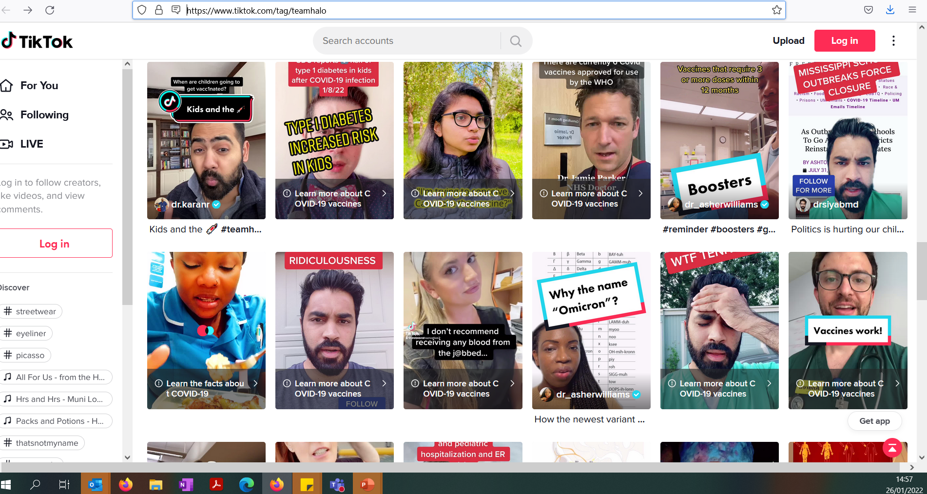
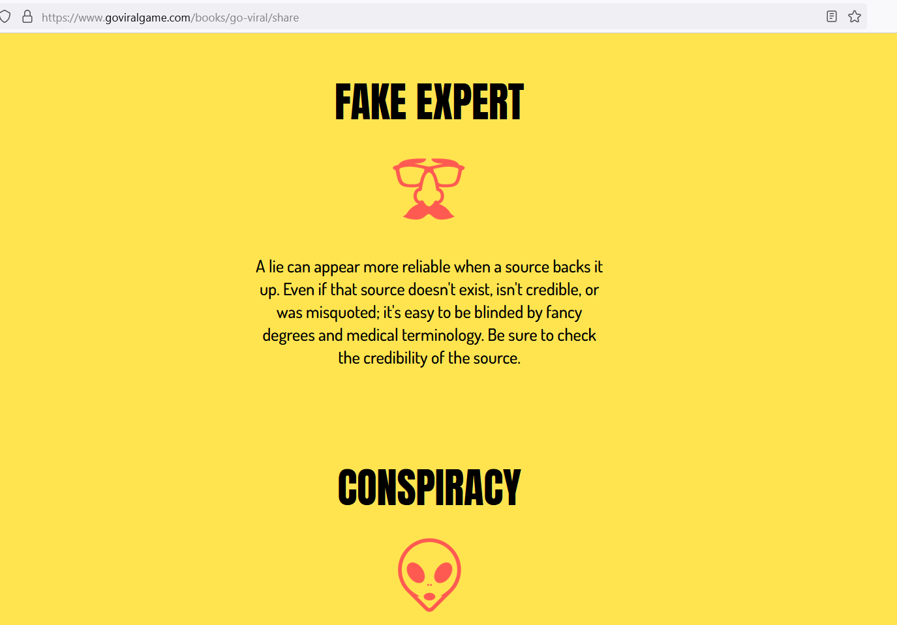

Other resources for addressing COVID-19 vaccine hesitancy and misinformation
There is a strong chance that staff may be getting information about vaccines from unreliable sources online - for example, content posted on social media.
When signposting to further information online, you should check that the sources you are using are reliable. If you see a news story, try to see if you can find it on the BBC website. If you can, the chances are it’s accurate and well reported.
As well as being full of potential misinformation, or disinformation, social media can also be a force for good. Team Halo works with science and clinical professionals on social media to spread accurate knowledge about COVID-19 and vaccines.
GoViral runs a simulation to demonstrate to users how easy it is for misinformation (especially about the COVID-19 virus) to spread and go viral
Check with your local authority for information about local events
Staff vaccine Q&A, presented by Professor Kevin Fenton.

Slide 28
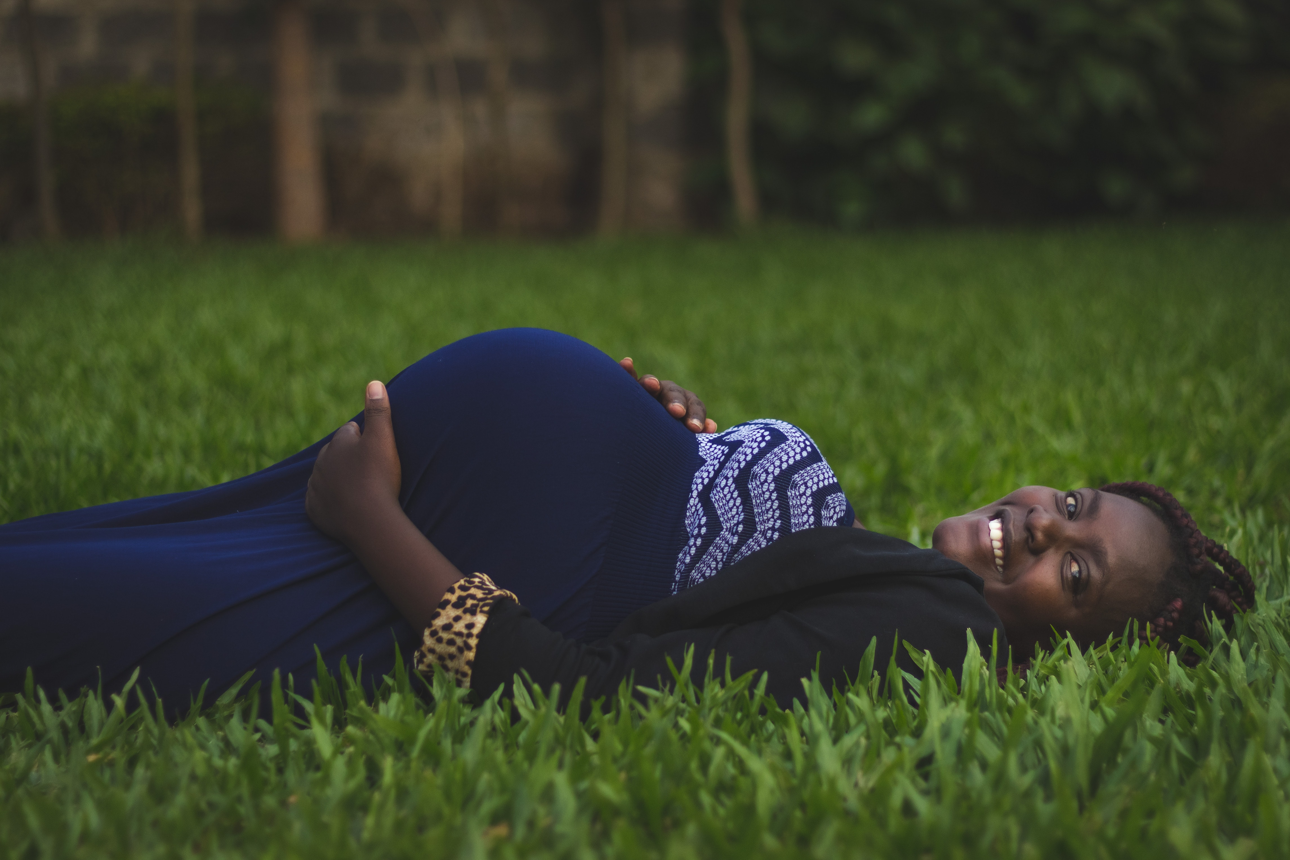
Pregnancy and Breastfeeding
The Joint Committee on Vaccination and Immunisation (JCVI) has identified pregnant women a priority group for vaccination following research showing that they are vulnerable to more serious illness and pregnancy complications if they are infected with COVID-19. Pregnant women should get primary and booster vaccines as soon as possible:
There is no evidence of an increased risk of miscarriage if you become infected during pregnancy. Although the overall risk from COVID-19 disease in pregnant women and their new babies is low, in later pregnancy some women may become seriously unwell and need hospital treatment. The best precaution for pregnant women is to get the vaccine.
Data from the United States shows that over 100,000 pregnant women have safely been vaccinated – mainly with Pfizer-Biontech and Moderna vaccines.
The JCVI advises that it’s preferable for pregnant women in the UK to be offered the Pfizer-BionTech or Moderna vaccines where available – there is no evidence other vaccines are unsafe, but more research is needed.
If a woman finds out she is pregnant after she has started a course of vaccine, she may complete the vaccination during pregnancy using the same product (unless contraindicated)
New assets for pregnant women getting the COVID vaccine:
Royal College of Obstetricians and Gynaecologists – COVID-19 Pregnancy and Women's Health
Royal College of Medicine – COVID Vaccines for Pregnant Women
Guidance – Women of childbearing age, currently pregnant, planning a pregnancy or breastfeeding
Video - How do we know vaccines are safe for pregnant people?

Slide 29
Pregnancy and Breastfeeding
You can find more information here and read a letter that went to NHS leads here
The Joint Committee on Vaccination (JCVI) has recommended that the vaccine can be received by breastfeeding mothers.
There is no data on the safety of COVID-19 vaccines for breastfeeding mothers or for infants. Despite this, COVID-19 vaccines are not thought to be a risk to the breastfeeding infant, and the benefits of breastfeeding are well known.
COVID-19 vaccination: a guide for all women of childbearing age, pregnant or breastfeeding
The Royal College of Midwives have recently information and guidance here.

Slide 30
Variants of concern
All viruses – including SARS-CoV-2, the virus that causes COVID-19 – evolve over time. When a virus replicates or makes copies of itself, it sometimes changes a little bit, which is normal for a virus. These changes are called “mutations”, or variants.
While we are learning more, we need to do everything possible to stop the spread of the virus in order to prevent mutations that may reduce the efficacy of existing vaccines.
Vaccines are a critical tool in the battle against COVID-19, and there are clear public health and lifesaving benefits to using the tools we already have. We must not put off getting vaccinated because of our concerns about new variants.
There is good evidence that being vaccinated offers the most effective protection against being seriously ill. Therefore, we must proceed with the vaccination programme, at pace. We need to use the vaccines and other measures we have available even while we continue to improve those tools.
As restrictions in the community change, enhanced infection prevention and control standards and testing in care homes must be maintained, even for people who have been fully vaccinated.
“We are all safe only if everyone is safe”
Learn more about the naming conventions of the vaccines here

Slide 31
What are the possible side effects?
Like all medicines, vaccines can cause side effects.
Most are mild or moderate, tend to be less common in older people and go away within a few days
If side effects such as pain and/or fever are troublesome, they can be treated by medicines for pain and fever such as paracetamol.
Common side effects: may affect more than 1 in 10 people
having a painful, heavy feeling and tenderness in the arm where you had your injection. This tends to be worst around 1-2 days after the vaccine
feeling tired
headache
general aches, or mild flu like symptoms.
Although feeling feverish is not uncommon for two to three days, a high temperature is unusual.
In some rare cases the Pfizer and Moderna vaccines have known to cause chest pain and have a rare link to Myocarditis and Pericarditis.
You can find further information on the vaccine information leaflets

Slide 32
How were the vaccines approved?
The NHS will offer a COVID-19 vaccination only when it has been approved by the Medicines and Healthcare products Regulatory Agency (MHRA), the official UK regulator, like all other medicines and devices.
Vaccines go through three phases of clinical trials – in the third phase the Pfizer vaccine was given to 21,000 volunteers including older people with no serious safety concerns
The vaccine went through all the normal stages of development and approval. It happened more quickly because of several reasons including:
There had been vaccine work on other coronaviruses
There was no waiting for funding
Development stages were run in parallel
This video explains how COVID-19 vaccines were developed quickly: https://www.youtube.com/watch?v=ddDiyIKUP0M&app=desktop
You can also find a video from the MHRA here: https://youtu.be/3HPpWelo1ro

Slide 33
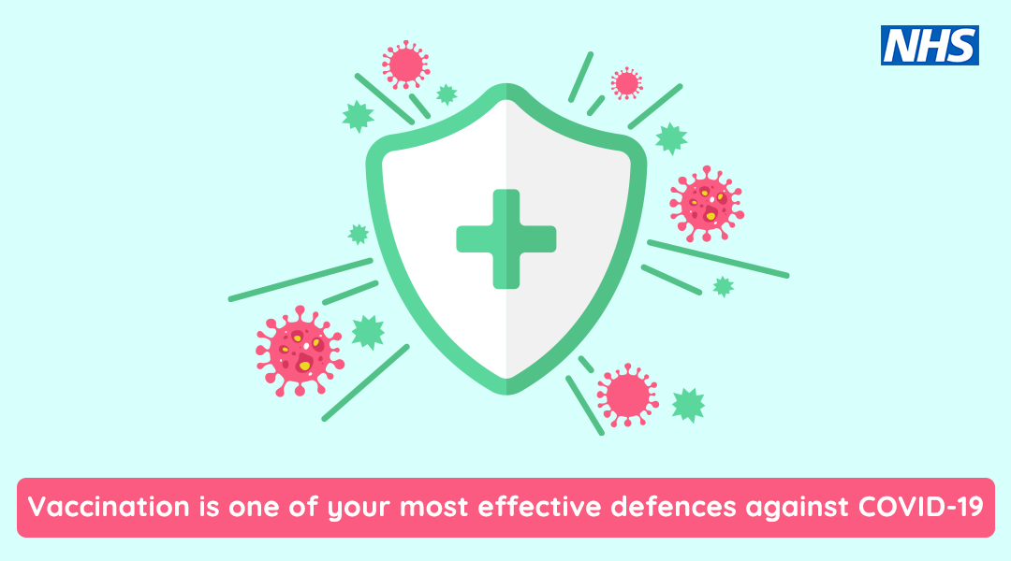

Slide 34

What happens after the vaccine?
The vaccine is just one tool in our tool box to prevent COVID-19, you should still;
Continue to wear PPE
Continue to follow infection prevention and control guidance
Continue with testing
Continue to follow guidance if anyone has symptoms of COVID-19
Download the NHS App, as you’ll be able to demonstrate your COVID-19 vaccination history using it
Notify your employer after each dose you receive.
You can find lots of useful information on the above in the COVID care home resource pack

Slide 35



After vaccinations
Lifting restrictions are partly thanks to the precautions taken by everyone. We need to be careful to continue with these.
Vaccination, though highly effective, is not 100% effective. Scientists are still investigating variants which are still circulating, in order to understand how these will affect people or spread.
As restrictions in the community lift, enhanced infection prevention and control standards and testing in care homes must be maintained.
The majority of people vaccinated will develop immunity after approximately 3 weeks. Since protection is not 100%, anyone with new symptoms or testing positive should be managed as an infectious case. They will still need to self-isolate and take all the same precautions that they would following a positive result before vaccination to avoid spreading the virus. Latest guidance on self-isolation can be found here.

Slide 36
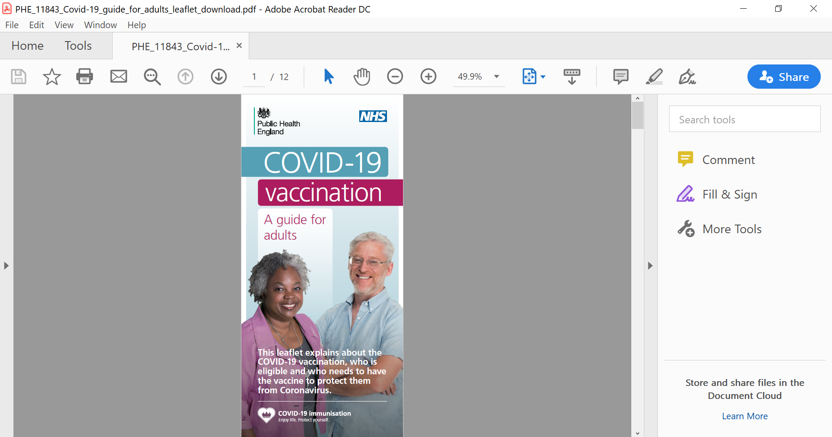
Vaccine information leaflets
You can find documents relating to the COVID-19 vaccination here
COVID-19 vaccine information for social care staff
COVID-19 vaccination guide for healthcare workers
Leaflet on why you are being asked to wait
COVID-19 vaccination guide for older adults
COVID-19 vaccination: a guide for all women of childbearing age, pregnant or breastfeeding
There are template letters for residents and relatives – see the consent form slide
Public Health England Leaflet - what to expect after your COVID-19 vaccinations
Accessible Information from Mencap on the Vaccine

Slide 37
Capacity Tracker
To track COVID-19 vaccinations in care homes care providers, the below questions are included in Capacity Tracker;
Number of staff and residents known to have had the first dose of the COVID-19 vaccination
Number known to have had the second dose of the COVID-19 vaccination
Number known to have had the COVID-19 booster vaccination
Number known to have had this season’s flu vaccination
Details of staff who are or may be exempt from getting vaccinated against COVID-19
During the vaccination roll-out it is vitally important to find out how many staff and residents are being vaccinated. This will also create an opportunity to see where additional support is needed to ensure we can maximise access to the vaccination.
Guidance will be available in Capacity Tracker to support filling in the questions as accurately as possible
You may find this video on capacity tracker useful: https://www.youtube.com/watch?v=jTMRxxPeXoo&feature=youtu.be (specific information on the vaccine at 7mins 23secs)
Contact | Name | Email | Phone
Capacity Tracker Technical Support Centre | n/a | necsu.capacitytracker@nhs.net | 0191 691 3729
Interpretation of questions support | n/a | Capacitytracker-guidance@dhsc.gov.uk
NHSEI London Capacity Tracker Regional Lead | Dan Heller | daniel.heller@nhs.net | n/a
London Support | n/a | london.capacitytracker@nhs.net | n/a
NECSU Capacity Tracker Regional Lead | Jennifer Kamau | jennifer.kamau1@nhs.net | n/a

Slide 38
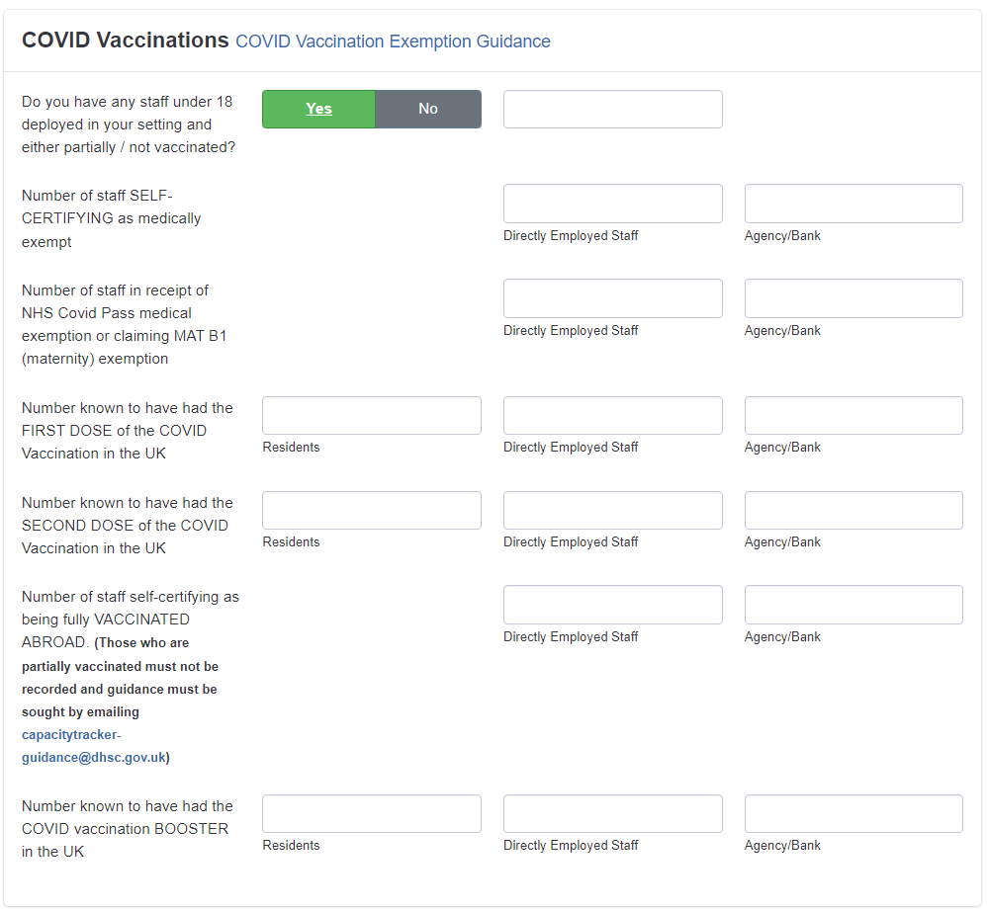
Capacity Tracker vaccination questions
Please note that Capacity Tracker questions change over time to reflect national priorities and developments. These questions are correct at the time of publishing.

Slide 39

FAQs regarding the vaccine
Do we need to have the vaccine if we have already had COVID-19 and if we have antibodies?
Yes, you still need to get the vaccine. The vaccine offers longer protection than natural protection.
How do we know if the vaccine has worked?
The vaccines have drastically reduced the numbers of people getting seriously ill and dying from COVID-19. Most people who fall critically ill with COVID-19 have either not been vaccinated at all or are only partially vaccinated.
How long will the vaccine/booster last for, will we need another one?
The JCVI is constantly monitoring the need or timing of booster doses of the COVID-19 vaccine, and whether further boosters will be needed. More information will be available once more is known. Watch this video for more information.
How do I get the vaccine?
Walk-in centres and pharmacies in London will accept health and social care workers such
as domiciliary care staff who bring a valid ID badge for a walk-in booster vaccination. Your employer may be able to arrange a vaccine. You can also book online using the NHS App.

Slide 40
FAQs regarding the vaccine
Does the vaccine contain animal products?
The Pfizer/Biotech, Oxford/AstraZeneca and Moderna vaccines do not contain any meat derivatives, porcine or squalene (from sharks) products. If, and when, further vaccines are approved, we will publish information about known allergens or ingredients that are important for certain faiths, cultures and beliefs.
Does the vaccine contain any blood products?
The Pfizer/Biotech, Oxford/AstraZeneca and Moderna vaccine do not contain any blood products. If, and when, further vaccines are approved we will publish information about known allergens or ingredients that are important for certain faiths, cultures and beliefs.
Can people with allergies have the vaccine?
The MHRA has released some updated guidance stating that anyone with a previous history of allergic reactions to the ingredients of a particular vaccine should not receive that one, but should discuss with their GP if they can get a different vaccine. Those with any other allergies such as a food allergy can have the vaccine. You can find more information here.

Slide 41
FAQs regarding the vaccine
In light of Omicron, what benefit does the booster provide over and above the two vaccine doses?
The Omicron variant has spread extremely fast in the UK. Two vaccine doses are not enough to give protection from symptomatic infection. However, a third dose prevents around 75% of people getting any COVID symptoms and reduces the chance of spreading COVID-19 infection. A booster dose is now more critical than ever.
We knew from before Omicron that protection against COVID-19 begins to wane over time. Both the Moderna and Pfizer-BioNTech vaccines have been shown to substantially increase antibody and T Cell levels when offered as a booster dose.
Boosting individual protection will provide the largest benefit in terms of reducing the impact of the Omicron variant on the UK population and avoid further restrictions.
Why get the booster?
As the efficacy of the original doses of the vaccines wane, it is imperative a booster is given to keep up levels of antibodies to fight off the virus. The booster offers a 93.1% protection rate in those who had AstraZeneca as their primary vaccines, and 94% for those who had Pfizer.

Slide 42
FAQs regarding the vaccine
What funding or support is available to support staff vaccination?
Part of the Infection Prevention and Control Funding (round 3) was made available to support social care providers with the costs associated with accessing COVID-19 and flu vaccinations. This will remain available until 31 March 2022. Future plans to continue funding are unknown.
Local Authorities should pass the direct funding portion of the vaccines funding allocation to:
Care homes, including residential drug and alcohol services, within the Local Authority's geographical area on a 'per bed' basis
CQC-regulated community care providers (domiciliary care, extra care and supported living) within the Local Authority's geographical area on a 'per user' basis
This funding has been made available to support the following measures:
Ensuring that staff who need to attend work or another location for the purposes of being vaccinated for COVID-19 or flu are paid their usual wages to do so
Any costs associated with reaching a vaccination facility
Any reasonable administrative costs associated with organising COVID-19 or flu vaccinations where these were not being supported by other Government funding streams
Providers should aim to use this funding for the above intended purposes – more information can be found here.

Slide 43
FAQs regarding the booster
Can I get the same vaccine I had initially?
The first two doses of the vaccine should be by the same company. The booster will either be one full Pfizer dose or a half dose of Moderna. If you have had an AstraZeneca vaccine you will get a Pfizer or Moderna booster.
Why is it mainly the Pfizer and Moderna vaccine available as a booster?
After reviewing data on booster responses from different combinations of COVID-19 vaccines, JCVI advises a preference for the Pfizer-BioNTech (Comirnaty®) vaccine to be offered as the third booster dose irrespective of which product was used in the primary schedule. There is good evidence that the vaccine is well tolerated as a third dose and will provide a strong booster response. Alternatively, individuals may be offered the Moderna (mRNA-1273/Spikevax®) vaccine, which is well tolerated and provides a strong booster response. A half dose (50µg) of Moderna (mRNA-1273/Spikevax®) vaccine is advised over a full dose due to the levels of reactogenicity seen following boosting with a full dose within the COV-BOOST trial.
What if I reacted badly to my first vaccine?
There is no clear data on the side effects of the booster, however, as with most medication, side effects are normal and usually only last for 24-48 hours. You can find further information on the vaccine information leaflets

Slide 44
FAQs regarding the booster
Is it safe to mix different vaccines?
The booster shots can be a different vaccine to your original two doses, as confirmed by the JCVI. However, it is advised that the first two doses should be the same vaccine.
If I’ve had no symptoms of COVID-19 but a Lateral Flow Test (LFT) shows positive, how long do I need to wait to get the booster?
You must wait 28 days until you can receive the booster after testing positive for COVID-19. There must still be at least 91 days since your second dose of the vaccine and the booster.
Where can I get a booster vaccine and will it show on the NHS App?
You are able to go to any walk-in site to receive the booster. Booking online will allow you to chose a specific time to have your booster. All vaccinations will show up on the NHS app regardless of where in the UK they are done.

Slide 45
FAQs regarding fertility and pregnancy
Can any of the vaccines affect fertility?
No – there is nothing in the vaccine that can affect the fertility of women or men.
Is it safe to try for a baby straight after the vaccine?
Yes – there is no need to avoid pregnancy after the vaccine.
Is the vaccine safe for women and their baby during pregnancy?
COVID-19 vaccines offer pregnant women the best protection against COVID-19 disease which can be very serious in later pregnancy for some women. COVID-19 vaccines do NOT contain live coronavirus or any ingredients that are harmful to pregnant women or their babies and cannot cause infection. Other non-live vaccines, such as whooping cough and flu, are considered to be safe for pregnant women and their unborn babies. mRNA vaccines (Pfizer and Moderna) are also quickly broken down once injected - within a
few days there will be no vaccine left. World-wide many women have been safely vaccinated with
COVID-19 vaccines in pregnancy.
Can I get an exemption if I am already pregnant/planning pregnancy? Women who are planning pregnancy, are in the immediate postpartum, or are breastfeeding can be vaccinated with any COVID-19 vaccine, depending on their age and clinical risk group. Pregnant women can alternatively use MAT B1 certificates to show their COVID status, if they choose to use a medical exemption. Pregnant women do not need to apply for a medical exemption NHS COVID Pass if they have a MAT B1 certificate.

Slide 46
FAQs regarding fertility and pregnancy
I am on the contraceptive pill, and I hear that causes increased risk of clots, can I have the vaccine?
The contraceptive pill is not known to increase the chance of this rare adverse effect with the COVID-19 vaccination.
Will I need to be vaccinated straight after giving birth?
For pregnant women, the exemption will expire 16 weeks post-partum. This will allow them to become fully vaccinated after birth. They will need to be fully vaccinated if they plan to return to work after 1st April 2022.
For more information:
Read: Government advice on the vaccine for women of childbearing age, pregnant or breastfeeding
Read: British Medical Journal article showing ‘no evidence that vaccines can affect fertility’
Read: RCOG guidance on COVID and pregnancy
Watch: Staff Q&A on the COVID-19 vaccine, fertility and pregnancy
Find more information: From the British Fertility Society

Slide 47
Additional FAQs
The flu vaccine is also available as a nasal spray. Will it be possible to have the COVID-19 vaccine as a nasal spray as well?
The COVID-19 vaccine is currently only delivered as an injection.
Will pharmacists be delivering the vaccine?
Yes, pharmacists are delivering the vaccine in their community pharmacies, and many have also been involved with the local vaccination sites run by GPs. You don’t need to call and book with your pharmacy in advance of receiving the vaccine. You can simply turn up for a walk-in vaccine.

Slide 48
Additional FAQs
What is my risk of getting a clot after the vaccine?
The data so far suggests that the risk of clot is an extremely rare adverse event associated with low platelets (a type of blood cell) after vaccination with the Oxford/AstraZeneca vaccine. This is usually experienced between day 4-28 after vaccination.
Joint Committee on Vaccination (JCVI) statement:
An extremely rare adverse event of thrombosis (blood clots) and thrombocytopenia (low platelets - type of blood cell) (Vaccine-induced Thrombotic Thrombocytopenia/ VITT) have been noted after 1st vaccination with AstraZeneca.

Slide 49
Additional FAQs
How will I know if I have a clot?
Clots linked to the Oxford/AstraZeneca vaccine have been experienced between days 4-28 after vaccination. Some of the signs may include:
1) a new, severe headache which is not helped by usual pain relief or is getting worse
a headache that is worse when lying down or bending over
a headache with blurred vision, nausea and vomiting, difficulty with speech, weakness, drowsiness or seizures
2) new, unexplained bruising or bleeding
3) shortness of breath
4) chest pain
5) leg swelling
6) persistent abdominal pain

Slide 50
Additional FAQs
I have a family history of blood clot, does this put me at increased risk?
Unless you have a personal history of one of the following listed conditions, you can proceed with the 2nd vaccination with Astra Zeneca;
a history of cerebral venous sinus thrombosis - acquired or hereditary thrombophilia
vaccine-induced thrombocytopenia and thrombosis(VITT or VIT type 2)
I have had a previous clot - DVT (deep vein thrombosis) and/or PE (pulmonary embolus), is it safe for me to have the vaccine?
There is no evidence that patients with previous history of clots are more at risk of developing this rare effect after the vaccine. The risk of clots from COVID-19 disease itself is far greater that the risk of this rare adverse effect from vaccination.
Can I choose to have another vaccine that is not AstraZeneca for my second one?
All those who have received the 1st dose of AstraZeneca should continue to be offered the 2nd dose of Astra Zeneca, irrespective of age, unless major clots were experienced with low platelets after the 1st dose.

Slide 51
Additional FAQs
Why have other countries stopped vaccinating with AstraZeneca, is it safe to have?
Every country has its own medicines authority so makes its own decision for based on the information they have. The UK has the MHRA (Medicines and Healthcare product Regulatory Authority) and JCVI,(Joint Committee on Vaccination and Immunisation), which continues to thoroughly assess all the data and weigh up the risk and benefit of the vaccination.
The decision in the UK is that the benefits of prompt vaccination with the Astra Zeneca COVID-19 vaccine far outweighs the risk of extremely rare adverse effects for individuals over 40 years old and those with underlying health conditions putting them at increased risk of COVID-19 disease. The WHO (World Health Organisation) and the European Medicines Agency have also concluded that the balance of risk/benefit is very much in favour of vaccination.
Why have under 40-year-olds been offered another vaccine?
There appears to be an increasing incidence of these rare adverse effects in the younger age groups. The risks of serious adverse effects from COVID-19 disease increases significantly with age. With the COVID-19 case numbers much lower currently, the risk of severe illness/death from COVID in these younger age groups is very low. Therefore, as a precaution, under 40yr olds without underlying health conditions can be offered another vaccine (if available) for their first COVID-19 vaccine but can still make an informed decision to receive the Astra Zeneca vaccine to receive earlier protection.
For the second vaccine, individuals aged 18-39yrs can proceed with having Astra Zeneca if no serious adverse effects experienced after their first vaccination with Astra Zeneca.

Slide 52
Resources
Standard operating procedure – vaccine deployment in community services
Public Health England COVID-19 Vaccine Resource Centre, including Vaccine Communications Toolkit for Adult Social Care
COVID-19 vaccine information for social care staff
COVID-19 vaccination guide for healthcare workers
COVID-19 vaccination guide for older adults
COVID-19 vaccination: a guide for all women of childbearing age, pregnant or breastfeeding
What to expect after your COVID-19 vaccination
Consent forms and letters
General vaccine fact sheets, which can be downloaded here
Guidance for COVID-19 vaccination in care homes that have cases or outbreaks
Q&A video for social care staff Download a zip file which has short videos (designed for social media) about the JVCI, what vaccines are, and the oxford vaccine here
Video on how the vaccine was made so quickly
RCOG guidance on COVID and pregnancy

Slide 53
Resources
Useful tips on COVID-19 vaccine for people with dementia
Learning disabilities
NHS England Learning Disability and Autism Programme social media clips on vaccination
London Learning Disability COVID-19 Vaccine information pack (Version 2)
Supporting Residents with dementia, mental health and/or learning disability to make a decision
Assessing Capacity in people with learning disabilities
North East and Cumbria paper on Delivering COVID-19 vaccine to adults with learning disability/autism
Information sheet COVID-19 Vaccine Accessibility and reasonable adjustments for individuals with severe learning disabilities whose behaviour challenges
Accessible Information from Mencap on the Vaccine
NHS England/Improvement Video on the COVID 19 Vaccine
PHE Easy read Guide to the COVID -19 Vaccine
If you require support in having these conversations do link in with your local Learning Disability Team. Contacts of all the London Learning Disability Teams can be found here

