Slide 1








London Care Home COVID-19 Vaccine information pack
Produced by
Healthy London Partnership
and NHS E/I in partnership with:
Publication date: 21/04/2022
Version 10
This London guide is designed to complement and not replace local guidance and professional judgement. It will be updated to align with other national and regional guidance once published.
To provide feedback on this pack please contact: london.hcic@nhs.net

Slide 2
Change log
Version 1 approved and cascaded on 22nd December 2020
Version 10 updates;
Updated slides:
Vaccine programme overview
Why are boosters important?
Truths about the vaccine
Booster vaccinations
What if there are COVID-19 cases or an outbreak at the home?

Slide 3
How to use this pack
This resource pack has been developed to provide clear guidance for London Care Homes about the COVID-19 vaccine and bring useful resources and information together in one place.
Please note that information and process are continuing to develop, please continue to follow local guidance.
Topics covered in this resource pack:
Key messages
Vaccine programme overview
Why should people receive a vaccine?
What is the process of getting a vaccine?
Managing vaccine anxiety and needle phobia
Techniques to manage anxiety and needle phobia
What are vaccines?
How do the Moderna and Pfizer/BioNTech vaccines work?
How do the Oxford/AstraZeneca and Janssen vaccines work?
Why are boosters important?
How have the vaccines been made quickly and safely?
Self certification of exemption
Demonstrating vaccination status in the NHS App
Truths about the vaccine
Who is receiving the vaccine?
Booster Vaccinations
Other Vaccinations
Information on the Oxford/AstraZeneca vaccine
COVID-19 vaccine animations tackling misinformation
Pregnancy and breastfeeding
Variants of concern
What are the possible side effects?
How were the vaccines approved?
Why should people with a Learning Disability have the Vaccine?
What happens after the vaccine?
Vaccine information leaflets
Care home managers – preparing for staff vaccines
Care home managers – accessing clinical support
Preparing for residents to receive the vaccine
Consent
Mental Capacity Act
Capacity Assessment
Supporting residents to make decisions
Supporting residents who cannot make decisions
Summary flow chart – capacity and best interests
What if there are COVID-19 cases or an outbreak at the home?
Supporting residents with dementia, mental health conditions and/or learning disabilities
Capacity Tracker
FAQs section
Resources

Slide 4
Key messages
Residents in care homes have been very badly affected by COVID-19
Care home staff are at increased personal risk of catching COVID-19, and passing it on to vulnerable people
This is why they were prioritised to receive the vaccine, including the booster
Vaccines are the best way to protect people from coronavirus and have saved thousands of lives.
You are far less likely to be hospitalised or pass on the virus if you are vaccinated.
Most people will get the currently approved vaccines in two doses, although some particularly vulnerable people will receive a third dose, including those who are immunosuppressed
Booster jabs are important for staff to maintain high levels of protection so will be available to all staff and residents 3 months after the last dose was received by the patient
Boosters will be one full dose of Pfizer or half a dose of Moderna
The vaccine is one tool to help prevent COVID-19, together with all your hard work in infection prevention control, wearing PPE and testing, which we need to keep up!
Some residents might not have capacity to consent to have the vaccine – the same process should be followed as for other interventions such as the flu jab
The vast majority of hospitalisations are from people who have not had their primary or booster vaccinations.
Staff who have tested positive for COVID-19 will not be able to get a vaccine dosage until 28 days post-infection.

Slide 5
Vaccine programme overview
Following extensive trials, there are four safe and effective vaccines for COVID-19 currently licenced by UK regulators, as per the Green Book, and three are in regular use. They are:
Pfizer BioNTech COVID-19 mRNA vaccine BNT162b2 (Comirnaty®)
AstraZeneca COVID-19 vaccine (Vaxzevria®)
Moderna COVID-19 vaccine (Spikevax®)
The single dose, Janssen COVID-19 vaccine (Janssen Ad26.COV2-S [recombinant]) has also been licenced in the UK, but the Moderna and Pfizer vaccines are being predominantly used.
Vaccines are now being delivered in hundreds of local vaccination services, pharmacies and pop-up venues. Find out your nearest vaccination site here.
As of April 4th 2022, the NHS has delivered over 16 million COVID-19 vaccines in London.

Slide 6
Why should people receive a vaccine?
Staff:
Care home staff are at increased personal risk of getting COVID-19 due to their work
If care home staff get COVID-19 they are at risk of passing it on to residents
It makes your work a safer place
The more people that get vaccinated, the more we can protect the most vulnerable people including your own family
Residents:
Residents are at higher risk of getting COVID-19 due to the environment that they live in
Residents are more likely to become seriously unwell and more likely to die from COVID-19 due to their age and underlying health conditions

Slide 7
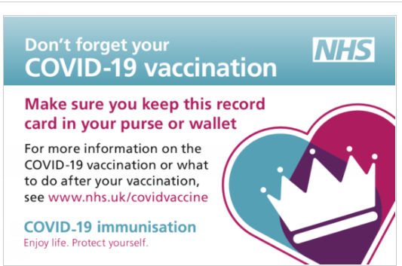
What is the process of getting a vaccine?
Staff can get their vaccine either by walking in to any Vaccination Centre or participating Community Pharmacy, showing their ID. Or they can book in via the National Booking Service across Vaccination Centres or participating Community Pharmacies:
Receive first vaccine
Given vaccine record card – take a photo in case you lose it
Given 2nd vaccine dose: around 8 weeks for people over the age of 18, or 12 weeks after first dose for younger people
Given booster 3 months after their second dose. Those who are immunosuppressed will be contacted separately to have a third and fourth full dose of the vaccine.
You can also download the NHS App, as you’ll be able to demonstrate your COVID-19 vaccination history using it

Slide 8
Managing vaccine anxiety and needle phobia
Key principles
Create a calm environment where the person feels ‘safe’ and comfortable
Avoid environmental triggers and keep distraction to a minimum, i.e. noise, glare, background distraction
Communicate clearly and offer reassurance and support
Explain the process and respond to queries
Provide an individualised and personalised approach
Use visual prompt cards and information leaflets
Choose a time and place that suits the person
Engage family – virtually present using video/telephone
Music
See here for guidance on having a confident COVID-19 conversation with different groups of people
Resources:
Dementia UK: useful tips on the COVID-19 vaccine for people with dementia
Alzheimer's Society: support for behaviours/anxiety and agitation
Guy’s and St Thomas’ NHS Foundation Trust Toolkit
Mind: tips for relaxation
Music for dementia: dose of music with COVID-19 vaccination

Slide 9
Techniques to manage anxiety and needle phobia
Distraction
Listen to favourite music
Read a book or magazine
Watch a programme on TV, iPad or phone
Engage in conversation
Engage family virtually
Comfort by holding hands
Recite songs or poems
Count to focus the mind
Relaxation
Breathing exercises
  Sit in comfortable position, relaxing jaws and shoulders
  Take long slow breath in through nose and out through mouth
  Count as you breathe
Imagery visualising ‘happy places’ that allow resident to relax
Guided online relaxation session
Music
Put on favourite song
Music with slow tempo, that is familiar, works best to make the vaccine space more friendly
Ask resident to pick out different instruments in the piece to focus on
Music puts people at ease, lessens the distress and provides a powerful distraction from pain. It may spark conversation which also decreases anxiety and stress

Slide 10
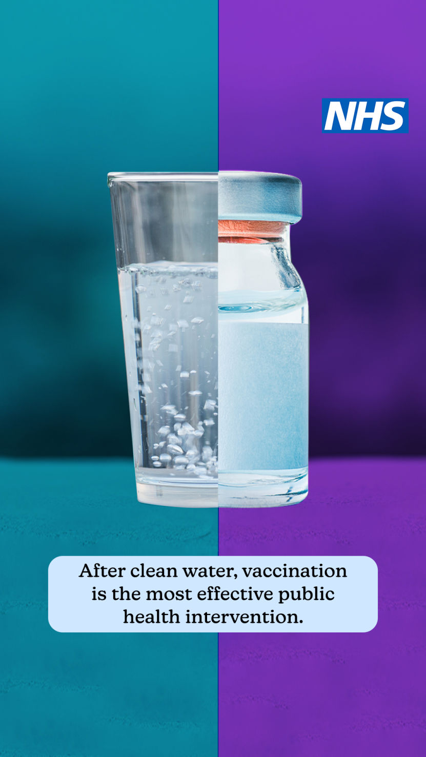
What are vaccines?
Vaccines are a medicine. Instead of treating patients with diseases, they:
Significantly reduce the chance that someone will catch a disease in the first place
Reduce the harm caused by the disease for people who do still catch it, so that they do not get seriously unwell from it
To keep high levels of protection it is important to have the full course of three vaccinations (doses 1, 2 and the booster)

Slide 11


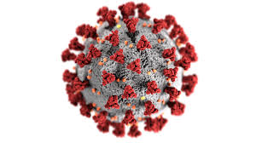

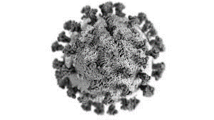

How do the Moderna and Pfizer/BioNTech* vaccine work?
The scientist takes part of the virus to make the vaccine. This part of the virus cannot give you COVID-19
Once injected the immune system produces virus fighters called anti-bodies and T-Cells
You have two injections a minimum of 8 weeks apart
If you come into contact with COVID-19 the virus fighters (anti-bodies and T-Cells) remember it and can fight it
*Pfizer BioNTech COVID-19 mRNA vaccine BNT162b2 (Comirnaty®) &
Moderna COVID-19 vaccine (Spikevax®)

Slide 12


How do the Oxford/AstraZeneca and Janssen vaccines work
Instructions on how to make the protein are found on the surface of the COVID-19 virus
The instructions are added to a safe virus to make the vaccine
You have two injections a minimum of 8 weeks apart
Once injected the vaccine stimulates your immune system to produce virus fighters called anti-bodies and T-Cells
If you come into contact with COVID-19. The virus fighters (anti-bodies and T-Cells) can fight it
You can find a video about the Oxford vaccine here: https://www.youtube.com/watch?v=DUTRaOOblI8&feature=youtu.be&app=desktop
AstraZeneca COVID-19 vaccine (Vaxzevria®). Janssen COVID-19 vaccine (Ad26.COV2-S [recombinant])

Slide 13

Why get vaccinated if I’ve already had COVID-19?
1. Exposure to COVID-19 through infection results in antibodies. Receiving a COVID-19 vaccination, causes the body to create, T cells. Both are virus fighters.
2. Unfortunately, the protection against the virus that antibodies give us wears off over time, so the virus can overpower our immune system again.
3. The vaccines also cause our immune systems to create a vastly increased amount of a type of white blood cell called T Cells. White blood cells, such as T Cells, are another effective virus fighter.
4. What’s so good about T Cells?
T Cells are ‘memory cells’, and recognise more protein snippets from viruses, than antibodies. They remember how to fight the virus, and can act quickly, which makes them more resilient in the face of new variants.
T

Slide 14
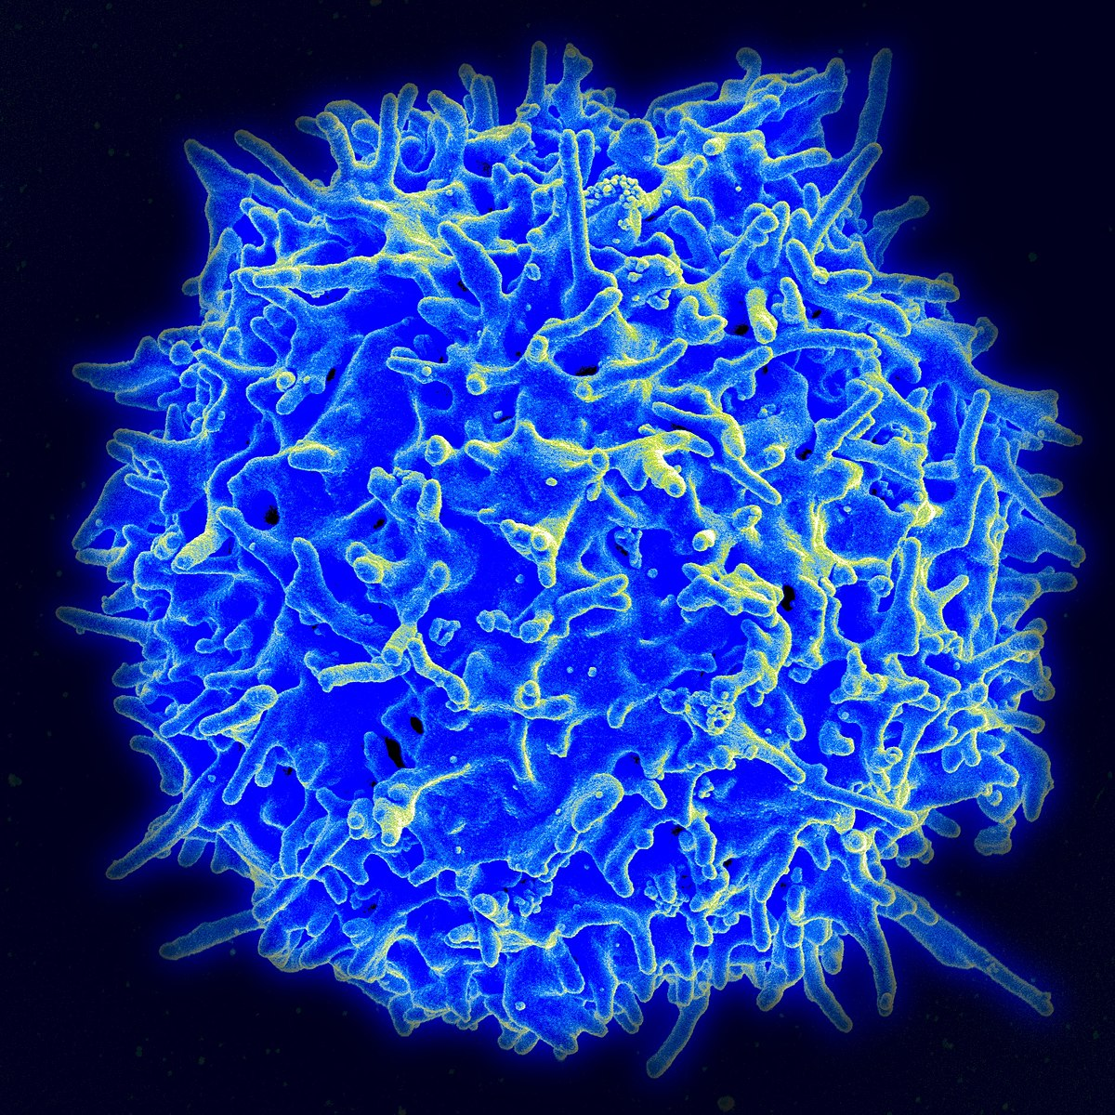
Why are boosters important?
Getting a booster vaccine not only tops up the antibodies in our body - it also ensures that older T cells are backed up by newer ones. This helps them retain their memory of how to fight the virus for longer. This ensures stronger, longer lasting protection against future infection than having had COVID-19 itself.
T cells help to prevent the virus from spreading to other cells and to clear an infection that has already started, which could spell the difference between mild and severe disease.
They also help to reduce transmission, by reducing the amount of virus that infected people carry in their bodies.
The findings show that around 6 months after a second dose of any of the COVID-19 vaccines, protection against death with Omicron was around 60% in those aged 50 and over. However, this increased to around 95% 2 weeks after receiving a booster vaccine dose.
The data continue to show high levels of protection against hospitalisation from the booster. After a Pfizer booster (after either primary vaccination course), vaccine effectiveness against hospitalisation started at around 90%, dropping to around 75% after 10 to 14 weeks.
After a Moderna booster (mRNA-1273) (after either primary vaccination course), vaccine effectiveness against hospitalisation was 90% to 95% up to 9 weeks after vaccination.
Notes:
Source: https://www.gavi.org/vaccineswork/t-cell-army-how-infection-busting-cells-previous-coronavirus-exposure-could-protect

Slide 15
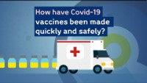
How have the vaccines been made quickly and safely?

Slide 16
Self-certification of exemption
Staff are now able to self-certify themselves as exempt from receiving the vaccine, either for medical reasons or because they have received an MHRA approved vaccine abroad. The MHRA approved vaccines are: the Pfizer/BionTech, the AstraZeneca, the Moderna, and the Janssen vaccines.
It is the responsibility of staff to make their own assessment of their eligibility for exemption. It is not the responsibility of managers to verify this, though they do need to see evidence of the self-certification.
Self-certification will be clinically assessed at a later stage.
Who is exempt
While this list is not exhaustive, examples of medical exemptions from COVID-19 vaccination could include individuals:
receiving end of life care where vaccination is not in the individual’s interests
with learning disabilities or autistic individuals, or with a combination of impairments which result in the same distress, who find vaccination and testing distressing because of their condition and cannot be achieved through reasonable adjustments such as provision of an accessible environment
with medical contraindications to the vaccines such as severe allergy to all COVID-19 vaccines or their constituents
who have had adverse reactions to the first dose (for example, myocarditis)
The information on medical exemptions and temporary self-certification applies to everyone entering care homes, including staff in NHS funded services. If a member of staff believes that they are exempt, they should start the medical exemption process as soon as possible.
Further information and template self-certification letters can be found here.

Slide 17
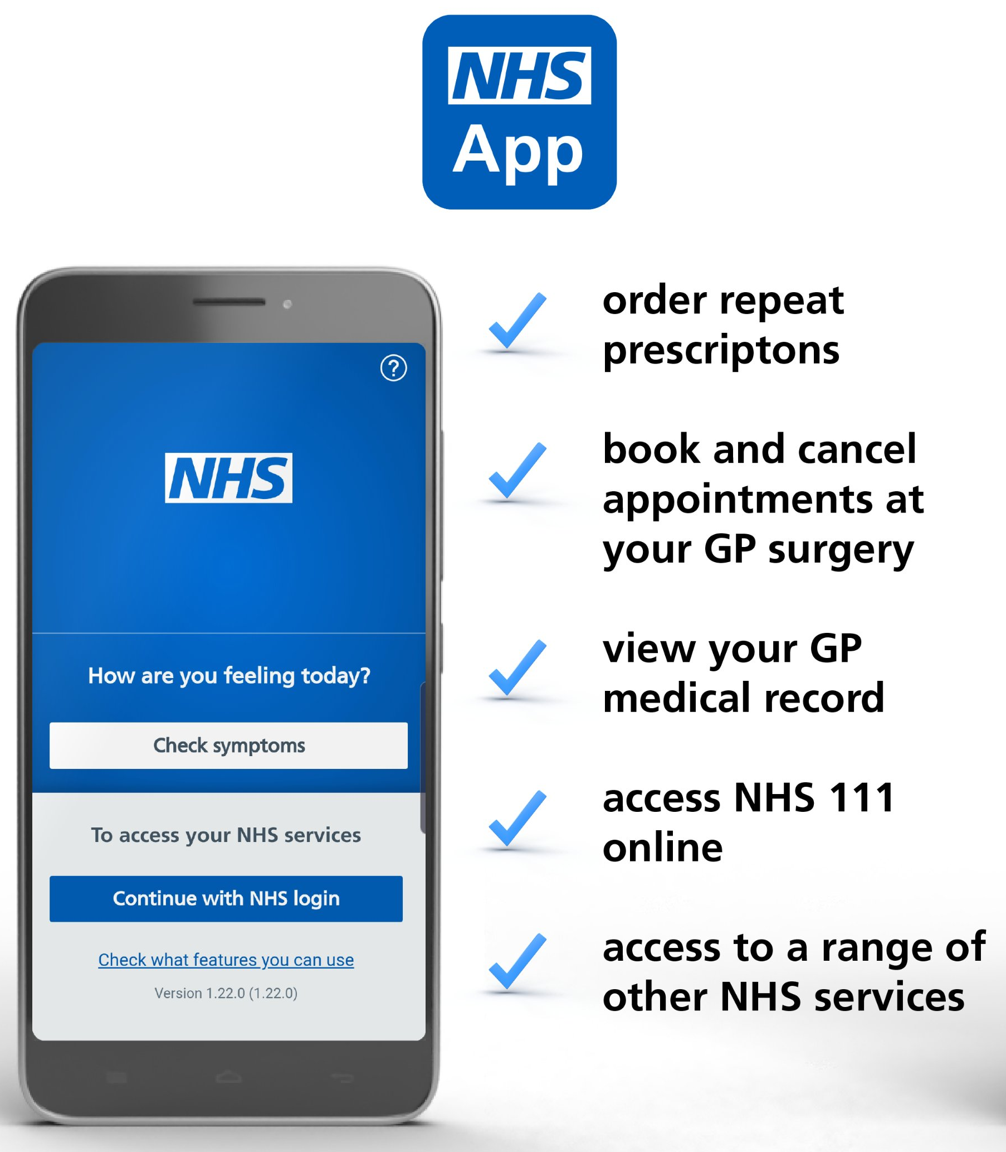
Demonstrating Vaccine Status in the NHS App
The NHS App is a simple and secure way to access a range of services on your smartphone or tablet. It is free from app stores. You need to be 16 or over to use the NHS COVID-19 Pass service and registered with an NHS GP practice in England. The NHS App should not be confused with the NHS COVID-19 App which offers the fastest way to see if you’re at risk from coronavirus.
Find out more about the app and its benefits here.
View and share the COVID-19 Pass on the app to demonstrate your vaccine status, for domestic use or travel abroad
Find out more here:
https://www.bt.com/content/dam/bt-sft/assets/documents/bt-skills-for-tomorrow-helping-others-nhs-app-guide-leaflet.pdf
https://www.bt.com/skillsfortomorrow/home-life/helping-others-nhs-app-guide
If you are struggling to access your vaccination status, then you should call 119 who will run through any issues with you. You should also receive a letter letting you know of any issues and who to contact.

Slide 18
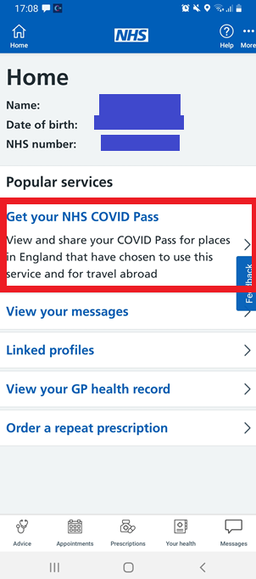
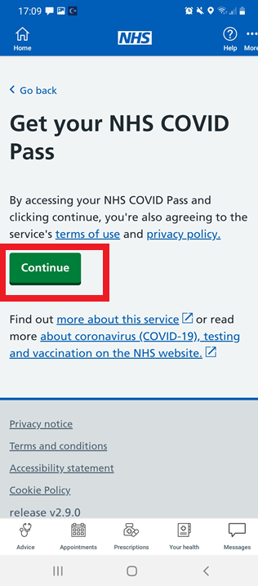
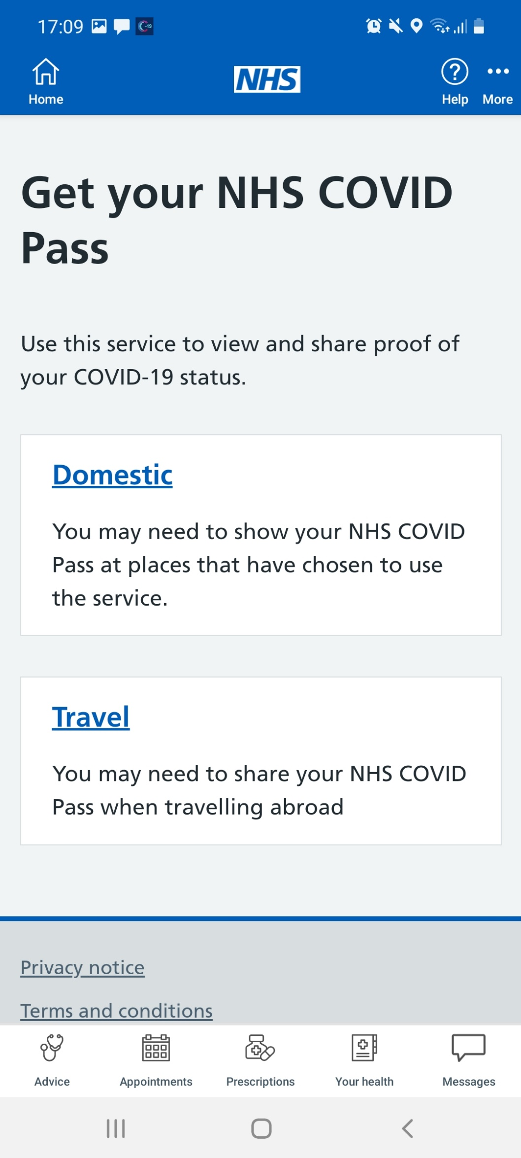
How to demonstrate your vaccination status in the NHS App
Once you have signed in to the NHS App, click ‘Get your NHS COVID Pass’
On the next screen, press ‘Continue’
Select ‘Travel’. This is because the travel pass offers more detail and better evidence of vaccination status

Slide 19
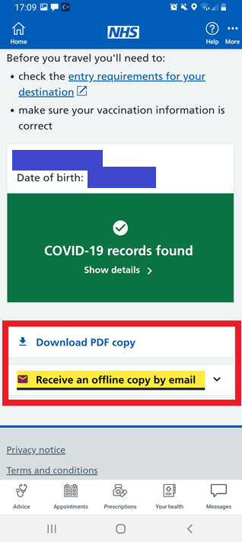
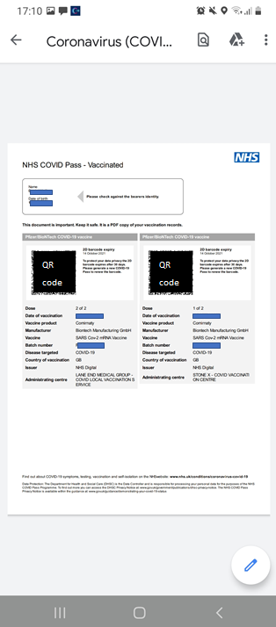
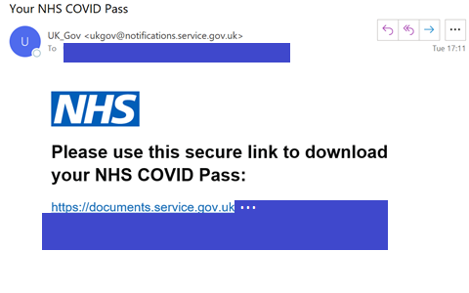
How to demonstrate your vaccination status in the NHS App
Select Download PDF copy or Receive an offline copy by email
You will be able to print the information that you receive (see right side of this slide), or email it to managers or colleagues to demonstrate vaccination status
People who have had a booster vaccine are also able to demonstrate this using the NHS App COVID Pass.

Slide 20
Truths about the vaccine
You may have seen some false information about the vaccine on the internet.
The statements that follow are truths about the vaccine:
The vaccine does not affect fertility. There is absolutely no evidence, and no theoretical reason, that any of the vaccines can affect the fertility of women or men. This video has more information on the safety of vaccines for pregnant women. And this video discusses the impact on new-borns, of mothers getting vaccinated in or before pregnancy.
Nothing goes into a vaccine unless it is absolutely necessary. The vaccine only contains what it needs in order to produce the virus fighting cells, be safe, be deliverable, and be stored. The vaccine does not contain any meat or blood products, does not contain a microchip, and is not magnetic.
The vaccine only gets you to produce an immune response (the “virus fighters”). The parts of the virus in the vaccine cannot reproduce in your body and cannot give you COVID-19.
Care Home staff are high priority to receive the vaccine due to the risk they have of catching COVID-19 (see the who receives the vaccine slide)
The vaccine went through all the normal stages of development and approval
By the beginning of March 2022, in London, almost 1.5 million vaccine doses had been delivered to Black Londoners of different backgrounds, with no different profile of side-effects to people from other ethnic groups. At the same time, over 3 million vaccine doses had been delivered to Asian or British Asian Londoners of different backgrounds, with no different profile of side-effects to people from other ethnic groups. See Weekly Data for more information.

Slide 21
Who is receiving the vaccine?
The Joint Committee on Vaccination (JCVI) and Immunisation advises UK health departments on immunisation
The JVCI advises that the first priorities of any COVID-19 vaccination programme should be the prevention of death from COVID-19 and the protection of social care and health care staff.
Care home staff and residents are in the highest priority groups specified by the JCVI, meaning that their access to vaccination is prioritised.
Everyone aged 12 and above is now eligible for two doses of the vaccine. For those aged 12-15 the second dose should be no sooner than 12 weeks after their first.
People who are immunosuppressed are being offered a third primary dose 8 weeks after their second dose. .
5 to 11 year olds who are either in a clinical risk group or are a household contact of someone of any age who is immunosuppressed should be offered a vaccine.
The JCVI has recommended a booster (fourth) jab, at least 3 months after their third primary dose, for those who are most vulnerable, for example those on chemotherapy or have issues with their immune system. Long term residents over the age of 65 and everyone over the age of 75 will also be eligible for the fourth jab.
Booster vaccine doses are available on the NHS, 3 months after the second dose, for all people aged 18 and over, people aged 16 and over with a health condition that puts them at high risk of getting seriously ill from COVID-19, people aged 16 and over who are a main carer for someone at high risk from COVID-19, and people aged 16 and over who live with someone who is more likely to get infections (such as someone who has HIV, has had a transplant or is having certain treatments for cancer, lupus or rheumatoid arthritis).
The full information is here: Priority groups for coronavirus COVID-19 vaccination

Slide 22
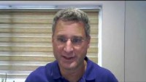
Boosters – keeping us all safe
UK study finds mRNA COVID-19 vaccines provide biggest booster impact (video from Reuters)

Slide 23
Booster vaccinations
First booster vaccine doses are available on the NHS, 3 months after the second dose, for all people aged 18 and over, people aged 16 and over with a health condition that puts them at high risk of getting seriously ill from COVID-19, people aged 16 and over who are a main carer for someone at high risk from COVID-19, and people aged 16 and over who live with someone who is more likely to get infections (such as someone who has HIV, has had a transplant or is having certain treatments for cancer, lupus or rheumatoid arthritis).
The JCVI has recommended a second (Spring) booster for all residents in an older adult care home and everyone in the general population over the age of 75, 3-6 months after their last dose. Full guidance can be found here. The Spring booster will also be available to people aged 12 years and over with a weakened immune system.
Most people will be offered a booster dose of the Pfizer/BioNTech vaccine or a half dose of the Moderna vaccine. This means your booster dose may be different from the vaccines you had for your first and second doses and is perfectly fine. Some people may be offered a booster dose of the Oxford/AstraZeneca vaccine if they cannot have the Pfizer/BioNTech or Moderna vaccine.

Slide 24
How to get a Booster Vaccine
It is easier now than ever for staff to access a vaccine.
If you had your second dose more than 3 months ago, you can get your vaccine in a local pharmacy, a vaccination centre, a walk-in centre, or a pop-up clinic.
The COVID-19 vaccination online booking service is available to use to book into a vaccine clinic online.
You can pre-book your COVID-19 booster dose online if it's been 2 months (61 days) since you had your 2nd dose. You'll be offered appointment dates from 3 months after the date of your 2nd dose.
It is helpful, but not essential, to know your NHS number when booking.
Staff can also attend a walk-in clinic from 3 months after their 2nd dose. You can find your nearest or most convenient walk-in vaccination site here.
Staff attending a walk-in site are encouraged to bring proof of employment such as staff ID, a letter or a payslip from their employer within the last 3 months.

Slide 25
Flu, Pneumococcal and Shingles Vaccines
Each year the NHS prepares for the unpredictability of flu. For most healthy people, flu is an unpleasant but usually self-limiting disease with recovery generally within a week. However, there is a particular risk of severe illness from catching flu and therefore it’s important that we offer flu and other immunisations to health and social care staff and those who are more at risk, such as;
older people
the very young
pregnant women
those with underlying disease, such as chronic respiratory or cardiac disease
those who are immunosuppressed
For information on Flu vaccines for care home residents and staff, please refer to the London Flu Standard Operation Procedure (SOP). The flu vaccine can be administered at the same time as the COVID-19 booster. For non-clinical staff (e.g., cleaners), they are eligible for a free flu vaccine in London’s participating community pharmacies – see www.myvaccinations.co.uk. Community pharmacies are also able to do onsite vaccination clinics for the care home if numbers to be immunised are above 10.
It is also important to ensure that all residents aged over 65 have received a one-off pneumococcal vaccine (PPV23) to prevent against invasive pneumococcal disease and pneumonia. This can be arranged with the patient’s GP and can be administered at the same time as the booster jab.
All residents aged between 70 and 79 should also receive a one-off shingles vaccine unless clinically contraindicated. This can be arranged with the patient's GP and there must be a 7-day gap between this vaccine and the booster jab.

Slide 26
Information on the Oxford/AstraZeneca vaccine
The benefits of the vaccine far outweigh the risks for the majority of adults. The Joint Committee on Vaccination (JCVI) has advised a preference for people under the age of 40, without underlying health conditions, to receive an alternative to the Oxford/AstraZeneca vaccine – where available and only if this does not cause substantial delays in being vaccinated. See here for more information.
Up to the end of December 2021, there were <0.001% of extremely rare blood clots (Vaccine-induced Thrombotic Thrombocytopenia/ VITT) with low platelet counts in the UK in people who have received the Oxford/AstraZeneca vaccine. Most of these reports were reported after a first dose. These extremely rare blood clots can occur naturally in people that have not had the vaccine and in people with COVID-19.
People who have had their first dose of the AstraZeneca vaccine should still get their second dose (unless they had one of the rare blood clots).
Some people should not have the AstraZeneca vaccine – Check here to find out more in relation to the vaccine, or speak to a clinician to check if your condition will impact your option of getting the vaccine.
Most people will be offered a booster dose of the Pfizer/BioNTech vaccine or a half dose of the Moderna vaccine. This means your booster dose may be different from the vaccines you had for your first and second doses and is perfectly fine. Some people may be offered a booster dose of the Oxford/AstraZeneca vaccine if they cannot have the Pfizer/BioNTech or Moderna vaccine.
You can find more information here.

Slide 27
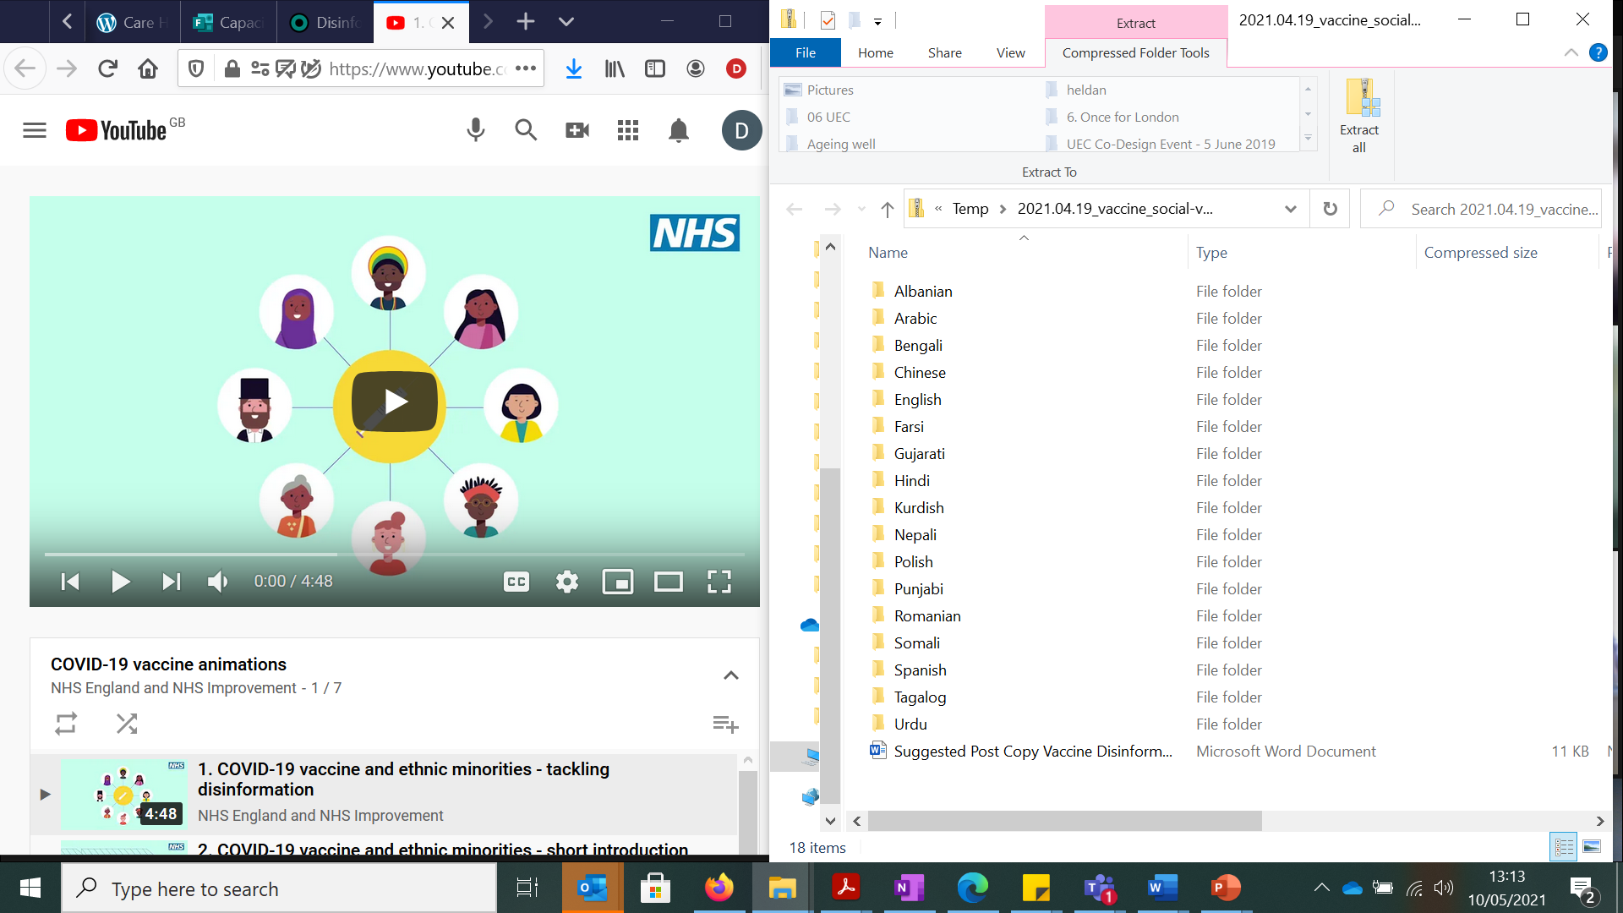
COVID-19 vaccine animations tackling disinformation
NHSE/I has launched a series of animations and suggested information aimed at tackling disinformation about the COVID-19 vaccine and encouraging uptake among ethnic minority groups. The animations are available in 17 different languages. Download them from the Campaign Resource Centre or watch on YouTube.

Slide 28
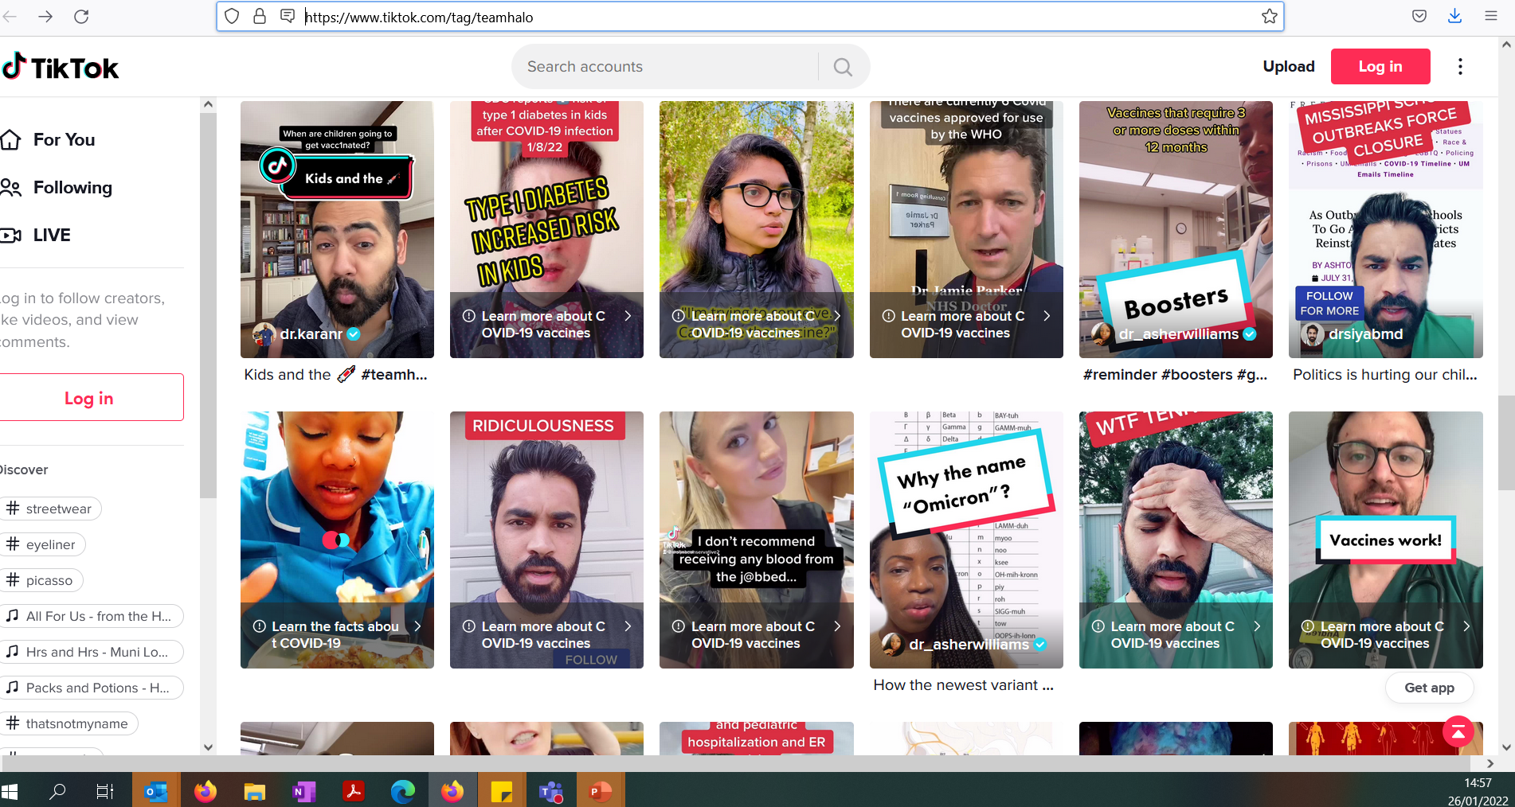
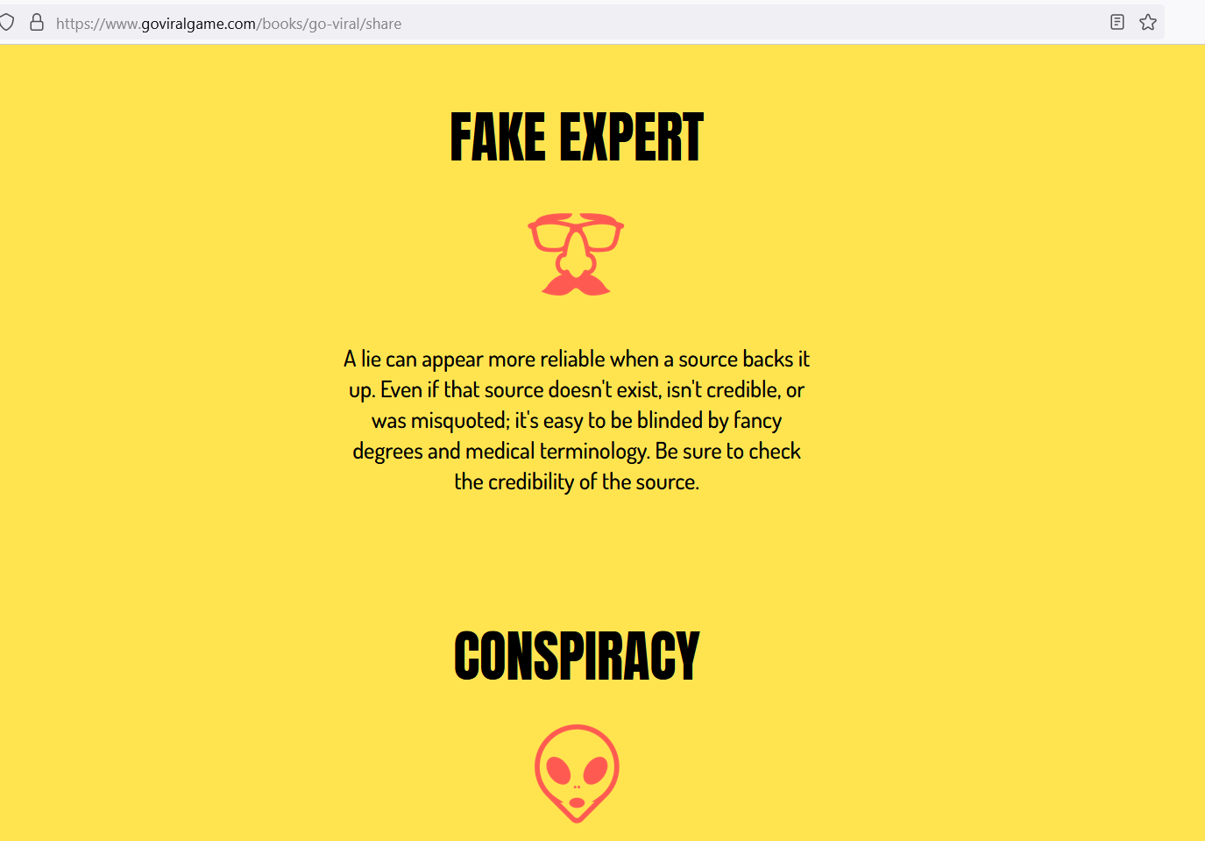

Other resources for addressing COVID-19 vaccine hesitancy and misinformation
There is a strong chance that staff may be getting information about vaccines from unreliable sources online - for example, content posted on social media.
When signposting to further information online, you should check that the sources you are using are reliable. If you see a news story, try to see if you can find it on the BBC website. If you can, the chances are it’s accurate and well reported.
As well as being full of potential misinformation, or disinformation, social media can also be a force for good. Team Halo works with science and clinical professionals on social media to spread accurate knowledge about COVID-19 and vaccines.
GoViral runs a simulation to demonstrate to users how easy it is for misinformation (especially about the COVID-19 virus) to spread and go viral
Check with your local authority for information about local events
Staff vaccine Q&A, presented by Professor Kevin Fenton.

Slide 29

Pregnancy and Breastfeeding
The Joint Committee on Vaccination and Immunisation (JCVI) has identified pregnant women a priority group for vaccination following research showing that they are vulnerable to more serious illness and pregnancy complications if they are infected with COVID-19. Pregnant women should get primary and booster vaccines as soon as possible:
There is no evidence of an increased risk of miscarriage if you become infected during pregnancy. Although the overall risk from COVID-19 disease in pregnant women and their new babies is low, in later pregnancy some women may become seriously unwell and need hospital treatment. The best precaution for pregnant women is to get the vaccine.
Data from the United States shows that over 100,000 pregnant women have safely been vaccinated – mainly with Pfizer-Biontech and Moderna vaccines.
The JCVI advises that it’s preferable for pregnant women in the UK to be offered the Pfizer-BionTech or Moderna vaccines where available – there is no evidence other vaccines are unsafe, but more research is needed.
If a woman finds out she is pregnant after she has started a course of vaccine, she may complete the vaccination during pregnancy using the same product (unless contraindicated)
New assets for pregnant women getting the COVID vaccine:
Royal College of Obstetricians and Gynaecologists – COVID-19 Pregnancy and Women's Health
Royal College of Medicine – COVID Vaccines for Pregnant Women
Guidance – Women of childbearing age, currently pregnant, planning a pregnancy or breastfeeding
Video - How do we know vaccines are safe for pregnant people?

Slide 30
Pregnancy and Breastfeeding
You can find more information here and read a letter that went to NHS leads here
The Joint Committee on Vaccination (JCVI) has recommended that the vaccine can be received by breastfeeding mothers.
There is no data on the safety of COVID-19 vaccines for breastfeeding mothers or for infants. Despite this, COVID-19 vaccines are not thought to be a risk to the breastfeeding infant, and the benefits of breastfeeding are well known.
COVID-19 vaccination: a guide for all women of childbearing age, pregnant or breastfeeding
The Royal College of Midwives have recently information and guidance here.

Slide 31
Variants of concern
All viruses – including SARS-CoV-2, the virus that causes COVID-19 – evolve over time. When a virus replicates or makes copies of itself, it sometimes changes a little bit, which is normal for a virus. These changes are called “mutations”, or variants.
While we are learning more, we need to do everything possible to stop the spread of the virus in order to prevent mutations that may reduce the efficacy of existing vaccines.
Vaccines are a critical tool in the battle against COVID-19, and there are clear public health and lifesaving benefits to using the tools we already have. We must not put off getting vaccinated because of our concerns about new variants.
There is good evidence that being vaccinated offers the most effective protection against being seriously ill. Therefore, we must proceed with the vaccination programme, at pace. We need to use the vaccines and other measures we have available even while we continue to improve those tools.
As restrictions in the community change, enhanced infection prevention and control standards and testing in care homes must be maintained, even for people who have been fully vaccinated.
“We are all safe only if everyone is safe”
Learn more about the naming conventions of the vaccines here

Slide 32
What are the possible side effects?
Like all medicines, vaccines can cause side effects.
Most are mild or moderate, tend to be less common in older people and go away within a few days
If side effects such as pain and/or fever are troublesome, they can be treated by medicines for pain and fever such as paracetamol.
Common side effects: may affect more than 1 in 10 people
having a painful, heavy feeling and tenderness in the arm where you had your injection. This tends to be worst around 1-2 days after the vaccine
feeling tired
headache
general aches, or mild flu like symptoms.
Although feeling feverish is not uncommon for two to three days, a high temperature is unusual.
In some rare cases the Pfizer and Moderna vaccines have known to cause chest pain and have a rare link to Myocarditis and Pericarditis.
You can find further information on the vaccine information leaflets

Slide 33
How were the vaccines approved?
The NHS will offer a COVID-19 vaccination only when it has been approved by the Medicines and Healthcare products Regulatory Agency (MHRA), the official UK regulator, like all other medicines and devices.
Vaccines go through three phases of clinical trials – in the third phase the Pfizer vaccine was given to 21,000 volunteers including older people with no serious safety concerns
The vaccine went through all the normal stages of development and approval. It happened more quickly because of several reasons including:
There had been vaccine work on other coronaviruses
There was no waiting for funding
Development stages were run in parallel
This video explains how COVID-19 vaccines were developed quickly: https://www.youtube.com/watch?v=ddDiyIKUP0M&app=desktop
You can also find a video from the MHRA here: https://youtu.be/3HPpWelo1ro

Slide 34
Why should people with a Learning Disability have the vaccine?
People with learning disabilities experience significant health inequalities and are at greater risk of premature deaths
The rate of COVID-19 deaths among people with learning disabilities are estimated to be about 6.3 times higher than in the general population
People with learning disabilities aged 35-44 are 19 times more likely to die of COVID-19. Those aged 45-64: 10 times more likely
During the first wave the number of deaths of people with a Learning Disability from all causes increased by 3.7 times in London compared the same period in previous years
COVID-19 accounted for 54% of deaths of adults with learning disabilities in residential care in this period
Data taken PHE (2020) Deaths of people identified as having learning disabilities with COVID-19 in England in the spring of 2020
London Learning Disability COVID-19 Vaccine information pack (Version 2)

Slide 35
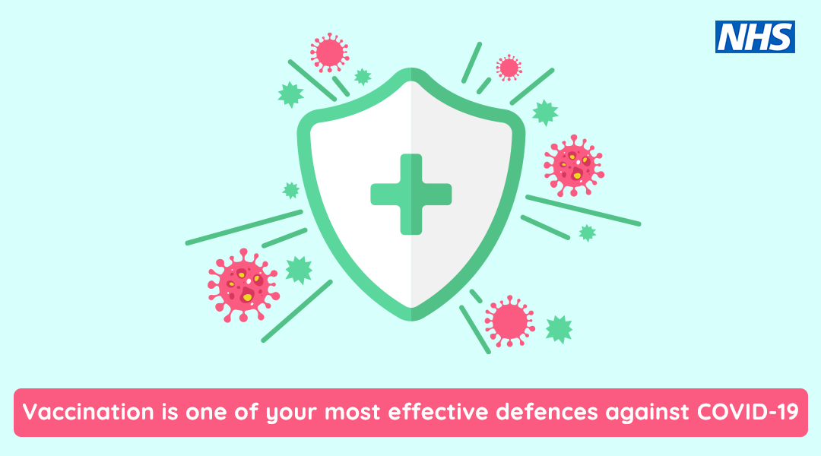

Slide 36

What happens after the vaccine?
The vaccine is just one tool in our tool box to prevent COVID-19, you should still;
Continue to wear PPE
Continue to follow infection prevention and control guidance
Continue with testing
Continue to follow guidance if anyone has symptoms of COVID-19
Download the NHS App, as you’ll be able to demonstrate your COVID-19 vaccination history using it
Notify your employer after each dose you receive.
You can find lots of useful information on the above in the COVID care home resource pack

Slide 37



After vaccinations
Lifting restrictions are partly thanks to the precautions taken by everyone. We need to be careful to continue with these.
Vaccination, though highly effective, is not 100% effective. Scientists are still investigating variants which are still circulating, in order to understand how these will affect people or spread.
As restrictions in the community lift, enhanced infection prevention and control standards and testing in care homes must be maintained.
The majority of people vaccinated will develop immunity after approximately 3 weeks. Since protection is not 100%, anyone with new symptoms or testing positive should be managed as an infectious case. They will still need to self-isolate and take all the same precautions that they would following a positive result before vaccination to avoid spreading the virus. Latest guidance on self-isolation can be found here.

Slide 38
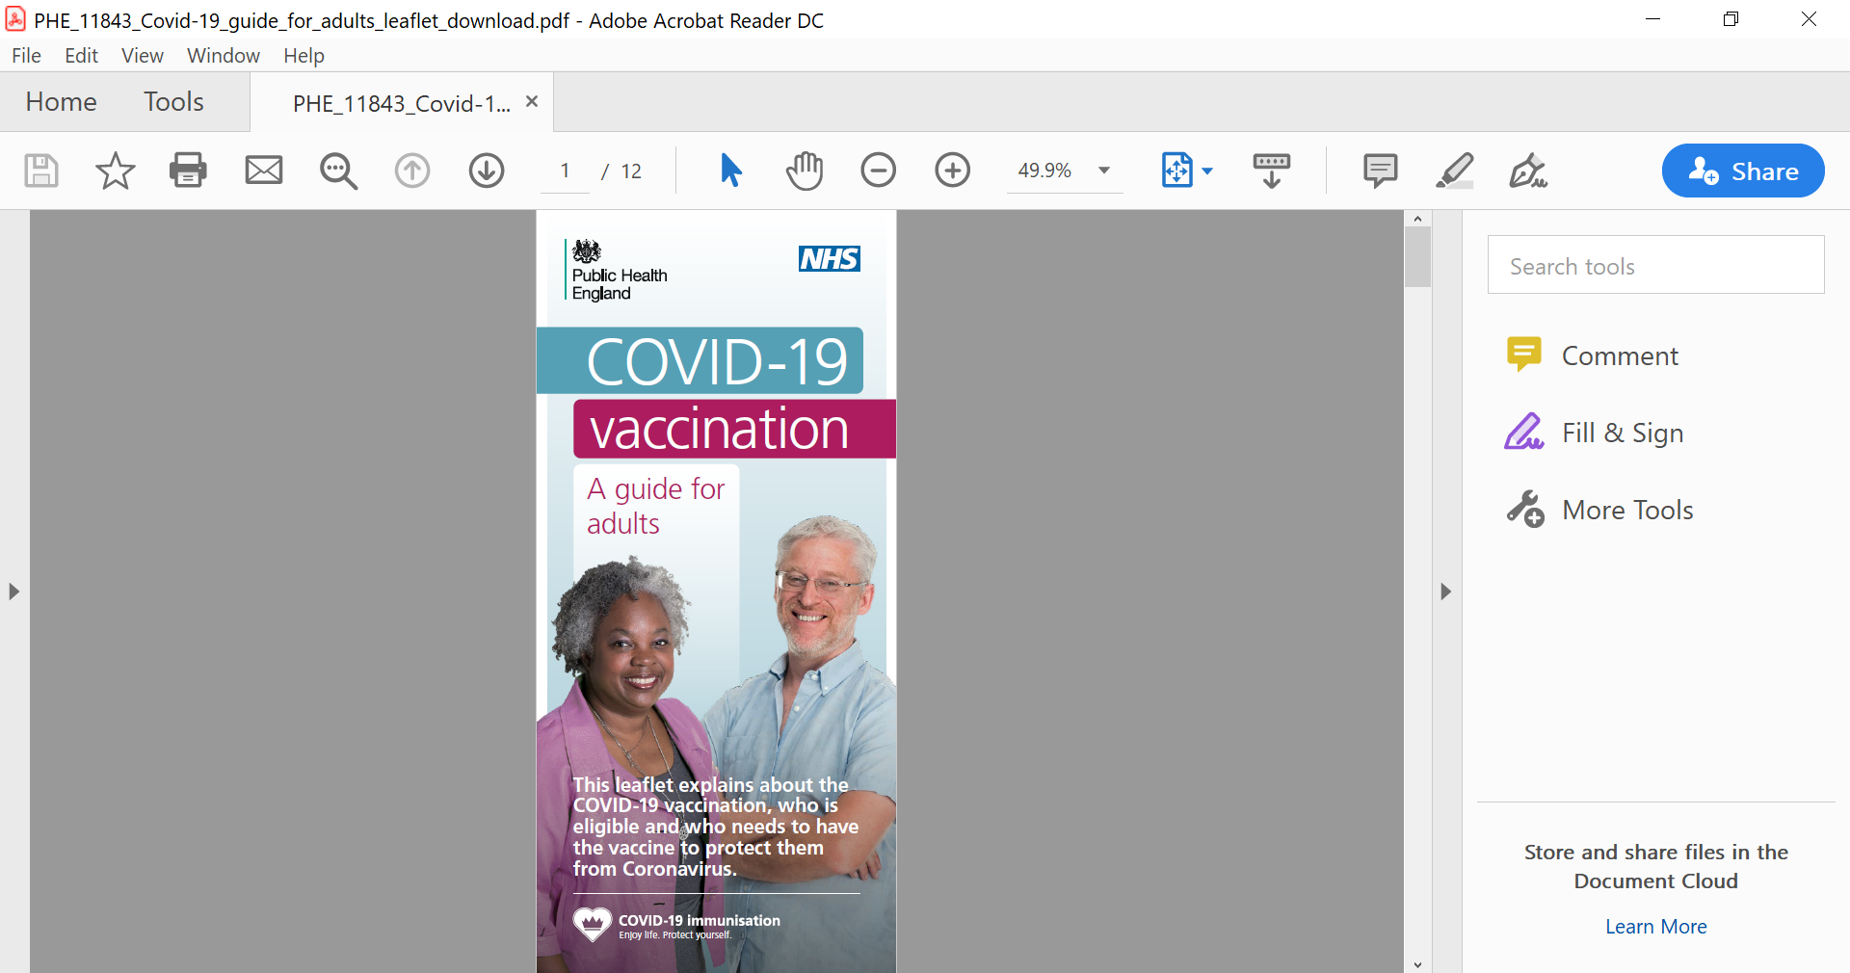
Vaccine information leaflets
You can find documents relating to the COVID-19 vaccination here
COVID-19 vaccine information for social care staff
COVID-19 vaccination guide for healthcare workers
Leaflet on why you are being asked to wait
COVID-19 vaccination guide for older adults
COVID-19 vaccination: a guide for all women of childbearing age, pregnant or breastfeeding
There are template letters for residents and relatives – see the consent form slide
Public Health England Leaflet - what to expect after your COVID-19 vaccinations
Accessible Information from Mencap on the Vaccine

Slide 39
Care home managers – preparing for staff vaccines
This includes agency staff
Keep staff records of vaccinations and report via the Capacity Tracker (as you do with flu vaccination) – see the Capacity Tracker slide.
Consider the logistics of releasing staff to receive their vaccine, while maintaining staffing levels within the home.
Support new staff to receive the vaccine. Understand that there may be a need for a few days off for staff after a vaccine dose.
Do talk to staff about the vaccine
Do use the resources in this pack
You may find the Q&A video for social care staff useful
London ADASS video – Go Get the COVID-19 Vaccine
London ADASS video – Vaccinations save lives
You may find the London care home COVID vaccine FAQs useful (please see the end of this pack for the FAQs, or contact england.londonehchprogramme@nhs.net if you want to check for updated questions)

Slide 40
Preparing for residents to receive the vaccine
For new residents
Establish if they have already had the vaccine and whether they have received both doses – if you don’t know, their GP can look on their records
If they need to have their first, second or booster dose, speak with their GP or local vaccination service about arranging their vaccine
Consent grouping – provisionally group residents into three categories to help prepare staff who will be giving the vaccine
- Residents who are likely to have capacity to consent
- Residents who have or may require a Legal Power of Attorney to consent on their behalf
- Residents who may need a best interest decision made on their behalf
See sections on consent and capacity for further information
Information on consent and preparing for the vaccine for residents with Learning Disability, is available from the London Learning Disability COVID-19 Vaccine information pack (Version 2)

Slide 41
Consent
Staff and all residents who are able to give informed consent are required to do so in order to receive the vaccine.
There is no legal requirement for consent to be in writing. A signature on a consent form is not conclusive proof that consent has been given, but records the decision and the discussions that have taken place.
Consent should be recorded – this is a required field on the Pinnacle system used by staff giving the vaccine.
Staff and residents should be provided with written information about the vaccine. Some people might not remember the information between the first and second dose.
Some residents might not have capacity to consent to have the vaccine – the same process should be followed as for other interventions such as the flu jab.

Slide 42
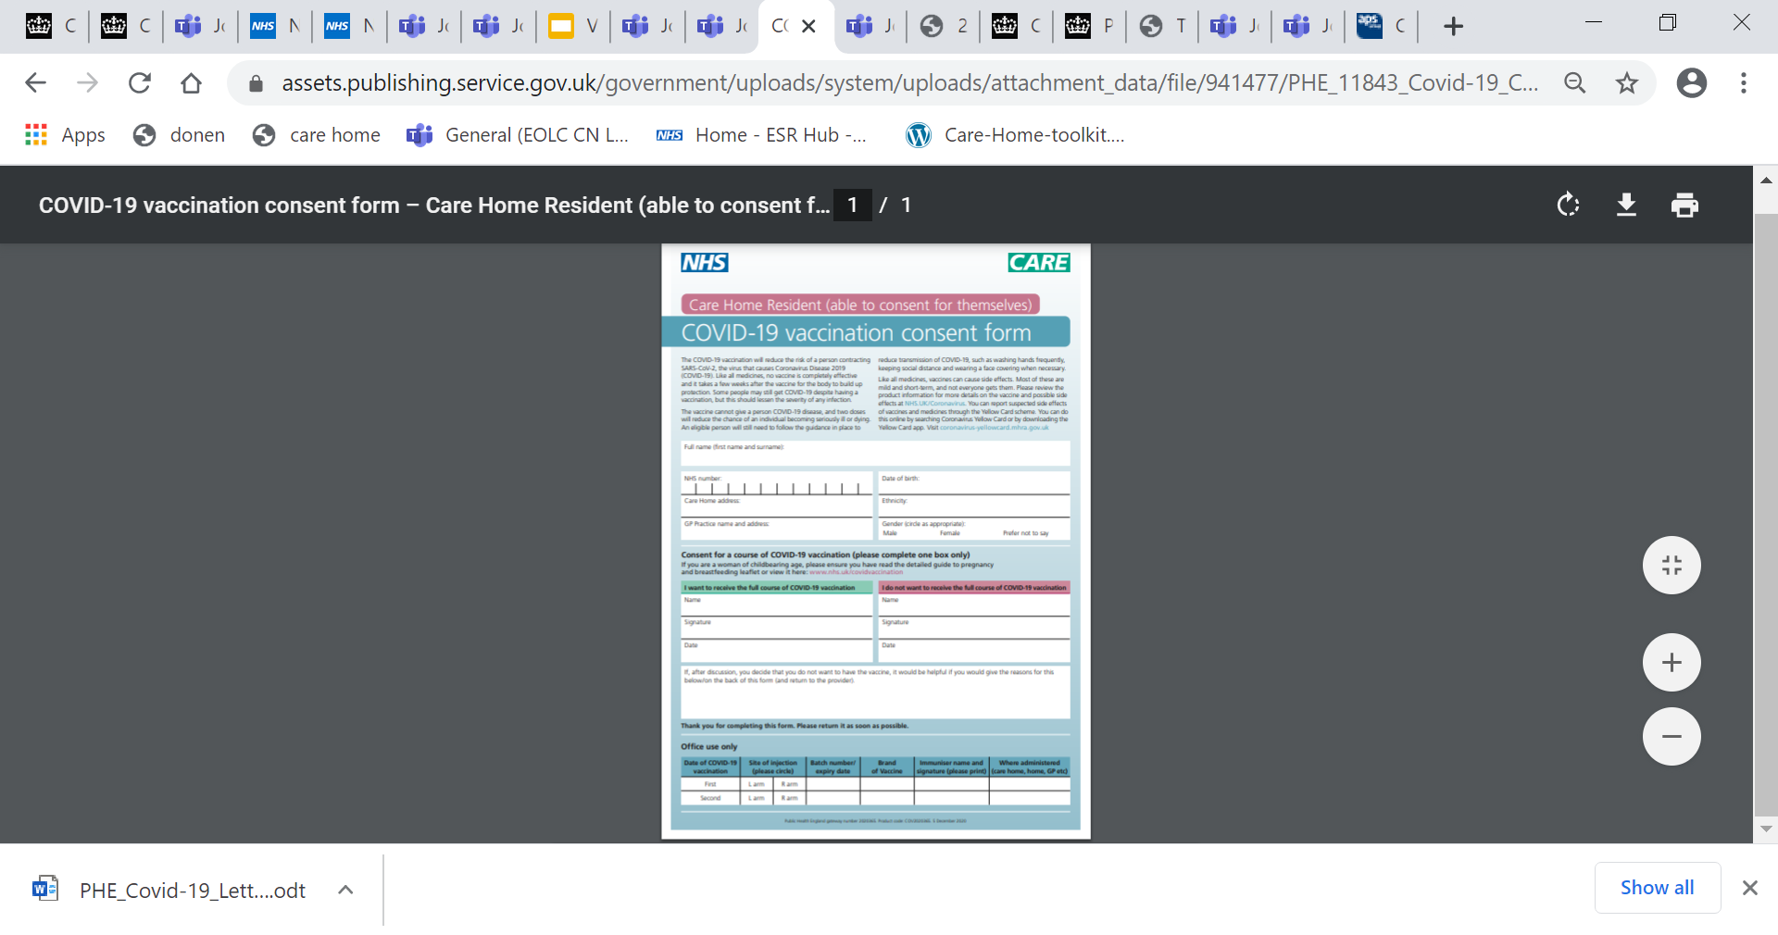
Consent forms
Consent forms can be found here: COVID-19-vaccination consent forms
This includes
Consent form for care home residents who are able to consent
Template letter for care home residents who are able to consent – contains information about the vaccine
Consent form for completion by Lasting Power of Attorney (health and welfare)
Template letter for Lasting Power of Attorney (LPA)
Form for a relative (person) with LPA to express their views which may be part of a best interest decision
Template letter for relatives
Staff consent form and letter can be found here

Slide 43
Mental Capacity Act
A reminder on the principles of the Mental Capacity Act
Assume a person has the capacity to make a decision themselves, unless it's proved otherwise
Wherever possible, help people to make their own decisions
Don't treat a person as lacking the capacity to make a decision just because they make an unwise decision
If you make a decision for someone who doesn't have capacity, it must be in their best interests
Treatment and care provided to someone who lacks capacity should be the least restrictive of their basic rights and freedoms
NICE guidance on decision making and capacity

Slide 44
Capacity Assessment
Remember that a capacity assessment is for a specific decision
People can lack capacity to make some decisions but have capacity to make other decisions
Mental capacity can fluctuate with time
Capacity assessment process:
Does the person have an impairment of their mind or brain?
Does the impairment mean the person is unable to make a specific decision when they need to?
The Mental Capacity Act says that a person is unable to make a decision if they can’t:
understand the information relevant to the decision
retain that information
use or weigh up that information as part of the process of making the decision
Before deciding a person lacks capacity it’s important to take steps to enable them to try to make the decision themselves (see the next slide)
A webinar was held by the National Capacity Forum – you can find more information here
A London webinar was recently held on the Mental Capacity Act – you can find the slides here

Slide 45
Supporting residents to make decisions
Before deciding a person lacks capacity, it's important to take steps to enable them to try to make the decision themselves.
Does the person have all the relevant information they need e.g., the benefits and possible side effects?
Could information be explained or presented in a way that's easier for them to understand (for example, by using simple language or visual aids)?
Are there particular times of day when the resident's understanding is better – some people with dementia are more confused in the evening?
Are there particular locations where the resident may feel more at ease e.g., in their room?
Accessible resources
About the Coronavirus (COVID-19) vaccine | COVID-19 vaccination programme resources
Keep Safe Easy read posters | NHS England/Improvement Video on the COVID 19 Vaccine
PHE Easy read Guide to the COVID -19 Vaccine | COVID-19 Vaccine: Accessibility and reasonable adjustments for individuals with severe learning disabilities whose behaviour challenges

Slide 46
Supporting residents who cannot make decisions
If the person concerned lacks capacity to consent to the COVID-19 vaccine then you should check whether that individual has a Lasting Power of Attorney (LPA) or deputy for health and welfare who can consent on their behalf. Where an individual does not have an LPA a Best Interest Decision approach is required.
The Best Interest Decision process should be made by more than one person, and involve people that know the individual very well, for example, family, advocates, or people that give care to that person, and can include their GP, their social worker etc.
If you are concerned about a decision made by the person with Lasting Power of Attorney of an individual, you can contact your local authority and request to speak to the adult safeguarding team, who will ask you for background information that they can then investigate.
Further information
Mental Capacity Act

Slide 47
Summary flow chart – capacity and best interests
No
Does the resident have capacity to make a decision about having the vaccine?
Yes
Does the resident have a Lasting Power of Attorney (LPA) for health and welfare?
No
The resident should decide if they want the vaccine. The resident completes the consent process
A decision should be made in the resident’s best interest:
Try and involve the resident if possible
Consider previous wishes such as whether they have previously had immunisations
Talk to those who know the resident best
Take into account the benefit to the individual and potential side effects e.g. distress
Yes
The LPA can consent for the resident.
If you are worried that the LPA is not acting in the residents best interest – speak to your local authority safeguarding lead/ team
Consent by the resident or LPA and best interest decision should be recorded – this is a required field on the Pinnacle systems that the clinicians giving the vaccine use

Slide 48
Summary – supporting residents with dementia, mental health conditions and/or learning disabilities
Does the resident wish to have a COVID-19 vaccine?
Yes
No
Provide information on:
Safety and efficacy
Process and side effects
Does the resident have the capacity to consent to having the COVID-19 vaccine?
Techniques to manage vaccine anxiety and needle phobia, as outlined on page 35:
Relaxation
Distraction
Music
Family/carer contact
Yes
No
The resident can decide if they want the COVID-19 vaccine
Check if have LPA for health and welfare?
Needs best interest decision?
Consented to have the vaccine?
Refer to:
Summary flow chart on capacity and best interests
Consent forms/letter templates
Conversation on recording capacity to consent
Yes
No
Administer vaccine

Slide 49
What if there are COVID-19 cases or an outbreak at the home?
An outbreak is defined as two or more COVID-19 cases in the care home (including residents and staff)
The COVID-19 vaccine should be offered to residents and staff, with the aim of achieving high uptake as quickly as possible.
Vaccination against COVID-19 may be temporarily deferred for some residents/staff e.g. if unwell or still within four weeks of onset of COVID-19 symptoms. However other staff and residents/staff should still have the vaccine during this time, if possible.
A risk assessment should be carried out by the lead vaccinator and care home manager. If needed, advice should be sought from others such as the local health protection team. The risk assessment may include:
- number of COVID-19 cases and suspected cases
- whether the outbreak is emerging or resolving
- ability to isolate residents
- the environment and space for the vaccine, e.g., isolating by floor
Guidance for vaccination in care homes that have cases and outbreaks.

Slide 50
Capacity Tracker and Data
To track COVID-19 vaccinations in care homes, vaccination uptake questions are now included in capacity tracker
During the vaccination roll-out it is vitally important to find out how many staff and residents are being vaccinated.
This will also create an opportunity to see where additional support is needed to ensure we can maximise access to the vaccination.
Guidance will be available in Capacity Tracker to support filling in the questions as accurately as possible
You may find this video on capacity tracker useful: https://www.youtube.com/watch?v=jTMRxxPeXoo&feature=youtu.be (specific information on the vaccine at 7mins 23secs)
Staff and residents should be updated on what information will be processed
The vaccine type and why an exemption was approved does not need to be kept by a provider – information should be recorded, but not kept.
More information surrounding how data should be used can be found here.
For queries relating to the interpretation of the questions, please contact Capacitytracker-guidance@dhsc.gov.uk
For any technical/system queries please contact the Capacity Tracker team using necsu.capacitytracker@nhs.net

Slide 51
Capacity Tracker
Care homes (as well as community rehab facilities, hospices, and substance misuse providers), are expected to complete daily returns documenting their capacity and business continuity information on the Capacity Tracker platform. They are also required to complete a weekly return for the Infection Control Fund.
Each borough will have a CCG and/or local authority ‘System Champion’ who liaises with care homes in the area to ensure that they are completing the returns, and escalate issues. STP, London and national contacts, as well as helpful resources are shown below:
Contact | Name | Email | Phone
Capacity Tracker Technical Support Centre | n/a | necsu.capacitytracker@nhs.net | 0191 691 3729
NHSEI London Capacity Tracker Regional Lead | Dan Heller | daniel.heller@nhs.net | 07702 419201
London Support | n/a | london.capacitytracker@nhs.net | n/a
NECSU Capacity Tracker Regional Lead | Jennifer Kamau | jennifer.kamau1@nhs.net | 07976 703617
LondonADASS Programme Manager | Tristan Brice | tristan.brice@londonadass.org.uk | 07702 553 593
ICS/ STP | ICS/STP CT Leads
NCL | Shafeeq Tejani & Jim Pursell
NEL | Tanvir Ahmed & Saem Ahmed
NWL | Cate Sendall
SEL | Tinu Ojo & Jonathan McInerny
SWL | Paul Harper & Sarah Adam
ONLINE RESOURCES
User Type | User Guide | Business Continuity Guide | Webinar
Commissioner | https://careproduksstore.blob.core.windows.net/carehomeuserdocs/champions.pdf | n/a: Included in System Champion User Guide | youtu.be/d3NmfFK33ig (18 June, 1300-1400)
Care Home | https://careproduksstore.blob.core.windows.net/carehomeuserdocs/care-home-userguide.pdf | https://careproduksstore.blob.core.windows.net/carehomeuserdocs/business-continuity.pdf | youtu.be/9O_fGqGF8VI (19 June, 1110-1210)
Community Rehab | https://careproduksstore.blob.core.windows.net/carehomeuserdocs/acute-userguide.pdf | n/a: Community Rehab providers do not report Business Continuity via Capacity Tracker
Hospice | https://careproduksstore.blob.core.windows.net/carehomeuserdocs/hospice-user-guide.pdf | https://careproduksstore.blob.core.windows.net/carehomeuserdocs/hospice-business-continuity-guide.pdf | youtu.be\XwnRnM6ddec (4 May)
Substance Misuse | https://careproduksstore.blob.core.windows.net/carehomeuserdocs/misuse-userguide.pdf | https://careproduksstore.blob.core.windows.net/carehomeuserdocs/misuse-continuity.pdf

Slide 52
Capacity Tracker - Current vaccination questions
To track COVID-19 vaccinations in care homes care providers, the below questions are included in Capacity Tracker;
Number of staff and residents known to have had the first dose of the COVID-19 vaccination
Number known to have had the second dose of the COVID-19 vaccination
Number known to have had the COVID-19 booster vaccination
Number known to have had this season’s flu vaccination
Details of staff who are or may be exempt from getting vaccinated against COVID-19
During the vaccination roll-out it is vitally important to find out how many staff and residents are being vaccinated. This will also create an opportunity to see where additional support is needed to ensure we can maximise access to the vaccination.
Guidance will be available in Capacity Tracker to support filling in the questions as accurately as possible
You may find this video on capacity tracker useful: https://www.youtube.com/watch?v=jTMRxxPeXoo&feature=youtu.be (specific information on the vaccine at 7mins 23secs)

Slide 53
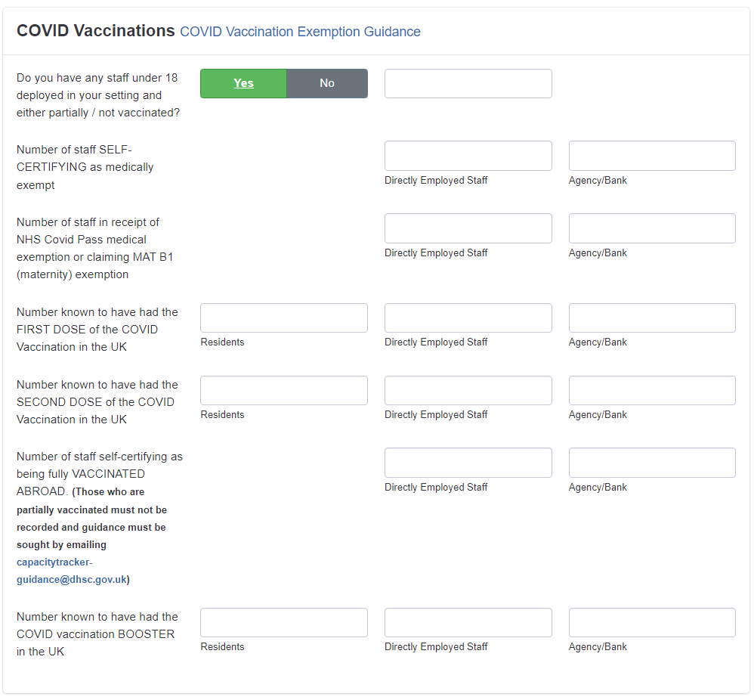
Capacity Tracker vaccination questions
Please note that Capacity Tracker questions change over time to reflect national priorities and developments. These questions are correct at the time of publishing.

Slide 54

FAQs regarding the vaccine
How do we know if the vaccine has worked, is there a test afterwards?
There are currently no approved tests that people can take after vaccination to indicate its effectiveness. The Pfizer/BioNTech vaccine is reported to be up to 95% effective in preventing severe COVID-19 infection. The Moderna vaccine is reported to be 94.1% effective, and the Oxford/AstraZeneca vaccine is reported to be 70% effective. These are all extremely high for vaccinations, and all have been shown to drastically reduce severe illness and death.
What happens if a resident refuses a jab?
The vaccine is not mandatory so people could refuse a dose. To be fully protected against COVID-19 residents would need to have two primary doses, plus the booster dosage(s).
Why get a booster?
As the efficacy of the original doses of the vaccines wane, it is imperative a booster is given to keep up levels of antibodies to fight off the virus. Data shows:
The efficacy of the primary vaccines wane over time. Protection from the Pfizer vaccine drops by over 15% after 20 weeks of having your second dose and it drops by nearly 10% after 12 weeks with Moderna, so getting a booster dose is crucial to allow longer lasting protection.
Early data shows the booster has a 93.1% protection rate in adults who had AstraZeneca as their primary vaccine, and 94% for those who had Pfizer.

Slide 55
FAQs regarding the vaccine
Will district nurses be able to deliver the vaccine?
There will be local decisions made on workforce (who is giving the vaccine). This could include district nurses. People giving the vaccine will have the training that they need.
Can residents be vaccinated by a GP who is not a GP at the practice they are registered to?
Yes, residents can be vaccinated by another GP - the information is added on to a national database and records of vaccination go to the resident's own GP's record.
Will pharmacists be delivering the vaccine?
Yes, pharmacists are delivering the vaccine in their community pharmacies, and many have also been involved with the local vaccination sites run by GPs.
Do care homes need to access training prior to the vaccination programme starting?
People delivering the vaccine will receive the training that they need to safely administer the vaccine.

Slide 56
FAQs regarding the vaccine
Do we need to have anaphylaxis training?
The staff administering the vaccine will have had anaphylaxis training. Please ensure staff have their mandatory training.
Will staff delivering the vaccine have epi pens?
The staff delivering the vaccine will have any emergency drugs necessary.
The flu vaccine is also available as a nasal spray will it be possible to have the COVID-19 vaccine as a nasal spray as well?
The COVID-19 vaccine is currently only delivered as an injection.
What if I reacted badly to my first vaccine?
There is no clear data on the side effects of the booster, however, as with most medication, side effects are normal and usually only last for 24-48 hours. You can find further information on the vaccine information leaflets

Slide 57
FAQs regarding the vaccine
What funding or support is available to support staff vaccination?
Part of the Infection Prevention and Control Funding (round 3) was made available to support social care providers with the costs associated with accessing COVID-19 and flu vaccinations. This will remain available until 31 March 2022. Future plans to continue funding are unknown.
Local Authorities should pass the direct funding portion of the vaccines funding allocation to:
Care homes, including residential drug and alcohol services, within the Local Authority's geographical area on a 'per bed' basis
CQC-regulated community care providers (domiciliary care, extra care and supported living) within the Local Authority's geographical area on a 'per user' basis
This funding has been made available to support the following measures:
Ensuring that staff who need to attend work or another location for the purposes of being vaccinated for COVID-19 or flu are paid their usual wages to do so
Any costs associated with reaching a vaccination facility
Any reasonable administrative costs associated with organising COVID-19 or flu vaccinations where these were not being supported by other Government funding streams
Providers should aim to use this funding for the above intended purposes – more information can be found here.

Slide 58
FAQs regarding the vaccine
Do we need to have the vaccine if we have already had COVID-19 and if we have antibodies?
Yes, we would recommend still getting the vaccine. The vaccine may offer longer protection then natural protection
Can people with allergies have the vaccine?
The MHRA has released some updated guidance stating that anyone with a previous history of allergic reactions to the ingredients of the vaccine should not receive it, but those with any other allergies such as a food allergy can now have the vaccine. You can find more information here
How long will the vaccine/booster last for, will we need another one?
The UK is constantly monitoring the need or timing of booster doses of the COVID-19 vaccine and is now rolling out a COVID-19 booster vaccine top up COVID protection for staff and residents. A second booster will be available to eligible residents in the Spring. The UK is also monitoring whether a booster will again be needed in future and more information will gradually come out in time. Watch this video for more information.

Slide 59
FAQs regarding the booster
Can I get the same vaccine I had initially?
The first two doses of the vaccine should be by the same company. The booster will either be one full Pfizer dose or a half dose of Moderna. If you have had an AstraZeneca vaccine you can still get a Pfizer or Moderna booster.
Why is it mainly the Pfizer and Moderna vaccines available as a booster?
After reviewing data on booster responses from different combinations of COVID-19 vaccines, JCVI advises a preference for the Pfizer-BioNTech (Comirnaty®) vaccine to be offered as the third booster dose irrespective of which product was used in the primary schedule. There is good evidence that the vaccine is well tolerated as a third dose and will provide a strong booster response. Alternatively, individuals may be offered the Moderna (mRNA-1273/Spikevax®) vaccine, which is well tolerated and provides a strong booster response. A half dose (50µg) of Moderna (mRNA-1273/Spikevax®) vaccine is advised over a full dose due to the levels of reactogenicity seen following boosting with a full dose within the COV-BOOST trial.

Slide 60
FAQs regarding the booster
Is it safe to mix different vaccines?
The booster shots can be a different vaccine to your original two doses, as confirmed by the government. However, it is advised that the first two doses should be the same vaccine.
If I’ve had no symptoms of COVID-19 but a Lateral Flow Test (LFT) shows positive. How long do I need to wait to get the booster?
You must wait 28 days until you can receive the booster after testing positive for COVID-19. There must still be at least 91 days since your second dose of the vaccine and the booster.
Where can I get a booster vaccine and will it show on the NHS App?
You are able to go to any walk-in site to receive the booster. Booking online will allow you to chose a specific time to have your booster. All vaccinations will show up on the NHS app regardless of where they are done.

Slide 61
FAQs regarding the booster
How do social care staff and residents access their booster?
Primary care teams are delivering boosters directly to care home staff and residents within settings. The NHS has already visited 99% of older adult care homes to offer booster vaccinations to residents and staff. The remainder will be visited by 24 December, subject to no further COVID-19 outbreak in the care home. Where possible staff will also receive the offer of flu vaccination at the same time.
In addition, social care workers can book a vaccination slot via the National Booking Service or attend a walk-in centre. All eligible frontline social care workers who have not already had their COVID-19 vaccine can also access their first and second doses via these routes.

Slide 62
FAQs regarding fertility and pregnancy
Can any of the vaccines affect fertility?
No – there is nothing in the vaccine that can affect the fertility of women or men
Is it safe to try for a baby straight after the vaccine?
Yes – there is no need to avoid pregnancy after the vaccine
Is the vaccine safe women and their baby during pregnancy?
COVID-19 vaccines offer pregnant women the best protection against COVID-19 disease which can be very serious in later pregnancy for some women. COVID-19 vaccines do NOT contain live coronavirus or any ingredients that are harmful to pregnant women or their babies and cannot cause infection. Other non-live vaccines, such as whooping cough and flu, are considered to be safe for pregnant women and their unborn babies. mRNA vaccines (Pfizer and Moderna) are also quickly broken down once injected- within a few days there will be no vaccine left. World-wide many women have been safely vaccinated with COVID-19 vaccines in pregnancy.
Can I get an exemption if I am already pregnant/planning pregnancy?
Women who are planning pregnancy, are in the immediate postpartum, or are breastfeeding can be vaccinated with any COVID-19 vaccine, depending on their age and clinical risk group. Time-limited medical exemptions are an option for pregnant women.

Slide 63
FAQs regarding vaccine status
Are people going to get vaccine passports so they can travel abroad?
The NHS App will contain copies of your vaccinations and can be easily downloaded so you are able to show your COVID-19 vaccination status when travelling abroad. Some countries are still not allowing visitors from the UK, and others have strict guidance to follow if you do visit. The UK also has a number of countries that people are banned from travelling to. Full and up-to-date guidance can be found here.
Do not contact your GP surgery about your COVID-19 vaccination status. GPs cannot provide letters showing your COVID-19 vaccination status.
Find out more and how to access it here

Slide 64
FAQs regarding residents
Do Power of Attorneys (health and welfare) have to fill out the consent form?
If there is a deputy or attorney with relevant authority, then the heath care professional can only give the vaccination if the deputy or attorney has first given their consent. A record of discussion e.g. via email is acceptable and should be stored in the residents records. Consent is recorded on the Pinnacle system by the staff giving the vaccine.
Will GPs make sure everyone is suitable for the vaccine, for example, the people giving the vaccine might not have their medical records?
There are very few medical reasons which would make someone unsuitable for the vaccine. If you are concerned about an individual resident’s suitability you could speak with their named GP. The MHRA has released some updated guidance stating that anyone with a previous history of allergic reactions to the ingredients of the vaccine should not receive it, but those with any other allergies such as a food allergy can now have the vaccine. As a precaution, the MHRA has stated that administration of COVID-19 Vaccine AstraZeneca in people of any age who are at higher risk of blood clots because of certain medical conditions should be considered only if benefits from the protection from COVID-19 infection outweigh potential risks.

Slide 65
Additional FAQs
What is my risk of getting a clot after the vaccine?
The data so far suggests that the risk of clot is an extremely rare adverse event associated with low platelets (a type of blood cell) after vaccination with the Oxford/AstraZeneca vaccine. This is usually experienced between day 4-28 after vaccination.
Joint Committee on Vaccination (JCVI) statement:
An extremely rare adverse event of thrombosis (blood clots) and thrombocytopenia (low platelets - type of blood cell) (Vaccine-induced Thrombotic Thrombocytopenia/ VITT) have been noted after 1st vaccination with AstraZeneca.

Slide 66
Additional FAQs
How will I know if I have a clot?
Clots linked to the Oxford/AstraZeneca vaccine have been experienced between days 4-28 after vaccination. Some of the signs may include:
1) a new, severe headache which is not helped by usual pain relief or is getting worse
a headache that is worse when lying down or bending over
a headache with blurred vision, nausea and vomiting, difficulty with speech, weakness, drowsiness or seizures
2) new, unexplained bruising or bleeding
3) shortness of breath
4) chest pain
5) leg swelling
6) persistent abdominal pain

Slide 67
Additional FAQs
I have a family history of blood clot, does this put me at increased risk?
Unless you have a personal history of one of the following listed conditions, you can proceed with the 2nd vaccination with Astra Zeneca;
a history of cerebral venous sinus thrombosis - acquired or hereditary thrombophilia
vaccine-induced thrombocytopenia and thrombosis(VITT or VIT type 2)
I have had a previous clot - DVT (deep vein thrombosis) and/or PE (pulmonary embolus), is it safe for me to have the vaccine?
There is no evidence that patients with previous history of clots are more at risk of developing this rare effect after the vaccine. The risk of clots from COVID-19 disease itself is far greater that the risk of this rare adverse effect from vaccination.
Can I choose to have another vaccine that is not AstraZeneca for my second one?
All those who have received the 1st dose of AstraZeneca should continue to be offered the 2nd dose of Astra Zeneca, irrespective of age, unless major clots were experienced with low platelets after the 1st dose.

Slide 68
Additional FAQs
Why have other countries stopped vaccinating with AstraZeneca, is it safe to have?
Every country has its own medicines authority so makes its own decision for based on the information they have. The UK has the MHRA (Medicines and Healthcare product Regulatory Authority) and JCVI,(Joint Committee on Vaccination and Immunisation), which continues to thoroughly assess all the data and weigh up the risk and benefit of the vaccination.
The decision in the UK is that the benefits of prompt vaccination with the Astra Zeneca COVID-19 vaccine far outweighs the risk of extremely rare adverse effects for individuals over 40 years old and those with underlying health conditions putting them at increased risk of COVID-19 disease. The WHO (World Health Organisation) and the European Medicines Agency have also concluded that the balance of risk/benefit is very much in favour of vaccination.
Why have under 40-year-olds been offered another vaccine?
There appears to be an increasing incidence of these rare adverse effects in the younger age groups. The risks of serious adverse effects from COVID-19 disease increases significantly with age. With the COVID-19 case numbers much lower currently, the risk of severe illness/death from COVID-19 in these younger age groups is very low. Therefore, as a precaution, under 40yr olds without underlying health conditions can be offered another vaccine (if available) for their first COVID-19 vaccine but can still make an informed decision to receive the Astra Zeneca vaccine to receive earlier protection.
For the second vaccine, individuals aged 18-39yrs can proceed with having Astra Zeneca if no serious adverse effects experienced after their first vaccination with Astra Zeneca.

Slide 69
Resources
Standard operating procedure – vaccine deployment in community services
Letter to care homes: https://www.gov.uk/government/publications/covid-19-vaccinations-and-care-homes-programme-launch/covid-19-vaccinations-and-care-homes-programme-launch
Public Health England COVID-19 Vaccine Resource Centre, including Vaccine Communications Toolkit for Adult Social Care
COVID-19 vaccine information for social care staff
COVID-19 vaccination guide for healthcare workers
COVID-19 vaccination guide for older adults
COVID-19 vaccination: a guide for all women of childbearing age, pregnant or breastfeeding
What to expect after your COVID-19 vaccination
Consent forms and letters
General vaccine fact sheets, which can be downloaded here
Guidance for COVID-19 vaccination in care homes that have cases or outbreaks
Q&A video for social care staff Download a zip file which has short videos (designed for social media) about the JVCI, what vaccines are, and the oxford vaccine here
Video on how the vaccine was made so quickly

Slide 70
Resources
Useful tips on COVID-19 vaccine for people with dementia
Learning disabilities
NHS England Learning Disability and Autism Programme social media clips on vaccination
London Learning Disability COVID-19 Vaccine information pack (Version 2)
Supporting Residents with dementia, mental health and/or learning disability to make a decision
Assessing Capacity in people with learning disabilities
North East and Cumbria paper on Delivering COVID-19 vaccine to adults with learning disability/autism
Information sheet COVID-19 Vaccine Accessibility and reasonable adjustments for individuals with severe learning disabilities whose behaviour challenges
Accessible Information from Mencap on the Vaccine
NHS England/Improvement Video on the COVID 19 Vaccine
PHE Easy read Guide to the COVID -19 Vaccine
If you require support in having these conversations do link in with your local Learning Disability Team. Contacts of all the London Learning Disability Teams can be found here

