Slide 1


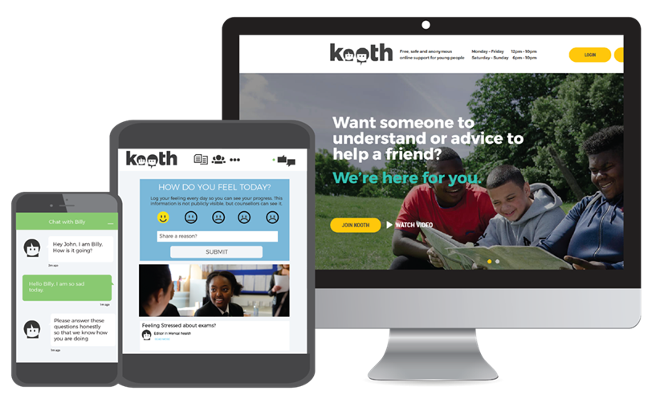
Discover Kooth
Online Mental Health & Wellbeing Service

Slide 2
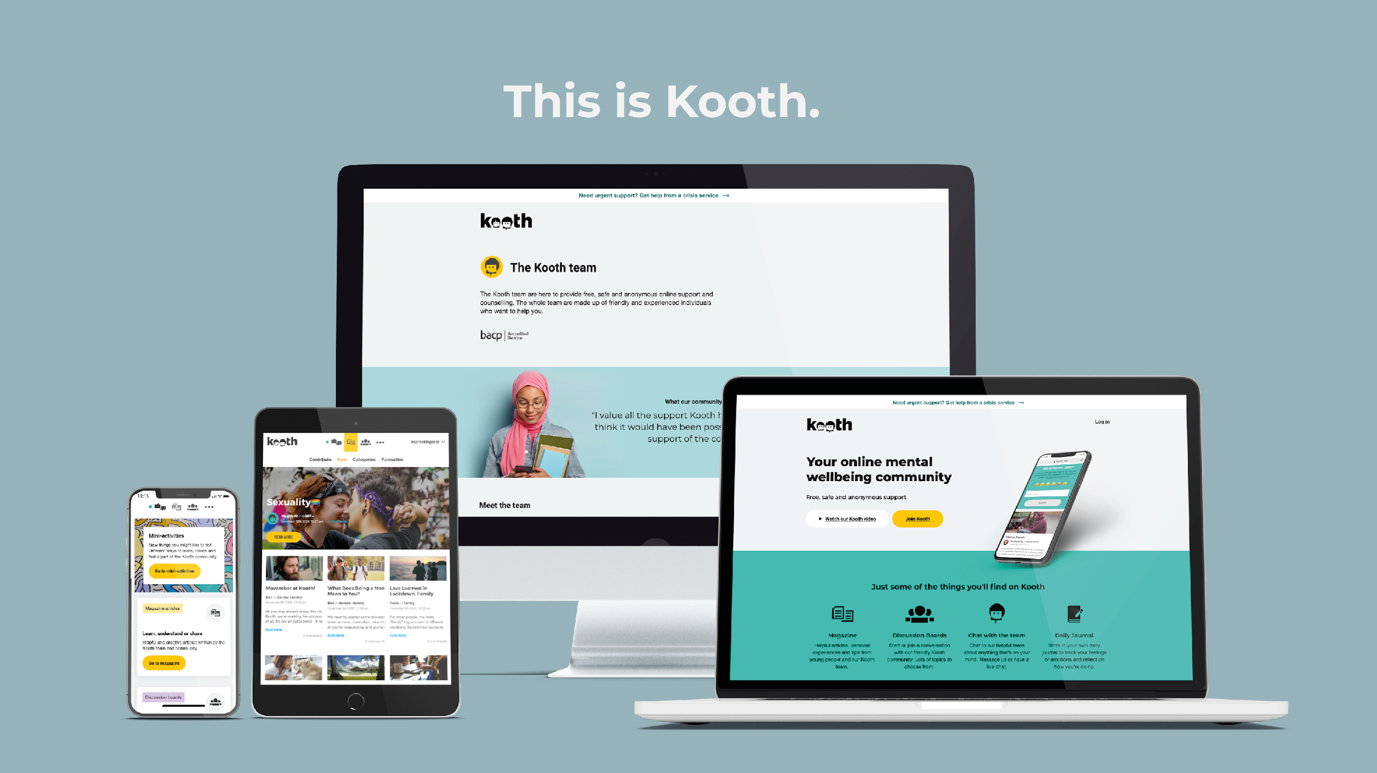
Kooth is a free online service offering emotional and mental health support for children and young people.
www.kooth.com

Slide 3


About Kooth.com
Kooth was founded in 2001 to help break down the stigma attached to mental health services. Our support is free, safe, and anonymous.
No waiting lists or thresholds, and individuals can self-refer
Available 365 days of the year
Counsellors are trained, qualified, and BACP accredited
Kooth is available in all London boroughs for ages 11-18, and up to 25 in many (as of May 2021)

Slide 4


Prevention through to support for most vulnerable
Anonymous Users
Therapeutic Choice
Our users remain anonymous, giving them confidence to speak out and access support without the fear of judgement.
We offer a full mental health toolkit - giving our users the opportunity to choose what which kind of support works for them.
Self-Help Resources
Community Support
Practitioner Intervention
Goal Setting
Journal
Activities
Discussion Boards
Magazine
Live Chat
24-Hour
Messaging
Personal goals can be set and monitored in a safe moderated environment
A private yet simple and effective way to track mood and identify personal triggers
Our inclusive and accessible mini-activities support in building a range of healthy habits, combined with peer support
Our vibrant community interacts with other users via our peer to peer support forums
Over 100,000 articles,
pre-moderated and 70% user generated
Have a 1-1 chat with a qualified practitioner through drop-in
or pre-arranged online chat
An inbox for you to message counsellors out-of-hours

Slide 5

Kooth in the Capital Report: Understanding and Supporting the Mental Health of London’s Children and Young People
The proportion of CYP presenting with suicidal thoughts, self-harm, school/college issues, and eating difficulties was higher in London compared to the rest of the country
Almost a 25% rise in under-18s in London presenting with school/college issues compared to the previous year
In London alone, new registrations by CYP to the Kooth platform rose by 33%, with 49% coming from CYP of Black, Asian, and Non-White backgrounds
https://explore.kooth.com/kooth-in-the-capital-2021/

Slide 6
Examples of Working Collaboratively with Schools and MHSTs
Collaborative workshops with Hammersmith, Fulham, Ealing & Hounslow Mind
12 schools attended the first workshop helping to reach over 1000 YP and raise awareness of mental health and support
Joint working with Hounslow MHSTs and Brent, Wandsworth, & Westminster (BWW) Mind to circulate Kooth information to all schools
In Hounslow, this has increased the number of engaged schools utilising Kooth’s support from 5 to 15, and led to a significant increase in new registrations on Kooth
BWW Mind only covers half of Westminster’s schools, so this work has ensured all schools in Westminster are receiving mental health support

Slide 7


If you would like to get in touch with us, please fill out this Google Form:
https://tinyurl.com/Kooth-form
Get in touch with us to:
Discuss how your school or team can embed Kooth
Register for your local newsletter for monthly Kooth updates
Book staff training or presentations for students
Order resources: digital and hard copy e.g. posters and pocket cards

