Slide 1
Good Thinking for children and young people

Slide 2
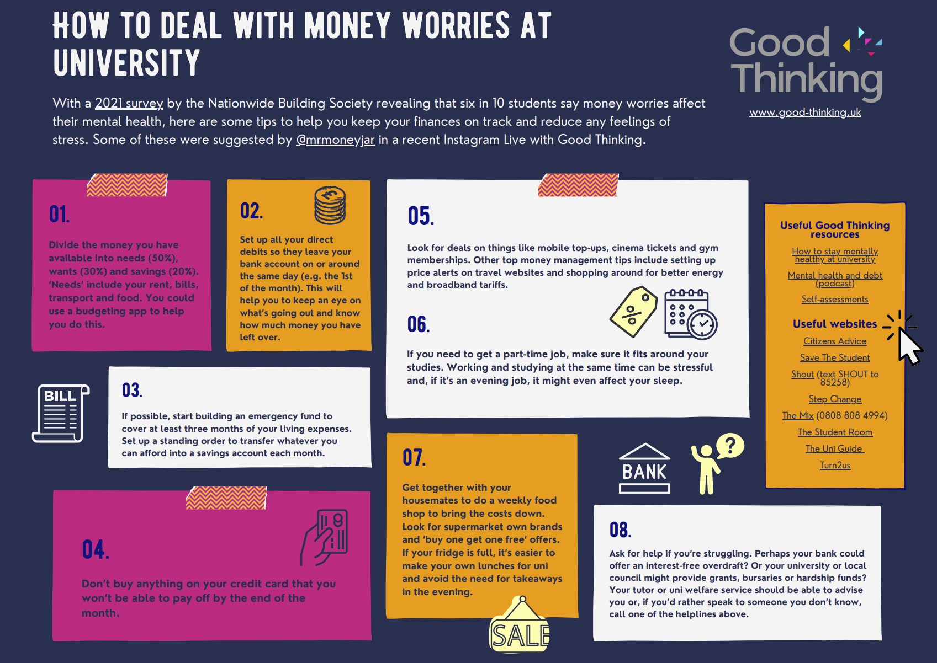
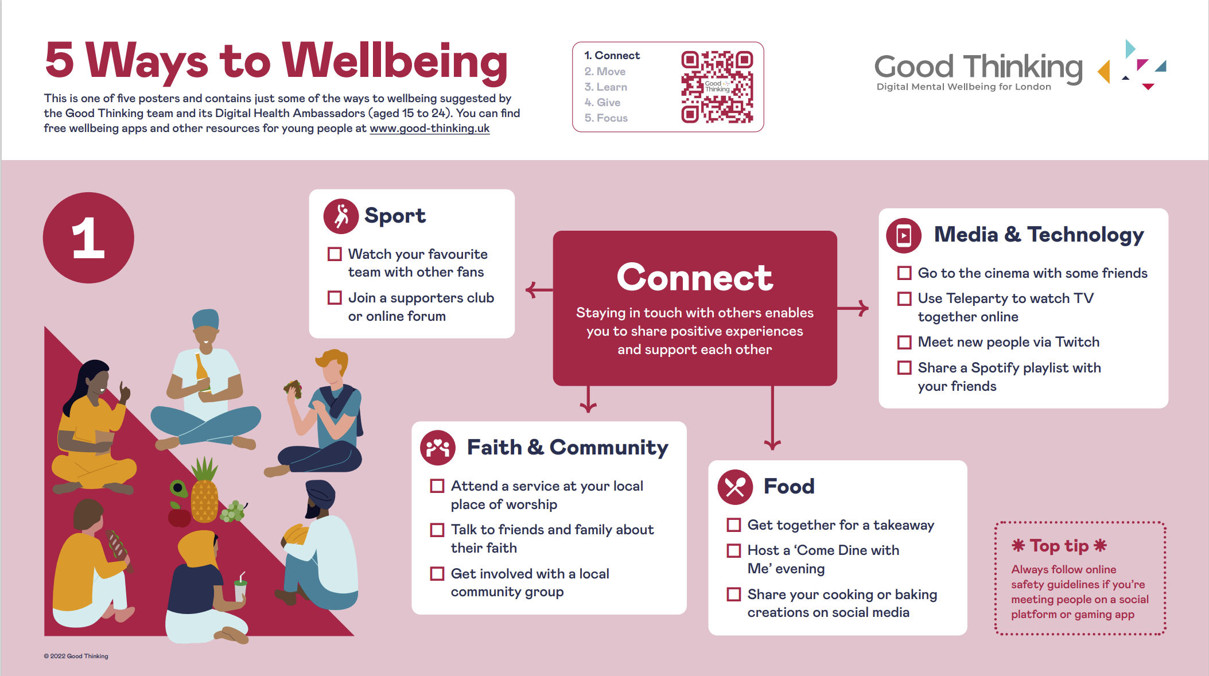
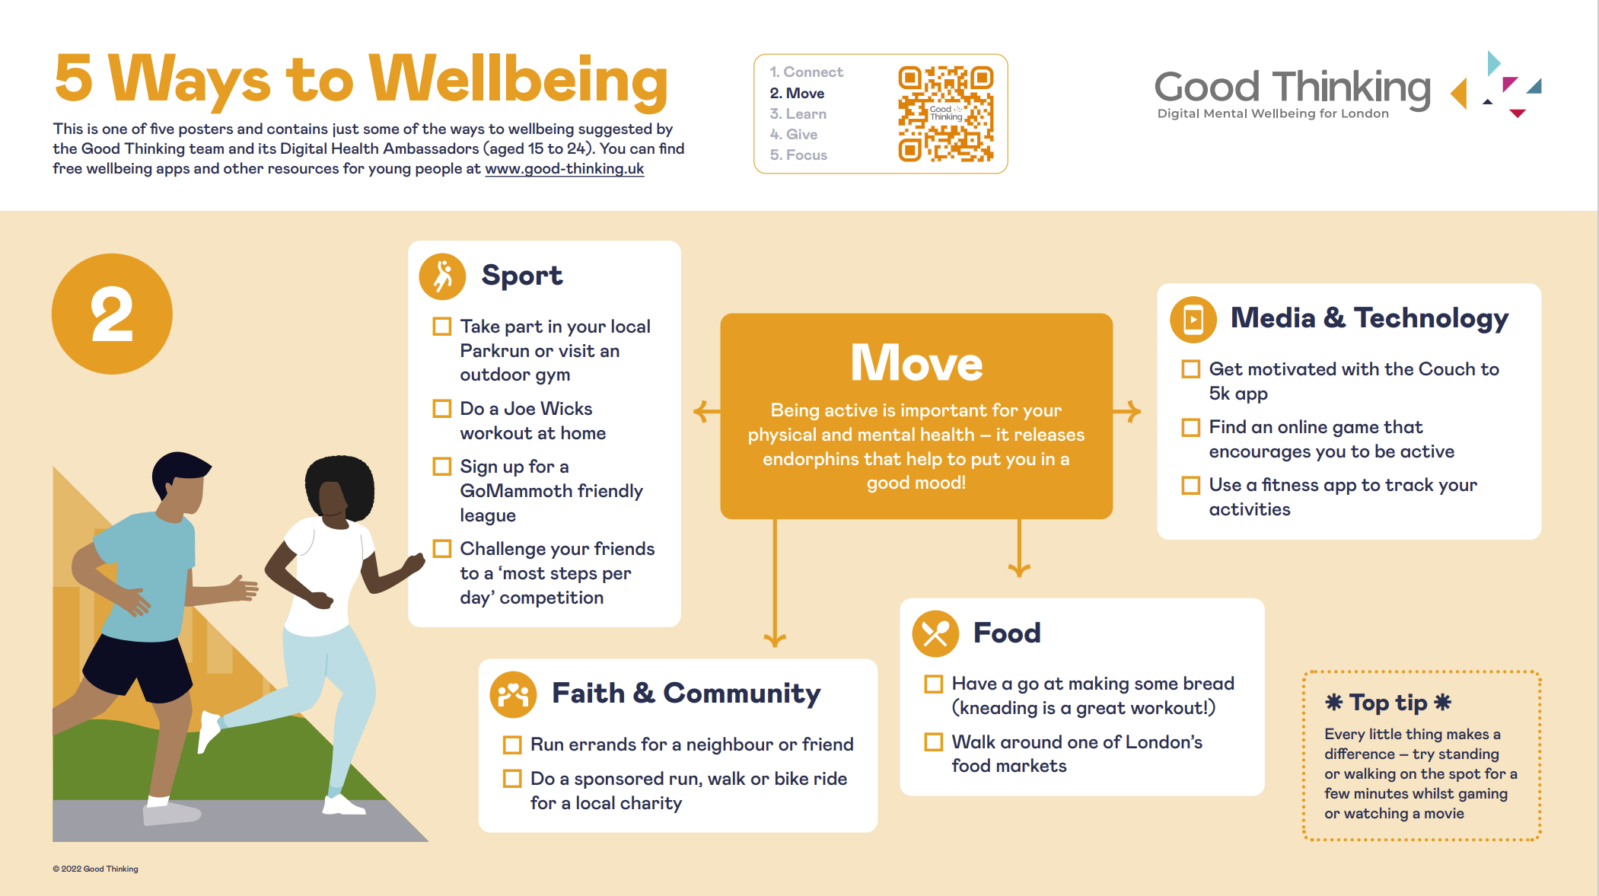
Resources for CYP
Dedicated library of CYP resources for individuals as well as parents and carers
Co-designed with young people through our relationship with Partnership for Young London and the Digital Health Ambassadors
Selection of articles, apps & podcasts created especially for young people
Topics covered include:
Moving to university
Eating disorders
Fake news
Bullying
Free apps such as Clear Fear which is aimed at reducing anxiety for 11-19 year olds

