Slide 1
Children and Young People’s Mental Health
Dr Jackie Chin
Consultant in Public Health
Office for Health Improvement and Disparities, London Region

Slide 2
Children and Young people’s mental health
Seventy-five percent of lifelong mental health problems in the UK start before the
age of 25 (RCPCH 2021).
At any one time, a child or young person may be anywhere on a spectrum between
being healthy and unwell. Many children move along the spectrum at different times

Slide 4
Implications for children and young people’s mental health (0–19 years) in the early stages of the pandemic
• Increase in stress and anxiety symptoms
• moderate increase in depressive symptoms and sadness
• moderate increase in anger, irritability and inattention, particularly among children with ADHD and/or autism
• increased alcohol and substance use and abuse among adolescents and young people, especially among adolescent boys
• decreased physical activity and irregular sleep patterns
• Fewer prosocial behaviours and, in
some studies, decreased life
satisfaction compared with the pre pandemic
period – particularly among those
with pre-existing neurodevelopmental
conditions and mental health issues
• mixed results – albeit based on limited
evidence – related to the impact of
COVID-19 on self-harm and suicide
NHS figures show that more children and young people were referred to mental health services between April 2020 and December 2020, up by 28% on 2019​
Life-in-Lockdown.pdf (unicef-irc.org)
A perfect storm: the impact of COVID-19 on the mental health of young people - The Pharmaceutical Journal (pharmaceutical-journal.com)

Slide 5
Impact of COVID-19
The Co-Space study found on average, behavioural, emotional, and attentional difficulties decreased as COVID-19 related restrictions eased from February to April 2021.
The decrease in symptoms since February was especially pronounced for primary school aged children (4-10 years old).
On average, children with special educational needs and/or neurodevelopmental disorder and those from low-income households have not shown this post-lockdown recovery and have continued to have elevated mental health symptoms.

Slide 6
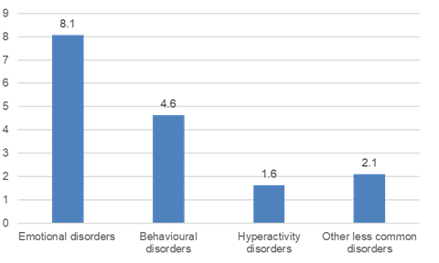
Based on data from a major prevalence survey in 2017, approximately 1 in 9 children and young people (10.8%) aged between 5 and 19 years had a probable mental disorder (this means they are highly likely to have a clinically diagnosable condition)
Prevalence (%) of MH disorders by type, 2017; Ages 5-19 years, England
Prevalence of particular types of mental health disorder were only collected in the 2017 Mental Health of Children and Young People Survey in England:
1 in 12 (8.1%) children and young people aged 5 to 19-years old had an emotional disorder (including anxiety, depressive, mania and bipolar affective disorders), with prevalence rates higher in girls (10.0%) than boys (6.2%).
1 in 20 (4.6%) children and young people aged 5 to 19-years old had a behavioural disorder (repetitive and persistent patterns of disruptive and violent behaviour where the rights of others, and social norms or rules, are violated), with rates higher in boys (5.8%) than girls (3.4%).
1 in 60 (1.6%) children and young people aged 5 to 19-years old had a hyperactivity disorder (inattention, impulsivity and hyperactivity), with rates higher in boys (2.6%) than girls (0.6%).
1 in 50 (2.1%) children and young people aged 5 to 19-years old were identified with one or more less common disorders, such as autism spectrum disorder (1.2%), eating disorders (0.4%), tic disorders and several low prevalence conditions (0.8%). Please note that due to the relatively few cases identified in the sample, the estimates presented for less common disorders may not all be precise. Based on more in-depth studies, prevalence of eating disorders in children and young people may be as high as 6%.
1 in 20 (5.0%) children and young people aged 5 to 19-years old met the criteria for two or more individual mental health disorders at the same time
Children and young people with mental health disorder were 5 times more likely to have speech or language problems (14.9%) than children without a mental health disorder (3.2%).
.
A follow-up survey with a smaller cohort using the same, robust methodology in July 2020 suggests this may have increased to 1 in 6 (16.6%)

Slide 7
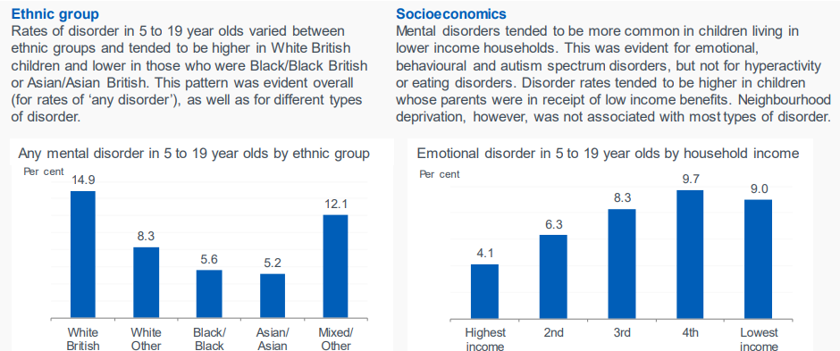
Breakdown by ethnicity and household income (from 2017 prevalence survey)

Slide 8
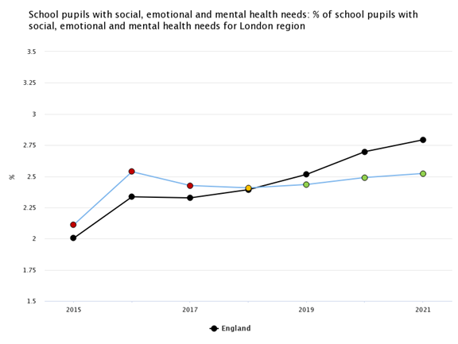
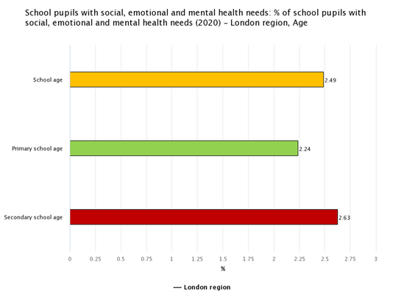
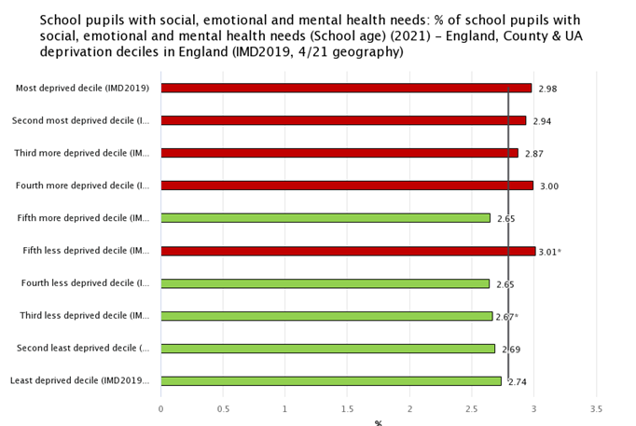
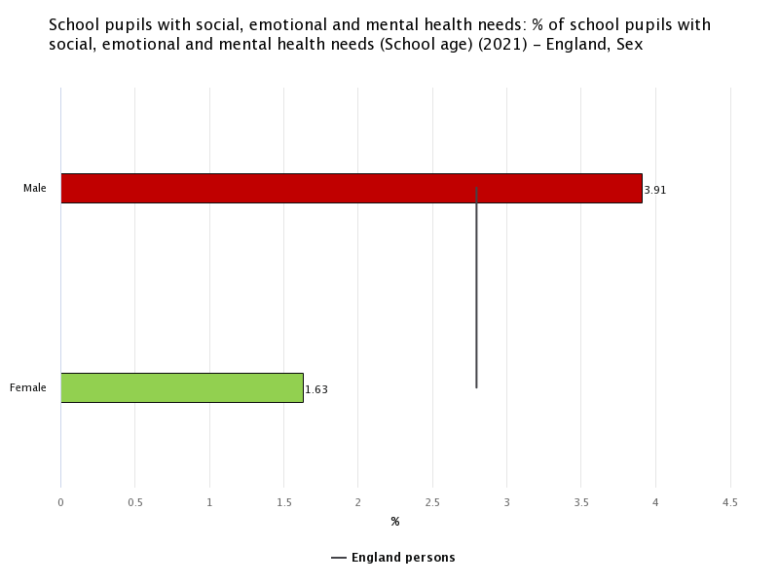
School pupils with social, emotional and mental health needs, London and England
London’s rate is increasing overall but not as steeply as England
London has higher rates for pupils of secondary school age
Rates are higher for more deprived areas in England
England has higher rates for males

Slide 9
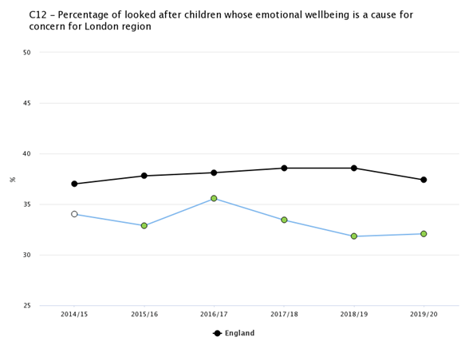
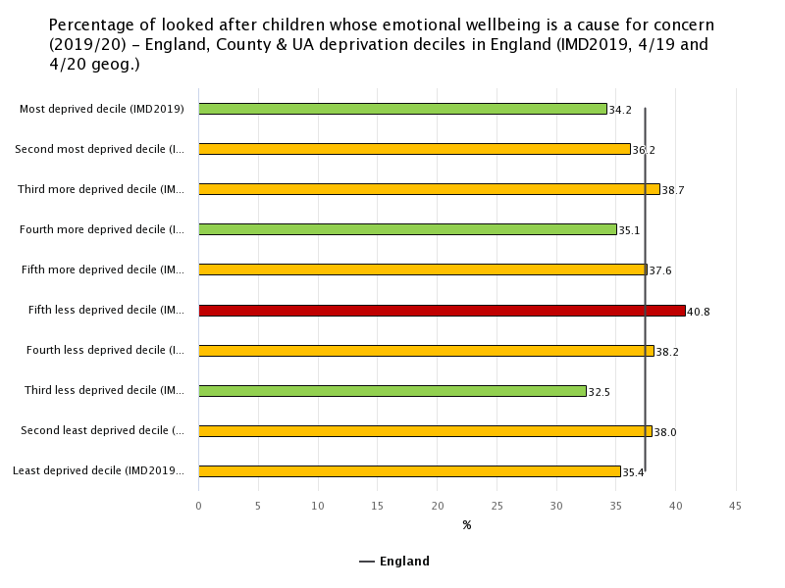
Percentage of looked after children whose emotional wellbeing is a cause for concern, London and England
Lower (better) rates for London than England
Recent trends show a plateau for London and a decline nationally
32.1% LAC in London, 37.4% England
Mixed profile for national rates by deprivation

Slide 10
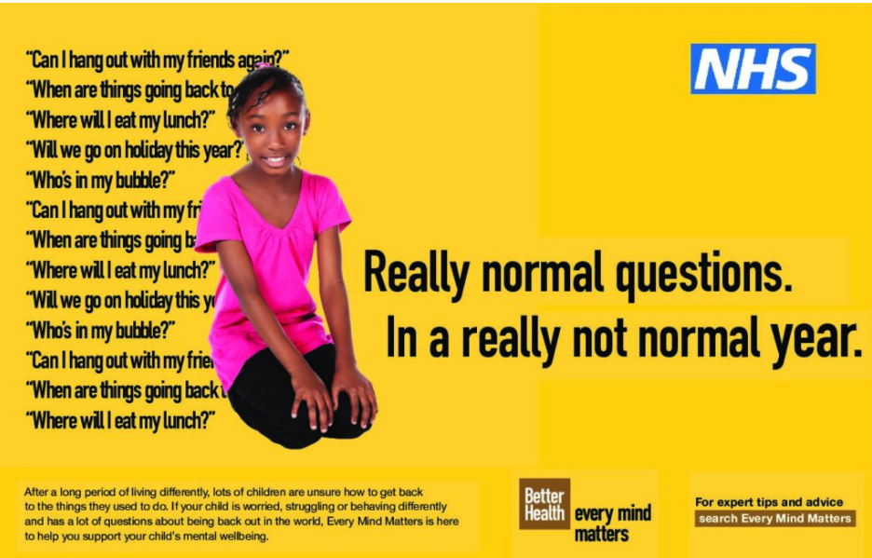
Every Mind Matters – Children’s mental health
Children's mental health - Every Mind Matters - NHS (www.nhs.uk)
Top tips to support children and young people
Going back to school or college
Signs something is wrong
Looking after your own mental health
Get support

Slide 11
Sources of data
Children and Young People's Mental Health and Wellbeing Profile https://fingertips.phe.org.uk/profile-group/mental-health/profile/cypmh
Public Health Outcomes Framework https://fingertips.phe.org.uk/profile/public-health-outcomes-framework
Child and Maternal Health Profile https://fingertips.phe.org.uk/profile/child-health-profiles
NHS Digital. (2018). Mental Health of Children and Young People in England, 2017 – Summary of Key Findings and data tables

