Slide 1
Social Prescribing for Children and Young People in London
Suzi Griffiths
Project Manager and NHS Social Prescribing Regional Facilitator London
Healthy London Partnership
suzi.griffiths@nhs.net / @suzig_24
March 2022

Slide 2
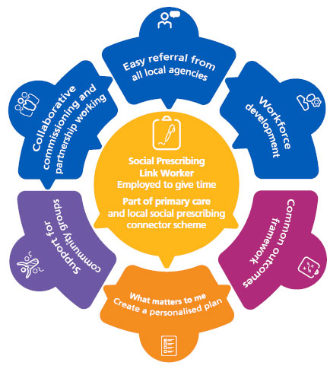
Social Prescribing – what is it?
Social Prescribing (SP) is the process by which health professionals refer patients to Social Prescribing Link Workers (SPLW) to address their non-clinical needs that are negatively impacting on their health and wellbeing.
SPLW connect people with community based organisations, services and activities to prevent the exacerbation of current issues and conditions, and ultimately help tackle health inequalities.
SP should be about what matters to me – friendship and society, creativity, physical activity, being outdoors, conversation, consolation, laughter, safety.
SPLW are there to listen and get people the help and support they need for issues such as finance, housing, employment, social welfare and legal advice.
SP is intended to support but not replace formal healthcare resources such as psychiatric support and medical treatment.
Source: NHS England https://www.england.nhs.uk/personalisedcare/social-prescribing/

Slide 3

Social Prescribing – opportunities for CYP
Social Prescribing (SP) is being mainstreamed by NHS England with Social Prescribing Link Workers (SPLW) based in Primary Care Networks (PCNs) since June 2019.
In London, there are Social Prescribing services based in all boroughs and more than 350 SPLW covering c200 PCNs. GP practices refer patients to the SPLW that works in their PCN.
The majority of SP services are for adults only when Personalised Care should deliver ‘whole population approaches to supporting people of all ages’ (NHSE, Universal Personalised Care Model).
There is a gap for babies children and young people that needs to be addressed more now than ever, recognising that 40% of activity in primary care relates to them.
Social Prescribing for CYP is an emerging area nationally and there is growing energy and commitment to develop approaches in London.
Social Prescribing for CYP can be all age (0 up to 18/25 years) and/or can be targeted at particular cohorts for specific reasons:
  Long term conditions such as asthma, diabetes
  Mental Health e.g waiting CAHMS assessment, social isolation, low level anxiety and depression
  At risk of youth violence
  Learning disabilities and autism e.g waiting autism assessment
  Families with young children aged 0-5 years
  Transition points (e.g. children to adults services, primary to secondary school, step down from statutory services)

Slide 4


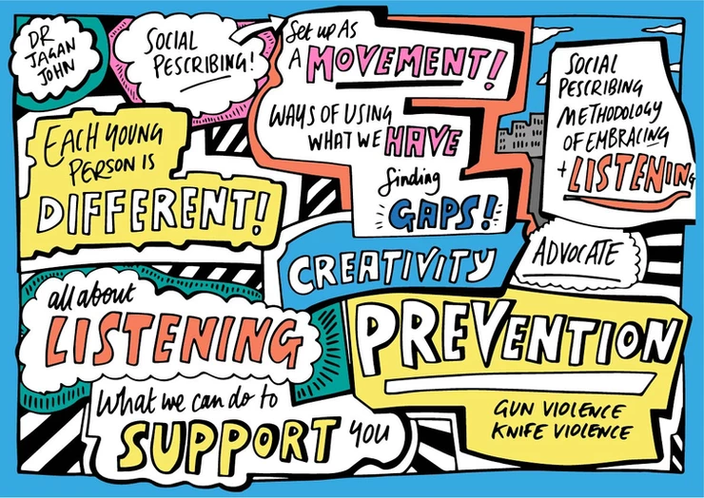
Overview
CYP Social Prescribing – development in London
Addressing a key inequality – ensuring all age social prescribing
The London ambition is to have CYP SP in every Borough by March 2024
21/22
22/23
23/24
Innovation funding available
Identifying mainstream funding
Integrated pathways across multiple partners
Pilots in boroughs & PCNs
Further pilots and implementation by borough
Alignment to local CYP integrated care models
CYP SP working groups at ICS level
Outcome/evaluation framework developed
Development opportunities for new CYP SP workforce
Notes:
image
No alt text provided.
textbox
No alt text provided.
image
No alt text provided.
actionButton
No alt text provided.
slicer
No alt text provided.
slicer
No alt text provided.
slicer
No alt text provided.
card
No alt text provided.
clusteredBarChart
No alt text provided.
card
No alt text provided.
clusteredColumnChart
No alt text provided.
ScrollingTextVisual1448795304508
No alt text provided.
donutChart
No alt text provided.

Slide 5
CYP SP - Current landscape in London
Early intelligence gathering in London has revealed activity/interest:
North East London initiated a series of 6-month test pilots in 2021 in 6 boroughs to develop local models of CYP SP
Waltham Forest Early Years SP project; City and Hackney; Redbridge and Newham
SP pilots for CYP in Enfield & Islington; Camden, Haringey and Barnet
West London looking to recruit CYP SPLW in 3 PCNs
Lewisham, Lambeth (Herne Hill Practice and Well Centre) and Bexley
Wandsworth, Merton and Croydon
Part of wider NHS London plans for CYP Integration and the Improvement Collaborative
Conversations about opportunities for CYP SP in secondary care / MH Trusts:
Imperial College Healthcare NHS Trust
Barts Health Trust
East London NHS Foundation Trust
Lewisham and Greenwich NHS Trust
Social Prescribing for CYP at risk of youth violence, led by the NHS London Violence Reduction Programme:
Development of a pathway and toolkit - https://www.england.nhs.uk/london/london-clinical-networks/our-networks/violence-reduction/social-prescribing/
Pilots in Enfield and Hackney

Slide 6
  A clear, shared definition - Social prescribing is a mechanism for linking all the different agencies that have contact with CYP and families, and want to support their physical, mental, emotional health and wellbeing.
  A clear, shared aim: Social Prescribing supports early intervention, and in preventing problems from reaching the point when clinical interventions may be necessary.
  Social Prescribing for CYP requires a different approach – Widely recognised that CYP don’t access primary care in the same way as adults. Need to consider local infrastructure and population health needs.
  A multi-agency approach is required – NHS needs to collaborate with local authorities, schools and VCSE sector to ‘join the dots’ about what services and activities are available locally to avoid duplication and build workable pathways.
  Mapping what is already out there – A great and diverse range of activities and services for CYP and families is available in communities provided by children’s centres, youth organisations, libraries, arts and cultural sector, sports and leisure facilities. Much of the work they do already is Social Prescribing (but not necessarily called it).
  Different service models for different cohorts – e.g working with families with younger children, working directly with older CYP.
  A different funding model compared to adults – PCNs can use the ARRS funding to employ CYP SPLW in the same way as adults SPLW. Examples of services funded by Council’s Public Health Teams and CCGs. A co-commissioned model by multiple agencies, which is co-designed with the youth VCSE sector, young people and parents is optimal.

Slide 7


Sources of further information on CYP SP
Street Games & National Social Prescribing Youth Network - https://network.streetgames.org/resources/young-peoples-social-prescribing-resources
NIHR Research Collaboration: CHOICES CYP Social Prescribing Mental Health - https://arc-swp.nihr.ac.uk/research/projects/cyp-choices/
University of East London (2020) ‘A two year evaluation of the Young People Social Prescribing pilot’ - https://repository.uel.ac.uk/item/88x15
Wales Youth Social Prescribing, Sport and Physical Activity – A rapid review (March 2021) https://www.streetgames.org/Handlers/Download.ashx?IDMF=f85d4cf2-6d10-4482-a89a-ccad37cbd679
UCL (2020) ‘Social Prescribing for children and young people: A review of the evidence’ https://www.ucl.ac.uk/evidence-based-practice-unit/sites/evidence-based-practice-unit/files/review_social_prescribing_in_children_and_young_people_final_0.pdf
For further information about Social Prescribing in London please contact the Healthy London Partnership team at: hlp.socialprescribing@nhs.net or @SP_LDN on Twitter.

