Slide 1


Slide 2
CELEBRATNG DIVERSITY at BWW Mind
Cristina Eddo, EMHP
Ayla Mammadova, Clinical Lead

Slide 3

Introduction
My name is Cristina and I am an Educational Mental Health Practitioner and I am from Mind in Westminster, Brent and Wandsworth. I work with various Primary and Secondary schools across Central London, delivering 1:1 and group self-guided sessions around anxiety, low mood and challenging behaviour for young people and their parents.
I am passionate about what I do, as I believe that mental health is a fundamental area of our lives that must be prioritised and looked after. I also love public speaking, so I enjoy delivering mental health related workshops for schools as part of my job!
As a team of mental health practitioners and clinical supervisors, we work across 33 schools in Westminster.
Ayla, our Clinical Lead, is here with me today.

Slide 4
Diversity project- 2019-2022 a Journey
2019- EMHPs started training and supervisors were recruited
2020- EMHPs qualified
Between 2020 and 2021 the theme of diversity emerged as a real need to address. This was particularly triggered as a result of the injustice faced by George Floyd.
Early 2021- A colleague took it upon her self to commence an audit of our service based on the BACBP Positive Practice Audit.
End of 2021 – The diversity project group commenced, which aims to make the team more culturally competent. This is a work in progress, as we continue to develop on this area.

Slide 5
The Purpose
Our vision as a team is to be able to have a workforce that is confident and skilled at meeting the emotional needs of a diverse population within the framework of our practice.
The purpose of the diversity project is to be able to invest time into discussing what the team needs in order to move closer to our overall vision.

Slide 6
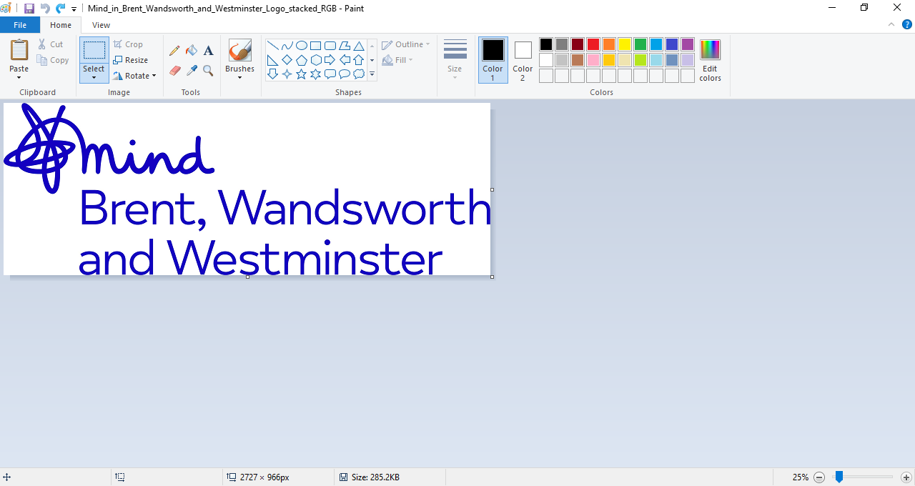
Audit main areas of development https://www.babcp.com/Therapists/BAME-Positive-Practice-Guide

Slide 7
1. Improving Access
Asking for ethnicity of all clients to help understand what ethnicities ‘other’ is made up of
Find ways of comparing referral statistics to the demographic of each individual school we are in (even if only can be done roughly) and discussing this with mental health leads
Getting SPSS to allow us to compare outcomes for different people groups
Establish the main languages spoken in the community we work in
Liaise with MHST that are creating information leaflets in community languages that we could use

Slide 8
2. Adapting Therapy
Clinical staff and supervisors accessing CPD which includes working with diversity (therapeutically and in terms of providing supervision)
Consistent requests for training in cultural competency. Some specific areas of training specified include: managing cultural/familial clashes due to treatment, incorporating matters of diversity into clinical work, understanding how mental health is approached/understood in different cultures, training in how to effectively use an interpreter as part of clinical practice

Slide 9
3. Improving engagement with service users and communities
Be more mindful of whether forums are representative. If not, share this information with the team so they can be aware of this when recruiting.
• Make use of both forums to ask explicit questions about matters of diversity.
Whilst the above areas have proven to be more challenging to meet in comparison to the points mentioned in previous slides, we are mindful of the importance of engaging communities and we therefore seek to build on this area of development.

Slide 10
4. Workforce and staffing
• There has been some reflection on difficulty in recruitment of EMHPs and wider issues in lack of diversity within the field of Psychology that can also be reflected in the senior management group.

Slide 11
Audit outcome in context
Diversity Case Study Summary
Success Story
Background Information: Farid (pseudonym) is a male adolescent with Asian heritage who was 18 at the time of the beginning of the intervention. He attended a high performing state school in Westminster. At an earlier age he was diagnosed with a behavioural condition of which he had been receiving medication for. Due to parental illness, and being the oldest sibling, Farid has increased responsibilities at home.
Due to where Farid lives, he faces the pressures and often witnesses the consequences of the gang culture prevalent in certain parts of Westminster. Despite deciding to not be involved, the permeating nature of this culture means that for him, he cannot completely ignore the consequences of this environment. A few months before treatment begun, Farid had been the victim of armed robbery and had experienced the murder of a friend. He has also experienced being stopped and searched by the Police in the local area of his school a high number of times, resulting in distrust in authority.
Farid’s desire to have academic success that would later lead to a career where he can help others is both a goal and protective factor.

Slide 12
Adapting Therapy
Space was given during sessions for Farid to reflect on his feelings about gang culture in West London and how he felt being stopped and searched had impacted his mental health.
The practitioner asked about ethnicity, culture and background and used this knowledge to help Farid in considering his values and therefore what pleasurable activities he could take part in that would help improve his wellbeing. Farid was given the space to reflect on the role of his faith in his wellbeing and the stigma prevalent in his culture.
Farid found it challenging to complete the weekly activity diaries due to his additional household responsibilities. Rather than allowing this to be a barrier for treatment, space was given for Farid to speak in depth about the activities he had done in the past week from what he could recall.

Slide 13
Results
ROMS demonstrated a reduction in depression scores. Farid spoke of having learnt methods of increasing his motivation and that consequently he had been more sociable and had been better managing his studies. Farid had gone back to doing the activities that were pleasurable and rewarding for him such a religious activities and spending listening to music. Farid had also learnt how to create and implement a routine in his life and discovered how much this helped him better manage the different aspects of his life and not feel overwhelmed. Overall, Farid had been feeling much better emotionally which helped him to feel more helpful about his upcoming academic assessments.

Slide 14

Statistics

Slide 15
1. Ethnicity
January 2020- July 23rd 2021
Notes:
The population referred to our service were more diverse than the population of Westminster as a whole. Specifically, Westminster MHST received less White referrals and more Black, Mixed and ‘Other’ referrals than is typically represented in Westminster.
All ethnicities who were referred were equally likely to complete treatment.

Slide 16
2. Ethnicity
January 2020- July 23rd 2021
Notes:
Non-white service users started with higher scores on most subscales than white service users, but showed more improvement in symptoms by the end of interventions than white service users.

Slide 17
3. Deprivation
January 2020- July 23rd 2021
Notes:
Compared to the population of Westminster as a whole, our service users tend to live in more deprived areas.

Slide 18
Concluding Remarks
Reflection and take home messages from diversity training received on 09/03/2022
As a team we have been using reflective practice as a platform to consider our level of comfort/discomfort in discussing race related themes with our clients.
The team has now received training from KaeMoTherapy. The aim was to equip the team with practical tools that can help us to confidently explore race in the therapeutic rapport.
I am proud to say that as a team, we have greatly benefitted from the training and there is a collective excitement around putting the knowledge learnt into practice, as well as continuing to make good use of supervision.
Notes:
https://www.kaemotherapy.com/

Slide 19
Thank you very much for listening!
This is not just a project, but it is a work in progress, an ongoing mission for the team.
Any questions?

Slide 20
4. Workforce and staffing
• There has been some reflection on difficulty in recruitment of EMHPs and wider issues in lack of diversity within the field of Psychology that can also be reflected in the senior management group.

