Slide 1







London Care Home Resource Pack
Produced by
Healthy London Partnership
and NHS E/I
in partnership
with
Publication date: 11/02/2022
Version 12.0
Review Date: If you are reading this guidance after 4th March 2022, please check to see if there is an updated version.
This London guide is designed to complement and not replace local guidance and professional judgement. It will be updated to align with other national and regional guidance once published.
To provide feedback on this pack please contact: london.hcic@nhs.net
Version 12.0 11022022

Slide 2
Change log
Slide no. | Topic | Changes since v11.1
4 | Summary: Suspected Coronavirus Care Pathway - Residential and Nursing Care Residents | Updated
11 | Infection prevention control - what happens after the vaccine? | Updated
12 | Infection prevention and control | Updated
13 | Cleaning products and processes for care homes with possible or confirmed cases of COVID-19 | Updated
15 | PPE and escalating your supply issues | Updated
20 | COVID-19 Symptoms | Updated
21 | What to do when you suspect a resident has respiratory symptoms, including Covid-19 | Updated
22 | Covid-19: testing in care homes | Updated
23 | Declaring an outbreak/managing an outbreak | New
24 | Testing during an outbreak | New
25 | Closing an outbreak | New
26 | Outbreak diagram | New
30 | Care home Covid-19 testing results: actions for care home residents and staff | Updated
31 | Principles of managing staff and residents who are contacts of Covid-19 cases | Updated
32 | Principles of managing staff and residents who are contacts of Covid-19 cases | Updated
33 | STAFF contacts of a Covid-19 case - what to do | Updated
34 | STAFF contacts of a Covid-19 case - what to do (cont’d) | Updated
35 | RESIDENTS who are contacts of a Covid-19 case - what to do | Updated
39 | Treatments for coronavirus (COVID-19) | New
42 | Enabling visits in the care home | Updated
43 | Visits out of the care homes | Updated
44 | Admissions into the care home | Updated
45 | Admissions into the care home | New
46 | Concern about accepting a resident | Updated
54 | Supporting residents with learning disabilities | Updated
71 | Supporting the ongoing treatment of care home residents who might be in the last year of life during the pandemic | Updated
80 | Staff experiencing Long Covid | New
81 | Interim visa arrangements for Social Care Workers – from 15 February 2022 | New
Version 12.0 11022022

Slide 3


This resource pack has been developed to provide clear guidance for London Care Homes aligned with NHS 111 Star lines and London COVID-19 Resource Pack for Primary Care ensuring that national guidance and good practice can be embedded locally by care providers. Ensure escalation routes are clearly identified for care providers.
If you have any suggestions for future topics please do let us know - england.londonehchprogramme@nhs.net
Topics covered in this resource pack:
Summary: Suspected Coronavirus care pathway - residential and nursing care residents Acute respiratory infection Your direct line to urgent clinical advice NHS 111 Starline* Vaccinations NHS App How to demonstrate your vaccination status in the NHS App Infection prevention control - what happens after the vaccine? Infection Prevention and Control Cleaning products and processes for care homes with possible or confirmed cases of COVID-19 Zoning PPE and escalating your supply issues Putting on (donning) PPE for care homes Taking off (doffing) PPE for care homes When residents should consider wearing face coverings COVID-19 Symptoms What to do when you suspect someone has COVID-19 symptoms Treatments for coronavirus (COVID-19) Managing respiratory symptoms Variants of concern Covid-19: testing in care homes Declaring an outbreak/managing an outbreak Testing during an outbreak Closing an outbreak Outbreak diagram Swabbing residents: top tips Void tests - Expired Test Kits Assessing capacity for Covid-19 testing Care home testing results: actions for care home residents and staff Covid-19 testing and flu/ other respiratory illness Principles of managing staff and residents who are contacts of Covid-19 cases STAFF contacts of a Covid-19 case - what to do STAFF contacts of a Covid-19 case - what to do (cont’d) RESIDENTS who are contacts of a Covid-19 case - what to do NHS COVID-19 app features How staff should use NHS COVID-19 app How residents should use NHS COVID-19 app Treatments for coronavirus (COVID-19) Enabling care home visits Enabling care home visits Visits outside the care home Admissions into the care home (part1 & part 2) |  | Concerns about accepting a resident Supporting residents to make decisions No decision about me without me Supporting eating and drinking Vitamin D supplements Recognising when residents become unwell Checking residents oxygen levels- Pulse Oximetry Supporting residents with learning disabilities Supporting residents with dementia Supporting residents who are more confused than normal Managing falls Preventing pressure ulcers Managing lower limb wounds Identifying and Managing Depression in residents Supporting residents’ health and wellbeing Supporting residents to exercise and get moving Supporting residents’ Spiritual needs Talking to relatives Pharmacy and medicines Working with primary care and community services Support from primary care and community services Advance Care Planning (ACP) More information about CMC How can we get access to CMC? Supporting ongoing treatment of residents in last year of life Supporting care in the last days of life Expected and unexpected deaths Verification of death: national guidance Care after death – using PPE and IPC Support for people who are bereaved Data Security and Protection Toolkit (DSPT) DSPT – support available from Digital Social Care Accessing support for digital transformation Staff experiencing Long Covid Interim visa arrangements for Social Care Workers – from 15 February 2022 Supporting care home staff wellbeing Staff mental health and emotional wellbeing Supporting wellbeing during and post Covid-19 Supporting care provider managers London Health and Wellbeing hubs – an overview London Health and Wellbeing Hubs
An updated resource pack will be shared with you every 1-2 months
Version 12.0 11022022

Slide 4
Summary: Suspected Coronavirus Care Pathway - Residential and Nursing Care Residents
Suspected Cases
Isolate and Monitor
Consider COVID-19 infection in a resident with any of the following:
New continuous cough, different to usual
High temperature (≥37.8°C), shivery, achy, hot to touch
Loss or change to sense of smell or taste
Headache, sore throat, or runny nose
Milder symptoms such as headache, sore throat, runny nose (bad head cold) have been reported with the newer COVID 19 variant Omicron.
Care home residents may also commonly present with non-respiratory tract symptoms, such as being more confused or sleepier than usual, having diarrhoea, dizziness, and other subtle signs of deterioration.
Record observations where possible: date of first symptoms, blood pressure, Pulse, respiratory rate and temperature (refer to thermometer instructions) – Remember to Maintain fluid intake
For more support, call the residents GP in the first instance
Call 111* Star 6 for urgent clinical advice, or if the GP is not available – this will put you in contact with a Clinician in NHS 111
Resident to be isolated for 10 days in a single bedroom. Use Infection Control guidance
Care for resident using PPE (what to use and how to wear and dispose)
Due to sustained transmission PPE is to be used with all patients. Additional PPE is required for Aerosol Generating Procedures.
Use correct handwashing technique (video)
Consider bathroom facilities. If no en-suite available:
Designate a single bathroom for this resident only
Use commode in room
If trained to do so, record observations if concerned to inform health services
If a resident deteriorates at any stage – Escalate to 111* Star 6 or 999
Be explicit that COVID-19 is suspected and ensure you have easy access to the residents CMC plan
If there are new cases in either staff or residents and these are the first new cases
following negative recovery testing:
Contact the UK Health Security Agency London Coronavirus Response Cell
Phone Number: 0300 303 0450
Email: LCRC@phe.gov.uk or phe.lcrc@nhs.net
LCRC will provide advice and and advise on further testing.
Regularly update: Capacity Tracker, your Local Authority and RIDDOR
Guidance: Admission and Care of Residents during COVID-19 Incident
Isolation for people who walk around for wellbeing (dementia, learning disabilities, autism)
Use standard operating procedures for isolating residents who walk around for wellbeing (‘wandering’). Behavioural interventions may be employed but physical restraint should not be used.
When caring for, or treating, a person who lacks the relevant mental capacity during the COVID-19 pandemic, please follow government guidance.
New community treatments for COVID-19 (Monoclonal antibodies & the oral antiviral Molnupiravir): People in clinical risk groups (eg some residents) who test positive by PCR should be contacted by the COVID-19 Medicines Delivery Unit (CMDU) with a view to having these treatments at home and being monitored remotely. Contact your GP or 111 for more information if you feel a resident may benefit from this treatment.
Communication with the NHS
If you have been trained to do so use a validated deterioration and escalation tool e.g. Restore2
Where appropriate please ensure that residents are offered advance care planning discussions and that their wishes are recorded on London Urgent Care Plan (formerly known as CMC). Make sure you have easy access to the residents London Urgent Care Plan or Ceiling of Treatment plan when you call NHS 111 *Star Line (or 999)
Do you have NHS Mail?
Send emails directly to your GP, Community Team and Hospital. Contact hlp.londonchnhsmailrequests@nhs.net to get an NHS.net email set up
Please register and use Capacity Tracker to support hospital discharge planning and other vital monitoring. User guide is available here and the business continuity guide is here. You can also access the Capacity Tracker masterclass webinar here.
How to access Personal Protective Equipment (PPE):
Order PPE through your normal supplier. If this isn’t possible arrangements have been made with seven wholesalers to provide the UK Health Security Agency to the social care sector.
Contact your Local Authority if you are still unable to get PPE provision.
PPE guidance for Residential Care Providers
Resources and Support for Care Home Staff
Guidance on how to work safely in care homes
COVID-19 Care Platform
Queens Nursing Institute Facebook Page
RIDDOR reporting of COVID-19
NICE guideline: Managing COVID-19 https://www.nice.org.uk/guidance/ng191/chapter/Recommendations
Version 12.0 11022022

Slide 5
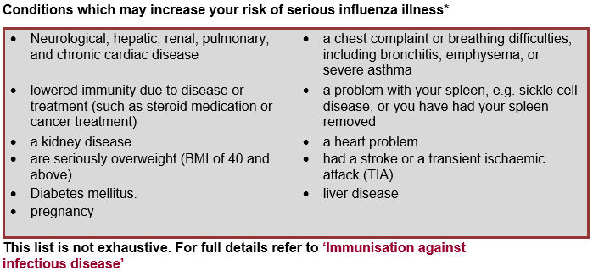
Acute respiratory infection
Co-circulation of COVID-19 and other respiratory viruses is likely this winter. It may be difficult to distinguish between symptoms of COVID-19, influenza, and other respiratory viruses.
In addition, care home residents may not present with classical symptoms of COVID-19 or influenza. Therefore, acute respiratory infection (ARI) should also be considered if there is a sudden deterioration in physical or medical health, with or without fever. Investigations into outbreaks of acute respiratory illness in care homes will need to consider the possibility that the outbreak is caused by COVID-19, influenza, or other respiratory viruses.
Care homes should continue to follow the current guidance on measures to prevent COVID-19. This includes maintaining routine asymptomatic testing regimes.
Where an outbreak of respiratory illness is suspected, the care home should contact the residents’ general practitioners for clinical assessment and the London Coronavirus Response Cell (LCRC) (Phone Number: 0300 303 0450; Email: LCRC@phe.gov.uk).
LCRC may organise additional swabbing for influenza and other respiratory viruses after conducting a risk assessment. This is so that appropriate antivirals can be provided if influenza virus is detected to treat and prevent further cases.
For more information on managing residents with symptoms of flu or acute respiratory viral illness, read the London Flu SOP on the Healthy London Partnership website.
Version 12.0 11022022

Slide 6

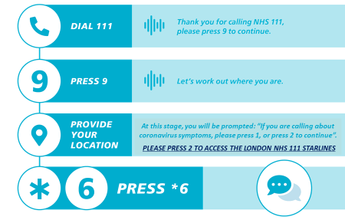
Your direct line to
urgent clinical advice
The NHS 111 Starline service will provide you with fast access to a clinical team who can give you the advice and medical input you need to care for residents instead of having to call 999 and transfer them to hospital.
This service has been relaunched to ensure that you are receiving an enhanced level of support as care providers.
It is not intended to replace your support locally but when you cannot speak to your GP or Community Support team NHS 111 can help.
There is a national COVID-19 111 service but in London, care home staff concerned about a resident who may have COVID-19 symptoms are being asked to call NHS 111 Star*6 for faster access to urgent advice from a senior clinician if they cannot get through to the resident’s own GP.
Before calling, record observations where possible: Date of first symptoms, blood pressure, pulse respiratory rate and temperature (refer to thermometer instructions). If there is a care plan for residents, for example a CMC or DNAR plan, please have access to it.
NHS Diabetes Advice Line provides urgent clinical advice for people who are unwell and manage their diabetes with insulin. It is available by dialling 0345 123 2399 or 111*6, Monday to Friday from 9am – 6pm.
Version 12.0 11022022

Slide 7
Vaccinations
For information on Flu vaccines for care home residents and staff, please refer to the London Flu Standard Operation Procedure (SOP):
Care Providers should identify a vaccination lead who will be responsible for identifying the numbers of staff and residents who require flu vaccination and COVID vaccination boosters and promoting vaccination uptake in the care home. This lead should track the numbers who have received ‘flu vaccination through their general practice or community pharmacy. This vaccine is free of charge. For non-clinical staff (e.g. cleaners), they are eligible for a free vaccine in London’s participating community pharmacies – see www.myvaccinations.co.uk. Community pharmacies are also able to do onsite vaccination clinics for the care home (if numbers to be immunised are >10).
It is also important to ensure that all residents aged over 65 have received a one off pneumococcal vaccine (PPV23) to prevent against invasive pneumococcal disease and pneumonia. All residents aged between 70 and 79 should also receive a one- off shingles vaccine unless clinically contraindicated. These can be arranged with the patient's GP (there should be a 7 day gap between administering shingles and COVID-19 vaccine)
For information relating to Covid-19 vaccines for care home residents and staff, please refer to the Care Homes Covid-19 Vaccination Information pack, with FAQ, which can be found here.
Version 12.0 11022022

Slide 8
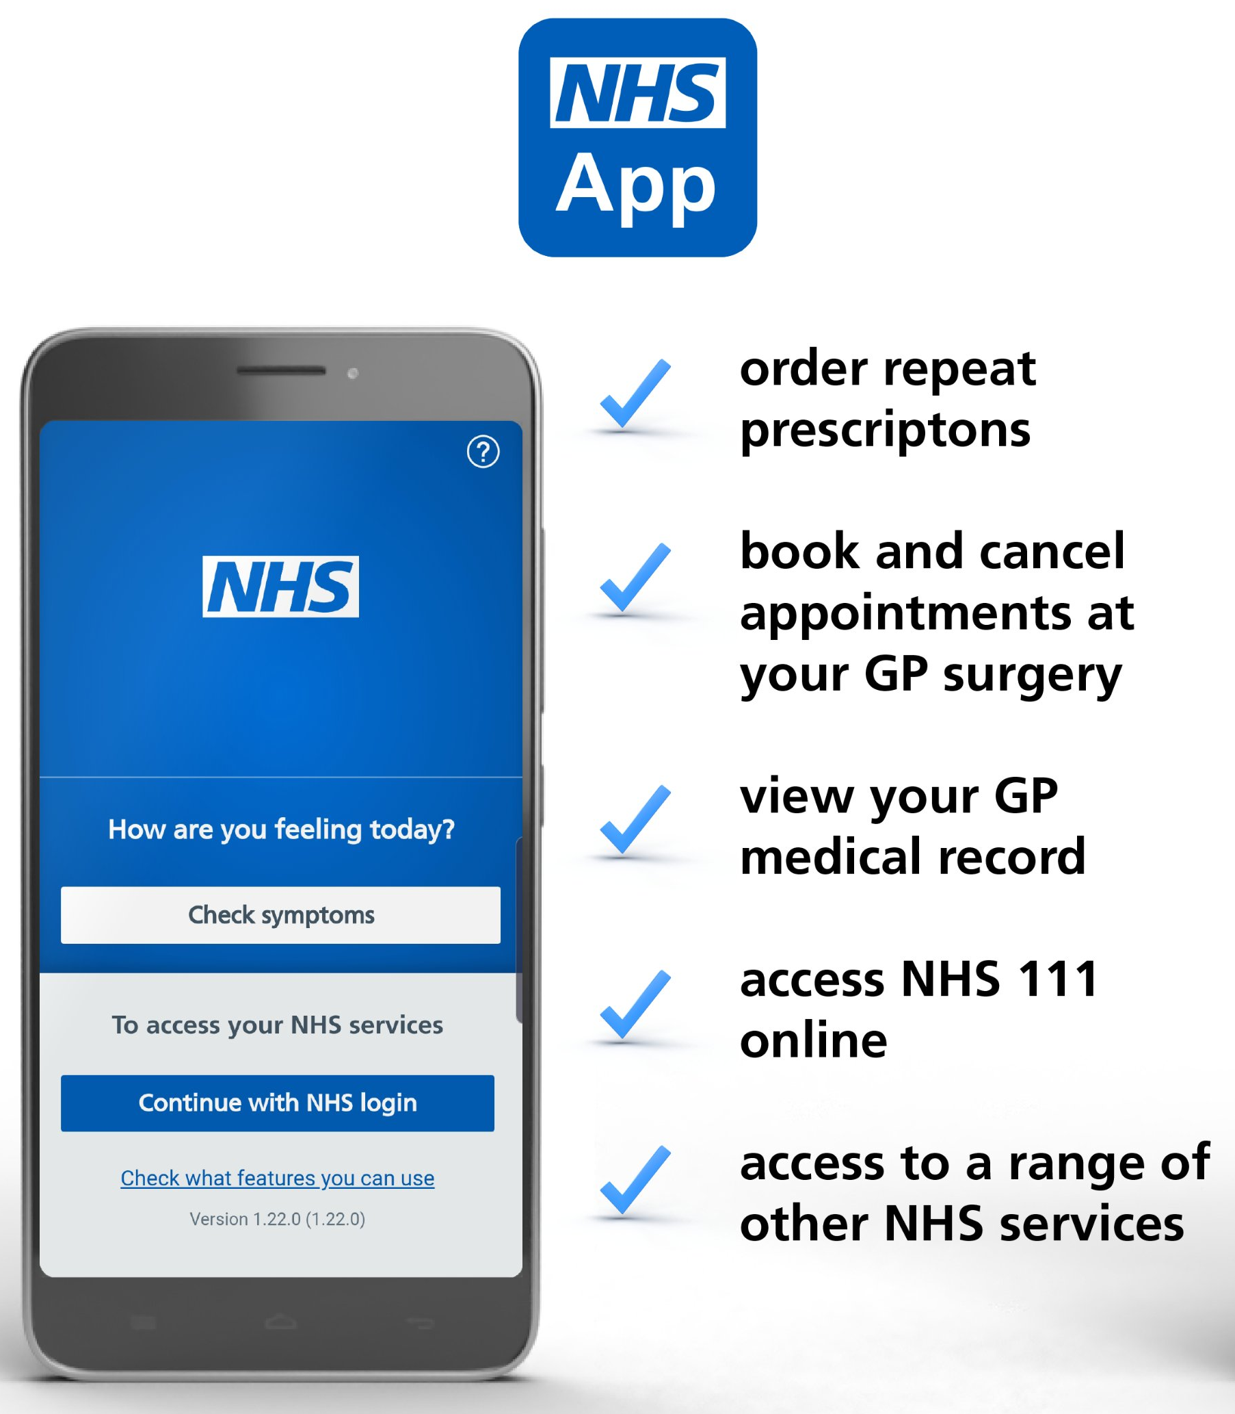
Demonstrating Vaccine Status using the NHS App
The NHS App is a simple and secure way to access a range of services on your smartphone or tablet. It is free from app stores. You need to be 16 or over to use the NHS COVID Pass service and registered with an NHS GP practice in England. The NHS App should not be confused with the NHS COVID-19 App which offers the fastest way to see if you’re at risk from coronavirus.
Find out more about the app and its benefits here.
View and share the Covid Pass on the app to demonstrate your vaccine status, for domestic use or travel abroad
Find out more here:
https://www.bt.com/content/dam/bt-sft/assets/documents/bt-skills-for-tomorrow-helping-others-nhs-app-guide-leaflet.pdf
https://www.bt.com/skillsfortomorrow/home-life/helping-others-nhs-app-guide
Version 12.0 11022022

Slide 9
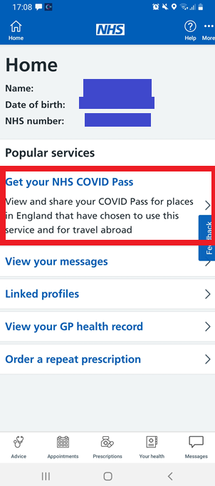
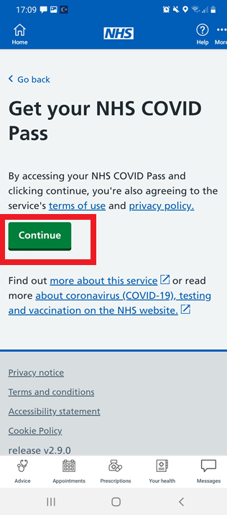
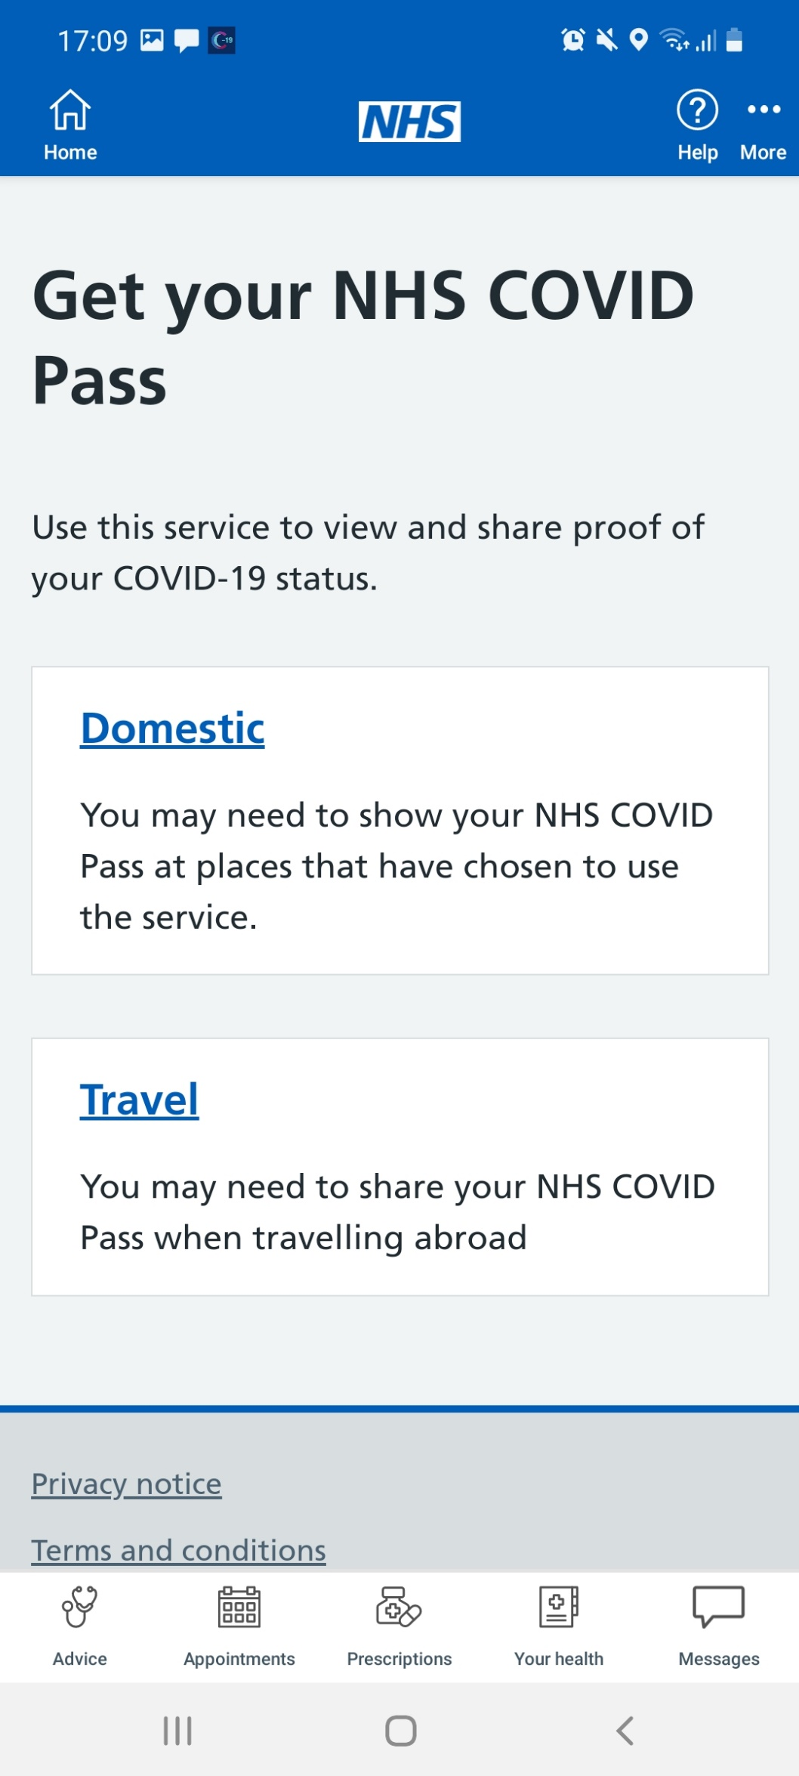
How to demonstrate your vaccination status in the NHS App
Once you have signed in to the NHS App, click ‘Get your NHS COVID Pass’
On the next screen, press ‘Continue’
Select ‘Travel’. This is because the travel pass offers more detail and better evidence of vaccination status
Version 12.0 11022022

Slide 10
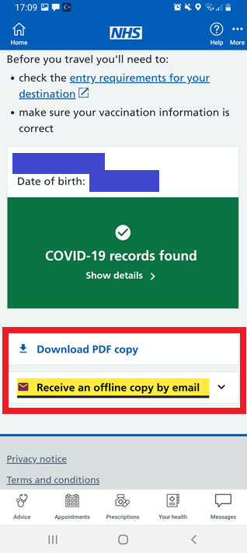
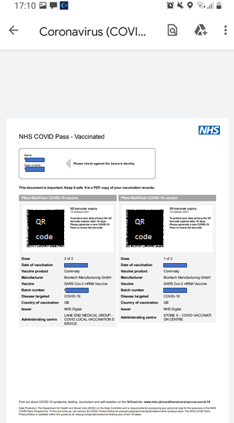
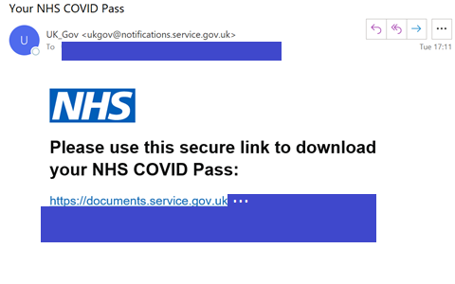
How to demonstrate your vaccination status in the NHS App
Select Download PDF copy or Receive an offline copy by email
You will be able to print the information that you receive (see right side of this slide), or email it to managers or colleagues to demonstrate vaccination status
People who have had a booster vaccine are also able to demonstrate this using the NHS App COVID Pass.
Version 12.0 11022022

Slide 11

Infection prevention and control - what happens after the vaccine?
The vaccine is just one tool in our tool box to prevent COVID-19
Even if staff and residents have received both doses of the vaccine (and a booster) you must continue infection prevention control measures:
Continue to wear PPE
Continue to follow infection prevention and control guidance
Continue with testing
Continue to follow guidance if anyone has symptoms of COVID-19
Continue to follow rules on staff isolation, where required
You can find lots of useful information about the vaccine in the care home vaccine information pack.
Version 12.0 11022022

Slide 12

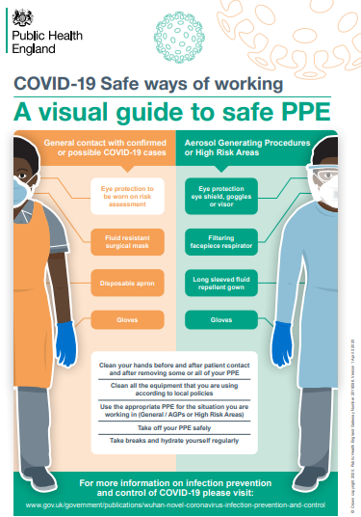
Infection prevention and control
Due to the high transmissibility of the Omicron variant, infection prevention and control, including the use of PPE, should continue in all health and care settings.
Follow guidance on handwashing and other ways to prevent infection which remains the same for all variants of COVID-19, including Delta and Omicron.
All staff should wear masks at all times until you take a break from duties (e.g. to drink, eat, for your break time if stepping outside of the care home or at end of shift when leaving the care home).
Staff should adhere to social distancing in communal areas, including break rooms.
Masks can be used continuously, depending on different scenarios
Gloves and aprons are for single patient use only.
Ensure that enhanced cleaning guidance is followed in all care home settings
If you take your mask off, it MUST go in the clinical waste bin
Follow clinical advice on length of isolation for residents which will depend on clinical symptoms and test results. Follow infection prevention and control guidance.
Care for residents using PPE (what to use and how to wear and dispose)
Due to sustained transmission PPE is to be used with all patients. Additional PPE is required for aerosol generating procedures (AGPs) as listed in the guidance (section 6.6)
Use correct handwashing technique (video and guidance)
Consider bathroom facilities. If no en-suite available, designate a single bathroom for this resident only, or use commode in room
Resources
Infection Prevention and Control: Guidance
COVID-19 Personal protective equipment use for non-aerosol generating procedures: Guidance
COVID-19 Personal protective equipment use for aerosol generating procedures: Guidance
COVID-19 How to work safely in care homes: Guidance
Best practice - How to hand wash: poster
Infection Prevention and Control guidance from Skills for Care
Version 12.0 11022022

Slide 13

Cleaning products and processes for care homes with possible or confirmed cases of COVID-19
Use a chlorine based solution at a dilution of 1000 parts per million (ppm) available chlorine (av.cl.)
  Either
  A combined detergent and chlorine disinfectant product e.g. Actichlor Plus, Chlor-Clean, SoChlor DST
  Or
  A neutral purpose detergent followed by chlorine disinfectant
Follow manufacturer’s instructions for dilution, application and contact times Products are available in tablet form to make up a solution with cold water (preventing fumes) for a single session of cleaning, before disposing of the solution
Any disinfectant wipes in use must conform to virucidal standard EN14476
Always perform hand hygiene and wear appropriate PPE for cleaning
Clean and disinfect all hard surfaces including floors, chairs, touch points (light switches, door handles), remote controls, sanitary fittings. Include reusable non-invasive care equipment
Single-use cloths and mop heads must be disposed of. Reusable ones must be laundered after use
For carpeted floors and soft furnishings, consult the manufacturer’s instructions for cleaning
Cleaning advice should be disseminated to all staff, capable residents and their relatives
Increase to two hourly cleaning in all communal areas that are not closed
Resources
Follow the guidance on cleaning: COVID-19: cleaning
Deep cleaning guidance in care homes: guidance
Version 12.0 11022022

Slide 14

Zoning
Dividing the care home into clearly marked risk zones should help reduce infection.
Example of zones:
Green
Residents with negative test or no symptoms and have been in the home for over 14 days
Areas used prior to full PPE such as offices, food prep and changing room
Amber
Residents with no symptoms but returned from hospital within last 14 days – after 14 days their room can become green
Areas such as elevators, visitor entrance, nursing station and laundry
Red
Residents who are symptomatic, had a positive test or confirmed contact with positive case.
Their laundry, dirty dishes (for soaking), waste etc.
Key considerations:
Look at the care home floor plan to consider how to implement e.g. separating floors or areas on one floor.
Staff (including cleaners) only working in one zone where possible. Keep staff from different groups separate
Where possible to use the same agency/bank staff
Constant infection prevention control measures when crossing zones
Vivid signage on infection prevention at all points between risk zones
Elevator plan e.g. one for each zone or using at different times of the day
Equipment –Keep for individual use where possible – when not separate storage areas for different zones
Resource
Download BushProof infection prevention control signage and zoning strategy document with lots of information including floor plan examples: http://www.bushproof.com/care-homes-strategy-for-infection-prevention-control-of-covid-19-based-on-clear-delineation-of-risk-zones/
Version 12.0 11022022

Slide 15

PPE and escalating your supply issues
Continue to order your usual PPE supplies of gloves, aprons and soap/sanitiser but we also know this has been a challenge and want to support you. COVID-19 has created unprecedented demand on the type and quantity of PPE required by the sector. The Winter Plan identifies that the supply of PPE to the care sector is fundamental to ensuring that care workers can safely provide care to those who need it. The government has already committed to providing free PPE to the care sector. Care settings will be given extra guidance for infection prevention and control measures and PPE.
When contacting your Local Authority:
Outline your concern including the requirement
Outline what your current stock levels are and if you have confirmed or suspected COVID cases within your home.
If you do not get a response from your local authority, please ask them to escalate to the STP for mutual aid support
Where issues with local supply exist, this will be escalated to the regional Supply Chain Team for support.
How to access Personal Protective Equipment (PPE):
Care homes and domiciliary care providers are eligible to register for the PPE portal and can obtain free PPE for COVID-19 requirements until March 2023. You can only log in and place an order if you’ve received an email invitation to register.
The PPE portal order limits which are under constant review can be found here
You should not use the portal to order PPE for non-COVID-19 requirements, you should get this through your normal supplier. If this isn’t possible arrangements have been made with seven wholesalers to provide PPE to the social care sector.
Contact your Local Authority if you are still unable to get PPE provision.
PPE guidance for Residential Care Providers
Resources
Government PPE Plan.
PPE Strategy
PPE for Residential Care Providers: Guidance
Version 12.0 11022022

Slide 16
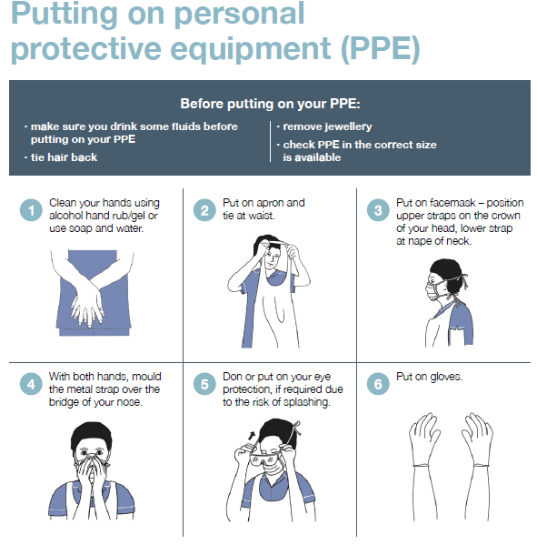
Putting on (donning) PPE for care homes
In your care home:
Different types of PPE are worn depending on the type of work people do and the setting in which they work. Click on this link to see the video on how to put on PPE and take it off in your care home. You can also use the poster on the right which can be downloaded here
Why are people wearing different PPE?
You may see other people wearing different types of PPE, for example, paramedics, district nurses and GPs. This is because some roles will have contact with more people in different procedures and settings, who are possibly infected. In addition, there are a number of styles of PPE made by different manufacturers. You will see, for example, not all face masks will look the same.
Resources
PPE in all settings: Guide
How to work safely in care homes: Guide
Version 12.0 11022022

Slide 17
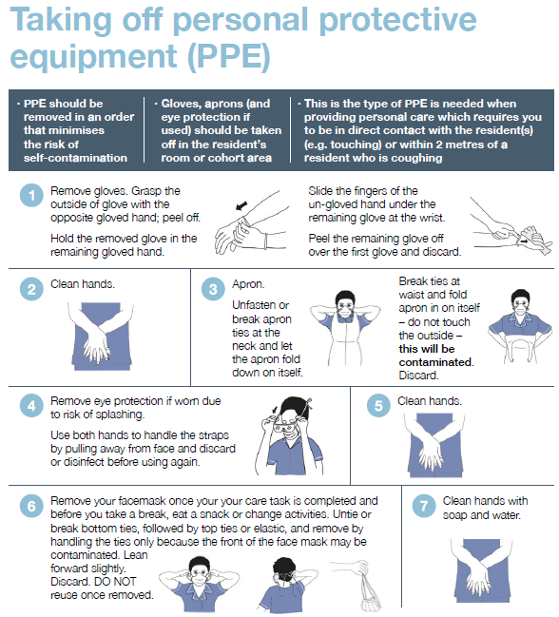
Taking off (doffing) PPE for care homes
In your care home:
Different types of PPE are worn depending on the type of work people do and the setting in which they work. Click on this link to see the video on how to put on PPE and take it off in your care home. You can also use the poster on the right which can be downloaded here
Why are people wearing different PPE?
You may see other people wearing different types of PPE, for example, paramedics, district nurses and GPs. This is because some roles will have contact with more people in different procedures and settings, who are possibly infected. In addition, there are a number of styles of PPE made by different manufacturers. You will see, for example, not all face masks will look the same.
Resources
PPE in all settings: Guide
How to work safely in care homes: Guide
Version 12.0 11022022

Slide 18

When residents should wear face coverings
It is now a legal requirement to wear face coverings on public transport and in shops unless you are exempt. In the context of the coronavirus (COVID-19) pandemic, a face covering is something which safely covers the nose and mouth. You can buy reusable or single-use face coverings.
In England, public and staff in public facing areas are required to wear face coverings in some settings, including:
Public Transport including Taxis and Transport Hubs – TFL still requires passengers to wear a face covering
Shops, Supermarkets and Shopping centres
Libraries, visitor attractions and entertainment venues
Premises providing hospitality (bars, pubs, restaurants, cafes), except when seated at a table to eat or drink
Places of Worship, community centres and social clubs
In hospitals or any NHS settings guidance requires visitors or those attending an appointment to wear a face covering
And any indoor places not listed here where social distancing may be difficult and where you will come into contact with people you do not normally meet
Wearing masks is particularly recommended when spending a long time in spaces, or with many people. Closed spaces with poor ventilation, crowded places with many people nearby, and/or close contact settings such as close range conversations are all examples of settings in which wearing a mask is helpful. Read more here.
Guidance and policies will vary between organisations, businesses and locations, so please check in advance.
Situations whereby individuals are exempt from wearing a face covering include:
children under the age of 11 (UK Health Security Agency does not recommend face coverings for children under the age of 3 for health and safety reasons)
people who cannot put on, wear or remove a face covering because of a physical or mental illness or impairment, or disability
where the putting on, wearing or removing a face covering will cause severe distress
instances where people are speaking to or providing assistance to someone who relies on lip reading, clear sound or facial expressions to communicate
to avoid harm or injury, or the risk of harm or injury, to yourself or others
police officers and other emergency workers – this may interfere with their ability to serve the public
Think
Are there any circumstances/situations within the care setting where the use of face coverings for residents should be considered?
Will the resident tolerate wearing a face covering?
Is the visit to the setting necessary, for health appointments can a virtual appointment take place?
Ask
Does the individual need to travel on public transport or can alternative forms of transport be considered?
Does the face covering meet the UK Health Security Agency recommended minimum of two or three layers?
Has a risk assessment been carried out, to determine whether face coverings are required?
Do
Make sure the resident can breathe ok
Wash your hands when you put it on and take off
Ensure that residents do not keep touching the face covering when wearing it
Resources
Guidance on Face Coverings to attend health appointments
Guidance on Face Coverings for other settings
Face Covering Exemption Resources
Version 12.0 11022022

Slide 19

Managing respiratory symptoms
A new continuous cough is one of the symptoms of COVID-19. However, coughing can continue for some time even if the person is getting better. This does not necessarily mean the person is still infectious, especially when other symptoms have settled down.
There are simple things you can do to help relieve coughing, e.g. drinking honey & lemon in warm water, sucking cough drops/hard sweets, elevating the head when sleeping and avoiding smoking.
Worsening or new breathlessness may indicate that the person is deteriorating. However, people can also appear breathless because they are anxious, especially when they are not used to being on their own in a room, or seeing staff wearing PPE. Breathlessness itself can cause anxiety which can lead to increased breathlessness.
50% of people with mild COVID-19 take about 2 weeks to recover. People with severe COVID-19 will take longer to recover.
Think
Does the resident look short of breath or have difficulty in breathing?
Is this worse than the day before?
Has the resident already got an advance care plan or Coordinate my Care (CMC) record for managing these symptoms?
Ask
Does the resident need another clinical assessment?
Should observations or monitoring commence?
Do
Try and reassure the resident and if possible, help them to adopt a more comfortable position, for example, sitting upright might help. Keep the room cool e.g. by opening a window (do not use a fan as this can spread infection)
Consider increased monitoring
If this is an unexpected change:
  Call the GP in the first instance
  Call NHS 111 Star*6 if concerned, or if GP is not available
  In emergency call 999
  Be explicit that COVID-19 is suspected
If this is an expected deterioration, and there is an advance care plan:
  Follow the care plan instructions
  Call GP for further advice if needed
  Call community palliative care team if they are already involved and further advice is needed
Resources
The content of this section aligns to the London Primary Care and Community Respiratory Resource pack for use during COVID-19. To receive the latest version please email: england.resp-cnldn@nhs.net
Supporting someone with breathlessness: Guide
Managing breathlessness at home during the COVID-19 outbreak: Guide
NICE guideline: Managing Covid-19 – recommendations on managing cough https://app.magicapp.org/#/guideline/L4Qb5n/section/EvybVn
For more information on managing residents with symptoms of flu or acute respiratory viral illness, read the London Flu SOP on the Healthy London Partnership website.
Version 12.0 11022022

Slide 20
COVID-19 Symptoms
The NHS and the UK Health Security Agency definition for COVID-19 infection is the following:
New continuous cough, different to usual
High temperature (≥37.8°C)
Loss or change to sense of smell or taste
Milder symptoms such as headache, sore throat, runny nose have been reported with the newer COVID 19 variants, e.g. Omicron. These are also common in other respiratory illnesses and non-infective illness, for example hay fever. It is therefore important to have a test to confirm or exclude COVID if these are a new presentation.
Care home residents may also commonly present with other signs of being unwell such as being more confused or sleepier than usual, having diarrhoea, dizziness, conjunctivitis and falls. Residents may also present with changes in usual behaviours such as being restless or changes in abilities such as walking.
About 1 in 3 people with COVID-19 do not have symptoms but can still infect others, which is why regular testing is important.
Version 12.0 11022022

Slide 21

What to do when you suspect a resident has respiratory symptoms, including Covid-19
If more than one case of acute respiratory infection or illness is suspected (amongst residents and staff), contact LCRC (details below). If a resident has symptoms of an acute respiratory infection (ARI), including COVID-19 symptoms you should test them using a Covid-19 PCR test and flu testing should be considered.
UK Health Security Agency guidance states that COVID-19 testing should be considered in older residents or residents with dementia or cognitive impairment who have acute confusion. These residents might not be able to report symptoms.
Record observations where possible: Date of first symptoms, blood pressure, pulse, respiratory rate and temperature (refer to thermometer instructions) – remember to maintain fluid intake
For more clinical support, call the residents GP in the first instance. Call NHS 111* Star 6 for urgent clinical advice, or if the GP is not available – this will put you in contact with a Clinician in NHS 111
If this is the first new case following recovery testing or you suspect a new outbreak and/or further cases call the UK Health Security Agency London Coronavirus Response Cell (LCRC) for infection control advice and advice about further testing. LCRC will provide advice and support along with local authority partners to help the care home manage an outbreak.
To ensure prompt investigation of possible ARI outbreaks in care homes, any suspected outbreak of ARI should be reported to the LCRC as soon as possible. Care homes should NOT wait for the results of COVID-19 tests before reporting a possible outbreak.
Phone Number: 0300 303 0450 Email: LCRC@phe.gov.uk
Update: Capacity Tracker, your Local Authority and RIDDOR
Guidance: Admission and Care of Residents during COVID-19 Incident
Guidance: London Flu Response in COVID-19 Pandemic: Standard Operating Procedure for Care Providers
Version 12.0 11022022

Slide 22

Covid-19: testing in care homes
Staff or residents who test positive with the Lateral Flow no longer need to confirm this result with a PCR test. Staff must start their isolation period immediately and inform their manager (see guidance).
All staff will have to take the Lateral Flow test prior to starting their shift on each day they are working
Staff are no longer required to take weekly PCR tests
Residents have PCR every 28 days (e.g. when symptomatic or when a contact) as well as in all Vivaldi research care homes.
If any resident or staff member has a positive PCR or Lateral Flow test, start rapid response testing immediately, by carrying out daily staff lateral flow tests in addition to weekly PCR testing.
Residents and staff who have had a positive PCR test result for COVID-19 should not be retested by PCR until 90 days after onset of their symptoms or positive PCR test date (if asymptomatic), except if they develop new symptoms of Covid-19, get a positive lateral flow test result, or need to return to the UK from abroad. They should continue to test using lateral flow devices.
Call 119 if you have any questions about swabbing
Include all bank and agency staff in your testing.
Symptomatic staff should self isolate at home and order a PCR test through the self referral portal
Call LCRC (0300 303 0450 ) for infection control advice and advice about further testing if you suspect a new outbreak or first new cases following negative recovery testing
Outbreak testing is now carried out via Pillar 2 (DHSC)
Carers and nurses who will be swabbing residents in care homes should complete the online care home swabbing competency assessment before carrying out swabbing. Register at www.genqa.org/carehomes
Watch out for updates from the DHSC on care home testing
Resources
Care_Home_Testing_Guidance_England
Version 12.0 11022022

Slide 23
Declaring an outbreak
An outbreak is defined as 2 or more clinically suspected or confirmed positives (rapid lateral flow or PCR) among residents or staff detected in the same 14-day period.
However, one positive test result may be the first sign of an outbreak, so you should contact LCRC for advice in this instance.
LCRC will advise you on the outbreak testing requirements for staff and residents. See guidance for further details.
Managing an outbreak
LCRC will carry out a risk assessment to determine whether your home needs to close to admissions, re-admissions, and visiting
An essential care giver (eg a nominated relative) and healthcare professionals can still visit the care home
If a resident is on an end of life care pathway, they may be able to have more visitors
LCRC’s risk assessment will determine any further local advice on managing during an outbreak
LCRC contact details:
Phone Number: 0300 303 0450 Email: LCRC@phe.gov.uk
Version 12.0 11022022

Slide 24
Testing during an outbreak
For advice on outbreak testing: call LCRC on 0300 303 0450
If two or more COVID-19 cases are detected in staff or residents, the suspected outbreak must be reported to the Health Protection Team, and outbreak control restrictions should be implemented:
Whole home PCR testing (staff and residents) should occur on day 0 of the suspected outbreak
Whole home PCR testing should be repeated at day 4 and 7 for those who test negative.
If the first and second rounds of PCR testing do not detect any further cases in residents or staff, then outbreak control restrictions may be lifted after consideration of:
Level of vaccine coverage in residents above 90% and staff above 80% and participation in routine staff weekly testing above 75%.
Compliance with IPC measures.
If residents or staff with respiratory symptoms are returning negative tests, contact LCRC on 0300 303 0450 or Email: LCRC@phe.gov.uk.
Version 12.0 11022022

Slide 25
Closing an outbreak
All staff and residents should be tested with PCR 14 days after the last resident or staff had a positive test result or showed coronavirus-like symptoms.
If there are no positive PCR results, and no new variants are identified from this ‘end of outbreak testing’, the HPT will declare the outbreak over.
Any further positive cases after this point is a new suspected or confirmed outbreak. The care home must contact LCRC and immediately begin rapid response testing again.
If no further cases are identified at this point, the outbreak is considered to have ended. Resume the normal testing regime.
LCRC will advise when the regular residents testing cycle will resume after the outbreak ended
LCRC contact details:
Phone Number: 0300 303 0450 Email: LCRC@phe.gov.uk
Version 12.0 11022022

Slide 26
Care Home meets threshold for OB (2+ cases within 14 days
with epidemiological link)
4 days later 1 * case
RESTART 14 DAY CLOCK
14 days later and no further cases
OUTBREAK OVER
14 days later and no further cases
OUTBREAK OVER
Version 12.0 11022022

Slide 27






Swabbing residents: top tips
Swabbing may feel uncomfortable and be frightening for some residents.
 | You might want to wait for a good moment where someone is engaged and not in distress for another reason
 | Explain the reasons behind the swab and that there might be some discomfort
 | Use pictures and simple information to help explain Example here: https://bnssgccg-media.ams3.cdn.digitaloceanspaces.com/attachments/Easy_Read_swab.pdf
 | Demonstrate what will happen on yourself, a colleague or a doll/teddy
 | Asking the person to open their mouth, stick out their tongue and say “ahhh..” can help with understanding
 | Keep explaining what you are doing during swabbing and give clear instructions
Version 12.0 11022022

Slide 28
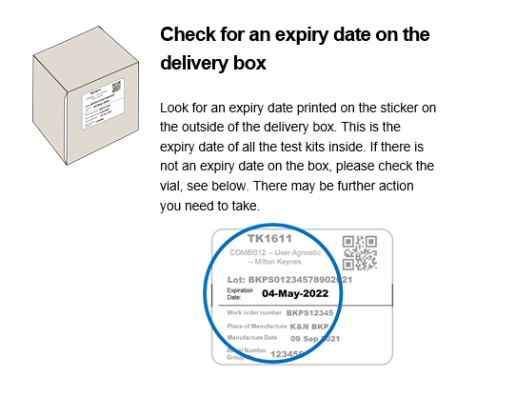
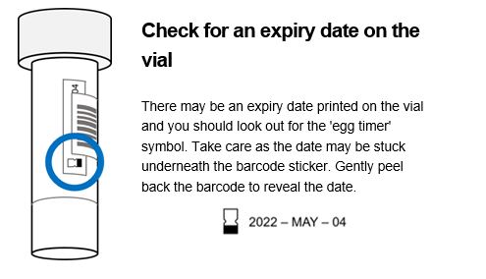
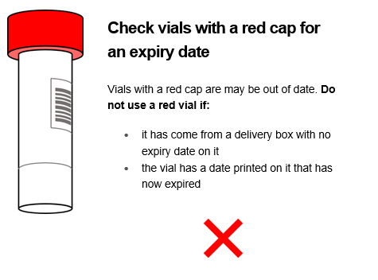
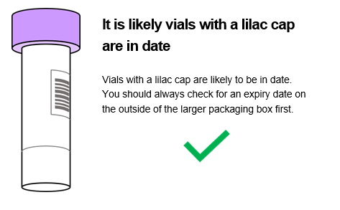
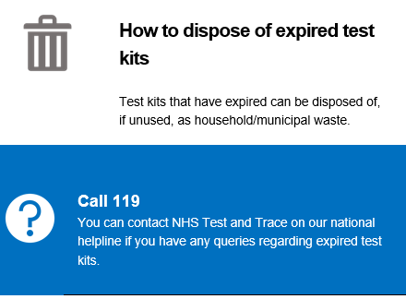
Void tests - Expired Test Kits
The majority of void tests currently being returned are due to testing with an expired kit, It is highly likely that the voids received are because of this reason. If you receive a void or “unable to read”, inconclusive result, please instruct staff to retest.
Important : Check your test kits have not expired: If the lab receives a vial that has expired, your test result will be returned as void.
Version 12.0 11022022

Slide 29

Assessing capacity for Covid-19 testing
For regular testing of all residents for COVID-19 in care home settings, see the below guidance for staff in cases where the relevant person may lack the capacity to consent to this procedure.
If there are doubts about a resident’s capacity to consent to a test for COVID 19, this decision should be approached by applying the practice and principles of the Mental Capacity Act (MCA) 2005.
Establish whether the individual does lack capacity to make this particular decision. In doing so you must support them, and take all practicable steps, to help them make their own decision.
Make sure the person has all relevant information, e.g. what the test is for, what the procedure involves and what the risks are of not being tested and what the benefits would be. This information should be given in an accessible way that is suited to the individual’s level of understanding.
The capacity assessment must be evidenced and recorded in the person’s care notes.
Is there a Lasting Power Of Attorney (LPA) for health and welfare Or Court Appointed Deputy ?
If the person concerned lacks capacity to consent to the COVID-19 test then you should check whether that individual has a Lasting Power of Attorney (LPA) or deputy for health and welfare who can consent on their behalf. Where an individual does not have an LPA a Best Interest Decision approach is required.
Blanket decision making’ cannot be made on the issue of testing a group of residents This would breach the person centred nature of the Mental Capacity Act - capacity is an individual issue and what may be in the best interests of one resident may not be in the best interests of another.
Best Interest Decision Making
In making this best interest decision, you must consider the best interest checklist. This includes:
Trying to ascertain the person’s views as much as is possible, encouraging the person’s participation in the decision
Consult others involved, e.g. family members and carers
Identifying the relevant factors that the person themselves would taken into account if they were able to make the decision themselves. For instance the risk of harm to them should they not be tested
Use your knowledge of the resident to identify whether they would have likely to have wanted the test had they been able to make the decision for themselves
Taking all these views and factors into account you can then make a best interest
decision on behalf of the individual.
Again, this should be evidenced and recorded in the individual’s care notes.
Implementing a Best Interest Decision to be tested
A Best Interest Decision on Testing Must Be Person Centred
Try to complete the test in course of daily care routines without the use of restraint.
If the person is resisting in any way and restraint is required, then you must be satisfied that it is a necessary and a proportionate response to the likelihood and seriousness of the harm that they would suffer should they not be tested.
If restraint and force is required to perform a COVID-19 test then questions will have to be asked if the risk of harm is actually great enough to justify this and whether testing that individual is really in their best interests given the level of distress it is causing. This can only be decided on a case by case basis and clearly documented.
(Content credited to Bath & North East Somerset Council)
Useful Resources
Webinar on testing, capacity and COVID 19
NICE guideline: Decision making and mental capacity
Capacity decision making flow chart
Social care quick guide on best interest decisions during COVID-19
Mental Capacity Act for Care Homes – webinar slides
Version 12.0 11022022

Slide 30
Care home Covid-19 testing results: actions for care home residents and staff
Testing
In Care Homes
Lateral Flow Test & PCR tests
Staff as part of regular, rapid response or outbreak testing
Resident as part of outbreak testing
Resident
Staff
Negative test
Positive test
Positive test
Negative test
If no symptoms, no isolation required
If develops symptoms, isolate and carry out a PCR as a suspected case – isolate for 10 days from onset of symptoms unless confirmed negative. Consider other respiratory infections. Call LCRC on 0300 303 0450, or email on lcrc@phe.gov.uk. Seek medical help as required. (see UK Health Security Agency care home guidance)
With no symptoms or symptomatic: Isolate in a single room for up to 10 days from the date of swab being taken, unless resident tests negative twice from days 5 and 6 on each day.
Seek medical help as required. (see UK Health Security Agency care home guidance)
Do not retest using a PCR for 90 days unless develop new symptoms.
More information regarding testing during an outbreak could be found here
Self-isolate for 10 days from date of test or onset of symptoms and can be further reduced with two negative Lateral Flow tests 24 hours apart from day 5 and 6 onwards
If both results are negative, self-isolation period can end. If positive, continue to isolate for the full 10 days.
Do not retest using a PCR for 90 days unless develop new symptoms
More information regarding testing during an outbreak could be found here
If staff member has no symptoms, and employer risk assessment deems no risk, return to work, and resume regular testing routine.
If has symptoms at the time of a negative PCR test, return to work when you feel well.
If develops symptoms after testing, self-isolate for 10 days from onset of symptoms and re-test. (Household members should then self-isolate for 10 days (see Stay at Home guidance). Consider other respiratory infections.
If you are fully vaccinated, you should still continue to take precautions including getting your booster vaccine, taking regular tests, using protective equipment, and following infection control guidelines
Version 12.0 11022022

Slide 31
Covid-19 testing and flu/ other respiratory illness
If a resident or staff member takes a Covid-19 test and gets a negative result, they could still have another acute respiratory infection, including Flu.
If symptoms are confirmed as having Flu, or there is high clinical suspicion of Flu, residents must self-isolate.
Residents with symptoms of respiratory illness and have received a COVID-19 negative PCR test result should be isolated for a minimum of 5 days after the onset of symptoms and until feeling well. (staff should stay at home).
Close contacts of a resident with a respiratory virus, other than COVID-19, do not need to self-isolate.
Ideally symptomatic residents should be cared for in single rooms and/or cohorted in different areas; keeping residents with Covid-19 or suspected Covid-19 separate to those with other suspected acute respiratory illness, in a separate floor or wing if possible.
Staff with symptoms of respiratory illness and have received a COVID-19 negative test result should stay at home for a minimum of 5 days after the onset of symptoms and until feeling well.
Version 12.0 11022022

Slide 32

Principles of managing staff and residents who are contacts of Covid-19 cases
If staff are identified as a close contact of a person with COVID-19 they should arrange for a PCR test and self-isolate until the PCR test result is received. Staff will not need to self-isolate if they meet the following criteria:
Have received their primary doses and booster dose of any eligible (MHRA approved) Covid-19 vaccine.
have a negative PCR test result
remaining free of COVID-19 symptoms (should immediately self-isolate if symptoms develop).
complying with all relevant infection control precautions
Residents who have been in close contact of a person with Covid-19 are required to self isolate for 10 days, but may end the 10 days early:
vaccinated residents can end their self-isolation if they receive 3 consecutive negative lateral flow tests taken on days 4, 5 and 6
unvaccinated residents can end their self-isolation if they receive 3 consecutive negative lateral flow tests taken on days 6, 7 and 8
any resident who is unable to test – regardless of their vaccination status – should self-isolate for 10 days
Definition of Close Contacts (residents without face coverings and staff without PPE or where there has been a breach in PPE) :
  having face-to-face contact with someone (less than 1 metre away)
  spending more than 15 minutes within 2 metres of someone
  travelling in a car or other small vehicle with someone (even on a short journey) or close to them on a plane
  has cleaned a personal or communal area of the home where a confirmed case has been located (note this only applies to the first time cleaning of the personal or communal area)
Guidance
COVID-19: management of staff and exposed patients or residents in health and social care settings here
https://www.gov.uk/government/news/frontline-health-and-care-staff-can-work-rather-than-self-isolate
Admission and care of residents in a care home during COVID-19
LCRC contact details Phone Number: 0300 303 0450 Email: LCRC@phe.gov.uk
Version 12.0 11022022

Slide 33
STAFF contacts of a Covid-19 case - what to do
All staff and residents identified as close contacts of a case should be tested via PCR
Staff who have received both their vaccines at least two weeks ago and those aged under 18 years and six months are no longer required to self-isolate if they are a close contact of someone who tests positive. They should instead:
Take a PCR test as soon as possible and do not return to work until a negative result is received
Take a pre-shift Lateral Flow Tests on each of the days they are working
Immediately self-isolate if any of these tests are positive or they have any COVID-19 symptoms.
2) Staff who are not fully vaccinated [14 days after a full primary course of an MHRA approved NHS administered vaccine (2 doses)] who are identified as contacts of someone with COVID-19 should:
Not attend work
Self-isolate for 10 days
Arrange for a PCR test
Full guidance https://www.gov.uk/government/news/frontline-health-and-care-staff-can-work-rather-than-self-isolate
Quick Guide: https://www.scie.org.uk/care-providers/coronavirus-covid-19/infection-control/quick-guide
Continued…
Version 12.0 11022022

Slide 34
STAFF contacts of a Covid-19 case - what to do (cont’d)
If the staff member works with residents who are clinically extremely vulnerable to COVID-19 (as determined by the organisation), a risk assessment should be undertaken, and consideration given to redeployment during the 10 day post- exposure period.
All staff should comply with all relevant infection control precautions and PPE should be worn properly throughout the day.
If more than one case of acute respiratory infection is suspected (amongst residents and staff), contact LCRC on 0300 303 0450 or LCRC@phe.gov.uk
Notes:
* 1) If health care staff are providing care to or are in close contact with an individual with COVID-19 infection and are wearing the correct PPE appropriately in accordance with the current infection prevention and control (IPC) guidance, they will not be considered as a contact
2) In non-patient facing areas, IPC precautions may unintentionally be less stringently adhered to. If IPC precautions have been compromised, or PPE has been worn incorrectly or breached, the staff member should be considered a contact
3) If there has been a breach of recommended PPE during the care episode then the staff member would be considered a contact
4) Remember to turn your contact tracing off on the NHS app while at work wearing proper PPE
** Fully Vaccinated = 14 days after a full primary course of an MHRA approved NHS administered vaccine (2 doses)
Full guidance: https://www.gov.uk/government/news/frontline-health-and-care-staff-can-work-rather-than-self-isolate
COVID-19: management of staff and exposed patients or residents in health and social care settings here
Version 12.0 11022022

Slide 35
RESIDENTS who are contacts of a Covid-19 case - what to do
All staff and residents identified as close contacts of a case should be tested via PCR
Residents who have had 2 primary doses and any eligible booster vaccine, are no longer required to self-isolate if they are a close contact of someone who tests positive. They should instead:
Take a PCR test as soon as possible and isolate until a negative result is received.
Take a lateral flow test on days 4, 5 and 6, to help slow the spread of COVID-19. If all three tests are negative self-isolation can stop.
Immediately self-isolate if any of these tests are positive or they have any COVID-19 symptoms.
2) Residents who are not fully vaccinated (eg have only had primary dose(s) or none at all) who are identified as contacts of someone with COVID-19 should:
Be isolated in a single room and not receive visitors for 10 days.
Continue to monitor their symptoms throughout their isolation period.
Request a PCR test if symptoms develop.
Take a lateral flow test on days 6, 7, and 8, to help slow the spread of COVID-19. If all three tests are negative self-isolation can stop.
If more than one case of respiratory conditions is suspected (amongst residents and staff), contact LCRC on 0300 303 0450 or LCRC@phe.gov.uk
Guidance: COVID-19: management of staff and exposed patients or residents in health and social care settings here
and Admission and care of residents in a care home during COVID-19
Version 12.0 11022022

Slide 36

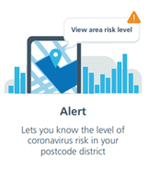
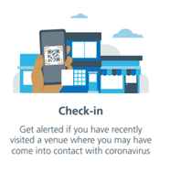
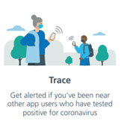


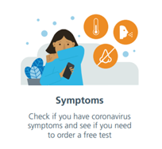
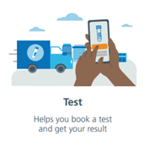
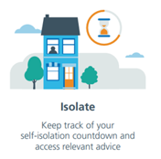
NHS COVID-19 app features
The free NHS COVID-19 app is a vital part of the NHS Test and Trace service in England Test, Trace, Protect service. It is the fastest way to see if you're at risk from coronavirus.
The app has a number of tools to protect you, including contact tracing, local area alerts and venue check-in.
The NHS COVID-19 app is entirely voluntary and you can choose whether or not to download it. You can also uninstall and delete the app whenever you like.
Every person who downloads the NHS COVID-19 app will be helping in the fight against coronavirus (COVID-19).
The app does all this while protecting users' anonymity. Nobody, including the government, will know who or where a particular user is.
The NHS COVID-19 app only works on smartphones that are compatible with the Exposure Notification framework developed by Apple and Google.
Below are the key app features
Download the app here
Resources
How to download the app NHS COVID-19 app video Your data and privacy
Using COVID-19 app to protect visitors and staff NHS COVID-19 information Create QR poster pdf
Version 12.0 11022022

Slide 37
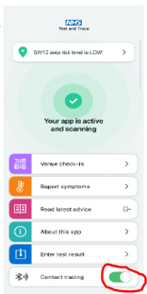
How staff should use NHS COVID-19 app
All care home staff should use the NHS COVID-19 app outside their places of work, please see NHS COVID-19 app features slide regarding instructions on how to download the app.
The NHS COVID-19 app only works on smartphones that are compatible with the Exposure Notification framework developed by Apple and Google
Use of app in care environment
Health and care workers should not use the NHS COVID-19 app
when they are working in a care environment, healthcare buildings,
including hospitals and GP surgeries.
If you’re a health or care worker practising infection prevention
and control (IPC), including wearing correct PPE, you should
pause contact tracing on your app.
How should health and social care workers pause contact
tracing?
Pause contact tracing within the app by scrolling down the
home screen to the Bluetooth image and turning the contract
tracing button to off as shown in the picture.
You should also pause the app when:
you’re working behind a fixed Perspex (or equivalent) screen
and are fully protected from other people - you should be
adequately protected
you store your phone in a locker or communal area
Remember to turn contact tracing back on once you leave this situation.
Use of app to protect visitors and staff
Care providers are encouraged to display official NHS QR code posters at their venue entrances to help support contact tracing.
This should be referenced in visitor’s policy and part risk assessment.
This means that if people visit the venue and later test positive for coronavirus, other app users who were there at the same time may be sent an alert, if local public health teams think this is necessary.
The app notification will not mention the name of your venue, it will just let app users know that they may have come into contact with coronavirus and provide them with public health advice.
If staff believe that they’ve been in contact with coronavirus, or gets an alert telling them that they’ve been in contact with someone who has tested positive, they should refer to their local public health risk assessment process.
Resources
How to download the app
NHS COVID-19 app video
Using COVID-19 app to protect visitors and staff
Your data and privacy
NHS COVID-19 information
Easy Read Test and Trace
Version 12.0 11022022

Slide 38
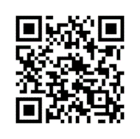
How residents should use NHS COVID-19 app
All residents should use the NHS COVID-19 app when they are visiting venues outside their places of residence, please see NHS COVID-19 app features slide regarding instructions on how to download the app. The app should be turned off in the care environment
The NHS COVID-19 app only works on smartphones that are compatible with the Exposure Notification framework developed by Apple and Google.
Using the COVID-19 Test and Trace App
The app can keeps a record of where they have been when visiting places outside the home. If other people were at the same venue at the same time as a resident, and later test positive for coronavirus (COVID-19), the resident may receive a notification.
Checking in to venues
Residents can use the app to check in to QR Code
venues when they visit.
Residents can check in to a venue by
pressing on the check in section and
scanning a QR code (see picture)
The QR for a venue is usually located
on a poster near the
entrance or service till in a shop.
You will find QR posters in cafes, restaurants, bars, leisure centres, hairdressers, beauticians, community centres and places of worship.
Where a QR code poster is not available, Residents may still need to fill out their details.
Using the App to check symptoms
Residents can use the app to check and report their symptoms.
By clicking on the select symptoms section the resident can choose the symptoms they may feel they are experiencing at the time.
By clicking the submit symptoms button it will let the resident know if they may need to have a Coronavirus test.
If the app advises to have a Coronavirus test, resident should follow local care home guidance for testing and not book test through the app.
The app will provide guidance on the number of days the resident will need to self isolate.
Resources
How to download the app
NHS COVID-19 app video
Your data and privacy
NHS COVID-19 information
Easy Read Test and Trace
Version 12.0 11022022

Slide 39
Treatments for coronavirus (COVID-19)
Two types of COVID-19 treatment are available for those classed in the high risk group, have a positive PCR test within the last 72 hours, and have COVID-19 symptoms within the last 5 days:
  Sotrovimab (Xevudy) is a neutralising monoclonal antibody (nMAb) administered as a single IV infusion, for adults and children aged 12 years or older who weigh at least 40kg (see eligibility criteria)
  Molnupiravir (Lagevrio) is an antiviral oral medicine given as a 5 day course, for adults aged 18 years and older (see eligibility criteria)
A doctor or specialist will confirm who is in the high risk group and advise what the recommended treatment for COVID-19 treatment will be. For those eligible for COVID-19 treatment, a PCR test kit will be sent to keep at home. Eligible residents will be sent a kit to the care home, and staff who are eligible will be sent one to their own home.
How to get a COVID-19 treatment
What happens if you test positive
Sotrovimab
Sotrovimab
Take a PCR test if you get symptoms
Eligible people will be given a test so they can get tested quickly at home if they have any of the main symptoms of COVID-19. The test should be taken as soon as possible, even if symptoms are mild. Tests will be sent to a lab to get the result.
When registering a test, it is important to enter your NHS number and postcode correctly. This is so the NHS can contact people about treatment if they test positive.
NHS Test & Trace will send a replacement test to anybody who uses one.
Call 119 if you think a resident or staff member may be eligible for treatment but have not received a test kit by 10 January 2022.
People who are eligible for treatment and test positive for COVID-19 should start the treatment as soon as possible.
The NHS will contact them within 24 hours of their positive PCR test result. This will usually be by text, email or phone call. For residents, this may mean contacting the care home. The call will provide more information and check if treatment is right for the person who has tested positive for COVID-19.
Treatments for COVID-19 are free of charge on the NHS. The NHS will never ask for bank account or card details, or ask for payment for treatment.
Resources:
GOV.UK: sotrovimab (Xevudy) patient information leaflet GOV.UK: molnupiravir (Lagevrio) patient information leaflet NHS England: easy read information about COVID-19 treatments (PDF, 1MB)
Version 12.0 11022022

Slide 40
Variants of concern
All viruses – including SARS-CoV-2, the virus that causes COVID-19 – evolve over time. When a virus replicates or makes copies of itself, it sometimes changes a little bit, which is normal for a virus. These changes are called “mutations”, or variants.
Data continues to be collected and analysed on new variants of the COVID-19 virus to understand how these variants affect the behaviour of the virus, including their impact on the effectiveness of vaccines, if any.
Depending on where the changes are located in the virus’s genetic material, they may affect a virus’s properties, such as transmission (for example, it may spread more or less easily) or severity (for example, it may cause more or less severe disease).
In the event that any of these vaccines prove to be less effective against one or more variants, it will be possible to change the composition of the vaccines to protect against these variants.
Manufacturers vaccine programmes may have to adjust to the evolution of the COVID-19 virus: for example, vaccines may need to incorporate more than one strain when in development, booster shots may be required to slow the spread of new variants, and other vaccine changes may be needed.
Currently, the B.1.1.529 a variant of concern, named Omicron, is the dominant variant of the virus in the UK. This means that most people in the UK catching Covid-19, are catching this variant (prior to this it was B.1.617.2 variant of Covid-19, also known as the Delta variant).
The Omicron variant is more transmissible than previous variants. The booster vaccine is effective against Omicron and reduces the risk of serious illness or hospitalisation. The booster programme has been upgraded as a response.
Some of the variants have emerged after the Covid-19 vaccinations were developed and tested. The COVID-19 vaccines that are currently in use or have been approved for primary doses and booster vaccines provide significant protection against the Omicron variant. Taking a booster will help top up waning protection from the primary doses, against new variants.
Learn more about the effects of the virus variants on Covid-19 vaccines here
Version 12.0 11022022

Slide 41
Variants of concern
While we are learning more, we need to do everything possible to stop the spread of the virus in order to prevent mutations that may reduce the efficacy of existing vaccines.
Vaccines are a critical tool in the battle against COVID-19, and there are clear public health and lifesaving benefits to using the tools we already have. We must not put off getting vaccinated because of our concerns about new variants.
There is good evidence that being vaccinated offers the most effective protection against being seriously ill with the Omicron variant, Therefore, we must proceed with the vaccination programme, at pace. We need to use the vaccines and other measures we have available even while we continue to improve those tools.
As restrictions in the community change, enhanced infection prevention and control standards and testing in care homes must be maintained, even for people who have been fully vaccinated.
“We are all safe only if everyone is safe”
Learn more about the naming conventions of the vaccines here
Version 12.0 11022022

Slide 42

Enabling visits in the care home
The national care home visiting guidance continues to be updated and should be checked at regular intervals:. Visiting is crucially important for maintaining health and wellbeing of residents, and it is vital for friends and families to spend time with their loved ones. Care homes should develop their own local policies in order to enable and encourage visiting in a risk-managed way, unless there is an outbreak. Local policies should cover factors such as infection prevention and control, social distancing and managing visitor numbers.
Care home managers should keep a temporary record of visitors, and each home should develop their own local policies, dynamic risk assessment (in consultation with residents and relatives) and can seek help from their local Director of Public Health or Director of Adult Social Services. They should make decisions on the number of visitors accordingly. End of life visits should always be enabled. All care homes, except in the event of an active outbreak should seek to enable:
Visitors There is no legal limit on the number of visitors per resident, however homes should consider implementing one in local policies, to reduce the risk of infection.
In the event of an outbreak - Only essential care givers will be allowed to visit residents indoors during an outbreak. Other visits may be facilitated, for example in well-ventilated spaces with substantial screens, visiting pods or from behind windows.
Every care home resident to nominate an essential care giver who provides a greater degree of personal care or support
Check local guidance to learn more about who can qualify as an essential care giver
All visitors should be tested using lateral flow tests on the day of every visit and produce a negative test prior to a visit.
All visitors are advised to wear appropriate PPE and follow other infection prevention control measures and maintain a 2 meter distance wherever possible.
Visitors are advised to keep physical contact to a minimum, maintain a 2 metres distance where possible
Outdoor visiting and screened visiting should be made available for families who prefer it
Visits involving children should be planned and agreed, where reasonable and appropriate visiting children should wear PPE (face coverings should not be worn by children under the age of 3).
Version 12.0 11022022

Slide 43

Visits out of the care home
The national care home guidance on visits, including out of the home, continues to be updated and should be checked at regular intervals.
Opportunities for residents to make visits out of the home are an important part of care home life. It is important that steps are taken to reduce risks.
All visits out of the care home should be supported without the need to isolate on return to the care home. This is subject to an individual risk assessment, however certain activities have a higher risk. Factors that may make a visit high risk include:
If there are a lot of people involved in the visit, who are not ‘usual contacts’, of the resident or people they do not usually mix with
If there are people on the visit who are unvaccinated, not fully vaccinated, or whose vaccination status is unknown
If those involved in the visit have not tested prior to the visit or have recently tested positive and have not completed their isolation (they should not be involved in the visit in this case)
If the visit setting, or transportation to the visit setting is an enclosed, unventilated and/or crowded setting
If the resident has recently return from an emergency stay in hospital and is completing a period of isolation
What if there is an outbreak?
In the event of an outbreak, all movements out of a setting should be minimised as far as possible.
Version 12.0 11022022

Slide 44

Admissions into the care home (part 1)
Transferring from an interim care facility, from another care home, or planned admissions from the community:
Newly admitted residents do not need to self-isolate upon arrival. Instead, they should:
  take a PCR test before they are admitted (within 72 hours before admission)
  take a PCR test on the day of admission (day 0)
When admitting residents from an interim care facility or another care home, individual risk assessments should take into account :
  have received their primary doses and booster dose of any eligible (MHRA approved) Covid-19 vaccine.
  risk assessments are carried out in line with current guidance and recommendations.
  the person admitted has no known contact with a COVID-positive person.
  the levels of transmission in the community within which the previous care home or care facility is situated.
  the COVID-19 outbreak management of the previous care home or care facility.
When admitting residents from the community, individual risk assessments should take into account:
  the person admitted has received their primary doses and any eligible booster dose of the Covid-19 vaccine.
  local public health guidance about community transmission of variants is followed.
  the circumstances at the person’s home, prior to admission - whether the individual has been in contact with someone with COVID-19 symptoms during the previous 10 days, or if they have been required to self-isolate by NHS Test and Trace (if a close contact has occurred, admission may be delayed until after the relevant period of isolation, though admission should not be delayed if there are safeguarding and welfare concerns)
If the risk assessment shows that an incoming resident should self-isolate, this should be for 10 days.
Urgent admissions from the community:
For urgent admissions, the individual should self-isolate for 10 days.
If the individual has taken a PCR test within 72 hours of admission, the manager must share the result with the home’s named clinical lead. If a PCR test has not been taken or was taken more than 72 hours before admission, the individual should be tested (rapid lateral flow or PCR).
If the test result is positive, the resident should self-isolate for 10 days within their own room.
If the test is negative, the care home manager should conduct a risk assessment to assess the need to continue self-isolation. The risk assessment should include information about risk and exposure prior to admission, and vaccination status.
Admission of residents discharged from hospital:
Residents being discharged from hospital, must receive a COVID-19 PCR test result within 48 hours before discharge.
Individuals who test positive should be discharged to a designated setting to complete their self-isolation period.
Individuals who receive a negative test result within 48 hours prior to hospital discharge should be discharged to a care home where they will not be asked to self-isolate, unless they were discharged following an emergency admission, there is possible contact with a known outbreak in the part of the hospital where they were treated, or if they are a contact of a suspected or confirmed positive case.
Residents who test positive for COVID-19 – regardless of their vaccination status should do the following :
  self-isolate and then take part in daily rapid lateral flow testing from day 5 (counting the day of the original positive test as day 0)
  end self-isolation after receiving 2 consecutive negative tests 24 hours apart, or after 10 days isolation.
  residents who are unable to test should self-isolate for the full 10 days following a positive test.
Care home residents retuning from hospital following an overnight stay for elective (planned) care:
Should take a PCR test prior to discharge. If the result is negative, they do not need to self-isolate. If they test positive, they should go to a designated setting and/or follow the 10 days self-isolation period.
Residents discharged from hospital following an unplanned hospital stay:
Should self-isolate, upon arrival, for 10 days, within their own room. Emergency admissions are deemed higher risk due to the increased likelihood that contact with people of unknown COVID status may be encountered during the hospital stay, during periods of high community transmission.
In all cases, it may be possible to reduce the 10 day self isolation period:
vaccinated residents can end their self-isolation if they receive 3 consecutive negative lateral flow tests taken on days 4, 5 and 6
unvaccinated residents can end their self-isolation if they receive 3 consecutive negative lateral flow tests taken on days 6, 7 and 8
any resident who is unable to test – regardless of their vaccination status – should self-isolate for 10 days
Resources
Admission and Care of Residents in a Care Home during COVID-19
Stepdown of infection control precautions and discharging COVID-19 patients: Guidance
COVID-19: Adult Social Care Action Plan
Version 12.0 11022022

Slide 45
Admissions into the care home (part 2)
Admission of residents who have tested positive for COVID-19 in the past 90 days, or cannot undergo testing
If residents cannot undergo testing, and are a known contact of a positive case or have had high risk exposure (such as a high-risk visit out)
they should be assumed to be potentially infectious as their COVID-19 status is unknown. Therefore, they should self-isolate for 10 days as a precaution. As designated settings are only for those who test positive for COVID-19, residents who cannot undergo testing should self-isolate within the care home, to minimise the risk of the spread of infection which could cause serious harm to people at higher risk of COVID-19.
Anyone who has had a COVID-19 positive test (PCR or rapid lateral flow test) within the past 90 days should not be tested again before being discharged from hospital or a care facility if they:
do not have severe immunosuppression
have completed their self-isolation period following the positive test result
They can be discharged into a care home if they:
meet the clinical improvement criteria included in the stepdown guidance
have no new symptoms
have no new COVID-19 exposure
If a patient develops new COVID-19 symptoms prior to discharge, a clinical assessment should be made to determine subsequent onward movement. Please refer to the stepdown guidance for more information.
If a person tested positive for COVID-19 more than 90 days ago, they should be tested again 48 hours prior to discharge. The result of this repeat test should be sent to the care home, For further guidance on discharge, please refer to the hospital discharge service guidance.
Exemption from routine testing for individuals who have previously tested positive within 90 days
If an individual has tested positive with a PCR or rapid lateral flow test, the testing they should undertake in the following 90 days may be different. Full guidance on what testing to undertake within 90 days of a positive PCR or lateral flow test result can be found in the COVID-19 management of staff and exposed patients or residents in health and social care settings guidance.

Slide 46
Concerns about accepting a resident
The guidance makes it clear that no care home will be forced to admit an existing or new resident to their care home if they are unable to provide the isolation for the 10 day period and safely manage any subsequent COVID-19 illness for the duration of the isolation period. This means that there may be grounds for a care home to decline admission if the home feels they are unable to manage the resident’s isolation needs.
Below is a summary of the current national guidance:
If there is a side room with an en-suite, then this is adequate facility for isolation but there may also be staffing challenges which may influence your decision to accept
If you are unable to accommodate a resident in isolation, the national guidance indicates that the Local Authority has some responsibility to help. However, your local CCGs will also support making the necessary arrangements with a joint approach between health and social care in supporting care homes with temporary alternative placements
If alternative provision is required this would be for a period of 10 days.
The key is that there is support when you have concerns about accepting a resident and you do still need to complete your assessment to ensure you can safely admit a resident under CQC requirements.
Think
Do you have a way of understanding your current dependency that will help you to articulate any concerns about not being able to meet a new or returning resident’s need? This can really help to have a positive conversation that is supportive rather than purely a challenging discussion.
Ask
Is there anything that you need to consider in terms of your admission process? Remember that your local CCG and Local Authority teams can help if you need it.
Ask for additional support from Primary Care team if needed
Do
Have early conversations with your local Hospital Discharge Services so that you understand how they will be working through this period and that they understand your need for an assessment under CQC requirements. This will help you both to understand the expectations that will support a safe and effective discharge for residents.
Start using NHS mail and MS Teams to support communication around discharge. This can help you to safely assess residents remotely. If you need help with this please email hlp.londonchnhsmailrequests@nhs.net and the NHSmail team will support you will this.
Feel confident to raise your concerns – throughout this the safety of care still remains the core priority.
Resources
Outbreak Information for adult social care services during the coronavirus (COVID-19) outbreak
Stepdown of infection control precautions and discharging COVID-19 patients: Guidance
COVID-19: Adult Social Care Action Plan
Version 12.0 11022022

Slide 47
Supporting residents to make decisions
Before deciding a person lacks capacity, it's important to take steps to enable them to try to make the decision themselves.
Does the person have all the relevant information they need e.g., the benefits and possible side effects?
Could information be explained or presented in a way that's easier for them to understand (for example, by using simple language or visual aids)?
Are there particular times of day when the resident's understanding is better – some people with dementia are more confused in the evening?
Are there particular locations where the resident may feel more at ease e.g., in their room?
Version 12.0 11022022

Slide 48
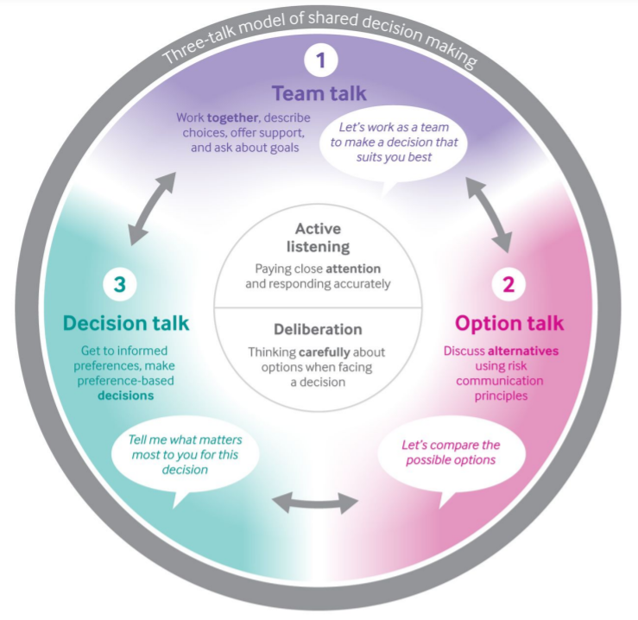
No decision about me without me
Shared decision making (SDM) is a joint process in which a healthcare professional works together with a person to reach a decision about care, based both on evidence and on the person’s individual preferences, beliefs and values.
The SDM approach to care recognises that both the healthcare professional and patient bring two different but complementary perspectives to the process.
It is important because when well informed people make choices about treatment/care it
  improves health outcomes and care experiences
  results in less unwanted interventions
  enhances the way resources are allocated
What do you need to do?
Involve residents in all decisions about the care they are receiving through discussion and information sharing.
This will ensure that the resident understands the risks, benefits and possible consequences of different options at different stages, including before, during and after discussions, so that they are fully involved throughout their care.
For more information please refer to the NICE shared decision making guideline.
There are tools/resources available to facilitate shared decision making discussions:
Three- talk model Elwyn G et al https://www.bmj.com/content/359/bmj.j4891
BRAN model https://www.choosingwisely.co.uk/wp-content/uploads/2020/11/CWUK_patient_leaflet_100120-1.pdf
NICE/Keele university online learning package to help develop the skills and knowledge to have conversations with people.
Version 12.0 11022022

Slide 49

Supporting eating and drinking
If you are concerned about a residents oral intake speak with their GP/healthcare professional. See the slide on recognising when residents become unwell
The impact of COVID-19 has affected eating and drinking for some residents – making it even more important to monitor food and fluid intake
If a resident has/ has had COVID-19 they may lose their sense of taste and smell and have reduced appetite
Isolation and a lack of sociable meal times can also affect how well people eat and drink
If residents are not eating and drinking enough this can lead to illness and infections, falls, reduced mobility and pressure sores.
Some people reduce their fluid intake due to incontinence but reduced fluid intake concentrates urine which irritates the bladder and makes incontinence and frequency worse.
Don’t forget about the importance of good oral health e.g. people with learning disabilities and people with conditions such as dementia and Parkinson’s disease are at greater risk of developing swallowing problems (dysphagia). The signs and symptoms of dysphagia are frequently missed. If you have notice that a resident displays any of the following: coughs/chokes when eating or drinking, brings food back, persistently drools, is unable to chew food or makes a ‘gurgly’ wet sounding voice when eating or drinking please notify their G.P. or lead health professional
Adding extra calories
Use a food first approach to add extra calories: (sugary food and drink should still be limited for residents with diabetes)
1 pint of fortified milk per day: 4 table spoons of dried skimmed milk power in 1 pint of full fat milk – use in porridge, mashed potato, milkshakes etc
High calorie snacks: Cheese and crackers, peanut butter toast, full fat yoghurt with fruit, crumpet with jam, homemade milkshakes etc
Add calories to meals: use full fat milk and butter, add cream to potatoes and puddings, add mayonnaise to sandwiches, grated cheese on meals, add olive oil to salads etc.
Reducing impact of isolation
Where able to (following infection control guidelines) continue residents eating together e.g. in smaller groups than usual maintaining distancing
Talk to residents about food to stimulate appetite, sit with them whilst they eat
Ask family members to bring in food they like – where non-perishable and external packaging can be wiped down - to maintain infection control
Relaxing music at mealtimes can sometimes help
Other tips
Some people loose taste sensations as they get older – you could try stronger flavours (herbs and spices), sweeter foods might be preferred
Little and often – offer snacks and drinks throughout the day. Some people improve intake with finger foods
Find out about food likes and dislikes
Ensure drinks are always in reach, moist soft food it easier to eat
Resources | MUST tool and resources | Managing malnutrition webinar
 | Hydration at home toolkit | Adding calories to meals ideas
Version 12.0 11022022

Slide 50
Vitamin D supplements
Care homes residents are at a higher risk of having low vitamin D.
This can lead to bone pain and muscle weakness, which may also increase the risk of falls in older people.
The best way to increase vitamin D intake is to spend time outdoors, as sunshine increases vitamin D levels in the body. Don’t forget to take residents outdoors, and that it can be good for their health!
The UK Health Security Agency recommends that care home residents should continue taking Vitamin D supplementation all year round.
A one-off 4-month free supply of Vitamin D to care/residential homes was prioritised by the DHSC in early 2021. This scheme has now finished. Therefore care homes are expected to arrange for further supplies to continue supporting appropriate residents to take Vitamin D supplements all year round.
The Vitamin D supplement should contain 10 micrograms or 400 International Units of vitamin D (also known as Vitamin D3 or cholecalciferol). Note that it is intended as a food supplement and not a prescribed medicine.
Please consider liquid forms to facilitate ease of administration for residents including those with swallowing difficulties e.g. Provitavit© drops.
These can be administered on a spoon or added to the resident’s food. Consult pharmacy / speech and language therapist if resident needs
thickened fluids, unable to take liquids, or has feeding tubes.
NOT ALL residents are suitable to receive the supplement - there are medical exclusions including medical diagnoses, allergies etc.
Think
Which of my residents should be receiving this?
Ask
Is the resident already taking Vitamin D supplementation? Make a record of this in resident’s care plan.
These will be documented on the residents’ MAR charts or medical care plans. Examples include:
  Cholecalciferol (D3)
  Ergocalciferol (D2)
  Alfacalcidol (D3)
  Alone or a combination of the above with calcium e.g. Accrete D3©, Adcal-D3©, Calceos©, Calcichew D3©
Is my resident taking any self-administered non-prescribed supplements which contain Vitamin D? Examples include:
  Multivitamin preparations
  Cod-liver or other fish oils
Version 12.0 11022022

Slide 51
Vitamin D supplements
Are there medical exclusions to taking the supplement?
Unless already communicated, check if any of the below listed medical conditions appear on the resident’s care plan or MAR:
  those under the care of a renal, endocrinology or cancer specialist
  people with high vitamin D levels
  people with kidney stones (now or in the past)
  people with too much parathyroid hormone (hyperparathyroidism)
  people with cancer (some cancers can lead to high calcium levels)
  people with severe kidney disease
  people with a rare illness called sarcoidosis
Does the patient have any documented allergies to the ingredients in the product?
Do
Check the resident’s suitability with the care homes pharmacist or GP routinely at the next scheduled check in.
Get consent from the resident or family.
Make a best interest decision with resident, family or Lasting Power of Attorney or make a best interest decision where resident consent is not possible.
Update the residents care plan to reflect if they will be taking the supplement.
This should be recorded on a relevant chart (this could include a MAR, daily notes, nutrition or dietary records) for residents who are to be given Vitamin D.
Please check with the care homes pharmacist or GP if you are unsure or unable to identify the information in the steps given from the residents’ care plan or MAR.
Resources
DHSC: Vitamin D and care homes guidance here
Covid-19 Rapid Guideline: Vitamin D. NICE guideline. here
Healthier and more sustainable catering: nutritional principles. UK Health Security Agency guideline. here
British Dietetic Association; Vitamin D: Food Fact Sheet here
NHS UK: How to get Vitamin D from sunlight. here
British Skin Foundation – sunlight and Vitamin D. here
London Care Homes Vitamin D Access and Implementation summary. here
Version 12.0 11022022

Slide 52
Recognising when residents become unwell
Whilst we all need to be vigilant for signs and symptoms of Covid-19 (slide), we know residents may also become unwell for other reasons, e.g. developing a urinary tract infection, becoming constipated or experiencing a fall. Early identification is important to get residents the right care (taking into account any agreed end of life care plans).
Consider using a soft signs tool to spot if a resident is at risk of or becoming unwell (e.g. Restore2, Is my resident well or Significant 7, training is required). This enables staff to compare what is usual for their residents with things like mobility, bladder and bowel habits, breathing patterns with what they are seeing in front of them. Noticing a change in residents might mean they are unwell or becoming unwell.
If you aren’t working with a specific tool it maybe useful for staff to look for changes in:
Changes in appetite, sleep patterns, levels of confusion, bladder and bowel habits, energy levels, mobility, as well as reduction in fluid intake, dry lips, evidence of shivering, feeling very hot or cold.
Once a change is recognised staff need to escalate their concerns. Some areas may have pathways associated with specific teams or services to support them, whilst others may discuss with a senior member of staff before taking further action. If staff are able to take physiological observations from the resident (e.g. blood pressure, temperature) this may be useful. Using a structured communication tool such as SBARD (Situation, Background, Assessment, Recommendation, Decision) can help staff and the person receiving the information understand the nature and urgency of response required.
Think
How is my resident today?
Any changes in their soft signs?
Are they unwell or at risk of becoming unwell?
Ask
How does what I have found today compare to what is usual or normal for the resident?
What do I need to do next with this information?
Do
Follow the relevant pathway if one is available, otherwise discuss with a more senior member of staff, call the GP or 111 *6 (see slide 4 in this pack for further information)
In an emergency call 999.
Resources
Restore 2 and Restore 2 Mini
Significant Care and Significant 7+
Is My Resident well? tool and training videos
Health Education England videos - a wide range of short training videos including how to recognise when a resident is becoming unwell, how to measure someone’s temperature, blood pressure and more.
Short video on SBARD
Improving care for deteriorating patients
Patient safety resources for care homes
Version 12.0 11022022

Slide 53
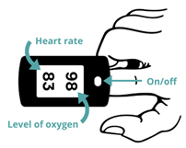
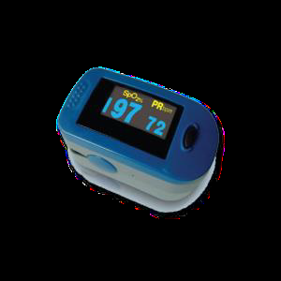
Checking residents oxygen levels- Pulse Oximetry
Pulse oximeters are being used in care homes/supported living services during the current COVID-19 pandemic. You may be asked to check residents oxygen levels. Your GP or practice nurse will tell you who and when to check and how to monitor and record or report results
Preparation
Explain to your resident that you are going to use a pulse oximeter and
prepare them appropriately
Remove any nail varnish or false nail on one finger
Wash resident’s hands with water or use antiseptic wipe and use a warm hand as cold can affect the reading
Get a pen and paper to write down to write down the numbers
How to use a Pulse Oximeter
1. Rest the resident’s hand flat on their leg, a table or arm of a chair
with nails facing upwards
2. Place the finger into the Pulse Oximeter
3. Press the button so the screen lights up
4. Keep the Pulse Oximeter on the finger for at least 30 seconds and continue for
up to 60 seconds until reading is stable.
5. Write both numbers down
Recording
Please record;
Date
Time
Oxygen level
Heart rate
****Consider whether the resident already has a pre-existing condition that may impact their oxygen levels. Do you know what oxygen saturation level is normal for your resident?****
Monitoring and escalation
Normal blood oxygen level for most people is between 95-100% – continue to check blood oxygen level as directed by GP or Practice Nurse
If 2 successive readings show blood oxygen levels between 93-94% OR continues to be lower than the resident’s usual reading where their normal oxygen saturation is below 95%; contact NHS 111 or the GP as soon as possible.
If 2 successive readings show blood oxygen levels of 92% or less; you must immediately seek advice from GP or NHS 111 as the resident may need to immediately attend the nearest A&E department.
Provide the recorded details to the appropriate healthcare professional as requested
Further information can be found here:
Important information to keep you safe while isolating at home
How to measure oxygen saturations using a pulse oximeter
Managing deterioration videos
Easy read resource on oximeters
Use of Pulse Oximeters as good practice
Care home staff can use Pulse Oximeters to measure blood oxygen saturation levels in residents who have become breathless, more unwell, confused or showing changes in behaviour. The measurements can be helpful to clinicians as part of a more holistic assessment
Check their oxygen levels and heart rate. Raise any concerns as per the above guidance.
Cleaning of Pulse Oximeters
To maintain good infection control practices, the Pulse Oximeter must cleaned with an antiseptic wipe after each use on a different resident.
Oxygen level
Heart rate
Version 12.0 11022022

Slide 54

Supporting residents with learning disabilities
People with learning disabilities may be at greater risk of infection because of other health conditions or routines and/or behaviours. It is important that staff are aware of the risks to each person and reduce them as much as possible.
Supporting patients of all ages who are unwell with coronavirus (COVID-19) in mental health, learning disability, autism, dementia, and specialist inpatient facilities.
This will mean significant changes to the persons care and support which will require an update in their care plan. If the resident needs to exercise or access the community as part of their care plan, it is important to manage the risk and support them to remain as safe as possible.
You may need help or remind the resident to wash their hands:
  Use signs in bathrooms as a reminder
  Demonstrate hand washing
  Alcohol-based hand sanitizer can be a quick alternative if they are unable to get to a sink or wash their hands easily.
Residents that are high risk and were subject shielding, will still need to take appropriate precautions to prevent contracting the coronavirus.
To minimise the risk to people if they need access health care services you should use supportive tools as much as possible such as a hospital passport and/or coordinate my care.
If you are aware that someone is being admitted to hospital, contact your local community learning disability service (click here) or learning disability nurse within the hospital.
Think (Consider using the STOP and Watch Tool)
Is something different? Is the person communicating less, needing more help than usual, expressing agitation or pain (moving more or less), how is their appetite
Does the person need extra help to remain safe and protected?
Ask
How can we engage the person to ensure that they understand the change in activities.
Do
Allow time to remind the person why routines may have changed.
Develop new care plans with the person and their family
Resources
Mental health, learning disabilities and autism: Covid-19 Guidance
Easy Read Posters regarding Covid 19
End of Life Care: guidance
MCA and DoLS COVID 19 guidance and summary
Tool to support monitoring for signs of deterioration STOP and WATCH
Hospital Passport
Hospital Visiting Guidance
Protecting extremely vulnerable people: Government guidance
SCIE COVID-19 Care staff supporting adults with learning disabilities or autistic adults: Guide
Leaflets and Pamphlets
Easy Read COVID resources and LD Coronavirus Resources
Version 12.0 11022022
Notes:
No changes

Slide 55

Supporting residents with dementia
There will be a significant change in routine for people living with dementia.
People may behave in ways that are difficult to manage such as walking with purpose (wandering). Behaviour is a form of communication, often driven by need. Someone could be hungry, in pain or constipated, they might be scared or bored. Ask someone walking if there is something that they need, try activities they like with them and if possible go for a walk with them.
Some people ask to go home – this is often because people want to feel safe and secure. Talking about family that they are missing and looking at photographs can help.
People might find personal care frightening (it might seem like they are aggressive). Giving them time to understand, showing them the towel and cloth, encouraging them to do what they can and keeping them covered as much as possible can help.
People with dementia may need help or reminders to wash their hands. Use signs in bathrooms as a reminder and demonstrate hand washing. Alcohol-based hand sanitizer can be a quick alternative if they cannot get to a sink or wash their hands easily but remember to store this safely as per your local policy to avoid ingestion.
People may find being approached by someone wearing PPE frightening - It may be helpful to laminate your name and a picture of your role and a smiley face.
People may find having a COVID swab frightening – see the Swabbing residents- top tips slide for practical information and information on capacity
If people with dementia become unwell they might get more confused, agitated or more sleepy (delirium). See the Supporting residents who are more confused than normal page for further information.
Think
Is my resident unwell or frightened?
Does my resident need extra help to remain safe and protected?
Ask
Have I done all I can to understand my resident’s needs?
What activities does my resident like to do?
Do
Introduce yourself and explain why you are wearing PPE
Allow time to remind residents why routines may have changed
Resources
Meeting the needs of people with dementia in care homes video
Walking with purpose guide for local adaptation
PPE- Reducing anxiety for residents with dementia
Communication cards - can help to talk about COVID-19
HIN activities resource people with dementia during COVID-1
Mental Capacity Act and Deprivation of Liberty Safeguards (DoLs) COVID 19 guidance and summary
British Geriatric Society short guide dementia and COVID-19
Social care dementia in care homes COVID-19 advice
Nutrition and dementia care toolkit
Dementia well pathway adapted for COVID-19
Version 12.0 11022022

Slide 56

Supporting residents who are more confused than normal
Delirium is a sudden change or worsening of mental state and behaviour. It can cause confusion, poor concentration, sleepiness, memory loss, paranoia, agitation and reduced appetite and mobility.
There are two types of delirium: Hypoactive – where someone is more sleepy Hyperactive – where someone is more agitated
COVID-19 can cause both types of delirium – it might be the only symptom. Delirium can also be caused by infections, hospital admissions, constipation dehydration and medications.
You can help to prevent delirium by:
Stimulating the mind e.g. listening to music and doing puzzles
Physical activity, exercise and sleeping well
Ensure hearing aids and glasses are worn
Ensuring plenty of fluids and eating well
Addressing issues such as pain and constipation
If you are concerned that a resident has delirium speak with their GP or call 111*6 who can try and identify the cause. Delirium in people with learning disabilities may indicate a deterioration in their physical or mental health - contact the individuals lead contact
Reducing noise and distractions, explaining who you are and your role and providing reassurance can help.
Think
What can I do to help prevent my resident becoming more confused than normal?
Has my resident changed – are they more confused? Has their behaviour changed?
What can I do to support my resident who is more confused then normal?
Ask
The residents GP or call 111*6 for advice and guidance
Why is my resident more confused then usual?
Do
Explain who you are and why you are wearing PPE
Provide reassurance
Add information on preventing new confusion to resident care plans
Resources
Delirium prevention poster
Delirium awareness video
Delirium and dementia video
Version 12.0 11022022

Slide 57
Managing falls
Think
Is an emergency ambulance required?
Ask
Contact your GP, community team or 111*6 for advice and support
Follow advice on NHS website on when to ring 999
Do
Use assessment and observation to monitor for deterioration or injury in the hours following a fall
Review medications as part of falls risk assessments
If available and safe use appropriate lifting equipment
If it is unsafe to move someone who has had a fall keep them warm and reassure them until the ambulance arrives
Ensure you have up to date moving and handling training
Continue to implement existing falls prevention measures
Prevention is better than cure and continuing to implement falls prevention interventions such as strength and balance exercises is important – see the exercise and moving slide
To help prevent falls:
Complete your local falls assessment and care plan
Keep call bell and walking aid in reach of residents
Ensure residents’ shoes fit well and are fastened and clothing is not dragging on the floor
Optimise environment – reduce clutter, clear signage and good lighting
Ensure the resident is wearing their glasses and hearing aids
Ask for a medication review (see pharmacy slide)
Residents do not need to go to hospital if they appear uninjured, are well and are no different from their usual self. People with learning disabilities or dementia may not be able to communicate if they are in pain or injured following a fall - take this into account when deciding on whether or not to go to hospital.
Going to hospital can be distressing for some residents. Refer to their advance care plan to make sure their wishes are considered and take advice e.g. from GP or 111*6. Ring 999 when someone is seriously ill or injured and their life is at risk.
Whilst waiting for an ambulance, keep resident as comfortable as possible. Offer a drink to avoid dehydration and painkillers such as paracetamol to ease discomfort - tell the ambulance staff what you have given the resident.
Resources – prevention
REACT to falls resource videos. Available as an app - Apple & Android
Greenfinches – Falls Prevention Resources
Free staff Frailty e-learning programme
Resources – falls
Falls in care homes management poster
I STUMBLE falls assessment tool which is available as an app
What to do if you have a fall
Resources – falls videos
Assisting someone who is uninjured up from the floor: Link
Using slide sheets in a confined space: Link
Using a hoist to move from floor to bed: Link
HSE - Moving and handling in health and social care
Version 12.0 11022022

Slide 58

Preventing pressure ulcers
Pressure ulcers also known as “bed sores” are a key indicator of the quality and experience of patient care.
They can be extremely painful and can range from slight discolouration on the skin which disappears when pressure is relieved to deep painful wounds which can become infected and cause people to become extremely unwell.
They most commonly occur over bony prominences e.g. sacrum, heels and hips where there is pressure for a period of time or friction/ shear or where devices such as a catheter are trapped/ pressed against the skin on a number of parts of the body.
They are largely preventable with a few simple strategies which should be in place for all residents/ patients.
Involve patients/ residents and their carers in the prevention of pressure ulcers by providing information about what to do such as changing position regularly. But healthcare professionals remain responsible for the provision of care.
There are simple steps which should be followed to help prevent pressure ulcers for all residents/ patients.
Think: about aSSKINg the right questions about preventing pressure ulcers
Assess risk: Use a validated risk assessment tool within 6 hours of admission to the home and ensure that it is reviewed regularly to understand the level of risk that the patients/ resident may have e.g. Waterlow, and Purpose T. This will help to determine what actions need to be taken.
Skin inspection and care: Regularly look at areas where pressure ulcers can occur, the frequency dependent on the level of risk. Early Inspection means early detection, tell residents/patients and carers what to look for. Ask them to tell you if they have any areas that are painful. Ensure that the skin is clean and dry.
Surface selection and use: Make sure patients/ residents have the right support in terms of equipment they are using. Select the right equipment based on the risk assessment , what will the patients/ resident need ? Remember to consider pressure relief in a chair as well as the bed. This will help relieve pressure.
Keep moving: Keep patients/ residents moving through changing position e.g. getting up and out of bed, going for a short walk, exercise.
Incontinence and increased moisture: Patients/ residents need to be clean and dry, make sure they are supported to access the toilet at a time which meet their needs. Use creams if skin gets dry. If they are regularly incontinent use barrier creams or wipes which clean to protect the skin.
Nutrition and hydration: Help patients/ residents have the right diet and plenty of fluids. Encourage them to drink each hour and give them food/ snacks which they can reach and give themselves. If they need assistance provide this as required.
give information: Provide residents/ patients with information about how to prevent pressure ulcer damage
Ask
Patients/ residents if they feel sore anywhere , if they have moved what would they like to do in terms of how they are positioned.
Is there any other equipment which I should be providing or checking?
When did they last eat and drink do they need help to eat and drink? What would they like to eat?
If devices are properly secured and not trapped underneath the body
Do
Ensure a risk assessment has been carried out and is up to date
Explain why changing position is important , check that information given is clear.
Access training to help your understanding if you are not sure
Have a Pressure Ulcer Policy that all staff can access
Know how to obtain and use equipment to help prevent pressure ulcers
Resources
https://nhs.stopthepressure.co.uk/
http://www.reacttoredskin.co.uk/
Pressure ulcer prevention
NICE-helping to prevent pressure ulcers
Think #Stopthepressure #aSSKINg
Version 12.0 11022022

Slide 59
Managing lower limb wounds
Leg and foot ulcers (wounds that fail to heal within a few weeks) and cellulitis is common in older, less mobile people with poor blood circulation, diabetes, chronic oedema or other chronic long term conditions that may cause skin healing problems.
Most leg and foot ulcers are due to poor circulation and can be healed if people receive an accurate diagnosis and appropriate treatment. Treating the underlying cause of non-healing will help prevent a wound on the lower leg or foot becoming an ulcer.
To help prevent lower limb wounds and cellulitis:
Avoid injuries
Regularly apply moisturiser to maintain the skin’s elasticity
Regularly check the skin on legs and feet to spot early signs of damage.
Prevent/ manage lower limb oedema with elevation/ compression therapy.
If elevating, raise the legs to at least level with the heart and avoid pressure on the heels.
To help prevent lower limb wounds becoming an ulcer:
For leg wounds, request an assessment from a clinician with expertise in leg and foot ulcer management. The assessment should be completed within 14 days.
For foot wounds, refer the person within 1 working day to the multidisciplinary foot care service or foot protection service.
Treatment for wounds on the leg will normally include:
A dressing which will need changing a least weekly, but sometimes more often if the wound is leaking a lot of fluid (exudate).
When there is an adequate blood supply, support or compression bandaging or hosiery to improve blood return. This bandaging/ hosiery is a very important part of care.
Treatment for cellulitis will normally include:
Antibiotic therapy
Treatment for wounds on the foot will normally include:
Regular dressing changes depending on the levels of exudate, offloading (removing pressure from the foot), and maybe debridement which should only be undertaken by a clinician with appropriate skills (e.g. podiatrist)
Management of any underlying conditions e.g. diabetes.
Think
Does this person need more care to protect their skin from injury or breakdown?
Do we have an up to date leg and foot ulcer policy?
What are our local services to refer to for leg and foot assessments?
Ask
Has this person with a lower limb wound been referred for a leg or foot assessment?
Has this person got lower limb oedema, and if so, would they benefit from compression therapy?
Has this person received a leg or foot assessment within 2 weeks of their wound occurring?
Is this person receiving the care that has been recommended?
Do
Contact your local service responsible for undertaking leg or foot ulcer assessments.
  Assessment should include a vascular assessment (usually using a Doppler)
  Foot wounds should also be assessed for neuropathy/ sensation.
Make sure that the recommended care is carried out. If this is difficult, ask for help and advice.
Resources
NHS England and Improvement: The Framework for Enhanced
Health in Care Homes
National Wound Care Strategy Programme: COVID-19 resources
Legs Matter: Resources for health care professionals, carers and patients
Accelerate CIC: Coronavirus (COVID-19) resources
Version 12.0 11022022

Slide 60
Identifying and Managing Depression in residents
Depression and anxiety are common and are not a normal part of growing old. Anxiety symptoms are frequently due to underlying depression in older people.
Problems with mental health can be hard to separate from normal everyday stresses and existing health conditions but it is important to identify warning signs such as poor sleep, reduced appetite or altered mood.
People living with long term conditions and chronic pain may be more likely to develop depression. Changes in day to day life and reduced contact with family and friends due to Covid restrictions may trigger or worsen anxiety, low mood and depression
Those with learning disabilities or dementia are more likely than the general population to experience a mental health issue such as depression and may find it difficult to communicate how they are feeling.
Depression is a treatable condition which can respond to lifestyle measures such as healthy diet, physical activity, reduced alcohol intake and increased social activity
People may also benefit from talking therapy or medication.
NHS talking therapy services (often referred to as IAPT) accept self referrals and you can find your local service here
Think
Has my resident's mood been noticeably different for more than 2 weeks?
Has their sleep pattern (waking early in the morning ) or appetite altered?
Have they shown less interest in their appearance and reduced enjoyment in activities that they previously enjoyed ?
Are they more anxious ?
Have they expressed any suicidal thoughts or wishes to be dead?
Have other people also noticed a change?
Ask the resident
During the last month have you been bothered by feeling down, depressed or hopeless?
During the last month have you often been bothered by having little interest or pleasure in doing things?
If the answer is yes to either question ask more about their mood as they could be depressed
Do
Talk to residents about how they are feeling and use “easy read” information to support discussions
Support the person to engage in distraction techniques such as gentle exercise, singing, art, games, music etc.
In particular help residents keep in touch with family and those close to them
Look at options for talking therapies
Mention your concerns to the GP or health care team as part of the regular care home “check ins”
Monitor any changes in mood or behaviour.
Resources
Mental health advice for older people
Depression in older adults
Feeling Down: Looking After My Mental Health easy read
Version 12.0 11022022

Slide 61
Supporting residents’ health and wellbeing
Your role is important in helping people in your care to enjoy their daily life and take a full part in it as much as they can and is possible. When choosing activities it is important to take in to account the likes and preferences of residents.
The Health Innovation Network (HIN) has produced an activities guide which collates a number of activities which are free to use and dementia friendly: activities on tablets, access to online newspapers and magazines, physical activity, film, music and TV and livestreams. The guide can be found here
Some residents may have lost friends that they lived with, care staff or family. At a Loss recommends speaking to the bereaved or offering help, listening (ask, don’t give solutions), showering them with good things, ensuring others do too, and keeping it up.
Cruse also recommends ways to support someone who is grieving. Be honest. Acknowledge the news by sharing your condolences, saying how sorry you are that their friend or relative has died. Share your thoughts about the person who died (if appropriate), tell your friend or relative how much the person will be missed and that you are thinking of them. Remind them that you are there for them, as much as you can be.
Think
How it can feel when you have nothing to do all day or no one to talk to?
How can I engage my resident in activities they like and enjoy?
How can I enable and support residents to make video calls?
Have you considered the spiritual needs of residents?
Ask
“What do you enjoy?” “what do you like to do?”
Family members about their loved ones preferences
Check the care plan to learn more about residents’ family and social history
Can the Local Authority and CCG support us?
Do
Refer to existing material such as the HIN’s activity guide
Use the NHS live well resources
Make activities fun and engaging
Resources
Physical activity for adults and older adults poster
Faith Action – advice and resources
Managing activities for older adults during COVID-19 (HIN) link
NHS Live Well link
Relatives & Residents Association helpline
At a Loss tips to help someone bereaved at this time here
Cruse – what to say when someone is grieving here.
Death & Grieving in Care Homes during COVID-19: Guidance
Mencap Keeping Busy During COVID -19
Version 12.0 11022022

Slide 62

Supporting residents to exercise and get moving
Exercise and physical activity help residents to keep moving and prevent falls. It can also improve mood and wellbeing, prevent constipation, pressure sores, reduce weight gain and improve sleep.
Some people don’t like exercise. Activities such as gardening and walking are also great activities for those who don’t enjoy exercise. Maintaining a routine is key
Simple things can help residents move more such as
Walking to the dining room for meals and laying the table
Sorting laundry
Going outside to feed the birds
If someone is isolating in their room it is really important to encourage physical activity. This can be as simple as practicing standing up and sitting down again or chair based exercises.
Residents who have had coronavirus or other illness may take some time to build up the amount of activity they can do. Healthcare professionals such as physiotherapists and occupational therapists can help – ask at your ‘weekly check in’
People with learning disabilities are at increased risk of being overweight or obese compared to the general population. A balanced diet and keeping active can help reduce obesity levels.
Slight soreness in muscles the day after exercise is common. If you are concerned a resident doesn’t look well or is in pain during physical activities – stop and get advice from your resident’s physiotherapist or GP.
Think
Some physical activity is always better then none
How can we help our residents to sit less and move more
What group activities can we do whilst maintaining social distancing, for example group chair exercises
Ask
Residents what physical activities they enjoy or used to enjoy
If you have an activities coordinator ask for their advice
Do
Include exercise/ physical activity in resident care plans
Check you resident is wearing supportive, well fitting shoes for exercise
If using a support for standing exercises use a sturdy chair or wall rail
Discuss with residents’ GP if you have any concerns
Resources
Simple set of exercises to stay active from the Chartered Society of Physiotherapists - video and a poster
Later life training you tube exercises including chair based exercises
Age UK exercise at home information
Royal College of Occupational Therapists living well in care homes
Mencap Sport
Version 12.0 11022022
Notes:
Updated resources

Slide 63
Supporting residents’ Spiritual needs
Think
How well do we assess the spiritual needs of individual residents?
How well do we provide spiritual care?
How aware are staff of different religious, spiritual and cultural identities, customs and priorities?
Do they require support/ training to be more aware?
Ask residents
“Do you consider yourself spiritual or religious?”
What matters to you?
Would you like to receive spiritual support in any way?
Is there any religious or spiritual ritual that you need support with?
Would you like to discuss you spiritual needs with a professional?
Would you like to stay in touch with your faith community in any possible way?
Would you like to share any religious traditions or rituals with other residents?
Do you want to see a spiritual / religious leader?
Do
Utilise to existing services
Use the resources
Use a care plan to record spiritual needs for end of life care
The majority of people, whether religious or not, need support systems in their life, especially in times of crisis. Many patients, carers and staff, especially those confronting serious or life threatening illness or injury, will have spiritual needs and will welcome spiritual care.
Those who have no such religious associations may still benefit from spiritual care, a skilled and sensitive listener who has time to be with them, and someone to connect them to any cultural reference points that bring them comfort and meaning.
consider whether spiritual care is provided to residents, carers and staff in ways that are responsive to their needs;
discuss how arrangements are made for the spiritual care of those who belong to smaller faith communities;
promote a close working partnership between your services and local faith communities on the provision of spiritual care services. If you are not sure how to access support from smaller communities, try asking local authority contacts or local community and voluntary sector networks if they are aware of a local community;
proactively use the networks forged by the spiritual care teams (if you have them) to advise and comment on other aspects of your local policy; and
ensure that the cultural and spiritual needs of individuals and family groups from ethnic minority faith communities are met, and that any necessary language support is provided.
Resources
Faith Action – advice and resources
https://network-health.org.uk/index.php/about/about-us-detl
https://www.england.nhs.uk/chaplaincy/
Secular chaplaincy - https://www.secularism.org.uk/chaplaincy/
http://faithsforum.com/contact-us/
For people with a learning disability https://www.learningdisabilities.org.uk/learning-disabilities/publications/religious-expression-fundamental-human-right
Version 12.0 11022022

Slide 64

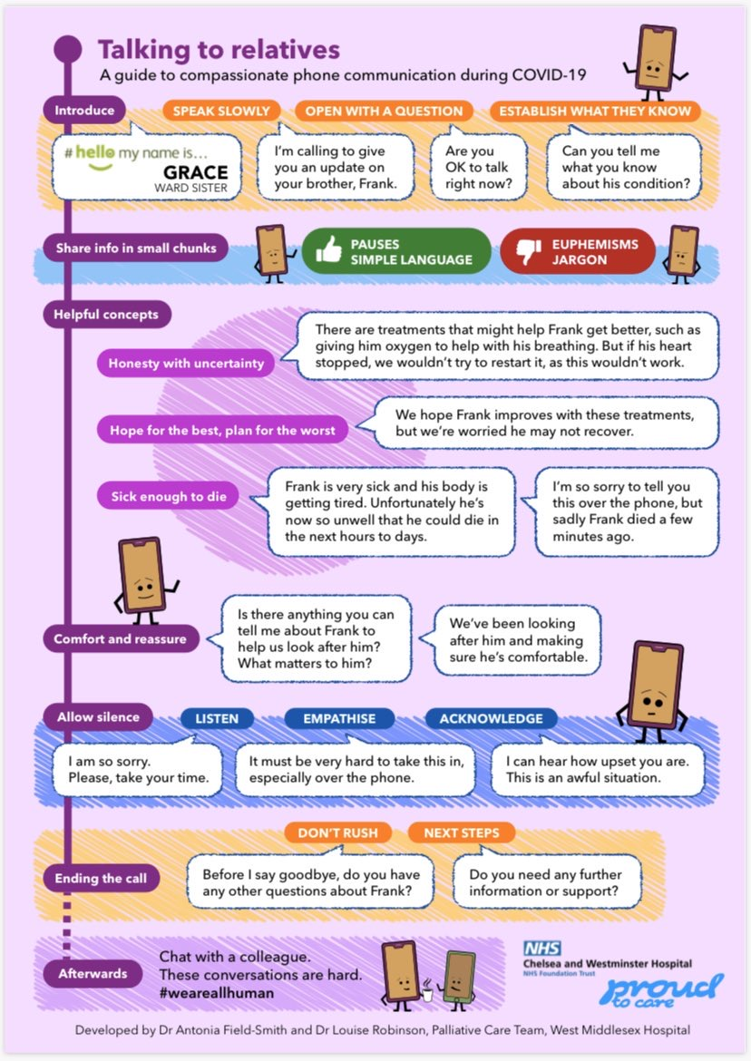
Talking to relatives
Conversations with relatives about COVID-19 can be challenging.
Think
What information do I need to tell the relative
How can I keep the language simple
Ask
If the relative is ok to talk
What the relative already understands about their loved one
If they have any questions or need any other advice or support
Do
Introduce yourself
Comfort and reassure
Allow for silence
Talk to colleagues afterwards
Resources
Real Talk evidence based advice about difficult conversations
VitalTalk COVID communication guide
Health Education England materials and films to support staff through difficult conversations arising from COVID-19.
Version 12.0 11022022

Slide 65

Pharmacy and medicines
Think
Which patients require an urgent medicines review as a priority? They could include:
Residents recently discharged from hospital
New residents
Residents with COVID-19 symptoms
Residents with acute illness that may need changes to medicines (e.g. due to renal impairment)
Residents at end of life
Residents in high-risk clinical groups (e.g. renal dysfunction, high risk medicines including insulin, anticoagulants and lithium, and falls risk).
Other residents that may need a medicines review:
Residents with a long-term respiratory condition
Residents with a learning disability, autism or dementia presenting with early indicators of deterioration such as mood or behaviour changes
Residents deemed to be at an increased risk of adverse medicine-related effects e.g. those on multiple medicines
Ask
Does the resident need a review from a pharmacy professional?
Is this a medicines supply issue?
What is the advice from my local pharmacy team and how do I contact them?
Could your medication ordering be set up electronically (if it isn’t already)? For example, could proxy ordering be set up? Your local GP practice will be able to help with this.
Do
Check and familiarise yourself with your local pharmacy team. Different members of the team will be providing different aspects of the service, working collectively as part of local MDTs.
Check that you have contact details at hand for the local care homes lead pharmacist.
Contact your usual community pharmacy for supply issues and urgent medicines requests.
General practice, care homes and CCG pharmacists and pharmacy technicians, supported by specialist community health services pharmacists, hospital pharmacists, and community pharmacy, are all working together in multidisciplinary primary and community care teams to support care homes across London.
In general, pharmacy professionals across the system within the borough will be working together to support care homes with:
Medicines reviews for new residents or those recently discharged from hospital
Structured medication reviews, via video or telephone consultation
Support for care homes with medication-related queries
Facilitating medication supply to care homes, including end of life medication
Participation in MDTs, as appropriate, to support medicines optimisation
Useful Resources
https://bnf.nice.org.uk/ (British National Formulary)
https://www.cqc.org.uk/guidance-providers/adult-social-care/controlled-drugs-stock-care-homes (Controlled Drugs in care homes)
https://www.sps.nhs.uk/articles/pharmacy-and-medicines-support-to-care-homes-urgent-system-wide-delivery-model/ (overview of pharmacy model)
How to stop over-medication: Tips for working with people with learning disabilities, autism or both
NICE guideline: Managing medicines in care homes Overview | Managing medicines in care homes | Guidance | NICE
Version 12.0 11022022

Slide 66

Working with primary care and community services
Think
Do we need to discuss new ways of working with our GPs and community services staff?
How do we support remote consultations and video links? E.g. access to laptops, tablets, internet access, means for video meetings etc.
How can we communicate in the most effective way to support our residents?
What help do we need to keep our residents safe?
Can you refer to an Urgent Community Response service for a 2 hour response, where this is more appropriate than calling an ambulance?
Ask
Which new ways of working with GPs and community services staff will be the most effective?
Are we prepared for weekly “Check ins” with our Primary care team (see next slide)?
Which service should I contact to support my residents and care home staff?
Can we work together to support proactive planning and Advance Care Plans for residents?
Your local community provider for referral details for your local Urgent Community Response service, or check them on MiDoS. Or if you’re not sure if referral to UCR is right, call 111 * 6 to check with a clinician
Do
Start using NHS mail - if you need help with this please email
Ask for help when you need it
Learn to communicate effectively using tools such as SBARD or other locally approved tools
Be clear about what support you can expect from your primary care and community services
It is important we work more closely than ever with our colleagues who provide care in the community, as well as GPs. Here are some checkpoints you should consider when working with primary care and the wider multi-disciplinary team:
Are all residents registered with a GP?
Are contact details (including bypass numbers) correct for GP, District nurse, pharmacist, hospice and other local services?
Are all care plans complete and updated regularly with primary care team input?
Are Advance Care Plans in place for all residents and shared on CMC? If not, can we help our primary care teams achieve this?
Have we identified any residents who are especially ‘at risk’ from COVID-19 and implemented plans to ‘shield’ them?
Are we ready and able to communicate with our primary care team by video link?
Keep a record of non urgent concerns and queries to discuss with your primary care team when convenient
Resources
Primary Care and community health support to care homes: letter
Version 12.0 11022022

Slide 67
Support from primary care and community services
Shielding in care home settings:
Thanks predominantly to the success of the Covid-19 vaccine, and improved treatments against Covid-19, the shielding programme for people considered clinically extremely vulnerable has ended, meaning that clinical check-ins and appointments no longer need to be virtual, although in some cases this may continue.
Check-ins:
Weekly “check-ins” will be carried out by GPs or other members of the primary care team for residents identified as a clinical priority, in CQC registered homes. These may either be virtual or face to face.
As at October 2021, care homes should have a nominated care home clinical lead and this can be a lead GP/GPs or any clinician who is a senior member of the primary care team.
The healthcare team (multi-disciplinary team/MDT) supporting your care home will work on a process to support development of personalised and individually agreed care plans including treatment escalation plans for residents reflecting their needs and wishes.
Your home should have direct support from primary care. For example, support could be from GPs, wider MDT, pharmacists, community nurses, geriatricians, community palliative care teams and a variety of other health care professionals, which may vary according to local provision.
Primary care pharmacists may be able to provide advice and support regarding medication for residents. This may include administration, provision and storage of medication, as well as medicine use reviews for residents.
Technical support will be needed to enable homes and the wider MDT to help deliver care, including Microsoft Teams, video conferencing etc (See next slide) where appropriate, or deemed best.
Access to equipment will be helpful in some care home settings, for example, via remote monitoring using pulse oximetry to test oxygen levels, as well as other equipment.
Version 12.0 11022022

Slide 68

Advance Care Planning (ACP)
Advance care planning offers people the opportunity to plan their future care and support, including medical treatment.
Conversations around end of life are challenging, particularly in these difficult times.
Open and sympathetic communication with residents and those important to them enables care wishes to be expressed. It is important that people do not feel pressurised in to such conversations and decisions before they are ready.
Conversations around end of life care should always be individualised. A blanket policy of advance care planning or do not attempt resuscitation is never appropriate.
Advance care planning discussions should be documented on London Urgent Care Plan (formerly known as CMC) so that urgent care services can view the persons wishes. See the Coordinate My Care slide for more information
Think
Does the resident have an ACP care plan which could be put onto London Urgent Care Plan?
If not, could the resident be supported with advance care planning and completing a Urgent Care Plan
Ask
The resident if they would like to talk about their wishes and preferences - involve those who matter to them in conversations
The resident if their advance care planning discussions can be shared through a Urgent Care Plan
Do
Assist clinicians in creating Urgent Care Plans from existing advance care plans
Have ACP discussions with new residents and their loved ones when they are admitted.
Resources
NICE quick guide for care homes on advance care planning
End of Life Care: Support during COVID-19: Guide
NICE quick guide: Advanced care planning https://www.nice.org.uk/about/nice-communities/social-care/quick-guides/advance-care-planning
Version 12.0 11022022

Slide 69
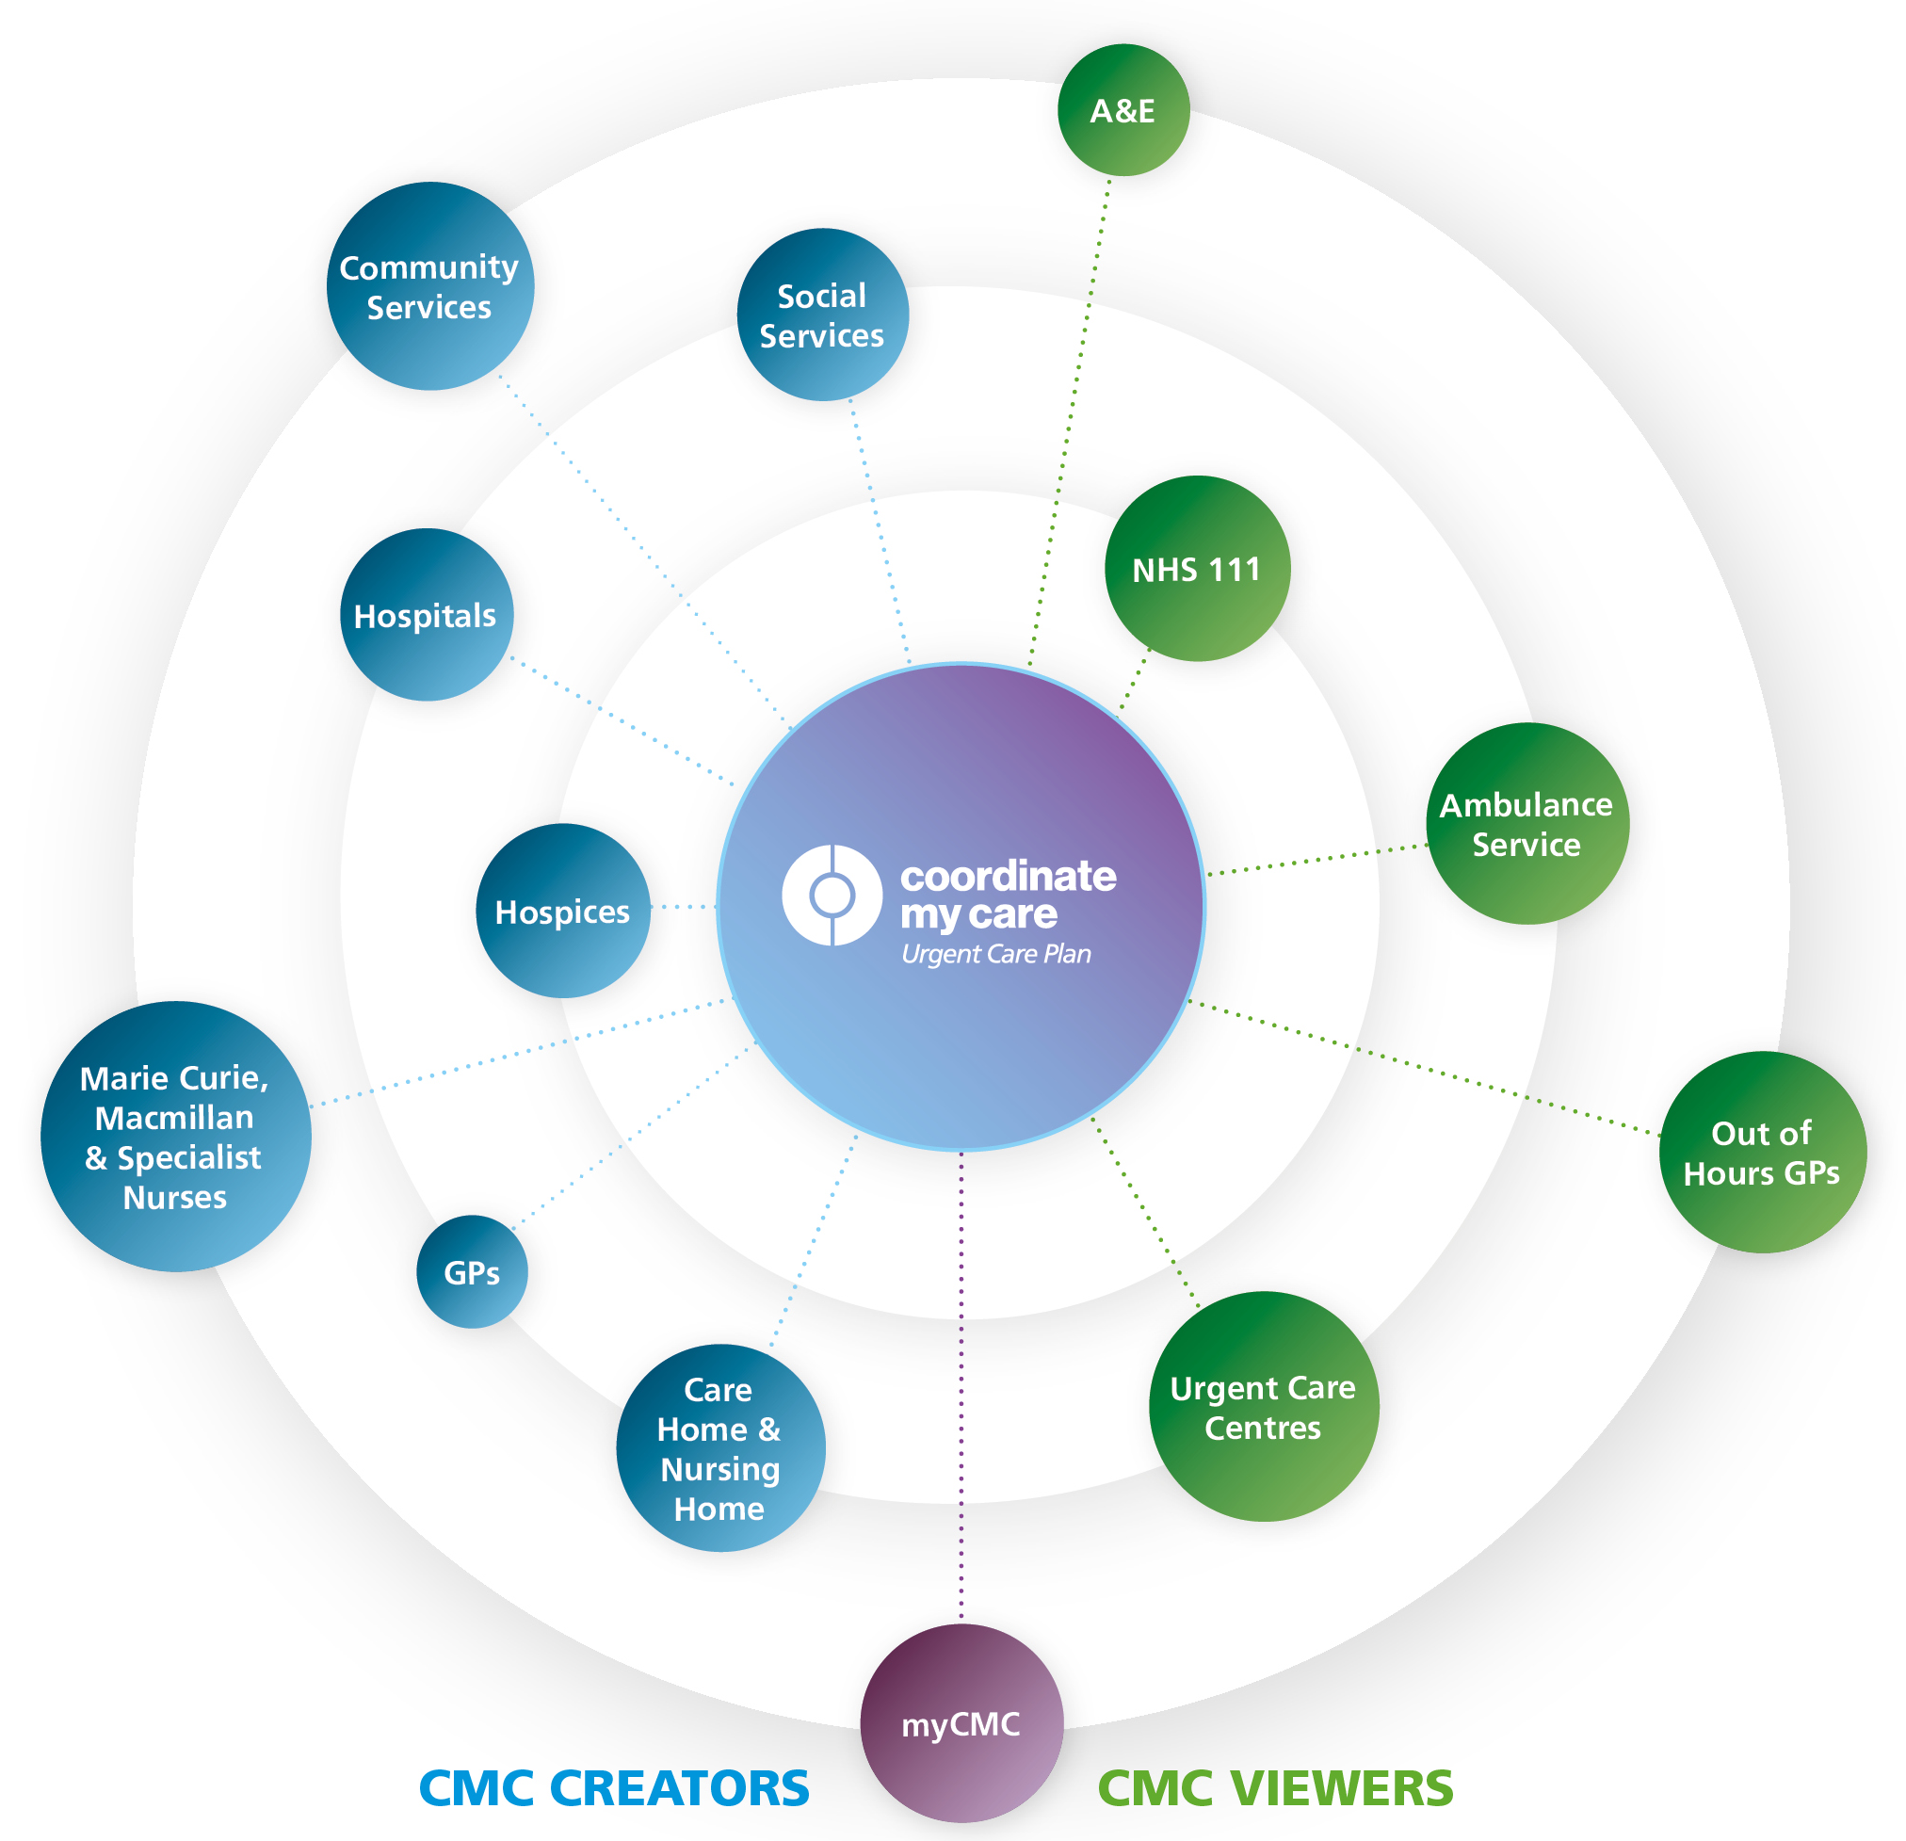
More information about CMC
What is CMC?
Coordinate My Care (CMC) is a digital urgent and advance care planning tool. CMC care plans include patient diagnoses, medical details, resuscitation status, medications and recommendations for the urgent care services to follow in an emergency. CMC care plans also include information about patient’s preferences and wishes in an urgent care situation, include their preferred place of death.
Once the CMC plan is approved by a clinician, it is immediately visible to all the urgent care services including 111, out of hours GPs, the ambulance (in their vehicles) and the emergency departments. This way everyone is in the loop with the patient in the middle.
What are the benefits of using a digital advance/urgent care plan?
Benefits for your residents
Your residents’ wishes are known and prioritised by all healthcare staff. As care home staff, you know your residents better than anyone else and are best placed to capture this information.
Reassurance for your residents that their preferences are documented and visible to all health and care services.
Reduces delays in treatment when paramedics have already read information about your resident.
Your residents can be treated at home if this is what they have expressed.
Benefits for your staff and care home
A digital care plan ensures that everyone has access to the same, up to date information.
There is no need to print documents about your residents in an urgent care situation;
Urgent care services will already have access to information that you have entered.
Paramedics and ED staff can update information about your resident. This information will be immediately visible to you.
Reduces LAS call-outs and conveyances which can be stressful for your resident and your staff.
There is going to be a change of provider for Advanced Medical Care Plans from April 2022. Existing plans will be transferred automatically, so we encourage care homes to continue to use CMC for now, and will provide more information when we have it about the new provider and the transfer.
Version 12.0 11022022

Slide 70
How can we get access to CMC?
How-to Steps
Ensure that your Care Home has met Data Security Protection Toolkit (DSPT) standards to ‘Standards Met 2019/20 or 2020/21’. You can check your organisation’s DSPT status here.
Obtain approval from your head office or management to begin using Coordinate My Care in your Care Home.
Agree with your Care Home clinicians the level of access that each member of staff requires to access the CMC system. Care home clinicians (e.g. nurses, GPs) can be assigned Clinician access. All other care home staff can be assigned Administrator access. All care organisations are responsible for ensuring that staff are assigned the appropriate access to CMC.
Ensure your Care Home has sufficient WiFi.
Ensure your Care Home has suitable IT equipment with up to date security software.
Ensure that users from your Care Home are up to date with NHS Information Governance training.
Read the CMC Information Sharing Agreement and sign here. The ISA signatory must be the organisation that holds the DSPT compliance status; this may be the care home site, the provider, or both.
8. Ensure that all staff who will be using the CMC system have completed training. CMC offer Webinar training and have training videos on the website. The care provider organisation is accountable for ensuring staff have undertaken adequate training.
9. Ensure that your staff members have read and understand the Responsibility to patient – consent information and the Your responsibility to your professional group information.
10. Request user log-in credentials for your staff members in order to access CMC.
11. Ensure that your care home staff have agreed to the acceptable use policy. This is prompted when logging in to CMC for the first time.
Further Resources
HIN guide to support care homes implement CMC
MyCMC Guide for care home staff
CMC contact: coordinatemycare@nhs.net 020 7811 8513
Getting CMC log-in credentials
CMC training
End of Life Care: Support during COVID-19: Guide
CMC training: cmctraining@nhs.net
Version 12.0 11022022

Slide 71
Supporting the ongoing treatment of care home residents who might be in the last year of life during the pandemic
Start Here
The resident is deteriorating
In hours: Call GP for clinical assessment
Out of Hours: Call NHS 111 *6
If urgent: CALL 999 IMMEDIATELY
Does the resident have an advance care plan in place including a Treatment Escalation Plan (TEP) that outlines whether the person should:
A) have active treatment initiated in the care home and / or be transferred to hospital should s/he deteriorate? OR
B) be cared for in the care home without active treatment? (This information could be on CMC or a care home specific record)
Yes
No
Has the clinician initiated active treatment?
Gradual deterioration
Request review by care home MDT
Create and/or update Urgent Care Plan
Consider requesting palliative care referral-care homes in general cannot refer to palliative care themselves, referral would need to be from a clinical member of care home MDT
Yes
Explain and discuss plans for care and treatment with resident and /or those important to them
No
Treatment and care at Care Home
Transfer to Hospital if this is appropriate
Discuss with resident and/or those important to him/her to explore understanding, explain clinical deterioration and plan of care
Quick Deterioration
Contact home’s clinical lead/direct referral to care home community in-reach service/rapid response
Contact NHS111*6 / GP for advice or reassessment.
Speak to resident and /or those important to him/ her about his / her wishes.
Contact Palliative care for advice if resident is known to them
Deliver care:
Ask for support from clinical team as needed
See Care Home Resource Pack’s guidance for care home residents in the last days / weeks of life slide
Resident condition deteriorates
Discuss with resident and/or those important to him/ her and seek further clinical assessment if needed
Resident condition stabilises and/or improves
Treatment plan reviewed
Rapid or unexpected deterioration
CALL 999 IMMEDIATELY
Version 12.0 11022022

Slide 72
Supporting care in the last days of life
Some residents will have expressed their wishes to not go to hospital and to stay in the care home and made as comfortable as possible when they are dying.
A family member is able to visit their relative who is dying. If they are unable to visit, they be can supported to connect using technology.
Common symptoms at the end of life are fever, cough, breathlessness, confusion, agitation and pain. People are often more sleepy, agitated and can lose their desire to eat and drink.
Breathing can sound noisy when someone is dying – due to secretions, medicine can be given to help.
Some people can become agitated or distressed when dying – provide reassurance and things the person would find comforting e.g. music.
Think
Have we contacted the family?
Does the resident have a CMC plan? – what are the resident’s wishes and preferences?
Have you considered the spiritual needs of residents and their families?
Do
Do we have the medication needed to help relieve symptoms (e.g. pain, nausea, breathlessness)?
Can I make the resident more comfortable - are they in pain (look or grimacing), are they anxious (can make breathlessness worse)
Can I use a cool flannel around face to help with fever and breathlessness. Sitting up in bed and opening a window can also help. Portable fans are not recommended
If the person can still swallow honey and lemon in warm water or sucking hard sweets can help with coughing
If having a full wash is too disruptive washing hands face and bottom can feel refreshing
Ask
The family and resident if they want to connect using technology
The GP or palliative care team or 111 if urgent for advice about symptom control and medication
Resources
Guidance on visitors for people in their last days of life: Guide
End of Life Care: Support during COVID-19: Guide
Key to care: End of life care
Royal College of GPs COVID: End of Life Care in community
NICE COVID-19 rapid guidelines managing symptoms in community
End of Lifecare for People with Learning Disabilities
Version 12.0 11022022

Slide 73

Expected and unexpected deaths
What is an expected death?
An expected death is the result of acute or gradual deterioration in the patient’s health and often due to advanced disease and terminal illness. For example, a person having an expected death due to metastatic cancer and unrelated to COVID-19
A patient diagnosed with COVID-19 who is being treated in the community with end of life care plans in place, would be an expected COVID-19 death and should be managed according to their end of life care plan. This will include patients with confirmed COVID-19 who have been discharged from Hospital to a care home with an end of life plan.
During core practice hours: call the person’s registered general practice
Outside of core practice hours: call NHS 111*6
What is an unexpected death?
These are deaths where the resident has died suddenly or without the cause being expected due to illness, or where the cause is unknown. This will include all cases where the death may be due to accident, apparent suicide, violent act and any other death that is not medically expected
Call NHS111*6
Verification of Death will need to be completed in the home soon after death. This can be done either by suitably trained Health Care Professional, such a registered nurse in the care home who has completed the correct training*, or another suitably trained Health Care Professional available to visit (eg. district/community nurse).
The Learning Disabilities Mortality Review (LeDeR) Programme was set up to review every death of a person with a learning disability over the age of 4. You can find out more about LeDeR and notify the LeDeR that someone has died here.
Resources
Special Edition of Care After Death: Registered Nurse Verification of Expected Adult Death (RNVoEAD) guidance
Skills for Care has developed guidance for adult social care workers on the verification of expected death with remote clinical support
Version 12.0 11022022

Slide 74
Verification of death: national guidance
The national guidance on verification of death can be found here: https://www.gov.uk/government/publications/coronavirus-covid-19-verification-of-death-in-times-of-emergency/coronavirus-covid-19-verifying-death-in-times-of-emergency
The guidance covers deaths in care homes (under community settings) which are expected including confirmed and unconfirmed COVID-19 cases.
The guidance states that “verification of death is performed by professionals trained to do so in line with their employers’ policies (for example medical practitioners, registered nurses or paramedics) or by others with remote clinical support.”
Equipment to assist verification of death includes:
Pen torch or mobile phone torch
Stethoscope (optional)
Watch or digital watch times
Appropriate personal protective equipment (PPE)
Process of verification in this period of emergency:
1. Check the identity of the person – for example photo ID.
2. Record the full name, date of birth, address, NHS number and, ideally, next of kin details.
3. The time of death is recorded as the time at which verification criteria are fulfilled.
For remote clinical support:
During core practice hours call the residents GP. Out of hours call NHS111*6 where a clinician will provide remote support to work through the process
Version 12.0 11022022

Slide 75
Care after death – using PPE and IPC
If the deceased person has suspected or confirmed COVID-19:
Care after death must be performed according to the wishes of the deceased as far as reasonably possible
Follow the usual processes for dealing with a death in your care home, ensuring infection prevention and control measures
PPE should be used, consisting of disposable plastic apron, disposable plastic gloves and a fluid-resistant surgical mask.
Ensure that all residents maintain a distance of at least two metres, or are in another room from the deceased person and avoid all non-essential staff contact with the deceased to minimise risk of exposure
Inform those who are handling the deceased when a death is suspected or confirmed to be COVID-19 related. The deceased should be transferred to the mortuary/funeral directors as soon as practicable.
Personal care – additional considerations
Collect all equipment needed prior to undertaking e.g. clean bed sheets, soap, towels, mouthcare equipment etc
Be cautious when cleaning their mouth
Any jewellery removed needs to be wiped down with a disinfectant wipe
Personal property – additional considerations
Contaminated clothes should ideally be disposed (with key contact consent)
Wipe down hard items with disinfectant wipes. Non wipeable items should be packed, sealed and not opened for 72 hours.
PHE guidance on the care of the deceased with suspected or confirmed coronavirus must be followed. Click on this link for more information.
Mementoes/keepsakes (e.g. locks of hair, handprints, etc) should be offered and taken at the time of care after death, as they will not be able to be offered at a later date. Mementoes should be placed in a sealed bag and the relatives must not open these for 72 hours.
Version 12.0 11022022

Slide 76
Support for people who are bereaved
Bereavement is the experience of losing someone important to us. It is characterised by grief, which is the process and the range of emotions we go through as we gradually adjust to the loss.
This guidance includes not only staff and relatives of someone who have died but also other residents.
Every bereaved person should be able to access appropriate support for the nature of their bereavement, where and when they need it. See resources section for more information
Bereavement affects everyone in different ways, and it's possible to experience any range of emotions. There is no right or wrong way to feel. Be kind to yourself and talk to family and friends about how you are feeling.
Some people may not have had the opportunity to say goodbye to their loved ones before they died, which can be particularly upsetting. The observance of other practices and traditions which normally occur after someone has died may also be affected. Those who are already struggling with bereavement, or whose relatives or friends die through other causes may also be affected.
When you are bereaved it may help to stay in touch with other people, however because of COVID-19, you may need to do this by telephone, video, and online.
Think
About developing rotas to accommodate regular and more frequent breaks for staff
About ways that people can remember, individually/collectively those who have died and celebrate the person’s life
Do
Try to maintain communication with family and friends
Ensure that usual focus on activity and wellbeing
Staff should be made aware that they are welcome speak to their manager and seek support whenever its required
Offer a routine check-in with staff to explore if any support is required
Ask
How residents/staff are feeling. See “Only human” campaign slide
For residents who have additional needs with memory and understanding see guidance: Here
Resources
Death and grieving in a care home during the COVID-19 pandemic: Guide
How to cope with bereavement and grief during the coronavirus outbreak: Here
Cruse Bereavement Care
Mind information support on bereavement
https://www.supportline.org.uk/problems/bereavement/
ThriveLDN has created a Bereavement Support Toolkit and has additional tools and resources to help your mental health and wellbeing.
The Good Grief Trust Newly Bereaved Resources
Keeping in touch when you can’t be with someone who is so ill that they might die from National Bereavement Alliance
PCPLD Network :Supporting people with learning disabilities to remember their loved ones that have died: A Podcast
Accessible Resources
When someone dies from coronavirus: a guide for family and carers free download from Books Beyond Words
Let’s talk about when someone is ill or dies from coronavirus Resource to support conversations with people with learning disabilities online, from Books Beyond Words
Version 12.0 11022022

Slide 77


Data Security and Protection Toolkit (DSPT)
The Data Security and Protection Toolkit (DSPT) is a really helpful annual self-assessment for health and care organisations. It shows you what you need to do to keep people’s information safe, and to protect your business from the risk of a data breach or a cyber attack. Once you’ve completed the DSPT, it will help you demonstrate, to the people you support, your commissioners, GPs and other NHS services, that you are handling information securely.
You can learn more about the DSPT on the Digital Social Care website. This website also provides practical tips and directs you to relevant guidance, templates and legislation to make completing the self-assessment even easier.
The ‘Better Security Better Care’ programme is supporting London social care providers to complete the DSPT via webinars, interactive online workshops and 1:1 support in 2021/22.
To get local support with completing DSPT, please contact your area lead
(see contact details on ‘Accessing support for digital transformation’ slide).
All CQC-registered care providers in England (including domiciliary care providers) are expected to register for DSPT.
Guidance on how to register is available on the Digital Social Care website.
Following registration, providers must complete and publish DSPT annually.
Providers who achieve Approaching Standards compliance are eligible to register for register for secure NHSmail at no cost.
If you have any questions or would like support with NHSmail or DSPT, email the NHS London team: hlp.londonchnhsmailrequests@nhs.net
Over 86% of care homes in London are now registered for DSPT. 48% of London care homes have achieved Standards Met and a further 8% Approaching Standards. That’s over 55% of care homes on their way to better digital security!
Version 12.0 11022022
Notes:
Updated resources

Slide 78

DSPT – support available from Digital Social Care
Digital Social Care, run by social care providers for social care providers, is a dedicated space to provide advice and support to the sector on technology and data protection.
The Digital Social Care website includes resources and guidance on all things digital which are relevant to adult social care providers.
You can access it at: https://www.digitalsocialcare.co.uk
From September 2021 to March 2022, Digital Social Care and NHSX are delivering a monthly masterclass webinar series aimed at adult social care providers on Adopting Digital Care Records. These webinars are designed to help you with adopting Digital Social CAre Records by sharing the knowledge and expertise of people who have already started to use these systems. To find out more or register, go to the Digital Social Care website’s Masterclass Series page.
Digital Social Care has set up a helpline to support the adult social care sector with harnessing technology during the COVID-19 pandemic.
The helpline is open Monday to Friday, 9am to 5pm, and you can access it by phone (0208 133 3430) or email (help@digitalsocialcare.co.uk).
A team of digital experts are available to help social care providers access practical advice to troubleshoot a technical problem or give in-depth one-to-one support, with expertise including:
MS Teams and video conferencing
Remote monitoring
NHSmail and secure email
Data protection (Guide to Data Protection | ICO)
E-learning
Care planning software
Assistive technology
Technology for recruitment
Version 12.0 11022022

Slide 79
Accessing support for digital transformation
Benefits of the Data Security and Protection Toolkit (DSPT)
DSPT enables access to digital tools supporting improved care for residents: NHSmail and MS Teams, to enable secure communication and video calls with other health and care professionals including GPs Access to health and care records of residents, supporting faster shared decision making and increased productivity for carers unlocking more time to provide direct care Remote Monitoring of residents, supporting improved clinical decision making, faster assessment, improved GP confidence on their view of resident health, and reduced A&E admissions Proxy Ordering of Repeat Medication for residents, allowing care staff to securely order repeat prescriptions electronically on behalf of patients and thereby removing time-consuming paper-based processes DSPT compliance also offers direct benefits for care homes: Demonstrate to CQC that you meet their expectations around data security and information sharing Improved protection from cyber attacks Evidence that you are complying with law and best practice
To access support for digital transformation in your area, contact:
North East London (Barking & Dagenham, City of London, Hackney, Havering, Newham, Redbridge, Tower Hamlets, Waltham Forest)
North East London Health and Care Partnership
Email elhcp.digitalfirstcare@nhs.net
North Central London (Barnet, Camden, Enfield, Haringey, Islington)
North London Partners in Health and Care
Email nclccg.nclcarehomes@nhs.net
North West London (Brent, Ealing, Hammersmith and Fulham, Harrow, Hillingdon, Hounslow, Kensington and Chelsea, Westminster)
North West London Integrated Care System
Email nwlccgs.covid19community@nhs.net
South East London (Bexley, Bromley, Greenwich, Lambeth, Lewisham, Southwark)
Our Healthier South East London
Email tumsilla.sethi1@nhs.net
South West London (Croydon, Kingston, Merton, Richmond, Sutton, Wandsworth)
South West London Health and Care Partnership
Email swlcarehomes.admin@swlondon.nhs.uk
Version 12.0 11022022

Slide 80
Staff experiencing Long Covid
Long COVID describes a range of symptoms, which may change over time. ‘Your COVID Recovery’ is an NHS website that can help people understand what has happened, what they might expect as part of their recovery and what support is available from the NHS.
If staff are concerned about any of their symptoms, they should always seek medical advice from their GP. They will discuss the support they think is required to help staff get better.
Financial support and support from employers:
Staff should keep their manager informed of problems they may be experiencing.
Staff, including agency staff, who are unable to work due to the effects of Long Covid, may be eligible for Statutory Sick Pay (SSP).
Staff who are not eligible, or whose SSP has ended, may be able to apply for Universal Credit or Employment and Support Allowance (ESA) if long COVID affects how much they can work. ESA gives money to help with living costs and support to get back into work if staff are able to. Staff can also apply for Personal Independence Payment if they have difficulty with everyday tasks and getting around.
Staff can get a health and social care assessment to find out what help they can get (for example equipment, home care, day centres) from their local council.
Employers should try to make reasonable adjustments to help staff to continue to work while they recover.
For more information:
Employers and employees can get advice from the Society of Occupational Medicine or ACAS on managing health conditions at work, returning to work after COVID-19 and sickness and absence because of long COVID.
Read full guidance here.
Version 12.0 11022022

Slide 81
Interim visa arrangements for Social Care Workers – from 15 February 2022
A Health and Care Worker visa allows medical professionals to come to or stay in the UK to do an eligible job with the NHS, an NHS supplier or in adult social care.
In recognition of retention and recruitment problems in social care settings, the government has accepted a recommendation to expand the Health and Care visa and add care workers to the Shortage Occupation List (SOL), so they can use the points-based system to apply for a new or renewed visa. The recommended minimum salary level required to accept a Health and Care worker for a care worker is £20,480.
This change is intended to make it easier to recruit foreign care workers to relieve staff shortages
The Home Office will need to keep this measure under close review, and may also need to consider the position further following the publication of a report on the impact of ending free movement on the social care sector in April 2022. There is an initial 12-month time window, which it is hoped will come into force in February 2022, whereby workers can apply for visas in this occupation. This would be reviewed internally at a later stage in 2022 to determine the success of this change, in relation to wider changes to the sector to attract and retain staff and the position with regard the impact of COVID-19.
The Home Office will work with the Department for Health and Social Care to determine the best way to assess the impact of this change and whether it remains appropriate for care workers to be on the Shortage Occupation List.
More information should become available in February 2022.
Version 12.0 11022022

Slide 82
Supporting care home staff wellbeing
The COVID-19 pandemic is affecting us all in many ways: physically, emotionally, socially and psychologically. It is a normal reaction to a very abnormal set of circumstances. It is okay not to be okay and it is by no means a reflection that you cannot do your job or that you are weak. Some people may have some positive experiences, such as taking pride in the work, or your work may provide you with a sense of purpose. Managing your emotional well-being right now is as important as managing your physical health. If you are concerned about your mental health, your GP is always a good place to start. If it is outside of working hours, contact the crisis line of your borough which is here or if you are known to services, please call your Care Coordinator or the service responsible for your care.
Below are some things to consider to support your own wellbeing:
These times are temporary and things will get better
Consider and acknowledge how you are feeling and coping, reflecting on your own needs and limits
Ask for help if you are struggling. Asking for help when times are difficult is a sign of strength
Stay connected with colleagues, managers, friends and family. Where possible do check on the needs of colleagues and loved ones
A lot of things might feel out of your control at the moment. It can help to focus on what we can control rather than what we cannot
Acknowledge that what you and your team are doing matters. You are doing a great job!
Choose an action that signals the end of your shift and try to rest and recharge when you are home
To speak to someone::
Urgent Support: Good-Thinking’s Urgent Support page has numbers and links to help you access urgent support,
1:1 Mental health support 24 hours a day: Text FRONTLINE to 85258 for a text chat or call 116 123 for a phone conversation
Visit Bereavement Support Online or call the free confidential bereavement support line (Hospice UK), on 0300 303 4434, 8am – 8pm
NHS Psychological therapy (IAPT): Search here to find out how to get access to NHS psychological therapy (IAPT)
Finances: If relatives of staff are financially effected by COVID-19, they can access the Money Advice Service web-chat or call 0800 138 1677, from www.moneyadviceservice.org.uk
Care Workers’ Charity’s grants are also available to staff who need them, and there is also a Covid-19 Emergency Fund
See next slide for more resources
Version 12.0 11022022

Slide 83
Staff mental health and emotional wellbeing
Evidence-based apps and personalised online tools:
Worry and anxiety: The free Daylight phone app teaches you to manage worry and anxiety by offering audio-led guidance tailored to you
Sleep: Sleepio is a highly personalised free digital sleep-improvement program which helps you get to the root of poor sleep.
Work and well-being:
Going Home checklist: Find simple steps to help you manage your own wellbeing at the end of each working shift in this video
Risk Assessment BAME staff: Use Risk Reduction Framework for staff at risk of COVID-19 infection (pages 9 and 10) here and assessment here
Preventing work related stress: Use Health and Safety Executive’s talking toolkit for preventing work related stress here
‘Mental Health and Psychosocial Support for Staff, Volunteers and Communities in an Outbreak of Novel Coronavirus’: Guidance from the British Red Cross for staff, volunteers and communities. Can be found here
Mental Health at work: Information and resources for managers on taking care of your staff. Learn how to support your staff here
Anxiety and worry: Access the Guide to managing worry and anxiety amidst uncertainty from Practitioner Health (Psychology Tools) here
Further resources:
The stigma of COVID-19 can cause distress and isolation. Learn how to fight it here
Building your own resilience, health and wellbeing website is a resource from Skills for Care
Reflective debrief after a death: Support carers to take time grieving and reflecting together about the person that has passed away, what happened leading up to the death, what went well, and what didn’t go so well, what could have been done differently, and what needs to change as a result of the reflection – Resource from ‘What’s Best for Lily’ by UCL Partners. Find out how to do this by downloading resources here.
For access to more tips, free guides, assessments and signposted resources, visit Good Thinking
Version 12.0 11022022

Slide 84


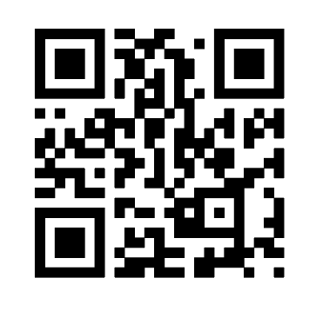

Supporting wellbeing during and post Covid-19
The #OnlyHuman campaign has been developed to positively support health and care staff to prioritise their physical health and emotional wellbeing needs in light of Covid-19 and beyond.
In April, the Institute for Public Policy Research reported that 1 in 2 workers felt their mental health had declined since the pandemic began and more than 1 in 5 were more likely to leave the profession as a result.
The campaign materials take on a peer-to-peer approach having found that staff can struggle to identify signs of stress within themselves, but are far better at spotting signs within colleagues.
It's easier to spot a change – and potentially a problem - in someone else than in yourself. Keep an eye out for changes among your team.
When asking a colleague how they are, try phrasing it as an open question ("how are you feeling?") rather than closed one ("you okay?").
Think about how you can set an example for colleagues by sharing your own challenges and vulnerabilities, whether that's in a huddle or one-to-one.
Set aside some time each day to reflect on what you and your team did well today, maybe as you leave the building.
Encourage discussions about familiar comforts and day-to-day experiences which haven't changed.
Remember to actively acknowledge the challenges and feelings that change and uncertainty can bring.
Small acts of kindness really matter - make a teammate a cuppa or bring in some biscuits to share.
You can always send teammates a message after work to let them know you are thinking of them.
Thank teammates for even the smallest thing. Day to day gratitude can make a difference.
Encourage a safe safe space for colleagues to get involved in and speak up ie team huddles.
Think of someone who rarely gets praised and make an effort to let them know you appreciate them. Specific examples make people feel appreciated and noticed.
Be mindful that new colleagues or people trying something for the first time will appreciate your support the most.
Resources
The use of the suite of materials is completely flexible. They are editable so you can add your own logo and choose from the five theme(s) listed above which are most relevant to your team. Please visit https://bit.ly/2OpMC7Q or scan the QR code using the camera on your phone.
Even when it feels difficult, try to reinforce the importance of breaks.
Find a moment every week to share tips about how you switch off and relax at the end of the day.
Set an example by making use of the wellbeing facilities your department has on offer.
Version 12.0 11022022

Slide 85
Supporting care provider managers
Skills for Care supports the adult care sector in England with workforce development resources and support to recruit, develop and lead quality care services. A key focus is the range of Support for registered managers
The Skills for Care Resource Finder will help managers and staff to find the right wellbeing resources for their needs.
This includes:
Supporting local Registered Managers networks & Whats App groups
A new London wide network for deputy managers
A national Facebook page for managers
A series of webinars, podcasts and bite sized resources for managers –all recorded and available to download from the website
A Registered Manager membership programme which includes a handbook, monthly newsletters, mentoring and peer support learning opportunities
An advice line
Leadership programmes and online learning including managers induction standards
Support with achieving good and outstanding and preparing for CQC
In addition Skills for Care provides advice on recruitment of staff, workforce development funding, a range of learning and development resources and support and much more see https://www.skillsforcare.org.uk/home.aspx
Please contact your Locality Manager for more information here.
Version 12.0 11022022

Slide 86

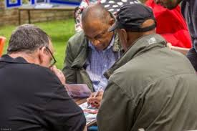
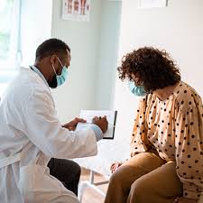

London Health and Wellbeing hubs – an overview
In response to Covid-19, the Integrated Care Systems (ICSs)* in London have set-up – or are in the process of setting up - new digital health and wellbeing hubs to support all health & social care staff (including ancillary workers) with their wellbeing and resilience needs
These offer free, confidential, psychological support services run by care professionals for care professionals in a positive health and wellbeing environment. They aim to support staff through this particularly challenging time and can assist with addressing issues such as anxiety and depression, as well as helping people better manage their work – life balance
There is no cost to access the services that the hubs provide - and all are delivered by health and care professionals with extensive experience of mental health issues
The services you can access will depend on your local hub, but some of the support available includes:
  A safe and confidential listening service via online chat, video call or phone call
  Wellbeing needs reviews and emotional wellbeing screening
  Signposting to relevant resources in your local community
  Psychological support using NICE recommended treatment, including Cognitive Behavioural Therapy and counselling
  Self-help digital tools
  Confidential fast-tracking of those with urgent needs to existing NHS mental health services
Opening hours will differ depending on the hub, but you will be able to access flexible appointments that work around shift patterns
To find out more and start accessing these services just visit the website of your local hub (see next slide). Please note that some hubs are still in the development phase and will be available shortly
* ICSs are partnerships that bring together providers and commissioners of NHS services across a geographical area with local authorities and other local partners, to collectively plan and integrate care to meet the needs of their population.
Version 12.0 11022022

Slide 87
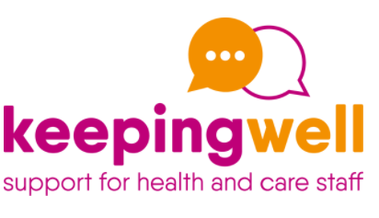




London Health and Wellbeing Hubs
ICS | Health and Wellbeing hub / website | Contact details | Web chat function | Wellbeing resources | Self-care tools | Support for teams
North West London | keepingwellnwl.nhs.uk | Keepingwell.NWL@nhs.net Support online live chat function 0300 123 1705 Monday to Friday 9.00am -5.00pm Including call back request |  |  |  | 
North Central London | keepingwellncl.nhs.uk | keepingwellncl@tavi-port.nhs.uk Support online chat function available via keepingwellncl.nhs.uk Monday to Friday 9.00am -5.00pm |  |  |  | 
North East London | keepingwellnel.nhs.uk | Keepingwell.NEL@nhs.net 8AM to 8PM, Monday to Saturday Free phone: 03005551201 Mobile SMS and voice: 07723484839 |  |  |  | 
South East London | Keepingwellsel.nhs.uk | Slm-tr.keepingwell.sel@nhs.net Monday to Friday 9.00am -5.00pm Support online live chat function 02032282563 |  |  |  | 
South West London | https://www.swlondon.nhs.uk/support-for-staff/ | St. Georges University Hospital NHS Trust - 020 8725 3368 Email: staffsupport@stgeorges.nhs.uk Epsom & St. Helier University Hospitals NHS Trust - 020 8296 2679. Email: esth.staffcounselling@nhs.net Croydon Health Services NHS Trust - 020 8401 3463 Email: ch-tr.staffcounselling@nhs.net Kingston Hospital NHS Foundation Trust - 07597590042 or ext. 6618. Email: khft.staffwellbeingappointments@nhs.net |  |  |  | 

