Slide 1
Peer Learning for London
“Working alongside other ARRS roles”
Wed 1st December 21

Slide 2
Plan for today
JOIN THE CONVERSATION
TIME | ITEM
12:30 | Welcome and introduction
12:40 | Overview of the roles: SPLW and Care Coordinator: Lianna Martin (RLC/PCN Advisor) Health and Wellbeing Coach: Caroline Haines (London Mentor for HWBCs)
1:00 | How a link worker can work with the two roles – Barnsley case study: Janie Wike (PCN manager and personalised care lead)
1:10 | Overcoming the challenges – how to work closer together – Barnet case study: Caitlin Bays; Louise McComiskie (SPLW manager; SPLW – Barnet)
1.20 | Embedding the roles to reduce health inequalities: Laura Rodriques-Benito (PCN CD – Sutton)
1.30 | Q&A
1.55 | Wrap up and thank you!
It is an informal session
– talk to each other & share resources in the chat
The presentations will be recorded & circulated
Working alongside other ARRS roles

Slide 3
Overview – what will you leave with...
By the end of this session, you will be able to:
Understand the possible work scopes of SPLWs, CCs and HWBCs
Increase your confidence in explaining the remit of your role and how it may differ
Identify different models of working between the three roles
Learn about ways of working that can help you work more effectively with different roles
Connect with SPLWs, CCs and HWBCs in your area
Working alongside other ARRS roles

Slide 4
The role of a SPLW and Care Coordinator
Lianna Martin,
Regional Learning Coordinator/ PCN advisor
Working alongside other ARRS roles

Slide 5
What do the roles do
Social Prescribing Link Workers | Health & Wellbeing Coaches | Care Coordinators
Address wider issues (social determinants of health) that impact people’s health & wellbeing. Take time with patient, using personalised care support planning, motivational interviewing & health coaching approaches, over several sessions to identify what matters to the person and connect them with; practical, social and emotional support within their community activities that promote wellbeing e.g. arts, sports, natural environment. Act as a bridge between primary care and the community - Identify and nurture community assets by working with partners such as VCSE, LA and NHS. Tend to support people experiencing loneliness, complex social needs, mental health needs or multiple LTCs. | Work with patients who will benefit from and provide: Goal setting - Guide and support people with LTCs to set self-identified health and wellbeing goals Behaviour change - Use specialist coaching and behaviour change techniques, usually over a number of sessions Tend to support with physical and mental health conditions, and with one or more LTCs such as type 2 diabetes, COPD, or those at risk of developing a LTC. | Work with patients who will benefit from, and provide: Support in navigating the health system and connecting with the right people Continuity of care – a point of contact alongside busy clinicians Allyship and advocacy - post appointment follow-up conversations, support in understanding health conditions, creating space to reflect on choices right for individual ensuring changing needs are addressed Provide coordination and access to other appropriate services and support. Can be main point of contact for care homes Tend to support those with multiple appointments, chronic conditions, frail/elderly and people with LTCs.
@SP_LDN
hlp.socialprescribing@nhs.net

Slide 6
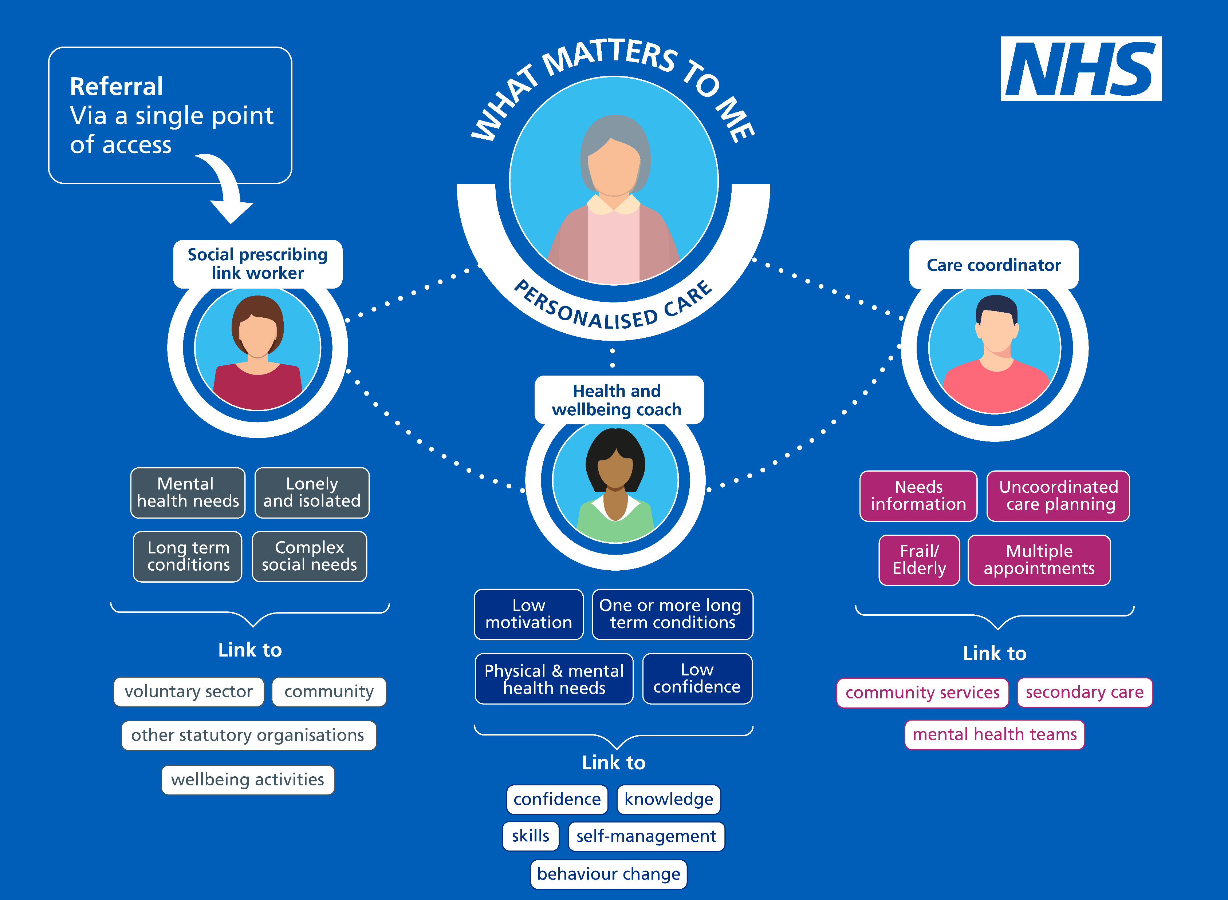
Ensuring the personalised care roles work effectively together
@SP_LDN
hlp.socialprescribing@nhs.net

Slide 7
The role of a Health and Wellbeing coach
Caroline Haines,
London Mentor for Health and Wellbeing Coaches
East Merton PCN
Working alongside other ARRS roles

Slide 8
How CCs and HWBCs can work with SPLW
Janie Wike,
PCN manager and Personalised care lead
Barnsley
Working alongside other ARRS roles

Slide 9
My influence
Started as Lead Social prescribing Link Worker
Gave me a unique insight into personalised care from an individuals prospective
As PCN Manager I have been able to build in that prospective when developing the new roles across Barnsley
This has resulted in the development of a strong personalised care team

Slide 10
Barnsley PCN
One single PCN – split into 6 neighbourhoods
Host by Barnsley Health Care Federation
Population of 260,000
32 GP practices
Building on previous success
- iHEART365 – extended hours
- GP Out of hours
- Training support for all practice staff
-

Slide 11
Personalised Care Team
Link Works - PCN Young persons social prescribing service
8 social prescribers
Next phase expend in all age social Prescribing service
Care Coordinators - 35 WTE embedding in all GP across Barnsley
Health and Wellbeing Coaches - 17 WTE working across Barnsley

Slide 12
How the Roles Work Together
Key to working together is all 3 roles all having an excellent understanding of personalised care and how each part of the team contributes
Care Coordinators are based in practices where they can identify the needs of both patients
Social Prescribing Link Workers work agile covering a neighbourhood each
Health and Wellbeing Coaches – Assigned to practices

Slide 13
Contribution to PCN
Specifications
Early Cancer Diagnosis
Enhanced Health in Care Homes
CVD prevention and diagnosis
Tackling Neighbourhood Health Inequalities
Anticipatory Care
Personalised Care
Impact and Investment Fund
Annual Health Checks
Flu vaccinations
Referrals to social prescribing
Reducing A and E attendants
Development of PCP
Delivery of ward rounds

Slide 14
Collaborate not duplicate
Education of all practice staff
Regular PCN meetings
Regular teams meeting of personalised care team
Shared learning and reflection
Clear defined job descriptions for each role

Slide 15
Top Tip to take away
Talk
To all Practices within your PCN
To patients which will allow you to understand their needs
To other services and Partners
Talk to the roles allows shared learning and further development

Slide 16
Overcoming challenges
Caitlin Bays
SPLW manager, Barnet
Louise McComiskie,
Social Prescribing link worker, Barnet
Working alongside other ARRS roles

Slide 17
Embedding the three roles to reduce health inequality
Laura Rodriques-Benito,
PCN Clinical director
Sutton
Working alongside other ARRS roles

Slide 18
Social Prescribing: key resources
1. | Summary Guide, which gives a clear picture of what a good social prescribing scheme looks like for everyone - also includes a common outcomes framework to help measure the impact of social prescribing on people, the local system, and the voluntary and community sector.​
2. | Reference Guide for PCNs supports PCNs with information on setting up social prescribing services including support for recruitment, induction and supervision - also outlines quality assurance measures, and how info can be gathered to help develop a consistent evidence base for social prescribing. ​
3. | Welcome and induction pack for link workers in primary care networks (PCNs).​
4. | Handout for practice staff to give to people who are referred to a social prescribing link worker. ​
5. | Themed fortnightly webinars for link workers​
6. | Regional Learning coordinators (London = lianna.martin@nhs.net) provide learning and peer support for link workers (SPLWs) at both a regional and Primary Care Network (PCN) level
7. | Regional Facilitators support local system leaders to bring partners together to create and deliver place-based plans across the ICS/STP footprint which support the development of social prescribing and communiy-based approaches and to embed link workers in every Primary Care Network​.
8. | Regional PCN Advisors - support PCNs to embed the three personalised care roles within primary care: Social Prescribing Link Workers (SPLWs), Health and Wellbeing Coaches (HWbCs) and Care Coordinators (CCs) (London = lianna.mrtin@nhs.net + hina.shahid1@nhs.net)
9. | Accredited online training through Health Education England​
10. | Personalised Care Institute - Free courses available through the Personalised Care Institute. Core skills training shared decision making and personalised care and support planning training that is available free online from the PCI would be, on the whole, relevant and of benefit to the personalised care roles.
11. | Social Prescribing Slide deck Generic slide deck for social prescribing presentations
12. | Directed Enhanced Service sets out how commissioners must offer to primary medical services contractors the opportunity to participate in the Network Contract Directed Enhanced Service (DES). It outlines the eligibility requirements and process for primary medical services contractors to participate; and sets out the relevant rights and obligations for PCNs and commissioners.
13. | Network Contract DES – VAT Information This document is an information note from NHS England regarding the Network Contract DES and VAT
14. | IIF Implementation Guidance 2021-22 This document sets out guidance for primary care networks (PCNs) implementing the Investment and Impact Fund, as per the requirements set out in the 2021/22 Network Contract Directed Enhanced Service (DES) Specification.
15. | Key DES-IIF and operating changes 2021-22
16. | FutureNHS Collaboration Platform Source of good practice guidance, webinars, updates and more. Something we should be encouraging link workers to join. To join please email: england.socialprescribing@nhs.net
@SP_LDN
hlp.socialprescribing@nhs.net

Slide 19
Supportive Self-Management: key resources
1. | Measurement and evaluation within supported self-management This guide describes the steps for planning hot to use measurement within supported self-management, based on evidence and good practice.
2. | Health & Wellbeing Coach Welcome pack - The welcome pack is designed for newly appointed health and wellbeing coaches in primary care networks.
3. | Care Coordinator workers Welcome pack - The welcome pack is designed for newly appointed care coordinators in primary care networks.
4. | Health Coaching guide and technical annex Designed to support the delivery of health coaching. This guide should be used when commission and when deciding what can or should be counted and reported as health coaching in a local area.
5. | Care Coordinator recruitment pack An optional resource to provide support to PCN’s in the recruitment or engagement of care coordinators. The resource includes: Sample job description Sample person specification Sample job advert Sample interview questions
6. | Health & Wellbeing Coach recruitment pack An optional resource to provide support to PCN’s in the recruitment or engagement of care coordinators. The resource includes: Sample job description Sample person specification Sample job advert Sample interview questions
7. | Care Co-ordination practice leaflet - Primary Care practice leaflet to explain the role of Care Coordinators to patients
8. | Health and Wellbeing FAQ’s
9. | Care Coordination- Primary Care leaflet - This document provides an in-depth summary of the roles and application of the Care Coordinator within primary care.
10. | Health & Wellbeing Coach Mentor: Caroline Haines, caroline.haines1@nhs.net
11. | Care Coordinator Mentor: Dr Ali Hassas, alihassas@nhs.net
12. | FutureNHS Collaboration Platform - Source of good practice guidance, webinars, updates and more. Something we should be encouraging link workers to join. To join please email: england.supportedselfmangement@nhs.net
@SP_LDN
hlp.socialprescribing@nhs.net

