Slide 1

London Learning Disability COVID-19 vaccine information pack (Version 4)
Developed with the support of the London Learning Disability Leadership Network and adapted from the Guys and St Thomas’ Supporting people with a learning disability around the COVID-19 vaccination programme toolkit
Publication date: 23/12/2021
This London guide does not replace local guidance and professional judgement. It will be updated in line with other national and regional guidance once published.
To provide feedback on this pack please contact: england.ldateamlondon@nhs.net

Slide 2
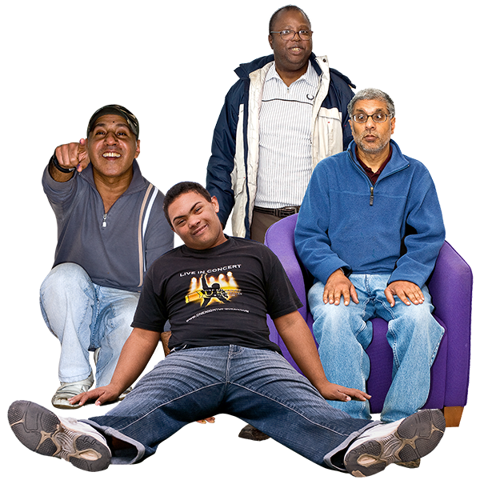
About this pack
This pack can be used by people with learning disabilities and their carers to find out more about the COVID-19 Vaccination.
What is COVID-19?
Who can catch COVID-19?
The COVID –19 Vaccination Programme
The COVID-19 vaccine
Frequently asked Questions about the vaccine
Who can have the vaccine ?
If you are worried about having an Injection
Making an appointment to have the vaccine
Having the vaccine
After having the vaccine
What to do if you feel unwell
Deciding whether to have the vaccine
Supporting a person with a learning disability with the COVID-19 Vaccination Process

Slide 3
What is COVID-19 ?
COVID-19 (also called Coronavirus) is a new illness.
It affects people in different ways.
It can make you feel very unwell.
It can cause pain in your chest and breathing may be more difficult.
Some people may have a cough.
Some people may lose sense of taste or smell.
It has killed some people.

Slide 4
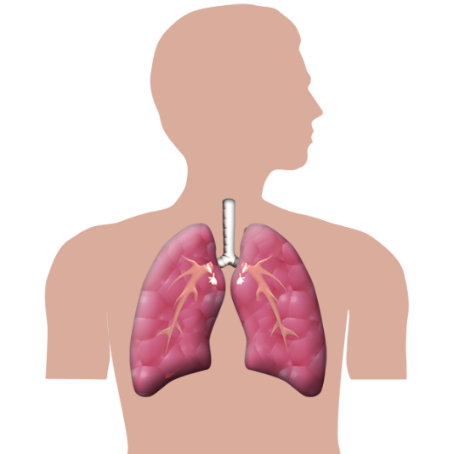
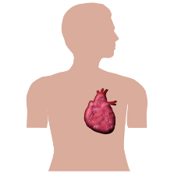
Who can catch COVID-19?
Anybody can catch COVID -19
People are more at risk of being very unwell and dying
if they already have a medical condition such as:
Diabetes
Liver and kidney problems
Heart problems
Breathing problems such as asthma
Are overweight
In the first wave of coronavirus which started in February and
ended in June 2020, People with a learning disability
were six times more likely to die than other people .
PHE Report

Slide 5
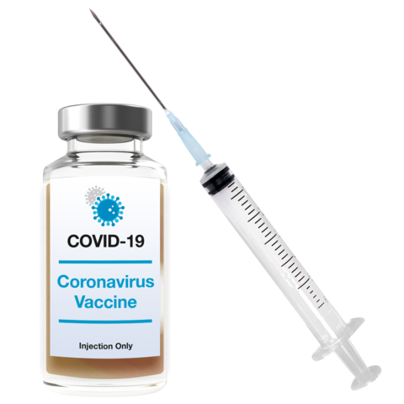
The COVID-19 Vaccination Programme
The NHS has been offering the vaccine to everyone over the last year
A vaccine is an injection and having the vaccine makes you less likely to get very ill from Coronavirus.
You can have the vaccine at hospital, GP surgeries, clinics and at home.
A nurse, doctor or someone who has been specially
trained called a vaccinator can give you the vaccine.

Slide 6
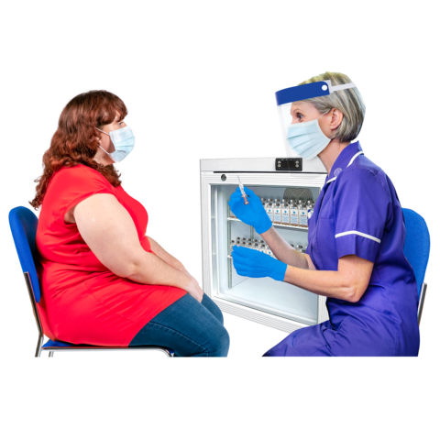
The COVID-19 vaccine
The vaccine doesn’t completely stop everyone getting Coronavirus,
but if you do still catch Coronavirus it shouldn’t make
you as unwell if you’ve had the vaccine.
You can find out more about the vaccine by watching this
Video: COVID-19 Vaccine film
Reading this leaflet: PHE Easy Read COVID-19 Vaccination leaflet

Slide 7
Frequently asked questions about the vaccine
How has the vaccine been produced so quickly?
A vaccine is tested in 3 stages of trials. A trial is when you try something out to see how well it works.
Stage 1: trials on a small group of people to make sure
that the vaccine is safe to use and how
much is needed to get the best results.
Stage 2: trials on a larger group of people
to check the vaccine works on more people
and gives them enough protection against the virus.

Slide 8
Frequently asked questions about the vaccine
Stage 3: trials on thousands of people
for scientists to see if the vaccine
protects people enough
against the virus.
Usually each stage follow each other but for
the COVID -19 Vaccine Stage 2 and 3
happened at the same time.

Slide 9

Frequently asked questions about the vaccine
Is the Vaccine Safe?
The Medicines and Healthcare Regulatory
Agency (MHRA) make sure vaccines are safe.
All vaccines in the UK are checked by the
Medicines and Healthcare Regulatory Agency.
How does the vaccine Work?
The vaccine helps your body to produce
antibodies / virus fighters to help fight the virus
if you come into contact with Coronavirus.

Slide 10
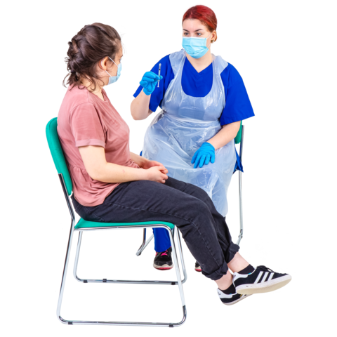
Frequently asked questions about the vaccine
Does the vaccine give you Coronavirus?
No the vaccine does not give you Coronavirus.
Who will give me the vaccine?
A person that has been trained to give injections.

Slide 11
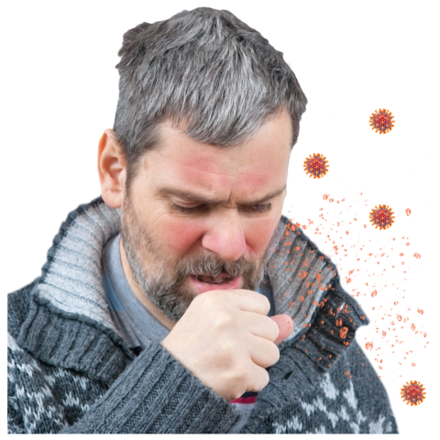
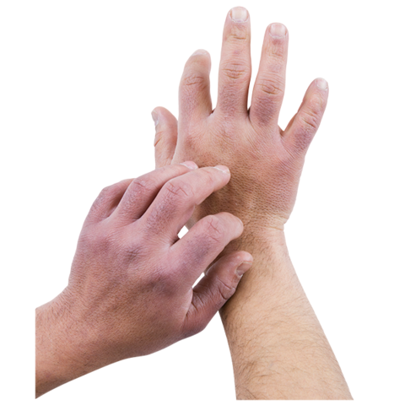
Frequently asked questions about the vaccine
Do I need the vaccine if I have had Coronavirus?
Yes you still need the vaccine if you have had coronavirus
If I have allergies can I still have the vaccine?
If you have any allergies you must tell the person that
is doing the vaccine.

Slide 12



Frequently asked questions about the vaccine
Is the vaccine made from animal or egg products?
The three types of vaccines being offered do
not contain animal or egg products.
Does the vaccine contain any blood products?
No
Can I have the vaccine during Ramadan if I am fasting?
Yes you can still have your vaccine if you are fasting,
having the vaccine will not break your fast.

Slide 13

Frequently asked questions about the vaccine
Can I choose which vaccine I have?
No you usually cannot choose which vaccine you have unless:
For people under 18 years of age you can only have
the Pfizer vaccine.
For people under 40 years of age if you have not already a vaccine you will be offered the Moderna or Pfizer Vaccine.
When you go to have your booster vaccine you may be given a different vaccine to the one you had for your 1st and 2nd vaccine injections

Slide 14
Frequently asked questions about the vaccine
I am worried about the reports on the News about the risk
of blood clots if I have the Astra Zeneca vaccine?
The number of people that have experienced blood clots
after having the Astra Zeneca vaccine is very low.
In the U.K, by the 20th of October 2021, 423 people that had the Astra Zeneca vaccine reported experiencing blood clots.

Slide 15
Frequently asked questions about the vaccine
I am worried about the reports on the News about the risk
of blood clots if I have the Astra Zeneca vaccine?
The Joint Committee on Vaccination and Immunisation advises that people should still have the vaccine as it does a good job of teaching your body how to fight COVID-19.
People who have had their first dose of the AstraZeneca vaccine should still get their second dose (unless they had one of the rare blood clots)

Slide 16
Frequently asked questions about the vaccine
I have had my 1st dose of the Astra Zeneca Vaccine, should
I have my 2nd dose?
Yes if you have had your 1st dose of the Astra Zeneca vaccine, you should
have your 2nd dose unless you experienced a rare blood clot after your 1st vaccine.
If you are worried of have any questions about having the Astra Zeneca vaccine please speak to your G.P or someone from your local learning disability team.

Slide 17
Frequently asked questions about the vaccine
I have not had any vaccinations yet – is it too late?
No - If you have not had any vaccination yet it is not too late to have it done.
Please speak to your G.P or someone from your local learning disability team.

Slide 18
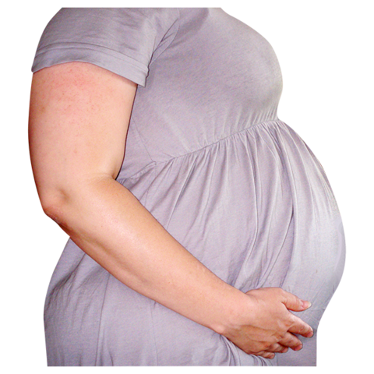
Frequently asked questions about the vaccine
Will the vaccine prevent me from getting pregnant?
There is no evidence to say the vaccine will
stop you from getting pregnant.
Can I have the vaccine if I am pregnant or breastfeeding?
Yes you can have the vaccine if you are pregnant or breastfeeding
PHE Easy Read information for people who are pregnant, might get pregnant or who are breastfeeding

Slide 19
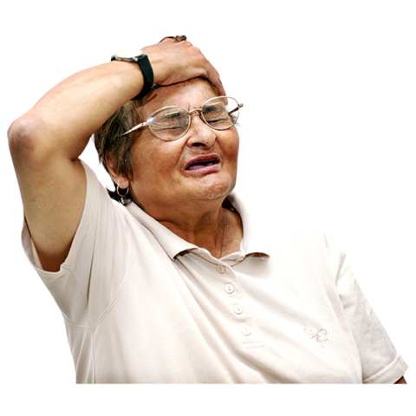
Frequently asked questions about the vaccine
Are there any other ways to have the vaccine if you do
not like injections?
No the vaccine can only be given by injection.
Can I have the vaccine if I have Coronavirus or unwell?
No, if you are unwell you should wait until you are better
before having the vaccine.

Slide 20
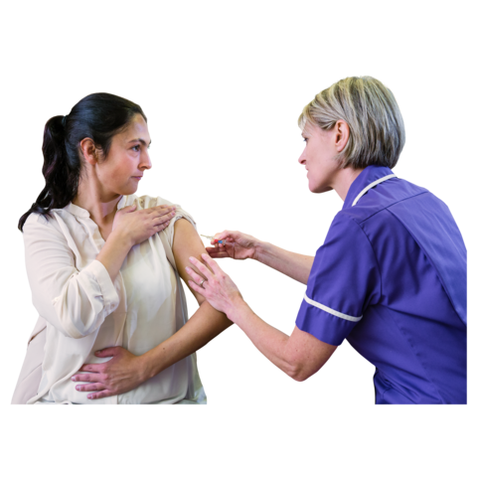
Frequently asked questions about the vaccine
I have recovered from coronavirus. Can I still have a vaccine?
Yes. You can go to your appointment if you feel well and
it is 4 weeks since you started having symptoms of coronavirus,
or 4 weeks from when you got a test that came back positive
(if you didn’t have any symptoms).
I’ve had my flu vaccine. Do I need a coronavirus vaccine as well?
Yes. The flu vaccine does not protect you from coronavirus.
You should have both vaccines and you can have both your coronavirus vaccine and the flu vaccine at the same time.

Slide 21
Who can have the vaccine?
Individuals that are on the G.P Learning Disability register are being invited to have the COVID-19 vaccination.
You can ask your G.P if you are on their Learning Disability
register.
If you are not registered with a G.P please ask someone
you trust to help you register with a G.P

Slide 22
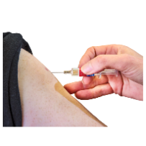
If you are worried about having an injection
Talk to someone you trust about this. This could be family member, your support worker, G.P or someone from your local learning disability team.
Your G.P or local learning disability team can help provide you with information and support if you are worried about having the vaccine.

Slide 23
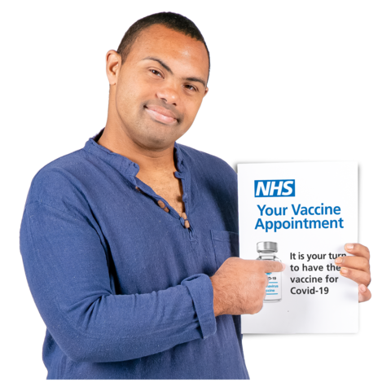
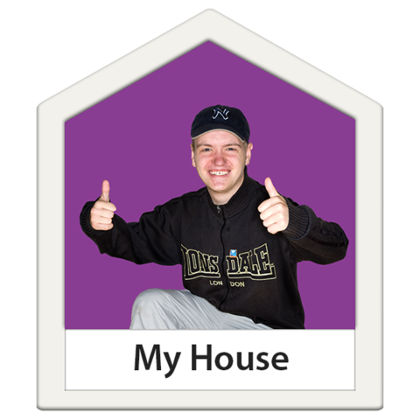
Making an appointment to have the vaccine
When it's your turn, the NHS will contact you by
letter, text or email with information on how
to book your appointment.
If you are clinically extremely vulnerable and cannot
leave your home then the NHS will arrange to vaccinate
you at home.

Slide 24
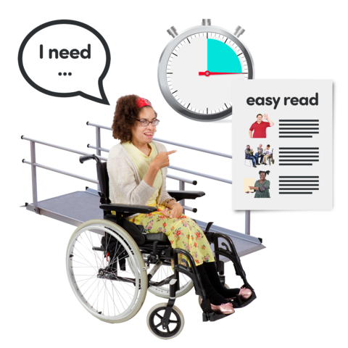
Making an appointment to have the vaccine
When you book your appointment you can tell the person you book the appointment with what help you need
Reasonable adjustments could include:
having a longer appointment
being given the vaccine by someone you have met before.
having the appointment at a certain time of day.
having someone come with you to attend the appointment
You can find out more about Reasonable Adjustments by watching this video

Slide 25
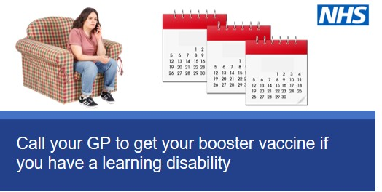
What is a booster vaccination and should I have it?
If you’ve had 2 doses of your coronavirus vaccine 3 months ago or more, you can now get a booster jab. Either book an appointment with your GP, call 119 or just walk in to your nearest vaccination centre.
Booster vaccine is an extra vaccination injection given to people who can get very unwell if they get Coronavirus and it includes people with a learning disability.
Getting your coronavirus booster jab is the best way to stop yourself from getting very ill from the virus. Speak to your GP or call 119 to book your booster jab.
Version 7.0 12112021

Slide 26
Having the vaccine
You will need to have 3 injections
1st 2nd 3rd (also called the booster)
at first appointment about 12 weeks later and about six months later
The person giving the vaccine will let you know when you need to come back. You need to have all injections and must be given at the right times to protect you better from the virus.
After every injection you will be safer from the virus

Slide 27
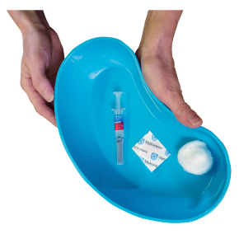
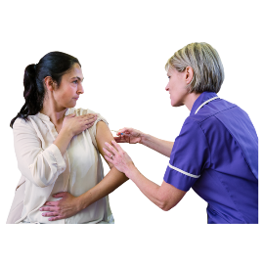
Having the vaccine
The trained person to give vaccines
will give you an injection in your arm
You may feel a little scratch.
A plaster will be put on your arm after the vaccine if
where you had the injection is bleeding.
You will be given a leaflet about the vaccine

Slide 28
After having the vaccine
You will still need to wear a face covering
when it is required
You will still need to socially distance
when it is required
You will still need to wash your hands regularly.

Slide 29
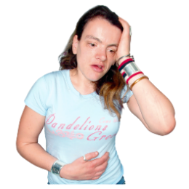
After having the vaccine
For a few days after the vaccination
You might be feel absolutely fine.
Your arm might be a little red and sore afterwards.
You might have a headache.
You might feel a little unwell a few days later.
You can report any unusual side effects via the yellow card or via
https://coronavirus-yellowcard.mhra.gov.uk/

Slide 30
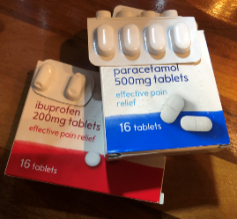
What to do if you feel unwell
Tell someone if you have pain in your arm.
Tell someone if you feel unwell.
You can take some pain relieve medication to help with this.
Call 111 for help if needed.
You can find out more by reading the leaflet below:
PHE Easy Read What to expect after the vaccine leaflet

Slide 31
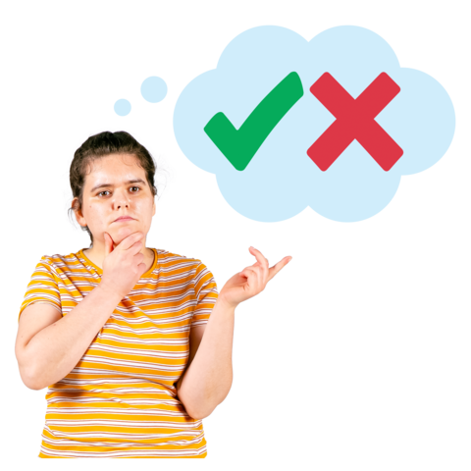
Deciding if you want to have the vaccine
To help decide if you want to have the vaccine you should:
Look at the information in this pack.
Speak to your G.P
Speak to someone you trust.
Ask for help if you are finding it hard to make a decision.

Slide 32
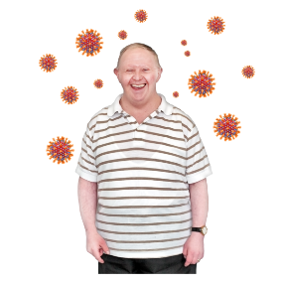
Supporting a person with a learning disability with the COVID-19 Vaccination Process
Tips for carers and family members

Slide 33
Step by Step tips for carers and family members to support the process
The following step by step guide can be used to support people with a learning disability with the COVID-19 Vaccination Process
Knowing the facts about Coronavirus and the vaccines
Deciding to have the vaccine
Preparing to get the vaccine
Getting the vaccine

Slide 34
Step by Step tips for carers and family members to support the process (Adapted from LDE Covid-19 Vaccination Factsheet)
Knowing the facts about Coronavirus and the Vaccines
People need to understand what coronavirus is and that it can be serious. People with learning disabilities are up to six times more likely to die of coronavirus than the general population. People need to know that coronavirus and COVID19 are the same. There are lots of easy read resources that explain coronavirus and people need to Have the chance to look at the information and have any questions answered. Understand what coronavirus is and how serious it can be. This is important for people to understand before they can make a decision about getting the vaccine. People need to know what a vaccine is, how they work and how they can keep them safe from illness. The below resources along with this pack can be used to provide information about the vaccine and the process. What is COVID 19/Coronavirus What is the COVID -19 Vaccine Having the COVID – 19 Vaccine Conversation The COVID Vaccination Toolkit

Slide 35
Step by Step tips for carers and family members to support the process
2. Deciding to have the Vaccine
The decision to or not to have the coronavirus vaccine must be made by the person. They need to be able to make an informed decision. This means that they need: 1. good information about the vaccine and the benefits it can give. 2. to know what the side effects of having the vaccine might be. 3. to know what could happen if they choose not to have the vaccine. When helping a person make a decision, it is important to think about what helps them make good decisions and the type of information that works for them. They may want friends or family to help them make the decision. It could be useful for carers, family members or friends that have had the vaccine to share their experience of what happened. It is important that carers who are worried about the vaccine do not try and put the person off. It is also important that people are not persuaded – they need clear and factual information. If the person, after looking at all the information decides not to have the vaccine, that is their choice, and they must not be treated unfairly or made to feel bad for their decision. If…. you have tried lots of different ways of helping the person you support understand about the vaccine and you still feel that the person is not able to understand and make a decision…Then a ‘best-interests’ decision must be made by relevant professionals in accordance with the Mental Capacity Act 2005. Please see slide If a person is unable to make a decision

Slide 36
Step by Step tips for carers and family members to support the process
3.Preparing to get the Vaccine
The more preparation you can do to support the person to know what will happen when they go for their vaccine the better. Its normal that a person might be apprehensive or anxious about having the vaccine and the more preparation that can be provided for the individual may help relieve these concerns. All people with a learning disability will be offered the vaccine. Individuals that are on the G.P Learning Disability register are now being invited to have the vaccination. You can check if the person is on the learning disability register by contacting their GP. Consider what reasonable adjustments the person will need to attend the appointment and discuss them with the GP practice or venue where they having the appointment. If you are supporting people in a care home or supported living, the vaccinator may come to the home . Contact the GP and let them know how many people you support. Use this pack to have conversations about the vaccine to help people talk through their anxieties and know what to expect. People are often worried about needles and a desensitisation programme may help. If the person you are caring for is worried about needles the following leaflet on Overcoming your Fear of Needles maybe helpful. For additional support with this matter please contact your GP or local learning disability team for support. A list of all the Learning Disability Teams in London can be found here .

Slide 37
Step by Step tips for carers and family members to support the process
4. Getting the Vaccine
Make sure the person has as much information as possible about the process of getting the vaccine before they attend their appointment. By the time the person goes to get their vaccine it should be really clear that they are in agreement to have the vaccine. The vaccinator needs to be clear that the person that is having the vaccine is giving their consent. Supporters can help the vaccinator get consent from the person by sharing information about how they communicate. There will be different places locally where you can get your vaccine. People might need some reasonable adjustments to assist the process of getting the vaccine. Help them think about what would make it easier: These could be: - having the appointment at the beginning or end of a day - having somewhere to wait that is quiet - having someone they know well accompany them to the appointment - having the vaccine given to them by someone who they have met before - having local anaesthetic on their arm before the vaccination

Slide 38
If a person is unable to make a decision
Remember that a capacity assessment is for a specific decision
People can lack capacity to make some decisions but have capacity to make other decisions
Mental capacity can fluctuate with time
Capacity assessment process:
Does the person have an impairment of their mind or brain?
Does the impairment mean the person is unable to make a specific decision when they need to?
The Mental Capacity Act says that a person is unable to make a decision if they can’t:
understand the information relevant to the decision
retain that information
use or weigh up that information as part of the process of making the decision
Before deciding a person lacks capacity it’s important to take steps to enable them to try to make the decision themselves (see the next slide)
A webinar was held by the National Capacity Forum – you can find more information here
A London webinar was held on the Mental Capacity Act – you can find the slides here
Questions regarding capacity The Essex Autonomy Project COVID Vaccination and the MCA FAQs1

Slide 39
Summary flow chart – capacity and best interests
No
Does the person have capacity to make a decision about having the vaccine?
Yes
Does the person have a Lasting Power of Attorney (LPA) for health and welfare, or a court appointed deputy acting on their behalf.
No
The person should decide if they want the vaccine. The person completes the consent process.
A decision should be made in the person's best interest:
Involve the person as much as possible
Consider previous wishes such as whether they have previously had vaccinations including the flu vaccine.
Talk to those who know the person well e.g., family
Take in to account the benefit to the person and potential side effects e.g., distress
Yes
The LPA or court appointed deputy can consent for the person.
If you are worried that the LPA is not acting in the person's best interest – you can contact your local authority and ask to speak to the safeguarding team, who will ask for background information so they can investigate.
Consent by the person /LPA and best interest decision should be recorded –

Slide 40
Consent forms
Consent forms can be found here: covid-19-vaccination consent forms
This includes
Easy Read Consent Form for adults
Consent form for care home residents who are able to consent
Template letter for care home residents who are able to consent – contains information about the vaccine
Consent form for completion by Lasting Power of Attorney (health and welfare)
Template letter for Lasting Power of Attorney (LPA)
Form for a relative (person) with LPA to express their views which may be part of a best interest decision
Template letter for relatives
Staff consent form and letter can be found here

Slide 41
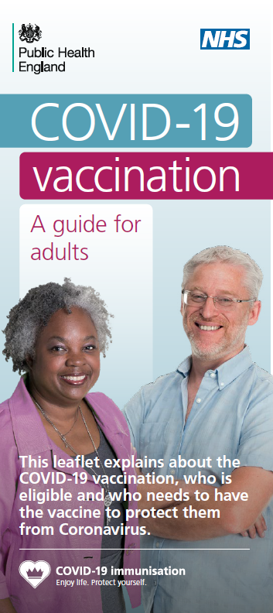
Vaccine information leaflets
You can find documents relating to the COVID vaccination here
Easy read Covid-19 leaflet
Video on Covid-19 vaccination
COVID-19 vaccine information for social care staff
COVID-19 vaccination guide for healthcare workers
Leaflet on why you are being asked to wait
COVID-19 vaccination guide for older adults
COVID-19 vaccine pregnancy information leaflet
Public Health England Leaflet - what to expect after your COVID-19 vaccinations
Public Health England easy read COVID 19 vaccination leaflet
Public Health England easy read What to expect after the vaccine leaflet

Slide 42
Supporting Resources
Mencap Assessing Capacity in people with learning disabilities
North East and Cumbria paper on Delivering COVID-19 vaccine to adults with learning disability/autism
Challenging Behaviour COVID 19 Resources
NHS England/Improvement Video on the COVID 19 Vaccine
Top tips on communicating with people with a learning disability and autistic people and highlight the range of reasonable adjustments that should be considered to ensure that a vaccination appointment goes well.
Enfield Integrated Learning Disabilities Service Makaton Signs to Support Communication about Coronavirus (COVID-19)
If you require support in having these conversations do link in with your local Learning Disability Team. Contacts of all the London Learning Disability Teams can be found here

