Slide 1








London Domiciliary Care Resource Pack
Produced by
Healthy London Partnership
and NHS E/I
in partnership
with
Publication date: 28/10/2021
Version 2
Review Date: 11/11/2021
This London guide is designed to complement and not replace local guidance and professional judgement. It will be updated to align with other national and regional guidance once published.
To provide feedback on this pack please contact: london.hcic@nhs.net
Version 2.0 13102021

Slide 2
Change log
Slide no. | Topic | Changes since v.1
6 | Covid-19 Vaccination as Condition of Deployment | New
7 | NHS App | New
8 | How to demonstrate your vaccination status in the NHS App | New
9 | How to demonstrate your vaccination status in the NHS App | New
10 | Domiciliary staff vaccine uptake: Top tips | New
11 | LDN London & ADASS London - Go Get the Vaccine! | New
13 | Infection prevention and control | Updated
17 | When clients should consider wearing face coverings | Updated
18 | COVID-19 Symptoms | Updated
19 | What to do when you suspect someone has Covid-19 symptoms | Updated
21 | Domiciliary care Covid-19 testing service - managers | Updated
23 | Management of exposed care workers | New
24 | Management of exposed care workers | New
25 | Management of exposed clients | New
28 | How clients should use NHS COVID-19 App | Updated
33 | Covid-19 & Workforce Risk Assessments | Updated
36 | Checking clients’ oxygen levels- Pulse Oximetry | New
37 | Recognising signs of deterioration | New
39 | Advanced Care Planning -CMC | New
42 | Accessing support for digital transformation | Updated
43 | Data Security and Protection Toolkit (DSPT) | Updated
44 | DSPT – support available from Digital Social Care | Updated
Version 2.0 13102021

Slide 3


This resource pack has been developed to provide clear guidance for London Domiciliary Care agencies aligned with NHS 111 Star lines and London COVID-19 Resource Pack for Primary Care ensuring that national guidance and good practice can be embedded locally by care providers. Ensure escalation routes are clearly identified for care providers.
If you have any suggestions for future topics please do let us know - england.londonehchprogramme@nhs.net
Topics covered in this resource pack:
Suspected Coronavirus Care Pathway – Domiciliary Care Clients Your direct line to urgent clinical advice Covid-19 Vaccination as Condition of Deployment NHS App How to demonstrate your vaccination status in the NHS App Domiciliary staff vaccine uptake: Top tips LDN London & ADASS London - Go Get the Vaccine! Infection prevention control - what happens after the vaccine? Infection prevention and control PPE and escalating your supply issues Putting on (donning) PPE for domiciliary care Taking off (doffing) PPE for domiciliary care When clients should consider wearing face coverings COVID-19 Symptoms What to do when you suspect someone has Covid-19 symptoms Regular testing for homecare workers Domiciliary care Covid-19 testing service – managers Domiciliary care Covid-19 testing service - staff Management of exposed care workers Management of exposed clients NHS COVID-19 app features How staff should use NHS COVID-19 App NHS Test and Trace: what does it mean for domiciliary care?- 1 NHS Test and Trace: what does it mean for domiciliary care?-2 How clients should use NHS COVID-19 App Returning home from hospital: package restart/ package acceptance What to expect from hospitals before a package restart/ package acceptance Covid-19 & Workforce Risk Assessments |  | Working with primary care and community services Supporting clients’ health and wellbeing Checking clients’ oxygen levels- Pulse Oximetry Recognising signs of deterioration Signposting and escalation in case of deterioration Talking to relatives Advanced Care Planning - CMC Supporting care in the last days of life Support for people who are bereaved Accessing support for digital transformation Data Security and Protection Toolkit (DSPT) DSPT – support available from Digital Social Care Supporting staff wellbeing Staff mental health and emotional wellbeing Supporting care provider managers London Health and Wellbeing hubs – an overview London Health and Wellbeing Hubs
An updated resource pack will be shared with you every 1-2 months
Version 2.0 13102021

Slide 4
Suspected Coronavirus Care Pathway – Domiciliary Care Clients
Suspected Cases
Isolate and Monitor
Consider COVID-19 infection in a client with any of the following:
New continuous cough, different to usual
High temperature (≥37.8°C), shivery, achy, hot to touch
Loss or change to sense of smell or taste
Clients may also present with symptoms, such as new onset/worsening confusion or diarrhea and other subtle signs of deterioration.
If you are trained to, record important information that you think might help health services, including date of first symptoms.
Arrange PCR test if you think client has symptoms.
Staff should be testing weekly, but should also take a PCR test if they suspect symptoms.
Caring for and monitoring clients living in the same home as other people.
If clients live with other people, only where possible, recommend that they isolate for 10 days in a single bedroom, and use a separate bathroom, away from other people living there, if this is possible.
Whether or not client displays symptoms, due to sustained transmission, care for client using PPE (overview and how to wear and dispose).
Use correct handwashing technique (video).
If you are trained to, record important information, such as symptoms and date of first symptoms, in order to inform health services
In order to protect clinically vulnerable clients, providers are recommended to divide people into ‘care groups’ and allocate subgroups of their staff team to provide care to each.
If providers are unable to divide their workforce into subgroups for each category, they may be able to divide the workforce into 2 groups:
one to support the clinically extremely vulnerable
the other to support ‘clinically vulnerable’ groups and everyone else
If a client deteriorates call their GP promptly. If the GP is not available call 111* Star 7 for urgent clinical advice, or in an emergency call 999.
Be explicit that COVID-19 is suspected.
How to access Personal Protective Equipment (PPE):
Order PPE through your normal supplier. If this isn’t possible arrangements have been made with seven wholesalers to provide PPE to the social care sector.
Contact your Local Authority if you are still unable to get PPE provision.
COVID 19: provision of home care
PPE guidance for Home Care Providers
Communication with the NHS
Do you have NHS Mail?
Domiciliary care providers - Send emails directly to your clients’ GP, Community Team and Hospital. Contact your CCG care home team or register here https://portal.nhs.net/Registration#/careprovider to get an NHS.net email address set up.
Capacity Tracker:
Domiciliary Care providers are asked to upload Covid-19 impact and business continuity information daily, including staff sickness due to Covid-19, and vaccination updates, onto Capacity Tracker. Contact london.capacitytracker@nhs.net for more information.
Resources and Support for Domiciliary Care Staff
Guidance on how to work safely in home care
Queens Nursing Institute Facebook Page
RIDDOR reporting of COVID-19
Testing for domiciliary care staff
Any other links eg vaccines?
Version 2.0 13102021

Slide 5


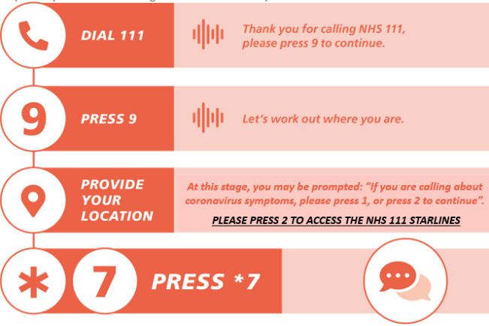
Your direct line to urgent clinical advice
In London, domiciliary care staff concerned about a client who may have COVID-19 symptoms should call their clients’ GP. If they can’t reach the GP, they need to contact the NHS 111 Starlines*.
The NHS 111 Starlines* service will provide you with a fast call-back, for rapid access to clinical advice you need to care for your client if you are unsure.
The service can be accessed by doing the following:
Callers in most of London should call NHS 111 Star*7 following the process on the right, for faster access to urgent advice from a senior clinician.
Callers in North East London STP/ICS should call NHS 111 Star*6 (follow the same process on the right, but press 6. If you cannot reach someone via Star 6, please dial 111 and once you get through to a call handler you will need to declare the following: “I am a Carer working for a Home Care provider and I am seeking access to 111 via the star line process”.
Before calling, if you are trained to recognise them, try to list the symptoms that you are concerned about, such as temperature, and including date of first symptoms, as this will help health services. If you know that your client has a care plan, for example a CMC or DNAR plan, please have access to it.
Version 2.0 13102021

Slide 6
Covid-19 Vaccination as Condition of Deployment
Consultation launched on 9th September on making vaccination a condition of deployment for all frontline workers in health and care settings
Staff may be required to have coronavirus (COVID-19) and flu vaccines to protect patients from infection, serious illness or death
COVID-19 and flu vaccines protect vulnerable people and staff members
The consultation ran for a period of 6 weeks, closed 22nd October, looking at whether requirements should apply for health and wider social care workers: those in contact with patients or clients, and people receiving care. It would mean only those who are fully vaccinated, unless medically exempt, could be deployed to deliver health and care services. The consultation will also seek views on whether flu vaccines should be a requirement for health and care workers.
Version 2.0 13102021

Slide 7
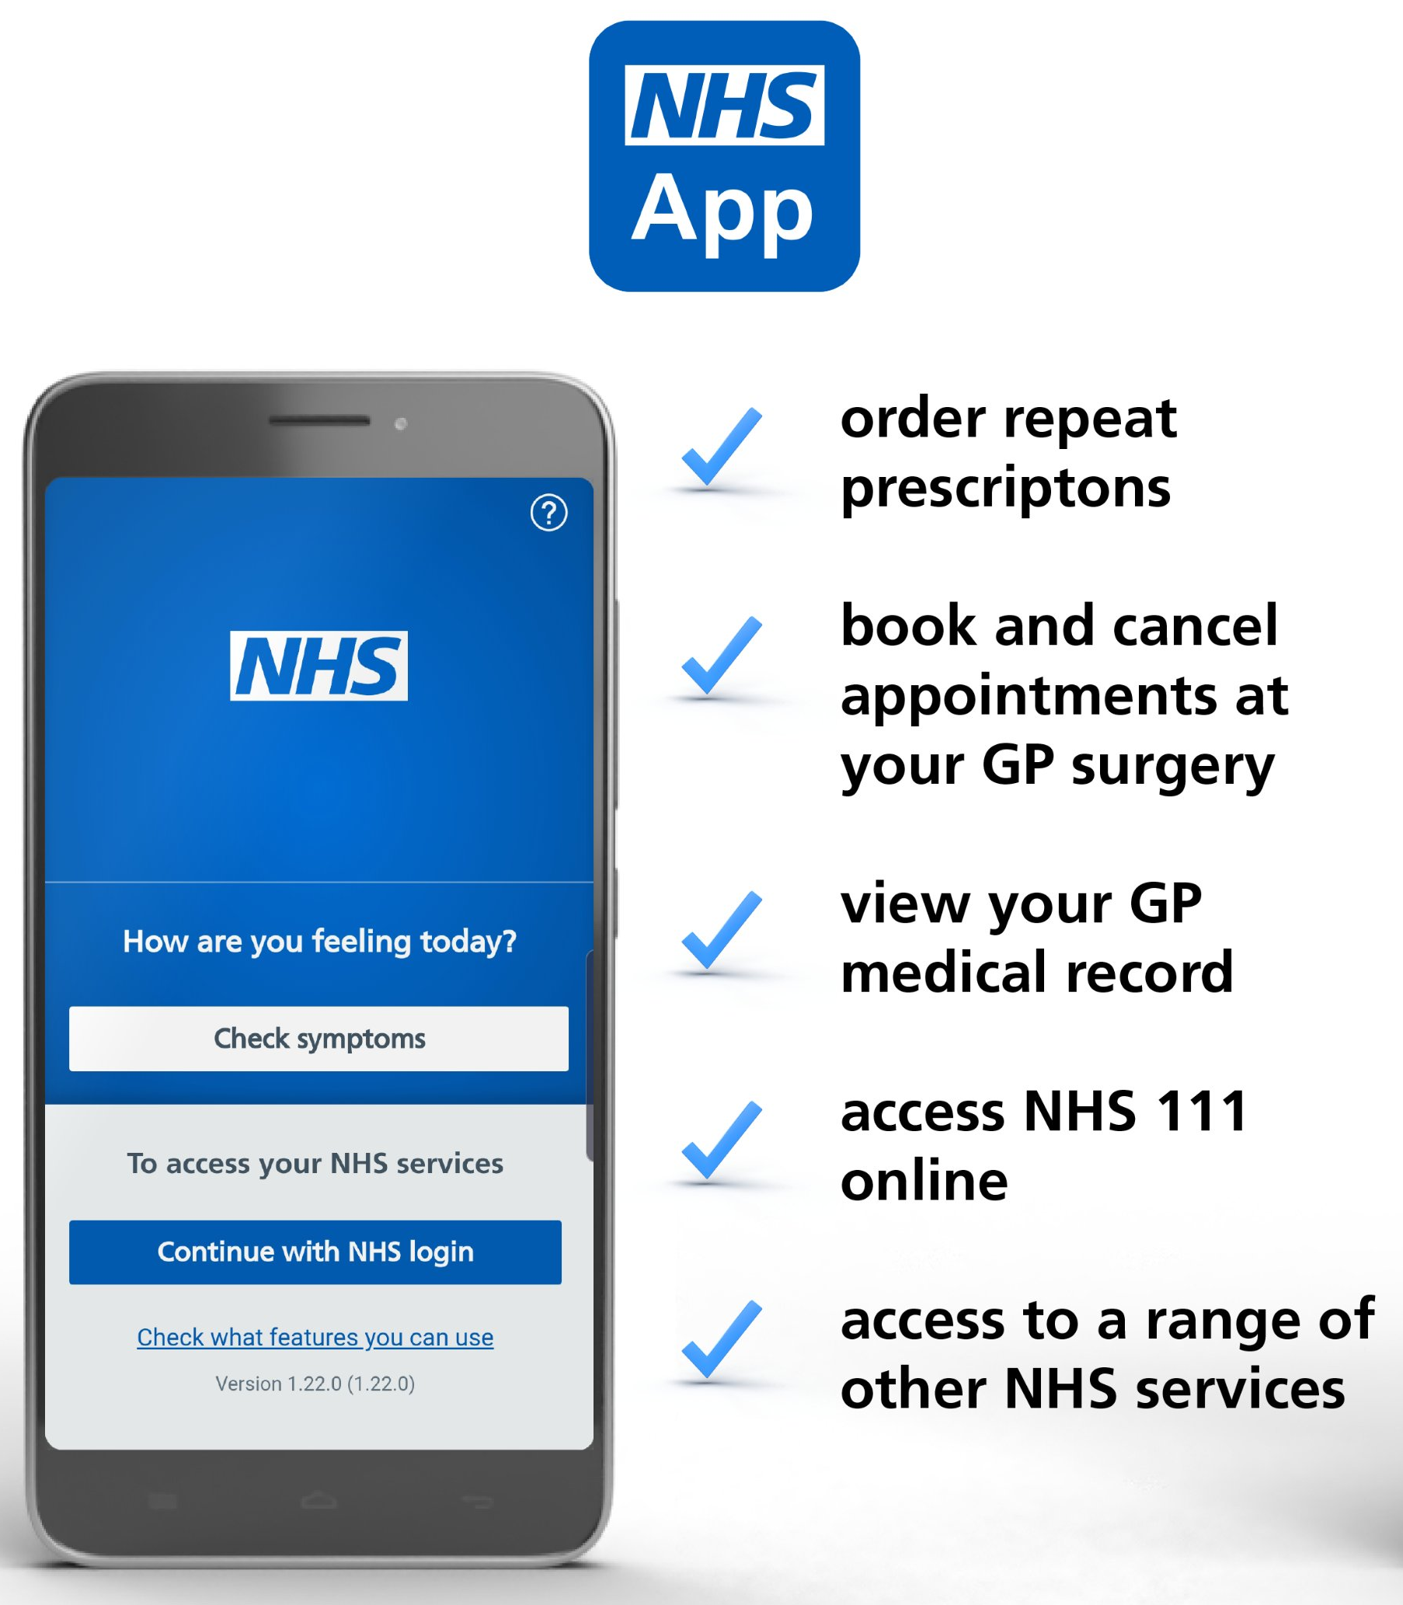
Demonstrating Vaccine Status using the NHS App
The NHS App is a simple and secure way to access a range of services on your smartphone or tablet. It is free from app stores. You need to be 16 or over to use the NHS COVID Pass service and registered with an NHS GP practice in England. The NHS App should not be confused with the NHS COVID-19 App which offers the fastest way to see if you’re at risk from coronavirus.
Find out more about the app and its benefits here.
View and share the Covid Pass on the app to demonstrate your vaccine status, for domestic use or travel abroad
Find out more here:
https://www.bt.com/content/dam/bt-sft/assets/documents/bt-skills-for-tomorrow-helping-others-nhs-app-guide-leaflet.pdf
https://www.bt.com/skillsfortomorrow/home-life/helping-others-nhs-app-guide
Version 2.0 13102021

Slide 8
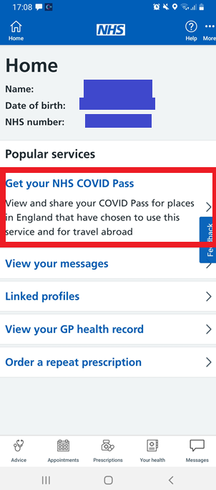
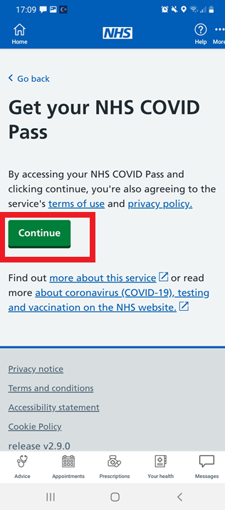
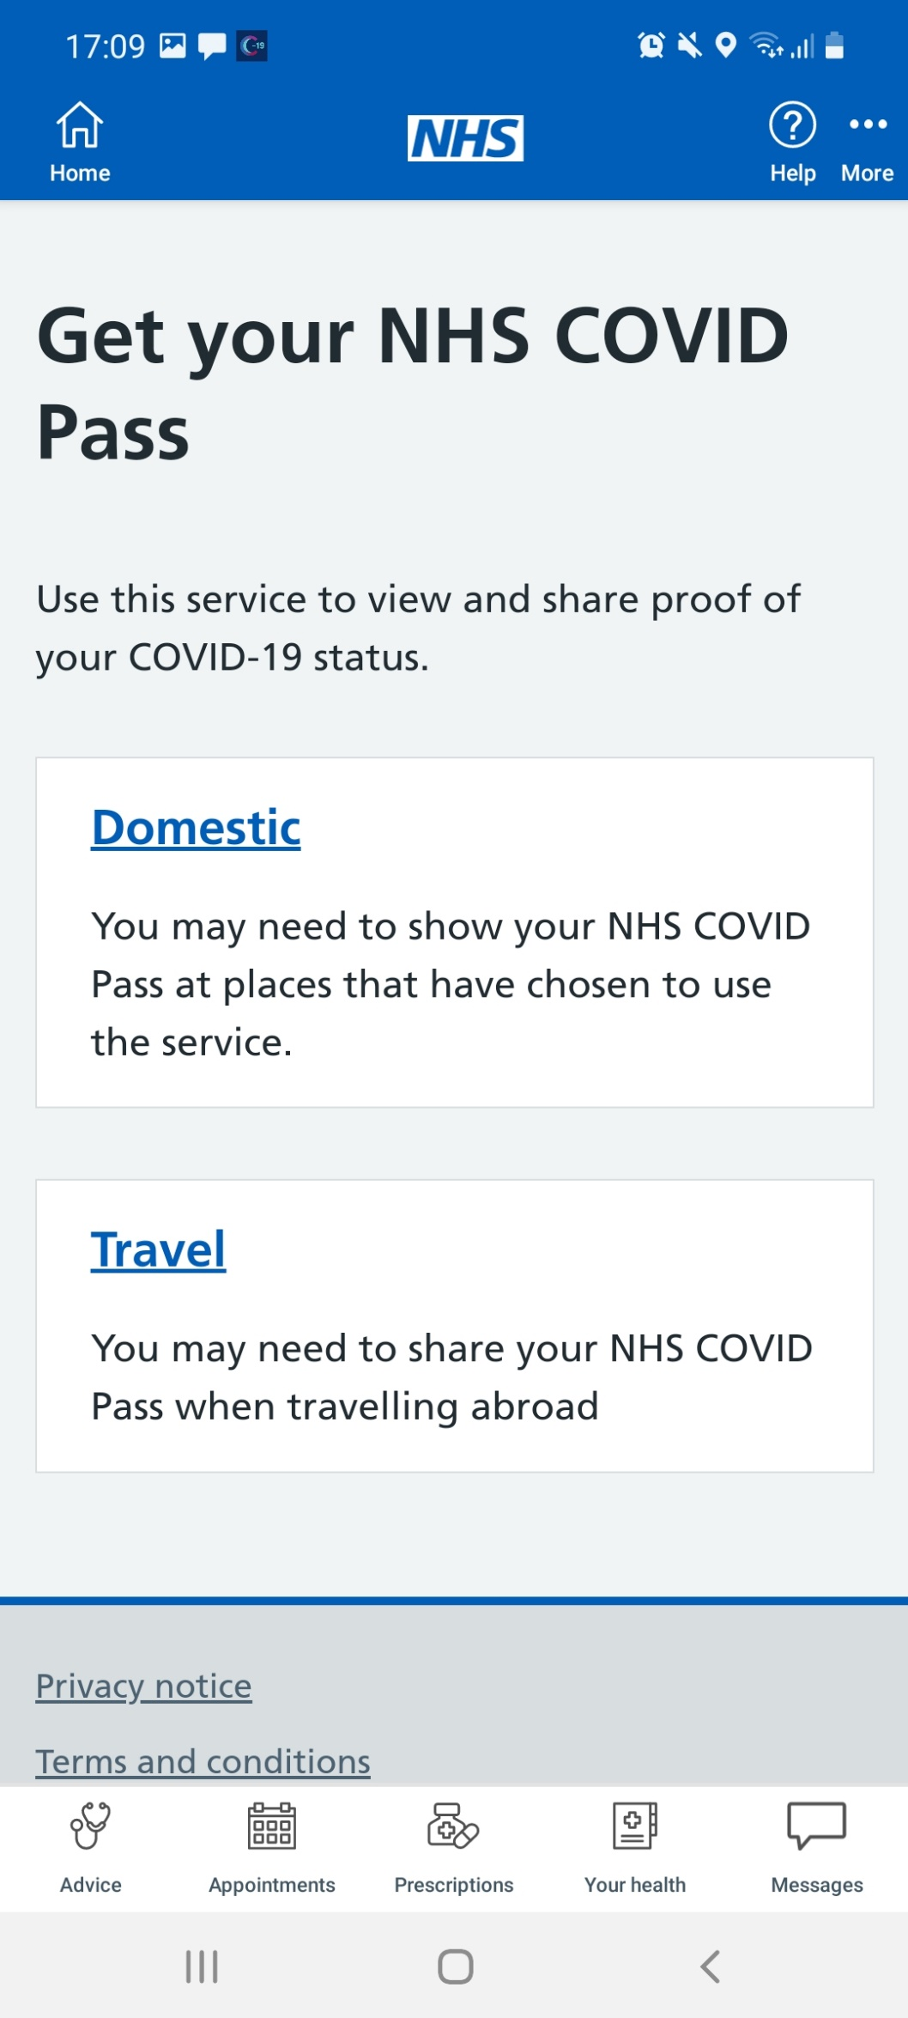
How to demonstrate your vaccination status in the NHS App
Once you have signed in to the NHS App, click ‘Get your NHS COVID Pass’
On the next screen, press ‘Continue’
Select ‘Travel’. This is because the travel pass offers more detail and better evidence of vaccination status
Version 2.0 13102021

Slide 9
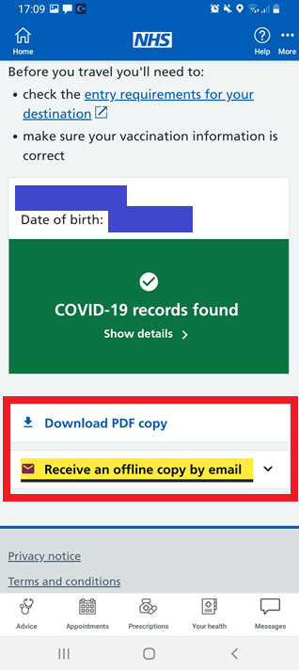
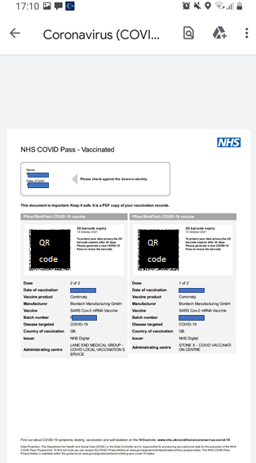
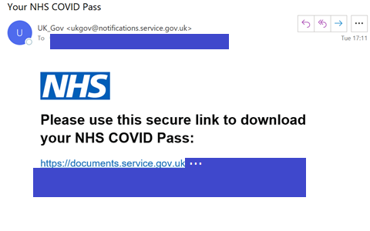
How to demonstrate your vaccination status in the NHS App
Select Download PDF copy or Receive an offline copy by email
You will be able to print the information that you receive (see right side of this slide), or email it to managers or colleagues to demonstrate vaccination status
Version 2.0 13102021

Slide 10
Domiciliary staff vaccine uptake: Top tips
Engagement
Use a combination of different methods:
- Videos of personal stories to help allay fears
- 1:1 conversations with people from similar backgrounds that are relatable, as well as with health professionals for conversations about specific concerns
- Q&A sessions and webinars
Access
Connect with local community champions to widen voices staff have access to
Partner with NHS colleagues and community groups to share up to date information with staff
Staff have been paid for the time taken to get the vaccine in their own time to remove financial barriers associated with lost earnings both to get the vaccine and for sick pay if they experience side-effects
Arrange for buddy schemes for peers to get the vaccines together
Ensure methods of booking are accessible and in multiple formats (text, phone line, online)
Ensure staff aware that they can drop-in for vaccine without a pre-booked appointment
Version 2.0 13102021

Slide 11

LDN London & ADASS London - Go Get the Vaccine!
Link to video here

Slide 12

Infection prevention control - what happens after the vaccine?
The vaccine is just one tool in our tool box to prevent COVID-19
Even if staff and clients have received both doses of the vaccine you must continue infection prevention control measures:
Continue to wear PPE
Continue to follow infection prevention control guidance
Continue with testing
Continue to follow guidance if anyone has symptoms of COVID-19
Continue to follow rules on staff isolation, where required
You can find lots of useful information about the vaccine in the Domiciliary Care Vaccine Information pack, which can be found here.
Version 2.0 13102021

Slide 13

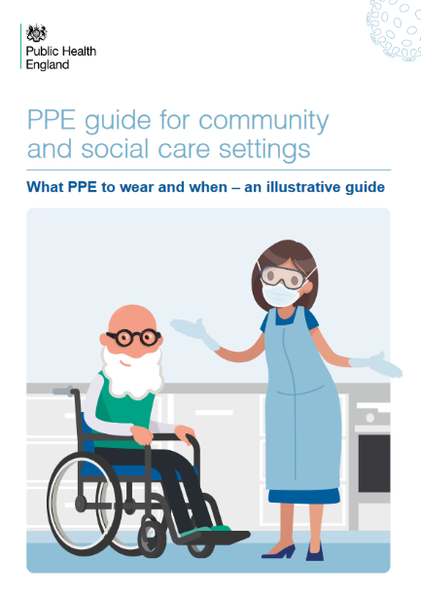
Infection prevention and control
Infection prevention and control:
Follow the guidance on Infection Prevention and Control
Use correct handwashing technique (video and guidance)
Follow the guidance to see if you should be using PPE
What PPE to use within 2 metres, and more than 2 metres from client
All staff should wear masks at all times when in the home of all clients. It is not recommended to eat at a client’s home, unless you provide live-in care
The guidance describes which items are single use or should be re-used, but more detail is here:
Fluid-repellent surgical masks (FRSMs) can be used continuously while providing care
Eye protection can be used continuously while providing care
Gloves and aprons are for single client use only
Resources
How to work safely in domiciliary care
Reducing contacts for clinically extremely vulnerable and clinically vulnerable people
Infection Control: Guidance
COVID-19 Personal protective equipment use for non-aerosol generating procedures: Guidance
COVID-19 Personal protective equipment use for aerosol generating procedures: Guidance
COVID-19 Provision of home care: Guidance
Best practice - How to hand wash: Poster
Version 2.0 13102021

Slide 14

PPE and escalating your supply issues
Continue to order your usual PPE supplies of gloves, aprons and soap/sanitiser but we also know this has been a challenge and want to support you. COVID-19 has created unprecedented demand on the type and quantity of PPE required by the sector. The Winter Plan identifies that the supply of PPE to the care sector is fundamental to ensuring that care workers can safely provide care to those who need it.
When contacting your Local Authority:
Outline your concern including the requirement
Outline what your current stock levels are and if you have confirmed or suspected COVID cases within your home.
If you do not get a response from your local authority, please ask them to escalate to the STP for mutual aid support
Where issues with local supply exist, this will be escalated to the regional Supply Chain Team for support.
How to access Personal Protective Equipment (PPE):
Care homes and domiciliary care providers are eligible to register for the PPE portal and can obtain free PPE for COVID-19 requirements until March 2022. You can only log in and place an order if you’ve received an email invitation to register.
The PPE portal order limits which are under constant review can be found here
You should not use the portal to order PPE for non-COVID-19 requirements, you should get this through your normal supplier. If this isn’t possible arrangements have been made with seven wholesalers to provide PPE to the social care sector.
Contact your Local Authority if you are still unable to get PPE provision.
PPE guidance for Residential Care Providers
Resources
Government PPE Plan.
PPE Strategy
PPE for Residential Care Providers: Guidance
Version 2.0 13102021

Slide 15

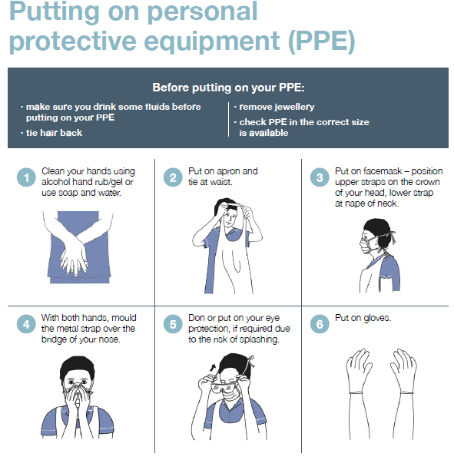
Putting on (donning) PPE for domiciliary care
In social care:
Different PPE is worn depending on the type of work you do and the setting in which you work. Click on this link to see the video on how to put on PPE and take it off in social care settings, and use the poster on the right which can be downloaded here.
You need to put a face mask on before you enter or immediately as you enter a client’s home or your work base.
Why are people wearing different PPE?
You may see other people wearing different types of PPE, for example, paramedics, district nurses and GPs. This is because some roles will have contact with more people in different procedures and settings, who are possibly infected. Also, there are different styles of PPE made by different manufacturers. For example, not all face masks will look the same.
Resources
PPE in all settings: Guide
Covid-19: Provision of domiciliary-care: Guide
COVID-19 PPE: recommendations for domiciliary care workers:
…within 2 metres of a client and providing close personal care (for example, touching) OR within 2 metres of anyone in the household who is coughing
…within 2 metres of a client or household members but not delivering personal care or needing to touch them, and there is no one within 2 metres who has a cough
…or any other work situation when in a client’s home; or in your work premises; or with other staff members
…explained
Version 2.0 13102021

Slide 16
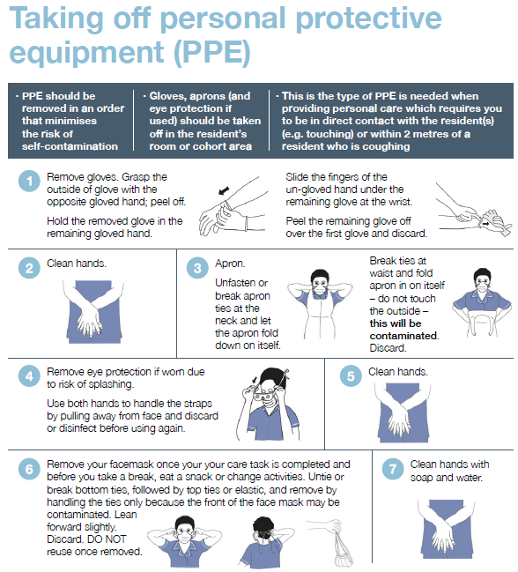
Taking off (doffing) PPE for domiciliary care
In social care:
Different PPE is worn depending on the type of work you do and the setting in which you work. Click on this link to see the video on how to put on PPE and take it off in social care settings, and use the poster on the right which can be downloaded here.
You need to put a face mask on before you enter or immediately as you enter a client’s home or your work base.
Why are people wearing different PPE?
You may see other people wearing different types of PPE, for example, paramedics, district nurses and GPs. This is because some roles will have contact with more people in different procedures and settings, who are possibly infected. Also, there are different styles of PPE made by different manufacturers. For example, not all face masks will look the same.
Resources
PPE in all settings: Guide
Covid-19: Provision of domiciliary-care: Guide
COVID-19 PPE: recommendations for domiciliary care workers:
…within 2 metres of a client and providing close personal care (for example, touching) OR within 2 metres of anyone in the household who is coughing
…within 2 metres of a client or household members but not delivering personal care or needing to touch them, and there is no one within 2 metres who has a cough
…or any other work situation when in a client’s home; or in your work premises; or with other staff members
…explained
Version 2.0 13102021

Slide 17

When clients should consider wearing face coverings
In the context of the coronavirus (COVID-19) outbreak, a face covering is something which safely covers the nose and mouth. You can buy reusable or single-use face coverings.
In England, although it is no longer a legal requirement, guidance states that “businesses can require or encourage customers, clients or their workers to wear a face covering.” Therefore, Directors of Public Health would recommend that staff and residents use face coverings in settings such as:
Public Transport including Taxis and Transport Hubs – TFL still requires passengers to wear a face covering
Shops, Supermarkets and Shopping centres
Libraries, visitor attractions and entertainment venues
Premises providing hospitality (bars, pubs, restaurants, cafes), except when seated at a table to eat or drink
Places of Worship, community centres and social clubs
In hospitals or any NHS settings guidance requires visitors or those attending an appointment to wear a face covering
And any indoor places not listed here where social distancing may be difficult and where you will come into contact with people you do not normally meet
Wearing masks is particularly recommended when spending a long time in spaces, or with many people. Closed spaces with poor ventilation, crowded places with many people nearby, and/or close contact settings such as close range conversations are all examples of settings in which wearing a mask is helpful. Read more here.
Guidance and policies will vary between organisations, businesses and locations, so please check in advance.
Situations whereby individuals are exempt from wearing a face covering include:
children under the age of 11 (Public Health England does not recommend face coverings for children under the age of 3 for health and safety reasons)
people who cannot put on, wear or remove a face covering because of a physical or mental illness or impairment, or disability
where the putting on, wearing or removing a face covering will cause severe distress
instances where people are speaking to or providing assistance to someone who relies on lip reading, clear sound or facial expressions to communicate
to avoid harm or injury, or the risk of harm or injury, to yourself or others
police officers and other emergency workers – this may interfere with their ability to serve the public
Think
Are there any circumstances/situations within the care setting where the use of face coverings for clients should be considered?
Will the client tolerate wearing a face covering?
Is the visit to the setting necessary, for health appointments can a virtual appointment take place?
Ask
Does the individual need to travel on public transport or can alternative forms of transport be considered?
Does the face covering meet the PHE recommended minimum of two or three layers?
Has a risk assessment been carried out, to determine whether face coverings are required?
Do
Make sure the client can breathe ok
Wash your hands when you put it on and take off
Ensure that clients do not keep touching the face covering when wearing it
Resources
Guidance on Face Coverings to attend health appointments
Guidance on Face Coverings for other settings
Face Covering Exemption Resources
Version 2.0 13102021

Slide 18
COVID-19 Symptoms
The NHS and PHE definition for COVID-19 infection is the following:
New continuous cough, different to usual
High temperature (≥37.8°C)
Loss or change to sense of smell or taste
Milder symptoms such as headache, sore throat, runny nose have been reported with the newer COVID 19 variants, e.g. Delta. These are also common in other respiratory illnesses and non-infective illness, for example hay fever. It is therefore important to have a test to confirm or exclude COVID if these are a new presentation.
About 1 in 3 people with COVID-19 do not have symptoms but can still infect others, which is why regular testing is important.
Domiciliary Care clients may also commonly present with other signs of being unwell such as being more confused or sleepier than usual, having diarrhoea, dizziness, conjunctivitis and falls. Clients may also present with changes in usual behaviours such as being restless or changes in abilities such as walking.
Version 2.0 13102021

Slide 19

What to do when you suspect someone has Covid-19 symptoms
The NHS and PHE definition for a suspected COVID-19 infection is the following:
New continuous cough, different to usual
High temperature (≥37.8°C)
Loss or change to sense of smell or taste
Clients may have milder symptoms such as headache, sore throat, runny nose, or other common signs of being unwell such as being more confused or more sleepy, having diarrhoea, dizziness, conjunctivitis and falls. Clients may also present with changes in usual behaviours such as being restless or changes in abilities such as walking. Some of these may be symptoms of other common illnesses or problems, so it is important for staff and clients to have regular lateral flow tests and PCR tests when it is felt that symptoms are present. If a client has COVID-19 symptoms then you should encourage them to get a PCR test.
If you are trained to recognise them, try to list the symptoms that you are concerned about, such as temperature, and including date of first symptoms, as this will help health services. If you know that your client has a care plan, for example a CMC or DNAR plan, please have access to it.
Consider home facilities. If the client lives with other people and there are sufficient rooms, consider separating client from other people living there, eg by designate a single bathroom for this client only, or using commode in room.
When home-care staff should take a PCR test:
If the client’s PCR test returns as positive, inform the home-care agency and book yourself a PCR test too. Take daily lateral flow tests for 10 days to keep checking for a negative test. Notify the agency so that they can make alternative arrangements in case you need to self-isolate. Notify the agency of your result.
If you feel any symptoms, book a PCR test.
The self-isolation period includes the day your symptoms started (or the day you had the test, if you do not have symptoms) and the next 10 full days. Find out how long to self-isolate
If you were already self-isolating and had a test because you've been in close contact with someone who tested positive, your self-isolation period restarts if you test positive.
If the manager of a Domiciliary Care service suspects a linked pattern of cases between positive staff and/or client cases, or complex cases, they should call Public Health England London Coronavirus Response Cell (LCRC) for infection control advice and access to initial testing. LCRC will arrange a risk assessment, and provide advice and support along with local authority partners to support home-care providers.
Phone Number: 0300 030 0340 Email: LCRC@phe.gov.uk or phe.lcrc@nhs.net
Update: Capacity Tracker, your Local Authority and RIDDOR
LCRC will provide infection control support and advise on any further testing
Resources COVID-19 Infection prevention and control (IPC): Guidance
Version 2.0 13102021

Slide 20
Regular testing for homecare workers
As well as testing when concerned about symptoms or identified as a contact of someone who has tested positive, a weekly home-care testing service is available and recommended to all home-care providers and staff.
Agencies can order and distribute test kits to all home-care staff for them to carry out on a weekly basis.
The service involves:
weekly testing of all homecare workers in adult social care. This includes all carers in domiciliary care organisations, homecare medicine providers and aseptic compounders
agency managers should order tests every 28 days for their homecare workers
4 tests are delivered for each homecare worker to the agency, for a 28-day testing cycle
each homecare worker should be given 4 test kits every 28 days
every 7 days a care worker should take a test, register it online, and return it by post between Thursday and Sunday the same day that the test was carried out (if the homecare worker is able to access a priority post box with Sunday collections).
You will receive their results in 2 to 4 days by email and text message
Inform your employer of a positive result immediately so that they can arrange alternative care for clients, in order to protect others that you may have come into contact with at work
If you tested positive, you must self-isolate straight away to avoid spreading the infection to other people. Check if people you live with need to self-isolate
You may be contacted by the NHS or your local council and asked for information to help the NHS alert your close contacts.
Regardless of your result, continue following all infection prevention and control (IPC) measures such as wearing personal protective equipment (PPE), washing your hands and socially distancing where possible
Resources
Weekly Department of Health and Social Care Home-care testing webinars covering: end-to-end process for homecare worker testing and a live Q&A with the homecare testing team. Sign up for the webinars
More information, including ordering and registering test kits and results
Poster for printing: Testing for Home Care Workers
If someone has tested positive with a PCR
test, they should not be tested using PCR
or LFT for 90 days, unless they develop new
symptoms during this time, in which case they
should be retested immediately using PCR.
This 90 day period is from the initial onset of
symptoms or, if asymptomatic when tested,
their positive test result. Individuals should use
evidence of their positive PCR test to show they
are currently exempt from asymtomatic testing.
The Infection Control Fund (ICF) can be used to pay the wages of staff who have to self-isolate (fund extended until March 2022).
Version 2.0 13102021

Slide 21

Domiciliary care Covid-19 testing service - managers
As well as testing when concerned about symptoms or identified as a contact of someone who has tested positive, a weekly home-care testing service is available and recommended to all home-care providers and staff.
All registered domiciliary care agencies have been contacted with details of how to apply for test kits for their domiciliary care workers. Domiciliary care agencies are responsible for ordering and distributing test kits to all domiciliary care workers for them to conduct at home on a weekly basis.
Testing is important because it:
identifies domiciliary care workers who currently have COVID-19 so they are able to self-isolate if positive
protects those receiving care from infection passed to them by homecare workers who are confirmed positive
prevents and controls the spread of the virus by identifying asymptomatic cases
The service involves:
weekly testing of all domiciliary care workers in adult social care. This includes all carers in domiciliary care organisations
agency managers should order tests every 28 days for their domiciliary care workers
4 tests are delivered for each domiciliary care worker to the agency, for a 28-day testing cycle
each domiciliary care worker should be given 4 test kits every 28 days
every 7 days a care worker should take a test, register it online, and return it by post between Thursday and Sunday
Domiciliary care workers will receive their results in 2 to 4 days by email and text message (SMS)
Responsibilities for Agency managers
If you are the manager of a homecare agency, responsible for a team of homecare workers or you have been delegated responsibility for testing by your organisation, your key responsibilities are to:
attend a webinar to understand the process (sign up here). These live webinars will talk you through the end-to-end process for homecare worker testing and include a live Q&A with the homecare testing team, who will be happy to answer your questions.
Order 4 test kits per domiciliary care worker for every 28-day testing cycle
communicate your agency’s Unique Organisation Number (UON) to domiciliary care workers
distribute test kits to domiciliary care workers
encourage and support your domiciliary care workers to complete weekly testing between Thursdays and Sundays
Familiarise yourself with the process here
Only notify LCRC in the event of a linked pattern of cases between staff and/or clients, or complex cases, on tel: 0300 030 0340 email lcrc@phe.gov.uk or phe.lcrc@nhs.net
LCRC will provide infection control support and advise on any further testing
Can you access infection prevention control funding (now available until March 2022) to support staff who have to self-isolate?
Version 2.0 13102021

Slide 22
Domiciliary care Covid-19 testing service - staff
Responsibilities for Homecare workers
If you are a domiciliary care worker who visits people with care and support needs at their homes, your key responsibilities are to:
conduct tests weekly between Thursdays and Sundays
register your tests as soon as you have completed them each week using your agency’s Unique Organisation Number (UON)
return your test kits at a Royal Mail priority post box on the same day that you complete the test
if you test positive: isolate, notify your line manager and provide contacts to NHS Track and Trace
regardless of your result, continue following all infection prevention and control (IPC) measures such as wearing personal protective equipment (PPE), washing your hands and socially distancing where possible
Familiarise yourself with the process here
If you develop symptoms in-between regular tests, you should self isolate at home and should order a test by calling 111, through the self referral digital portal or using local arrangements for testing where they exist.
What to do if you have a positive test result:
Ensure self-isolation process is followed for 10 days following onset of symptoms or following the test
Staff who have had a positive test result for COVID-19 do not need to retest for 90 days.
Testing is important because it:
identifies domiciliary care workers who currently have COVID-19 so they are able to self-isolate if positive
protects those receiving care from infection passed to them by homecare workers who are confirmed positive
prevents and controls the spread of the virus by identifying asymptomatic cases
Version 2.0 13102021

Slide 23
Management of exposed care workers
Contacts could be anyone living in the same household as someone who has COVID-19 symptoms or a positive test, or someone who has had face-to-face contact within one meter, been within one meter for one minute or longer without face-to-face contact, or been within 2 metres of someone for more than 15 minutes, with someone who has tested positive. A person may also be a close contact if they have travelled in the same vehicle or plane as a person who has tested positive for COVID-19 (more information here) **
Guidance for the management of exposed health and social care staff and residents has recently been updated:
1) Staff who are identified as contacts who are **fully vaccinated: -
are not required to self-isolate but should immediately inform the workplace and arrange for a PCR test and obtain a negative result before returning to work.
The staff member should undertake a lateral flow test (LFD antigen) test every day for the 10 days following their last contact with the case (even on days they are not at work) and obtain a negative result to be able to avoid isolation.
the staff member should not have any COVID-19 symptoms
Additional mitigations may be put in place by employers in different settings for fully vaccinated staff who are identified as household contacts. Refer to organisational guidance as necessary.
2) Staff who are identified as contacts who are unvaccinated or partially vaccinated: -
arrange for a PCR test
self-isolate unless exempt from being vaccinated (due to medical reasons or part of a clinical trial for a COVID-19 vaccine)
if exempt, do not attend clients for the period of time required to self-isolate and comply with mitigations outlined in the guidance (outlined in 2.5.1) and obtain a negative PCR test result.
Version 2.0 13102021

Slide 24
Management of exposed care workers
If the staff member works with clients who are highly vulnerable to COVID-19 (as determined by the organisation), a risk assessment should be undertaken, and consideration given to redeployment during the 10-day self-isolation period.
All staff should comply with all relevant infection control precautions and PPE should be worn properly in client’s homes/ care settings.
Further information can be found in the updated national guidance documents:
COVID-19: management of staff and exposed patients or residents in health and social care settings.
* 1) If care staff are providing care to or are in close contact with an individual with COVID-19 infection and are wearing the correct PPE appropriately in accordance with the current infection prevention and control (IPC) guidance, they will not be considered as a contact
2) In non-client facing areas, IPC precautions may unintentionally be less stringently adhered to. If IPC precautions have been compromised, or PPE has been worn incorrectly or breached, the staff member should be considered a contact
3) If there has been a breach of recommended PPE during the care episode then the staff member would be considered a contact
** Fully Vaccinated = 14 days after a full course of an MHRA approved NHS administered vaccine
Version 2.0 13102021

Slide 25
Management of exposed clients
We would advise all contact identified clients to be tested via PCR
Contacts could be anyone living in the same household as someone who has COVID-19 symptoms or a positive test, or someone who has had face-to-face contact within one meter, been within one meter for one minute or longer without face-to-face contact, or been within 2 metres of someone for more than 15 minutes, with someone who has tested positive. A person may also be a close contact if they have travelled in the same vehicle or plane as a person who has tested positive for COVID-19 (more information here) **
Guidance for the management of exposed health and social care staff and residents has recently been updated:
1) Clients who are identified as contacts and are fully vaccinated and asymptomatic: -
arrange for a PCR test
will not require self-isolation if certain additional mitigations are in place (**Fully vaccinated, negative PCR test and asymptomatic)
2) Clients who are identified as contacts and are partially or un- vaccinated: -
arrange for a PCR test
isolate in own home for 14 full days, if possible, after their last exposure to a COVID-19 case
Domiciliary care provision must continue
Version 2.0 13102021

Slide 26

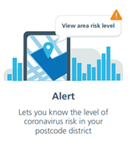
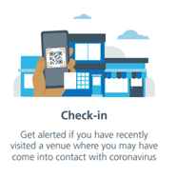
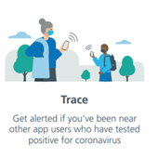


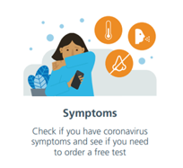
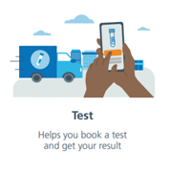
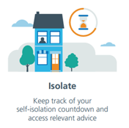
NHS COVID-19 app features
The free NHS COVID-19 app is a vital part of the NHS Test and Trace service in England Test, Trace, Protect service. It is the fastest way to see if you're at risk from coronavirus.
The app has a number of tools to protect you, including contact tracing, local area alerts and venue check-in.
The NHS COVID-19 app is entirely voluntary and you can choose whether or not to download it. You can also uninstall and delete the app whenever you like.
Every person who downloads the NHS COVID-19 app will be helping in the fight against coronavirus (COVID-19).
The app does all this while protecting users' anonymity. Nobody, including the government, will know who or where a particular user is.
The NHS COVID-19 app only works on smartphones that are compatible with the Exposure Notification framework developed by Apple and Google.
Below are the key app features
Download the app here
Resources
How to download the app NHS COVID-19 app video Your data and privacy
Using COVID-19 app to protect visitors and staff NHS COVID-19 information Create QR poster pdf
Version 2.0 13102021

Slide 27
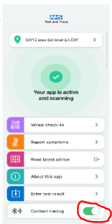
How staff should use NHS COVID-19 App
All Domiciliary Care staff should use the NHS COVID-19 app outside their places of work, please see NHS COVID-19 app features slide regarding instructions on how to download the app.
The NHS COVID-19 app only works on smartphones that are compatible with the Exposure Notification framework developed by Apple and Google
Use of app in the client’s home
Health and care workers should not use the NHS COVID-19 app when they are working in care environment, such as a client’s home, healthcare buildings, including hospitals and GP surgeries.
If you’re a health or care worker practising infection prevention
and control (IPC), including wearing correct PPE, you should pause contact tracing on your app when wearing the correct PPE in the clients home. In your day to day life, or if taking a client outside of a care setting, the app should be switched on.
How should health and social care workers pause contact
tracing?
Pause contact tracing within the app by scrolling down the
home screen to the Bluetooth image and turning the contract
tracing button to off as shown in the picture.
Remember to turn contact tracing back on once you leave this situation.
The free NHS COVID-19 app is a vital part of the NHS Test and Trace service in England Test, Trace, Protect service. It is the fastest way to see if you're at risk from coronavirus.
The app has a number of tools to protect you, including contact tracing, local area alerts and venue check-in.
The NHS COVID-19 app is entirely voluntary and you can choose whether or not to download it. You can also uninstall and delete the app whenever you like.
Every person who downloads the NHS COVID-19 app will be helping in the fight against coronavirus (COVID-19).
The app does all this while protecting users' anonymity. Nobody, including the government, will know who or where a particular user is.
The NHS COVID-19 app only works on smartphones that are compatible with the Exposure Notification framework developed by Apple and Google.
Download the app here
Resources
How to download the app NHS COVID-19 app video Your data and privacy
Using COVID-19 app to protect visitors and staff NHS COVID-19 information Create QR poster pd
Easy Read Test and Trace
f
Version 2.0 13102021

Slide 28
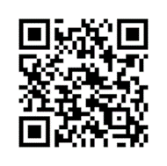
How clients should use NHS COVID-19 App
All clients should use the NHS COVID-19 app when they are visiting venues outside their places of residence, please see NHS COVID-19 app features slide regarding instructions on how to download the app. The app should be turned off when in the clients’ home.
The NHS COVID-19 app only works on smartphones that are compatible with the Exposure Notification framework developed by Apple and Google.
Using the COVID-19 Test and Trace App
The app can keeps a record of where they have been when visiting places outside the home. If other people were at the same venue at the same time as your resident, and later test positive for coronavirus (COVID-19), the resident may receive a notification.
Checking in to venues
Clients can use the app to check in to QR Code
venues when they visit.
Clients can check in to a venue by
pressing on the check in section and
scanning a QR code (see picture)
The QR for a venue is usually located
on a poster near the
entrance or service till in a shop.
You will find QR posters in cafes, restaurants, bars, leisure centres, hairdressers, beauticians, community centres and places of worship.
Where a QR code poster is not available, clients may still need to fill out their details.
Using the App to check symptoms
Clients can use the app to check and report their symptoms.
By clicking on the select symptoms section the client can choose the symptoms they may feel they are experiencing at the time.
By clicking the submit symptoms button it will let the resident know if they may need to have a Coronavirus test.
If the app advises to have a Coronavirus test, this can be booked by calling 111, through the self referral digital portal or using local arrangements for testing where they exist.
The app will provide guidance on the number of days the resident will need to self isolate.
Resources
How to download the app
NHS COVID-19 app video
Your data and privacy
NHS COVID-19 information
Easy Read Test and Trace
Version 2.0 13102021

Slide 29

NHS Test and Trace: what does it mean for domiciliary care?- 1
Health and care workers should not use the NHS COVID-19 app when they are working in care environment, such as a client’s home, healthcare buildings, including hospitals and GP surgeries.
If you’re a health or care worker practising infection prevention and control (IPC) you should pause contact tracing on your app when wearing the correct PPE in the clients home. In your day to day life, or if taking a client outside of a care setting, the app should be switched on.
It is not clear if previous infection gives immunity or not, therefore this system will apply to anyone (client or staff) who is a close contact of a confirmed case, whether they have had the virus before or not.
Full details on NHS Test and Trace and maintaining records of staff, customers and visitors are on GOV.UK.
Domiciliary Care providers may be contacted if any of their staff or clients have tested positive for coronavirus in order to alert those who have been in close contact with them.
Domiciliary care providers can assist NHS Test and Trace by keeping a temporary record of their care staff and recipients of care, to store and provide this information on request.
If you do not currently have a system to record this information, this should be done in a way that is manageable, but sufficiently detailed.
It is recommended that providers ensure that they can report quickly on request.
The domiciliary care provider manager should identify close contacts as per test and trace processes:
having face-to-face contact with someone (less than 1 metre away)
spending more than 15 minutes within 2 metres of someone
travelling in a car or other small vehicle with someone (even on a short journey) or close to them on a plane
has cleaned a personal or communal area of a home where a confirmed case has been located (note this only applies to the first time cleaning of the personal or communal area)
If the domiciliary care provider identifies linked cases in staff and clients, or there is a complex case, please notify the local authority and contact LCRC on 0300 303 0450 or LCRC@phe.gov.uk or phe.lcrc@nhs.net. The local authority homecare team will be able to provide further advice and support.
Version 2.0 13102021

Slide 30
NHS Test and Trace: what does it mean for domiciliary care?-2
If a provider is contacted, the following information may be requested at short notice:
the name and telephone number for a domiciliary care worker
the dates and times that a domiciliary care worker is at work
a log of the care worker’s visits to individuals receiving care for the previous 21 days. This should include, where possible, arrival and departure times of their visit, as well as a record of the name and residence of any individual(s) they provided care to (‘the client’)
the name and telephone number of the client and/or the client’s representative
the names and telephone numbers of other domiciliary care workers, when working in close proximity (for example, during a ‘double up’ visit)
NHS Test and Trace will ask for these records only where it is necessary
GDPR, Test and Trace and home-care providers:
All collected data must comply with the General Data Protection Regulation (GDPR) and should not be kept for longer than is necessary.
To comply with General Data Protection Regulation (GDPR), any records or reports produced specifically for NHS Test and Trace should be held for 21 days. After 21 days, this information should be securely disposed of or deleted. When deleting or disposing of data, you must do so in a way that does not risk unintended access (for example, shredding paper documents and ensuring permanent deletion of electronic files). Reports to NHS Test and Trace should not contain data that goes beyond what is requested.
Click here for more information on GDPR and Test and Trace in relation to your staff
Version 2.0 13102021

Slide 31

Returning home from hospital: package restart/ package acceptance
All clients being discharged from hospital, and starting a new or restarting a package will be swabbed 48 hours before discharge. Hospitals should describe care needs and COVID status with relevant community and social care partners planning subsequent care once the patient is discharged.
All individuals can be safely cared for at home by domiciliary care providers, regardless of their COVID status, if the guidance on use of PPE is correctly followed.
Testing must not delay a timely discharge as detailed in the hospital discharge service guidance.
Any individual being taken on by a domiciliary care provider should be cared for as possibly COVID-positive until a 10-day period has passed, within their home, regardless of the swab result. Providers should follow the relevant guidance for use of personal protective equipment for COVID-positive people during this 10-day period.
Where clients need to admit visits from carers or other agencies to their home in this period, all IPC advice should be followed and PPE worn.
Think
Make sure that your staff know that the client they are visiting has recently been discharged from hospital
Ask
Is there anything that you need to consider in terms of your clients return to their home.? Remember that your local CCG and Local Authority teams can help if you need it.
Do
Have early conversations with your local Hospital Discharge Services so that you understand how they will be working through this period. This will help you both to understand the expectations that will support a safe and effective discharge for your resident.
Communicate clearly with your local brokerage service
Send emails directly to your clients’ GP, Community Team and Hospital. Contact your CCG care home team or register here to get an NHS.net email address set up
Feel confident to raise your concerns – throughout this the safety of care still remains the core priority.
Resources
Stepdown of infection control precautions and discharging COVID-19 patients: Guidance
COVID-19: Adult Social Care Action Plan
Version 2.0 13102021

Slide 32
What to expect from hospitals before a package restart/ package acceptance
Informed by discharge guidance for hospitals, below are considerations for domiciliary care providers in the discharge process/ at the (re)start of a domiciliary care package. The guidance on discharge to assess is clear that the discharge to assess pathways must include NHS organisations working closely with adult social care colleagues, the care sector and the voluntary sector. No person should be discharged before it is clinically safe to do so.
Section 5.1 of the guidance advises that to create a safety net and increase confidence in discharging, consider:
Guidance for hospitals | What domiciliary care providers should consider
Person-initiated follow up – give people the direct number of the ward discharged from to call back for advice. Do not suggest going back to their GP or coming to A&E | Has the client been provided with the direct number of the ward discharged from? You should consider calling them for advice soon after discharge.
Telephoning the following day after discharge to check and offer reassurance or advice | Check with the client if they think they’ve been called the day after discharge by the ward. If they are not sure, can you call?
Calling them back with results of investigations and any changes or updates to a person’s management plan | If the hospital has called back with results of investigations and/or changes to the clients management plan, what impact does that have on the social care you are providing?
Bringing them back under the same team or speciality | Is your team likely to need to help arrange any follow-ups?
Requesting community nursing follow up with a specific clinical need | If community nursing follow up, ensure there is coordination with them and you
Requesting GPs to follow up in some selected cases | If GP follows up, make sure that there is coordination between them and you
Where people are discharged from an acute or community hospital back to their own home, the requirements of the hospital discharge service guidance apply. The guidance requires that each locality appoints a local co-ordinator with accountability for all elements of the discharge process covered by the guidance, including the provision of discharge summaries. | Where home care agencies identify inadequacies in discharge summaries, these need to be escalated to the local co-ordinator. All areas are required to have a local co-ordinator during the COVID-19 response. Contact your local authority for clarity around who this person is if required.
All registered providers and managers will need to have confidence that legal requirements for assessments will be met, and that particular consideration will be given to safety and infection control-related needs during this heightened period. This will require hospital, community health, and social care providers to work together to make sure people have the right support in place.
Version 2.0 13102021

Slide 33

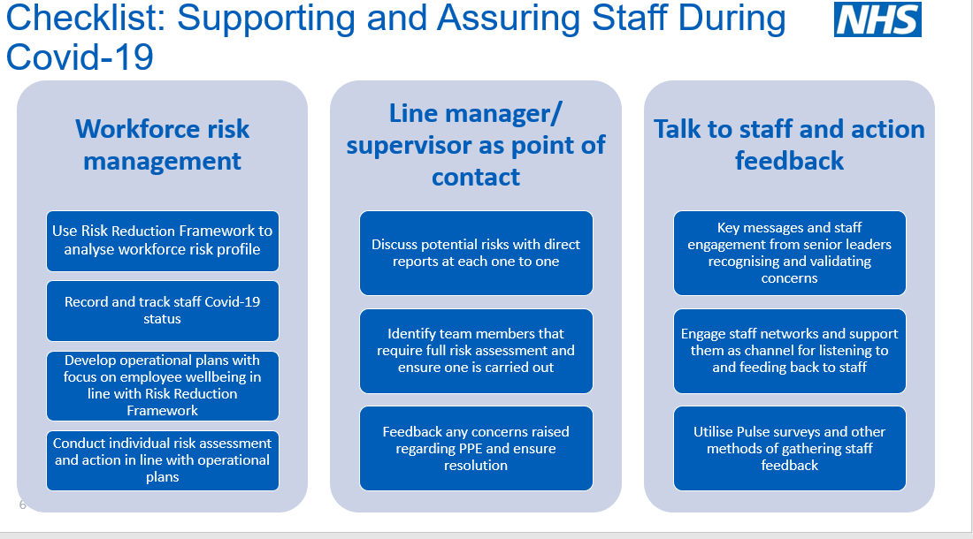
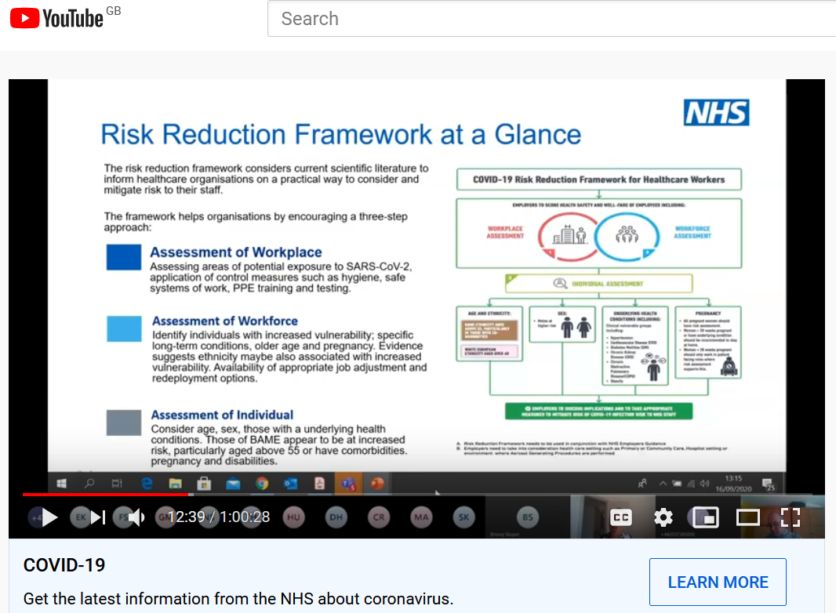
Covid-19 & Workforce Risk Assessments
As both flu and Covid-19 are communicable respiratory viruses, there is a strong link between them, and the risk of death is higher in patients who have both viruses. The protective precautions taken to prevent the spread of one can also help to prevent the spread of another.
Due to heightened concern over Covid-19, there has been a sustained campaign to increase uptake of the flu vaccine amongst domiciliary care staff
This winter there is heightened focus on health and social inequalities impacting the risk of catching flu or Covid-19, and efforts to reduce risk factors against both, in light of the disproportionate effect of COVID-19 on BAME and older populations. Efforts to increase uptake of both the flu vaccine and the Covid-19 have focused on, and will focus on targeted campaigns highlighting risks to audiences
Click here for the recording of a webinar from September 2020, with case studies from care providers showing participants how they have used a Workforce Risk Assessment checklist to ensure that staff health and wellbeing risks are identified, and how they have implemented the required protective measures. The webinar recording and slides, including the risk assessment tool are available here.
Version 2.0 13102021

Slide 34

Working with primary care and community services
Think
Do we need to discuss new ways of working with our GPs and community services staff?
How can we communicate in the most effective way to support our clients?
What help do we need to keep our clients safe?
Ask
Which new ways of working with GPs and community services staff will be the most effective?
Do my staff need training in order to do so?
Which service should I contact to support my clients and staff?
Where appropriate, can we work together to support proactive planning and Advance Care Plans for clients?
Do
Start using NHS Mail - Contact your CCG care home team or register here https://portal.nhs.net/Registration#/careprovider to get an NHS.net email address set up.
Ask for help when you need it
If trained to do so, learn to communicate effectively using tools such as SBAR or other locally approved tools
Be clear about what support you can expect from primary care and community services
It is important we work more closely than ever with our colleagues who provide care in the community, including GPs and community health teams. Here are some checkpoints you should consider when working with primary care and wider healthcare colleagues:
Is your client registered with a local GP?
Is the GP aware of any recent hospital admissions and discharges?
If your client or you have any concerns about their recent discharge or their condition, you should ensure that the GP is informed. They should then decide on the best course of action, and should keep you or the client informed
Request GP contact including visits if there are concerns about the client after discharge
If appropriate, check that an advanced care plan such as Coordinate My Care (CMC) is in place. Clients may have had discussions already with their families and GP about this.
Clients can start their own plan through my CMC with family or staff support. That initiated work is then checked, edited and signed off by an appropriate health care professional making it visible to all appropriate users including Urgent Care Services.
Version 2.0 13102021

Slide 35

Supporting clients’ health and wellbeing
Supporting clients’ health and wellbeing
Think
How it can feel when you have nothing to do all day or no one to talk to?
Can I enable and support clients to make video calls?
Ask
“What do you enjoy?” “what do you like to do?”
Family members about their loved ones preferences
Check the care plan to learn more about your clients family and social history
Can the Local Authority, CCG or voluntary sector support?
Do
Refer to existing material such as the HIN’s activity guide (dementia friendly activities for older adults during the national response to Covid-19)
Use the NHS live well resources
Supporting clients to exercise and get moving
Think
Some physical activity is always better than none
How can we help our clients to sit less and move more
Does my client need specific exercise, for example to reduce falls – you can get advice from a healthcare professional
Ask
Your client what physical activities they enjoy or used to enjoy
Your client if they have a home exercise plan
Do
Include exercise/ physical activity in your clients care plan, if appropriate
Consider the risk of falls, and put in steps to prevent them
Check your client is wearing supportive, well fitting shoes for exercise
If using a support for standing exercises - use something sturdy e.g. kitchen worksurface or sturdy chair
Discuss with your clients GP if you have any concerns
Resources
Physical activity for adults and older adults poster
Faith Action – advice and resources
Managing activities for older adults during COVID-19 (HIN) link
At a Loss tips to help someone bereaved at this time here
Cruse – what to say when someone is grieving here
Activity ideas for people with learning disabilities
NHS Live Well link
Death & Grieving in Care Homes during COVID-19: Guidance
Resources
Simple set of exercises to stay active from the Chartered Society of Physiotherapists - video and a poster
Later life training you tube exercises including chair based exercises
Age UK exercise at home information
Version 2.0 13102021

Slide 36
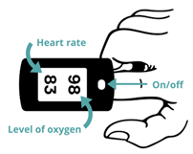
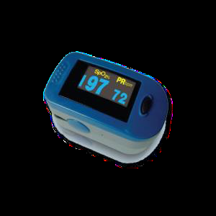
Checking clients’ oxygen levels- Pulse Oximetry
*This slide applies only to providers involved in remote monitoring pilots*
Pulse oximeters are being used to support people receiving social care during the current COVID-19 pandemic. You may be asked to check clients’ oxygen levels. If the clients’ GP or practice nurse asks you to help with this they will tell you how and when to check and how to monitor and record or report results.
Preparation
Explain to the client that you are going to use a pulse oximeter and
prepare them appropriately
Remove any nail varnish or false nail on one finger
Wash client’s hands with water or use antiseptic wipe and use a warm hand as cold can affect the reading
Get a pen and paper to write down to write down the numbers
How to use a Pulse Oximeter
1. Rest the client’s hand flat on their leg, a table or arm of a chair
with nails facing upwards
2. Place the finger into the Pulse Oximeter
3. Press the button so the screen lights up
4. Keep the Pulse Oximeter on the finger for at least 30 seconds and continue for
up to 60 seconds until reading is stable.
5. Write both numbers down
Recording
Please record;
Date
Time
Oxygen level
Heart rate
Monitoring and escalation
Normal blood oxygen level for most people is between 95-100% – continue to check blood oxygen level as directed by GP or Practice Nurse
If 2 successive readings show blood oxygen levels between 93-94% OR continues to be lower than the client’s usual reading where their normal oxygen saturation is below 95%; contact their GP or 111 * 7 as soon as possible.
If 2 successive readings show blood oxygen levels of 92% or less; you must immediately seek advice from GP or NHS 111 as the client may need to immediately attend the nearest A&E department.
Provide the recorded details to the appropriate healthcare professional as requested
Further information can be found here:
Important information to keep you safe while isolating at home
How to measure oxygen saturations using a pulse oximeter
Managing deterioration videos
Easy read resource on oximeters
Use of Pulse Oximeters as good practice
Care staff can use Pulse Oximeters to measure blood oxygen saturation levels in clients who have become breathless, more unwell, confused or showing changes in behaviour. The measurements can be helpful to clinicians as part of a more holistic assessment
Check their oxygen levels and heart rate. Raise any concerns as per the above guidance.
Cleaning of Pulse Oximeters
To maintain good infection control practices, the Pulse Oximeter must cleaned with an antiseptic wipe after each use on a different resident.
Oxygen level
Heart rate
****Consider whether the client already has a pre-existing condition that may impact their oxygen levels. Do you know what oxygen saturation level is normal for your client?****
Version 2.0 13102021

Slide 37
Recognising signs of deterioration
Various levels of expectation on domiciliary care staff around deterioration. Sometimes it can be obvious that someone is unwell. Other times the signs might be much harder to spot. Main responsibility is recognising signs of it, and signposting/ seeking help.
This short film from Health Education England explains what soft signs are and what to do if you spot them. https://www.youtube.com/watch?v=JYafrPgAUL4.
How to spot soft signs?
It is good practice to ask the people you care for, ‘how are you feeling today’? Allow them time to answer the question in their own way and make a note of individual or unique soft signs in the client’s records for future reference. You should encourage friends and family to tell you if they notice any soft signs. Soft signs are particularly useful for clients who have difficulty communicating or understanding information due to dementia or learning difficulties.
There are several tools available help you recognise physical deterioration and take the appropriate actions. Some of these resources can be viewed and downloaded from the AHSN / NPSC 'soft signs' webpage.
Types of soft signs
Soft signs can be related to many things including the client’s:
Changes in a person’s physical presentation such as:
  being short of breath
  not passing much urine
  being hot, cold or clammy to touch
  being unsteady when walking
Changes in someone’s mental state such as:
  feeling more anxious or agitated
  having new or worse confusion
  being more withdrawn than normal
Changes in behaviour or ability such as:
altered sleep patterns
increased tiredness
reduced inhibitions
being very restless or hyperactive
For more examples of soft signs see the RESTORE2mini handbook (page 12) or the RESTORE2mini chart – both developed by West Hampshire CCG and Wessex Patient Safety Collaborative.
Resources
Soft signs of being unwell: https://www.youtube.com/watch?v=JYafrPgAUL4
Telling someone you are worried: https://www.youtube.com/watch?v=tkVJw8QZ7EE
Adopted from information on the West Hampshire CCG and Wessex Patient Safety Collaborative websites. RESTORE2TM is trademarked and copyright West Hampshire Clinical Commissioning Group 2019
Version 2.0 13102021

Slide 38
Signposting and escalation in case of deterioration
If you notice that a client has deteriorated, and are concerned about their condition:
Keep a record of non urgent concerns and queries to discuss with the client’s family, primary care team, or community health colleagues, when convenient
If a client rapidly deteriorates call their GP promptly. If the GP is not available call 111* Star 7 for urgent clinical advice
Start using NHS mail - if you need help with this please email hlp.londonchnhsmailrequests@nhs.net
Learn to communicate effectively, in order to share information, using tools such as SBAR/ SBARD or other locally approved tools
Follow the relevant pathway if one is available, otherwise discuss with a more senior member of staff, call the GP or 111 *6 (see slide 4 in this pack for further information)
In an emergency call 999.
Version 2.0 13102021

Slide 39

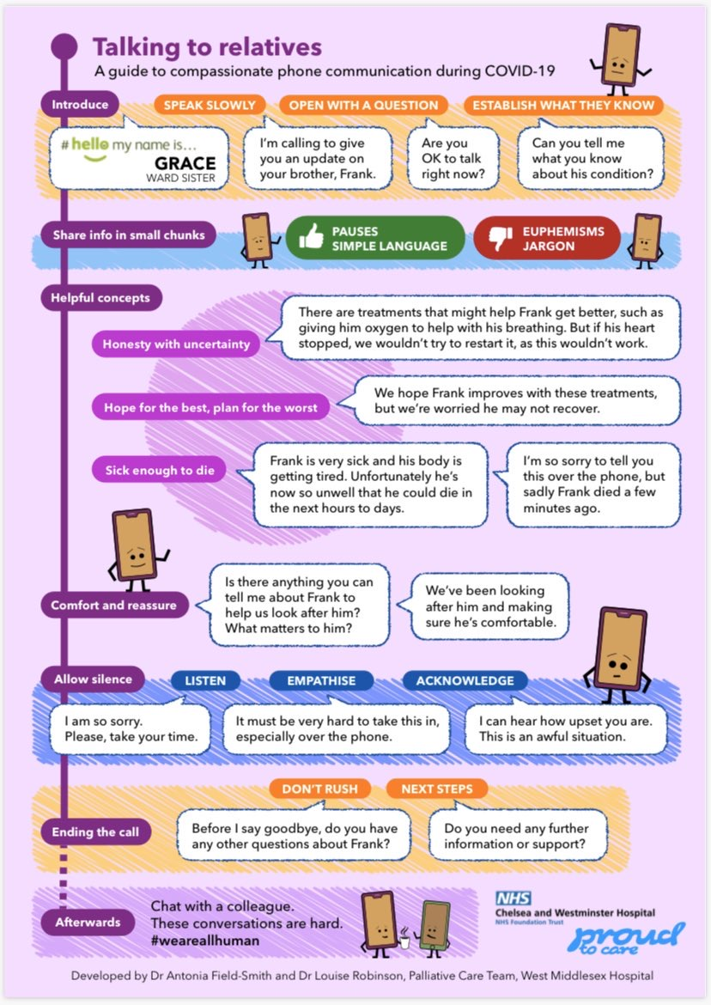
Talking to relatives
Conversations with relatives about COVID-19 can be challenging.
Think
What information do I need to tell the relative
How can I keep the language simple
Ask
If the relative is ok to talk
What the relative already understands about their loved one
If they have any questions or need any other advice or support
Do
Introduce yourself
Comfort and reassure
Allow for silence
Talk to colleagues afterwards
Resources
Real Talk evidence based advice about difficult conversations
VitalTalk COVID communication guide
Health Education England materials and films to support staff through difficult conversations arising from COVID-19.
Version 2.0 13102021

Slide 40
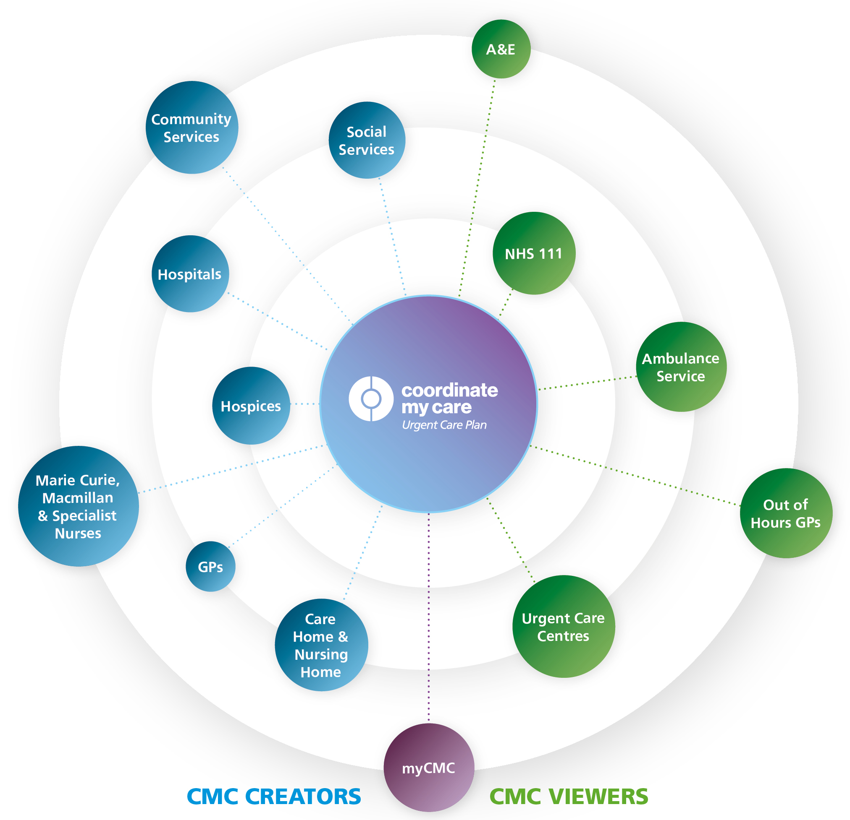
Advanced Care Planning - CMC
Advance care planning offers people the opportunity to plan their future care and support, including medical treatment. It can be a very powerful tool in planning end of life care.
Clients may have discussed with relatives and healthcare professionals, and made an advanced care plan, documented using Coordinate My Care so that urgent care services can view the persons wishes. For example, they may request a ‘do not attempt resuscitation’ order if they deteriorate seriously.
Conversations around end of life are challenging, particularly in these difficult times, but it is helpful to know the wishes of the client and their family, so it is good to discuss it with them.
What are the benefits of using a digital advance/urgent care plan?
Benefits for your staff and care home
A digital care plan ensures that everyone has access to the same, up to date information.
There is no need to print documents about your residents in an urgent care situation;
Urgent care services will already have access to information that you have entered.
Paramedics and ED staff can update information about your resident. This information will be immediately visible to you.
Reduces LAS call-outs and conveyances which can be stressful for your resident and your staff.
What is CMC?
Coordinate My Care (CMC) is a digital urgent and advance care planning tool. CMC care plans include diagnoses, medical details, resuscitation status, medications and recommendations for the urgent care services to follow in an emergency. CMC care plans also include information about people’s preferences and wishes in an urgent care situation, include their preferred place of death.
Once the CMC plan is approved by a clinician, it is immediately visible to all the urgent care services including 111, out of hours GPs, the ambulance (in their vehicles) and the emergency departments. This way everyone is in the loop with the person in the middle.
Think
Does the client have an ACP care plan on CMC?
Is there anything from your knowledge of or relationship with a client that could inform best plans for their ACP?
Resources
NICE quick guide for home care services on advance care planning
End of Life Care: Support during COVID-19: Guide
Version 2.0 13102021

Slide 41

Supporting care in the last days of life
Some clients will have expressed their wishes to not go to hospital and to stay in their home and made as comfortable as possible when they are dying.
Common symptoms at the end of life are fever, cough, breathlessness, confusion, agitation and pain. People are often more sleepy, agitated and can lose their desire to eat and drink.
Breathing can sound noisy when someone is dying – due to secretions, medicine can be given to help.
Some people can become agitated or distressed when dying – provide reassurance and things the person would find comforting e.g. music.
Think
Have I contacted the family?
Does the resident have a CMC plan? – what are the client’s wishes and preferences?
Have you considered the spiritual needs of clients and their families?
Do
Does the client have the medication needed to help relieve symptoms (e.g. pain, nausea, breathlessness)?
Can I make the client more comfortable - are they in pain (look or grimacing), are they anxious (can make breathlessness worse)
Can I use a cool flannel around face to help with fever and breathlessness. Sitting up in bed and opening a window can also help. Portable fans are not recommended
If the person can still swallow honey and lemon in warm water or sucking hard sweets can help with coughing
If having a full wash is too disruptive washing hands face and bottom can feel refreshing
Ask
The family and client if they want to connect using technology if they cannot be there in person
The GP or palliative care team or call 111 *7 if urgent for advice about symptom control and medication
Resources
Guidance on visitors for people in their last days of life: Guide
End of Life Care: Support during COVID-19: Guide
Key to care: End of life care
Royal College of GPs COVID: End of Life Care in community
NICE COVID-19 rapid guidelines managing symptoms in community
End of Lifecare for People with Learning Disabilities
Version 2.0 13102021

Slide 42

Support for people who are bereaved
Bereavement is the experience of losing someone important to us. It is characterised by grief, which is the process and the range of emotions we go through as we gradually adjust to the loss.
This guidance includes not only staff and relatives of someone who have died but also clients who may be bereaved.
Every bereaved person should be able to access appropriate support for the nature of their bereavement, where and when they need it. See resources section for more information
Bereavement affects everyone in different ways, and it's possible to experience any range of emotions. There is no right or wrong way to feel. Be kind to yourself and talk to family and friends about how you are feeling.
Some people may not have had the opportunity to say goodbye to their loved ones before they died, which can be particularly upsetting. The observance of other practices and traditions which normally occur after someone has died may also be affected. Those who are already struggling with bereavement, or whose relatives or friends die through other causes may also be affected.
When you are bereaved it may help to stay in touch with other people, however because of COVID-19, you may need to do this by telephone, video, and online.
Think
About developing rotas to accommodate regular and more frequent breaks for staff
About ways that people can remember, individually/collectively those who have died and celebrate the person’s life
Do
Try to maintain communication with family and friends
Ensure that usual focus on activity and wellbeing
Staff should be made aware that they are welcome speak to their manager and seek support whenever its required
Offer a routine check-in with staff to explore if any support is required
Ask
How clients/staff are feeling. See “Only human” campaign slide
For clients who have additional needs with memory and understanding see guidance: Here
Resources
Death and grieving in a care home during the COVID-19 pandemic: Guide
How to cope with bereavement and grief during the coronavirus outbreak: Here
Cruse Bereavement Care
Mind information support on bereavement
https://www.supportline.org.uk/problems/bereavement/
ThriveLDN has created a Bereavement Support Toolkit and has additional tools and resources to help your mental health and wellbeing.
The Good Grief Trust Newly Bereaved Resources
Keeping in touch when you can’t be with someone who is so ill that they might die from National Bereavement Alliance
PCPLD Network :Supporting people with learning disabilities to remember their loved ones that have died: A Podcast
Accessible Resources
When someone dies from coronavirus: a guide for family and carers free download from Books Beyond Words
Let’s talk about when someone is ill or dies from coronavirus Resource to support conversations with people with learning disabilities online, from Books Beyond Words
Version 2.0 13102021

Slide 43
Accessing support for digital transformation
To access support for digital transformation in your area, contact:
North East London (Barking & Dagenham, City of London, Hackney, Havering, Newham, Redbridge, Tower Hamlets, Waltham Forest)
North East London Health and Care Partnership
Email elhcp.digitalfirstcare@nhs.net
North Central London (Barnet, Camden, Enfield, Haringey, Islington)
North London Partners in Health and Care
Email nclccg.nclcarehomes@nhs.net
North West London (Brent, Ealing, Hammersmith and Fulham, Harrow, Hillingdon, Hounslow, Kensington and Chelsea, Westminster)
North West London Integrated Care System
Email nwlccgs.covid19community@nhs.net
South East London (Bexley, Bromley, Greenwich, Lambeth, Lewisham, Southwark)
Our Healthier South East London
Email tumsilla.sethi1@nhs.net
South West London (Croydon, Kingston, Merton, Richmond, Sutton, Wandsworth)
South West London Health and Care Partnership
Email swlcarehomes.admin@swlondon.nhs.uk
Project | Benefits include
Data Security and Protection Toolkit (DSPT) | Enables access to digital tools supporting improved care for service users: NHSmail and MS Teams, to enable secure communication and video calls with other health and care professionals Access to health and care records of service users, supporting faster shared decision making and increased productivity for carers unlocking more time to provide direct care Direct benefits for domiciliary care provider organisations: Demonstrate to CQC that you meet their expectations around data security and information sharing Improved protection from cyber attacks Evidence that you are complying with law and best practice
NHSmail | Improved communication with key stakeholders: Safely send and receive information with service users’ GP practices Faster communication across health and care organisations Direct communication with community healthcare professionals
Version 2.0 13102021

Slide 44


Data Security and Protection Toolkit (DSPT)
The Data Security and Protection Toolkit (DSPT) is a really helpful annual self-assessment for health and care organisations. It shows you what you need to do to keep people’s information safe, and to protect your business from the risk of a data breach or a cyber attack. Once you’ve completed the DSPT, it will help you demonstrate, to the people you support, your commissioners, GPs and other NHS services, that you are handling information securely.
You can learn more about the DSPT on the Digital Social Care website. This website also provides practical tips and directs you to relevant guidance, templates and legislation to make completing the self-assessment even easier.
The ‘Better Security Better Care’ programme is supporting London social care providers to complete the DSPT via webinars, interactive online workshops and 1:1 support in 2021/22.
To get local support with completing DSPT, please contact your area lead
(see contact details on ‘Accessing support for digital transformation’ slide).
All CQC-registered care providers in England (including domiciliary care providers) are expected to register for DSPT.
Guidance on how to register is available on the Digital Social Care website.
Following registration, providers must complete and publish DSPT annually.
Providers who achieve Approaching Standards compliance are eligible to register for register for secure NHSmail at no cost.
If you have any questions or would like support with NHSmail or DSPT, email the NHS London team: hlp.londonchnhsmailrequests@nhs.net
Version 2.0 13102021
Notes:
Updated resources

Slide 45

DSPT – support available from Digital Social Care
Digital Social Care, run by social care providers for social care providers, is a dedicated space to provide advice and support to the sector on technology and data protection.
The Digital Social Care website includes resources and guidance on all things digital which are relevant to adult social care providers.
You can access it at: https://www.digitalsocialcare.co.uk
From September 2021 to March 2022, Digital Social Care and NHSX are delivering a monthly masterclass webinar series aimed at adult social care providers on Adopting Digital Care Records. These webinars are designed to help you with adopting Digital Social CAre Records by sharing the knowledge and expertise of people who have already started to use these systems. To find out more or register, go to the Digital Social Care website’s Masterclass Series page.
Digital Social Care has set up a helpline to support the adult social care sector with harnessing technology during the COVID-19 outbreak.
The helpline is open Monday to Friday, 9am to 5pm, and you can access it by phone (0208 133 3430) or email (help@digitalsocialcare.co.uk).
A team of digital experts are available to help social care providers access practical advice to troubleshoot a technical problem or give in-depth one-to-one support, with expertise including:
MS Teams and video conferencing
Remote monitoring
NHSmail and secure email
Data protection (Guide to Data Protection | ICO)
E-learning
Care planning software
Assistive technology
Technology for recruitment
Version 2.0 13102021

Slide 46
Supporting staff wellbeing
The COVID-19 outbreak is affecting us all in many ways: physically, emotionally, socially and psychologically. It is a normal reaction to a very abnormal set of circumstances. It is okay not to be okay and it is by no means a reflection that you cannot do your job or that you are weak. Some people may have some positive experiences, such as taking pride in the work, or your work may provide you with a sense of purpose. Managing your emotional well-being right now is as important as managing your physical health. If you are concerned about your mental health, your GP is always a good place to start. If it is outside of working hours, contact the crisis line of your borough which is here or if you are known to services, please call your Care Coordinator or the service responsible for your care.
Below are some things to consider to support your own wellbeing:
These times are temporary and things will get better
Consider and acknowledge how you are feeling and coping, reflecting on your own needs and limits
Ask for help if you are struggling. Asking for help when times are difficult is a sign of strength
Stay connected with colleagues, managers, friends and family. Where possible do check on the needs of colleagues and loved ones
A lot of things might feel out of your control at the moment. It can help to focus on what we can control rather than what we cannot
Acknowledge that what you and your team are doing matters. You are doing a great job!
Choose an action that signals the end of your shift and try to rest and recharge when you are home
To speak to someone::
Urgent Support: Good-Thinking’s Urgent Support page has numbers and links to help you access urgent support,
1:1 Mental health support 24 hours a day: Text FRONTLINE to 85258 for a text chat or call 116 123 for a phone conversation
Visit Bereavement Support Online or call the free confidential bereavement support line (Hospice UK), on 0300 303 4434, 8am – 8pm
NHS Psychological therapy (IAPT): Search here to find out how to get access to NHS psychological therapy (IAPT)
Finances: If relatives of staff are financially effected by COVID-19, they can access the Money Advice Service web-chat or call 0800 138 1677, from www.moneyadviceservice.org.uk
Care Workers’ Charity’s grants are also available to staff who need them, and there is also a Covid-19 Emergency Fund
See next slide for more resources
Version 2.0 13102021

Slide 47

Staff mental health and emotional wellbeing
Evidence-based apps and personalised online tools:
Worry and anxiety: The free Daylight phone app teaches you to manage worry and anxiety by offering audio-led guidance tailored to you
Sleep: Sleepio is a highly personalised free digital sleep-improvement program which helps you get to the root of poor sleep.
Work and well-being:
Going Home checklist: Find simple steps to help you manage your own wellbeing at the end of each working shift in this video
Risk Assessment BAME staff: Use Risk Reduction Framework for staff at risk of COVID-19 infection (pages 9 and 10) here and assessment here
Preventing work related stress: Use Health and Safety Executive’s talking toolkit for preventing work related stress here
‘Mental Health and Psychosocial Support for Staff, Volunteers and Communities in an Outbreak of Novel Coronavirus’: Guidance from the British Red Cross for staff, volunteers and communities. Can be found here
Mental Health at work: Information and resources for managers on taking care of your staff. Learn how to support your staff here
Anxiety and worry: Access the Guide to managing worry and anxiety amidst uncertainty from Practitioner Health (Psychology Tools) here
Further resources:
The stigma of COVID-19 can cause distress and isolation. Learn how to fight it here
Building your own resilience, health and wellbeing website is a resource from Skills for Care
Reflective debrief after a death: Support carers to take time grieving and reflecting together about the person that has passed away, what happened leading up to the death, what went well, and what didn’t go so well, what could have been done differently, and what needs to change as a result of the reflection – Resource from ‘What’s Best for Lily’ by UCL Partners. Find out how to do this by downloading resources here.
For access to more tips, free guides, assessments and signposted resources, visit Good Thinking
Version 2.0 13102021

Slide 48


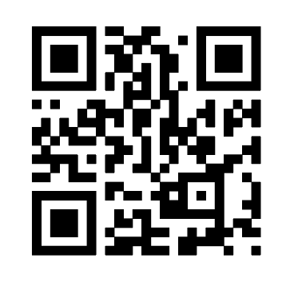

Supporting wellbeing during and post Covid-19
The #OnlyHuman campaign has been developed to positively support health and care staff to prioritise their physical health and emotional wellbeing needs in light of Covid-19 and beyond.
In April, the Institute for Public Policy Research reported that 1 in 2 workers felt their mental health had declined since the pandemic began and more than 1 in 5 were more likely to leave the profession as a result.
The campaign materials take on a peer-to-peer approach having found that staff can struggle to identify signs of stress within themselves, but are far better at spotting signs within colleagues.
It's easier to spot a change – and potentially a problem - in someone else than in yourself. Keep an eye out for changes among your team.
When asking a colleague how they are, try phrasing it as an open question ("how are you feeling?") rather than closed one ("you okay?").
Think about how you can set an example for colleagues by sharing your own challenges and vulnerabilities, whether that's in a huddle or one-to-one.
Set aside some time each day to reflect on what you and your team did well today, maybe as you leave the building.
Encourage discussions about familiar comforts and day-to-day experiences which haven't changed.
Remember to actively acknowledge the challenges and feelings that change and uncertainty can bring.
Small acts of kindness really matter - make a teammate a cuppa or bring in some biscuits to share.
You can always send teammates a message after work to let them know you are thinking of them.
Thank teammates for even the smallest thing. Day to day gratitude can make a difference.
Encourage a safe safe space for colleagues to get involved in and speak up ie team huddles.
Think of someone who rarely gets praised and make an effort to let them know you appreciate them. Specific examples make people feel appreciated and noticed.
Be mindful that new colleagues or people trying something for the first time will appreciate your support the most.
Resources
The use of the suite of materials is completely flexible. They are editable so you can add your own logo and choose from the five theme(s) listed above which are most relevant to your team. Please visit https://bit.ly/2OpMC7Q or scan the QR code using the camera on your phone.
Even when it feels difficult, try to reinforce the importance of breaks.
Find a moment every week to share tips about how you switch off and relax at the end of the day.
Set an example by making use of the wellbeing facilities your department has on offer.
Version 2.0 13102021

Slide 49
Supporting care provider managers
Skills for Care supports the adult care sector in England with workforce development resources and support to recruit, develop and lead quality care services. A key focus is the range of Support for registered managers
This includes:
Supporting local Registered Managers networks & Whats App groups
A new London wide network for deputy managers
A national Facebook page for managers
A series of webinars, podcasts and bite sized resources for managers –all recorded and available to download from the website
A Registered Manager membership programme which includes a handbook, monthly newsletters, mentoring and peer support learning opportunities
An advice line
Leadership programmes and online learning including managers induction standards
Support with achieving good and outstanding and preparing for CQC
In addition Skills for Care provides advice on recruitment of staff, workforce development funding, a range of learning and development resources and support and much more see https://www.skillsforcare.org.uk/home.aspx
Please contact your Locality Manager for more information here.
Version 2.0 13102021

Slide 50
London Health and Wellbeing hubs – an overview
In response to Covid-19, the Integrated Care Systems (ICSs)* in London have set-up – or are in the process of setting up - new digital health and wellbeing hubs to support all health & social care staff (including ancillary workers) with their wellbeing and resilience needs
These offer free, confidential, psychological support services run by care professionals for care professionals in a positive health and wellbeing environment. They aim to support staff through this particularly challenging time and can assist with addressing issues such as anxiety and depression, as well as helping people better manage their work – life balance
There is no cost to access the services that the hubs provide - and all are delivered by health and care professionals with extensive experience of mental health issues
The services you can access will depend on your local hub, but some of the support available includes:
  A safe and confidential listening service via online chat, video call or phone call
  Wellbeing needs reviews and emotional wellbeing screening
  Signposting to relevant resources in your local community
  Psychological support using NICE recommended treatment, including Cognitive Behavioural Therapy and counselling
  Self-help digital tools
  Confidential fast-tracking of those with urgent needs to existing NHS mental health services
Opening hours will differ depending on the hub, but you will be able to access flexible appointments that work around shift patterns
To find out more and start accessing these services just visit the website of your local hub (see next slide). Please note that some hubs are still in the development phase and will be available shortly
* ICSs are partnerships that bring together providers and commissioners of NHS services across a geographical area with local authorities and other local partners, to collectively plan and integrate care to meet the needs of their population.
Version 2.0 13102021

Slide 51
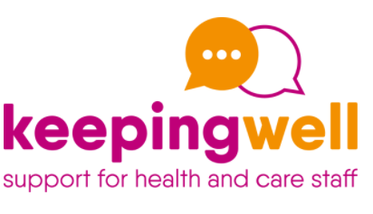
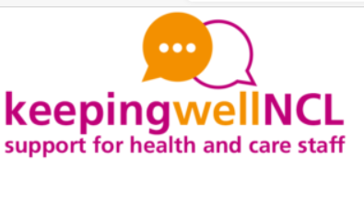


London Health and Wellbeing Hubs
ICS | Health and Wellbeing hub / website | Contact details | Web chat function | Wellbeing resources | Self-care tools | Support for teams
North West London | keepingwellnwl.nhs.uk | Keepingwell.NWL@nhs.net 03001231705 Monday to Friday 9.00am -5.00pm Including call back request |  |  |  | 
North Central London | keepingwellncl.nhs.uk | nclinmind@tavi-port.nhs.uk Support online chat function available via keepingwellncl.nhs.uk Monday to Friday 9.00am -5.00pm |  |  |  | 
North East London | keepingwellnel.nhs.uk | Keepingwell.NEL@nhs.net Callback request via website or SMS: 07723484839 |  |  |  | 
South East London | Keepingwellsel.nhs.uk | keepingwellsel@slam.nhs.uk and COVID-19StaffWellbeing@gstt.nhs.uk https://www.kingshealthpartners.org/our-work/mind-and-body/staff-health-and-wellbeing | Coming in May |  |  | 
South West London | Currently SWL intranet, with plan to make it public facing. On-site and embedded psychological and wellbeing support in Trusts. | staff@swlondon.nhs.uk | Coming soon |  |  | 
Version 2.0 13102021

