Slide 1
PERSONALISED CARE FOR LONDON
“Using your three personalised care ARRS roles effectively”
July 2021
@SP_LDN
hlp.socialprescribing@nhs.net

Slide 2
Plan for today
JOIN THE CONVERSATION
TIME | ITEM
12:30 | Intro to personalised care
12:40 | Purpose of 3 roles
12:55 | Examples in practice
1:15 | Support available in London
1:25 | Q&A
1:50 | Reflections and next steps
Scan this QR code with your phone
or join at slido.com
with #859551
To ask questions to speakers and join the polls
The presentations will be recorded & circulated with slides
It is an informal session – talk to each other & share resources in the chat
@SP_LDN
hlp.socialprescribing@nhs.net
@SP_LDN
hlp.socialprescribing@nhs.net
www.slido.com with #859551
PERSONALISED CARE FOR LONDON: using the 3 PC ARRS roles effectively

Slide 3
Dr Jagan John London Personalised Care Clinical Lead, NHS/E – London / HLP Chair, NEL CCG

Slide 4
Personalised care…
What it is:
“Personalised care means people have choice and control over the way their care is planned and delivered. It is based on ‘what matters’ to them and their individual strengths and needs.”
Person centred care strives to see an individual as bio-psycho-social whole, as a person and not a disease or a collection of conditions.
Commitment in NHS Long Term Plan:
Put in place more than 1,000 Social Prescribing link workers by the end of 2020/21, rising further by 2023/24, with the aim that more than 900,000 people are connected to wider community services that can help improve health and well-being.
For London this means working towards 800 SPLWs operating by 23-24
= approx. 4 per PCN of average population of 50,000
Vision for London:
Commitment to expanding Social Prescribing in all 5 ICS operating plans across the region
Core element of the London Vision and GLA’s COVID recovery plan – to be joint working at a neighbourhood level, taking an asset-based approach to working solutions
PERSONALISED CARE FOR LONDON: using the 3 PC ARRS roles effectively
@SP_LDN
hlp.socialprescribing@nhs.net
www.slido.com with #859551

Slide 5
Why is personalised care important for London?
5 London boroughs in top 10% most deprived boroughs in UK – PC role intrinsic tool for PCNs in community recovery
Use appropriate team according local population needs & ensure roles working together, embedded in PCN and being used in the right way
Currently have:
approx. 300 SPLW (soft count Mar 21) + because of appetite to grow SPLW teams there will be more initiative to follow
Several examples of how the ARRS is being used in innovate ways to fund specialist SPLW posts i.e. social welfare legal advice, C&YP, Lead SPLWs etc
Data currently being collated on numbers of CC (approx. 50) & H&WBC (approx. 20) *workforce return incomplete*
Less than 10 PCNs will all three roles active
Significant ARRS underspend in London – funding & support available to grow these teams
Impact these roles can have on patients, community & surgeries can be significant
PERSONALISED CARE FOR LONDON: using the 3 PC ARRS roles effectively
@SP_LDN
hlp.socialprescribing@nhs.net
www.slido.com with #859551

Slide 6
Personalised Care roles in Primary Care
Nicola Gitsham, Head of Social Prescribing NHSE/I
@nicola.gitsham@btinternet.com
July 2021

Slide 7
Personalised care is one of the five major, practical changes to the NHS that will take place over the next five years, as set out the recently published Long Term Plan (Jan 2019).
Universal Personalised Care was written into an implementation or action plan for the rolling out personalised care across England, to reach 2.5 million people by 2023/24 and then aim to double that again within a decade.

Slide 8
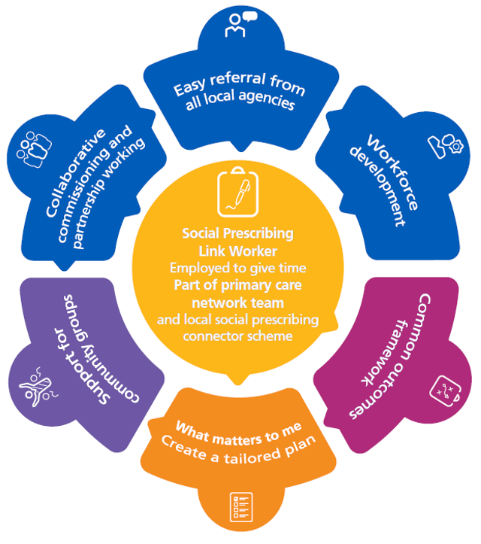
What is social prescribing?
Social prescribing enables all local agencies to refer people to a link worker.
Link workers give people time and focus on what matters to the person as identified through shared decision making or personalised care and support planning. They connect people to community groups and agencies for practical and emotional support.
Link workers collaborate with local partners to support community groups to be accessible and sustainable and help people to start new groups
Social prescribing is especially helpful for people
with one or more long-term conditions
who need support with their mental health
who are lonely or isolated
who have complex social needs which affect their wellbeing

Slide 9
Social prescribing and community-based support: not just a ‘nice to do’
April 2021: Planning guidance: 1.2 million personalised care interventions to be delivered in 2021 supported by 3 additional roles in PCNs (social prescribing link workers)
March 2021: c1,800 link workers in PCNs (and growing). Exceeded the LTP target of 1000 by April 2021.
COVID-19 pandemic: Since March ‘20 social prescribing demand has surged.*
Dec 2019: c300 link workers in PCNs
Nov 2019 Conservative manifesto: 26k extra ‘primary care professionals’ inc.4500 social prescribing link workers by 2023/24
July 2019: PCNs come into operation
April 2019: new 5-year GP contract commits to social prescribing, and link workers become part of new primary care networks (PCNs)
Jan 2019: NHS Long Term Plan (LTP) commits to personalised Care – and to social prescribing. 900,000 people to benefit by 2023/24
*Social Prescribing Observatory. RCGP and University of Oxford.

Slide 10
“How many link workers do we need ?”
In addition to generic link workers who can support your practice we are also seeing the development of specialist roles around the country. For example:
Children and young people link workers,
Specific issues – e.g. Welfare Advice,
Specific client groups (e.g. cancer, mental health, learning disability, armed forces and families),
Communities most at risk of health inequalities such as BAME communities and or people from health inclusion groups.
Some PCNs are also working together to share development roles – manager, community development.
Good questions
Where is their pressure on your practice that a social prescribing link worker could help with?
What are the needs of your local population (PHM and soft intelligence) and how can you address health inequalities? Proactive outreach and targeted support.
Take a strategic approach
Develop place based strategic plans with local partners (such as LAs, VCSE, PH and schools) which;
Shared implementation plan for social prescribing link workers and other community connecting roles,
Identifies community assets and resources and work together to address gaps in provision.
Notes:
LTP ambition - Stress role of link workers – not just seeing people but ‘community development’ identifying and nurturing community support and groups. Building support with a wide range of organisations
Evidence shows it’s the time with people and the community development that results in effectiveness. Need to make sure they have enough for them to fulfil their role. Then seeing specialisms and place based roles and managers

Slide 11
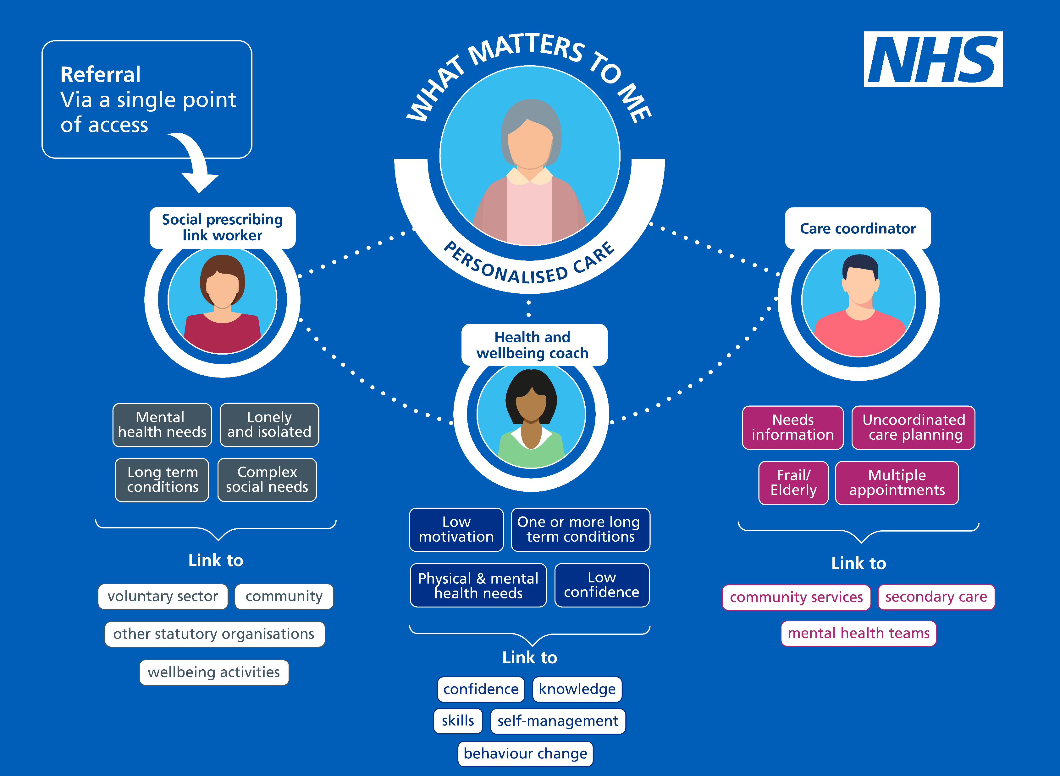
How the three roles work together
Notes:
By 2023/24, the Network Contract DES commits an investment of £2.4 billion into primary care across the country, or £1.47 million per typical PCN. This includes funding for around 26,000 more health professionals including additional clinical pharmacists, physician associates, first contact physiotherapists, community paramedics and social prescribing link workers. Bigger teams of health professionals will work across PCNs, as part of community teams, providing tailored care for patients and will allow GPs to focus more on patients with complex needs
The DES provides reimbursement for 3 personalised care roles in PCNs social prescribing link workers, health and wellbeing coaches & care coordinators
The introduction of health and wellbeing coaches and care coordinators from 01 April 2020 is in addition to the existing Social Prescribing Link Worker role which has been in place since July 2019
Working together through a single point of access, these three roles reduce and support the workload of GPs and other staff by supporting people to take more control of their health and wellbeing and addressing wider determinants of health such as poor housing, debt, stress and loneliness.
Fewer appointments with clinicians
Increased satisfaction
Dedicated time for patients
Better outcomes
Lower costs

Slide 12
Unique contribution of each role & who to refer
Social Prescribing Link Workers | Health & Wellbeing Coaches | Care Coordinators
Address wider issues that affect people’s health & wellbeing. Use personalised care, support planning & health coaching approaches, over several sessions to identify what matters to the person and connect them with; practical, social and emotional support within their community and activities that promote wellbeing e.g. arts, sports, natural environment. Identify and nurture community assets by working with partners such as VCSE, local authorities and health. Tend to support people experiencing loneliness, complex social needs, mental health needs or multiple LTCs. | Proactive identification and caseload management of people with LTCs. Guide and support people with LTCs to reach self-identified health and wellbeing goals. Use specialist coaching and behaviour change techniques, usually over a number of sessions. Tend to support with physical and mental health conditions, and with one or more LTCs such as type 2 diabetes, COPD, or at risk of developing a LTC. | Proactively identify patients who need support to: prepare for follow-up clinical conversations with primary care professionals be actively involved in managing their care, to make choices right for them develop personalised care & support plans understand and manage their condition, ensuring changing needs are addressed. Provide coordination and access to other appropriate services and support. Tend to support those with multiple appointments, frail/elderly and people with LTCs.
“Using your three personalised care ARRS roles effectively”
“Using your three personalised care ARRS roles effectivel
PERSONALISED CARE FOR LONDON: using the 3 PC ARRS roles effectively
@SP_LDN
hlp.socialprescribing@nhs.net
www.slido.com with #859551

Slide 13
Role interdependencies
First point of referral can be any of the three, but more likely to be care co-ordinator or SPLW
Can refer to each other and good communication between 3 roles essential
sing the 3 PC ARRS roles effectively
Social Prescribing Link Worker Service
Health & Wellbeing Coach
Care Coordinator
Referral
Referral
Pro-active case identification
PERSONALISED CARE FOR LONDON: using the 3 PC ARRS roles effectively
@SP_LDN
hlp.socialprescribing@nhs.net
www.slido.com with #859551

Slide 14
Caroline Haines Health & Wellbeing Coach + London Mentor for Health & Wellbeing Coaches East Merton PCN + NHSE Associate

Slide 15
Janie Wike Primary Care Network Manager & Lead for Social Prescribing Link Workers Barnsley Healthcare Federation CIC

Slide 16
Dr Naheed Khan-Lodhi GP and the Clinical Director Walthamstow West PCN

Slide 17
Dr Mohan Sekeram PCN Clinical Director, RCGP Regional Clinical Lead - Person Centred Care, Clinical Lead for Personalised Care, SWL, Social Prescribing Wandsworth and Merton CCG Merton East PCN / SWL ICS

Slide 18
Lianna Martin Programme Manager, Personalised Care & Social Prescribing + London Regional Learning Coordinator for SP Healthy London Partnership + NHSE Associate

Slide 19
Support available in London
HLP Personalised Care Team
Supporting the London system to spread and scale personalised care
Convening multisector partnership work to support, develop and innovate social prescribing
NHSE Associate roles supporting frontline staff
Regional Learning Coordinator for Social Prescribing – Lianna Martin
Health and Wellbeing Coach Mentor – Caroline Haines
Care Coordinator Mentor – TBC
NHSE Associate roles supporting the system
PCN Advisor – team TBC
Local Training Hubs
ICS Personalised Care Clinical Leads
One for each of the ICS & Dr Jagan John as Pan London Lead
PERSONALISED CARE FOR LONDON: using the 3 PC ARRS roles effectively
@SP_LDN
hlp.socialprescribing@nhs.net
www.slido.com with #859551

Slide 20
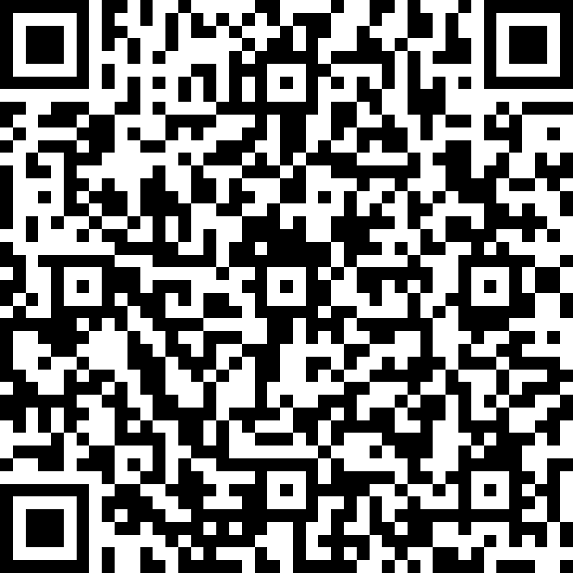
Support available in London
Social Prescribing – Regional Learning Co-ordinator: Lianna Martin
Purpose of the role:
Working to understand how SP services are adapting, what challenges SPLWs are facing and where there are opportunities to support, the RLC role organises relevant activities and feeds back to the NHS and voluntary sector partners where additional guidance and support is needed for SPLWs and the work they do.
Who is in post:
Having worked across the voluntary and social enterprise sectors for over 20 years, Lianna works at Healthy London Partnerships as the Programme Manager for Personalised Care and Social Prescribing, passionate about the opportunities social prescribing offers to support primary care in moving to a preventative model of care
What support is available:
Fortnightly drop in peer support: sign up via eventbrite HERE
Monthly peer support for Managers of Social Prescribing Services: sign up via eventbrite HERE
Monthly peer learning webinar (last Wednesday of the month): sign up for Aug via eventbrite HERE
Monthly newsletter packed with events, guidance, resources and interesting reads: sign up HERE
Get in touch directly: lianna.martin@nhs.net
PERSONALISED CARE FOR LONDON: using the 3 PC ARRS roles effectively
@SP_LDN
hlp.socialprescribing@nhs.net
www.slido.com with #859551

Slide 21
Support available in London
Health & Wellbeing Coaches – Regional Mentor for HWBC: Caroline Haines
Purpose of the role:
Create a network of HWBCs & provide support
Scale up the HWBC service and create consistency
Supporting conversations with PCNs interested in implementing HWB coaching
Who is in post:
Caroline qualified as Health Coach in March 2020 with the Health Coach Institute and has been a Health & Wellbeing Coach in East Merton PCN since Jan 2021. Prior to this she worked in banking & finance but always with a keen interest in nutrition, fitness and holistic care.
Sign up to receive support:
If you are a HWBC or have HWBCs in your network, please ask them to complete this form: https://forms.office.com/r/SnNtxL8TZt
Or get in touch directly: Caroline.haines1@nhs.net
PERSONALISED CARE FOR LONDON: using the 3 PC ARRS roles effectively
@SP_LDN
hlp.socialprescribing@nhs.net
www.slido.com with #859551

Slide 22
Support available in London coming up…
Care Coordinators – Regional Mentor for London: TBC
Purpose of the role:
Create a network of CCs & provide support
Scale up the CC service and create consistency
Supporting conversations with PCNs interested in implementing CC
PCNs & Network Managers - PCN Advisor: Blended team TBC
Purpose of the role:
Targeted support to PCNs with implementing & embedding 3 personalised care roles
Support ongoing delivery of social prescribing & SSM
Support PCNs with scaling of numbers
PERSONALISED CARE FOR LONDON: using the 3 PC ARRS roles effectively
@SP_LDN
hlp.socialprescribing@nhs.net
www.slido.com with #859551

Slide 23
Support available in London
ICS Personalised Care Clinical Leads
Purpose of the role:
To form a London Personalised Care Advisory Group bringing together relevant clinicians, personalised care leads and other stakeholders across London. The Personalised Care Advisory Group will provide governance and leadership for personalised care across London.
To ensure that personalised care is an integral part of the wider London COVID-19 response and fully embedded as part of London STP/ICS Long Term Plans.
To form a London Personalised Care Clinical Leads Network designed to bring together Personalised Care Clinical Leads across London to provide expert clinical leadership to personalised care programmes.
To provide expert clinical input, feedback and challenge to personalised care programmes in the London region and contribute to the emerging narrative on personalised care.
To champion the rollout of personalised care programmes in the London region
To work closely with and provide strategic leadership support to STPs/ICSs in the delivery of their personalised care programmes
PERSONALISED CARE FOR LONDON: using the 3 PC ARRS roles effectively
@SP_LDN
hlp.socialprescribing@nhs.net
www.slido.com with #859551

Slide 24
Support available in London
ICS Personalised Care Clinical Leads
What does this mean in practice:
Facilitating local discussion about the three roles and how fits into network (working alongside Personalised Care Team at HLP)
Identifying innovation, sharing good practice and connecting people locally
Examples of what is happening in local systems:
NCL – convening an ICS level multistakeholder, personalised care board
SWL – activated formal and informal champions and troubleshooting
PERSONALISED CARE FOR LONDON: using the 3 PC ARRS roles effectively
@SP_LDN
hlp.socialprescribing@nhs.net
www.slido.com with #859551

Slide 25
Support available in London
ICS Personalised Care Clinical Leads
Who is in post:
ICS | WHO | CONTACT
NEL Barking & Dagenham, Havering, Redbridge, Waltham Forest, Tower Hamlets, Newham, Hackney | Dr Ben Molyneux | benmolyneux@nhs.net
NCL Barnet, Camden, Haringey, Enfield, Islington | Dr Katie Coleman | katie.coleman@nhs.net
NWL Brent, Central, Ealing, Hammersmith & Fulham, Harrow, Hillingdon, Hounslow & West | Dr Nilesh Bharakhada | nbharakhada@nhs.net
SWL Croydon, Kingston, Merton, Richmond, Sutton, Wandsworth | Dr Mohan Sekeram | mohan.sekeram@swlondon.nhs.uk
SEL Bexley, Bromley, Greenwich, Lambeth, Lewisham, Southwark | Dr Ruchira Paranjape | ruchira.paranjape@nhs.net
PERSONALISED CARE FOR LONDON: using the 3 PC ARRS roles effectively
@SP_LDN
hlp.socialprescribing@nhs.net
www.slido.com with #859551

Slide 26
Resources to support you in your work...
DOCUMENTS
NHS Long Term Plan available here.
London Vision plan available here.
GLA’s COVID recovery plan available here.
VIDEO
Social prescribing: A GP’s perspective #NHSLongTermPlan – Link Here
EXAMPLE PCN WORK PLAN
Health & Wellbeing Coaches and Care Coordinators Work Plan available here.
The primary care network handbook 2021-22
This handbook has been created to give advice and options to practices looking to establish and develop a primary care network (PCN). The “Workforce and employment” section provides in depth descriptions of all PCN roles.
FutureNHS Collaboration Platform
Please feel free to join the Personalised Care Collaborative Network here.
London Region Social Prescribing area available here.
PCN Clinical Directors Update – PowerPoint presentation covering the Wandsworth ARRS and Recruitment Support available here.
SPLWs, HWBCs & CCs MAILING LIST
In order to receive a monthly newsletter packed with events, guidance, resources and interesting reads: sign up here.
PERSONALISED CARE FOR LONDON: using the 3 PC ARRS roles effectively
@SP_LDN
hlp.socialprescribing@nhs.net
www.slido.com with #859551

