Slide 1
London Social Prescribing
Ways to utilise Social Prescribers in tackling vaccine cautiousness
Thursday 1st July 21

Slide 2
Agenda
TIME​ | ITEM​
12:30​ | Welcome & Introductions​
12:35 | Personalised Care Additional Roles Supporting Vaccine Roll Out​ Dr Jagan John, Clinical Lead for Healthy London Partnership, Clinical Director and GP B&D
12:40​ | Examples of great practice… Social Prescribing Link Workers David Sagman, Ninian Schmeising-Barnes, Farah Ahmed, Saiba Salam and Gay Palmer GP & Personalised Care Team Dr Mohan Sekeram, Clinical Director and GP Vaccine Peer Support Champions Anne Bowers, Strategic Community Engagement Lead, Public Health
13:20​ | Q&A
13:35 | Your Suggestions & Reflections Can you replicate approaches in your area?
13:45 | Resources and Support
13:55 | Thank you and Close
It is an informal sharing session – share your approaches and ask any questions in the chat
The presentation will be recorded & circulated
Tackling vaccine cautiousness

Slide 3
Personalised Care Additional Roles Supporting Vaccine Roll Out
Following the extension of restrictions, vaccine uptake and tackling cautiousness is a top priority for London.
Given the skills and expertise of Personalised Care roles in community engagement and support they continue to play an important role during this period. Proactively engaging with parts of the community that primary care has historically struggled to connect with.
Social Prescribing Link Workers can support more vulnerable groups in accessing and understanding the vaccine:
Reach out to signpost patients / residents (regardless of legal status) to get vaccinated / discuss vaccination concerns with clinical teams you work with, and to link in with appropriate patients’ champions about their experience (with consent)
Work with local communities to proactively reach out to our most vulnerable populations. Supporting and signposting to organisations that can provide further support.
Tackling vaccine cautiousness

Slide 4
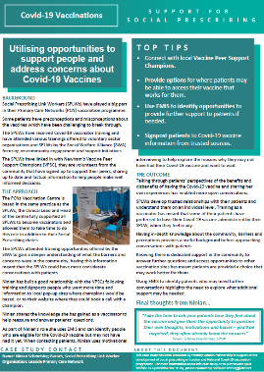
Opportunities to support people and address concerns
Use EMIS/SystmOne to identify opportunities to provide further
support to patients if needed.
Connect with local Vaccine Peer Support Champions.
Provide options for where patients may be able to access their
vaccine that works for them.
Signpost patients to Covid-19 vaccine information from trusted
sources.
“Take the time to ask your patients how they feel about the vaccine and give
them the opportunity to question their own thoughts, motivations and biases – you’ll be surprised, they often already know the answers”.
Ninian Schmeising-Barnes, SPLW, Leaside PCN
Examples of great practice

Slide 5
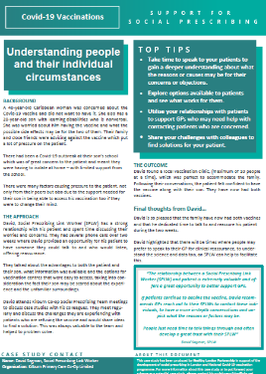
Understanding people and their individual circumstances
Take time to speak to your patients to gain a deeper understanding about what the reasons or causes may be for their concerns or objections.
Explore options available to patients and see what works for them.
Utilise your relationships with patients to support GPs who may need help with contacting patients who are concerned.
Share your challenges with colleagues to find solutions for your patient.
“The relationship between an SPLW and patient is extremely valuable and offers a great opportunity to better support GPs.
If patients continue to decline the vaccine, David recommends GPs reach out to their SPLWs to contact these individuals, to have a more in-depth conversations and unpick what the reasons or factors may be”.
David Sagman, SPLW, Kilburn Primary Care Co-op
Examples of great practice

Slide 6
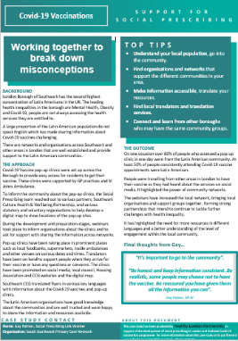
Working together to break down misconceptions
Understand your local population, go into the community.
Find organisations and networks that support the different communities
in your area.
Make information accessible, translate your resources.
Find local translators and translation services.
Connect and learn from other boroughs who may have the same
community groups
“It’s important to go to the community”.
“Be honest and keep information consistent. Be realistic, some people may choose not to have the vaccine.
Be reassured you have given them all the information you can”.
Gay Palmer, SPLW, South Southwark PCN
Examples of great practice

Slide 7
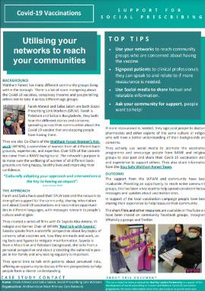
Utilising your networks to reach your communities
Use your networks to reach community groups who are concerned about having the vaccine.
Signpost patients to clinical professionals they can speak to and relate to if more reassurance is needed.
Use Social media to share factual and relatable information.
Ask your community for support, people want to help!
“Culturally adapting your approach and interventions is the key to having an impact”.
Farah Ahmed, SPLW, Walthamstow West PCN
Examples of great practice

Slide 8
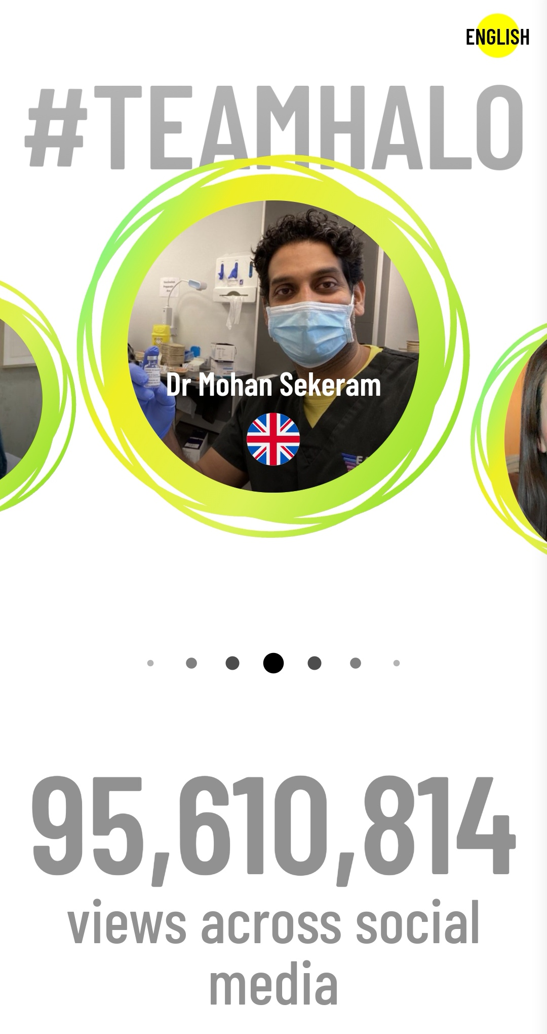
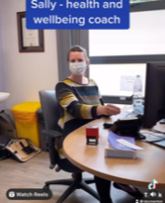
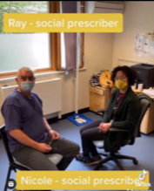
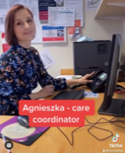
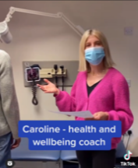
Personalised Care Teams working together
Vaccine confidence
UN Programme
Messaging audience
Sharing data
Challenging misinformation
Webinars
Link in to community - young people
Trust with groups
Supporting resilience and questions
Engaging with the public via TikTok and Instagram
Examples of great practice

Slide 9
Q&A

Slide 10
Your Suggestions & Reflections
Reassuring with statistics and benefits of a wider uptake. Incorporate in to the conversation at the end of initial call or review calls – Zerrin Buckle
Practice can run a search to identify those who have not responded to an invitation. The list can then be sent to the social prescriber to go through and contact patients - Rahma Fararh
Social Prescribing should be used as an outreach event in sensitising and educating people on the need for vaccine uptake – Petronilla Duru
Encourage people who are hesitant to speak to a professional, ask them questions on why they don’t want a vaccine ( usually misinformation) - Farah Ahmed
Making calls to patients who have declined or are hesitant, using our coaching and active listening skills to help them to come to an informed decision. – Katy Szita
Undertake training and inform/educate patients regarding facts of the various vaccines and dispelling myths – Emma Williamson
Utilising Engagement Leads to support vaccine roll out especially with BAME patients at practice level – Adeole Adeleke
Face to face discussion in community spots to attract particular sections of marginalised groups – Rouksana Dyer
Work in partnership with community leaders and voluntary sector agencies - Marilyn Mayor
List the benefits of having it and risks of not having it - Nathaniel Leroux
Direct contact with patients and carers – Rashmi Thaman
Open non threatening listening conversation - Barnabas
Investing in relationships built with patients – Alex Trigg
Running Q and A sessions – Ninian Barnes
Tackling vaccine cautiousness

Slide 11
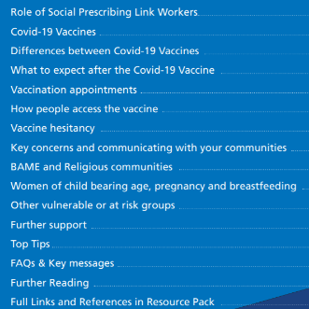
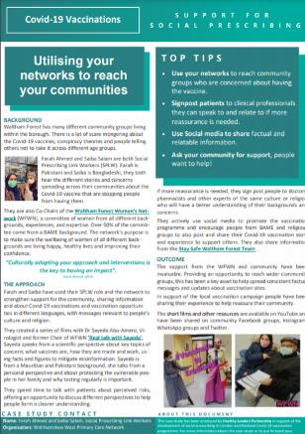
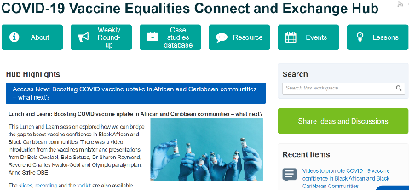
Resources and Support
Resource Pack Case Studies
Recorded Training and Q&A Sessions
London Social Prescribing Future NHS Collaboration Platform
COVID-19 Vaccine Equalities Connect and Exchange Hub
London Social Prescribing Newsletters
Tackling vaccine cautiousness

Slide 12
Thank You
We hope you enjoyed todays session and want to thank you for joining
We value your feedback and would appreciate you taking a few minutes to complete our feedback form:
Share your feedback: CLICK HERE
If you would like to share the great work you and your team are doing, please do get in touch:
Email the team: hlp.socialprescribing@nhs.net

