Slide 1
Peer Learning for London
“Supporting migrant communities and people with refugee status”
Wed 25th August 2021

Slide 2
Plan for today
JOIN THE CONVERSATION
TIME | ITEM
12:30 | Introductions
12:35 | Claire Zhang – PHE evidence review findings & Migrant Health Guide new social prescribing page recommendations
12:55 | Yusuf Ciftci and Oluwakemi Ogunlana – DOTW toolkit for SPLW
1:10 | Christine Double – Croydon Voluntary Action
1:20 | Sarah Jowett – One Westminster
1:25 | Esther Bissessar – Mission Practice
1:30 | Rosanna Horsley – HostNation
1:40 | SPLW experiences and challenges supporting refugees, asylum seekers, migrant populations
2:00 | Close
Until 2:30 | Q&A and Networking
It is an informal session
– talk to each other & share resources in the chat
The presentations will be recorded & circulated
Peer Learning: Supporting migrant communities and people with refugee status

Slide 3
Overview – what will you leave with...
By the end of this session, you will be able to:
build your confidence in working with refugees, asylum seekers and migrant communities;
describe the evidence base for social prescribing for migrants in the UK;
know Migrant Health Guide recommendations;
use Supporting Migrants Access to Healthcare: Toolkit for Social Prescribing Link Workers;
refer to organisations supporting refugees, asylum seekers and migrant communities.
Peer Learning: Supporting migrant communities and people with refugee status

Slide 4
Social prescribing for migrants in the UK
Claire Zhang
National Migrant Health Lead & Inclusion Health Officer
Public Health England 25th August 2021

Slide 5
Contents
Findings from Public Health England’s evidence review*
Migrant Health Guide: new social prescribing page
* submitted for peer-reviewed academic publication
Notes:
- Key findings only, submitted for peer-reviewed publication so more details available in future to read in paper

Slide 6
Acknowledgements
Evidence review co-authors:
Fatima Wurie
Annabel Browne
Steven Haworth
Rachel Burns
Rob Aldridge
Dominik Zenner
Anh Tran
Ines Campos-Matos
Migrant Health Guide social prescribing page development:
Public Health England national migrant health & inclusion health teams
Public Health England regional migrant health leads
NHS England & NHS Improvement social prescribing team
Yusuf Ciftci, Doctors of the World UK

Slide 7
Migrant health
Country of origin
Disease epidemiology
Socioeconomic and environmental conditions
Healthcare
Journey
Reason, mode, duration and circumstances
Break of social ties
Destination
Legal status & migration policies
Working conditions, living conditions
Language & cultural differences
Exclusion and discrimination
Notes:
For those who have worked with migrants, may already be familiar with why the health of migrants is often different from the UK-born population
For those who are relatively new to the field: factors that shape migrant health

Slide 8
Evidence review
Aim: To describe the evidence base for social prescribing for migrants in the UK:
approaches that have been evaluated for migrants
their effects on migrants
physical and mental health and wellbeing
healthcare utilisation
self-esteem, confidence, control and empowerment
knowledge and skills
social connectivity
the experiences of implementation from the perspectives of migrants, providers and referrers to social prescribing programmes
Notes:
- SP part of NHS Long-Term plan, but evidence is limited and only reviewed for the general population

Slide 9
Database & grey literature search
Methods
UK studies published between 1 January 2000 and 1 June 2020
Study type: Controlled and uncontrolled experimental study designs, observational studies, grey literature (e.g. evaluation reports, other programme/intervention-related reports with measurable outcomes, case studies, unpublished papers)
Population: At least 1 migrant in the sample/cohort
Intervention: Any social prescribing approach involving an intermediary/coordinator linking migrants to a prescribed activity

Slide 10
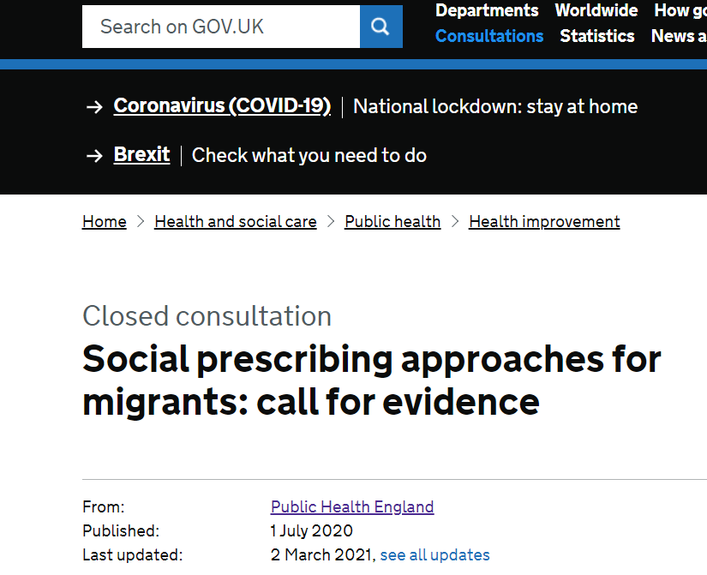
Call for evidence
Call for evidence
1 July – 30 October 2020 (4 months)
27 items submitted by 8 stakeholders
25 items UK, 2 items Europe/worldwide
Local government, local and national voluntary or third-sector organisations, academic institutions and clinical commissioning groups

Slide 11
Included studies

Slide 12
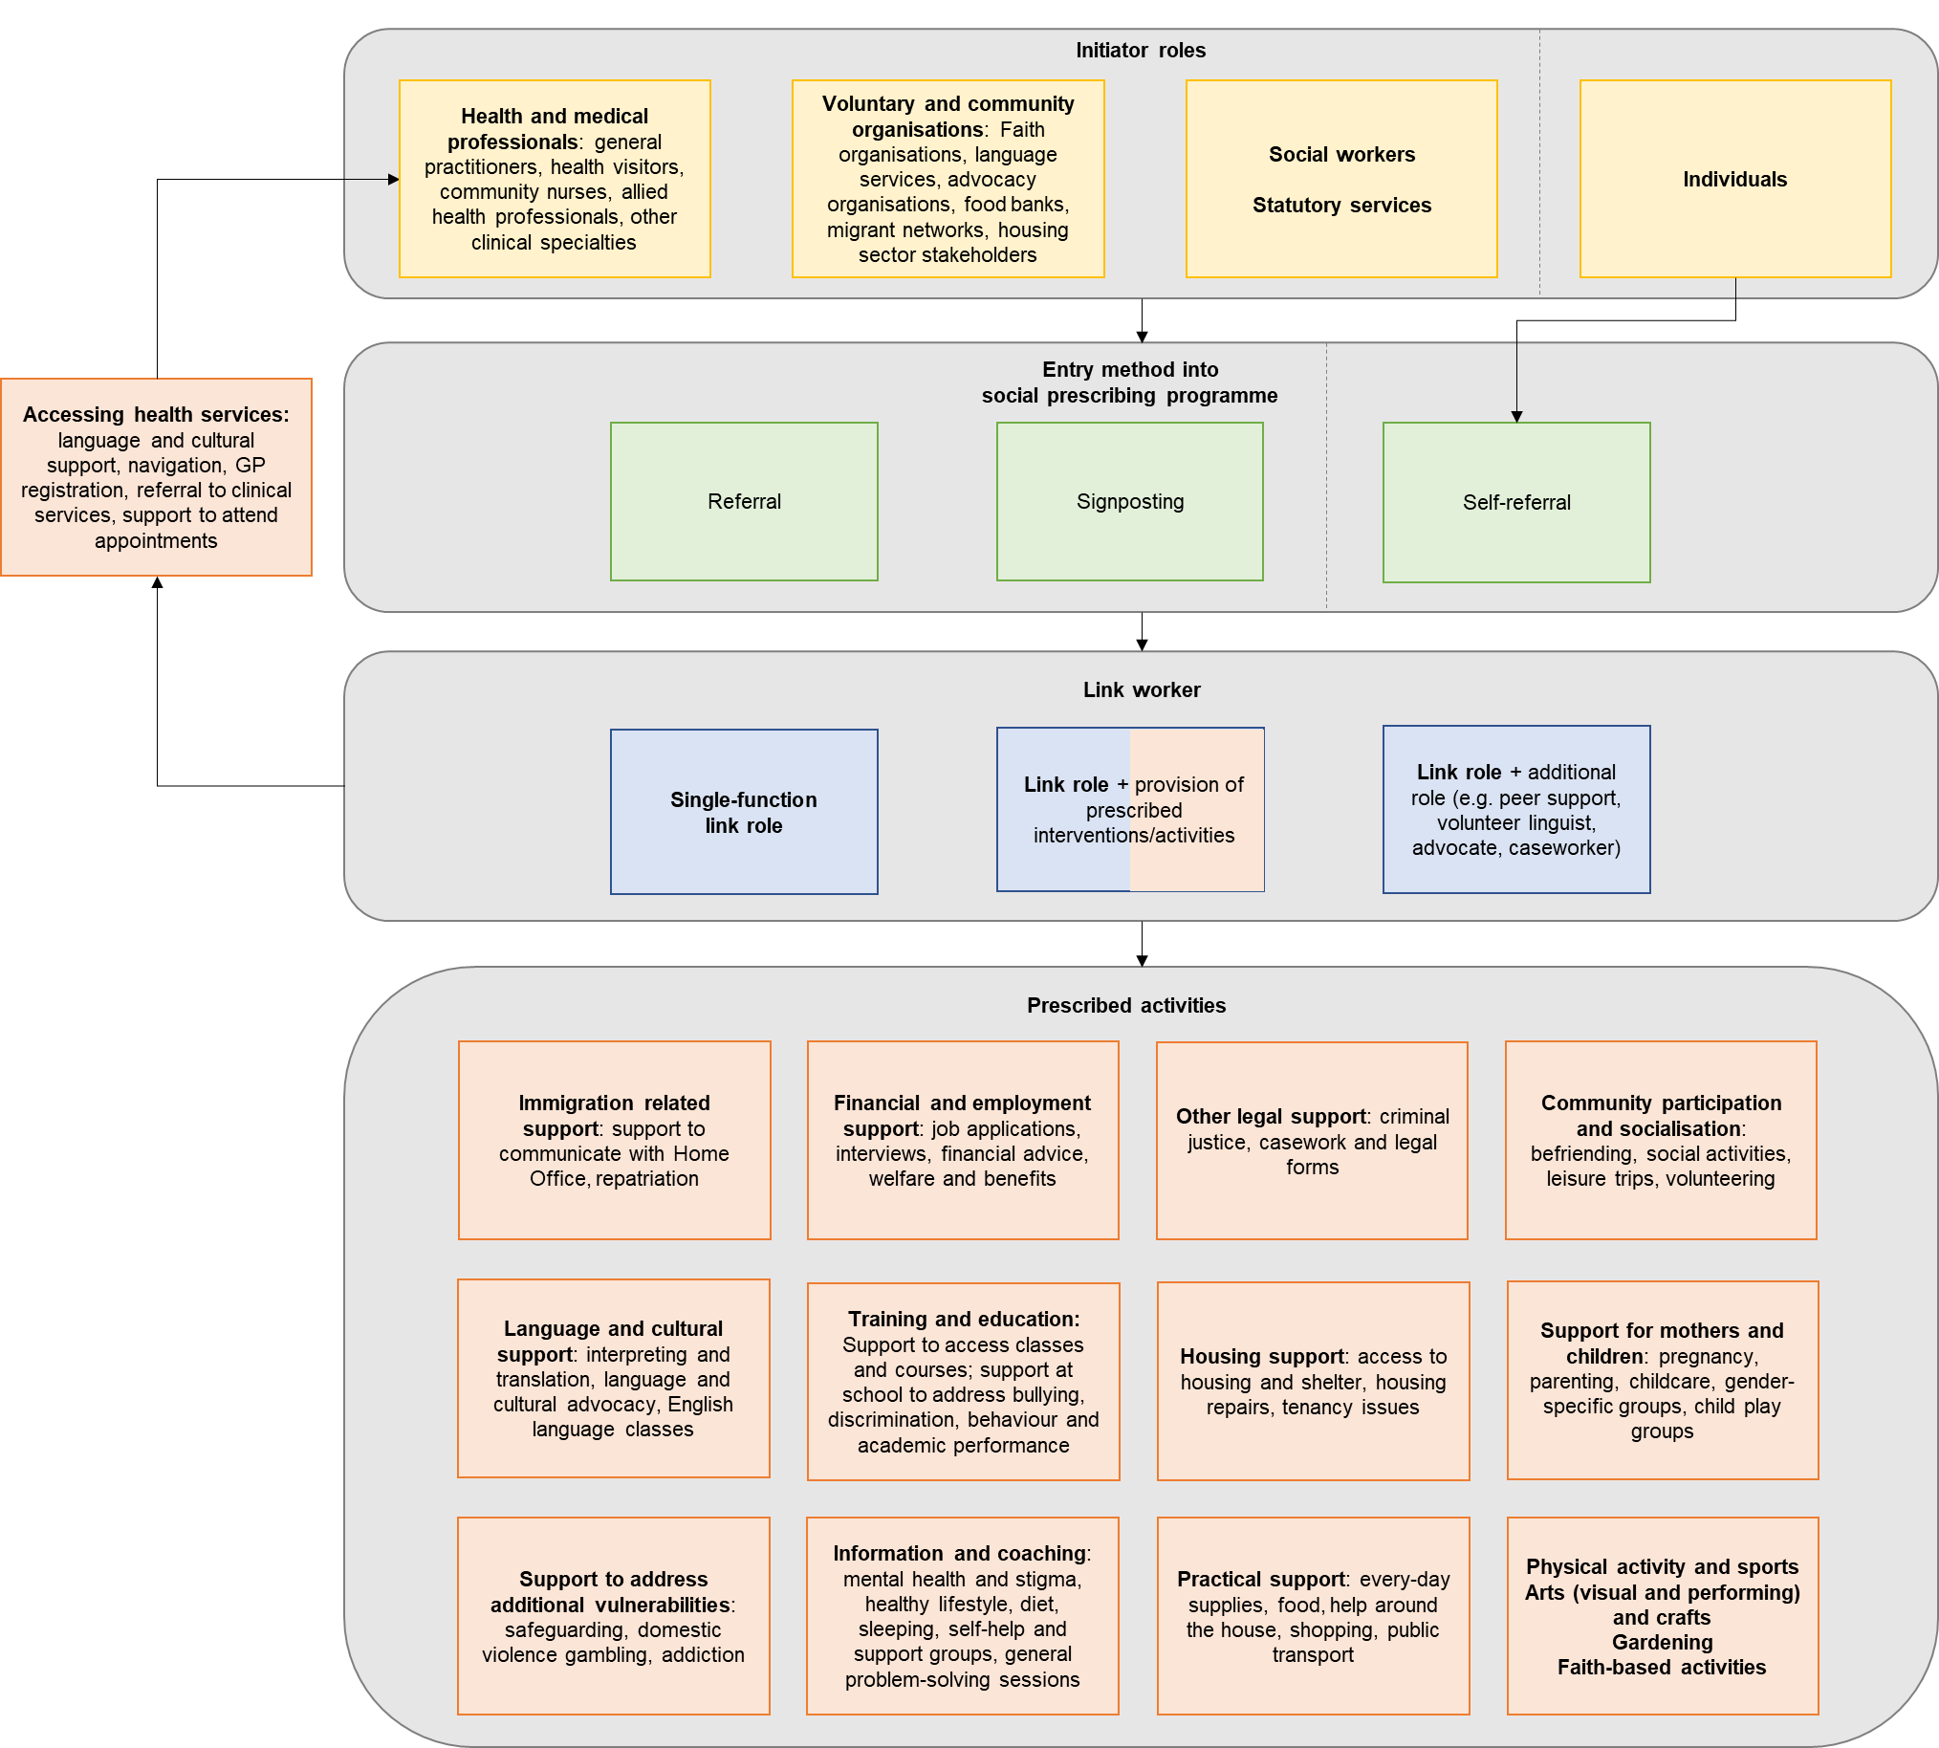
Findings: SP approaches
Approaches vary widely
Breadth of prescribed activities
SP link worker taking on additional roles

Slide 13
Initiator roles
Health and medical professionals: general practitioners, health visitors, community nurses, allied health professionals, other clinical specialties
Voluntary and community organisations: Faith organisations, language services, advocacy organisations, food banks, migrant networks, housing sector stakeholders
Social workers
Statutory services
Individuals
Entry method into
social prescribing programme
Referral
Signposting
Self-referral
Link worker
Single-function
link role
Link role + provision of prescribed interventions/activities
Link role + additional role (e.g. peer support, volunteer linguist, advocate, caseworker)

Slide 14
Health and medical professionals: general practitioners, health visitors, community nurses, allied health professionals, other clinical specialties
Initiator roles
Accessing health services: language and cultural support, navigation, GP registration, referral to clinical services, support to attend appointments
Prescribed activities
Immigration related support: support to communicate with Home Office, repatriation
Financial and employment support: job applications, interviews, financial advice, welfare and benefits
Other legal support: criminal justice, casework and legal forms
Community participation and socialisation: befriending, social activities, leisure trips, volunteering
Language and cultural support: interpreting and translation, language and cultural advocacy, English language classes
Training and education: Support to access classes and courses; support at school to address bullying, discrimination, behaviour and academic performance
Housing support: access to housing and shelter, housing repairs, tenancy issues
Support for mothers and children: pregnancy, parenting, childcare, gender-specific groups, child play groups
Link worker
Support to address additional vulnerabilities: safeguarding, domestic violence gambling, addiction
Information and coaching: mental health and stigma, healthy lifestyle, diet, sleeping, self-help and support groups, general problem-solving sessions
Practical support: every-day supplies, food, help around the house, shopping, public transport
Physical activity and sports
Arts (visual and performing) and crafts
Gardening
Faith-based activities

Slide 15
Findings: SP effects
Improved self-esteem, confidence, empowerment and social connectivity frequently reported
Largely anecdotal evidence of improved health and wellbeing
Lack of measurement of impact on healthcare utilisation

Slide 16
Findings: SP implementation
Service access: referrals & waitlists
Service resourcing and coverage: funding shortages & gaps in services
Service delivery:
cultural responsiveness & individual preferences
blurred boundaries
Service capability: link worker knowledge and training
External considerations:
awareness of services
hostile environment

Slide 17
Limitations of included items
Low internal and external validity
Poor quality data
Lack of robust evaluation methods
Broad interventions that integrated aspects of SP and other interventions
Effects on migrants (overall, and specific subgroups) vs general population not clear
Incomplete descriptions of interventions
Lack of recording of migration-related demographic information
Inconsistent and infrequent measures of effect

Slide 18
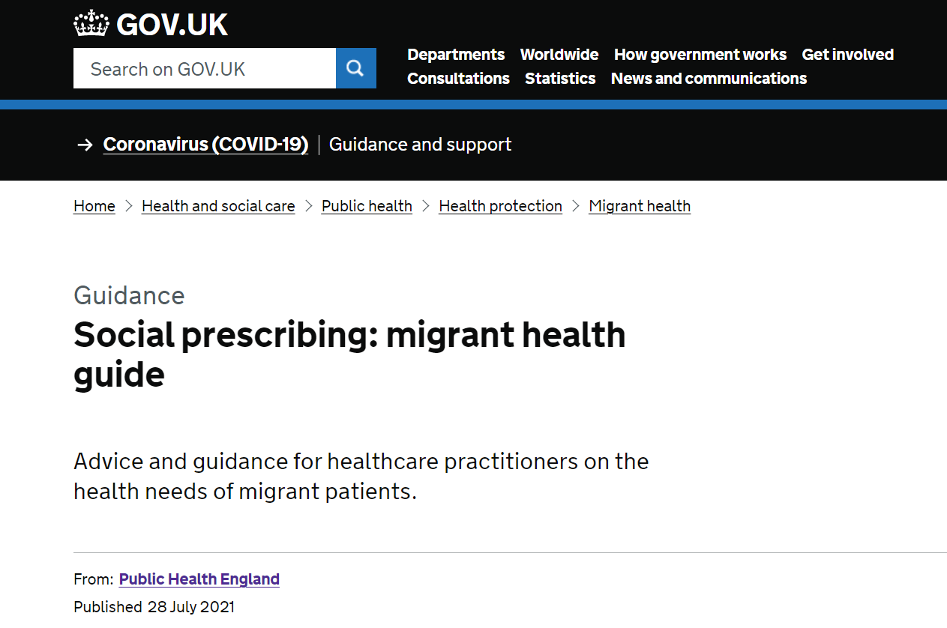
Migrant Health Guide
New social prescribing page

Slide 19
Migrant Health Guide recommendations
1. For referrers
Those who refer migrants to social prescribing programmes should:
be aware that migrants may require a greater range of prescribed interventions/activities than the general population to holistically address their health and wellbeing needs (e.g. language support, healthcare navigation, immigration support)
record social prescribing referrals and activities in electronic health records for routine monitoring and evaluation

Slide 20
Migrant Health Guide recommendations
2. For social prescribing link workers
Before providing social prescribing services to migrants, link workers should develop knowledge in:
migrants’ entitlements to healthcare and other public services
how to support migrants to access mainstream healthcare services and preventive care
how to identify the health needs of migrants and when these require referral to specialist health services
wider determinants of migrant health
trauma-informed approaches to service provision
how risk of communicable diseases and non-communicable diseases in migrants’ country of origin affect their health and wellbeing
safeguarding children and adults
looking after their own health and wellbeing as a service provider

Slide 21
Migrant Health Guide recommendations
When providing social prescribing services to migrants, link workers should:
ensure that services are culturally responsive and tailored to the needs of individuals, including their preferences for:
language (e.g. interpreting, translation, and other bilingual support in social prescribing sessions like working with a bilingual advocate)
culture (e.g. as much as possible, allowing the individual to choose a link worker from the same or different ethnic and religious background)
sex (e.g. link workers of the same sex, and same- or mix-sex groups)
service delivery format (e.g. individual or group sessions)
personalised care (e.g. some individuals may want personalised conversations about their health and wellbeing, while others prefer quick signposting)

Slide 22
Migrant Health Guide recommendations
clearly define link worker role boundaries, including whether they may need to take on additional responsibilities and support roles when providing services to migrants.
consider whether access to healthcare is an important part of a migrant’s health needs, and provide appropriate support for migrants to understand the healthcare system and access healthcare services
identify ‘windows of opportunity’ for service provision and be prepared to problem-solve any changes to migrants’ housing, legal status, location, and readiness to engage with services

Slide 23
Migrant Health Guide recommendations
3. For monitoring and evaluation
To improve the understanding of how social prescribing works and for whom, those who commission, plan, deliver and manage social prescribing services should ensure that:
programmes are adequately funded to allow robust evaluation of implementation and outcomes
evaluations use comparative designs and prospective data collection where possible

Slide 24
Migrant Health Guide recommendations
data collection is standardised to include sociocultural and demographic characteristics of social prescribing recipients. This can include collection of data on country of birth, languages spoken, migration history, type of migrant (e.g. labour migrant, refugee, asylum seeker) and ethnicity.
It is important to note that some migrants may be hesitant to disclose details about their immigration history, so it is important to build trust and help them to understand why you are asking these questions, what you will do with the information, and the circumstances in which health services share non-clinical information with the Home Office.

Slide 25
Migrant Health Guide recommendations
measurement of a range of social prescribing outcomes follows a framework (e.g. NHS England and NHS Improvement Social Prescribing Common Outcomes Framework), and considers the effect of social prescribing on migrants’ physical health, mental health, healthcare utilisation, confidence/self-esteem/empowerment, knowledge and skill development, and social connectivity
provider- and patient-reported measures are synthesised together with routine data from sources like electronic health records, particularly to capture referrals and measures of effect for outcomes like healthcare utilisation
patient-reported outcome tools for health and wellbeing outcomes in migrants are assessed for cultural and linguistic appropriateness

Slide 26
Migrant Health Guide recommendations
4. For researchers
Future research on social prescribing for migrant populations in the UK could consider:
validating measurements tools in social prescribing settings for migrant populations
assessing why link workers take on additional roles when providing services to migrants, and whether migrants’ holistic health and wellbeing needs are better addressed through single-function link worker roles, transdisciplinary support roles, or other types of support

Slide 27
Over to you
Literature vs. in practice
Challenges supporting migrant communities
Taking on additional roles and responsibilities
Role boundaries
Feasibility of recommendations

Slide 28
Get in touch
Email claire.zhang@phe.gov.uk or MigrationHealth@phe.gov.uk

Slide 29
Q&A
Please feel free to ask your question(s).
Peer Learning: Supporting migrant communities and people with refugee status

Slide 30
Supporting Migrants Access to Healthcare: Materials for Social Prescribers
Oluwakemi Ogunlana
DOTW National Health Advisor
Dr Yusuf Ciftci
Policy and Advocacy Manager
Doctors of the World UK, part of the Médecins du Monde network

Slide 31
Supporting Migrants Access to Healthcare Toolkit
a gap in link workers’ knowledge about NHS rights and entitlements for migrant populations
how barriers to GP registration might impede access to social prescribing models.
Public Health England’s call for evidence for social prescribing approaches for migrants (summer 2020)
Consultation with stakeholders by London Plus, the Greater London Authority (GLA) and the HEAR network (November 2020)
producing materials for link workers
Notes:
The main purpose of the workshop is to provide feedback on a draft resource for link workers about migrants access to healthcare. We will be looking at the draft resource, but also we will have some discussions on what to be added to the resource too.
It is useful to know that there has been some developments that lead to this production of resource. Last year, during summer Public Health England has made a call for evidence for social prescribing approaches for migrants. This is to look at what approaches are there and is there a possibility to have a standard model for link workers to apply when they provide service to migrants.
There was also another consultation session with stakeholders by London Plus, the GLA and the HEAR network, which included conversations about the same topic, how do we ensure that we provide a holistic and quality social prescribing to migrants. This consultation revealed two important findings. These are a gap in SPLW knowledge about NHS rights and entitlements for migrants and the fact that barriers to GP registration for migrants can affect their access to social prescribing.
We were then commissioned by the GLA to produce materials to address this gap. Social prescribing is about providing a wider welfare support, other than health services, but it will not be complete if the patients do not have a meaningful access to healthcare. So we are looking forward to hearing your views on what would be useful for you in your work in terms of migrants access to healthcare.

Slide 32
Barriers to healthcare for migrants
Out of the 2188 attempts by DOTW to register patients with their local GP in 2018, 419 were refused.
Lack of ID / proof of address
Immigration status
Fear of arrest / data sharing
Language barrier
Digital exclusion
Charging in secondary care
Notes:
Before we move on to discussions, it is useful to just go over the barriers to healthcare for migrants. DOTW has clinics and advice line where migrants and other marginalised communities can get support in registering with a GP. According to the 2018 data from theclinics, out of 2188 attempts of registration, 419 were wrongly refused by the GPs. And this is a tip of an iceberg, as this is a figure when English speaking caseworkers are advocating on behalf of migrants, if we consider migrants themselves registering, this would be much higher. It amounts to 19% of all attempts so roughly 1 in 5 patients are refused.
You can see some of the reasons and some other barriers here for migrants to register with a GP. If we consider that most referrals to social prescribers are through GPs, it is clear from this picture that, migrants will also have barriers to access social prescribing.

Slide 33
Development of the resource & findings
Research
Findings
Link workers can play an important role because they provide personalized care
Many migrants are not aware of the social prescribing service
Further training and resource on immigration statuses and entitlements to healthcare would help link workers
Consultation & workshop
Feedback
Notes:
Before we move on to discussions, it is useful to just go over the barriers to healthcare for migrants. DOTW has clinics and advice line where migrants and other marginalised communities can get support in registering with a GP. According to the 2018 data from theclinics, out of 2188 attempts of registration, 419 were wrongly refused by the GPs. And this is a tip of an iceberg, as this is a figure when English speaking caseworkers are advocating on behalf of migrants, if we consider migrants themselves registering, this would be much higher. It amounts to 19% of all attempts so roughly 1 in 5 patients are refused.
You can see some of the reasons and some other barriers here for migrants to register with a GP. If we consider that most referrals to social prescribers are through GPs, it is clear from this picture that, migrants will also have barriers to access social prescribing.

Slide 34
How to build trust with migrants
Try not to introduce yourself as a ‘social prescriber’ at first; instead, try introducing yourself and what you do in a simple way.
Do not ask a patient about their immigration status if it is not relevant to the issue you are trying to address.
Using a translator can help patients facing language barriers feel more confident.
Consider meeting your patients in a familiar or convenient place, like a children’s centres or at a pop-up clinic.
Give examples of the types of services you can help them to access.

Slide 35
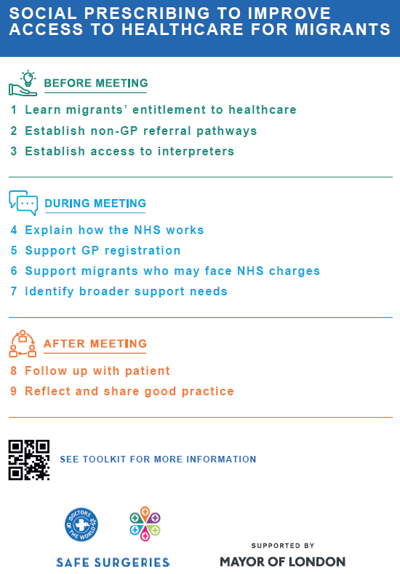
Toolkit and Poster
www.bit.ly/SPLWtoolkit
www.bit.ly/SPLWposter

Slide 36
Q&A
Please feel free to ask your question(s).
Peer Learning: Supporting migrant communities and people with refugee status

Slide 37
Christine Double - Croydon Voluntary Action
Christine Double,
Head of Operations and Sport,
Croydon Voluntary Action
CVA supports citizens and community organisations in Croydon to take active roles in their neighbourhoods and make positive social change.
Christine.double@cvalive.org.uk
www.cvalive.org.uk
Peer Learning: Supporting migrant communities and people with refugee status

Slide 38
We Stand Together:
Aim: To use sport as a tool to improve social integration between refugees and asylum seekers and the wider community in Croydon
Develop sport ‘activators’ with lived experience of seeking asylum, identify their skills and passions and support them to implement and lead sessions
Over 850 participants and 25 activators engaged in 2 and half years.
Croydon Refugee and New Communities Forum – with over 45 community organisations and a 5 point action plan
Peer Learning: Supporting migrant communities and people with refugee status

Slide 39
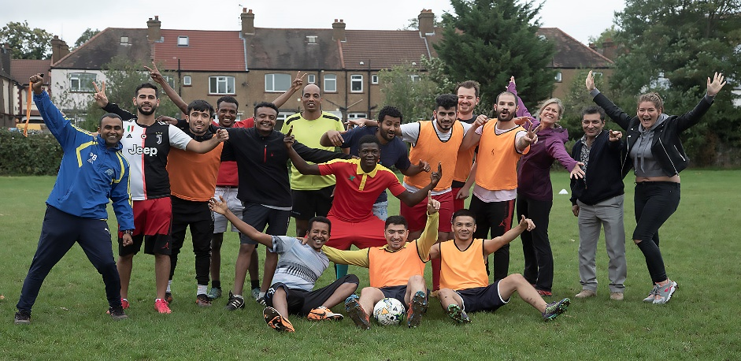
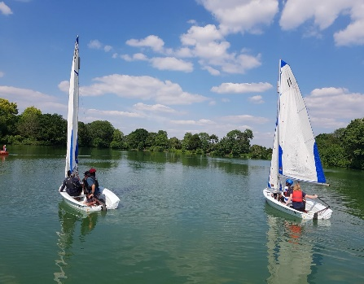
We Stand Together
Peer Learning: Supporting migrant communities and people with refugee status

Slide 40
We Stand Together
Top Tips:
Connect with other local community organisations working with your target group and those delivering quality services (in our case community sports deliverers)
Listen to those with lived experience and help them deliver their own solutions
Build trust with partners and participants – by listening, responding, respecting their views, helping tackle any barriers - direct or indirect
Have Fun!
Peer Learning: Supporting migrant communities and people with refugee status

Slide 41
We Stand Together
Peer Learning: Supporting migrant communities and people with refugee status

Slide 42
Sarah Jowett – One Westminster
Roughly half of the patients that I have worked with over the last year have been asylum seekers, migrants or refugees.
Travelled to the UK from a range of different countries, including Iran, Syria, Ghana
Have come to the UK for various reasons, e.g. fleeing conflict, victims of human trafficking, familial reasons
In the following slides I hope to share some insight into supporting migrant communities, on the basis of this experience…
Peer Learning: Supporting migrant communities and people with refugee status

Slide 43
Sarah Jowett – One Westminster
It helps to prepare yourself to support asylum seekers by acquiring knowledge…
The Right to Remain Toolkit
A guide to the UK immigration and asylum system:
https://righttoremain.org.uk/toolkit/
City of Sanctuary Mental Health Resource Pack
This resource pack will help you understand the circumstances of refugees and asylum seekers’ lives and how these circumstances affect their emotional wellbeing.
https://health.cityofsanctuary.org/resources
Peer Learning: Supporting migrant communities and people with refugee status

Slide 44
Sarah Jowett – One Westminster
Legal Considerations
How long have they been in the UK
How did they travel to UK (if recent i.e. was it by boat?)
Do they have a current active asylum claim?
Do they have a legal representative?
Have they been told they are at risk of detention/deportation?
For individuals who are living in hotels and who do not currently have legal representation, you can contact Care 4 Calais, who are working hard to make sure all individuals housed in hotels have access to a solicitor: access@care4calais.org. Care 4 Calais are also helping newly arrived individuals to access warm clothing if required.
Practical Considerations
Do they have access to essentials such as food, shelter, and warm clothing?
Are they registered with a GP?
Do they know what healthcare services they are entitled to and how to access these?
If they have recourse to public funds, are they aware of entitlements to welfare benefits and how to access these?
Peer Learning: Supporting migrant communities and people with refugee status

Slide 45
Sarah Jowett – One Westminster
General Advice
Be mindful of the person’s cultural background. For example, people have different ways of understanding and expressing mental distress. Refer to organisations that are sensitive to cultural difference, continue to educate yourself about cultural competency, think carefully about the language you use.
In order to build a trusting relationship, be generous with your time. There are various reasons why somebody might be anxious or hesitant about engaging with the service (e.g. feelings of shame, fear of persecution or deportation).
We know social prescribing is about “what matters to me”, but its helpful to remember that each person we are working with is an individual. Take time to get to know the person you are working with, help them to think about their strengths and work towards their goals, offer genuine human connection.
Be mindful of the impact on your own mental wellbeing. Speak to your colleagues, utilise peer support or supervision if you have access to this. Recognise the remit of your role – there is a lot that we can do as Social Prescribers, but people who have experienced complex trauma need specialist psychological support.
Peer Learning: Supporting migrant communities and people with refugee status

Slide 46
Sarah Jowett – One Westminster
“Emma” is a 27-year-old asylum seeker who came to the UK as a victim of sex-trafficking. At the time of referral, she was living in a hotel, where she has been placed by the Home Office. She presented to her GP with low-mood and was referred to the Mental Health team for support.
The Mental Health Team identified that she had a number of unmet social and practical needs, and referred her to the Social Prescribing Service.
Emma told me that she was spending her days alone in her room and was feeling bored and lonely. She was also anxious about navigating London alone, due to her past experiences. Emma’s priority was to learn English, in order to integrate socially. I arranged to accompany Emma to a local college and helped her to enrol for a beginners ESOL class. Due to Covid, the class moved online, however, I was able to apply for a tablet through a local charity, so that Emma could continue to attend remotely.
In order to support Emma with social integration, I connected her with a conversational speaking group so that she could practice English and socialise with others. I received the following feedback from one of the organisers: "Emma has continued to engage with Speaking Group (from the look of our attendance log, she has only missed one week's session since she first started joining the group in late January). She's definitely become more confident over the weeks. I think it has helped that there are other people in the group from the same country as her so she has something in common & feels at ease. She definitely volunteers to speak more and give it a go even if she's unsure of her language skills. She'll often apologise if she isn't sure she has said it right but we tell her she doesn't need to apologise and it's just good to give it a go. She is a great addition to the group."
Emma also confided that the food served at the hotel was poor quality and was making her feel unwell. To ensure that she received at least one nutritious meal each week, I arranged for a hot-food delivery from an organisation delivering free meals.
Complaints about conditions in the hotel were not unique to this young woman. I collated information about complaints and advocated on behalf of patients; contacting Housing Services and local councillors to voice my concerns. In turn, I was invited to attend a meeting with London Councils, the London Boroughs Faith Network and other VCS organisations which highlighted the importance of sharing information to build a wider picture, and making connections between organisations.
Peer Learning: Supporting migrant communities and people with refugee status

Slide 47
Sarah Jowett – One Westminster
Recommended Organisations
Refugee Council
Therapeutic Services
Refugee Advice Project London
Starbucks Employment
Support Programme
London Destitution Service
Just Bread Project
https://www.refugeecouncil.org.uk/
Refugee Action
London Asylum Crisis Project: For asylum seekers in London who are struggling with finding safe housing and food and the organisations providing them with support.
https://www.refugee-action.org.uk/project/asylum-crisis-project/
Migrant Help
Asylum Support
Victims of Slavery and Human Trafficking Support
Refugee Resettlement
https://www.migranthelpuk.org/
Waterloo Community Counselling
Multi-Ethnic Counselling Project:
Provides mother-tongue counselling to migrants, refugees and asylum seekers at no cost to the clients. Can support people with complex psychological and emotional problems arising from traumatic experiences in their countries of origin.
https://waterloocc.co.uk/multi-ethnic-counselling-service/
Peer Learning: Supporting migrant communities and people with refugee status

Slide 48
Sarah Jowett – One Westminster
“The term refugee is not enough to describe anything vaguely important about a person’s character” – Kwabena Ansa
Peer Learning: Supporting migrant communities and people with refugee status

Slide 49
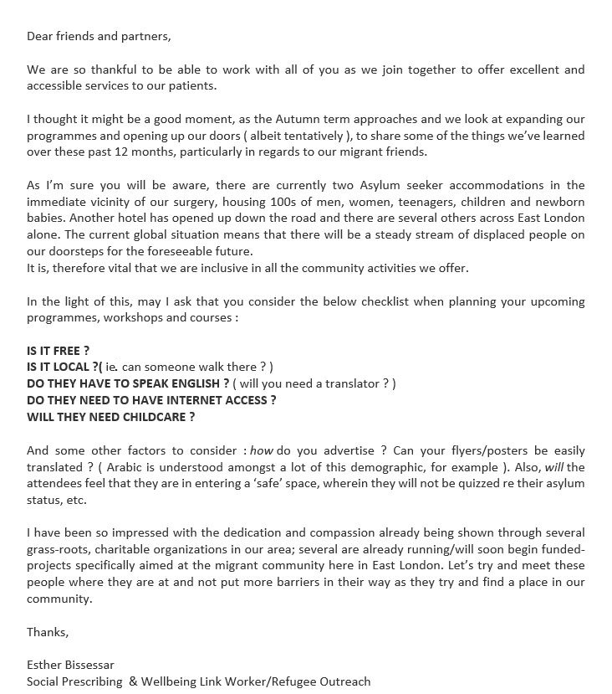
Esther Bissessar – Mission Practice
The Mission Practice provides social prescribing support to a high number of refugees, asylum seekers and migrants. There are currently two Asylum seeker accommodations in the immediate vicinity of our surgery, housing hundreds of men, women, teenagers, children and newborn babies.
Social prescribing plays a crucial part in providing support to people living in this type of accommodation. It enables them to access information about services available to them.
Resource to share:
We have written a letter to encourage social prescribing partners to meet with refugees, asylum seekers and migrants where they currently live to reduce barriers as they try and find a home in our community.
Top tips:
Avoid introducing yourself as a “Social Prescriber” - it is likely to be translated as “Social Worker” making it more difficult to build trust.
It may be better to introduce yourself as a helper
Peer Learning: Supporting migrant communities and people with refugee status

Slide 50
Rosanna Horsley - HostNation
Peer Learning: Supporting migrant communities and people with refugee status

Slide 51
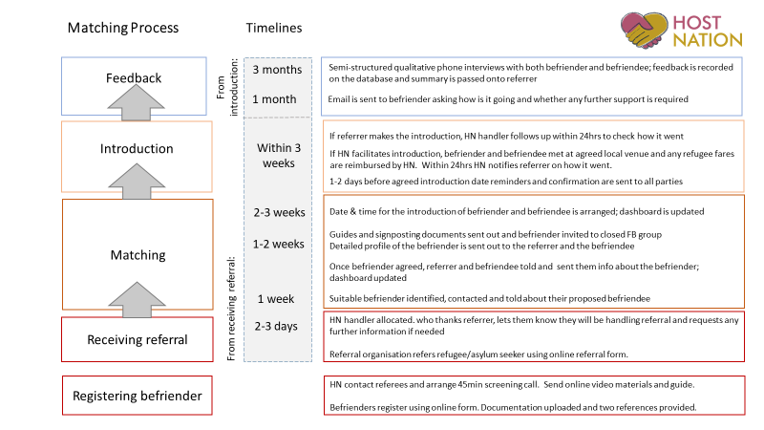
Rosanna Horsley - HostNation
Peer Learning: Supporting migrant communities and people with refugee status

Slide 52
Rosanna Horsley - HostNation
Peer Learning: Supporting migrant communities and people with refugee status

Slide 53
Resources
You can access all resources via the FutureNHS Collaboration Platform: London SPLW Toolkit.
DOCUMENTS
New social prescribing page - https://www.gov.uk/guidance/social-prescribing-migrant-health-guide
Social Prescribing to improve access to healthcare for migrants - www.bit.ly/SPLWposter
Supporting migrant’s access to healthcare: Toolkit for SPLWs- www.bit.ly/SPLWtoolkit
The Right to Remain Toolkit - https://righttoremain.org.uk/toolkit/
City of Sanctuary Mental Health Resource Pack - https://health.cityofsanctuary.org/resources
ORGANISATIONS
Directory of Services & Organisations for Refugees, Asylum Seekers & Migrants: 2020 Edition available here.
Care 4 Calais - access@care4calais.org
HostNation - https://www.hostnation.org.uk/ Referral form available here.
Refugee Action - https://www.refugee-action.org.uk/project/asylum-crisis-project/
Refugee Council - https://www.refugeecouncil.org.uk/
Waterloo Community Counselling - https://waterloocc.co.uk/multi-ethnic-counselling-service/
Peer Learning: Supporting migrant communities and people with refugee status

Slide 54
Resources shared in our chat
Resources
Refugee Action Kingston - a local charity, supporting refugees and asylum seekers in the Kingston area - https://refugeeactionkingston.org.uk/
The London Youth Games - https://www.londonyouthgames.org/
Language interpreting and translation: migrant health guide - https://www.gov.uk/guidance/language-interpretation-migrant-health-guide
Hestia - Modern Slavery Response: Provides support workers for victims of trafficking and modern slavery - https://www.hestia.org/modernslaveryresponse
Refugee & Migrant Forum of Essex and London (RAMFEL) charity supports vulnerable migrants to access justice and provides vital support in moments of individual crisis - http://www.ramfel.org.uk/
Talking Bubble: Dialogue Society Befriending Campaign to End Loneliness - http://www.dialoguesociety.org/notices/1246-dialogue-society-befriending-campaign-to-end-loneliness.html
Peer Learning: Supporting migrant communities and people with refugee status

Slide 55
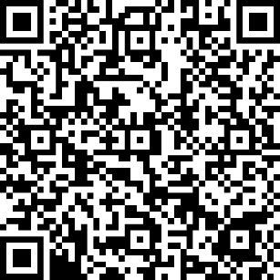
Feedback
Thank you for participating in our Peer Learning Session: Supporting migrant communities and people with refugee status. We hope you have enjoyed it and found it useful.
It would be great if you could complete this quick feedback form to let us know your honest opinions:
https://forms.office.com/r/tJ6PR61Ve6 or
Our next session on 6th October will be:
Caseload management & ending your professional relationship with a client. Sign up here.
Please feel free to email us if you have any questions. Lianna Martin: lianna.martin@nhs.net Justyna Sobotka: j.sobotka@nhs.net
Peer Learning: Supporting migrant communities and people with refugee status

