Slide 1
Peer Learning for London
“Outcome measures and presenting the impact of your work”
Wed 28th July 21

Slide 2
Plan for today
JOIN THE CONVERSATION
TIME | ITEM
12:30 | Introductions
12:40 | Martin Cattermole – SNOMED and minimum data set
12:50 | Michaela Coker – ONS4, collating and presenting reports to the PCN
1:05 | Dan Hopewell – BBBC, MYCAW & clinician surveys
1:15 | Louise McComiskie – GP attendance
1:25 | Katalin Swan – Case studies
1:35 | Kerri Fowkes-Morley – LEAF-7, Patient's feedback and presenting reports to stakeholders
1:45 | Sharing best practice
2:00 | Q&A and Networking
2:30 | Close
It is an informal session
– talk to each other & share resources in the chat
The presentations will be recorded & circulated
Peer Learning for London: Outcome measures and presenting the impact of your work

Slide 3
Overview – what will you leave with...
By the end of this session you will be able to:
understand what data on Social Prescribing should be collected;
know what outcome measure is required by the NHSE;
gain information on different outcome measures used by SPLWs and SP Managers across London;
share best practice and resources related to measuring outcomes;
know how to present the outcomes of SPLW work in a short, easy-to-digest way;
get examples of reports created to present the impact of Social Prescribing interventions;
reflect on your current methods of measuring outcomes and create a plan allowing effective outcome measures and high standard of SP reports
Peer Learning for London: Outcome measures and presenting the impact of your work

Slide 4
ZOOM POLL
Do you use any outcome measuring tools/questionnaires?
Peer Learning for London: Outcome measures and presenting the impact of your work

Slide 5
QUESTION
Which outcome measuring tools/questionnaires do you use?
Please share using chat.
Peer Learning for London: Outcome measures and presenting the impact of your work

Slide 6
NHS Requirements
All Social Prescribing Link Workers should measure impact of their work focusing on SP interventions impact on the person, community groups and the health and care system (details in Social prescribing and community-based support. Summary guide).
Social Prescribing Link Workers should consider collecting following data*:
Using Systematised Nomenclature of Medicine (SNOMED) codes on GP IT systems to record social prescribing referrals made and social prescribing referrals declined
Outcomes from the Office for National Statistics wellbeing scale - ONS4
Total number of referrals to the social prescribing link worker
Where referrals have come from such as GPs, other PCN staff, the police, fire service, self-referrals, etc.
Reasons for the referral, for example isolation, long term condition, depression, etc.
The number and type of contacts each person has had with their link worker, for example, first contact, when, where, number of phone calls, 1-2-1 meetings (including the amount of time spent with each person)
Where the person is being connected to, such as money/welfare rights, housing support, statutory services, employment support, practical support with aids and adaptations, etc.
Information about their personalised care plan
How satisfied the person was with the support
* Source: Social Prescribing - Learning for Link Workers
Peer Learning for London: Outcome measures and presenting the impact of your work

Slide 7
Martin Cattermole, Head of evidence unit Personalised Care Group, NHS England and NHS Improvement
SNOMED CT is a multilingual healthcare terminology originally created by, and annually enhanced through, extensive clinical input. It contains over 350,000 concepts with unique meanings and formal logic-based definitions.
The Network Contract DES Specification 2020/21 (sections 5.4.6. and 10.4.) requires core network practices of a PCN to use the relevant SNOMED codes. Annex B3.6. of the DES Specification document provides that a PCN must ensure referrals to the SPLW are recorded within GP clinical systems using the following codes, which are listed in section 10.4:
871731000000106 – Referral to social prescribing service (procedure)
To be used when an individual accepts a referral to the SPLW– for first interaction in an episode of care only, not to be used to code ongoing activity.
871711000000103 – Social prescribing declined (situation)
To be used when an individual declines a referral to the SPLW.
Peer Learning for London: Outcome measures and presenting the impact of your work

Slide 8
Q&A
Please feel free to ask your question(s).
Peer Learning for London: Outcome measures and presenting the impact of your work

Slide 9
Michaela Coker – Social Prescribing Link Worker
AGE UK Lambeth & Streatham PCN Social Prescribing
My PCN consists of 7 practices that accumulate to 54.000 patients
My initial appointments will be booked for 1 hour follow ups 30min appointments
Initial appointment introduces the nature of my role and asks the patient to take
time explaining there issues/ support required.
I then do ONS4 and create a personalised care plan with targets for the patient
I tend to work with people up to 8-10 weeks and patients may re-refer should they need the service again.
What is ONS4 and why do we use it?
The ONS4 is the only outcome measure required by NHSE.
Rickter scale measures observable factors like: employment, education, social life, health, physical activity, finances, housing and looking at how the patient may feel about them.
By evaluating the patient using these tools in we ensure accurate details of their feeling and the impact our service has had for them from beginning to end.
Peer Learning for London: Outcome measures and presenting the impact of your work

Slide 10
Michaela Coker – Social Prescribing Link Worker
How do we do this?
The first time I saw the Rickter Board or ONS4 in 2019 I wondered “ how do we get a patient to want to do this evaluation”?
We all have our own unique ways of how we connect and build trust with our patients. What works for one of us might not work for another. Nevertheless, in majority of cases we would be able to introduce ONS4 questions in a pleasant way – with our patient’s acceptance.
Completing ONS4 - demonstration using a dummy patient.
Challenges using ONS4 and Rickter Scale
Like every tool in the world nothing is ever #perfect!
One of the main challenges for me is that some patients have had really negative experiences with CBT therapy and these tools and questions can be daunting or irritating to them.
My hack: rephrase how I ask the question, personalise the relevance, so they feel confident that the data shared is for their best interest.
Peer Learning for London: Outcome measures and presenting the impact of your work

Slide 11
Michaela Coker – Social Prescribing Link Worker
Why is it good to collate qualitative data for our PCNs?
Due to the fast paced nature of the role often we are not always physically visible in our PCNs
For this reason in particular, I have found that presenting case studies of patients that have met targets and made progress is key in promoting our amazing work.
Not only does sharing case studies or good news stories share what you have achieved, it will give a gentle reminder of the power of social prescribing in the community and encourage new referrals.
When to collate and what to do after?
Collating Via Elemental: Upon discharge from the Social Prescribing Service, I review the case notes, highlight most relevant info and create a good news story.
Like any traditional story it has the beginning, middle and end as follows:
Why the patient was referred to me
How I supporting them, actions, targets achieved, where the patient has been referred to
Finalising outcome of last appointment, ONS4 result summary and sustainable changes made to patients life.
I then send a monthly keeping in touch email to Clinical Directors, GP leads, Practice managers to share the impact of my case studies.
Peer Learning for London: Outcome measures and presenting the impact of your work

Slide 12
Michaela Coker – Social Prescribing Link Worker
How using ONS4 helps me present quarterly reports?
I have attached a copy of a drafted quarterly report so you can see how it was presented to my PCN.
This covers either ONS4 OR Rickter scale demographics for the patients that I supported in that time period.
Feel free to access the report here.
Peer Learning for London: Outcome measures and presenting the impact of your work

Slide 13
Michaela Coker – Social Prescribing Link Worker
My Top Tips
Practice using the tool with your peers and take turns being a difficult patient and review how you ask the questions.
Be your authentic self, although we remain professional at all times patients sense when we are being “textbook” be mindful on how we speak with each individual
Create yourself a folder of case studies so you have them prepared upon request which saves you admin time!
If in doubt and you need additional training or support always ask for help. Whether it be with your PCN or external organisation there are pathways in place to support us.
Peer Learning for London: Outcome measures and presenting the impact of your work

Slide 14
Q&A
Please feel free to ask your question(s).
Peer Learning for London: Outcome measures and presenting the impact of your work

Slide 15
Dan Hopewell – London Region Facilitator for Social Prescribing
Outcomes Measurement and Evaluation
Cross-service/cross-organisation outcomes measurement.
With members of the local community Bromley by Bow has developed the knowledge and skills to measure change due to our work that is based entirely on what matters to the local community.
The two-year Bromley by Bow qualitative study Unleashing Health Communities identified the ‘ingredients of a good life’ from the perspective of local community members, set within the current and a historical context.
These have been grouped and now form the Bromley by Bow Outcomes Framework. Our team has operationalised the Framework into 14 domains and 40 indicators and has developed an evaluation tool that routinely and consistently measures the change clients experience as a direct result of the Bromley by Bow activity they participate in, across the integrated Bromley by Bow Centre and Health.
For this work we are grateful to be supported by an Advisory Group
and funded by the Health Foundation.
Peer Learning for London: Outcome measures and presenting the impact of your work

Slide 16
Q&A
Please feel free to ask your question(s).
Peer Learning for London: Outcome measures and presenting the impact of your work

Slide 17
Louise McComiskie – Social Prescribing Link Worker, Barnet
Description of SP service
Within the PCN that I work in, there are 3 SPLW including myself and between us we cover 7 surgeries. The sessions can last anywhere from 10 minutes to just over 30 minutes depending on the needs of the patients and what they have referred for.
What do we measure and why?
We use a software called Elemental. This is where we receive referrals and make notes from the conversations we have with the patients. We record the social prescription and the ONS4 and GP visits in the first session and then record it again once we have discharged the patient.
We also have a feedback survey which we send out to patients via email at the end of service to gain information on how helpful they found the service and how we can improve.
How do we do it
We do this by using Elemental and inputting the data that is then pulled by the SP manager every month.
Summary
By using Elemental it helps us to keep a record of how well SP works with the surgeries whom we support. It helps us see if SP is working for patients who are referred to us and record the data once we have discharged them to find out if the patient isn’t going to see the GP as much as they were before being referred to the SP service.
Peer Learning for London: Outcome measures and presenting the impact of your work

Slide 18
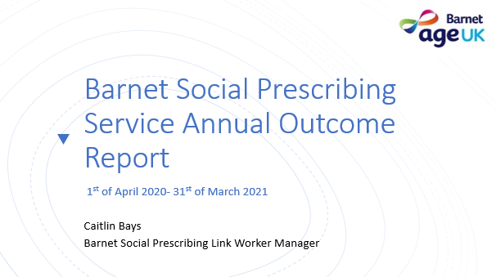
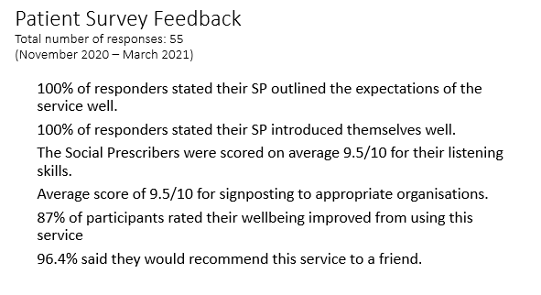
Louise McComiskie – Social Prescribing Link Worker, Barnet
In our annual reports we include information related to:
Overall Summary
Referral totals (per month and PCN split)
Referral by GP practice
Age and gender of total referrals made
Appointment types and number of appointments made by PCN
Contact times of appointments made
Most common referral reasons for the service identified
Most common signposting and referrals made by SPLW
Percentage of referrals made for each Referral reason to the service
Outcome data ONS and GP attendance records
Feedback Survey results
Peer Learning for London: Outcome measures and presenting the impact of your work

Slide 19
Louise McComiskie – Social Prescribing Link Worker, Barnet
The slide illustrates how we report GP attendance, hospital admission and A&E admissions.
The report is presented to the PCN on a regular basis.
Peer Learning for London: Outcome measures and presenting the impact of your work

Slide 20
Q&A
Please feel free to ask your question(s).
Peer Learning for London: Outcome measures and presenting the impact of your work

Slide 21
Katalin Swann, Care Navigation and Social Prescribing Manager S
CARE NAVIGATOR
Self-management – food provision, prescription delivery, arranging POC, Falls team, Physio, DNs, dentist, podiatry, optician, pendant alarm, carers, appointment support, employment support
Home management – OT assessment, home adaption, home repair issues, key top ups, hoarding, looking after pets
Housing support – homeless applications, social housing, repairs, moving, liaising with Housing departments
Finance – Benefit assessment, Debt advise, PIP, Attendance allowance
Transport – arranging hospital transport, Blue badge and taxi card applications
Mental Health - liaising with secondary services and GP, referrals to mental health services, Counselling
Social isolation – befriending, activity classes, day centres.
SOCIAL PRESCRIBING LINK WORKER
Social isolation – activity classes in person and online, befriending, volunteering opportunities, exploring ways to connect back with the local community, finding activities that mirrors client’s interest
Improve overall wellbeing – support with positive health behaviours, provide a holistic approach to overall wellbeing – environment, mental and emotional wellbeing
Life-style/behaviour change – support with making healthier life-style choices, diet, alcohol consumption, smoking, exercise
Peer support groups – online and face to face – managing diabetes, long Covid, Walking group etc
Returning patients – offer support to those patients who are frequently returning or calling the GP practice
Mental Health - liaising with secondary services and GP, referrals to mental health services, Counselling
Finance/Housing support/Transport – Out of borough patients
Peer Learning for London: Outcome measures and presenting the impact of your work

Slide 22
Katalin Swann, Care Navigation and Social Prescribing Manager S
Client Feedback
Feedback to evidence time saved by Social Prescribing
Did the help you received from Care navigator/SPLW focus on the thing you wanted support with?
Did you feel the care navigator/SPLW understood your need and what you wanted/needed?
Since working with the Care navigator/SPLW do you have a better understanding of how to manage your health and wellbeing?
Did the Care Navigator/SPLW have good knowledge of local services for you?
I am satisfied with the help I received from the Care Navigator/SPLW.
The Care navigator/SPLW involved me in decisions about my care and support.
Did your Care navigator/SPLW help you link with other services?
Any other information
Did using our service save you from attending one or more GP appointments? (60.47%)
Did using our service save you from attending one or more nurse appointments? (35.53%)
Did using our service save you from contacting a non medical staff member at the GP practice, e.g receptionist, secretary ? (70.59%)
Did using our service save you from attending one or more appointments with other healthcare professionals? (27.45%)
If you had not use our service where would you have gone for help? - GP surgery (66.38%, Camden Council (11.18%) Other (Charity/Voluntary Organisation – 25.93%, not known – 11.26%)
(% based on Jan 21 – March 21)
Peer Learning for London: Outcome measures and presenting the impact of your work

Slide 23
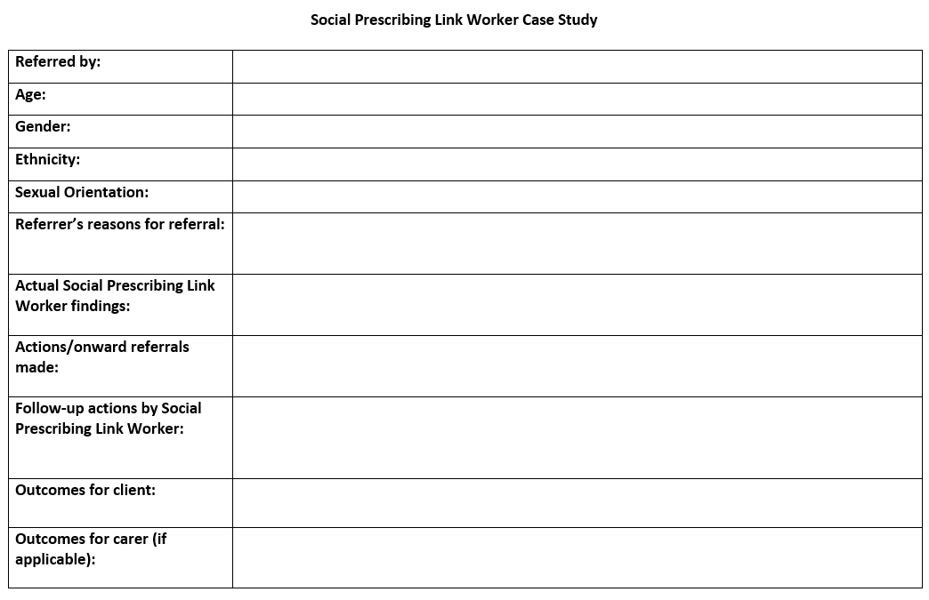
Katalin Swann, Care Navigation and Social Prescribing Manager S
Social Prescribing Link Worker Case Study - case example
Referred by: Adelaide Medical Centre. 111 Adelaide Road, London, NW3 3RY
Age: 82
Gender: Female
Ethnicity: White-British
Sexual orientation: Heterosexual
Referrer’s reason for referring: Isolated, lonely, struggling with weight loss,
anxious about health and risk of Covid, health advocacy required
Actual Link Worker Findings: Findings as described. Additionally,
client discussed sleep problems due to noise issues at home residence
Action/Onward referrals made:
Referred to Camden Nutrition and Dietetics Service
Signposted to Old Vic Pen Pal Scheme, Community Connectors, and Age UK Befriending Scheme
Contacted Genesis Housing Association to discuss noise issues and requested for a poster to be advertised to residents asking for consideration re noise
Blank case study template available here.
Peer Learning for London: Outcome measures and presenting the impact of your work

Slide 24
Katalin Swann, Care Navigation and Social Prescribing Manager S
Follow up action by Link Worker:
Referred to NHS Responders for hospital transport.
Liaised with client’s GP to discuss queries around Ensure prescription, recommendations for blood test, chest X-ray, stool sample.
Liaised with Royal Free to arrange appointment.
Liaised with UCH for foot appointment.
Liaised with Western Eye Hospital to arrange appointment.
Regularly updated client with information around ever-changing Covid regulations
Supported client through multiple panic attacks over the phone, including encouraging breathing exercises.
Signposted client to organisations to help with anxiety including Mind, Icope and Anxiety UK
Encouraged client to increase social connections by drawing on current social networks given client’s disinterest in befriending and community connectors
Outcomes for client:
Weight loss reversal through new diet/strategies as suggested via Camden Dietetics and Nutrition referral
Successfully scheduled appointments with various hospitals
Arranged transport to appointments inc Covid vaccination.
Reduced anxiety through weekly wellbeing calls, encouraging breathing exercises when panicky and health advocacy with hospitals and GP.
Reduced social isolation through encouraging client to make use of social networks already in place
Peer Learning for London: Outcome measures and presenting the impact of your work

Slide 25
Q&A
Please feel free to ask your question(s).
Peer Learning for London: Outcome measures and presenting the impact of your work

Slide 26
Kerri Fowkes-Morley, Head of Social Prescribing Sutton
Social Prescribing Sutton
Commissioned by the Primary Care Networks
All-adult (18+) holistic service
Delivered in partnership with Sutton GPs and voluntary sector, with Age UK Sutton as the lead delivery partner
6 Link Workers:
x 4 aligned to each of the PCNs
x 2 supporting MDT / Virtual Wards (complex combination of medical and non-medical needs)
Connecting you with what matters
Peer Learning for London: Outcome measures and presenting the impact of your work

Slide 27
Kerri Fowkes-Morley, Head of Social Prescribing Sutton
Wellbeing and outcome measurement:
​P-CAT (Person-Centred Assessment Tool):
ONS4 / LEAF-7
Service User Evaluations:
Patients’ feedback
Managing daily living
Health management
Feeling safe and secure
Doing the things you enjoy
Social contact
Doing what’s important to you
Living life the way you choose
LEAF-7:
Started by Age UK Wakefield District in 2009, and developed with Leeds Beckett University and more recently Sheffield Hallam University.
Assesses a person’s quality of life
Supports holistic assessment and goal setting – easily highlighting areas to focus on, as identified by client
Overview of wellbeing rather than snapshot
http://leafoutcomes.uk/
Peer Learning for London: Outcome measures and presenting the impact of your work

Slide 28
Kerri Fowkes-Morley, Head of Social Prescribing Sutton
Who do we report the outcomes to?
To the PCNs
To the Commissioners
To other stakeholders, including Sutton’s Social Prescribing Steering Group and Age UK Sutton’s Quality Committee
Monthly:
AUKS internal leadership meetings to report on KPI activity, referrals, trends, etc.
Information on referrals submitted to PCNs (written and presented verbally at CRTs)
Presentation at Sutton’s Social Prescribing Steering Group
Quarterly:
Qualitative report + spreadsheet on KPI activity submitted to Commissioners and AUKS Quality Committee
Annually:
End of Year Report shared with Commissioners, Steering Group and other stakeholders
Peer Learning for London: Outcome measures and presenting the impact of your work

Slide 29
Q&A
Please feel free to ask your question(s).
Peer Learning for London: Outcome measures and presenting the impact of your work

Slide 30
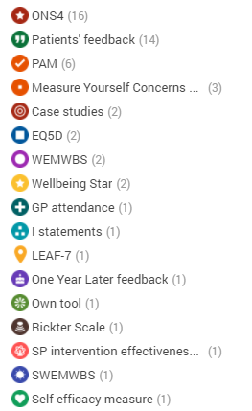
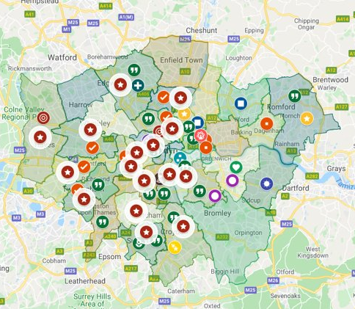
What London is using....
The map illustrates current knowledge on using outcome measures across London.
Peer Learning for London: Outcome measures and presenting the impact of your work

Slide 31
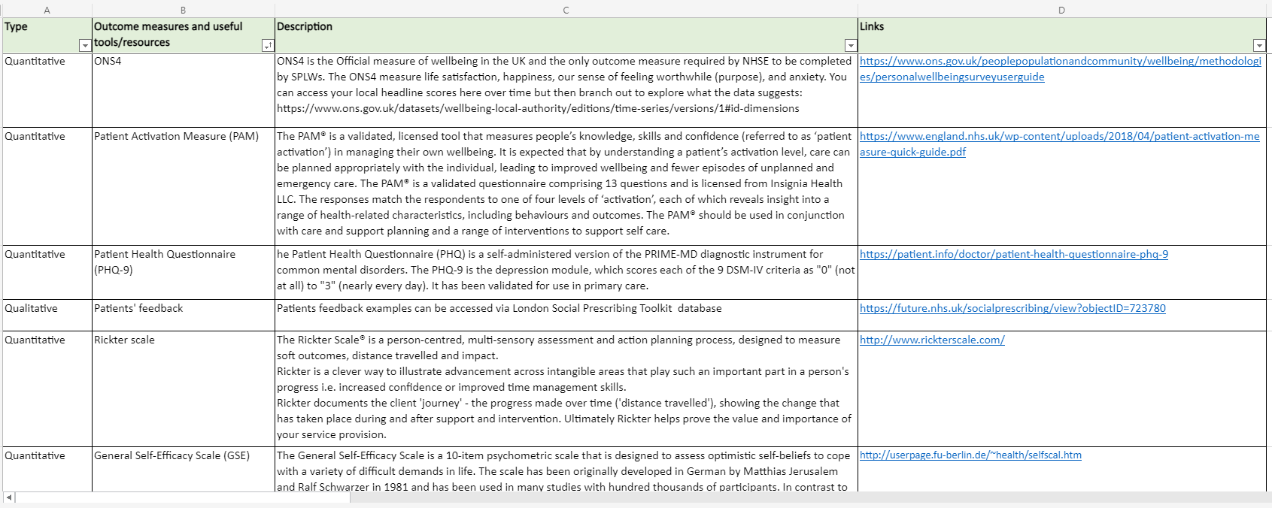
Summary of tools
Quantitative:
SNOMED
EMIS/SystmOne
ONS4
Measure Yourself Concerns and Wellbeing (MYCaW)
The Warwick-Edinburgh Mental Wellbeing Scale (WEMWBS)
Patient Health Questionnaire (PHQ-9)
Patient Activation Measure (PAM)
Rickter scale
LEAF-9
EQ5D
Wellbeing Star
Wellbeing Prism
Qualitative:
Patients’ feedback
Case studies
Compliment/ Complaint forms
The outcome measures database can be accessed via London Social Prescribing Toolkit page available here.
Peer Learning for London: Outcome measures and presenting the impact of your work

Slide 32
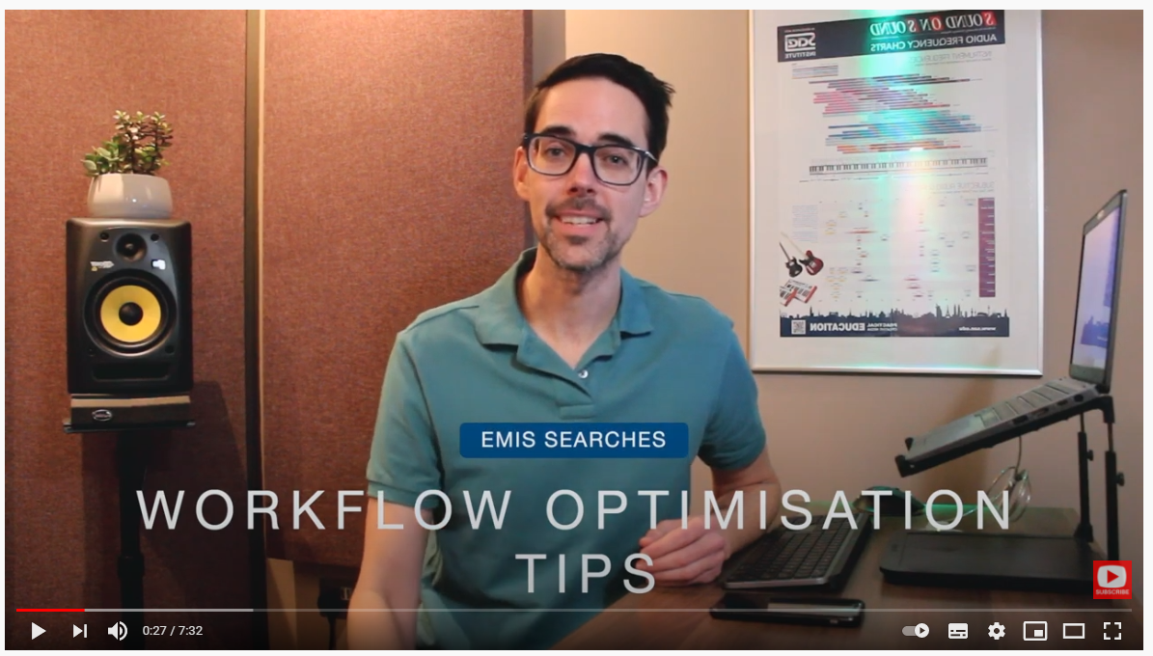
EMIS and SystmOne Reports
You can create reports based on data obtained from your GP IT system e.g. Emis or SystmOne.
The videos below present creating searches in Emis, and step-by-step instruction on how to run searches using SystmOne. Best practise indicates it is always advised to seek your line manager's approval before running searches.
Creating EMIS searches
Building SystmOne reports
Peer Learning for London: Outcome measures and presenting the impact of your work

Slide 33
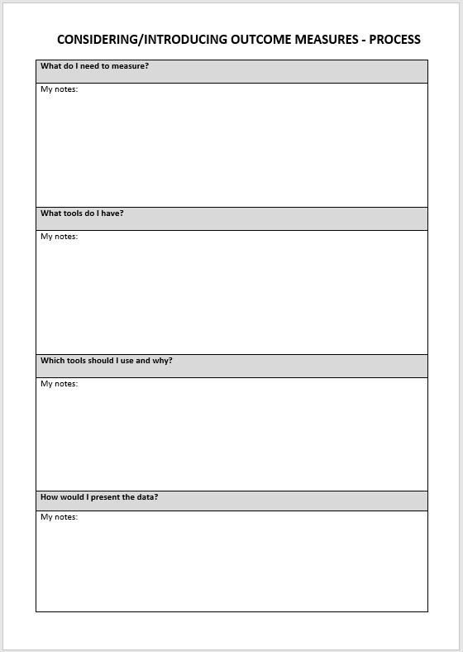
Process
If you would like to introduce or evaluate your outcome measures
it may be useful to complete a written exercise.
You can find the editable file here.
Questions you may consider asking yourself could include:
What do I need to measure?
What tools do I have?
Which tools should I use and why?
How would I present the data?
Peer Learning for London: Outcome measures and presenting the impact of your work

Slide 34
Discussion
How can you be feeding back on the impact of your work (top tips, meetings etc.)
Peer Learning for London: Outcome measures and presenting the impact of your work

Slide 35
Resources
NHSE guidance documents – PDF document
SNOMED – PDF document
ONS4 – MS Excel file
Using ONS 4 – NHSE recorded webinar
Personalised care plan template by Michaela Coker – MS Word document
PCN quarterly report sample by Michaela Coker – PDF document
Bromley By Bow Centre outcome measures - recorded session
Grid of Social Prescribing outcome measures – MS Excel file
Introducing Outcome Measures Process – MS Word document
Recording on how to run searches using EMIS – YouTube link
Recording on how to build reports using SystmOne – Vimeo link
London Case Studies – FutureNHS Collaboration Platform database
Social Prescribing Case Study template by Katalin Swann – MS Word document
SSM resources – FutureNHS Collaboration Platform page
Peer Learning for London: Outcome measures and presenting the impact of your work

Slide 36
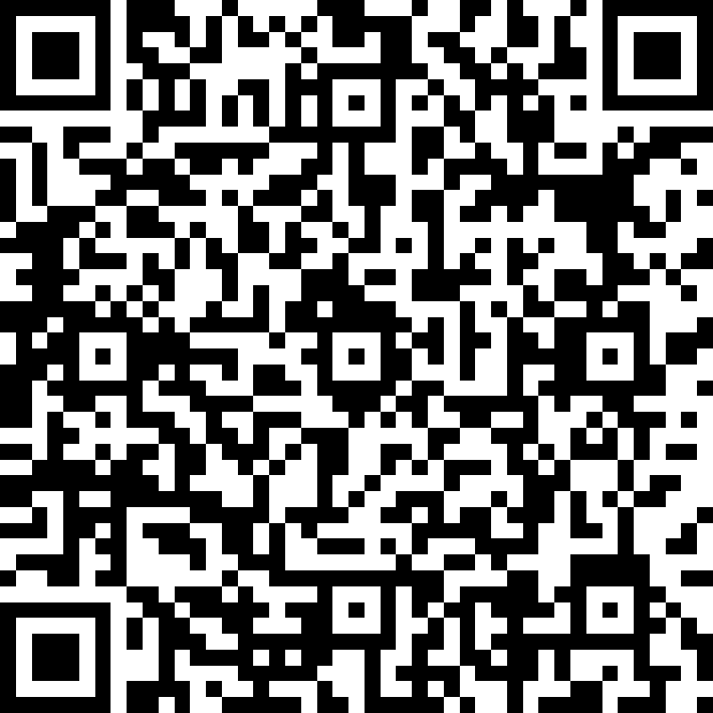
Feedback
Thank you for participating in our Peer Learning: Using outcome measures and presenting the impact of your work session. We hope you have enjoyed it and find it useful.
It would be great if you could complete this quick feedback form to let us know your honest opinions:
https://forms.office.com/r/kBvGRVRrYj or
Our next session on 25th August will be:
Supporting migrant communities and people with refugee status. Sign up here.
Please feel free to email us if you have any questions. Lianna Martin: lianna.martin@nhs.net Justyna Sobotka: justyna.s@bbbc.org.uk
Peer Learning for London: Outcome measures and presenting the impact of your work

