Slide 1
Working with disordered eating presentations to the acute hospital during Covid-19 13.7.21
Dr Joel Khor, Consultant C&A Psychiatrist
Dr Luci Etheridge, Consultant Paediatrician
SWL St George’s CYP eating disorders service & St George’s Hospital CWDT

Slide 2
Covid-19 context
Greater burden of unmet mental health need accrued during lockdowns / changes going into and out of lockdown
Increased focus on eating and weight in the whole population
Further demands on CYP-CEDS and general CAMHS services, overwhelming already limited capacity
Increase in the “disordered eating” group since start of 2021
“Disordered eating” presenting more to borough Tier 3 CAMHS and CYP-CEDS, but greatest challenges are with presentations to acute hospitals
The nature of the presentations has highlighted gaps in services and service organisation, and posed challenges to joint working
This is currently one of the major organizational needs for all paediatric and CYP MH services
Status quo = perverse incentives and iatrogenic harm

Slide 3
SWLSTG CYP Community ED Monthly referral rates
Notes:
Numbers of referrals continue to go up significantly
Numbers of urgent cases continue to go up significantly
Many more cases where at referral screening, there doesn’t seem to be an eating disorder

Slide 4
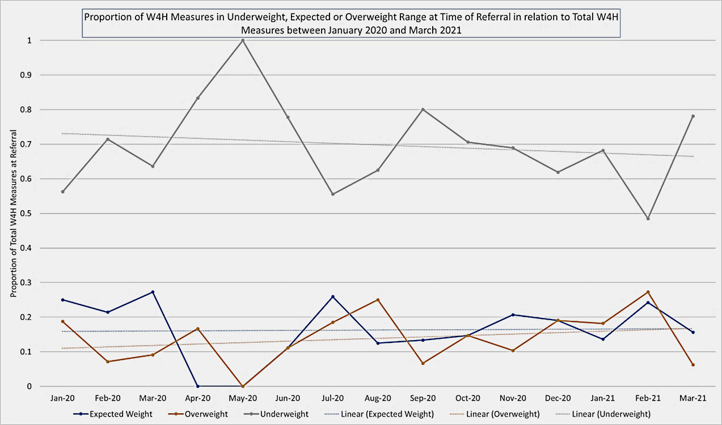
CYP-CEDS Trend in %EBW at referral
=> Trend increase in relative proportion of cases at or above expected body weight

Slide 5
Trend in paediatric admissions
In 2020-2021
66% increase in paeds admissions to SGH
46% (vs 22% in 19-20), self-present to A&E, many prior to diagnosis
54% (vs 10%) fed by NGT, mainly due to complete food and fluid refusal +/- low blood sugar
LoS doubled (range 1-140 days)
Overall inc in complexity and severity of mental health need at admission to paediatric ward, no real change in severity or complexity of physical health

Slide 6
“Disordered eating”: What is it?
CYP with other mental health and psychosocial needs presenting with food and fluid avoidance, phobias and refusal
Not primary DSM-5 Anorexia Nervosa, Bulimia Nervosa, or OSFED (the focus of CYP-CEDS)
SWLSTG/SGH using “constrained eaters” as the interim term - coined by SWLSTG COO
Three categories¹ might be helpful to consider: food-avoidance, food phobias, and food refusal
¹Nicholls, D., Barrett, E. and Huline-Dickens, S. (2014). Atypical early-onset eating disorders. Advances in Psychiatric Treatment, volume 20, pp. 330–339.

Slide 7
“Disordered eating”: What is it?
Anorexia Nervosa Diagnostic Criteria (DSM-5)
Restriction of energy intake relative to requirements, leading to a significantly low body weight in the context of age, sex, developmental trajectory, and physical health. Significantly low weight is defined as a weight that is less than minimally normal or, for children and adolescents, less than that minimally expected.
Intense fear of gaining weight or of becoming fat, or persistent behavior that interferes with weight gain, even though at a significantly low weight.
Disturbance in the way in which one’s body weight or shape is experienced, undue influence of body weight or shape on self-evaluation, or persistent lack of recognition of the seriousness of the current low body weight.
OSFED-Atypical Anorexia Nervosa Diagnostic Criteria (DSM-5)
“All of the criteria for anorexia nervosa are met, except that despite significant weight loss, the individual’s weight is within or above the normal range”

Slide 8
“Disordered eating”: What is it?
Should we be talking about ARFID?
Most areas do not have an ARFID pathway / service, therefore
These presentations fall under borough T3 CAMHS
No additional resource
DSM-5 ARFID Criterion D:
“The eating disturbance is not attributable to a concurrent medical condition or not better explained by another mental disorder. When the eating disturbance occurs in the context of another condition or disorder, the severity of the eating disturbance exceeds that routinely associated with the condition or disorder and warrants additional clinical attention.”
Most challenging is interface with emotion dysregulation (which ARFID category may not handle well?) and ASD
Conversations about “is this ARFID” currently do not help to access treatment – there is nowhere else to send them
There will always be an interface, even with an ARFID pathway / service
Need to find a way to work with these presentations now, within existing frameworks

Slide 9
“Disordered eating”: How to assess?
Assessment of eating and eating behaviours has to be objective – what is the evidence?
Assessment and treatment planning has to be holistic
Don’t just focus on eating
Holistic assessment of mental health including other disorders
Personal / developmental history
Family history and social context
Is there a better explanation than an eating disorder?
Medical conditions
Axis 1 disorders, developmental disorders, emotion dysregulation / emerging EUPD
A form of communication (e.g. protest, anger, frustration, pain)
“In these children, food refusal may be one of only a few ways that they are able to communicate that something is either physically or emotionally wrong…” (ibid.)
At every level, don’t jump to a diagnosis of Anorexia Nervosa in complex cases with diagnostic uncertainty

Slide 10
“Disordered eating”: Who can / should assess?
A+E
On-call paediatric team
On-call liaison nurse
On-call SpR
Ward-based paediatric team
Borough-based Tier 3 CAMHS
Adolescent assertive outreach team
Liaison psychiatry team
CYP-CEDS
Feeding disorders team (if present)

Slide 11
“Disordered eating”: inpatient psychiatric admission
Do not do well on SEDUs:
long-stays
Different profile of needs from CYP with AN
Influence to escalate eating behaviours to prove they belong
Difficulties with returning to home/school
Disruptive for SEDUs - may escalate to LSU / “HDU”
Most units that can choose will not accept referrals
Efficacy of out of area placements (?)
Hard to avoid admission to Tier 4 once on paed ward with NG tube in situ without an exit strategy
Recent CYP after 4m on paed ward negotiated brief admission to acute unit with clear plan to increase eating + parallel multiagency planning for post-discharge support, including borough T3, AOT, social care and education (+ ASD assessment)

Slide 12
Case study: 15 years old girl
Low mood and self-harm from age 13 – referred T3 CAMHS
Started SSRI
Tried to access ASD assessment
Inc restriction of eating and weight loss
Sent to A&E
Referred CEDS
Longstanding sensory issues with food and limited diet, eats alone, feels guilty, hates thighs
Acute food and fluid refusal plus inc suicidal ideation. High unmet needs in the family
Admitted to paeds ward
Worsening restriction on ward
NGT passed parental consent
Assessment at CEDS
Refusal of NG feeds
MHA assessment
Notes:
Self harm cutting, impulsive behaviour, identified longstanding sensory issues and rigidity so referred ASD assessment
Low mood managed as depressive episode, ad hoc contact for self harming
Since starting treatment inc restricted and would try to go long periods of not eating, seen at review and had lost weight so sent to A&E
Loss of 2kg in 2 weeks at attendance, rest of obs normal, parents felt unable to manage at home and concerned about inc suicidal ideation
Identified longstanding limited diet, beige foods, little enjoyment of food, rigid patterns of eating, using fasting app and challenging herself
Unhappy on ward, did not like food or environment, refused to eat and unable to engage in discussions about why
After 4 days NGT passed, initially accepted
Assessed at CEDS and given initial diagnosis AN
Other YP on ward with AN refusing NG feeds, began holding NGT and refusing access, leading to MHA assessment
Over next several weeks able to better work with her and family and understand background and formulation revised – not AN, longstanding sensory issues with food and eating in context of ASD and emotional dysregulation, restriction as coping leading to entrenched patterns of food refusal as part of a way of managing emotions

Slide 13
Managing “disordered eating”: where to focus
How to avoid acute paediatric admission?
What frameworks to set up?
Do you have a lead paediatrician for these presentations?
How you do mobilise mental health and social services response urgently and robustly?
How to avoid NG tube insertion?
How to achieve joint working between paediatrics and CAMHS to effectively support community treatment?
How do you improve assessment and treatment planning within existing resources?

Slide 14
“Disordered eating”: Admission Avoidance
Admission Avoidance
Paediatric admission decision guide
Shared paediatric / mental health pathway
Outpatient ambulatory paediatric model
Mobilising appropriate community mental health involvement

Slide 15
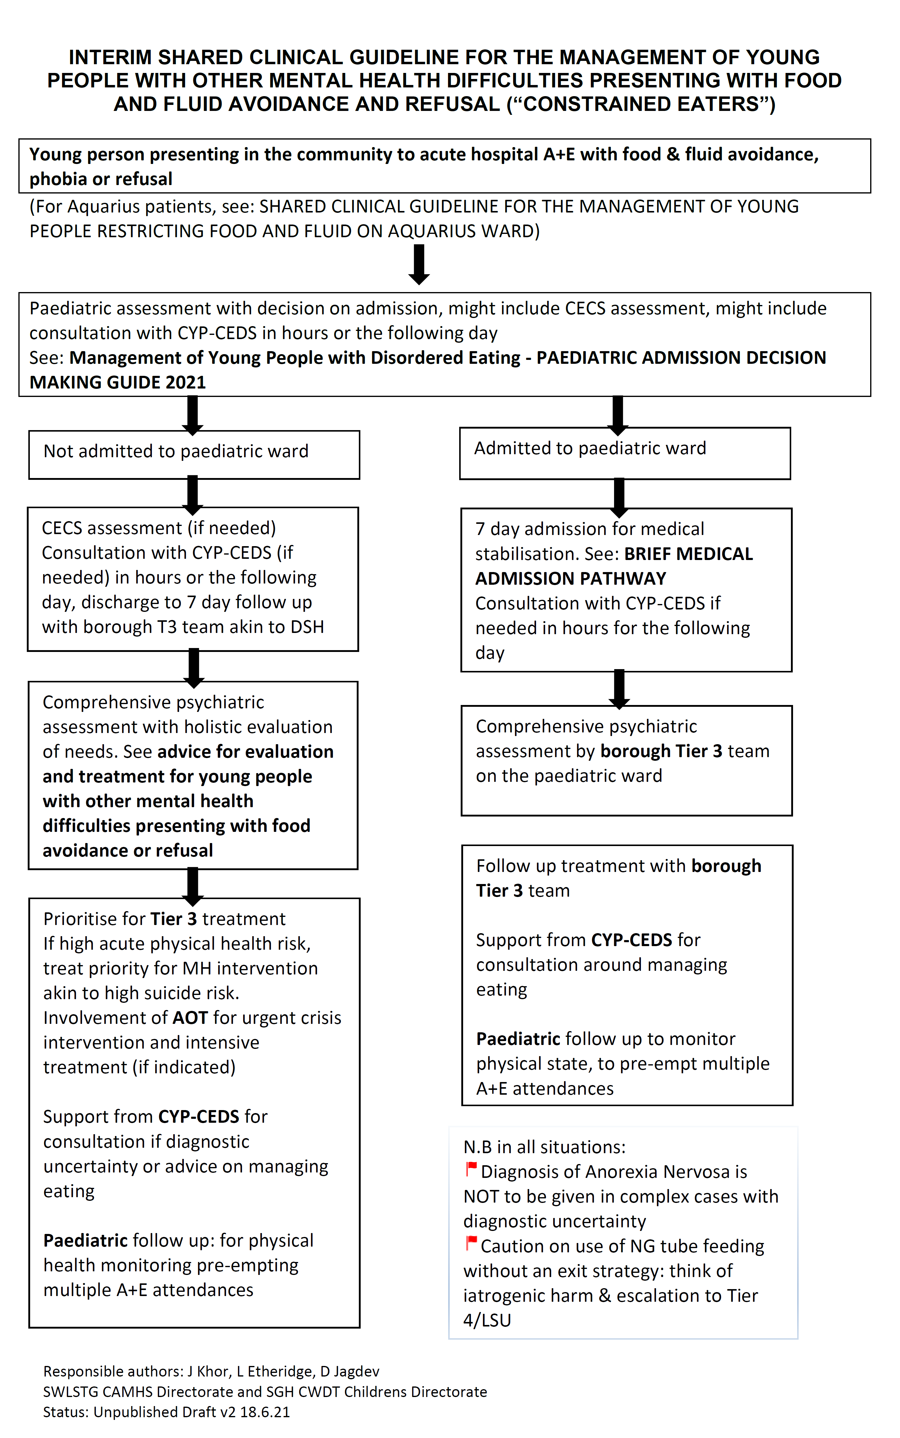
SWLSTG/SGH pathway

