Slide 1
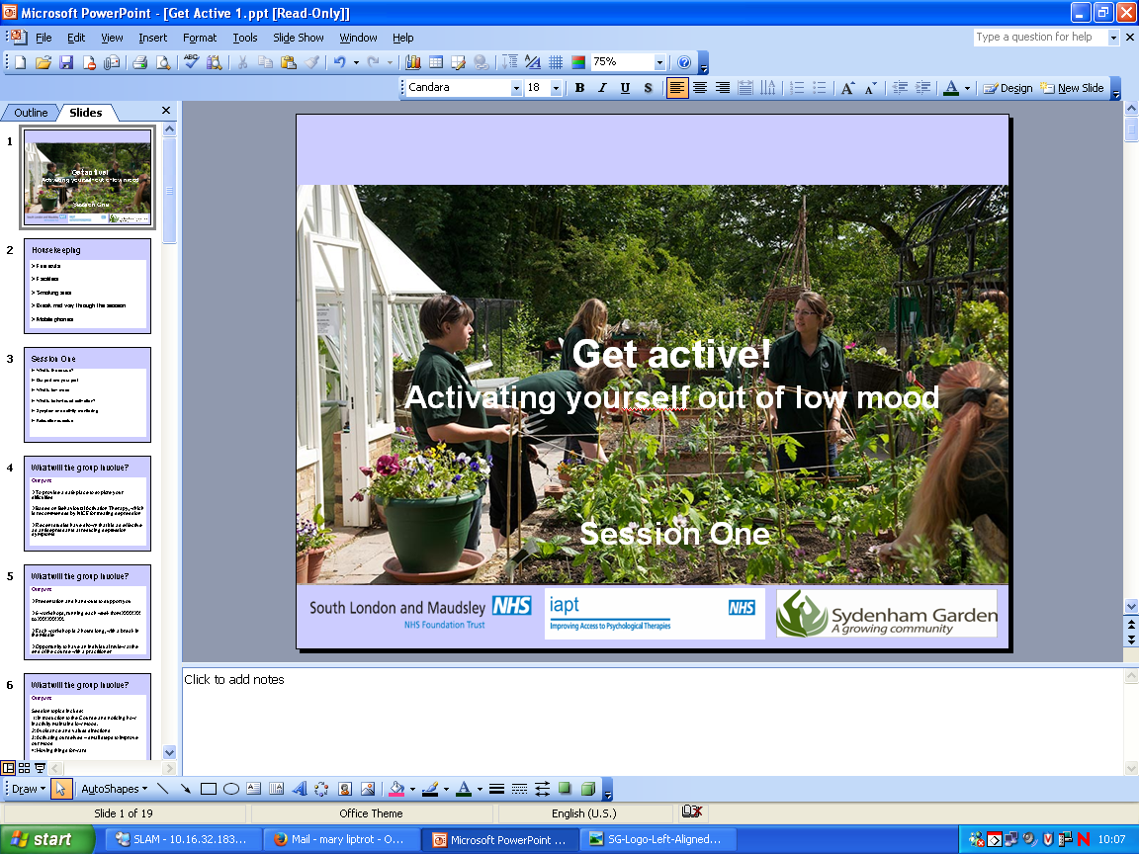
Anxiety
By Yvonne Agyemang

Slide 2
What will the group involve?
Our part…
To provide a safe place to explore your difficulties
Based on Worry Time, Problem Solving and Progressive Muscle Relaxation which is recommended by NICE for treating anxiety
Notes:
Explain NICE – who decide what treatment should be offered in the NHS according to research.

Slide 3
What will be covered
What is anxiety?​
Possible triggers to anxiety?
First steps to feeling better…​
What are Worry Time, Problem Solving and Progressive Muscle Relaxation?​
Getting to know the link between our anxiety- seeking reassurance, worrying and avoidance

Slide 4
Housekeeping
Phones off
Respect one another
A lot to get through
Not talking over each other
Confidentiality
Any thing else?

Slide 5
Symptoms of Anxiety
Panic attacks (separate workshop on this which goes into more detail. We will be focusing more on Generalised Anxiety
Worrying about everything and finding it hard to stop worrying
Troubles concentrating and sleeping
Feeling restless and tense
Reduction of energy​
Physical symptoms- increased heartbeat, sweating, dizziness
Sense of dread and constantly feeling ‘on edge’
Irritability
Notes:
Breakout groups- any experience of these symptoms and when did they occur ?

Slide 6
How Common Is Anxiety?
Feeling worried is a normal part of being human​
It is a common condition and estimated to affect 5% of the UK population (NHS website, 2020)
Reported by more women than men​

Slide 7
Anxiety across cultures
In some cultures it is common to use the psychological term of anxiety. In some cultures this word does not exists and may be better described as ‘nervousness’ (Martinez, 2020)
Research indicates that certain anxiety disorders (e.g., generalized anxiety disorder and panic disorder) may vary greatly in rate across cultural groups. It indicates that the clinical presentation of anxiety disorders, with respect to symptom presentation and the interpretation of symptoms, varies across cultures (Marques et al, 2014)

Slide 8
Other symptoms of anxiety?
Are there any other symptoms or ways in which anxiety is understood or manifest in your own cultural background?
Notes:
(note: use this as an interactive pause – giving the group a couple of minutes and then feedback to the whole group – capture this information as this will be valuable data for fine tuning the adaptation of therapy to this community)

Slide 9
Triggers to Anxiety
If anxiety manifests in symptoms then it is important to think about the triggers or things that lead to anxiety
What has made you feel anxious in the past?
Notes:
Breakout groups if this topic has not been discussed previously

Slide 10
Triggers to Anxiety?
Stress- unable to balance lots of different demands and worries about how you are going to be able to cope
Being a worrier- worrying about lots of different things
Financial Concerns- Worrying about money, being in debt
Significant life events- death of someone close, moving houses, having a baby, getting married
Racism - experiencing discrimination at work or in searching for work, feeling excluded in college – can lead to low mood, affect self esteem, motivation etc….
Personal Relationships pressures (within the family and outside of the family – difficulties in relationships at home can affect our mood…… health issues, employment or housing issues, caring responsibilities etc
Migration– difficulties with migration status, feeling isolated and missing family from the country of origin, difficulties with integrating to the new community, language difficulties can all lead to low mood…
Struggling with cultural differences between expectations of own cultural background and the dominate culture

Slide 11
Case Study
Jack struggles with GAD
It interferes with his ability to do everyday things as he constantly worries about whether or not he is making the right decision. He also always thinks about the worst case scenario
He constantly finds himself trapped in a cycle of anxiety, causing him to always feel restless and on edge. As a result his sleep is impacted and he is often irritable with others
Jack has always been a worrier but now struggles to stop worrying. He also worries about the fact that he worries so much and the impact that this may have on his health
Sometimes he thinks that worrying is a useful way to prevent things going wrong. However, he wishes he could stop worrying and over analyzing everything
Notes:
Can anyone relate to Jack? Breakout room

Slide 12
How It Can Affect Us
Behavioural- Worrying, seeking reassurance from others and putting things off/avoiding doing things
Physical- Sweating, disturbed sleep, headaches, irritable, tired, pins and needles and tension
Thoughts- Tend to be predicting that something bad is going to happen and unable to stop ourselves from worrying

Slide 13
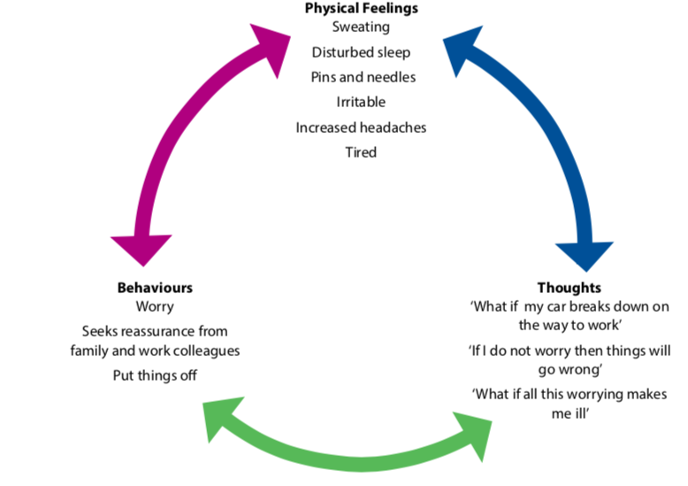
First Steps to Feeling Better

Slide 14
Summary of Cycle of Worry
When we are worrying about something we tend to avoid solving the problem, seeking reassurance from others or worrying
These behaviours maintain symptoms of anxiety as we are not dealing with the issue at hand
As a result we continue to worry that something bad is going to happen and therefore keep the fight and flight system going, which maintains the physical symptoms of anxiety
The key to start feeling better to replace worrying, seeking reassurance and avoiding things with other tools which will break the cycle.

Slide 15
Worry
Worry can be helpful- helps us problem solve
Worry can be unhelpful when it is excessive, predicts the worse and gives us physical symptoms or anxiety- headaches, tension, troubles concentrating
People who worry may start to worry about the fact they are worrying so much and what this may mean for their health, or what this says about them as a person.

Slide 16
Different types of Worry
Practical Worries: These are worries that are often affecting you now and for which there is a practical solution. For example, these can include things like ‘I haven’t paid the gas bill this quarter’
Hypothetical Worries: This type of worry is often about things that may be well in the future and may not have a solution no matter how hard you try to find one. ‘For example ‘What if the plane crashes on the way to Manchester?’, ‘What if the bus is late tomorrow to take me to the hospital?’,

Slide 17
Managing Worries
Practical Worries:
Problem solving is an evidence-based intervention that helps you initially distance yourself from your worries to help you think about different types of practical solutions that there may be.
Hypothetical Worries:
Worry time is giving yourself time to worry, but at a time that you choose and are more in control of during the day. When you are worrying it can distract your focus away from what you are doing in the present moment onto future concerns.

Slide 18
Problem Solving
Step 1: Identify the worry you want to focus on
Step 2: Convert the worry into a practical problem
Step 3: Identify solutions
Step 4: Analyse the strengths and weaknesses of each solution
Step 5: Select a solution
Step 6: Develop a plan
Step 7: Put your plan into action
Step 8: Review your plan

Slide 19
Worry Time
Step 1: Plan your worry time
A time where you can spend 10 minutes worrying
Step 2: Write down your hypothetical worries
Acknowledge that they are there, do not try to stop them and write them down
Step 3: Refocus on the present moment
Color distraction technique or 5 sense technique
Step 4: Your scheduled worry time - Now worry!
Worry as much as you want to for 10 minutes and end with a mentally exhausting task

Slide 20
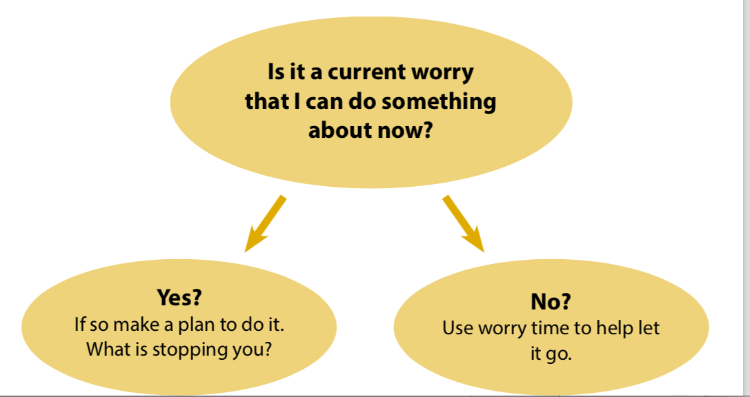
Reminder of Tools To Apply

Slide 21
Progressive Muscle Relaxation
Our bodies respond automatically to stressful situations and thoughts by becoming tense. The opposite relationship also works: a good way of relaxing the mind is to deliberately relax the body.
In a progressive muscle relaxation each muscle group is tensed in turn, and the tension is then released.

Slide 22
Questions?

