Slide 1




LGBTQ+ Wellbeing Group
SESSION 2
INTRODUCTION TO COGNITIVE BEHAVIOURAL THERAPY (CBT) & LIFESTYLE

Slide 2
House KEEPING
Mobile phones on silent/vibrate
Microphones on mute when not speaking
10-15 minute break
Listen respectfully to others
Respect of confidentiality
If you need the toilet or have to attend to something at home e.g. children, please feel free to do this and return to the group as soon as you can
Notes:
This is a Workshop, designed to cover the basic, taking in to consideration the additional factors impacting LGBTQ+ community. We will start promply today to allow time for the group.

Slide 3
Session 2 Overview
Introduction to Cognitive Behavioural Therapy
5 Area Model: Learning our vicious cycles of Low mood, Anxiety & Stress
The importance of lifestyle on our mood (diet and exercise)
SMART GOALS

Slide 4
Session 1 Recap
Intro to Stress
Fight/Flight
Barriers for the LGBTQ+ community getting support for MH
Notes:
We discussed barriers, last week which we sent you some information but we did not have chance to discuss, impact of having specific groups and how this supports LGBTQ community. - Stats on this...

Slide 5
Home Tasks from Last Week
Complete your own STRESS BUCKET
Write down your COPING STRATEGIES
Notes:
Were you able to give last week’s tasks a go?
Is there anything you learned from the tasks?
What will you do differently this week?

Slide 6
What is stress, anxiety and low mood?
In CBT we often use a 5 areas model to break down difficulties like stress, anxiety and low mood into their different parts:
Thoughts:
Situation
Body:
Feelings:
Behaviours:
Notes:
Explain the CBT model

Slide 7
What is stress, anxiety and low mood?
What happens to you when you are feeling stressed?
In your body?
In your feelings?
In your behaviours?
In your thoughts?
What happens to you when you are feeling anxious?
In your body?
In your feelings?
In your behaviours?
In your thoughts?
What happens to you when you are feeling low?
In your body?
In your feelings?
In your behaviours?
In your thoughts?
Notes:
Use the board to create a big hot cross bun of all the different symptoms of low mood, stress and anxiety

Slide 8
What is stress, anxiety and low mood?
Everybody experiences these feelings at some point in their lives.
They become a problem when they are constant, overwhelming or limiting the things we can do.
1 in 4 of us will experience a mental health problem at some point of our lives.
2 in 5 in the LGBTQ+ population
Notes:
1 in 4 experience mental health (25%) in general and with the LGBTQ community it is more than 40 percent of LGBTQ+ people will experience a significant mental health problem which is 2 in 5 people.

Slide 9
What is stress, anxiety and low mood?
There can be many causes for stress, anxiety and low mood. These may be
Biological/Genetic
Psychological
Situational/ socio-environmental
They are often a combination of all 3, and sometimes the cause maybe a complex combination of everything.
Notes:
We also discussed last week the addition factors that can feed into minority groups and in particular LGBTQ and our experiences - ++++example+++

Slide 10
What MAINTAINS stress, anxiety and low mood?
Sam, 44, has a disability assessment coming up. This is causing them to feel very anxious as they find speaking about their health conditions difficult. They also worry whether the health assessor will judge them for being gay and presenting differently. Sam is thinking about it constantly. They stop going to their local art class and put off seeing their friend. Sam has trouble sleeping at night because of racing thoughts and begins to drink a bottle of wine each evening to try and relax. Waking up in the mornings becomes harder as Sam feels physically exhausted and emotionally drained. Sam worries their benefit will stop and they will struggle financially. This causes their heart to race and their stomach to churn. They feel like they're not coping.
Notes:
Lets go through some examples of how stress, anxiety and low mood may be maintained. Looking at Sam’s life what might be maintaining their difficulties?

Slide 11
What is stress, anxiety and low mood?
What would Sam’s 5 Areas look like?
Thoughts:
Situation
Body:
Feelings:
Behaviours:
Notes:
Explain the CBT model
At any one time, we have 5 different processes happening at once
We have our situation which is made up of all the things external to us
We have 4 internal processes happening
Our situation, thoughts, feelings, body and behaviours are all interlinked and influence each other
They can influence each other in a way that causes a vicious cycle that is difficult to break out of

Slide 12

Group Exercise
What does Sam’s 5 areas look like?
As a group lets discuss Sam’s 5 areas
Notes:
NOTE: Info gathered does not have to be personal but more general; think about questionnaires symptoms?
PLAN B: 5 areas based on vignettes
GROUP EXERCISE: split into breakout rooms on Zoom, groups less than 3

Slide 13
What is stress, anxiety and low mood?
Take a minute to think about your own 5 Areas model. What might be maintaining your difficulties? If people feel comfortable, they can speak about their experiences.
Thoughts:
Situation
Body:
Feelings:
Behaviours:
Notes:
Explain the CBT model

Slide 14

Does it affect our mental wellbeing?

Slide 15
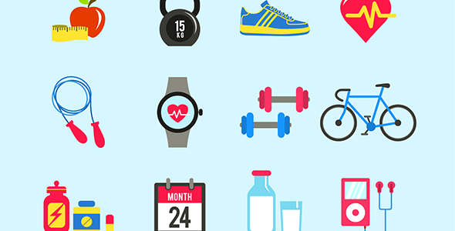
Why Lifestyle?
Taking care of yourself physically and socially can help you manage stress and feel good.
Our body is connected to and affects how we feel, think and behave.
A tired, stressed body is more likely to make you feel stressed.
We are also highly social beings. Some individual differences however, we all need regular contact with others.
Notes:
2. Misconception that mind and body are separate
4. Some people recharge more in other people’s company, while others do so better on their own

Slide 16
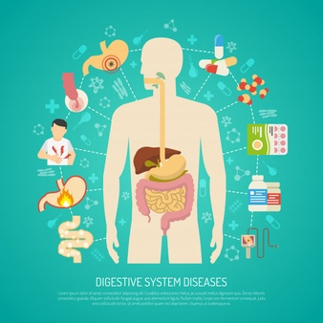
The mind-body link and your health
Digestive System: It is common to experience an upset stomach (e.g. nausea, diarrhoea, bloating or pain) during times of stress. There are lots of nerve connections between the brain and the gut.
Fun fact: In fact, the gut is sometimes called the ‘Little Brain’ for this reason.
People with skin conditions, including eczema or psoriasis, notice that during stressful periods their symptoms can become worse.
Can you think of any others?
Notes:
IBS, immune system is weak= more susceptible to illnesses

Slide 17
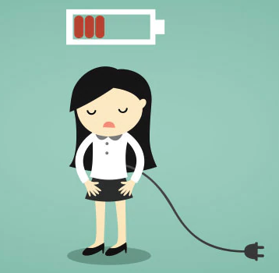
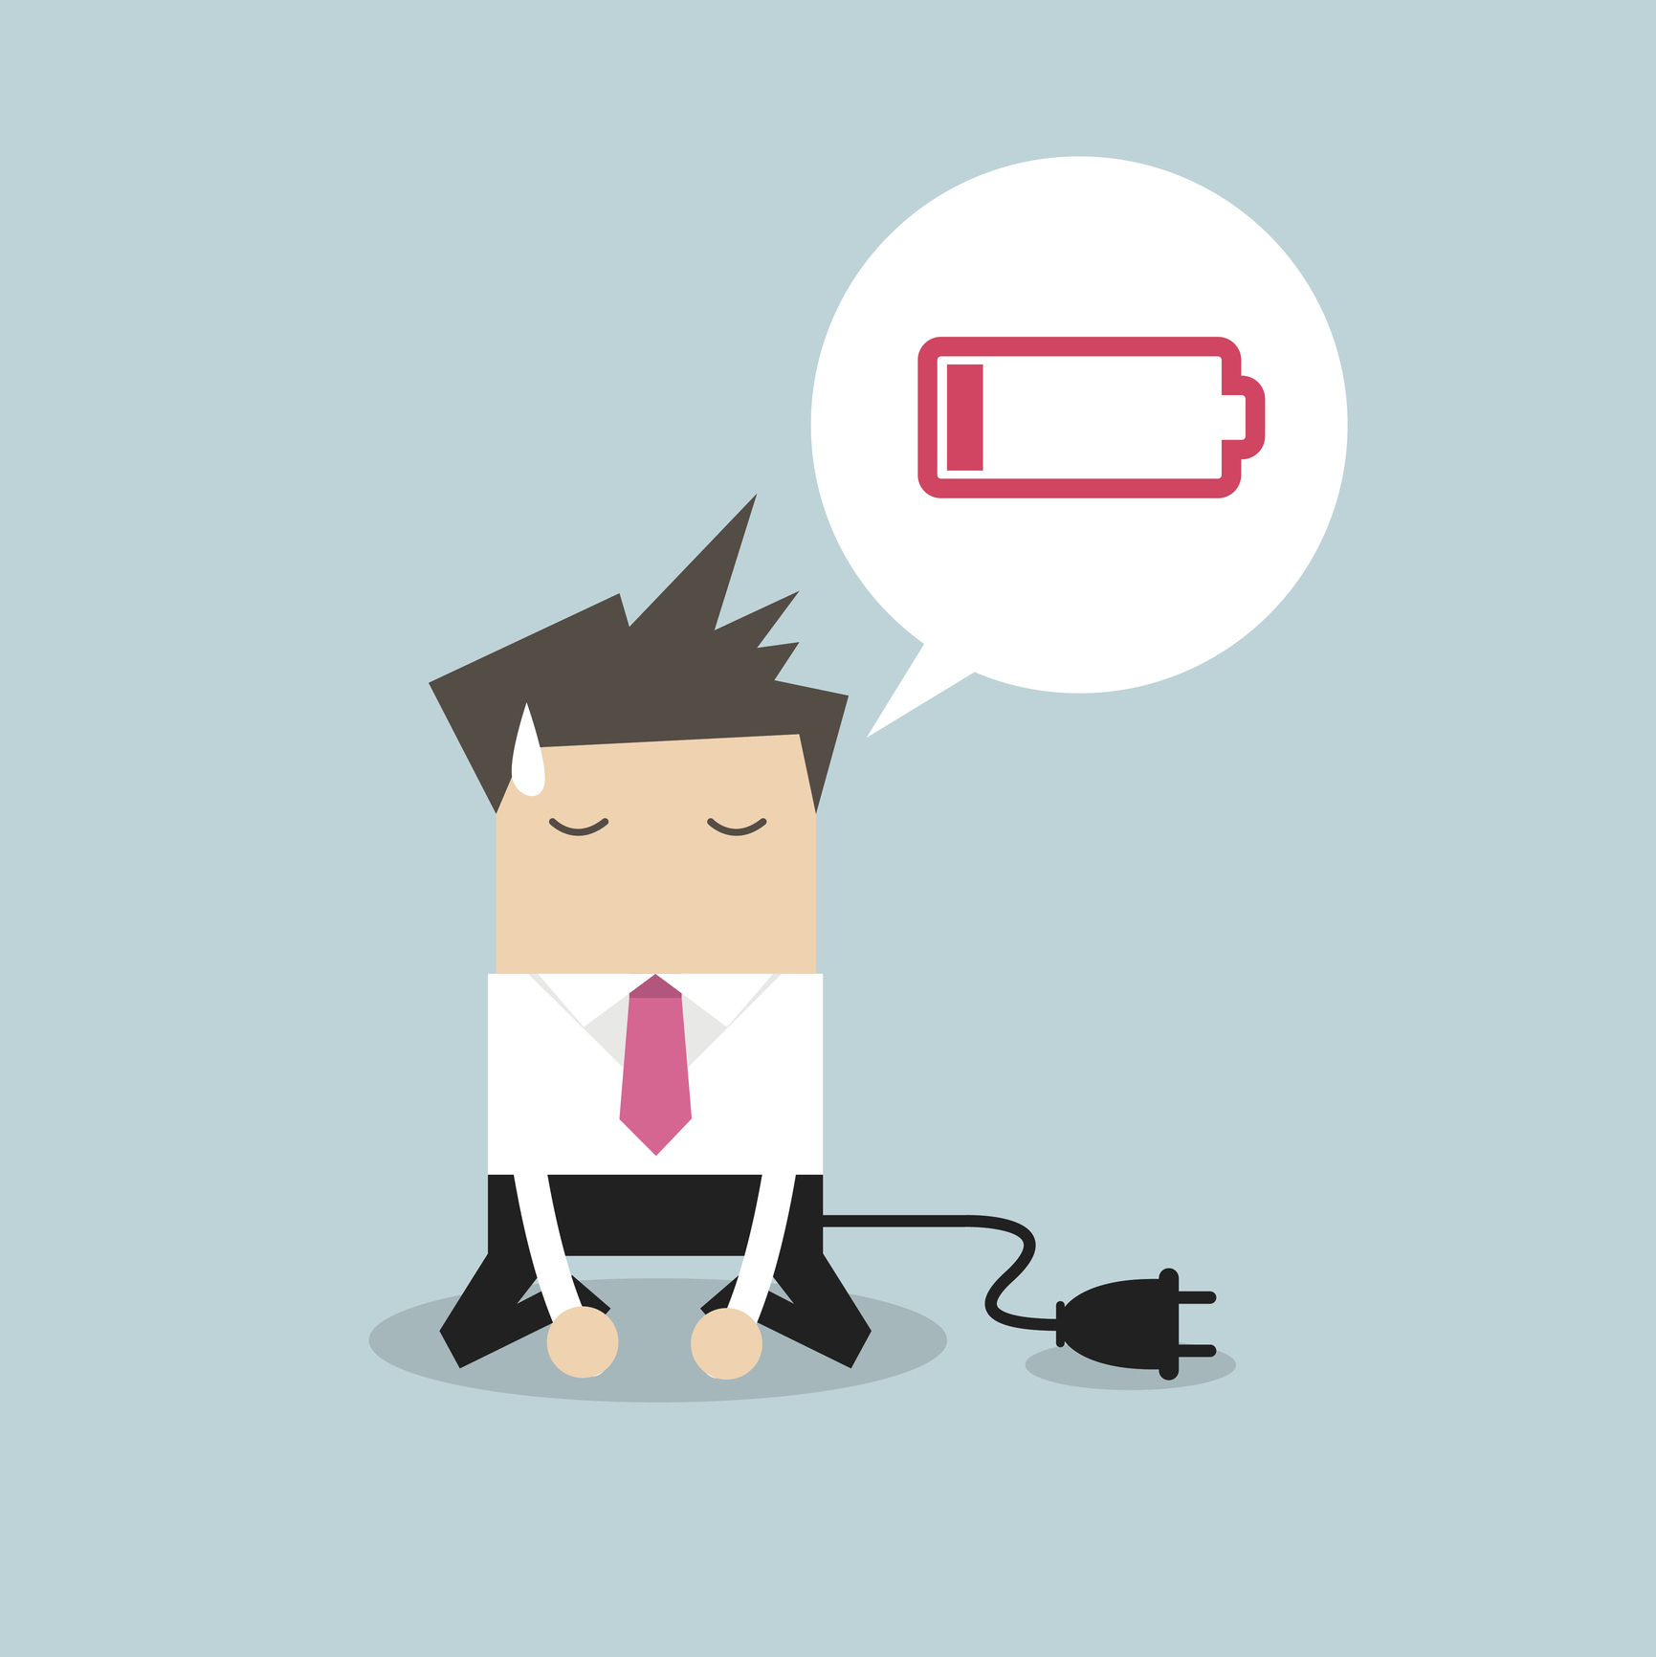
The mind-body link and your health
Pain is both a physical and emotional experience and is affected by the mind and the body. For example, the experience of pain can be affected by stress, anxiety and depression.
Fatigue can also be affected by how we think and feel. For example, boredom can lead to feeling fatigued and sleepy whereas an unexpected piece of good news could give you a burst of energy
Notes:
Pain: is a complex symptom which can sometimes be difficult to understand and treat. Experiences are individual
When the body is stressed, muscles tense up. Muscle tension is almost a reflex reaction to stress — the body's way of guarding against injury and pain. For example, both tension-type headache and migraine headache are associated with chronic muscle tension in the area of the shoulders, neck and head.

Slide 18
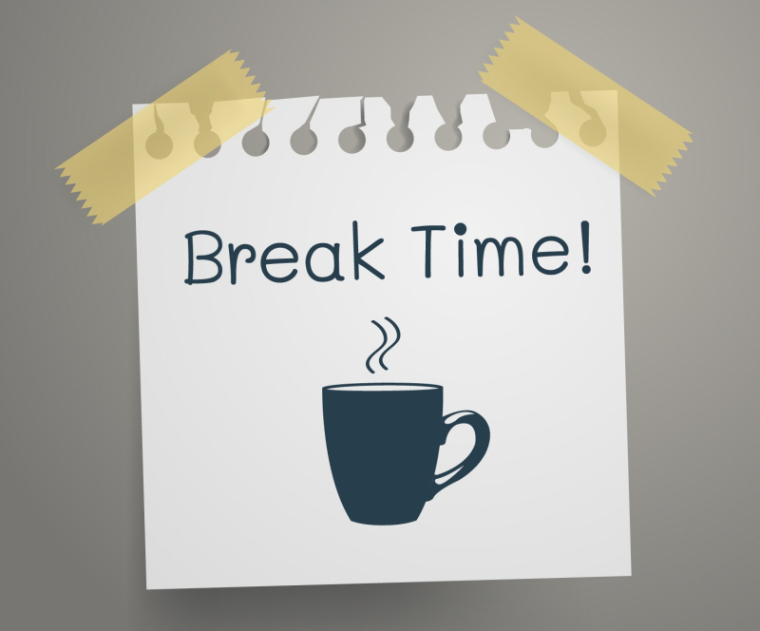
LET’S TAKE A BREAK

Slide 19

Exercise: Feel Good Factor
When we exercise, several good things happen to our body and mind:
Endorphins (the feel-good chemicals) are released into your blood stream helping you feel happier, calmer and better about yourself.
Your muscles let go of the tension that builds up when stressed, resulting in your mind relaxing too.
You get a sense of achievement, which is likely to increase your confidence
Notes:
LGBTQ+ sports teams in lewisham - https://pridesports.org.uk/lgbt-club-finder/
https://www.meetup.com/topics/lgbt-sports/gb/17/london/

Slide 20
Improved sleep: research has shown that people who exercise regularly fall asleep faster, sleep longer, have better quality sleep and wake up less often during the night.
Protection from illness, injuries and aches: ‘working out’ lowers the risk of coronary heart disease, diabetes, and some cancers.
It also lowers bad cholesterol and blood pressure. When your muscles are strong and flexible, they’ll support your bones and joints better, therefore making it less likely that you twist your ankle or pull a muscle.
Keep your weight in check: you can eat more and not gain weight! You’ll tone up your muscles and your skin will clear.

Slide 21


Start Now!?
Make time in your life for physical activity – it doesn’t matter what you do, just find something you enjoy and keep doing it!
Even just a small amount of movement releases feel-good chemicals (endorphins) in your body and gets rid of the ones that build up when your stress response is active (cortisol).
You do not have to spend hours exercising and it does not have to be a chore.
Try something you enjoy and make some room for it in your daily life. Could you go for a walk? Could you walk up the stairs instead of taking the lift?
Notes:
LGBTQ+ sports teams in lewisham - https://pridesports.org.uk/lgbt-club-finder/
https://www.meetup.com/topics/lgbt-sports/gb/17/london/

Slide 22
HOW MUCH EXERCISE DO WE NEED?
Notes:
What do you all think?

Slide 23
How Much Exercise?
The ideal amount of exercise for an adult (18-64) is about 2 ½ hours a week 30 minutes per day.
There are different types of exercise: the kind that ends up in you breaking a little sweat (aerobic) or the one that builds up strength (muscle strengthening).
Aerobic exercise is any continuous, repetitive activity that you do long enough for your heart to start beating faster and break a bit of a sweat. For example, walking, swimming, running and climbing stairs.
Muscle strengthening exercise aims at increasing the strength, power, endurance and muscle mass. Examples are things such as weight lifting, push-ups etc.
It is a good idea to try and have a mix of these two types of exercise.
Notes:
1. You don’t have to do it all in one go and you could break this down to 10 minutes 3 times a day.

Slide 24

What Exercises Do You Enjoy?

Slide 25

Tips to get Active
Tip 1: Do it! Action precedes motivation. It is very rare for anyone to feel like exercising. Rather, once you start doing something, you then feel like doing it.
Tip 2: Reward yourself: People commonly forget to reward themselves for their efforts. Yet doing so is crucial. We learn to keep doing the things that result in some kind of benefit or reward. By rewarding yourself, you are more likely to do it again.
Tip 3: Squeeze it in: Finding the time to exercise can be challenging. However, sometimes it is a matter of making it a priority. Thinking that exercise has to take hours might be putting you off. For example getting off the bus a few stops earlier, walking up the stairs instead of taking the lift or walking around the block at lunchtime.
Tip 4: Bring company: Exercising is easier when done with someone else. Is there someone you know who may go for a short walk? Or a local group you could join? Maybe you could get a pet or you could offer to walk someone else’s dog?
Notes:
3. You might also find it helpful to build it into your routine; remind yourself that a few minutes’ walk still is exercise – and that those few minutes add up over a week!
Does anyone else have any other tips?

Slide 26
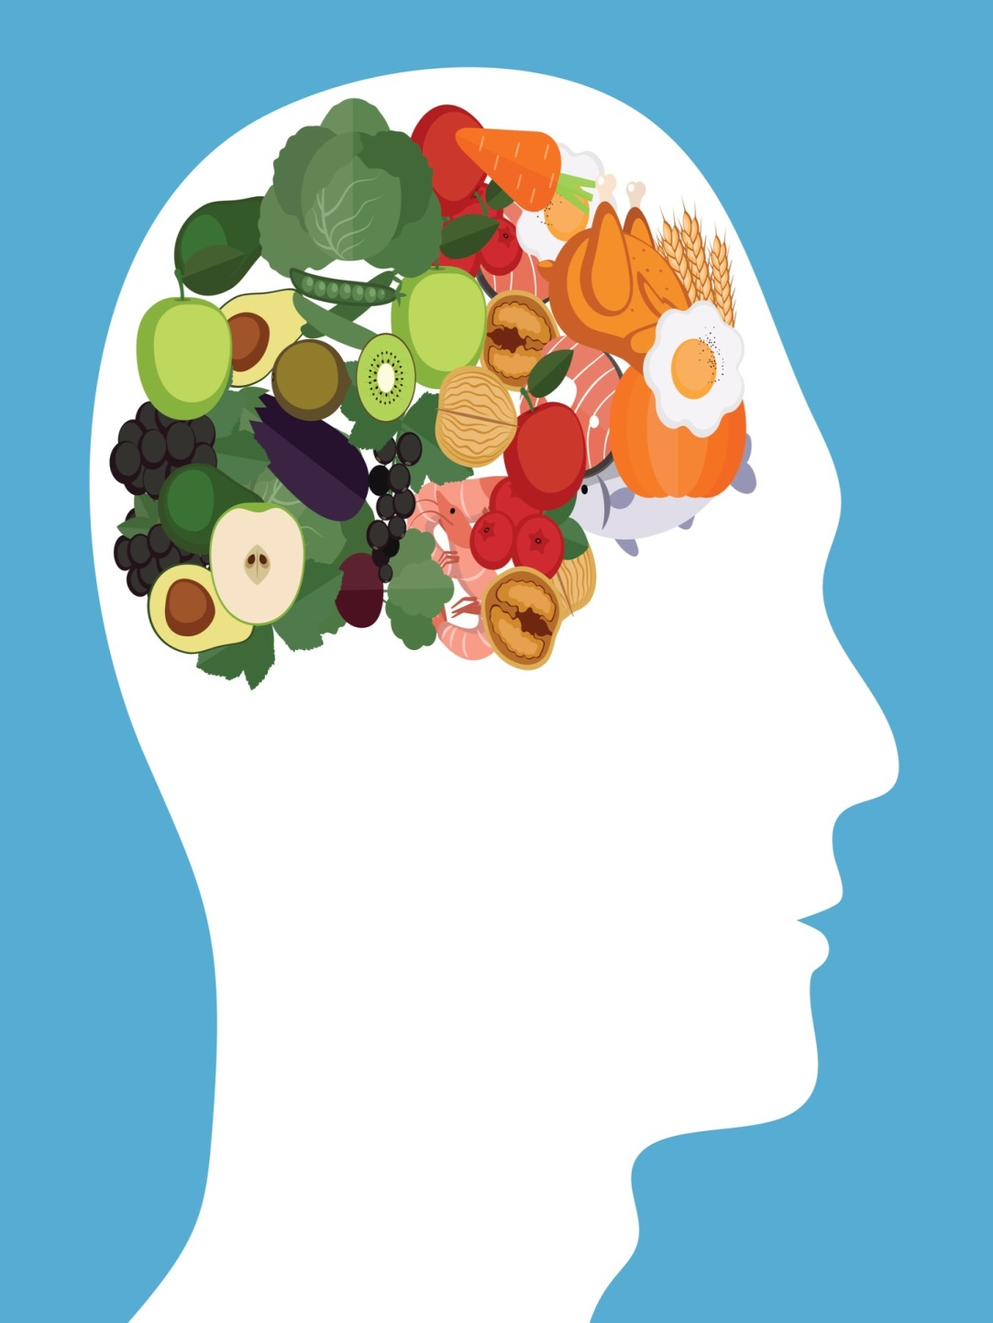
Food & Mood?
Is there a link?

Slide 27
Stress - Eater?
When we feel stressed, we tend to reach for things that give us a quick feel-good fix.
Sugary foods, soft drinks, coffee and alcohol are some of the most common things we reach for when we feel in need of a boost and some comfort. This is a very natural reaction.
The problem is that while these foodstuffs often give us a lift in the short term, they end up backfiring in the long run and making our stress worse:
These foods are full of simple carbohydrates (or carbs). The body turns these carbs into sugar and burns them up very quickly, giving us a fast energy boost. The problem is that the fast burn leads to a rapid drop in blood sugar levels which in turn can lead to plunging moods and irritability.
Further cravings for these foods or sugar highs begin all over again.
Making some simple changes to how and what you eat can make a big difference to how you feel.

Slide 28
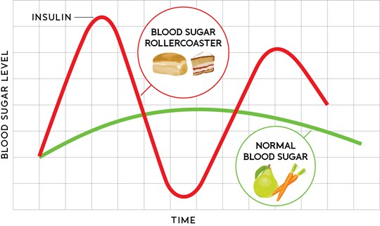
Notes:
Link between diabetes and low mood due to rapid drop of sugar levels

Slide 29
More about FOOD & MOOD
What we eat can affect how we feel
Symptoms of low blood sugar include:
  Nausea
  Mood changes
  Trembling
  Sweating
  Muddled thinking
95% of Serotonin is produced in the gut (Carpenter, 2012)
Nutrient deficiencies can lead to tiredness, brain fog and mood changes
Omega-3 and Vitamin B12 have been particularly linked to low mood
Notes:
Next we will spend some time thinking about things you may want to schedule into (or out of) your weekly planner
https://www.mentalhealth.org.uk/a-to-z/d/diet-and-mental-health

Slide 30
Tips On Eating
Moderation and balance are key to a healthy diet.
Enjoy small, frequent portions
Portion sizes have ballooned in the last 50 years or so. Most people simply eat too much at one sitting nowadays.
Use smaller plates. This creates an optical illusion, where you think you’re eating more food than you really are. When eating out, split a meal with a friend or eat half and ask for the remainder to be boxed up to take home with you.
Eat slowly. This gives your stomach time to tell your brain that you’re full and should stop eating. It can take 20 minutes for this to happen!
Moderate moderation! It’s okay to indulge yourself from time to time, you just have to be careful how frequently you do this.
Notes:
Fill your plate once, and put away the leftovers before you start eating.

Slide 31
More tips
Plan ahead for the times when you know you’ll need a quick fix or sugar high
Try to eat nuts (not salted or roasted) or dried fruit (dates are nature’s toffee!). Or you might try eating a piece of fruit first, before reaching for the chocolate or cookies.
Eating well is not about dieting or following a specific diet regime. Healthy eating is about making sure your body gets everything it needs to function well.
Balance is the key here: our bodies need the right mix of carbohydrates, protein, fats, and other nutrients to work well. If your body is functioning at an optimum level, your mind will also be in a better place to cope with stress.

Slide 32
KNOWING YOUR NUTIRENTS
Complex carbohydrates release energy into your body slowly and produce serotonin, which is calming. Trying adding slow acting carbohydrates such as potatoes, brown rice, and pasta
Proteins are essential for the body to repair itself. It is also another source of slow-releasing energy. Protein is found in large quantities in animal products (such as meat, eggs, milk) but also certain vegetables (mushrooms and soya). Grains and nuts are also good sources of protein in smaller quantities. Protein is particularly helpful when eaten earlier in the day.
Fresh Fruit & Vegetables are rich in many important nutrients, including vitamins, minerals and anti-oxidants. Ensuring that you eat your recommended five portions a day is also a great way to manage times of stress,
Notes:
Cooking: if you overcook potatoes, rice and pasta you process the sugar faster / don’t overcook your food
The more colourfull your plate is the more nutrients you get.

Slide 33
Fats have a bad reputation and many people try to avoid them. However, fats have an important function in our bodies. For example, fats are used to “insulate” neurons so that they can communicate faster. Try adding “Good fats” which are found in olive oil (and other vegetable oils), fish, certain nuts, and flaxseeds.
Fibre helps your digestive system work properly. You will naturally get enough fibre through your ‘five a day’.
Water - Many do not drink much water, preferring soft drinks, tea and coffee. Dehydration is a common problem, and can lead to headaches and fatigue. Many of us misinterpret thirst as being hungry. Tip: Try to switch soft drinks or juice for water, and carry a bottle of water with you.
Breakfast is a very important meal for preparing us for our day, and yet many of us often skip it. An ideal breakfast will have a mix of carbohydrates, protein and fruit.

Slide 34
ALCOHOL & CAFFEINE
Try and limit alcohol, caffeine and sugar in your diet.
Alcohol
Having a drink or two can leave you feeling more relaxed. Alcohol can take the edge off in the short term, but it is likely to make you feel more edgy in the longer term.
It interferes with your sleep and dehydrates you, which can make you feel more tired and stressed.
Tip: Limit or avoid alcohol. Try notice whether and how you use alcohol to cope with stress. If you find it has become a main way to deal with stress you may consider cutting back and finding other ways to help you relax.
Caffeine
Being stressed can leave us feeling drained and tired. Sleeping might also become challenging if we are under a lot of pressure. It is only natural then to reach out for things that will give that boost of energy.
If you are already on edge, adding some caffeine to the mix might leave you feel jittery and might get in the way of getting a good night sleep.
Be mindful that many energy drinks also contain high levels of caffeine; they sometimes also have other herbal stimulants which may have a similar effect to caffeine.
You can replace your coffee with a decaf drink
Or avoid drinking coffee 4 hours before going to bed
Notes:
Are you using alcohol to cope with stress? Or are you drinking alcohol to enjoy your stress?
Metaphor about the alcohol intake

Slide 35
Smart Goals
It is difficult to plan a journey when you don’t know where you are heading.
Set yourself some goals that will help you make the most of this workshop. Make sure they are:
Positive (focus on things you will start doing, rather than stop doing)
Specific and Measurable (so you know when you have achieved them)
Achievable and Relevant to your values (set yourself up for success)
Time-limited (know when you want to start and finish by)
Not too many (we suggest two or three)

Slide 36
EXAMPLE OF SMART GOALS
For example, Sam decided to set three SMART goals:
To make an appointment with the job centre by the end of the week.
Sign up to an employment website by Friday this week.
To walk the dog for half an hour every other day with his partner starting today.

Slide 37
LEARNING TASKS & Next Session
Complete your own 5 Areas Diary
Think about your lifestyle & Diet and how this may impact your wellbeing.
Set yourself a SMART GOAL
Next Session 3: Getting Active.
Why scheduling activities is key to better mood.
Notes:
Over the next week, use the diary to record when your mood changes

Slide 38

Well Done &
Thank you for Coming
See you Next Week!

