Slide 1
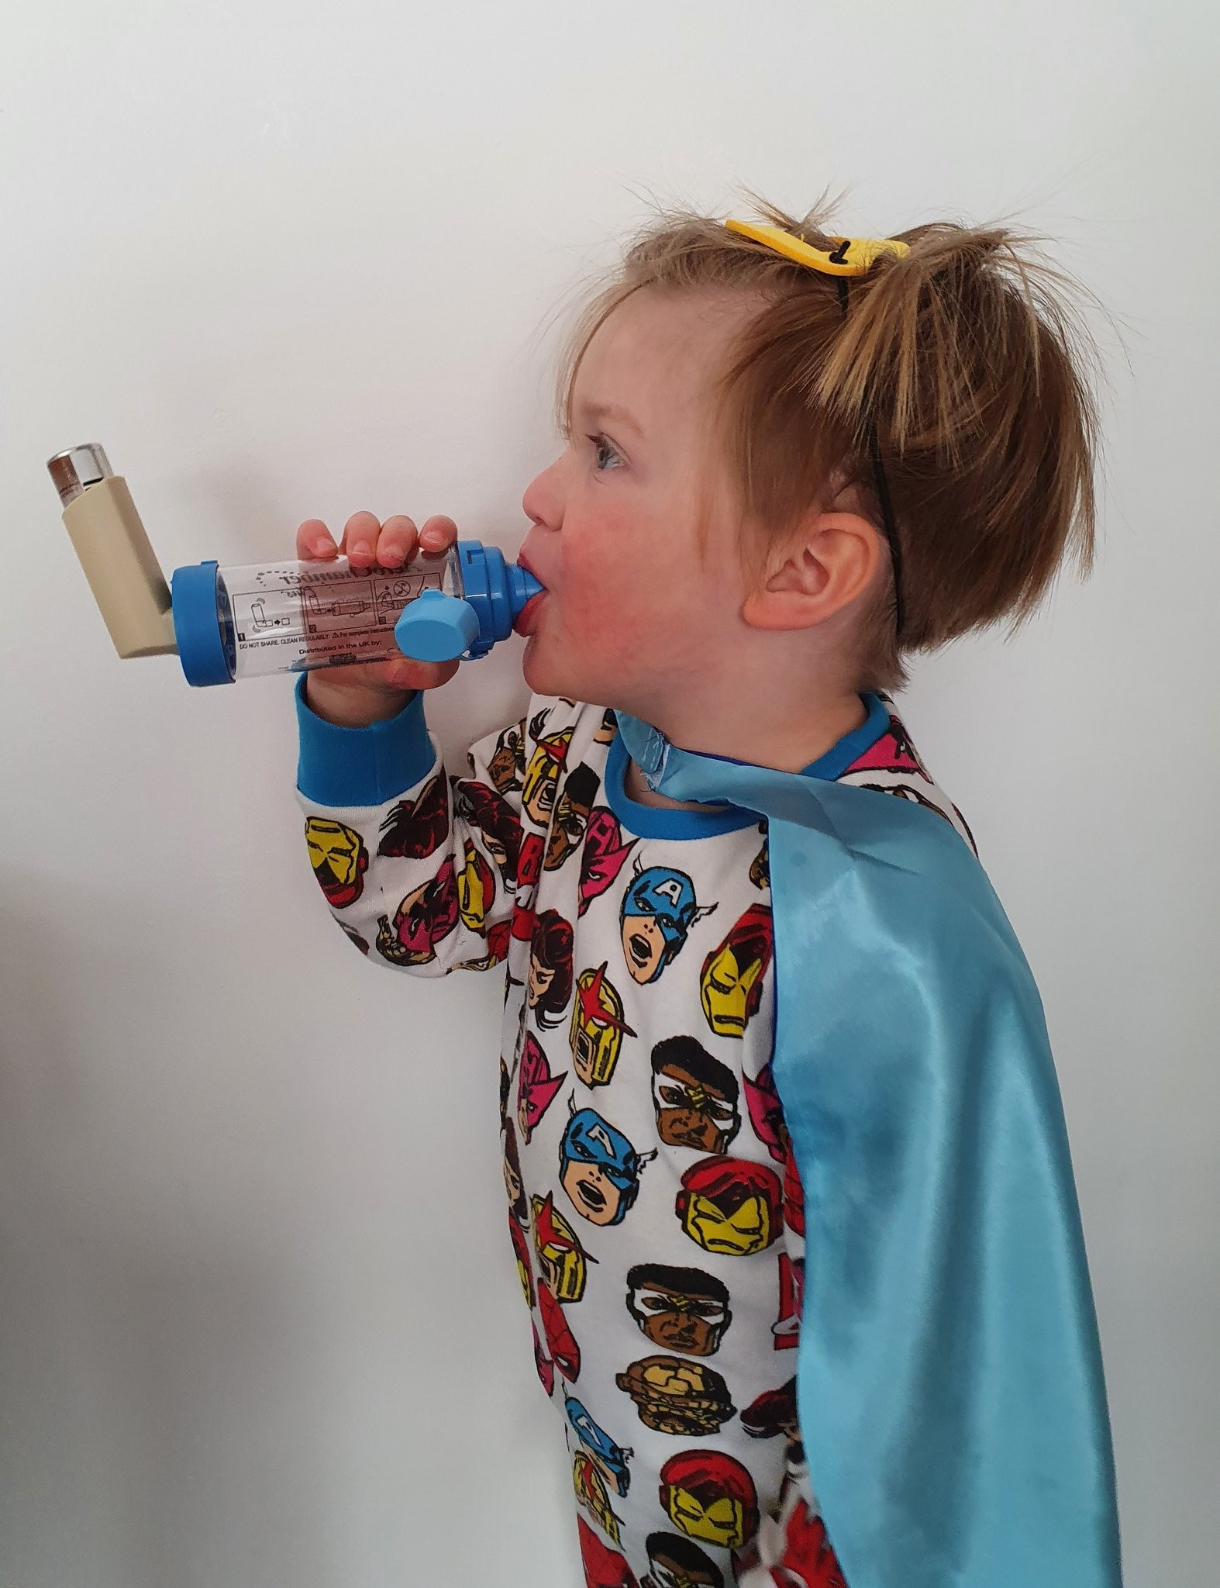
Sara Nelson RGN, BSc (Hons), MSc, QN
Olivia Fulton, Patient and Public Engagement Lead
Viv Marsh, RGN, RSCN, SCPHN, BSc (hons), PGCE

Slide 2
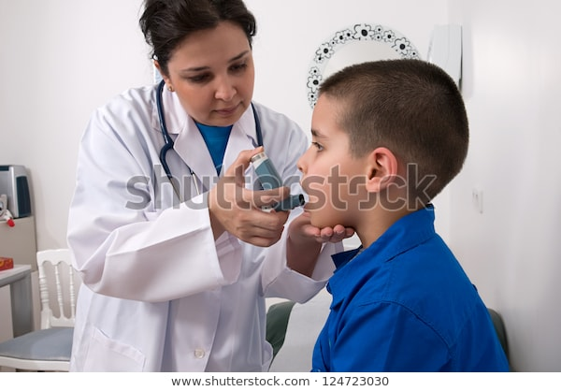
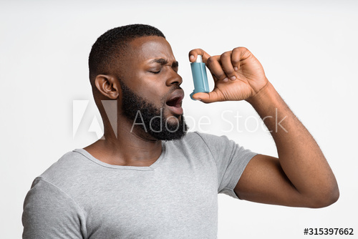
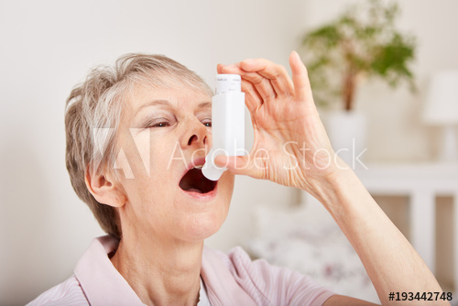
What is the problem?
Labelled Dr applying oxygen treatment!!!
Notes:
Even NICE got it wrong
IPCRG have researched all major stock image suppliers and found very few appropriate images amongst many hundreds of poor ones like these

Slide 3
Aims and objectives - Right Inhaler Image Campaign
To improve the quality of information for patients, health care professionals and the public about use of inhalers by promoting use of images representing inhalers being used accurately and appropriately.
Focussing on children, young people, and adults with asthma
Awareness: Raise awareness, increase, and improve knowledge of asthma management across the country using the right images, (right person, right treatment, right inhaler/spacer, right technique)
Inform: To inform the media, professionals, adults, CYP and families about the correct use of inhalers to manage asthma (Use the right image to send the right message)
Support: Support media companies and health professionals to help people with asthma by always using right inhaler images
Campaign Launch - World Asthma Day on 5th May 2021 – Uncovering Asthma Misconceptions

Slide 4
1. Poor Inhaler Technique
Poor asthma control
Asthma attacks
Asthma death
2. Overuse of blue/reliever inhalers
Poor asthma control
Asthma attacks
Asthma death

Slide 5
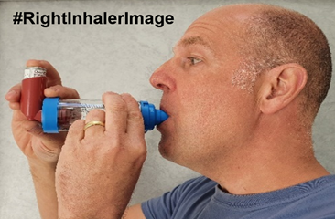
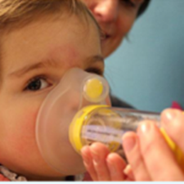
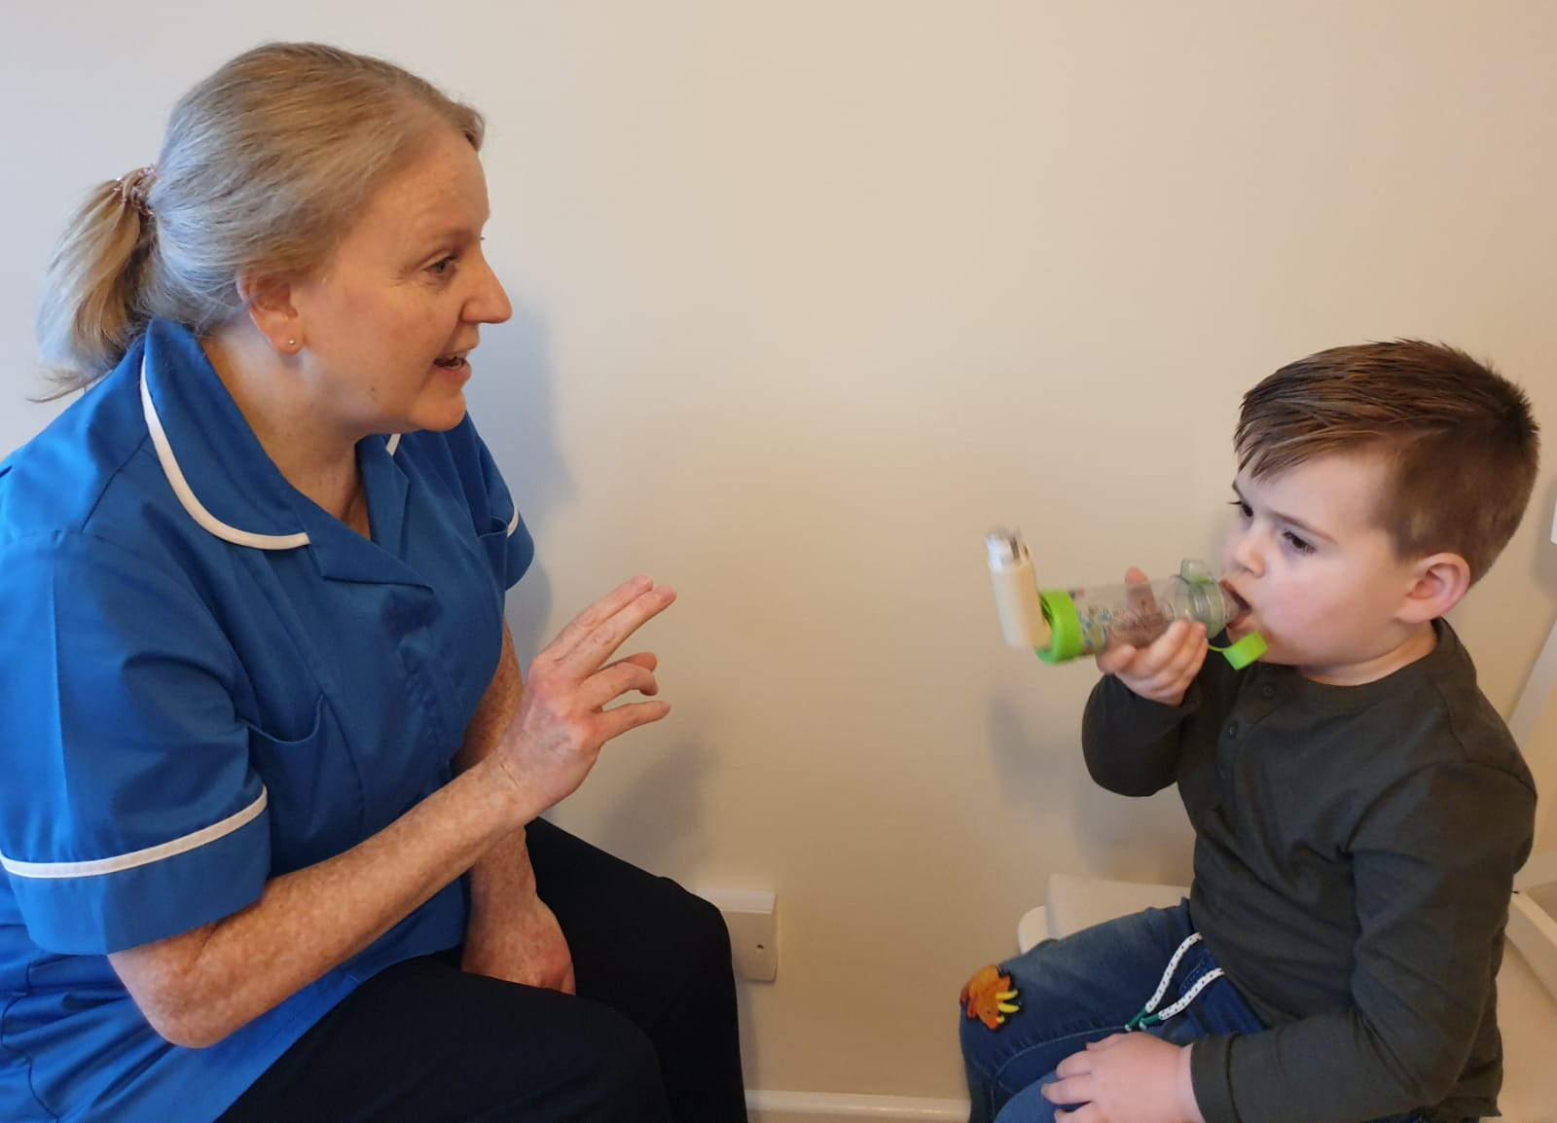
Right Inhaler Images should portray
Inhaler device appropriate for the person
Inhaler device being used correctly
pMDI’s used with spacer for all children (and adults)
Spacer appropriate for the person
Preventer inhalers (not blue)

Slide 6
#RightInhalerImage
Campaign
Media
Public
Professionals
Open letter
Image guide
Access to good images
Access to expert patient & professional opinion
Articles
Interviews
Blogs
Infographics
Image library
Story telling
Guide badge
Open letter
Image guide
Access to good images
Glossary of hashtags
Educational resources
Notes:
Generate a clear, simple and robust campaign through use of #RightInhalerImage
Engage healthcare professionals and professional bodies and voluntary organisations to pledge support through co-signing a joint letter to be sent to media industry and getting involved with campaign activities
Invite media industry to support campaign and to remove poor images from their image libraries (sign post to our image library)
Guide users of inhaler images about accurate and appropriate use
Signpost users of inhaler images to reliable sources (our image library)
Use the hashtag to praise positive use and call out inappropriate use of images
Provide a communication toolkit for adaptation across the country

Slide 7
Support the campaign, use the resources, spread the word
https://www.healthylondon.org/rightinhalerimage-campaign/

