Slide 1
Primary Care Nursing and Cancer
Transforming Cancer Services Team for London

Slide 2
Background

Slide 3
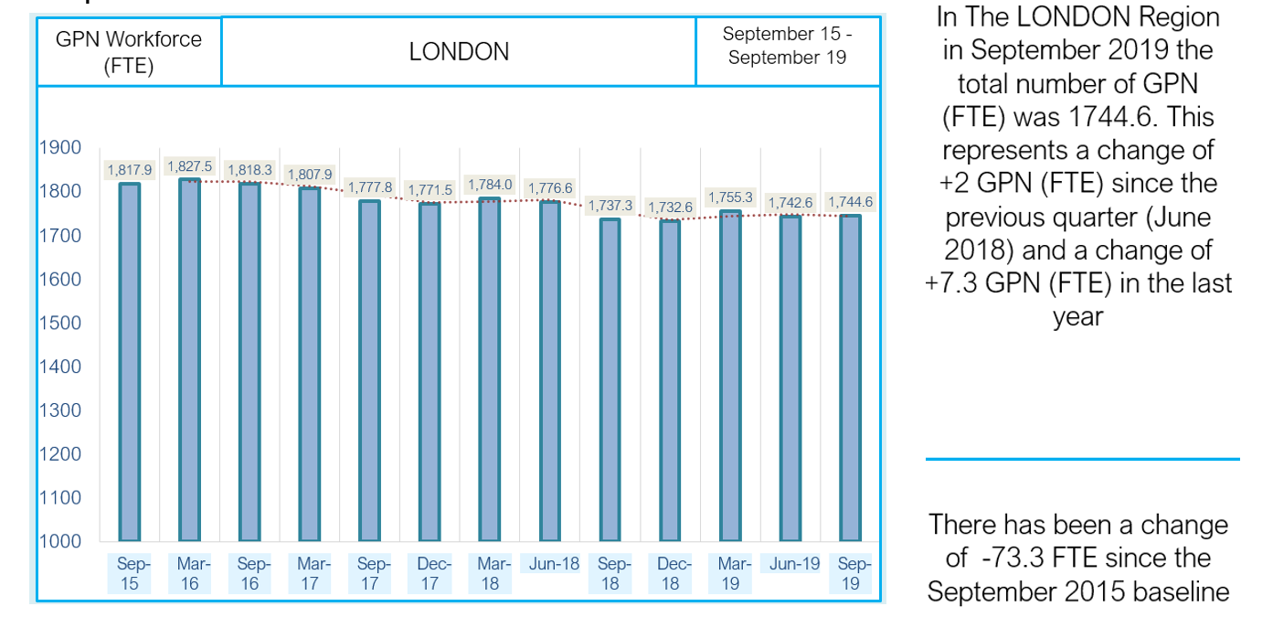
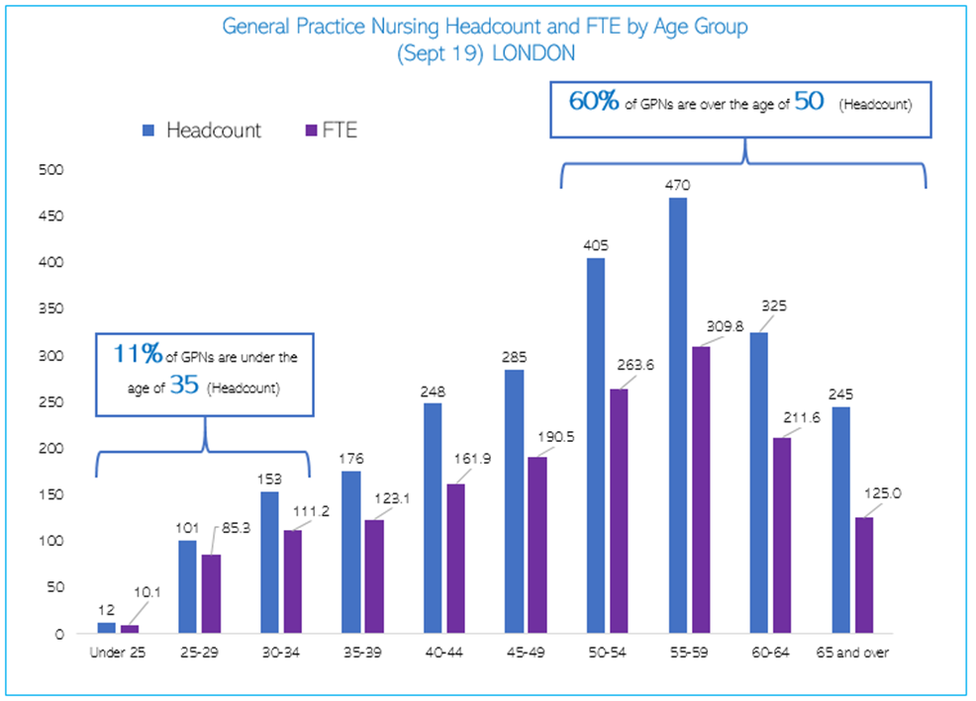
Primary Care Nursing in London
General Practice Nursing
Stable workforce in London BUT 60% > 50 years and 41.8% >55 (higher than rest of England )
GPN 10 point plan delivery board- COVID GPN Leads Group- reports into Jane Clegg (Director of Nursing and Deputy Regional Chief Nurse. Comprised of STP/ICS GPN Leads , and HEE/ HLP
HEE pan London GPN reference group (developing SPIN/education offer to GPNs),
Community Nursing
Nationally – ageing workforce with 46% planning retirement/ leaving the NHS in next 6 years
Lack of IT – interoperability issues, no contemporaneous access to primary care record
Growing caseloads, increasing complexity of caseloads- patient safety issues highlighted
Stagnation and lack of progression in workforce
Community nurses crucial to delivery of long term plan

Slide 4

GPN 10 point action plan
3 year programme that completes in March 2021
Emphasis on developing career pathways in primary care for GPNs
Establishing primary care as first choice career
Addressing variation
Developing leadership
Improving access to education
Improve retention
London wide- Power of Practice Nursing Event 4th November – GPN leaders came together to map out strategic next steps after 10pp completes in March.
Notes:
Strategic plan to address issues with retention and recruitment
Inititiatives to strengthen leadership – eg access to bespoke GPN Rosaland Franklin programme ( NHS leadership academy)
More student nurse placements in primary care to promote as first career choice
Induction toolkit to standardize
Fellowships for new to primary care/ newly qualified
Foundation and academic programmes at HEIs funded by HEE via training hubs

Slide 5

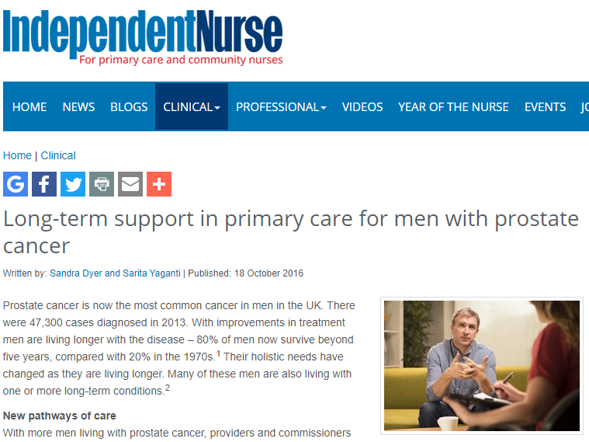
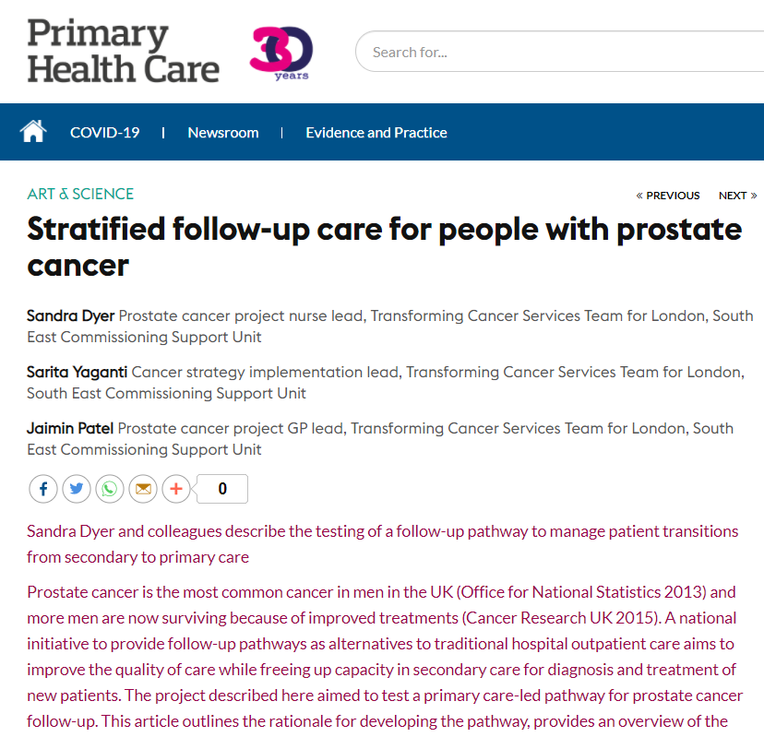
Primary Care Nursing and Cancer
Background
Primary care nurses- generalists leading on LTC care/management- TCST, Macmillan and others asked ‘why not cancer?’
Macmillan practice Nurse Course developed and has been running in London for last 5 years + but hasn’t translated into significant changes in practice
TCST/PCUK Primary Care SFU Project 2014-16 - opportunities for GPNs to lead on SFU were identified
2017 TCST and SWL developed proposal to test the impact of a strategic nursing role embedded in to the STP- Macmillan agreed funding for a 2 year project.
Notes:
My previous role in TCST

Slide 6
SW London Macmillan Primary Care Nursing project

Slide 7
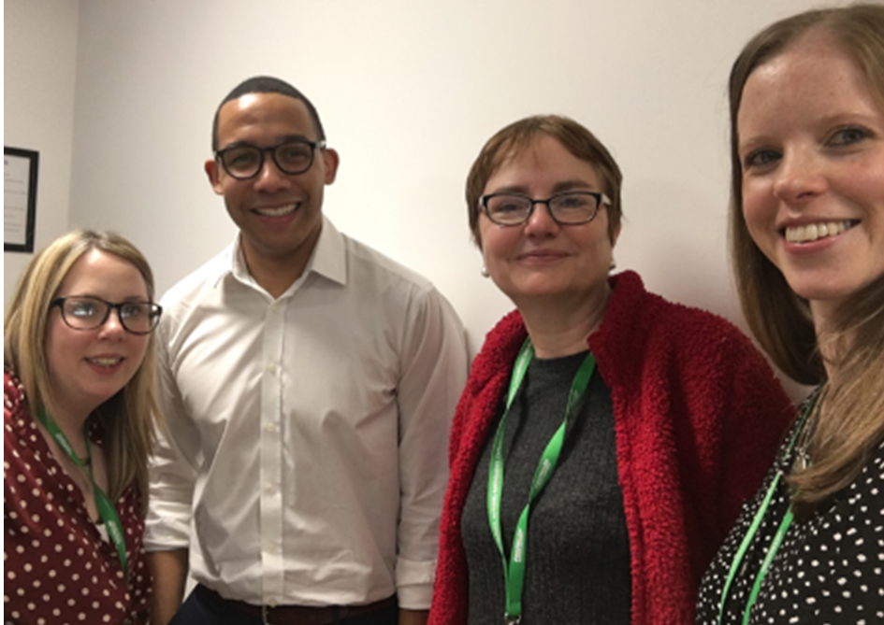
Project Summary
2 Years of funding from Macmillan:
Macmillan Primary Care Lead Nurse x 1 (AFC 8b- 0.7 WTE)
Macmillan Specialist Clinician x 1 (AFC 7- 0.4 WTE)
Macmillan Project Manager x1 (AFC 7-1.0 WTE)
The project was hosted by SW London Health and Care partnership.
The focus was on developing the role of Primary Care Nurses in relation to cancer as a long term condition.
Case for change was based on increasing cancer survival rates and number of people living longer following a cancer diagnosis, with unique ongoing care needs (management of physical and psychosocial consequences of treatment)
The steering group was chaired by the TCST Assistant Director for Personalised Care and Cancer.

Slide 8
Acknowledgements
South West London Health and Care Partnership – host organisation for the project
Macmillan – funders
TCST- Associate Director ( personalised care for cancer) for support in creating the project and chairing the steering group
Our patient partners for their support and steer to keep patients at the heart of the project
All members of the steering group for their dedication and support.
Full acknowledgements are found in the evaluation report.

Slide 9
Scoping
Scoping report – Headlines
Cancer Care Reviews
Very few nurses undertaking them despite some nurses having completed the Macmillan Practice Nurse Course
Incentive schemes not effectively incentivising all GPs to complete
No evaluation of quality for incentive scheme or QOF CCR s
Prostate Cancer Primary Care Stratified Follow up
Very few nurses undertaking reviews
Some examples of excellent practice that are replicable
Community Nursing
Meeting with providers- focus of their role very much on EOLC with little recognition of potential to support those LWBC
Consensus that competency development unhelpful at this point and project will focus on education
Higher education Institutions
Cancer as a long term condition not featured on post reg programmes for GPNs or community nurses
Engagement with Kingston, LSBU, City
Conversations started to include cancer as LTC in course content.
Barriers
Lack of protected learning time for GPNs
GPs not necessarily seeing value of CCRs for patients even where incentive schemes in place
Workloads and wide variation in roles
Variation in contract – No AFC for GPN
Community nursing roles task driven
Recruitment/ retention challenges

Slide 10
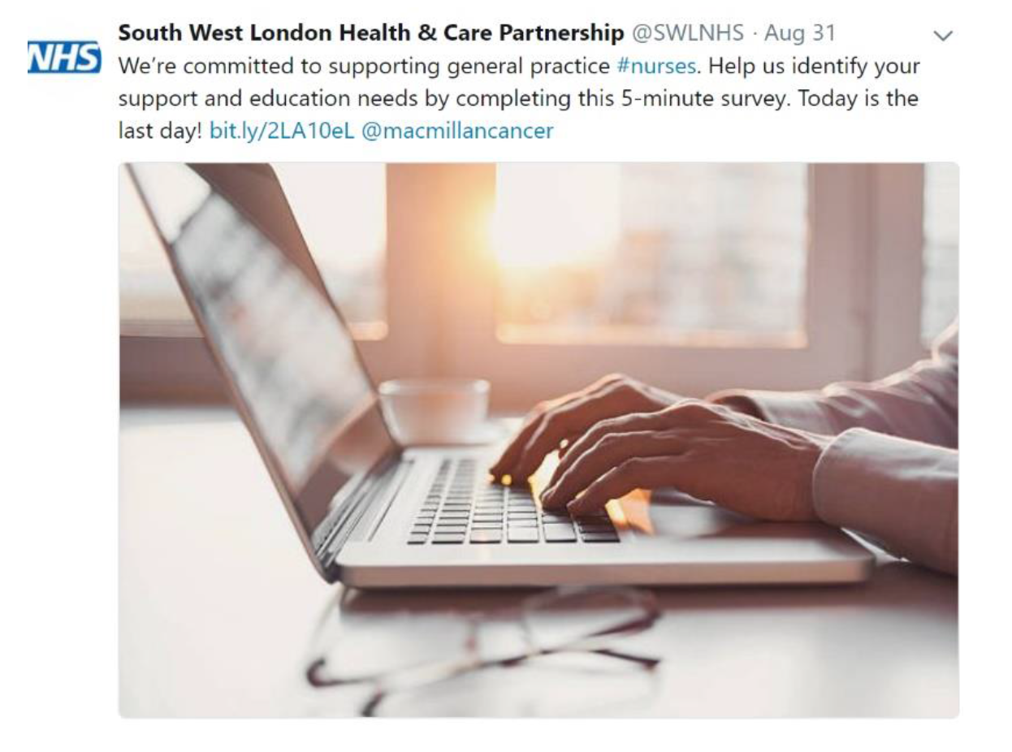
TNA Headlines
Headlines of the 2018 report:
  55% have been working in general practice for over 10years
  58% of respondents are asked questions relating to cancer at least on a daily or weekly basis
  60% were clear about their role in supporting patients with a cancer diagnosis (focused on emotional support)
  Only 11% currently complete CCRs, 13% were unaware of them.
  Over 70% were not confident in completing a CCR
  Over 70% of respondents had not received any training specific to cancer, of those who had, the majority related to screening services.
The 2018 and end of project TNA 2019 are available here

Slide 11
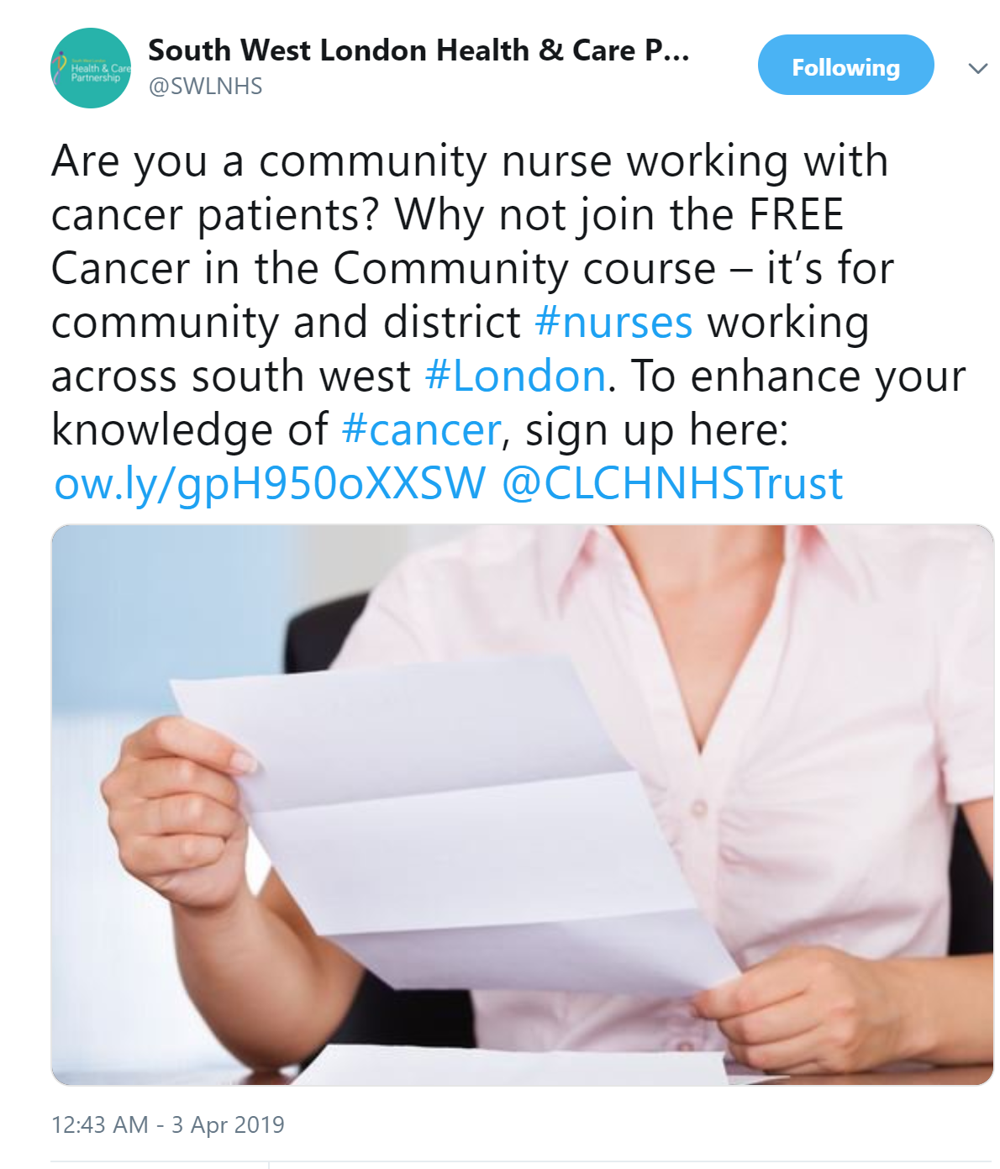
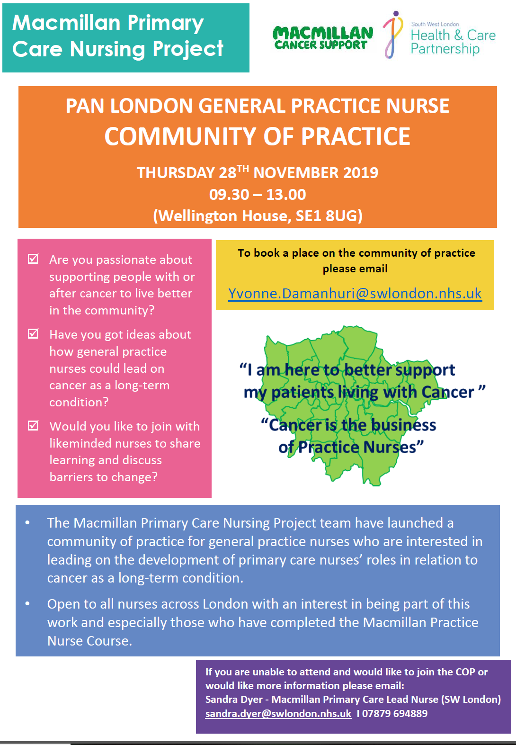
Influencing and Education-Headlines
Training/engagement with GPNs in all boroughs in SWL -cancer as a long-term condition taster session developed and delivered. Promoting Macmillan Practice Nurse Course as the next step.
Videos developed to promote value of CCRs and the role of nurses in delivering them , as well as a series of podcasts
Development of a pan cancer London Community of Practice for GPNs – Launched 4th July 2019 with headline speakers- Jane Clegg (Director of Nursing & Deputy Regional Chief Nurse for London at NHS England) and Karen Roberts ( Chief Nurse/AHP- Macmillan).
Development of an education toolkit for GPNs to include competencies, recommended e-modules, and links to the community of practice.
Developed, delivered and currently evaluating a community nursing short course- Cancer in the Community in partnership with CLCH academy.
Snap shot audit of DN caseloads- exploring opportunities for role development.
Working with HEIs to ensure cancer as a LTC visible sustainable content in post registration education for GPNs. For example- Influenced curriculum content at Kingston , and London South Bank and City Universities.

Slide 12
Cancer in the Community
Using HEE funding the project developed and successfully piloted a Cancer in the Community course for community nurses (a partnership with CLCH academy)
The course consisted of a three-day face to-face course with an additional placement day, Two modules of e-learning from Cancer in the Community e-Learning for Healthcare (ELFH) were essential pre-course learning.
The blended learning approach allowed participants to study at their own pace, as well as introducing information that was later reinforced in the classroom setting.
The Module ran in 2019. The full evaluation is available here. (Link to document)
The evaluation demonstrated that community nurses benefited from education on cancer as a long term condition and that it was highly relevant to their role by enabling them to improve quality of care.
The project team worked with CLCH, TCST and HEE to examine opportunities to maximise the learning from the course. HEE commissioned CLCH to run the course for further cohorts across London in 2020. This activity is currently paused due to the COVID 19 pandemic.

Slide 13
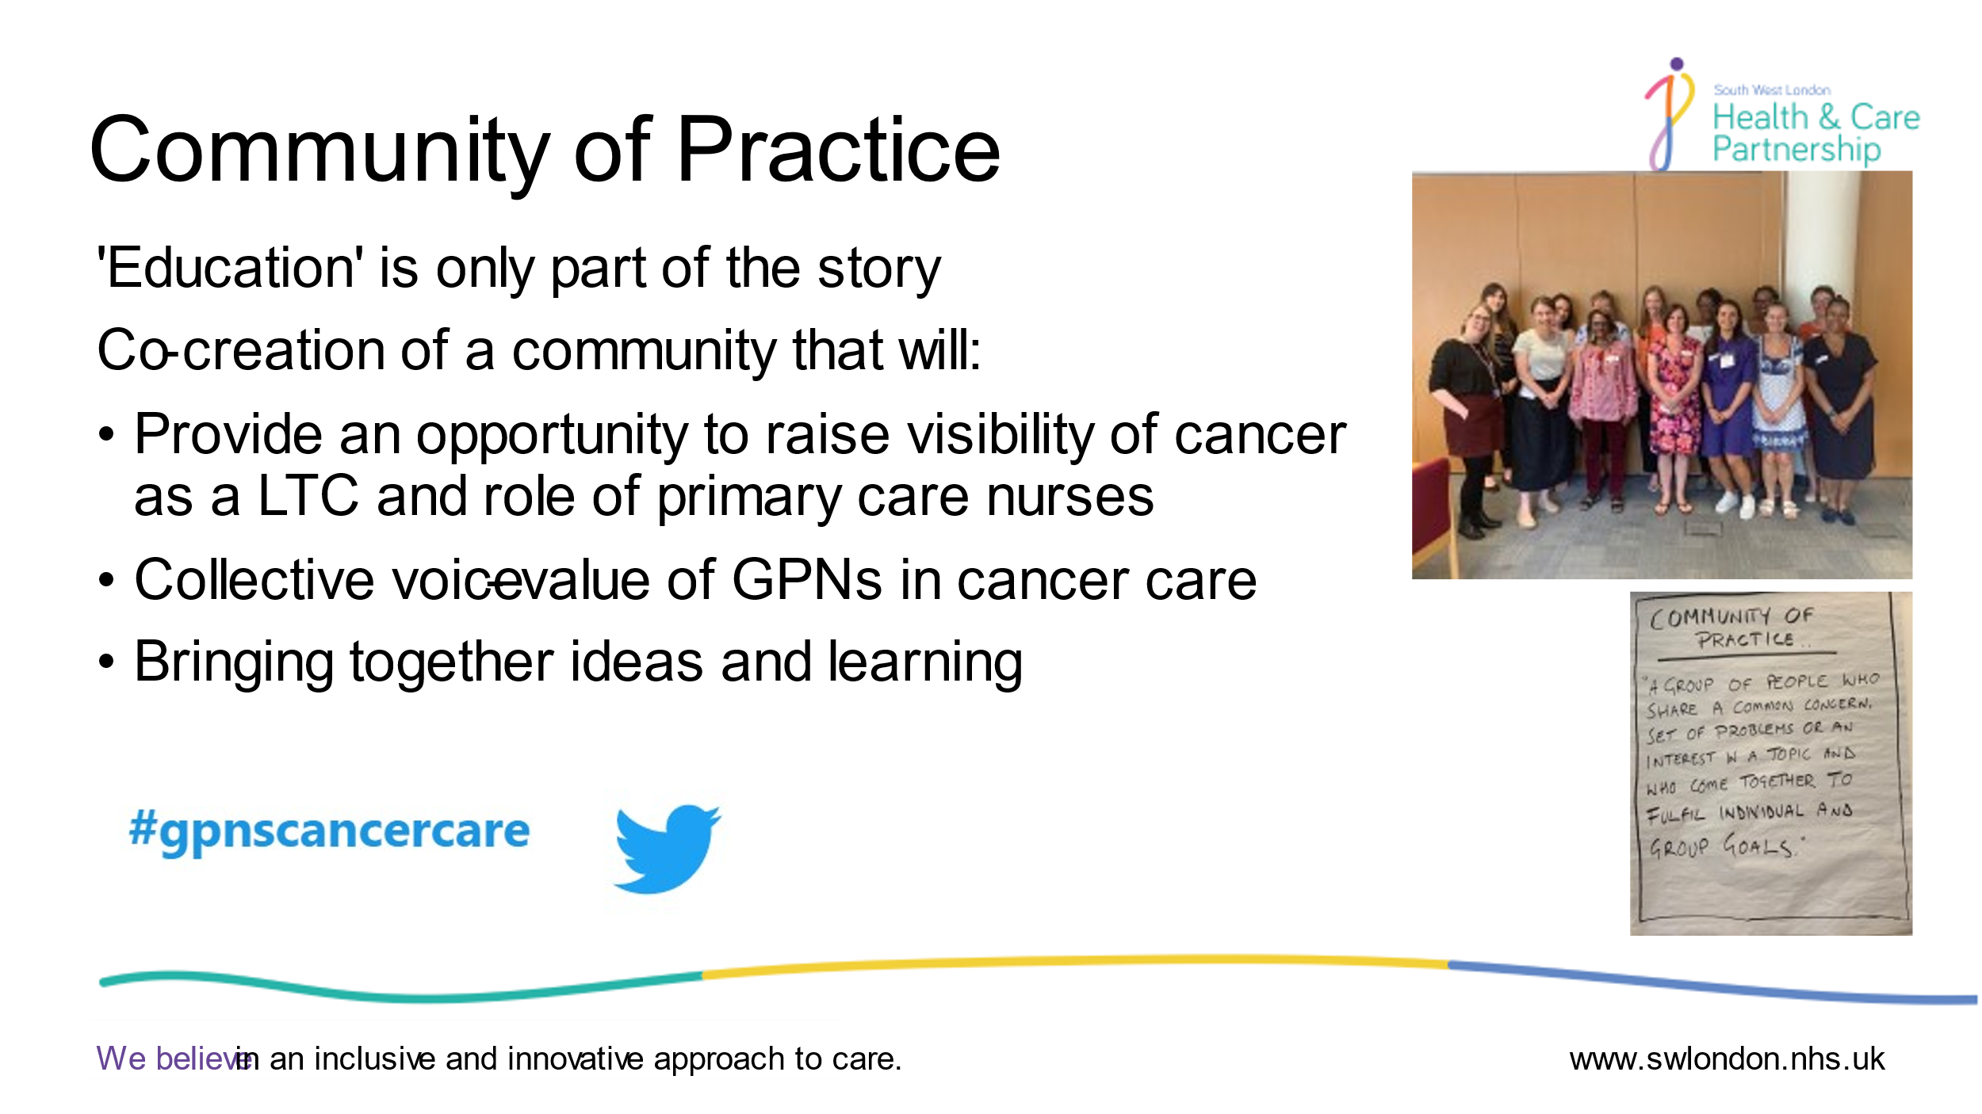
London Cancer Community of Practice for General Practice Nurses
The Macmillan Primary Care Nursing Project, in collaboration with the Transforming Cancer Services Team, supported the establishment of a Pan London General Practice Nurse Community of Practice in managing cancer as a long-term condition. This group aims to support the growth of clinical leadership amongst GPNs in London around cancer. The group was launched in July 2019 and met quarterly during the duration of the SW London project.
It is now hosted by TCST and currently meets on a monthly basis using MS Teams due to the constraints of the COVID 19 pandemic.
The group have worked collaboratively with NHSE, and Macmillan to develop the role of the General Practice Nurse in relation to cancer and have established connections with their local cancer colleagues. Members have created a number of resources including a draft business case to be used by members and other General Practice Nurses to encourage change in practice.
If you would like more information or to join the Community of Practice, please contact Sandra.Dyer1@nhs.net

Slide 14
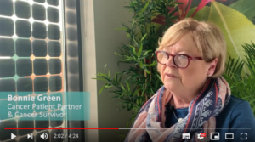
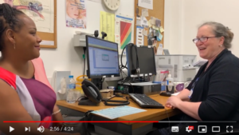
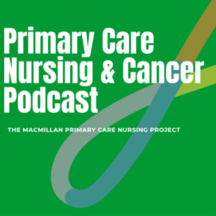
Project resources
Videos
These short videos were produced to help GPNs and the wider system in primary care, understand the importance of supporting patients living with cancer following treatment. They also demonstrate how to carry out a cancer care review and offer useful tips and other resources that can be used
The value of good cancer care reviews, and the role that nurses play in delivering them
How to carry out an effective Cancer Care Review
Primary Care Nursing and Cancer Podcast Channel
The South West London project team launched a podcast channel, ‘Primary Care Nursing and Cancer Podcast’. Episodes explored the work that took place in SWL on topics such as what does good practice look like in primary care, the value of working collaboratively, the importance of patient partners and more.

Slide 15

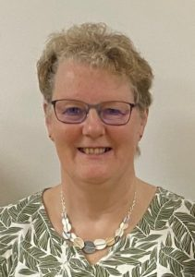

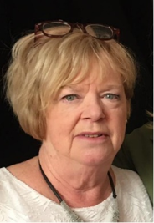
Patient Voices
The project had patient partner involvement at every step of the project from planning, recruitment, engagement, steering group membership, and delivering education.
We have held three patient focus groups across south west London to gain insight and feedback on the support that patients have been receiving from Primary Care following their cancer treatment.
The input from our Patient Partners pictured below (L-R: Bonnie, Sharon, Christine, and Lindsay) was invaluable and ensured that patients’ needs are prioritised always. Read the report (PDF document)
If you would like to find out more about our collaborative work with our Patient Partners, you can listen to a podcast episode: ‘Working with Patient Partners – a case study of good practice’.

Slide 16
Evaluation and recommendations

Slide 17
Project Evaluation
Leadership and influencing
Considerable current and potential value:
achieving recognition of the issue
building and maintaining a case for change
more to do to cement strategic success through training and hands on support
Education and Influencing
Challenge in reaching GPNs- however short intervention has impact – confidence to discuss diagnosis, and change in culture- cancer is a LTC.
Cancer as a LTC can be incorporated into existing post grad courses
Macmillan Course- uptake improved by project
Patient Voices
Vital member of the project team – ensured project is patient focused
Focus groups- patients value support offered by primary care team . There is variation in quality and provision
Notes:
Current and potential values
Clear and consistent rationale – platform for change – but personalised care questions to be resolved
For the postholder to have influence they need credibility – clinical experience and ongoing practice are necessary
Continued leadership is required to sustain efforts to develop the role of primary care nurses in delivery of cancer care
Further work to enable colleagues to identify how practice could improve
Continued presence
Workforce lead roles – will need to secure buy in – should consider developing specialism within each PCN
Macmillan’s future work – make use of materials developed and engage early with training hubs (on an operational level)
Recognition that changes will take hold in some places than others and consider – level of influence / activity of the Mac GP in CCG / STP,

Slide 18
Project Evaluation Recommendations
Leadership and influencing
Lead Nurse role valuable- having current primary care clinical experience important for credibility
Active support from Mac GPs, Clinical Leads and training hub lead nurses maximises impact
Education and Influencing
Cancer as a LTC needs to be on curriculum for undergraduate nurses, and covered in post grad GPN /Community nursing courses.
Nurses need support in practice to develop cancer knowledge and skills
Cancer in the Community Module- needs to be promoted pan London
Patient Voices
Patient partners need to be involved in planning and developing further work with primary care nurses
There is a need to improve patient experience in out of hospital care
As increased interventions such as cancer care reviews are nurse led there is a need to evaluate quality and outcomes for patients
Notes:
Current and potential values
Clear and consistent rationale – platform for change – but personalised care questions to be resolved
For the postholder to have influence they need credibility – clinical experience and ongoing practice are necessary
Continued leadership is required to sustain efforts to develop the role of primary care nurses in delivery of cancer care
Further work to enable colleagues to identify how practice could improve
Continued presence
Workforce lead roles – will need to secure buy in – should consider developing specialism within each PCN
Macmillan’s future work – make use of materials developed and engage early with training hubs (on an operational level)
Recognition that changes will take hold in some places than others and consider – level of influence / activity of the Mac GP in CCG / STP,

Slide 19
STP recommendations
The full and active support of Macmillan GPs, Cancer clinical leads, and Training Hub lead nurses would maximise the impact of any future work. There is still more to do to influence GPs, commissioners and nurses around the potential role of nurses in managing cancer as an LTC.​
Developing Primary Care Networks provide an opportunity to improve patient experience and quality of care at scale. Future work needs to consider the opportunities provided by the revised GP Contract and Primary Care Network DES to find novel and innovative approaches to improving care through the involvement of primary care nurses.​
Primary care education around cancer at Cancer Alliance, or CCG level needs to be planned, promoted and delivered to be inclusive of primary care nurses and other non-medical members of the primary care team.​
Nurses need support in practice in order to develop their cancer knowledge and skills. Education intervention alone are not effective to implement sustained change. The impact of access to a range of support such as communities of practice, action learning and clinical supervision need to be considered to embed sustained change.​
There is considerable value in the Lead Nurse role. Having contemporary clinical experience in primary care is an enabler to success. This needs to be considered if workforce leadership is being considered across London.​
Training Needs Analysis is extremely valuable in project scoping, planning and demonstrating outcomes. A multi-professional tool (such as the TCST tool) needs to be considered if future work includes AHPs.​

Slide 20
Recommendations for London
A pan London view has been important to the success of the SW London project. When other Workforce Leads are appointed in the other STP areas it is important that there is pan London overview and shared learning.​
There is the potential to develop and test a rotational scheme for primary care nurses to enable skill development and improve knowledge and confidence in managing cancer as an LTC. Such an approach would support role development and clinical leadership in cancer for primary care nurses.​
Community nurses play an extremely important role in the care of people living with long term conditions who are housebound. There is huge potential value in providing education and training to empower them to improve the care of people living with cancer that they already care for.​
Cancer as a LTC needs to be on undergraduate and post graduate course curriculum for primary care nurses. The project has demonstrated that this can be influenced, and ongoing work is needed for London. ​

Slide 21
SWL project recommendations in context of COVID
The SW London Macmillan funded Primary Care Nursing Project demonstrated opportunities for primary care nurses to lead on care of cancer as a LTC in primary care .
Primary care nurses are well placed to identify patients with worrying symptoms who haven’t presented to primary care but may be having routine nursing care. In context of COVID this is pertinent potentially for both early diagnosis and recurrences of primary cancers and secondary cancers especially as there are issues in provision of secondary care follow up.
GPNs/ Community nurses seeing high volumes of patients F2F Vs mostly remote consultations by GPs/ACPs etc- Primary care nurses well placed to support patients waiting for cancer diagnostics and treatment
Innovation in delivery of primary care in the COVID pandemic could support new ways of supporting people living with cancer – through group online consultations for example .
Education interventions for GPNs ( and primary care teams ) around cancer remains a need . New ways of working provide opportunities to innovate education delivery . Multi professional learning reflects changing make up of primary care but co-design/co-delivery vital to ensure meets the needs of different professional groups.

Slide 22
What questions do you have ?
Contact : Sandra.dyer1@nhs.net or england.tcstlondon@nhs.net

