Slide 1



COVID-19 Staff Health & Well-being Support for Managers in Ealing
29 April 2020
Please contact: Estelle.Moore@westlondon.nhs.uk
Chair: COVID-19 Staff Health & Well-being Workstream, West London

Slide 2
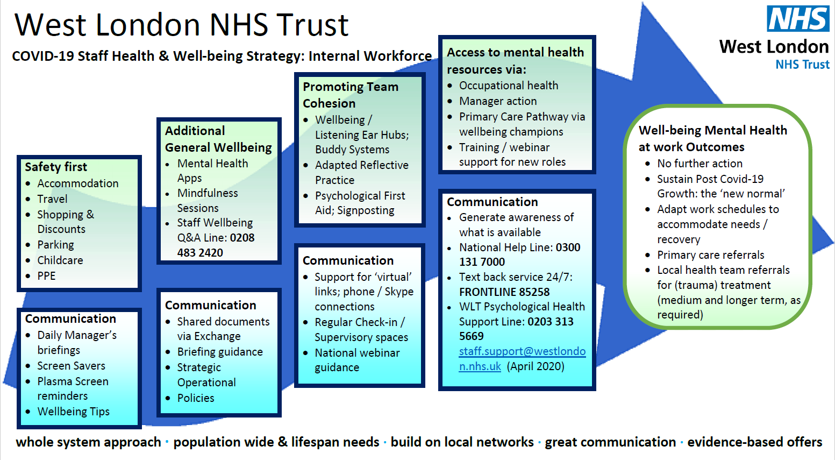
COVID-19 Staff Health & Well-being strategy

Slide 3


TWO KEY MESSAGES
TEAM RESILIENCE Taking your team’s emotional temperature

Slide 4

Crisis, trauma and threat make everything seem harder barriers, gaps, existing tensions etc in/between services and our clients? underlying health conditions in focus: >confusion, >withdrawal, >anxiety, >distress …
LESS TIME (!)

Slide 5

Healthworkers face unique challenges: under pressure (by no means a reflection that you cannot do your job!) we have to manage (our own) emotional health as well as physical health
Take care of ourselves (first) know how to provide support to people affected with COVID-19

Slide 6

Managers face specific challenges: protecting others from chronic stress knowing that the situation won’t go away overnight - endurance
Communicating - psychological first aid watching, supporting, identifying distress

Slide 7

Psychological first aid: create a sense of safety calm self and collective efficacy connection hope (control)

Slide 8
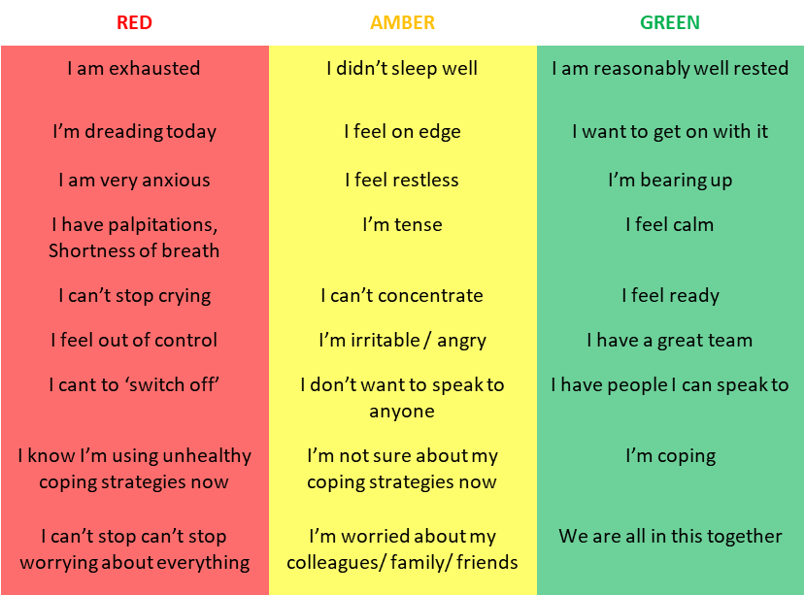
Checking in: Where are you today?
TEAM RESILIENCE: HOW?

Slide 9
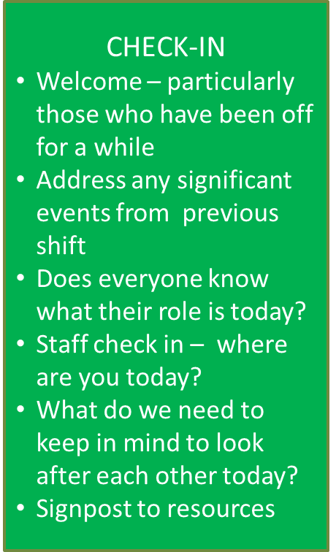
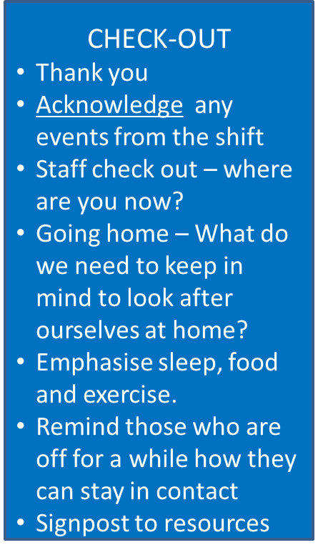



Checking in: Where are you today?
TEAM RESILIENCE: HOW?

Slide 10

How was the shift?
What could we have done differently?
What issues do we need to escalate to other colleagues?
What positives have there been today?
Safety Huddles

Slide 11
Staff Well-being SPA: 0208 483 2420
National helpline: 0300 131 7000
Text back service: 24/7 FRONTLINE 85258
Back up resources

