Slide 1


Line managers
Supporting staff during Covid19 – focus on wellbeing

Slide 2
Overview
What we know about staff wellbeing in a pandemic
What you can do as a line manager
What support is available
Specific issues your staff may face
Looking after yourself
References and useful resources

Slide 3
Staff wellbeing – what we know
There are many different stages in the pandemic
As we move through the stages we can expect that staff will have different concerns and need different support

Slide 4
Stages of pandemic and related staff wellbeing concerns – chart/ diagram to be inserted.

Slide 5

Best practice for staff wellbeing
What is likely to help
  Staying well: eating well, taking breaks, getting enough sleep, safety at work (inc PPE)
  Checking in: asking what they need, what will help and dong this regularly
  Clear communication: knowing what is happening, when and why. Honesty is key.
  Familiar support: peers at work, family and friends
  Referral to psychological support: for some people who are particularly vulnerable or struggling. Needs to be evidence-based

Slide 6

What is unlikely to help
  Single-sessions that require staff to talk about their thoughts or feelings – this may increase the likelihood of PTSD
  One size fits all – everyone is responding differently and will need a variety of support at different times
  Psychological treatment too soon – most people will use their own coping mechanisms and rushing to treatment may interfere with these
  Generic training e.g. mental strength training – no evidence this is effective and may send the wrong messages

Slide 7
What can a line manager do?
Make sure everyone is taking breaks
Encourage staff to take annual leave
Ask staff how they are in a confidential space
Keep asking – people need different things at different times
Let people know about the support available
Direct to Occupational Health and staff support
Ask for advice from health and safety, your line manager, staffside, HR, Occupational Health
Display wellbeing information in staff rooms and offices
Don’t feel you have to do it all yourself -

Slide 8

Not sure where to start?
It may be difficult to start a conversation about wellbeing
You may not feel confident and your staff member may not find it easy
If you have clinical training remember you shouldn’t start doing an assessment – refer to OH and remain in line management role
There is an HSE Talking toolkit (see resources) that has a structure and specific questions to ask your team members
    It’s not specific to Covid
    It has useful open-ended questions about demands at work, support available etc.

Slide 9
Support available
Occupational Health
Staff support phone line
OCCUPATIONAL HEALTH
HR workforce partner
Staffside
PARTNERSHIP WORKING
Wellbeing activities e.g. mindfulness
Wellbeing champions
COVID WELLBEING WORK

Slide 10
Exhaustion and burnout
Look for signs that someone may be exhausted and at risk of ‘burnout’:
  Tired all the time, headaches, irritability, finding it harder to make decisions, overwhelmed, withdrawn
Importance of breaks and annual leave
Notice if staff are working additional hours and speak to them, work
Talking toolkit - focus on control and levels of responsibility

Slide 11
Sleep problems
Sleep problems are common – may have difficulty getting to sleep or waking. Leads to exhaustion and may increase likelihood of burnout.
Shift workers – can’t stick to set times for waking and sleeping
Sleepio is a clinically-evidenced sleep improvement programme that is fully automated and highly personalised, using cognitive behavioural techniques to help improve poor sleep. Free access to Sleepio for all NHS staff is active now until 31st December 2020.
  https://onboarding.sleepio.com/sleepio/access/77#1/1?utm_campaign=C19_FreeAccess&utm_medium=Employers&utm_source=NHSEngland

Slide 12
Support for staff with pre-existing conditions
Two large COVID-19 studies suggest that the staff who are most in need of psychological support are the least likely to request or receive it.
Check-in regularly with team members you know may be vulnerable
Don’t wait to offer help
Suggest making an OH referral to them
Focus them on what helped before – encourage staff to seek help from GP or health team

Slide 13

Those who are shielding
Many feel very isolated and cut-off
Check-in regularly with staff who are shielding
Include them in team meetings and other forums as much as possible via remote dial-in and video calls
Look for opportunities for projects that would support the rest of the team and can be completed from home

Slide 14
Bereavement
Staff members have lost friends, family and loved ones
Ensure they know they can request Compassionate Leave.
Funerals are happening with very few people allowed to be there – many people are planning a celebration later on
  Even if someone cannot attend a funeral in person they can request compassionate leave on that dayCHECK WITH LAURA – is wording OK??)
  Can take compassionate leave to attend events even if they don’t take place for a long time(CHECK WITH LAURA – is wording OK???)
Each person is different. For some people returning to work is an important way of coping, having a routine and feeling normal again. For others they may find work is harder and they may need to take more time off or need more support
People will be affected by bereavement for a very long time. Anniversaries and special occasions like birthdays or family celebrations can be particularly difficult times.
Do express condolences and ask the person how they would like to be supported by you
Don’t avoid bringing up the subject because you don’t want to upset them.
Keep asking if there is anything that you can do to help - it may change over tim

Slide 15
Death of a colleague
If a colleague dies then this tragedy will have a profound effect on the whole team.
Additional support will need to be provided – this should be for the whole team with individual support for those who need it. Contact senior managers to arrange this immediately.
The Trust chaplaincy service and Occupational Health services are there to support
As a line manager there are reporting processes you need to complete. These may seem insensitive but are very important to ensure the bereaved relatives receive pension and other entitlements. IR1 completed

Slide 16

Looking after yourself
All of the advice and support applies to you as well
Line managers may be holding a lot of responsibility and speaking to a lot of distressed staff – it may feel overwhelming
Don’t feel you have to manage
alone – ask for help
You need to take breaks
Don’t try and be superhuman!

Slide 17
Resources – HR contacts

Slide 18
Resources - other
Contact details for Occupational Health: 020 8354 8919; Ohealth@westlondon.nhs.uk
Staffside contact details: http://theexchange/sorce/beacon/default.aspx?pageid=Unions
Staff wellbeing information: http://theexchange/sorce/beacon/?pageid=CoronavirusSupportResources
Talking toolkit (HSE) - https://www.hse.gov.uk/stress/assets/docs/stress-talking-toolkit.pdf
Links to selected staff wellbeing publications
Links to national support lines for staff
https://people.nhs.uk/
https://people.nhs.uk/support-for-leaders/

Slide 19
Resources - other
Links to selected staff wellbeing publications
Links to wellbeing posters we would recommend are displayed in all workplaces
  Raising concerns and Freedom to Speak up Guardian
  Staff counselling and staff support line
  Staffside points of contact

Slide 20
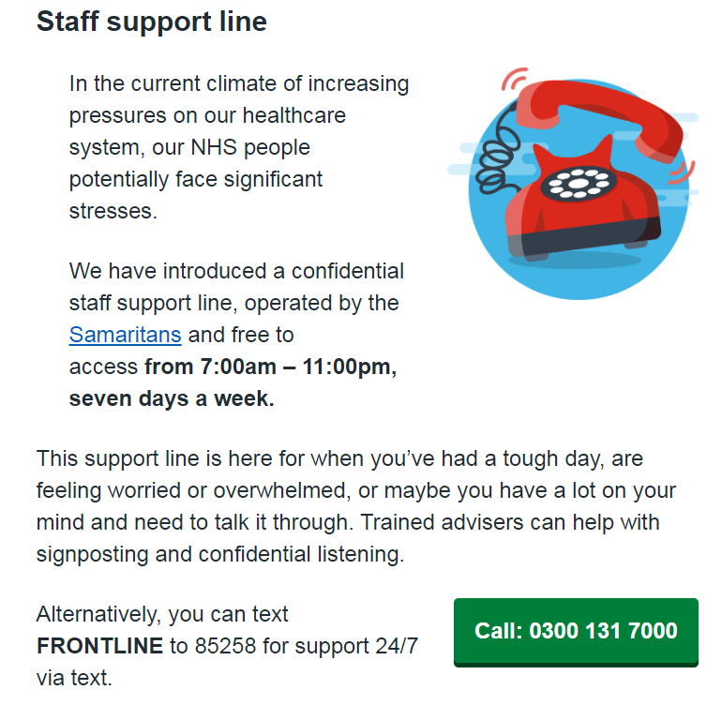
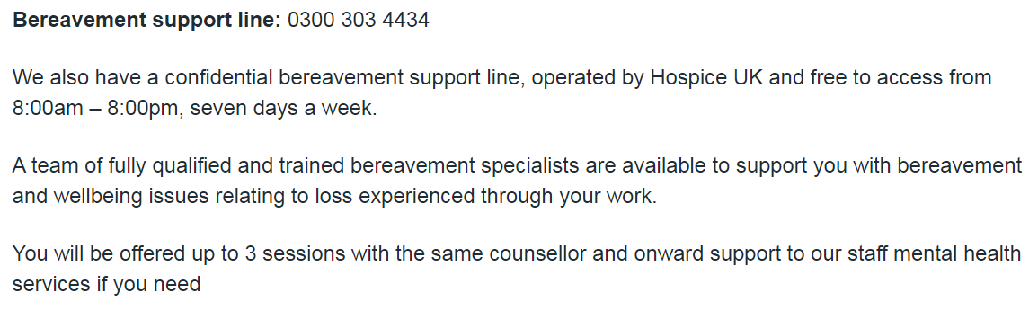
National NHS support for staff:

Slide 21
